Slide 2
Experts knowledge share
Current opinions on how to identify, test and treat NTRK fusion positive cancer
Prof. David Hong, Prof. Frédérique Penault-Llorca and Prof. Ezra Cohen
20th January 2021

Slide 3
EXPERTS KNOWLEDGE SHARE
THE OBJECTIVE of this meeting is to share Current opinions on how to identify, test and treat NTRK fusion positive cancer
Your opportunity to discuss and share learnings on challenging topics within the area of NTRK Fusion positive cancer
A chance to hear the views of Experts and allow them to answer the questions that are important to you
Review and discuss Patient Case Studies, using the questions that you have sent in advance of this event

Slide 4

EXPERTS KNOWLEDGE SHARE
Educational objectives
To discuss current opinions on how to identify, test and treat NTRK fusion positive cancer:
  Treating NTRK fusion cancer today and in the future
  Testing methodologies and tumour-specific algorithms
  Adverse events associated with TRK inhibitors

Slide 5



Introducing the scientific committee
David Hong
Frédérique Penault-Llorca
Ezra Cohen
University of Texas MD Anderson Cancer Center, Houston, USA
University of Clermont-Ferrand, France
UC San Diego Health-Moores Cancer Centre
California, USA

Slide 6
Disclaimer
This meeting is based on an independent medical educational grant from Bayer. The programme is therefore independent; the content is not influenced by Bayer and is the sole responsibility of the experts
Please note:
The views expressed within this presentation are the personal opinions of the experts. They do not necessarily represent the views of the experts’ academic institutions or the rest of the faculty

Slide 7
Experts knowledge share agenda
Time | Topic | Facilitator
5 minutes | Welcome and introductions | Iain Murdoch (COR2ED)
5 minutes | Overview and scene setting | David Hong
15 minutes | Treating NTRK fusion cancer today | David Hong
15 minutes | Testing methodologies and tumour-specific algorithms | Frédérique Penault-Llorca
15 minutes | Adverse events associated with TRK inhibitors | Ezra Cohen
30 minutes | Two breakout rooms Groups discussing questions, case studies and sharing experiences | All
5 minutes | A look to future treatments and closing remarks | David Hong and Iain Murdoch (COR2ED)

Slide 8
Treating NTRK Fusion CancerS today
David S. Hong, MD
The University of Texas MD Anderson Cancer Center.
Professor
Deputy Chairman in the Dept of Investigational Cancer Therapeutics
(Phase 1 Program)
Associate Vice President of Clinical Research

Slide 9
Disclosures (last 36 months)
Research/Grant Funding: AbbVie, Adaptimmune, Aldi-Norte, Amgen, AstraZeneca, Bayer, BMS,
Daiichi-Sankyo, Eisai, Fate Therapeutics, Genentech, Genmab, Ignyta, Infinity, Kite, Kyowa, Lilly, LOXO, Merck, MedImmune, Mirati, miRNA, Molecular Templates, Mologen, NCI-CTEP, Novartis, Numab, Pfizer, Seattle Genetics, Takeda, Turning Point Therapeutics, Verstatem
Travel, Accommodations, Expenses: Bayer, LOXO, miRNA, Genmab, AACR, ASCO, SITC
Consulting, Speaker or Advisory Role: Alpha Insights, Acuta, Amgen, Axiom, Adaptimmune, Baxter, Bayer, Boxer Capital, COG, Ecor1, Genentech, GLG, Group H, Guidepoint, HCW Precision, Infinity, Janssen, Merrimack, Medscape, Numab, Pfizer, Prime Oncology, Seattle Genetics, ST Cube, Takeda, Tavistock,
Trieza Therapeutics, WebMD
Other ownership interests: Molecular Match (Advisor), OncoResponse (Founder), Presagia Inc (Advisor)
Notes:
These are my disclosures

Slide 10
TRK Biology
TRK, tropomyosin receptor kinase

Slide 11
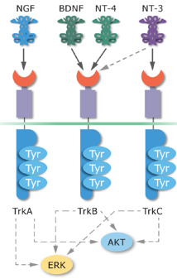
TRK Receptors Mediate Neurotrophin Signalling
Neurotrophins are important growth factors that promote sympathetic nervous system development^{1,2}
Neurotrophin signalling occurs through activation of the tropomyosin-receptor kinase (TRK) receptor family^{1,2}
Neurotrophin signalling^{1,3}
Neurotrophin Family of Receptors^{1–6}
TRK Receptor | Gene (Chromosomal Location) | Functions | Natural Ligands
TRKA | NTRK1 (1q23.1) | Pain signaling, thermoregulation | Nerve growth factor (NGF), neurotrophin-3 (NT-3)
TRKB | NTRK2 (9q21.33) | Regulation of movement, memory, mood, appetite, body weight | Brain-derived neurotrophic factor (BDNF), neurotrophin-4 (NT-4), NT-3
TRKC | NTRK3 (15q25.3) | Proprioception | NT-3
AKT, protein kinase B; ERK, extracellular signal-regulated kinase; NTRK, neurotrophic tyrosine receptor kinase; TRK, tropomyosin receptor kinase; Tyr, tyrosine
1. Nakagawara A. Cancer Lett. 2001;169:107-14; 2. Vaishnavi A, et al. Cancer Discov. 2015;5:25-34; 3. Blake J, et al. EORTC-NCI-AACR Conf. 2016;69:ENA-0491/
Poster No. 442; 4. https://www.ncbi.nlm.nih.gov/gene/4914, accessed January 17, 2021; 5. https://www.ncbi.nlm.nih.gov/gene/4915, accessed January 17, 2021;
6. https://www.ncbi.nlm.nih.gov/gene/4916, accessed January 16, 2021

Slide 12
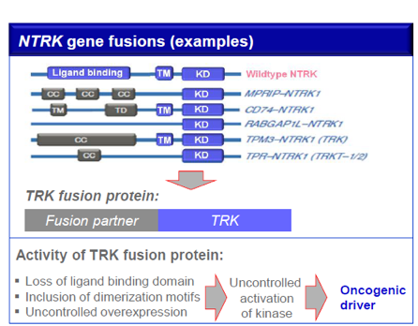
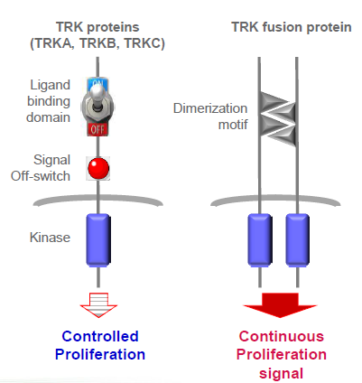
Biology of TRK Fusion Proteins
CC, coiled coil domain; KD, kinase domain; NTRK, neurotrophic tyrosine receptor kinase; TD; trimerisation domain: TM, transmembrane domain; TRK, tropomyosin receptor kinase

Slide 13
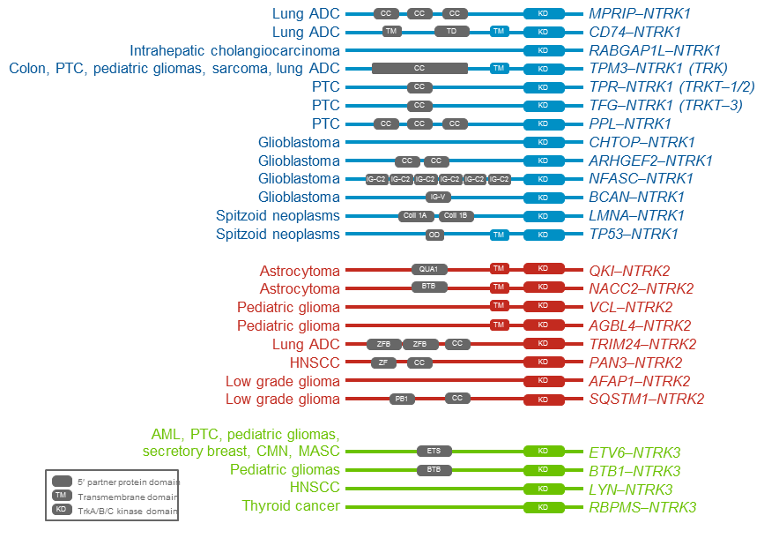
There are Numerous NTRK Gene Fusion Types Across Multiple TumoUr Types
There are a number of known NTRK1 (blue), NTRK2 (red), and NTRK3 (green) fusions and tumours types in which they have been identified
Not all gene fusions have been characterised functionally
Novel/non-canonical fusions are common, including in IFS
ADC, adenocarcinoma; AML, acute myeloid leukaemia; BTB, bric-a-brac, tram-track, and broad complex domain; CCD, coiled-coil domain; CMN, congenital mesoblastic nephroma; ETS, E26 transformation-specific domain; HNSCC, head and neck squamous cell cancer; IFS, infantile fibrosarcoma; IG-C2, immunoglobulin-like C2-type domain; IG‑V, immunoglobulin-like V domain; KD, kinase domain; MASC, mammary analogue secretory carcinoma; NTRK, neurotrophic tyrosine receptor kinase; OD, oligomerization domain; PTC, papillary thyroid cancer; TD, trimerization domain; TM, transmembrane domain; ZF, Zinc finger domain; QUA1, quaking 1 domain
Vaishnavi A, et al. Cancer Discov. 2015;5:25-34

Slide 14
TRK Cancer Epidemiology
TRK, tropomyosin receptor kinase

Slide 15

NTRK Gene Fusions Are Found in Many Cancers With High Unmet Need
Adult
Brain cancers (0.4–3.1%)¹
Salivary (MASC; 90–100%)¹
Secretory breast cancer (92%)^{2*}
Pancreatic cancer³
Cholangiocarcinoma (3.6%)¹
Thyroid cancer (1.5–14.5%)¹
Lung cancer (0.2–3.3%)¹
GIST (3.2%)⁴
Colon cancer (1.5%)¹
Melanoma (0.3%)^{1,5}
Sarcomas (1%)^{5*}
Paediatric
Spitzoid neoplasms (16.4%)⁶
Gliomas (7.1%)¹
Thyroid (9.4–25.9%)^{7,8}
Infantile fibrosarcoma (91–100%)⁹
Congenital nephroma (83%)¹
Secretory breast cancer (92%)^{2*}
Sarcomas (1%)^{5a}
Vaishnavi A, Le A, Doebele RC. Cancer Discov. 2015;5:25-34.
Tognon C, et al. Cancer Cell. 2002;2:367-376.
Pishvaian MJ, et al. Journal of Clinical Oncology 36, no. 4_suppl (February 1 2018) 521-521.
Brenca M, et al. J Pathol 2016;238:543-549.
Stransky N, et al. Nat Communications 2014;DOI: 10.1038/ncomms5846.
Wiesner T, et al. Nat Communications 2014;5:3116. doi:10.1038/ncomms4116.
Ricarte_Filho_JC, et al. J Clin Invest 2013;123:4935-4944.
Prasad ML, et al. Cancer 2016; DOI: 10.1002/cncr.29887.
Bourgeois JM, et al. Am J Surg Pathol 2000;24: 937–946.
ªFrequency in adult vs paediatric patients not specified
GIST, gastrointestinal stromal tumour; MASC, mammary analogue secretory carcinoma; NTRK, neurotrophic tyrosine receptor kinase

Slide 16
TRK INHIBITORS
TRK, tropomyosin receptor kinase

Slide 17
TRK Inhibitors and Clinical Development status
larotrectinib and entrectinib are the two currently approved TRK inhibitors*
Drug Name (Sponsor) | Molecular Targets | Development Stage and tumour Types
larotrectinib (Bayer) | NTRK1-3 | Phase 1/2 in solid tumours in adults and adolescents (NCT02122913, NCT02637687, NCT02576431)
entrectinib (Roche/ Ignyta)¹ | NTRK1-3, ALK, ROS1 | Phase 1/2 in solid tumours in adults (NCT02568267, NCT02097810, NCT02650401)
TSR-011 (Tesaro)¹ | NTRK, ALK | Phase 1/2 in solid tumours and lymphomas (NCT02048488)ª
sitravatinib (MGCD516) (Mirati Therapeutics)¹ | NTRK1-3, DDR2, MET, KIT, KDR, PDGFR | Phase 2 in combination with nivolumab in NSCLC; advanced liposarcoma and other soft tissue sarcomas (NCT02954991, NCT02978859)
DS-6051b (Daiichi Sankyo)¹ | NTRK1-3, ROS1 | Phase 1 in solid tumours (NCT02675491,ª NCT02279433ª); Status unknown; presented at ESMO 2017 but not mentioned in latest independent research materials⁴
merestinib (Eli Lilly)¹ | NTRK1-3, MET, AXL, ROS1, MKNK2, FLT3, TEK, DDR1, DDR2 | Phase 1/2 in combination with LY2874455^{b} in R/R AML; advanced/metastatic cancer; NSCLC and solid tumours; biliary tract cancers (NCT03125239,^{c} NCT03027284, NCT02920996, NCT02711553)
cabozantinib (Exelexis)¹ | NTRK, KDR, MET, RET, ROS1, KIT, FLT1,3,4, AXL | Phase 2 in NSCLC (NCT01639508)
PLX7486 (Plexxikon)¹ | NTRK1-3, CSF1R | Phase 1 in solid tumours (NCT01804530)
TPX-0005 (TP Therapeutics)² | NTRK1-3, ALK, ROS1 | Phase 1/2 in advanced solid tumours (NCT03093116)
ONO-7579 (Ono)³ | NTRK1-3 | Phase 1/2 in advanced solid tumours (NCT03182257)ª
ª Trial is terminated; ^{b} LY2874455 is an FGFR inhibitor; ^{c} Trial is completed
ALK, anaplastic lymphoma kinase; AML, acute myeloid leukemia; AXL, tyrosine-protein kinase receptor UFO; CSF1R, colony stimulating factor 1 receptor; DDR, discoidin domain-containing receptor; ESMO, European Society for Medical Oncology; FGFR, fibroblast growth factor receptor; FLT, fms related tyrosine kinase; KDR, kinase insert domain receptor; KIT, mast/stem cell growth factor receptor; MET, c-MET proto-oncogene; MKNK, MAP kinase-interacting serine/threonine-protein kinase; NSCLC, nonsmall-cell lung carcinoma; NTRK, neurotrophic tyrosine receptor kinase; PDGFR, platelet-derived growth factor receptors; R/R, relapsed/refractory; RET, rearranged during transfection proto-oncogene; ROS1, proto-oncogene tyrosine-protein 1; TEK, tunica interna endothelial cell kinase; TRK, tropomyosin receptor kinase
*Larotrectinib is approved in the US, Australia, Brazil, Canada, European Union, Hong-Kong, Israel, Saudi Arabia, Singapore, South Korea and Switzerland. Entrectinib is approved in
the US, Australia, European Union and Japan
1. http://www.onclive.com/publications/oncology-live/2017/vol-18-no-15/trk-inhibitors-advance-rapidly-in-tumouragnostic-paradigm?p=2 (accessed January 16, 2021);
2. ClinicalTrials.gov. NCT03093116; 3. ClinicalTrials.gov. NCT03182257; 4. Takeda M, et al. Ann Oncol. 2017;28 (suppl_5):486-7

Slide 18
larotrectinib

Slide 19
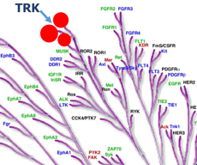
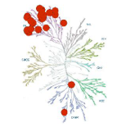
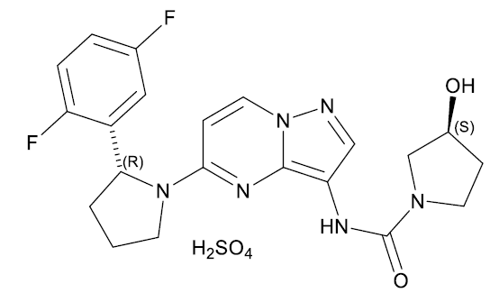
Larotrectinib Is a Highly Selective TRK Inhibitor
larotrectinib
First and only selective TRK inhibitor¹
High potency against TRKA, TRKB,
and TRKC¹
  IC₅₀ = 5-11 nM in cellular assays
Slow dissociation; inhibitor stays bound
to target²
  T_{1/2}: 160 min
High selectivity^{1,2}
  Limited inhibition of other kinases
  ≥100-fold selectivity versus
  229 other kinases
entrectinib
IC₅₀, half maximal inhibitory concentration; T_{1/2}, half-life; TRKA/B/C, tropomyosin receptor kinase A/B/C
1. Hyman DM, et al. J Clin Oncol. 2017;35:LBA2501; 2. Drilon A, et al. Ann Oncol. 2019;30 (suppl_8):viii23-viii30

Slide 20
Larotrectinib clinical data:
Integrated analysis Study design
Primary*
n=55
  Supplementary†
  n=120
Adult phase 1 (NCT02122913)
Age ≥18 years
Advanced solid tumours
175 patients with TRK fusion cancer
TRK fusion status determined
by local CLIA (or similarly accredited) laboratories
Dosing
Initial larotrectinib dose
  Adult: 100 mg BID
  Paediatric‡: 100 mg/m² BID (max. 100 mg BID)
n=8
n=5
SCOUT: paediatric phase 1/2 (NCT02637687)
Age ≤21 years
Advanced solid tumours
n=12
n=45
Primary endpoint
ORR (RECIST v1.1)
Secondary endpoints
  DoR
  PFS
  OS
  Safety§
NAVIGATE: adult/adolescent phase 2 ‘basket’ trial (NCT02576431)
Age ≥12 years
Advanced solid tumours
TRK fusion cancer
n=35
n=70
Data cut-off: July 15, 2019.
* The primary dataset comprises the original patients included in the primary report with longer follow up
† The supplementary dataset comprises the additional patients included in this analysis
‡ The starting dose was determined by Simcyp® modelling, which predicted that the doses needed to match the larotrectinib exposure in adults given 100 mg BID are 9.6, 17, 28, 39, 49, 55, and 55 mg/m² for patients aged 1-3 months, 3-6 months, 6 months to 1 year, 1-2 years, 2-6 years, 6-12 years, and 12-18 years, respectively
§ The safety population included all patients enrolled in one of the three clinical trials, who received at least one dose of larotrectinib, regardless of TRK fusion status (n=279).
BID, twice daily; CLIA, Clinical Laboratory Improvement Amendments; DoR, duration of response; ORR, objective response rate; OS, overall survival;
PFS, progression-free survival; RECIST, Response Evaluation Criteria in Solid Tumours; TRK, tropomyosin receptor kinase
McDermott R, et al. Ann Oncol. 2020;31 (suppl_4):S1034-S1051

Slide 21
Larotrectinib clinical data:
Integrated analysis Baseline characteristics
 | Integrated dataset (N=175)
Sex, n (%) Male Female | 86 (49) 89 (51)
Age, median (range), years Paediatric (<18 years), n (%) Adult (≥18 years), n (%) | 43 (0.1-84) 59 (34) 116 (66)
ECOG PS, n (%) 0 1 2 3 | 85 (49) 67 (38) 20 (11) 3 (2)
Known CNS metastases at enrollment, n (%) | 14 (8)
Number of prior systemic therapies, median (range) | 1 (1-10)
Number of prior systemic therapies, n (%) 0 1 2 ≥3 | 44 (25) 50 (29) 35 (20) 46 (26)
NTRK gene fusion, n (%) NTRK1 NTRK2 NTRK3* | 72 (41) 6 (3) 97 (55)
Cervix
Bone sarcoma
Cholangiocarcinoma
Appendix
Congenital mesoblastic nephroma
Pancreas
Unknown
Hepatic
Prostate
~1% each
Data cut-off: July 15, 2019
* Directly demonstrated or inferred (9 of 97 patients)
CNS, central nervous system; ECOG PS, Eastern Cooperative Oncology Group performance status; GIST, gastrointestinal stromal tumour; NTRK, neurotrophic tyrosine receptor kinase
McDermott R, et al. Ann Oncol. 2020;31 (suppl_4):S1034-S1051

Slide 22
Larotrectinib clinical data:
Integrated analysis Best response by tumour type
 | Integrated dataset (N=175) | CNS metastases (n=14) | Adult patients (n=116) | Paediatric patients (n=59)
Objective response rate, % (95% CI) | 78 (71-84) | 71 (42-92) | 71 (62-79) | 92 (81-97)
Best overall response, n (%) Complete response Partial response Stable disease Progressive disease Not determined | 33 (19)† 103 (59)‡ 23 (13) 12 (7) 4 (2) | 0 10 (71) 2 (14) 2 (14) 0 | 12 (10) 70 (60)§ 19 (16) 11 (9) 4 (3) | 21 (36)† 33 (56)§ 4 (7) 1 (2) 0
Other STS
Lung
GIST
Prostate
IFS
Colon
Pancreas
CMN
Thyroid
Breast
Cholangiocarcinoma
Unknown
100
Salivary gland
Melanoma
Bone sarcoma
Appendix
* Pathological complete response
CNS metastases
Cervix
80
60
40
20
Maximum change in tumour size (%)
0
‒20
‒40
‒60
‒80
*
‒100
*
*
*
*
*
Data cut-off: July 15, 2019
* Patients with a pathological complete response
† Including 6 patients with pathological complete response
‡ 4 partial responses pending confirmation
§ 2 partial responses pending confirmation
CI, confidence interval; CMN, congenital mesoblastic nephroma; CNS, central nervous system; GIST, gastrointestinal stromal tumour; IFS, infantile fibrosarcoma;
STS, soft tissue sarcoma
McDermott R, et al. Ann Oncol. 2020;31 (suppl_4):S1034-S1051

Slide 23




Larotrectinib clinical data:
Integrated analysis DoR, PFS, and OS
DoR
PFS
OS
100
100
100
90%
83%
81%
69%
75
66%
75
61%
75
Duration of response (%)
Progression-free survival (%)
Overall survival (%)
50
50
50
Median DoR
NE (95% CI 26.3, NE)
Median PFS
36.8 months (95% CI 25.7, NE)
Median OS
NE (95% CI 44.1, NE)
25
Median follow-up:
13.5 months
25
Median follow-up:
13.8 months
25
Median follow-up:
15.3 months
0
0
6
12
18
24
30
36
42
48
54
0
0
6
12
18
24
30
36
42
48
54
0
0
6
12
18
24
30
36
42
48
54
Months from start of response
Months from start of treatment
Months from start of treatment
No. at risk
132
90
57
39
21
11
5
3
1
0
No. at risk
175
114
66
46
27
16
7
4
1
0
No. at risk
175
114
93
64
43
30
17
7
2
0
  Rate of ongoing response at 12 months:
  81% (95% CI 73, 89)
  Rate of ongoing response at 24 months:
  66% (95% CI 53, 78)
  In 14 evaluable patients with brain metastases
    Median DoR: 14.8 months (95% CI 3.7, NE) (median follow-up: 9.5 months)
    Rate of ongoing response at 12 months: 61% (95% CI 26, 96)
  PFS rate at 12 months: 69% (95% CI 61, 76)
  PFS rate at 24 months: 61% (95% CI 51, 70)
  OS rate at 12 months: 90% (95% CI 85, 95)
  OS rate at 24 months: 83% (95% CI 75, 90)
Data cut-off: July 15, 2019
CI, confidence interval; DoR, duration of response; NE, not estimable; OS, overall survival; PFS, progression-free survival
McDermott R, et al. Ann Oncol. 2020;31 (suppl_4):S1034-S1051

Slide 24
Larotrectinib In intracranial disease: Characteristics of first prospective analysis
methods
Adult phase 1 trial (NCT02576431)
Age ≥18 years
Advanced solid tumours
24 patients with intracranial disease:
18 patients primary
CNS tumours*
6 patients
non-primary CNS tumours and brain metastases†, ‡
Endpoints
  Objective response
  (RECIST 1.1/RANO)
  Intracranial response**
Imaging
  Serial MRI/CT brain required with baseline intracranial disease
n=1
Paediatric phase 1/2 trial (SCOUT, NCT02637687)
Age 1 month to 21 years
Locally advanced or metastatic solid tumours or CNS tumours
n=12
TRK fusion status
  Local molecular profiling
Initial larotrectinib dose
  100 mg or 100 mg/m²
  (maximum of 100 mg) BID
Adult/adolescent phase 2 basket trial
(NAVIGATE, NCT02576431)
Age ≥12 years
Advanced solid tumours
TRK fusion cancer
n=11
* Data cut-off: February 19, 2019. † Data cut-off date July 30, 2018. ‡ Symptomatic or unstable brain metastases excluded. ** In tumour for patients with brain metastases; not a formal endpoint.
BID, twice daily; CNS, central nervous system; CT, computed tomography; MRI, magnetic resonance imaging; NTRK, neurotrophic tyrosine receptor kinase; RANO, response assessment in neuro-oncology; RECIST, Response Evaluation Criteria in Solid Tumours; TRK, tropomyosin receptor kinase
Drilon A, et al. J Clin Oncol. 2019;37 no. 15_suppl:2006-2006

Slide 25
Larotrectinib in intracranial disease:
Baseline characteristics in patients with non-primary CNS solid tumours
Histology
Frequency of brain metastases in
TRK fusion-positive solid tumours: 5% (n=6/121)
Characteristic | N=6
Gender, n (%) Female Male | 4 (67%) 2 (33%)
Age, median (range) | 65 years (25-76)
Prior therapies, n (%) Systemic therapy Prior CNS Surgery/Radiotherapy Yes* No | 5 (83%) 2 (33%) 4 (67%)
Number of prior systemic therapies, median (range) | 2 (0-5)
Fusion
*2 patients received radiation for intracranial disease >1 year prior to larotrectinib, 1 of whom also underwent surgery for intracranial disease >1 year prior to larotrectinib
CNS, central nervous system; NSCLC, non-small cell lung cancer; NTRK, neurotrophic tyrosine receptor kinase; TRK, tropomyosin receptor kinase
Drilon A, et al. J Clin Oncol. 2019;37 no. 15_suppl:2006-2006

Slide 26
Larotrectinib in intracranial disease:
Response in patients with non-primary CNS solid tumours
Overall efficacy | Evaluable patients N=5
Objective response rate, median (95% CI) | 60% (15-95)
Best objective response*, n (%) Partial response Stable disease Progressive disease | 3 (60%)** 2 (40%) 0 (0%)
Data cut-off: July 30, 2018
* Investigator assessment based on RECIST 1.1. **One patient pending confirmation
CI, confidence interval; NTRK, neurotrophic tyrosine receptor kinase; RECIST, Response Evaluation Criteria in Solid Tumours
Drilon A, et al. J Clin Oncol. 2019;37 no. 15_suppl:2006-2006

Slide 27
Larotrectinib in intracranial disease: responsE/treatment duration in patients with non-primary CNS solid tumours
Best change in intracranial target tumour size*
Time to response and overall treatment duration
Thyroid
†
Maximum change in tumour size (%)
Lung
Median duration of treatment:
8.3 months
(range 0.95+ –18.4+)
‡
Treatment ongoing
Start of partial response
Treatment after progression
Time (months)
Data cut-off: July 30, 2018. Disease assessments were performed by investigators
* Intracranial target tumour responses in patients with measurable disease, based on RECIST 1.1 sum of longest diameter. † Dose increased to 150 mg BID. ‡Progression in brain
BID, twice daily; NTRK, neurotrophic tyrosine receptor kinase; PR, partial response; RECIST, Response Evaluation Criteria In Solid tumours; SD, stable disease
Drilon A, et al. J Clin Oncol. 2019;37 no. 15_suppl:2006-2006

Slide 28
entrectinib

Slide 29
Integrated efficacy and safety analysis of entrectinib: study design
STARTRK-2¹
Phase 2, multicentre, global basket study 600 mg QD, 28-day cycle
n=51 NTRK+ patients
Integrated analysis
Efficacy population
54 adult patients with NTRK fusion-positive, TRK inhibitor-naïve solid tumours
Safety population
68 patients with NTRK fusion-positive solid tumours have received at least one dose of entrectinib
355 patients overall have received entrectinib
(all tumour types and gene rearrangements)
Primary endpoints*
ORR and DoR
Secondary endpoints*
PFS and OS
Intracranial ORR
and DoR†
Safety and tolerability
PROs
STARTRK-1²
Phase 1 dose escalation
n=2 NTRK+ patients
ALKA-372-001²
Phase 1 dose escalation
n=1 NTRK+ patient
Data cut-off: May 31, 2018
*BICR, blinded independent central review measured by RECIST v1.1
†Patients with measurable CNS lesions at baseline and patients with measurable and non-measurable CNS lesions at baseline
CNS, central nervous system; DoR, duration of response; NTRK, neurotrophic tyrosine receptor kinase; ORR, objective response rate; OS, overall survival; PFS, progression-free survival; PROs, patient-reported outcomes; QD, once daily; Response Evaluation Criteria In Solid tumours; TRK, tropomyosin receptor kinase
1. https://clinicaltrials.gov/ct2/show/NCT02568267
2. Drilon, et al. Cancer Discov 2017

Slide 30
Integrated efficacy and safety analysis of entrectinib: Baseline characteristics
Baseline characteristics |  | NTRK+ tumour-agnostic population (n=54)
Age, years | Median (range) | 57.5 (21-83)
Sex, % | Female Male | 59.3 40.7
Race, % | White Asian | 79.6 13.0
ECOG PS, % | 0 1 2 | 42.6 46.3 11.1
Prior lines of systemic therapy, % | 0 1 ≥2 | 37.0 20.4 42.6
CNS disease at baseline, % |  | 22.2
Data cut-off: May 31, 2018
* Does not include any paediatric congenital fibrosarcoma patients
CNS, central nervous system; CRC, colorectal cancer; ECOG PS, Eastern Cooperative Oncology Group performance status; MASC, mammary analogue secretory carcinoma; NSCLC, nonsmall-cell lung carcinoma; NTRK, neurotrophic tyrosine receptor kinase

Slide 31
Integrated efficacy and safety analysis of entrectinib: Individual ORR by tumour type* (BICR)
 | NTRK+ all patients (n=54)
ORR (95% CI) | 57.4% (43.21-70.77)
SD, n (%) | 9 (16.7)
PD, n (%) | 4 (7.4)
Non-CR/PD, missing or unevaluable, n (%) | 10 (18.5)
50
40
30
20
15
0
-10
-20
Best % change from baseline in tumour SLD
-30
-40
-50
-60
-70
-80
-90
-100
Individual patients
Tumour type
Sarcoma
NSCLC
MASC
Breast
Thyroid
CRC
Pancreatic
Neuroendocrine tumours
Gynaecological
Cholangiocarcinoma
Data cut-off: May 31, 2018
* Patients with missing SLD percent change (n=6) were excluded from the plot
BICR, blinded independent central review; CI, confidence interval; CR, complete response; CRC, colorectal cancer; MASC, mammary analogue secretory carcinoma; NSCLC, nonsmall cell lung carcinoma; NTRK, neurotrophic tyrosine receptor kinase; ORR, overall response rate; PD, progressive disease; SD, stable disease; SLD, sum of longest diameter

Slide 32
Integrated efficacy and safety analysis of entrectinib: Individual ORR by CNS tumour involvement* (BICR)
50
 | CNS disease at baseline (n=12)†
ORR (95% CI) | 50.0% (21.09-78.91)
40
30
20
15
0
-10
-20
Best % change from baseline in tumour SLD
-30
-40
-50
-60
-70
-80
-90
-100
Individual patients
CNS disease at baseline
No CNS disease at baseline
Data cut-off: May 31, 2018
* Patients with missing SLD percent change (n=6) were excluded from the plot
† One of the 12 patients with CNS disease at baseline was excluded from the plot for having no post-baseline assessment
BICR, blinded independent central review; CNS, central nervous system; NTRK, neurotrophic tyrosine receptor kinase; ORR, overall response rate; SLD, sum of longest diameter

Slide 33
Integrated efficacy and safety analysis of entrectinib: DoR, PFS and OS (BICR)
DoR with entrectinib (individual patients)
 | DoR | PFS | OS
Patients included in analysis (responders, n) | 31 | 54 | 54
Patients with event, n (%) | 16 (51.6) | 29 (53.7) | 16 (29.6)
PD, n Death, n | 13 3 | 20 9 | – 16
Median time to event (months) 95% CI for median | 10.4 7.1-NE | 11.2 8.0-14.9 | 20.9 14.9-NE
0
5
10
15
20
Time (months)
DoR
Censor
First PD
Death
Median follow up for survival (PFS, OS): 12.9 months
Median follow-up for DoR: 13.1 months
BICR, blinded independent central review; CI, confidence interval; DoR, duration of response; NE, not estimable; NTRK, neurotrophic tyrosine receptor kinase; OS, overall survival; PD, progressive disease; PFS, progression-free survival

Slide 34
Integrated efficacy and safety analysis of entrectinib: Intracranial ORR in patients with CNS disease at baseline (BICR)
 | CNS metastases at baseline by BICR (n=11)
Intracranial ORR, n(%) (95% CI) CR, n (%) PR, n (%) SD, n (%) PD, n (%) Non CR/PD, n (%) Missing or unevaluable, n (%) | 6 (54.5) (23.38-83.25) 3 (27.3) 3 (27.3) 1 (9.1) 1 (9.1) 2 (18.2) 1 (9.1)
Intracranial median DoR, months (95% CI) | NE (5.0-NE)
Intracranial median PFS, months (95% CI) | 14.3 (5.1-NE)
RECIST v1.1, data cut-off: May 31, 2018
BICR, blinded independent central review; CI, confidence interval; CNS, central nervous system; CR, complete response; DoR, duration of response; NE, not estimable; NTRK, neurotrophic tyrosine receptor kinase; ORR, overall response rate; PD, progressive disease; PFS, progression-free survival; PR, partial response; RECIST, Response Evaluation Criteria In Solid tumours; SD, stable disease

Slide 35
Summary of main clinical data:
Larotrectinib vs Entrectinib
 | larotrectinib¹ | entrectinib²
Target | Selective for NTRK | Multikinase
Response Rate (RR) | 78% | 57.4%
RR in CNS | 71% | 54.5%
Median PFS | 36.8 months | 11.2 months
Median OS | NE (95%CI 44.1-NE) | 20.9 months
Adverse Events (AEs) | Mostly grade 1-2 | Mostly Grade 1-2
Most common AEs | Fatigue (33%) | Dysguesia (47.1%)
¹Data cut-off: 15 July 2019; ²Data cut-off: 31 May 2018
CNS, central nervous system; NE, not estimable; NTRK, neurotrophic tyrosine receptor kinase; OS, overall survival; PFS, progression-free survival
¹McDermott R, et al. Ann Oncol. 2020;31 (suppl_4):S1034-S1051

Slide 36
Final thoughts
Fusions are truly oncogenic drivers
TRK inhibitors are truly transformative molecules
The prevalence of NTRK fusion cancer patients is rare but treatment can be life-saving-TEST! TEST! TEST!
NTRK, neurotrophic tyrosine receptor kinase; TRK, tropomyosin receptor kinase

Slide 37
Testing methodologies and tumour-specific algorithms
Prof. Frédérique Penault-Llorca
University of Clermont-Ferrand, France

Slide 38
Disclosures
Research/Grant Funding: Abbvie, Astrazeneca, Bayer, BMS, MSD, Roche
Speaker fee: Abbvie, Agendia, AstraZeneca, Bayer, BMS, Chugai-Roche, Daiichi Sankyo, Eisai, Genomic Health, Illumina, Ipsen, Lilly, MSD, Myriad Genetics, Nanostring, Novartis, Pfizer, Pierre Fabre, Puma, Sanofi, Ventana-Roche.
Notes:
These are my disclosures

Slide 39
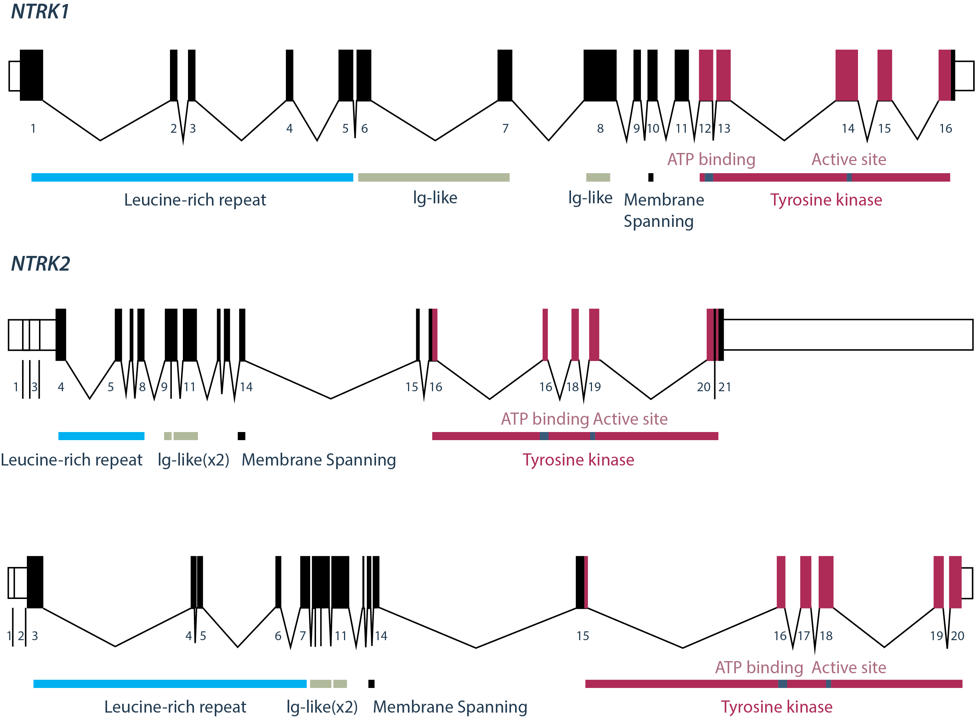
NTRK gene fusion characteristics to consider for detection¹⁻⁵
NTRK gene fusions have multiple fusion partners
and with inconsistent break points that are tumour‑agnostic
The resulting chimeric genes have a variable number of intronic regions with variable lengths
The resulting chimeric genes have low complexity, GC‑rich sequences
TRK fusion proteins are endogenously expressed in some tumour/tissue types
➔ Impact on testing strategies
Source: Farago AF, et al. JCO Precis Oncol. 2018. 2018:PO.18.00037
ATP, adenosine triphosphate; Ig, immunoglobulin; NTRK, neurotrophic tyrosine kinase; TRK, tropomyosin receptor kinase
1. Vaishnavi A, et al. Cancer Discov. 2015;5:25-34; 2. Sigal D, et al. J Natl Compr Canc Netw. 2017;15:1317-22; 3. Gagan J and Van Allen EM. Genome Med. 2015;7:80;
4. Shaw AT, et al. Nat Rev Cancer. 2013;13:772-87; 5. Farago AF, et al. JCO Precis Oncol. 2018;2018:PO.18.00037

Slide 40
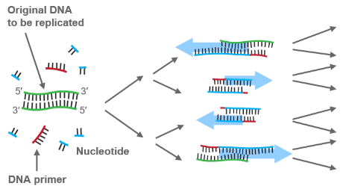
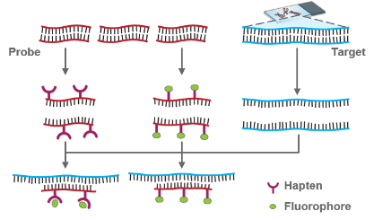
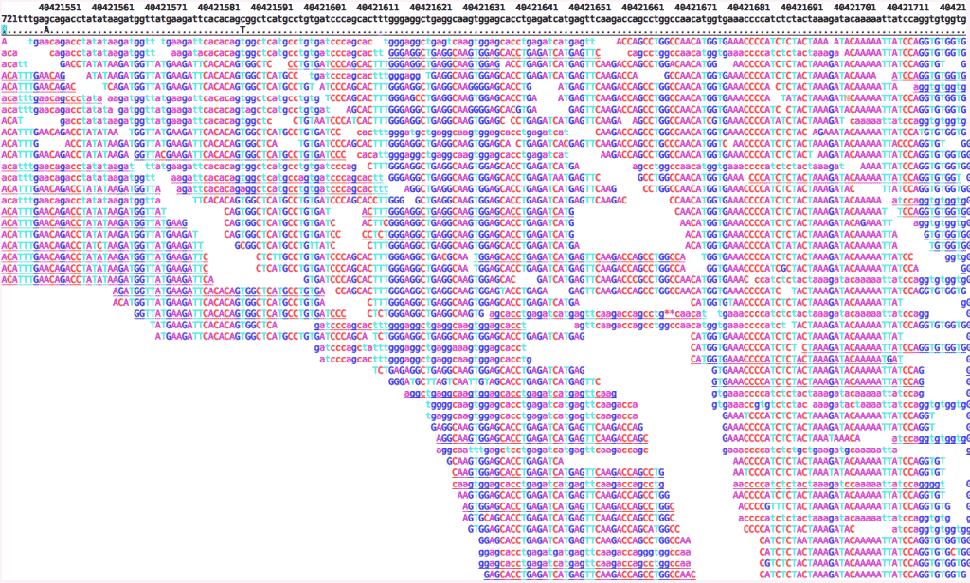
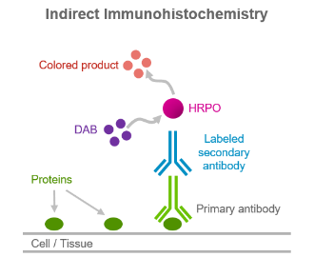
Diagnostic testing overview
NTRK gene fusions are oncogenic genomic alterations that are generally mutually exclusive with other driver gene mutations such as ALK and BRAF¹
Testing for NTRK gene fusions is essential to identify patients who harbour these genomic alterations and may therefore benefit from TRK inhibitors¹⁻³
NTRK gene fusions can be detected indirectly or directly by multiple methods, including:²⁻⁴
RT-PCR
FISH
NGS
IHC*
*Only detects TRK protein expression, confirmatory genomic testing is required
ALK, anaplastic lymphoma kinase; BRAF, serine/threonine-kinase B-Raf/proto-oncogene B-Raf; FISH, fluorescence in situ hybridisation; IHC, immunohistochemistry; NGS, next generation sequencing; NTRK, neurotrophic tyrosine kinase; RT-PCR, reverse transcriptase-polymerase chain reaction; TRK, tropomyosin receptor kinase
1. Stransky N, et al. Nat Commun. 2014;5:4846; 2. Prasad ML, et al. Cancer. 2016;122:1097-1107; 3. Brenca M, et al. J Pathol. 2016;238:543-9;
4. Hechtman JF, et al. Am J Surg Pathol. 2017;41:1547-51

Slide 41
Immunohistochemistry (IHC)

Slide 42
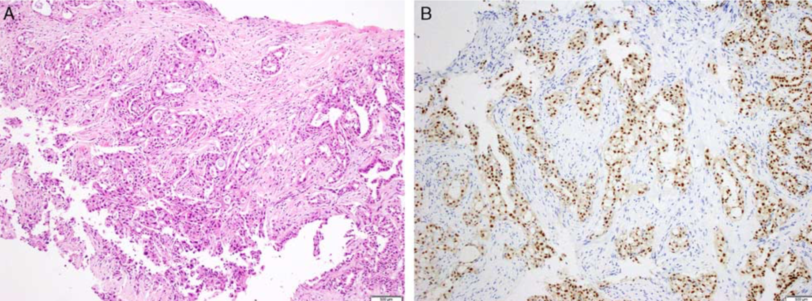
Immunohistochemistry
The pattern of TRK expression detected by IHC can be variable in intensity
and subcellular localisation
Nuclear pan-TRK IHC can be considered a diagnostic surrogate of NTRK3 fusions but other patterns can be associated
Moderate to strong diffuse cytoplasmic pan-TRK IHC staining are more frequent in case of NTRK1/NTRK2 fusions
ETV6-NTRK3 fusion positive case
IHC, immunohistochemistry; NTRK, neurotrophic tyrosine kinase; TRK, tropomyosin receptor kinase
Images from Hechtman JF, et al. Am J Surg Pathol. 2017;41:1547-51

Slide 43
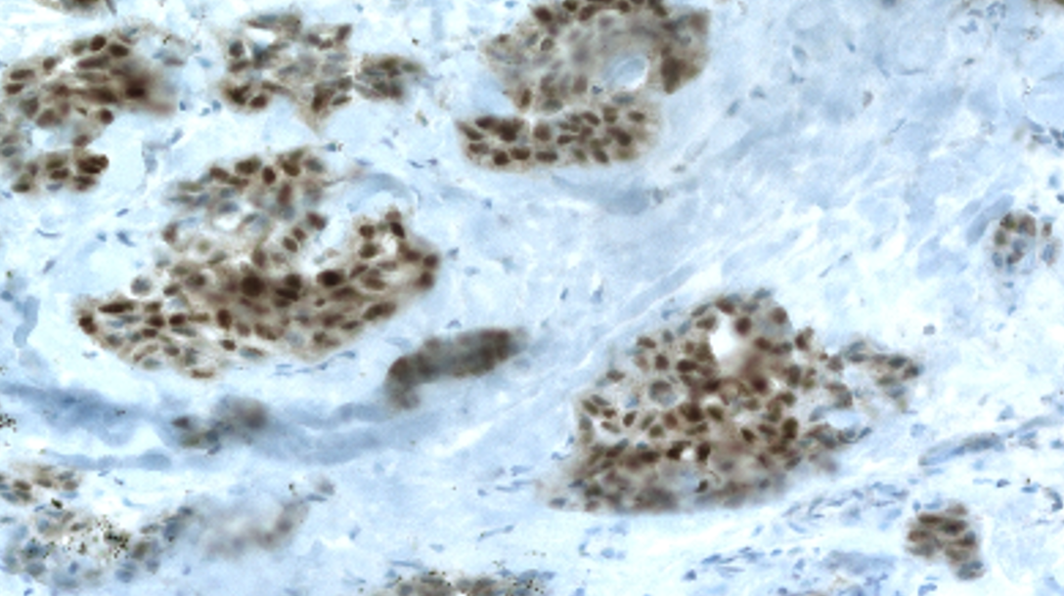
Immunohistochemistry
Advantages
Less expensive, reimbursed in many countries
Fast turnaround time
Protein localisation provides clues on the presence of specific fusions
Disadvantages
Low expression or rare types of fusion may give false negative results (low protein expression levels)
Constitutive expression or low expression not associated with fusion (low specificity in nervous, neuroendocrine tumours), heterogeneous non specific staining in some sarcoma
Does not detect involved genes and exons
Does not detect concomitant alterations

Slide 44
Fluorescence in situ hybridisation (FISH)

Slide 45
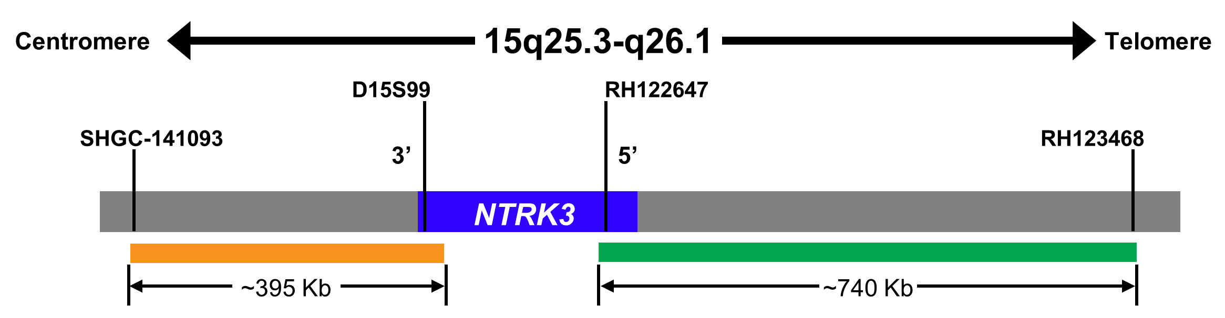
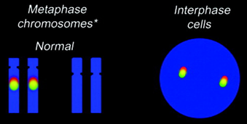
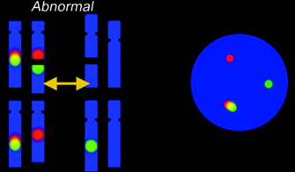
Break-apart FISH is particularly useful for detecting gene translocations
Break-apart FISH uses separate, locus-specific, and differently
coloured probes for the 5′ and 3′ ends of the gene of interest¹
Yellow (red/green) signals in normal interphase nuclei versus split red and green signals in cell carrying translocation²
Metaphase chromosomes
Interphase
cells
Normal
Zytovision ZytoLight® NTRK3 Dual Colour Break Apart Probe
Translocation
  While break-apart FISH can identify gene disruptions in DNA,
  it cannot confirm in-frame, functional fusions
FISH, fluorescence in situ hybridisation; NTRK, neurotrophic tyrosine kinase
Zytovision. https://www.zytovision.com/downloads_products/datasheets/z-2206-ce-ivd.pdf. Accessed December 22, 2020
1. Cheng L, et al. J Path Clin Res. 2017;3:73-99; 2. Ventura RA, et al. J Mol Diag. 2006;8:141-51

Slide 46
Fluorescence in situ hybridisation (FISH)
Advantages
Commonly used method for detecting gene fusions
Fast turnaround time
Disadvantages
Tests have to be run for each gene
While break-apart FISH can identify gene disruptions in DNA, it cannot confirm in-frame,
functional fusions
No indication about the partner gene
Subjective interpretation
Requires specific equipment
May show up to 30% false negative results
FISH, fluorescence in situ hybridisation

Slide 47
RT-PCR or RNA targeted fusion panels (non NGS)
NGS, next generation sequencing; RT-PCR, reverse-transcriptase polymerase chain reaction

Slide 48
DETECTION of FUSION transcripts by RT-PcR
BENEFITS
Detects known and unknown fusion transcripts
Proven effectiveness
Inexpensive
RT-PCR
Or NanoString
LIMITATIONS
Too many TRK fusion partners
Cannot detect novel fusion partners
Presence of alteration is not excluded by a negative result
RT-PCR, reverse-transcriptase polymerase chain reaction; TRK, tropomyosin receptor kinase

Slide 49
Next generation sequencing (NGS)

Slide 50
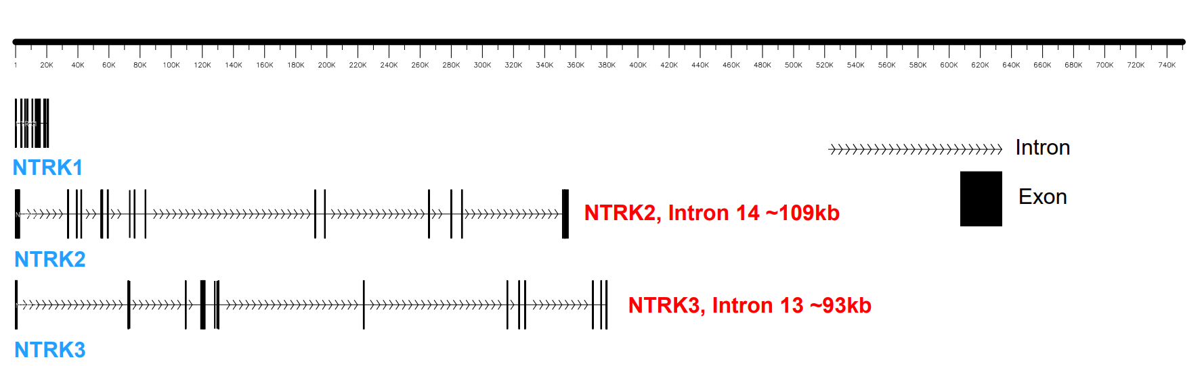
The challenge: Detecting fusions in NTRK1-3 genes
Because of large intronic spaces (and difficult regions within them), fusion detection by DNA NGS
can be complicated
  Lower capacity (fewer samples to multiplex to get appropriate coverage)
  More complications with difficult introns
NTRK, neurotrophic tyrosine kinase; NGS, next generation sequencing

Slide 51

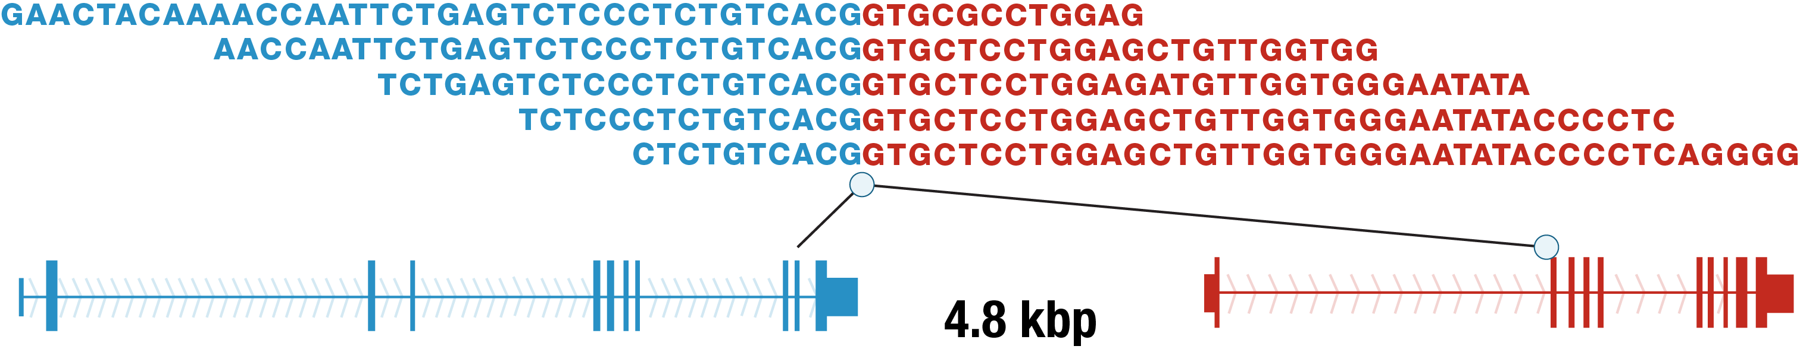

Advantages of NGS in detecting NTRK fusions
General NGS
High sensitivity and specificity potential
Multiplexing: simultaneously queries
multiple potentially actionable targets
(e.g., NTRK, ALK, ROS1, RET)
Detects both known and novel fusions, regardless of break point or fusion partner (depending on library preparation method)
RNA-based NGS
Able to distinguish in-frame, transcribed gene fusions versus out-of-frame fusions
Avoids difficulties of sequencing large intronic regions in the NTRK genes
RNA-based NGS is the preferred method for detecting NTRK fusions in cancer
ALK, anaplastic lymphoma kinase; NGS, next generation sequencing; NTRK, neurotrophic tyrosine kinase
Kumar S, et al. Wiley Interdiscip Rev RNA. 2016;7:811-23

Slide 52
Advantages of RNA NGS in detecting NTRK fusions
Prospective DNA NGS MSK-IMPACT (Memorial Sloan Kettering-Integrated Mutation Profiling of Actionable Cancer Targets) of 2,522 lung adenocarcinomas
  195 (7.7%) fusions
  254 driver-negative ➔ 254 underwent RNASeq ➔ 27 in-frame fusions
MSK-IMPACT negative
(n=232)
MSK-Fusion positive
(n=36)
Clinical benefit of matched targeted therapy
(n=10)
Other/
Non-targetable
3
Rearrangement | Matched therapy | Best response*
EML4-ALK | Alectinib | SD
CD74-ROS1 | Entrectinib | SD
SQSTM1-NTRK3 | Larotrectinib | PR**
STRN-NTRK2 | Larotrectinib | SD
CD74-ROS1 | Entrectinib | PR**
CD74-NRG1 | Afatinib | SD
MET Exon14 skipping | Crizotinib | SD
SLC34A2-ROS1 | Crizotinib | PD
SLC34A2-ROS1 | Crizotinib | SD
SDC4-NRG1 | Afatinib | PD
RET
3
ROS1
10
MSK-Fusion
positive
36
Other/
targetable
5
MSK-Fusion
negative
196
ALK
4
METex14
6
NRG1
5
* Response assessment by RECIST v1.1. ** Confirmed PR
ALK, anaplastic lymphoma kinase; NGS, next generation sequencing; NTRK, neurotrophic tyrosine kinase; PD, progressive disease; PR, partial response; SD, stable disease
Benayed R, et al. Clin Cancer Res. 2019;25:4712-22

Slide 53
Conclusion - Detecting NTRK Fusions
The perfect NTRK fusion test does not exist
 | Pros | Cons | Comment
NGS | Comprehensive hypothesis free | Gene fusions require deliberate and challenging assay design | RNA > DNA for fusion sensitivity
RT-PCR | Proven, inexpensive | Too many TRK fusion partners | Only detects fusions you know to look for
FISH (break apart) | Built for fusions | Single-plex, fusion partner not identified | Three NTRK genes = six probes/colours
IHC | Proven, inexpensive | Single-plex, “positive” does not necessarily indicate fusion | ALK gene fusion success story
All in one solution but not available everywhere and expensive
Targeted research but simple tools
Useful for the “pathognomonic”
NTRK positive cancers
Useful screening tool but low sensibility with some clones
ALK, anaplastic lymphoma kinase; FISH, fluorescence in situ hybridisation; IHC, immunohistochemistry; NGS, next generation sequencing; NTRK, neurotrophic tyrosine kinase; TRK, tropomyosin receptor kinase
https://www.fda.gov/downloads/AdvisoryCommittees/CommitteesMeetingMaterials/Drugs/OncologicDrugsAdvisoryCommittee/UCM516803.pdf

Slide 54
Testing strategies for NTRK fusions

Slide 55
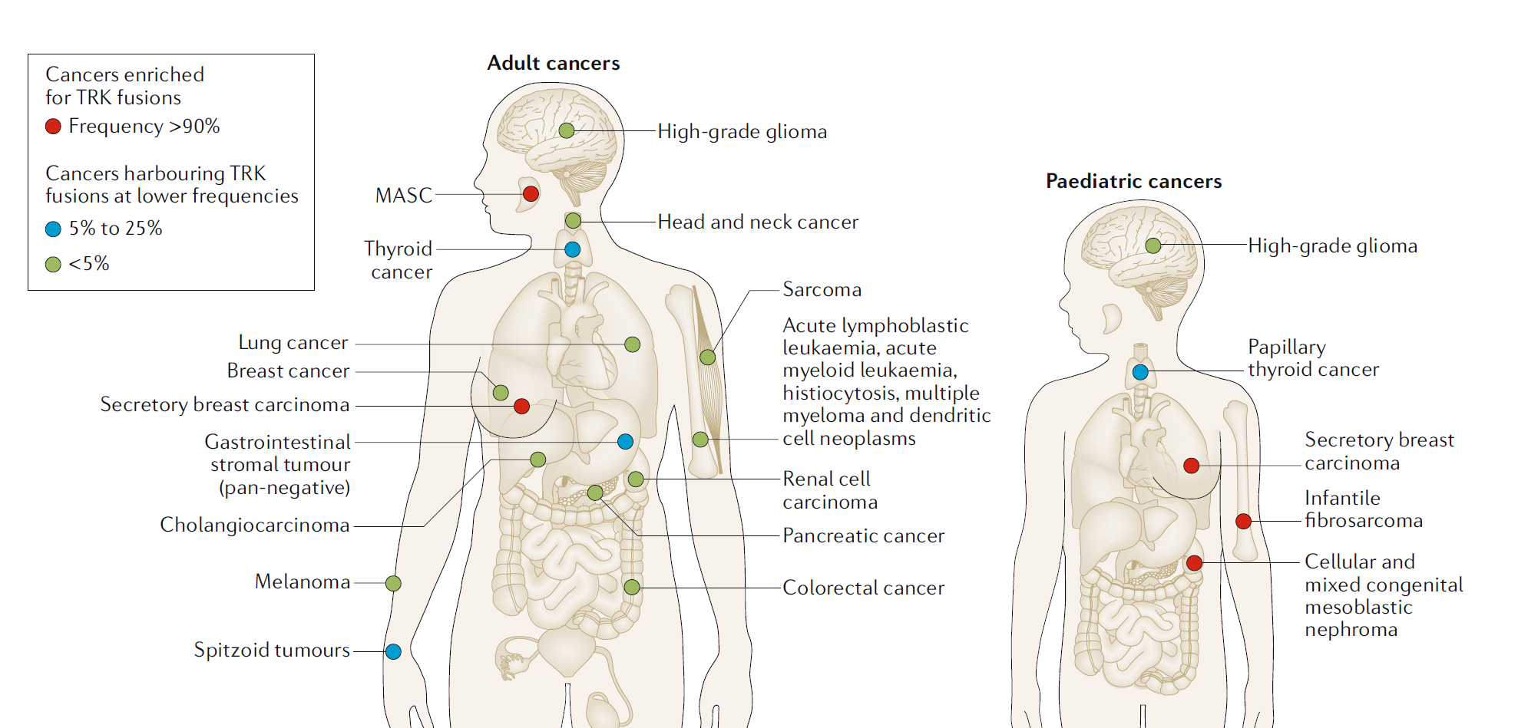
Distribution and frequency of NTRK fusions in adult and paediatric tumours
MASC, mammary analogue secretory carcinoma; NTRK, neurotrophic tyrosine kinase; TRK, tropomyosin receptor kinase
Cocco E, et al. Nature Rev Clin Oncol. 2018;15:731-47

Slide 56
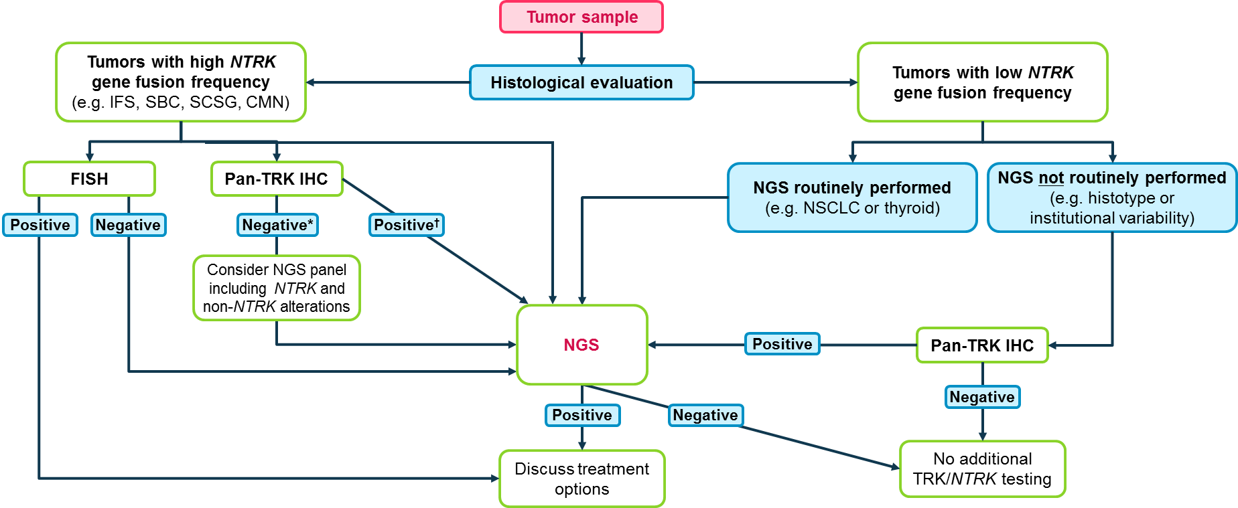
Testing algorithm for NTRK fusion cancer
* If histology typical, then confirmation by NGS is recommended; † Concurrent NGS or FISH testing and treatment to be considered
CMN, congenital mesoblastic nephroma; FISH, fluorescence in situ hybridisation; IFS, infantile fibrosarcoma; ; IHC, immunohistochemistry; NGS, next generation sequencing; NSCLC, non-small-cell lung carcinoma; NTRK, neurotrophic tyrosine kinase; SBC, secretory breast carcinoma; SCSG, secretory carcinoma of the salivary glands; TRK, tropomyosin receptor kinase
Penault-Llorca F, et al. J Clin Pathol. 2019;72:460-7

Slide 57
Testing guidance:
Ideal and alternate testing behaviours
 |  | Lung |  | Colorectal |  | Thyroid (RAI-refractory) |  | Sarcoma (GIST)
Who should I test? | Ideal | Test all metastatic or locally advanced patients at diagnosis for oncogenic drivers (i.e. EGFR, ALK, ROS1) and NTRK |  | Test all metastatic or locally advanced patients at diagnosis along with other biomarkers, such as KRAS, NRAS and BRAF |  | Test all RAI-refractory patients for NTRK |  | Test all metastatic or locally advanced patients at diagnosis along with other biomarkers (KIT, PDGFRA, SDH, NF1, BRAF, MDM/CDK4….)
 | Alternative | Negative for EGFR, ALK, ROS1, wild-type BRAF (Testing for NTRK should be conducted regardless of PD-L1 status) |  | 1) All MSI-H patients 2) Wild-type KRAS, NRAS and BRAF |  | Negative BRAF V600 |  | KIT, PDGFRA-negative …… patients
When should I test? | Ideal | At diagnosis of metastatic or locally advanced disease |  | At diagnosis of metastatic or locally advanced disease |  | At diagnosis of metastatic or locally advanced disease |  | At diagnosis of metastatic or locally advanced disease
 | Alternative 1 | At diagnosis after EGFR, ALK, ROS1 |  | At metastatic diagnosis following KRAS, NRAS, BRAF and MSI |  | At metastatic diagnosis - following BRAF |  | At metastatic diagnosis following KIT, PDGFRA
 | Alternative 2 | After first- or second- line SOC |  | 1) After first-line for MSI-H patients 2) Following first-line SOC for wild-type patients |  | After first-line SOC |  | After first- or second- line SOC
How should I test? | Ideal | RNA-based NGS
 | Preferred | Pan-TRK IHC followed by molecular confirmation (except lung and CRC: NGS preferred if available)
 | Alternative | RT-PCR or FISH for NTRK 1,2,3
WHO
WHEN
HOW
ALK, anaplastic lymphoma kinase; BRAF, serine/threonine-kinase B-Raf/proto-oncogene B-Raf; CRC, colorectal cancer; EGFR, epidermal growth factor receptor; FISH, fluorescence in situ hybridisation; GIST, gastrointestinal stromal tumour; IHC, immunohistochemistry; MSI-H, microsatellite instability-high; NGS, next generation sequencing; NTRK, neurotrophic tyrosine kinase; PDGFRA, platelet-derived growth factor receptor alpha; PD-L1, programmed death-ligand 1; RAI, radioactive iodine; RT-PCR, reverse-transcriptase polymerase chain reaction; SOC, standard of care; TRK, tropomyosin receptor kinase

Slide 58
Routine pan-cancer screening:
Tumour agnostic biomarker
Screening for rare molecular events that occur across a variety of cancers can help to determine optimal treatment options for patients with advanced cancers
  NGS is broad and can detect many mutations, copy number variations, certain rearrangements, and microsatellite status
  Mutation- and fusion-specific IHC have advantages in small samples or low tumour content cases
  RNA testing can identify a variety of fusions in ‘driver-negative’ cancers
IHC with pan-TRK clones represent an interesting screening tools for frequent tumours (some limitations exist)
IHC, immunohistochemistry; NGS, next generation sequencing; TRK, tropomyosin receptor kinase

Slide 59
Adverse events associated with Trk inhibitors
Prof. Ezra Cohen, MD, FRCPSC, FASCO
UC San Diego Health – Moores Cancer Center
La Jolla, California, USA

Slide 60
disclosures
Prof. Ezra Cohen has received honoraria from the following: ALX Oncology, Ascendis, Bayer, Bioline Rx, BMS, Debio, Dynavax, MSD, Merck , Regeneron and Sanofi.

Slide 61
Background: List of TRK inhibitors and current development stage (ongoing)
TRK inhibitor | Targets | Development status in NTRK-positive population¹
larotrectinib, LOXO-101 | NTRK1/2/3 | Approved*
entrectinib, RXDX-101 | NTRK1/2/3, ALK, ROS1 | Approved**
selitrectinib, LOXO-195, BAY2731954 | NTRK1/3 (resistant) | Phase 1/2, completed (NCT04275960) and recruiting (NCT03215511)
repotrectinib, TPX-0005 | NTRK1/2/3, ALK, ROS1 (resistant) JAK2, SRC, DDR1, FAK | Phase 1/2, recruiting (NCT04094610; NCT03093116)
merestinib, LYS2801653 | NTRK1/2/3, MET, MST1R, FLT3, AXL, MERTK, TEK, ROS1, DDR1/2; MKNK1/2 | Phase 2, active, not recruiting (NCT02920996)
sitravatinib, MGCD516 | NTRK1/2/3, MET, KIT, PDGFRA, KDR, DDR2, RET, CBL | Phase 1, active, not recruiting (NCT02219711)
taletrectinib, DS-6051b, AB-106 | NTRK1/2/3, ROS1 | Phase 1/2, active, not recruiting (NCT02675491), not yet recruiting (NCT04617054)
cabozantinib, XL184 | NTRK1/2/3, RET, ROS1, MET, and AXL | Phase 2, recruiting (NCT01639508)
FCN-011 | NTRK1/2/3 | Phase 1, not yet recruiting (NCT04687423)
*Larotrectinib is approved in the US, Australia, Brazil, Canada, European Union, Hong-Kong, Israel, Saudi Arabia, Singapore, South Korea and Switzerland . **Entrectinib is approved in the US, Australia, European Union and Japan
ALK, anaplastic lymphoma kinase; CBL, casitas B-lineage lymphoma; DDR1/2, discoidin domain receptor tyrosine kinase 1/2; FAK, focal adhesion kinase; FLT3, FMS-like tyrosine kinase 3; JAK2, Janus kinase 2; KDR, kinase insert domain receptor; MKNK1/2, MAP kinase-interacting serine/threonine-protein kinase 1/2; MST1R, macrophage stimulating 1 receptor; NTRK, neurotrophic tyrosine receptor kinase; PDGFRA, platelet-derived growth factor receptor alpha; RET, rearranged during transfection; ROS1, c-ros oncogene 1; TRK, tropomyosin receptor kinase
1. Source : ClinicalTrials.gov website last accessed: on 11 January 2021

Slide 62
Safety profile of the current approved trk inhibitors larotrectinib (specific TRK inhibitor) entrectinib (TRK, ROS1, ALK inhibitor)
ALK, anaplastic lymphoma kinase; ROS1, c-ros oncogene 1; TRK, tropomyosin receptor kinase

Slide 63
Pooled analysis of Aes with larotrectinib
Data cutoff:
19 February 2019
 | Treatment-emergent AEs, n (%)* |  |  | Treatment-related adverse events*
 | Grade 1-2 | Grade 3 | Grade 4 | Grade 3 | Grade 4
Fatigue | 79 (30%) | 6 (2%) | 0 | 1 (<1%) | 0
Alanine aminotransferase increased | 64 (25%) | 7 (3%) | 2 (<1%) | 7 (3%) | 1 (<1%)
Cough | 71 (27%) | 1 (<1%) | 0 | 0 | 0
Constipation | 69 (27%) | 1 (<1%) | 0 | 0 | 0
Anaemia | 44 (17%) | 25 (10%) | 0 | 6 (2%) | 0
Aspartate aminotransferase increased | 62 (24%) | 6 (2%) | 1 (<1%) | 2 (<1%) | 0
Dizziness | 64 (25%) | 2 (<1%) | 0 | 1 (<1%) | 0
Nausea | 62 (24%) | 2 (<1%) | 0 | 2 (<1%) | 0
Vomiting | 62 (24%) | 2 (<1%) | 0 | 0 | 0
Diarrhoea | 59 (23%) | 3 (1%) | 0 | 0 | 0
Pyrexia | 50 (19%) | 2 (<1%) | 1 (<1%) | 0 | 0
Dyspnoea | 35 (13%) | 6 (2%) | 0 | 0 | 0
Myalgia | 38 (15%) | 3 (1%) | 0 | 2 (<1%) | 0
Peripheral oedema | 40 (15%) | 1 (<1%) | 0 | 0 | 0
Headache | 38 (15%) | 1 (<1%) | 0 | 1 (<1%) | 0
Neutrophil count decreased | 18 (7%) | 12 (5%) | 2 (<1%) | 4 (2%) | 1 (<1%)
Lymphocyte count decreased | 22 (8%) | 7 (3%) | 2 (<1%) | 2 (<1%) | 0
Hypokalaemia | 12 (5%) | 8 (3%) | 1 (<1%) | 0 | 0
Hypophosphatemia | 5 (2%) | 9 (3%) | 0 | 0 | 0
Adult in Phase 1
Advanced solid tumours
NCT02122913
N=12
Paediatric in Phase 1/2
Advanced solid tumours
SCOUT: NCT02637687
N=50
Adult/adolescent in Phase 2
Advanced solid tumours
NAVIGATE: NCT02576431
N=97
*Data are n (%). n=260. The adverse events listed here are those that occurred at any grade in at least 15% of patients, or at grade 3 or worse in at least 3% of patients, regardless of attribution. Refer to NTRK CONNECT for full publication details: https://ntrkconnect.info/ntrk-connect-key-publication-snapshot-1-larotrectinib-and-entrectinib-efficacy-and-safety-profile-in-solid-tumours/
AEs, adverse events
Source: Hong DS, et al. Lancet Oncol. 2020;21:531-40

Slide 64
Expanded pooled analysis of Aes with larotrectinib
Expanded safety dataset (N=279)
Data cutoff:
15 July 2020
 | Treatment-emergent AEs, n (%) |  |  | Treatment-related AEs, n (%)
 | Grade 1-2 | Grade 3 | Grade 4 | Grade 3 | Grade 4
Fatigue | 85 (30%) | 7 (3%) | 0 | 1 (<1%) | 0
Cough | 82 (29%) | 1 (<1%) | 0 | 0 | 0
Alanine aminotransferase increased | 70 (25%) | 7 (3%) | 2 (1%) | 7 (3%) | 2 (1%)
Constipation | 75 (27%) | 1 (<1%) | 0 | 0 | 0
Diarrhoea | 69 (25%) | 4 (1%) | 0 | 0 | 0
Dizziness | 70 (25%) | 3 (1%) | 0 | 1 (<1%) | 0
Anaemia | 45 (16%) | 26 (9%) | 0 | 6 (2%) | 0
Aspartate aminotransferase increased | 64 (23%) | 6 (2%) | 1 (<1%) | 2 (1%) | 1 (<1%)
Vomiting | 69 (25%) | 2 (1%) | 0 | 0 | 0
Nausea | 67 (24%) | 2 (1%) | 0 | 2 (1%) | 0
Pyrexia | 60 (22%) | 4 (1%) | 1 (<1%) | 0 | 0
Myalgia | 45 (16%) | 3 (1%) | 0 | 2 (1%) | 0
Dyspnoea | 40 (14%) | 7 (3%) | 0 | 0 | 0
Arthralgia | 43 (15%) | 2 (1%) | 0 | 1 (<1%) | 0
Oedema peripheral | 43 (15%) | 1 (<1%) | 0 | 0 | 0
Headache | 41 (15%) | 1 (<1%) | 0 | 1 (<1%) | 0
Weight increased | 30 (11%) | 10 (4%) | 0 | 2 (1%) | 0
Neutrophil count decreased | 18 (6%) | 17 (6%) | 2 (1%) | 7 (3%) | 1 (<1%)
Lymphocyte count decreased | 24 (9%) | 10 (4%) | 2 (1%) | 3 (1%) | 0
Adult in Phase 1
Advanced solid tumours
NCT02122913
N=13
Paediatric in Phase 1/2
Advanced solid tumours
SCOUT: NCT02637687
N=57
Adult/adolescent in Phase 2
Advanced solid tumours
NAVIGATE: NCT02576431
N=105
Data presented are from AEs in the expanded safety dataset (N=279)
The safety population included all patients enrolled in one of the three clinical trials, who received at least one dose of larotrectinib, regardless of TRK fusion status (n=279) The AEs listed here are those that occurred at any grade in at least 15% of patients, or at Grade 3 or 4 in at least 3% of patients regardless of attribution
AEs, adverse events; TRK, tropomyosin receptor kinase
Source: McDermott R, et al. Ann Oncol. 2020;31 (suppl_4):S1034-S1051

Slide 65
Integrated safety data for entrectinib
Data cutoff:
31 May 2018
Treatment-related adverse events (n=68)* | Grade 1–2 | Grade 3 | Grade 4
Dysgeusia | 32 (47%) | 0 | 0
Constipation | 19 (28%) | 0 | 0
Fatigue | 19 (28%) | 5 (7%) | 0
Diarrhoea | 18 (27%) | 1 (2%) | 0
Oedema peripheral | 16 (24%) | 1 (2%) | 0
Dizziness | 16 (24%) | 1 (2%) | 0
Blood creatinine increased | 12 (18%) | 1 (2%) | 0
Paraesthesia | 11 (16%) | 0 | 0
Nausea | 10 (15%) | 0 | 0
Vomiting | 9 (13%) | 0 | 0
Arthralgia | 8 (12%) | 0 | 0
Myalgia | 8 (12%) | 0 | 0
Weight increased | 8 (12%) | 7 (10%) | 0
AST increased | 7 (10%) | 0 | 1 (2%)
ALT increased | 6 (9%) | 0 | 1 (2%)
Muscular weakness | 6 (9%) | 1 (2%) | 0
Anaemia | 5 (7%) | 8 (12%) | 0
Asthenia | 5 (7%) | 0 | 0
Peripheral sensory neuropathy | 4 (6%) | 1 (2%) | 0
Neutrophil count decreased | 4 (6%) | 0 | 0
Rash | 4 (6%) | 0 | 0
Treatment-related adverse events (n=68)* | Grade 1–2 | Grade 3 | Grade 4
Disturbance in attention | 3 (4%) | 0 | 0
Pain of skin | 3 (4%) | 0 | 0
Neutropenia | 3 (4%) | 2 (3%) | 0
Localised oedema | 2 (3%) | 1 (2%) | 0
Hyperaesthesia | 2 (3%) | 0 | 0
Ataxia | 2 (3%) | 0 | 0
Platelet count decreased | 2 (3%) | 0 | 0
Hyperuricaemia | 2 (3%) | 0 | 2 (3%)
Hypophosphatemia | 2 (3%) | 2 (3%) | 0
Dehydration | 2 (3%) | 0 | 0
Diplopia | 1 (2%) | 1 (2%) | 0
Hypotension | 1 (2%) | 1 (2%) | 0
Pyrexia | 1 (2%) | 0 | 0
Lymphocyte count decreased | 1 (2%) | 0 | 0
Pruritus | 1 (2%) | 0 | 0
Hypoxia | 1 (2%) | 0 | 0
Fall | 1 (2%) | 0 | 0
Osteoarthritis | 0 | 1 (2%) | 0
Blood uric acid increased | 0 | 0 | 1 (2%)
Hypermagnesemia | 0 | 1 (2%) | 0
Cardiac failure | 0 | 1 (2%) | 0
Cardiac failure congestive | 0 | 1 (2%) | 0
ALKA-372-001: Phase 1
Solid tumours
EudraCT 2012-000148-88
N=1
STARTRK-1: Phase 1/2
Solid tumours
NCT02097810
N=2
STARTRK-2: Phase 2
Solid tumours
NCT02568267
N=51
*Data are n (%). n=68. The treatment-related adverse events listed here are those that occurred in the NTRK fusion-positive safety-evaluable population. Refer to NTRK CONNECT for full publication details: https://ntrkconnect.info/ntrk-connect-key-publication-snapshot-1-larotrectinib-and-entrectinib-efficacy-and-safety-profile-in-solid-tumours/
ALT, alanine aminotransferase; AST, aspartate aminotransferase; NTRK, neurotrophic tyrosine receptor kinase
Doebele RC, et al. Lancet Oncol. 2020;21:271-82

Slide 66
Characterisation of On-Target Adverse Events Caused by TRK Inhibitor Therapy
Liu D, et al. Ann Oncol. 2020;31:1207-15
TRK, tropomyosin receptor kinase

Slide 67
DEFINITION & retrospective STUDY DESIGN
On-target refers to pronounced and adverse pharmacological effects at the target molecule of interest in the test system¹
Off-target refers to adverse effects as a result of modulation of other target molecules; these may be related biologically or totally unrelated to the target of interest¹
Eligibility criteria
Treated in the Early Drug Development Service of Memorial Sloan Kettering Cancer Center between January 1st 2013→ April 1st 2019
Pathologic evidence of a solid tumour
Advanced or unresectable disease
treated with at least one dose of a tyrosine kinase inhibitor with potent anti-TRK activity
n= 96
Treatment-emergent AEs Analysis
AE likely to be mediated by TRK inhibition were analysed:
Paraesthesias
Weight gain
Dizziness with or without ataxia
Pain with temporary or permanent TRK inhibitor withdrawal
Data collection
Demographics
Toxicity assessment
AE management
AE, adverse event; TRK, tropomyosin receptor kinase
1. DG Rudmann. Toxicol Pathol. 2013;41:310-4

Slide 68
Demographics and baseline characteristics
Clinicopathologic features of the study population (n=96) | n (%) and continuous as median (range)
Age* (years) | 52 (5-81)
Female sex | 49 (51%)
Histology
Lung | 43 (45%)
Gastrointestinal | 10 (10%)
Salivary | 8 (8%)
Sarcoma | 8 (8%)
Thyroid | 6 (6%)
Melanoma | 6 (6%)
Primary brain tumour | 5 (5%)
Neuroblastoma | 5 (5%)
Other | 7 (7%)
Clinicopathologic features of the study population (n=96) | n (%) and continuous as median (range)
Genomic alteration
NTRK fusion | 39 (41%)
ROS1 fusion | 24 (25%)
Other** | 29 (30%)
Unknown | 4 (4%)
TRK inhibitor
First-generation TKI | 81 (84%)
Other TKI | 30 (31%)
TRK inhibitor duration (months) | 6 (1-42)
*Seven patients were <18 years old
**Other alterations included NTRK mutation (N = 1), NTRK amplification (N = 2), ROS1 mutation (N = 1), and ALK fusion/mutation (N = 25)
ALK, anaplastic lymphoma kinase; NTRK, neurotrophic tyrosine receptor kinase; ROS1, c-ros oncogene 1; TKI, tyrosine kinase inhibitor; TRK, tropomyosin receptor kinase

Slide 69
Safety profile of on-target Aes with TRK inhibition
100%
82%
80%
66%
60%
59%
47%
No AE
Grade 1
Grade 2
Grade 3
% of patients
40%
32%
23%
22%
17%
20%
12%
11%
8%
8%
11%
1%
1%
0%
Weight gain
Dizziness or ataxia
Withdrawal pain
Paraesthesia
TRKA inhibition
Neuropathy: sensory or autonomic
Congenital insensitivity to pain with anhidrosis
TRKB inhibition
Hyperphagia or hyperdipsia
Dorsal root neuron loss
Nociception and memory impairment
TRKC inhibition
Proprioception defects
Motor neuron afferent loss
AEs, adverse events; TRK A/B/C, tropomyosin receptor kinase A/B/C

Slide 70
Weight gain management
Weight Gain
Supportive medication in weight gain
Agent(s) | Mechanism of action
Liraglutide | GLP-1 analogue
Orlistat | Inhibits fat absorption
Phentermine/ topiramate combination | Increases norepinephrine release; GABA receptor agonist
Lorcaserin | 5-HT_{2C} receptor agonist
Naltrexone/ bupropion combination | µ-opioid receptor antagonist; dopamine and norepinephrine reuptake inhibitor
Metformin | Modulates hypothalamic appetite regulatory centers
100
Grade 1
Grade 2
Grade 3
80
3%
13%
23%
25%
60
Frequency (%)
22%
28%
40
1%
31%
42%
9%
20
38%
33%
25%
23%
17%
0
3
6
12
24
> 24
Months
Patients, n
96
64
46
35
12
➔Authors recommend to monitor serially weight gain during treatment with TRK Inhibitor
5-HT, 5-hydroxytryptamine; GABA, γ-aminobutyric acid; GLP-1, glucagon-like peptide-1; TRK, tropomyosin receptor kinase

Slide 71
Dizziness management
Time to treatment discontinuation in patients who developed dizziness*
Supportive medication in dizziness management
 | Agent(s) | Mechanism of action
Dizziness (ataxia or vertigo) | Meclizine | H₁ histamine receptor antagonist, suppresses vestibular stimulation, anticholinergic
 | Scopolamine | Antagonises histamine and serotonin
Dizziness (orthostasis) | Midodrine | α₁ adrenergic receptor agonist, increases vascular tone
 | Fludrocortisone | Mineralocorticoid
 | Droxidopa | Metabolized to norepinephrine, induces vasoconstriction
Vertigo
Positional
light-headedness
Mixed
8%
(3/39)
5%
(2/39)
36%
(14/39)
33%
(13/39)
18%
(7/39)
First TKI
Second TKI
Third TKI
Dizziness
Discontinued treatment
Intervention
Unspecified
Imbalance
0
3
6
9
12
15
18
21
24
27
30
48
Months
➔ Authors recommend to characterise the dizziness and to manage it accordingly
*Each bar represents a single patient. Pie chart shows the frequency distribution of the categories of dizziness that patients experienced.
TKI, tyrosine kinase inhibitor

Slide 72
Withdrawal PAIN management
Time to discontinuation discontinuation in patients who developed withdrawal pain*
First TKI
Second TKI
Third TKI
Grade 1 withdrawal pain
Grade 2 withdrawal pain
Grade 3 withdrawal pain
No withdrawal pain
Discontinued treatment
0
6
12
18
24
30
36
42
48
54
60
96
Months
➔ Authors highlight that withdrawal pain can occur with temporary or permanent TKI treatment
with anti-TRK activity discontinuation
*Each bar represents a single patient
TKI, tyrosine kinase inhibitor; TRK, tropomyosin receptor kinase

Slide 73
Conclusion
Identifying AEs related to TRK inhibitors are important in order to manage them during treatment approaches
On-target AEs with TRK inhibition can occur as shown in the retrospective study analysing patients with advanced or unresectable solid tumours treated with at least one dose of a TKI with potent anti-TRK activity
Dizziness, weight gain and withdrawal pain are the three identified on-target AEs
On-target AE profile is consistent with the known physiological mechanism of the TRK signalling pathway
Limitations:
  The inhibitory actions of TKIs are not only specific to TRKs
  In the retrospective study, only 41% harboured an NTRK-positive solid tumour
Due to the small size of the study, more detailed assessment of no-target AEs is needed, especially with the TRK-specific inhibitors such as larotrectinib
AE, adverse event; NTRK, neurotrophic tyrosine receptor kinase; TKI, tyrosine kinase inhibitor; TRK, tropomyosin receptor kinase

Slide 74
Treating NTRK Fusion Cancers
Tomorrow-Next steps?
David S. Hong, MD
The University of Texas MD Anderson Cancer Center.
Professor
Deputy Chairman in the Dept of Investigational Cancer Therapeutics
(Phase 1 Program)
Associate Vice President of Clinical Research

Slide 75
Resistance mechanisms

Slide 76
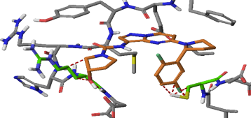
Mechanism of resistance to first generation of TRK inhibitors
Mutations that limit drug binding are the most common form of acquired resistance; often, the oncogene-addicted tumour remains addicted to the same oncogene
Early lines of evidence offer a molecular understanding of potential mechanisms of resistance to larotrectinib in patients with
NTRK gene fusions:
  Preclinical modelling
  Precedent paralogous targets (e.g. ALK, ROS1)
  Clinical case reports^{1,2}
larotrectinib bound to ATP-binding pocket of TRKA:
steric hindrance caused by G595R or G667C
larotrectinib
595R
667C
Solvent front
Activation loop
ALK, anaplastic lymphoma kinase; ATP, adenosine triphosphate; NTRK, neurotrophic tyrosine receptor kinase; ROS1, proto-oncogene tyrosine-protein 1; TRK, tropomyosin receptor kinase
1. Russo M, et al. Cancer Discov. 2016;6:36-44; 2. Drilon A, et al. Ann Oncol. 2016;27:920-6

Slide 77
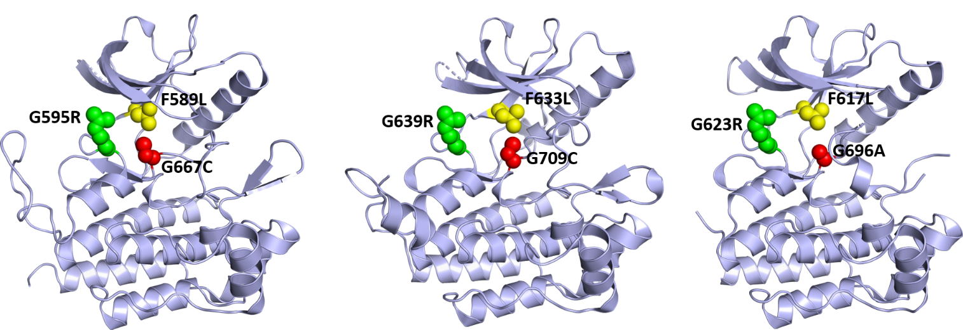
On-target resistance to TRK inhibitors
TRKA
TRKB
TRKC
Solvent Front (SF)
xDFG
Gatekeeper (GK)
Acquired TRK kinase domain mutations in three recurrent motifs result in
on-target resistance to current generation of inhibitors
TRK, tropomyosin receptor kinase; xDFG, xDFG motif
Cocco E, et al. Nat Rev Clin Oncol. 2018;15:731-47

Slide 78
On-target and off-target resistance to TRK inhibitors
BRAF, v-raf murine sarcoma viral oncogene homolog B1; IGF1R, insulin-like growth factor 1 receptor; MET, c-MET proto-oncogene; KRAS, Ki-ras2 Kirsten rat sarcoma viral oncogene homolog; TKI, tyrosine kinase inhibitor; TRK, tropomyosin receptor kinase; xDFG, xDFG motif
Drilon A., Ann Oncol. 2019;30(Suppl_8):viii23-viii30

Slide 79
Next-generation TRK INHIBITORS
TRK, tropomyosin receptor kinase

Slide 80
MAIN Next-generation TRK Inhibitors and Clinical Development status
Drug Name (Sponsor) | Molecular Targets | Development Stage and tumour Types
selitrectinib, LOXO-195, BAY2731954 (Bayer) | NTRK1/3 (solvent front, XDFG, gatekeeper mutations) | Phase 1/2, recruiting (NCT04275960; NCT03215511)
repotrectinib, TPX-0005 (Turning Point) | NTRK1/2/3 (solvent front, XDFG, gatekeeper mutations), ALK, ROS | Phase 1/2, recruiting (NCT04094610; NCT03093116)
ALK, anaplastic lymphoma kinase; NTRK, neurotrophic tyrosine receptor kinase; ROS, proto-oncogene tyrosine-protein; TRK, tropomyosin receptor kinase; xDFG, xDFG motif

Slide 81
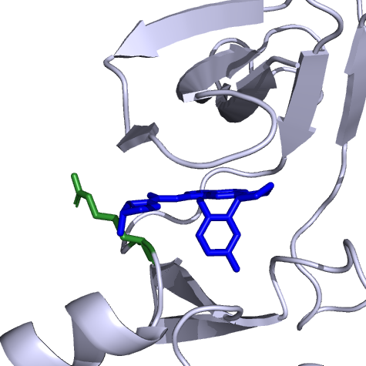
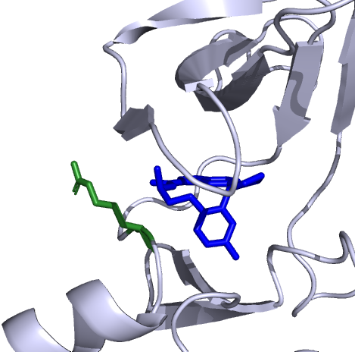
Selitrectinib (LOXO-195/BAY 2731954)
Potent second-generation inhibitor of all three TRK tyrosine kinases with IC₅₀ between 2.0 and 9.2 nM for the 3 on-target resistance mutations
Selective: >1,000x more selective for TRK over 98% of 226 non-TRK kinases
Activity against acquired solvent front, xDFG, gatekeeper, and TRK mutations demonstrated in enzyme- and cell-based assays and in vivo tumour models
Excellent drug properties: orally dosed, high exposure
larotrectinib
Solvent front mutation
selitrectinib
IC₅₀, half maximal inhibitory concentration; TRK, tropomyosin receptor kinase; xDFG, xDFG motif
Drilon A, et al. Cancer Discov. 2017;7:963-72

Slide 82

Thank you!
Thank you for your participation and input during this meeting, slides will be made available for download.
Please complete the post-meeting survey
Honorarium forms can be submitted via the COR2ED Engage meeting page

