Slide 2
Individualising treatment strategies for nmCRPC Dr. Ray A. Manneh Kopp, MD Sociedad de Oncología y Hematología del Cesar, Valledupar, Colombia November 2021
nmCRPC, non-metastatic castration-resistant prostate cancer

Slide 3
Disclaimer and disclosures
Please note: The views expressed within this presentation are the personal opinions of the authors. They do not necessarily represent the views of the author’s academic institution or the rest of the GU CONNECT group.
This content is supported by an independent educational grant from Bayer.
Dr. Ray A. Manneh Kopp has received financial support/sponsorship for research support, consultation or speaker fees from the following companies:
Astellas, AstraZeneca, Bayer, BMS, Dr Reddy’s, Janssen, Lilly, MSD, Novartis, Pfizer, Roche, Tecnofarma

Slide 4
introduction
Patients with nmCRPC progress to metastatic disease and are at risk of developing cancer-related symptoms and morbidity, eventually dying of their disease
While patients with nmCRPC are generally asymptomatic from their disease, they are often older and have chronic comorbidities that require long-term concomitant medication. Therefore, careful consideration of the benefit–risk profile of potential treatments is required
CV, cardiovascular disease; nmCRPC, non-metastatic castration-resistant prostate cancer
Saad F, et al. Prostate Cancer Prostatic Dis. 2021;24(2):323-34; Morgans AK, et al. Urol Oncol. 2021;39(1):52-62

Slide 5
What is nmCRPC?
Testosterone in castration levels
No evidence of disease w/ conventional imaging (CT, MRI, bone scan)
Rising PSA levels
Met HSPC
Rising PSA despite castrate levels of testosterone
Identification of metastases
Localised/locally advanced prostate cancer
Rising PSA
Definitive therapy
Biochemical recurrence
Start ADT
Both criteria met
Met CRPC
Rising PSA despite castrate levels of testosterone
Identification of metastases
M0 CRPC
ADT, androgen deprivation therapy; CRPC, castration-resistant prostate cancer; CT, computed tomography; HSPC, hormone-sensitive prostate cancer; M0, non-metastatic; Met, metastatic; MRI, magnetic resonance imaging; PSA, prostate-specific antigen
Saad F, et al. Prostate Cancer Prostatic Dis. 2021;24(2):323-34

Slide 6
Second-generation androgen receptor inhibitors
Second-generation androgen receptor inhibitors have demonstrated an overall survival benefit in nmCRPC patients:
Apalutamide
Enzalutamide
Darolutamide
It is important to balance the clinical benefit they offer with potential adverse events and the consequential impact on quality of life, physical capacity, and cognitive function
Management strategies for patients with nmCRPC also treated for comorbidities including CV disease require appropriate selection of therapy, diet, and exercise to meet the needs of the individual patient profile
CV, cardiovascular disease; nmCRPC, non-metastatic castration-resistant prostate cancer
Saad F, et al. Prostate Cancer Prostatic Dis. 2021;24(2):323-34; Morgans AK, et al. Urol Oncol. 2021;39(1):52-62

Slide 7
Second-generation androgen receptor inhibitors
enzalutamide
apalutamide
darolutamide
Darolutamide is structurally distinct from apalutamide and enzalutamide and is characterised by low blood–brain barrier penetration^{1,2}
This could result in less CNS toxicity and improved tolerability
CNS, central nervous system
1. Zurth C, et al. J Clin Oncol. 2018;36 suppl 6:345; 2. Zurth C, et al. J Clin Oncol. 2019;37 suppl 7:156; Fizazi K, et al. J Clin Oncol. 2019;37 suppl 7:140; Images from PubChem database: https://pubchem.ncbi.nlm.nih.gov/; Saad F, et al. Prostate Cancer Prostatic Dis. 2021;24(2):323-34

Slide 8
Which treatment for which patient?

Slide 9
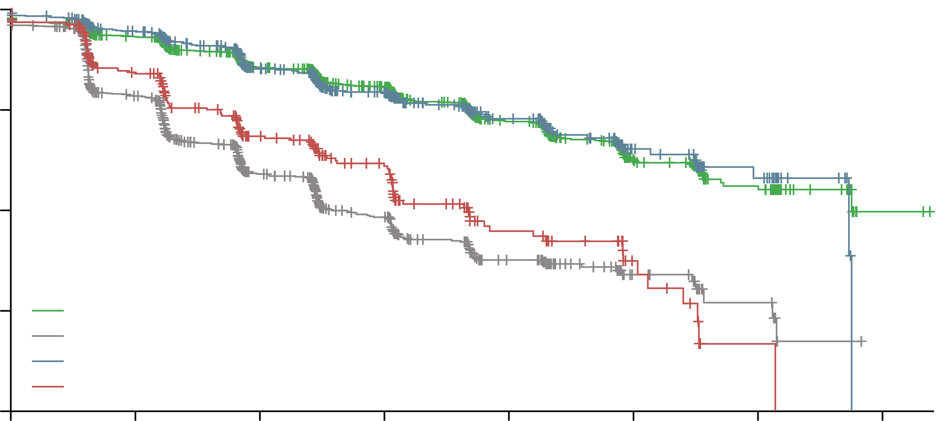
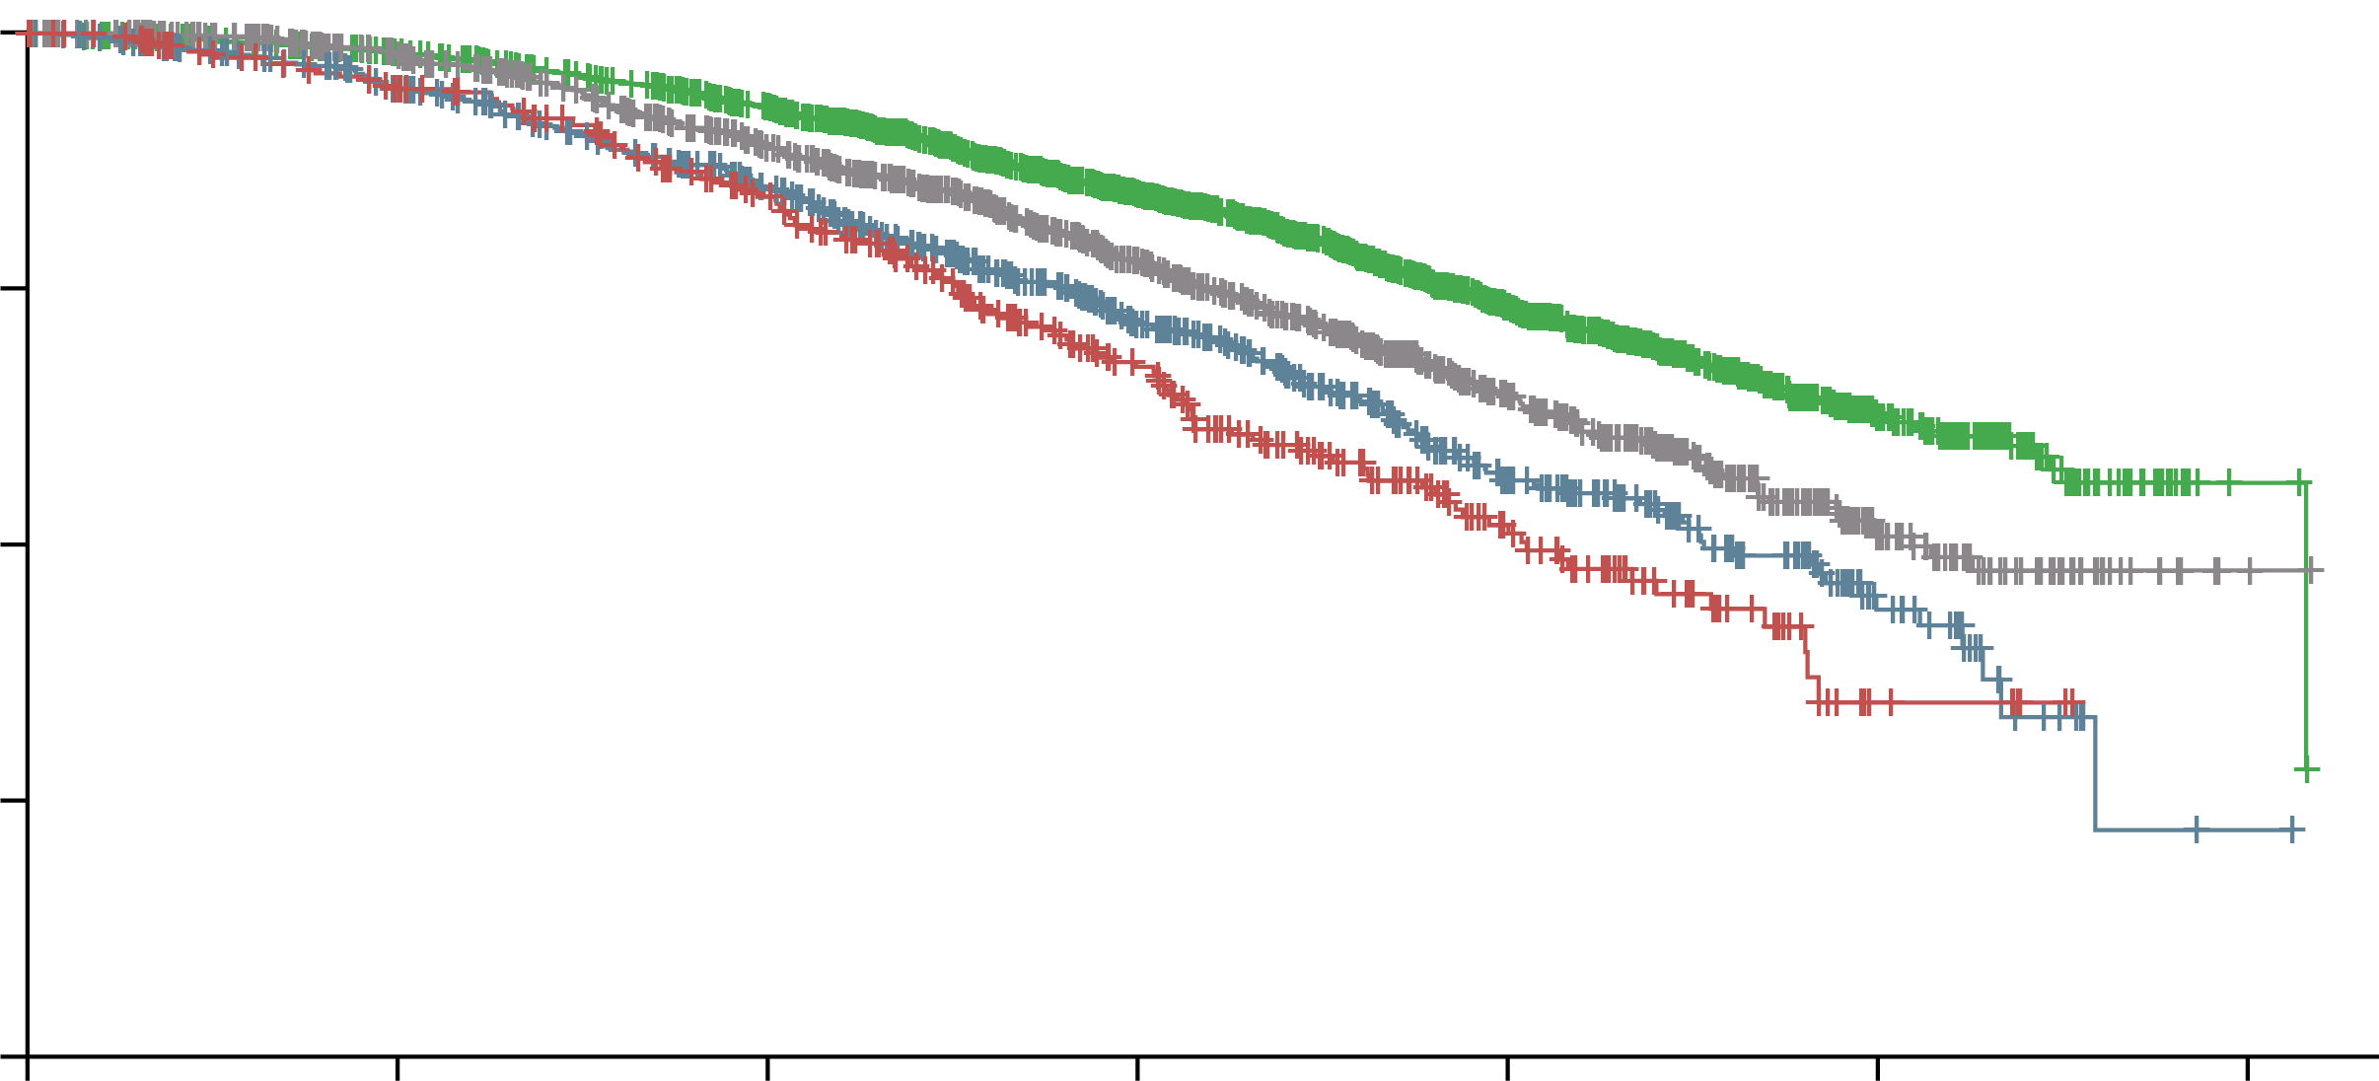
Survival outcomes in older men with nmCRPC
METASTASIS-FREE SURVIVAL
100
OVERALL SURVIVAL
75
Metastasis-free survival (%)
100
50
25
Androgen receptor inhibitor groups, age <80 years
Placebo groups, age <80 years
Androgen receptor inhibitor groups, age ≥80 years
Placebo groups, age ≥80 years
75
0
Overall survival (%)
0
6
12
18
24
30
36
42
50
Number at risk (number censored)
Androgen receptor inhibitor groups, age <80 years
Placebo groups, age <80 years
Androgen receptor inhibitor groups, age ≥80 years
Placebo groups, age ≥80 years
Time since randomisation (months)
2,019 (0) 1,075 (0)
675 (0)
348 (0)
1,704 (183) 694 (170)
558 (83)
238 (60)
1,183 (580) 342 (374)
361 (233)
141 (117)
905 (798) 204 (459)
265 (307)
90 (155)
479 (1,149) 94 (533)
127 (429)
36 (190)
152 (1,434) 23 (599)
48 (498)
11 (211)
66 (1,510) 8 (611)
21 (521)
1 (216)
2 (1,572) 0 (617)
0 (540)
0 (216)
25
Androgen receptor inhibitor groups, age <80 years
Placebo groups, age <80 years
Androgen receptor inhibitor groups, age ≥80 years
Placebo groups, age ≥80 years
0
0
12
24
36
48
60
72
Number at risk (number censored)
Androgen receptor inhibitor groups, age <80 years
Placebo groups, age <80 years
Androgen receptor inhibitor groups, age ≥80 years
Placebo groups, age ≥80 years
Time since randomisation (months)
2,019 (0) 1,075 (0)
675 (0)
348 (0)
1,916 (65) 974 (79)
602 (38)
303 (27)
1,707 (173) 800 (167)
486 (95)
242 (56)
1,187 (554) 519 (362)
307 (206)
148 (107)
630 (987) 260 (550)
144 (319)
64 (163)
157 (1,397) 61 (712)
32 (412)
7 (208)
3 (1,543) 2 (768)
1 (438)
0 (215)
nmCRPC, non-metastatic castration-resistant prostate cancer
Fallah J, et al. Lancet Oncol. 2021:22:1230-39

Slide 10
Cardiovascular Risk
The ABCDE algorithm for managing CVD in patients with Prostate cancer
Prostate cancer and cardiovascular disease (CVD) share several risk factors, with the incidence of both rising with increasing age
ARIs are associated with an increased risk of hypertension and major adverse CV events
It is important to try to mitigate CV risk for nmCRPC patients where possible by considering drug–drug interactions when prescribing ARIs, especially for men with CV comorbidities
Apalutamide and enzalutamide are substrates of CYP2C8, CYP2C9, and CYP3A4, and this should be noted when prescribing vitamin K antagonists
The potential for ARI interaction with statins or anti-hypertensives should be considered
Awareness
A
Blood pressure
B
Cholesterol, cigarettes
C
D
Diet, diabetes
E
Exercise
ARI, androgen receptor inhibitor; CV, cardiovascular; CVD, cardiovascular disease; CYP, cytochrome P450; nmCRPC, non-metastatic castration-resistant prostate cancer
Morgans AK, et al. Urol Oncol. 2021;39(1):52-62

Slide 11
Cognitive dysfunction
Prostate cancer is mainly a disease of older men, with a median age of 66 years at diagnosis. The risk of neurocognitive decline generally increases over 60 years of age in people without cancer
Cognitive decline may further increase in prostate cancer patients due to exposure to androgen deprivation therapy and other hormonal therapies
This is particularly an issue on CRPC patients as they receive continuous, long-term androgen deprivation therapy combined with a second-generation androgen receptor inhibitor
Second-generation anti-androgens are well tolerated
Signs of cognitive decline should be proactively evaluated during treatment
The inclusion of specific questions for monitoring of cognitive function may be useful to enhance safety
CRPC, castration-resistant prostate cancer
Morgans AK, et al. Clin Genitourin Cancer. 2021;19(5):467.e1-467.e11; Manneh R, et al. Manuscript awaiting publication

Slide 12
Assessing On-Treatment Cognitive Function in Patients With Prostate Cancer
Before initiating treatment, evaluate vulnerability to cognitive deterioration: patient factors, comorbidities, concomitant medications
Establish baseline cognitive function via open dialog with patient and caregiver
Individualise treatment selection
Symptoms that may affect cognitive function reported: explore further
Monitor for on-treatment changes
Possible cognitive impairment identifiedª: refer to neuropsychologist for full evaluation
ª In the absence of organic complications
Morgans AK, et al. Clin Genitourin Cancer. 2021;19(5):467.e1-467.e11

Slide 13
Toxicity profile
There appears to be increased grade 3–4 toxicity, serious adverse events, falls, and fractures in patients aged ≥ 80 years compared with patients < 80 years, regardless of treatment with second generation ARIs or placebo
Adverse events of special interest associated with ARI treatment, are:
Fatigue
Hypertension
Rash
Falls
Fractures
Mental impairment disorders
Enzalutamide, apalutamide and darolutamide have not been directly compared in a clinical trial, therefore conclusions should not be drawn by comparing safety data across the trials due to differences in clinical trial design and populations
the individual safety profiles should therefore be considered for each patient
ARI, androgen receptor inhibitor; nmCRPC, non-metastatic castration-resistant prostate cancer
Fallah J, et al. Lancet Oncol. 2021:22:1230-39; Smith MR, et al. N Engl J Med. 2018;378:1408-18; Smith MR, et al. Eur Urol. 2021;79:150-8; Sternberg CN, et al. N Engl J Med. 2020;382:2197-206; Fizazi K, et al. N Engl J Med. 2020;383:1040-9

Slide 14
Incidence of adverse events
SPARTAN:^{1,2} apalutamide
ARAMIS:⁴ darolutamide
Fatigue
Bone fracture^{m}
Falls including accident
Weight decreased, any event
Asthenic conditions^{n}
Rashº
Seizure, any event^{p}
Patients (%)
Mental impairment disorders^{q}
PROSPER:³ enzalutamide
Depressed mood disorders^{q}
Hypertension
Fatigueª
Musculoskeletal event^{b}
Fall
Hypertension^{d}
Fracture^{c}
Cognitive and memory impairment^{e}
Cardiovascular events^{f}
Ischaemic heart disease^{g}
Second primary cancer
Loss of consciousness^{i}
Rash^{h}
Renal disorder
Heptatic disorder^{k}
Angioedema^{j}
Thrombocytopenia^{l}
Neutropenia
Severe cutaneous adverse reaction
Seizure
Posterior reversible encephalopathy syndrome
Hot flush
Cardiac arrhythmias^{q, r}
Coronary artery disorders^{q}
Heart failure^{q}
Patients (%)
Incidence of adverse events associated with ARIs reported in the final analyses of the SPARTAN, PROSPER, and ARAMIS clinical trials.
SPARTAN: at final analysis, median follow-up was 52.0 months; median treatment duration in apalutamide arm was 32.9 months and in the placebo arm was 11.5 months.
PROSPER: at final analysis, median follow-up was 48.0 months; median treatment duration in enzalutamide arm was 33.9 months (95% CI 0.2–68.8) and in the placebo arm was 14.2 months (95% CI 0.1–51.3). ªFatigue events included asthenia. ^{b}Musculoskeletal events included back pain, arthralgia, myalgia, musculoskeletal pain, pain in extremity, musculoskeletal stiffness, muscular weakness, and muscle spasms. ^{c}Fracture events included bone and joint injuries. ^{d}Hypertension events included hypertensive retinopathy, increased blood pressure, systolic hypertension, and hypertensive crisis. ^{e}Events of cognitive and memory impairment included disturbance in attention, cognitive disorders, amnesia, Alzheimer’s disease, dementia, senile dementia, mental impairment, and vascular dementia. ^{f}Cardiovascular events included haemorrhagic central nervous system vascular conditions, ischaemic central nervous system vascular conditions, and cardiac failure. ^{g}Events of ischaemic heart disease included myocardial infarction and other ischaemic heart disease. ^{h}Rash events included maculopapular rash, generalised rash, macular rash, papular rash, and pruritic rash. ^{i}Loss-of-consciousness events included syncope and presyncope. ^{j}Angio-oedema events included urticaria, eyelid oedema, periorbital oedema, swollen tongue, swollen lip, face oedema, laryngeal oedema, and pharyngeal oedema. ^{k}Hepatic disorders included hepatic failure, fibrosis, cirrhosis, and other liver damage-related conditions, and hepatitis and liver-related investigations, signs, and symptoms. ^{l}Thrombocytopenia events included decreases in platelet count.
ARAMIS: at final analysis, median follow-up was 29.0 months; median exposure in darolutamide arm was 18.5 months and in the placebo arm was 11.6 months. ^{m}Combined term comprising MedDRA terms of any fractures and dislocations, limb fractures and dislocations, skull fractures, facial bone fractures and dislocations, spinal fractures and dislocations, and thoracic cage fractures and dislocations. ^{n}Combined term comprising MedDRA terms of asthenic conditions, disturbances in consciousness, decreased strength and energy, malaise, lethargy, and asthenia. ºCombined term comprising MedDRA terms of rash, macular rash, maculopapular rash, papular rash, and pustular rash. ^{p}One additional incidence of seizure occurred in the darolutamide group during the open-label period, in a patient with a history of epilepsy. ^{q}MedDRA High Level Group term. ^{r}Although the incidence of cardiac arrhythmia was higher with darolutamide than with placebo, both a history of cardiac arrhythmia and electrocardiogram abnormalities were present to a greater extent in the darolutamide group at baseline, as observed at primary analysis.
Patients (%)
ARI, androgen receptor inhibitor; CI, confidence interval; MedDRA, Medical Dictionary for Regulatory Activities
1. Smith MR, et al. N Engl J Med. 2018;378:1408-18; 2. Smith MR, et al. Eur Urol. 2021;79:150-8; 3. Sternberg CN, et al. N Engl J Med. 2020;382:2197-206; 4. Fizazi K, et al. N Engl J Med. 2020;383:1040-9; Figure adapted from: Saad F, et al. Prostate Cancer Prostatic Dis. 2021;24(2):323-34

Slide 15
Potential Drug–Drug interactions
Polypharmacy for age-related comorbidities is common in patients with nmCRPC, and this increases the risk of drug–drug interactions
Comorbidities and DDIs should therefore be considered when selecting treatment for nmCRPC patients
Apalutamide
Concomitant use with medications that are sensitive substrates of CYP3A4, CYP2C19, CYP2C9, UGT, P-gp, BCRP, or OATP 1B1 may result in loss of activity of these medications
Enzalutamide
CYP2C8 inhibitors may increase the plasma exposure of enzalutamide
strong CYP3A4 inducers may decrease the plasma exposure to enzalutamide
CYP3A4, CYP2C9 and CYP2C19 substrates may result in loss of activity of these medications
Darolutamide
Avoid concomitant use with combined P-gp and strong or moderate CYP3A inducers
Monitor patients for AEs with concomitant combined P-gp and strong CYP3A inhibitors
Avoid concomitant use with drugs that are BCRP substrates where possible
Concomitant use may increase the plasma concentrations of OATP1B1 or OATP1B3 substrates
AEs, adverse events; BCRP, breast cancer resistance protein ; CYP, cytochrome; DDIs, drug–drug interactions; nmCRPC, non-metastatic castration-resistant prostate cancer; OATP, organic anion transporter peptide; P-gp, P-glycoprotein; UGT, uridine 50-diphosphoglucuronosyltransferase
apalutamide Prescribing Information (09/2021); enzalutamide Prescribing Information (07/2021); darolutamide Prescribing Information (01/2021)

Slide 16
Potential drug–drug Interactions
Interaction | Substrate AR inhibitor increases plasma level of comedication May increase risk of AEs associated with comedication | Substrate AR inhibitor decreases plasma level of comedication May lead to a decrease in activity of comedication | Inducer Comedication decreases plasma level of AR inhibitor May lead to a decrease in activity of AR inhibitor |  | Inhibitor Comedication increases plasma level of AR inhibitor May increase risk of AEs associated with AR inhibitor
Medicinal product |  | Apalutamide | Enzalutamide |  | Darolutamide
Antithrombotics | Clopidogrel |  | ✘
 | Dabigatran | CAUTION | CAUTION
 | Rivaroxaban | ✘ | ✘
 | Warfarin | ✘ | ✘
Calcium channel blockers | Amlodipine | CAUTION | CAUTION
 | Diltiazem |  | ✓
 | Nifedipine, felodipine | ✘ | ✘
 | Verapamil |  | CAUTION
Cardiac glycosides | Digoxin | CAUTION | CAUTION
Proton pump inhibitor | Omeprazole | ✘ | ✘
Analgesics | Fentanyl | CAUTION | ✘
Hypnotics | Diazepam | ✘ | ✘
 | Midazolam | ✘ | ✘
Antipsychotics | Haloperidol | ✘ | ✘
Antibiotics | Clarithromycin | CAUTION |  |  | CAUTION
 | Rifampicin |  | ✘ |  | ✘
Anticonvulsants | Carbamazepine |  | ✘ |  | ✘
Statins | Rosuvastatin | CAUTION |  |  | ✘
Note: Recommendations provided in the US PI, EMA SPC, and NICE BNF. ✓ Comedication can be combined with AR inhibitor. ✘ Avoidance or substitution of comedication is recommended. CAUTION indicates comedication should be administered with caution and/or dose adjustment based on efficacy/tolerability is recommended.
AE, adverse event; AR, androgen receptor; BNF, British National Formulary; EMA, European Medicines Agency; NICE, National Institute for Health and Care Excellence; PI, prescribing information; SGARIs, second-generation androgen receptor inhibitors; SPC, summary of product characteristics
Olivier KM, et al. Int J Urol Nurs. 2021;15:47-58

Slide 17
Treatment Is Associated With Maintenance of HRQoL
Second generation ARIs prolonged survival while maintaining HRQoL
No treatment-induced deterioration in QoL occurred
Improvement and delay in time to deterioration was also observed in some items evaluated
Study/SGARI | QoL Instrument | Median time to deterioration, Mo (95% CI) |  | P-value
 |  | SGARI | Placebo | P-value
SPARTAN¹ (apalutamide) | FACT-P total score | 6.6 (5.6-8.3) | 8.4 (6.5-12.9) | 0.60
 | FACT-P PCS | 3.8 (3.7-4.7) | 3.8 (2.9-4.8) | 0.60
PROSPER² (enzalutamide) | FACT-P total score | 22.11 (18.63-25.86) | 18.43 (14.85-19.35) | 0.037
 | FACT-P PCS | 18.43 (14.85 -18.66) | 14.69 (11.07-16.20) | 0.0042
 | EORTC QLQ-PR25 Urinary | 36.86 (33.35-NE) | 25.86 (18.53-29.47) | <0.0001
 | EORTC QLQ-PR25 Bowel | 33.15 (29.50-HR) | 25.89 (18.43-29.67) | 0.0018
ARAMIS³ (darolutamide) | FACT-P PCS | 11.07 (11.04-11.14) | 7.88 (7.46-11.07) | 0.0005
 | EORTC QLQ-PR25 Urinary | 25.8 (22.0-33.1) | 14.8 (11.2-15.1) | <0.0001
 | EORTC QLQ-PR25 Bowel | 18.4 (14.8-18.5) | 11.5 (11.1-14.8) | 0.0027
ARIs, androgen receptor inhibitors; CI, confidence interval; EORTC QLQ-PR25, European Organisation for Research and Treatment of Cancer Quality of Life Questionnaire; FACT-P(CS), Functional Assessment of Cancer Therapy–Prostate (Cancer Subscale); HRQoL, health-related quality of life; NR, not reached; PCS, Prostate Cancer Subscale; QoL, quality of life;
1. Oudard S, et al. Eur Urol Focus 2021: doi: 10.1016/j.euf.2021.08.005; 2. Tombal B, et al. Lancet Oncol 2019; 20: 556-569; 3. Smith M, et al. European Journal of Cancer 2021; 154: 138-146

Slide 18
summary
nmCRPC patients are generally asymptomatic and treatment should be carefully selected according the patient profile
Risk–benefit analysis usually favours initiating treatment with second generation ARIs even in older patients
Comorbidities and drug–drug interactions have to be considered
Cognitive function should be evaluated prior to initiation of treatment as well as continuously monitored during treatment
ARIs, androgen receptor inhibitors; nmCRPC, non-metastatic castration-resistant prostate cancer

Slide 19
REACH GU CONNECT VIA TWITTER, LINKEDIN, VIMEO & EMAIL OR VISIT THE GROUP’S WEBSITE http://www.guconnect.info
Follow us on Twitter @guconnectinfo
Follow the GU CONNECT group on LinkedIn
Watch us on the Vimeo Channel GU CONNECT
Email sam.brightwell@cor2ed.com

