Slide 2
Translating the biology of diffuse large B-cell lymphoma into treatment
Prof. Alexey V. Danilov, MD, PhD,¹ Dr. Massimo Magagnoli, MD,² Dr. Matthew J. Matasar, MD³
SELECTED HIGHLIGHTS
¹City of Hope National Medical Center, Duarte, CA, USA; ²Humanitas Cancer Center, Humanitas Clinical and Research Center – IRCCS, Rozzano, Milan, Italy; ³Memorial Sloan Kettering Cancer Center, New York, NY, USA
January 2022
Danilov AV, et al. The Oncologist 2022;oyab004

Slide 3
Conflict of Interest and Funding
This LYMPHOMA & MYELOMA CONNECT programme is supported through an independent educational grant from Bayer. The programme is therefore independent, the content is not influenced by the supporters and is under the sole responsibility of the experts.
Please note: The views expressed within this presentation are the personal opinions of the authors.
They do not necessarily represent the views of the author’s academic institution, or the rest of the LYMPHOMA & MYELOMA CONNECT group.
The authors have received financial support/sponsorship for research support, consultation, or speaker fees from the following companies:
Prof. Alexey Danilov: Research funds from Takeda Oncology, Gilead Sciences, TG Therapeutics, Bayer Oncology, Bristol Meyers Squibb, SecuraBio, Genentech. Honoraria from Genentech, Bristol-Myers Squibb, AstraZeneca, Bayer, Abbvie, TG Therapeutics, Beigene, Bristol-Meyers Squibb, Pharmacyclics, Morphosys
Dr. Massimo Magagnoli: Honoraria from AstraZeneca, Sanofi
Dr. Matthew Matasar: Research funds from Genentech, Roche, GlaxoSmithKline, IGM Biosciences, Bayer, Pharmacyclics, Janssen, Rocket Medical, Seattle Genetics, Immunovaccine Technologies. Stock/other ownership interests from Merck. Honoraria from Genentech, Roche, GlaxoSmithKline, Bayer, Pharmacyclics, Janssen, Seattle Genetics, Immunovaccine Technologies, Takeda. Consulting/advisory roles for Genentech, Bayer, Merck, Juno Therapeutics, Roche, Teva, Rocket Medical, Seattle Genetics, Daiichi Sankyo, Takeda. Reimbursement for travel/accommodation/expenses from Genentech, Roche, Seattle Genetics, Bayer

Slide 4
Summary and Implications for Practice
Diffuse large B-cell lymphoma (DLBCL) is a heterogenous disease with a high relapse rate and poor outcomes in the relapsed/refractory (R/R) setting
Assessing the molecular profile is fundamental to the diagnosis but can also guide treatment decisions
Advanced understanding of DLBCL biology has facilitated the development of novel drugs in this area
Sophisticated classification methods that incorporate molecular characteristics and other prognostic indicators are likely to transform the management of DLBCL and improve the outcomes for patients
The paper provides an overview of recent advances in DLBCL biology and how they can be translated into clinical care
Danilov AV, et al. The Oncologist 2022;oyab004

Slide 5
Stratification of DLBCL
The various clinical indices used with the goal of risk-stratification in DLBCL, including the (revised) IPI and NCCN-IPI, do not routinely lead to a qualitative change in the chemotherapy backbone
  Integrating molecular features into prognostic models could better characterise high-risk patients
Gene expression profiling classifies DLBCL into:
  Germinal centre B-cell-like (GCB), the most prevalent subtype
  Activated B-cell-like (ABC)
  Unclassified or type 3 subtype (neither GCB nor ABC)
Suggested alternative approaches to classifying DLBCL include methods based on the metabolic program, stromal gene signatures and immunohistochemistry-based approaches
ABC, activated B-cell-like; DLBCL, diffuse large B-cell lymphoma; GCB, germinal centre B-cell-like; IPI, International Prognostic Index; NCCN, National Comprehensive Cancer Network
Danilov AV, et al. The Oncologist 2022;oyab004

Slide 6
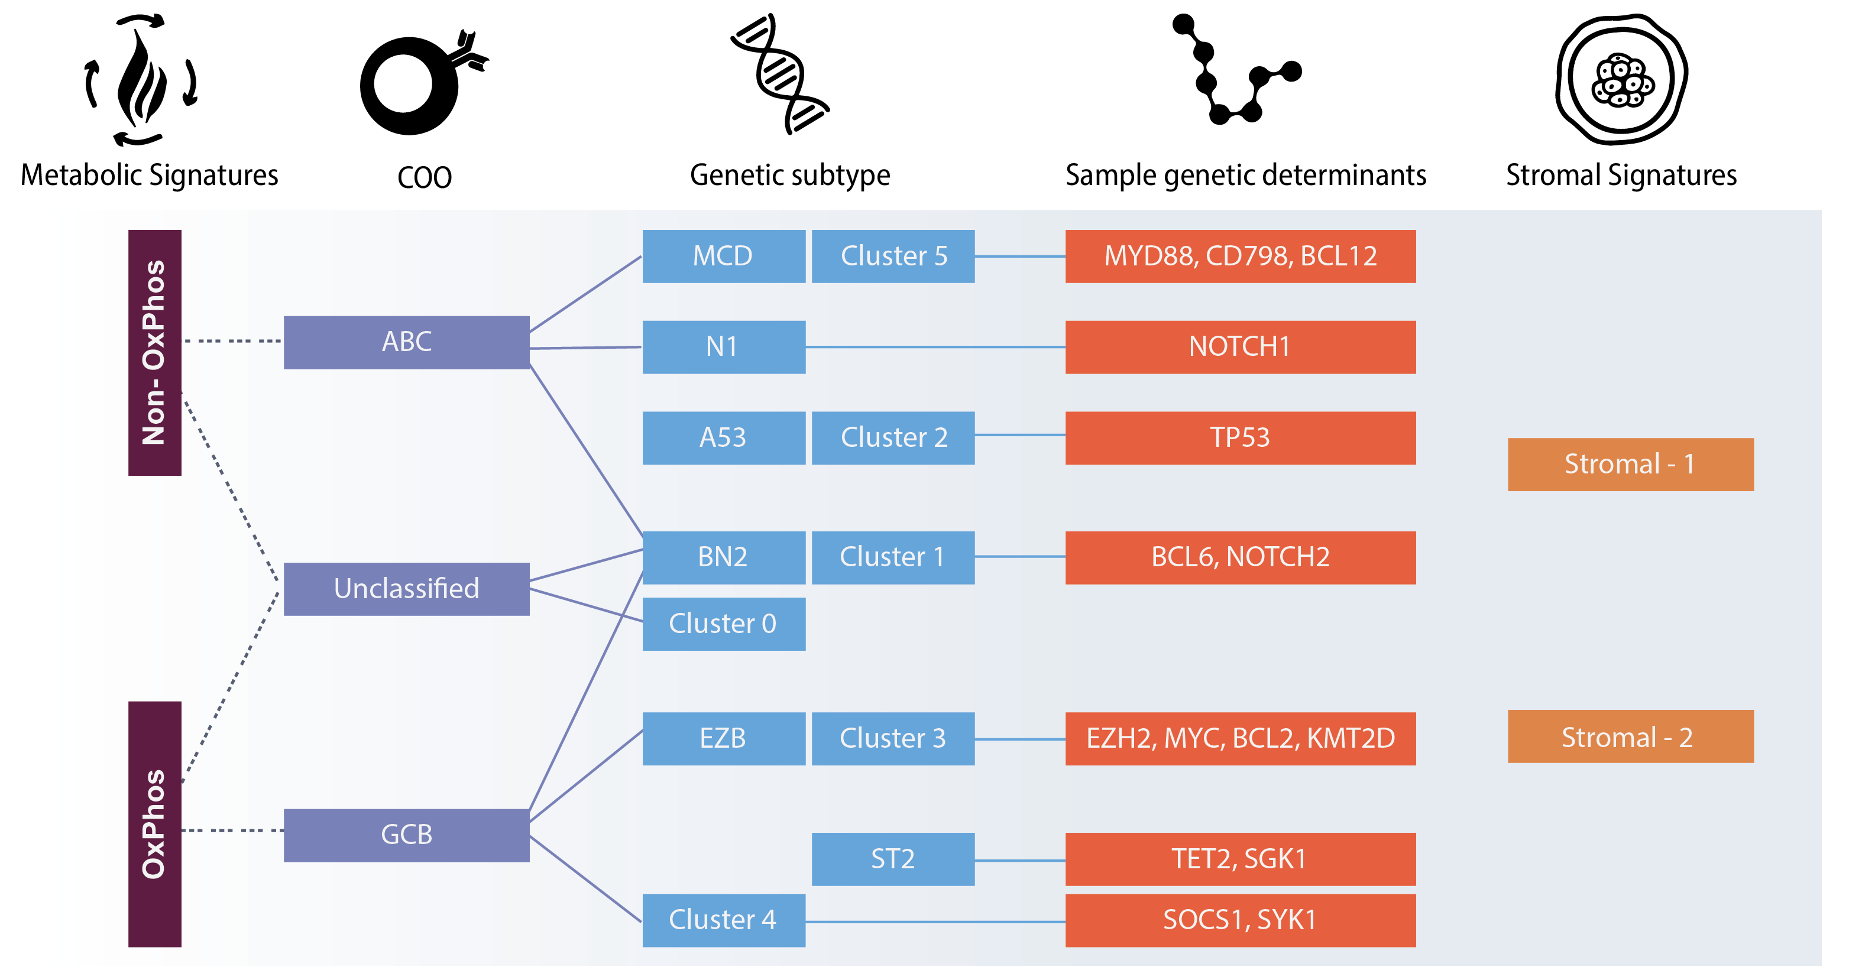
Gene expression profiling-based classifications, novel genetic subtype classifications and possible interface between them
ABC, activated B-cell; COO, cell of origin; DLBCL, diffuse large B-cell lymphoma; GCB, germinal centre B-cell
Danilov AV, et al. The Oncologist 2022;oyab004. Chapuy B, et al. Nat Med 2018;24:679-90. Schmitz N, et al. J Clin Oncol 2016;34:3150-6. Wright GW, et al. Cancer Cell 2020;37:551-568 e514. Caro P, et al. Cancer Cell 2012;22:547-60; Lenz G, et al. N Engl J Med 2008;359:2313-23

Slide 7
Current standard of care in DLBCL treatment
Newly diagnosed DLBCL
No survival benefit of escalating therapy or other anti-CD20 monoclonal antibodies
Relapsed/refractory DLBCL
Transplant-ineligible patients: management tailored to the patient’s tolerance
Younger, fit patients: platinum-based salvage chemoimmunotherapy (CIT) followed by ASCT
R-CHOP remains the standard of care
Except dose-intensive R-ACVBP in patients <60 years with low-intermediate risk IPI DLBCL
Poor outcomes and high unmet need
ASCT, autologous stem cell transplantation; DLBCL, diffuse large B-cell lymphoma; IPI, International Prognostic Index; R-ACVBP, rituximab, doxorubicin, cyclophosphamide, vindesine, bleomycin, and prednisone; R-CHOP, rituximab, doxorubicin, vincristine, cyclophosphamide, prednisone
Danilov AV, et al. The Oncologist 2022;oyab004

Slide 8
How to Better Leverage our understanding of DLBCL biology to advance novel therapies in frontline setting
Flexible trial design
Narrowing screening windows
Trial approach closer to clinical practice
Tailoring trial populations by genetic abnormalities
Focus exclusively on high-risk population
Innovative clinical trials
DLBCL, diffuse large B-cell lymphoma
Danilov AV, et al. The Oncologist 2022;oyab004

Slide 9
Tractable targets in GCB DLBCL¹
BCL2
CAVALLI study showed promising efficacy and safety of 1st-line venetoclax + R-CHOP or G-CHOP^{2,3}
Randomised phase 2/3 study of 1st-line venetoclax + CIT in patients with MYC/BCL2 double-hit and double expressing lymphomas is ongoing (NCT03984448)
EZH2
First-line tazemetostat + R-CHOP (Epi-R-CHOP) is under investigation in first line (NCT02889523)
MYC
Oral BET inhibitor CC-90010 is in early development in DLBCL (NCT03220347)
CDK9
AZ4573 is in early clinical development in DLBCL (NCT03263637)
A-1592668 + venetoclax demonstrated synergistic activity in vitro and ex vivo⁴
Particularly in double expressors
BCL2, B-cell lymphoma 2; BET, bromodomain and extra-terminal motif; CDK, cyclin-dependent kinase; CIT, chemoimmunotherapy; DLBCL, diffuse large B-cell lymphoma; EZH2, enhancer of zeste homolog 2; GCB, germinal centre B-cell-like; G-CHOP, obinutuzumab, doxorubicine, vincristine, cyclofosfamide, prednison; R-CHOP, rituximab, doxorubicin, vincristine, cyclophosphamide, prednisone
1. Danilov AV, et al. The Oncologist 2022;oyab004. 2. Zelenetz AD, et al Blood 2019;133:1964-197. 3. Morschhauser F, et al. Blood 2021;137:600-9. 4. Phillips DC, et al. Leukemia 2020;34:1646-57

Slide 10
Tractable targets in ABC DLBCL¹
FRONT-LINE OPTIONS IN CLINICAL DEVELOPMENT
BTK
PHOENIX showed improved overall survival among patients <60 years treated with ibrutinib + R-CHOP vs R-CHOP alone²
Acalabrutinib + R-CHOP is under investigation in patients <65 years (ESCALADE; NCT04529772)
Proteasome inhibitors
In phase 2 bortezomib showed higher efficacy in ABC vs GCB DLBCL³
However, the phase 3 REMoDL-B trial found no significant improvement in efficacy of bortezomib + R-CHOP vs R-CHOP in GCB or ABC DLBCL⁴
First-line bortezomib + R-CHOP is studied in phase 1/2 (ImbruVeRCHOP; NCT03129828)
PI3K-AKT pathway
Copanlisib
First-line copanlisib + R-CHOP is under investigation in phase 2 (Copa-R-CHOP; NCT04263584)
In the R/R setting
Copanlisib + nivolumab is under investigation (NCT03484819; NCT03884998).
Umbralisib
In R/R DLBCL, umbralisib + ublituximab is under investigation in phase 2b (UNITY-NHL; NCT02793583)⁶
Single-agent copanlisib showed activity in phase 2⁵
Copanlisib + venetoclax is under investigation in phase 1/2 (NCT04572763)
ABC, activated B-cell-like; AKT, protein kinase B; BTK, Bruton’s tyrosine kinase; DLBCL, diffuse large B-cell lymphoma; GCB, germinal centre B-cell-like; PI3K, phosphatidylinositol-3-kinase; R/R, relapsed/refractory; R-CHOP, rituximab, doxorubicin, vincristine, cyclophosphamide, prednisone
1. Danilov AV, et al. The Oncologist 2022;oyab004. 2. Younes A, et al. J Clin Oncol 2019;37:1285-95. 3. Dunleavy K, et al Blood 2009;113:6069-76. 4. Davies A, et al. Lancet Oncol 2019;20:649-62. 5. Lenz G, et al. Leukemia 2020;34:2184-97. 6. Lunning M, et al. Blood 2019; 134: 1811-20.

Slide 11
Tractable targets in ABC DLBCL¹
CLINICAL DEVELOPMENT in the R/R setting
BTK
Ibrutinib
Ibrutinib-containing therapy can improve outcomes in non-GCB DLBCL²
Single-agent ibrutinib and ibrutinib + methotrexate + rituximab have shown promising activity in R/R CNS lymphoma^{3,4}
Pirtobrutinib (LOXO-305)
Phase 1/2 BRUIN trial showed activity in B-cell malignancies⁵
ARQ 531
Under investigation in phase 2 (NCT03162536)
Immunomodulation
Lenalidomide modestly improved response rates and progression-free survival vs investigator-choice chemotherapy6
After the inconclusive results from the ROBUST trial⁷, R-CHOP +/- lenalidomide is investigated in newly diagnosed double-expressor DLBCL (NCT04164368)
Lenalidomide + tafasitamab showed encouraging activity in phase 2 in R/R DLBCL
(L-MIND; NCT02399085)
Now approved for R/R DLBCL
ABC, activated B-cell-like; BTK, Bruton’s tyrosine kinase; CNS, central nervous system; DLBCL, diffuse large B-cell lymphoma; GCB, germinal centre B-cell-like; R/R, relapsed/refractory; R-CHOP, rituximab, doxorubicin, vincristine, cyclophosphamide, prednisone
1. Danilov AV, et al. The Oncologist 2022;oyab004. 2. Hou K, et al. Crit Rev Oncol Hematol 2020;152:103010. 3. Grommes C, et al. Cancer Discov 2017;7:1018-29. 4. Grommes C, et al. Blood 2019;133:436-45. 5. Mato AR, et al. Lancet 2021;397: 892-901. 6. Czuczman MS, et al. Clin Cancer Res 2017;23:4127-37. 7. Vitolo U, et al. Hematol Oncol 2019;37:36-7

Slide 12
COO agnostic therapies¹
Antibody drug conjugates
Polatuzumab vedotin (Pola)²
Loncastuximab tesirine is approved in R/R DLBCL
CART-cell therapy
Axicabtagen ciloleucel (axi-cel) and tisagenlecleucel are approved in R/R DLBCL^{4,5}
Immune checkpoint inhibitors
Nivolumab
Early phase 3 front-line data of Pola + R-CHP seem promising (POLARIX, NCT03274492)
Ongoing phase 3 studies in R/R DLBCL evaluate platinum-based CIT +/- Pola
POLARGO (NCT04182204) is assessing RGemOx +/- Pola
PolaR-ICE (NCT04665765) is evaluating RICE + Pola prior to autoSCT
Pola + BR is approved for R/R DLBCL after ≥2 prior therapies
Durvalumab
Pembrolizumab + MK-4280, another PD-L1 inhibitor, is under investigation (NCT03598608)
Results as single agent were disappointing⁶
Front-line durvalumab + R-CHOP showed encouraging safety and efficacy in high-risk DLBCL, including double-hit lymphoma (NCT03003520)
Pembrolizumab
Front-line pembrolizumab + R-CHOP showed encouraging efficacy⁷
In the pivotal trials, outcomes were not associated with COO
Ongoing trials evaluate CART vs. platinum-based second line therapy with planned auto transplant
ZUMA-7 (NCT03391466)
BELINDA (NCT03570892)
TRANSCEND (NCT02631044)
It is studied in phase 2 combined with ibrutinib (NCT03684694)³
ABC, activated B-cell-like; CIT, chemoimmunotherapy; COO, cell of origin; DLBCL, diffuse large B-cell lymphoma; GCB, germinal centre B-cell-like; PD-L1, programmed death ligand 1; Pola, polatuzumab vedotin; Pola-BR, polatuzumab vedotin + bendamustine + rituximab; R/R, relapsed/refractory; R-CHP, rituximab, doxorubicine,, cyclofosfamide, prednison; R-CHOP, rituximab, doxorubicin, vincristine, cyclophosphamide, prednisone; RGemOx, rituximab + gemcitabine + oxaliplatin; RICE, rituximab + ifosfamide + carboplatin + etoposide
1. Danilov AV, et al. The Oncologist 2022;oyab004. 2. Sehn LH, et al. J Clin Oncol 2020;38:155-65. 3. Kahl BS, et al. Clin Cancer Res 2019;25:6986-94. 4. Locke FL, et al. Lancet Oncol 2019;20:31-42. 5. Schuster SJ, et al. N Engl J Med 2019;380:45-56. 6. Ansell SM, et al. J Clin Oncol 2019;37:481-9. 7. Smith SD, et al. Br J Haematol 2020;189:1119-26.

Slide 13
COO agnostic therapies¹, Cont’d
Bispecific antibodies
Blinatumomab
Mosunetuzumab
CD47 blockade
Magrolimab (Hu5F9-G4)
Several SIRPα inhibitors are in development
XPO1 inhibition
Blinatumomab + pembrolizumab is under investigation in R/R DLBCL (NCT03340766)
Encouraging single agent results in R/R DLBCL and after front-line R-CHOP^{2,3}
Glofitamab⁵
Glofitamab + R-CHOP is under phase 1 investigation in front line (NCT03467373)
Durable complete responses in phase 1⁴
Glofitamab +/- obinutuzumab is under phase 1 investigation in R/R NHL (NCT03075696)
Glofitamab + gemcitabine/oxaliplatin vs rituximab + gemcitabine/oxaliplatin in under phase 3 investigation the R/R setting (NCT04408638)
Promising efficacy in R/R DLBCL in phase 1b⁶
Phase 2 trial of magrolimab + rituximab ongoing (NCT02953509)
Also evaluated with other agents targeting CD47, such as TTI-622 (NCT03530683
Selinexor is approved for R/R DLBCL
Based on the phase 2b SADAL study⁷
COO, cell of origin; DLBCL, diffuse large B-cell lymphoma; NHL, non-Hodgkin lymphoma; R/R, relapsed/refractory; R-CHOP, rituximab, doxorubicin, vincristine, cyclophosphamide, prednisone; XPO-1, Exportin 1 (CRM1)
1. Danilov AV, et al. The Oncologist 2022;oyab004. 2. Viardot A, et al. Blood 2016;127:1410-6. 3. Katz DA, et al. Blood 2019;134:4077-7. 4. Schuster SJ, et al. Blood 2019;134: 6-6. 5. Hutchings M, et al. J Clin Oncol 2021. 6. Advani R, et al. N Engl J Med 2018;379:1711-21. 7. Kalakonda N, et al. Lancet Haematol 2020;7: e511-e522.

Slide 14
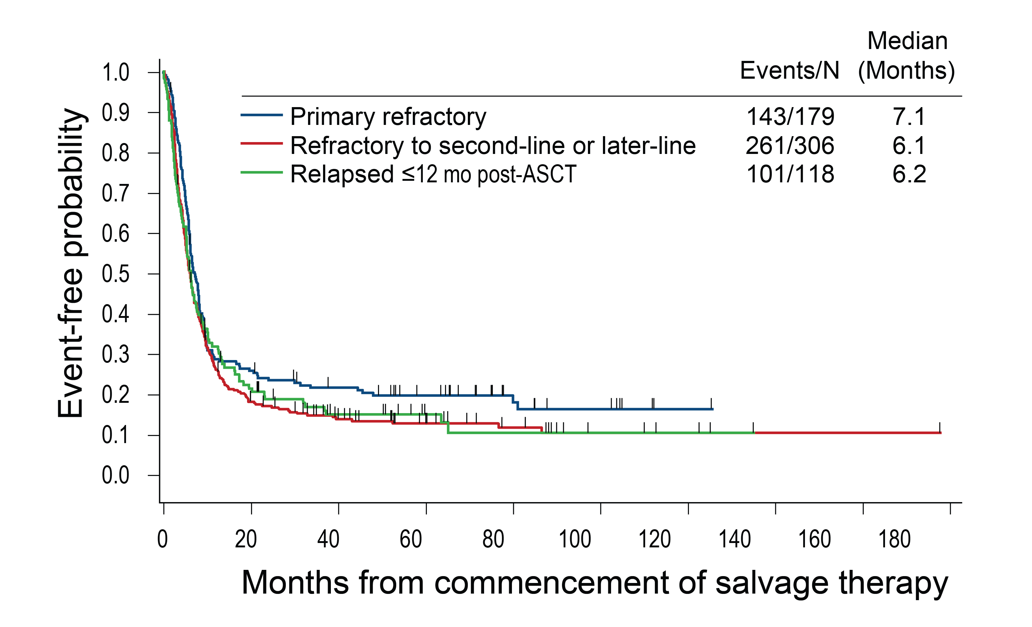
Future directions¹
With advanced understanding of its biology, further parsing of DLBCL is poised to facilitate the development of novel agents for patients with specific needs
The fact that large phase 3 trials of novel targeted agents + CIT have been largely unsuccessful in showing improved outcomes begs the question whether all-comer trials are still appropriate in DLBCL
Emerging data raise expectations for an increasing role of genetic profiling in DLBCL
Informed and refined by novel classifications, prospective trials in the front-line setting might perform molecular subtyping during the initial cycle of R-CHOP and then allocate patients to treatment with an appropriate targeted agent, hence translating biology into individualised treatment
SCHOLAR-1 showed the futility of chemotherapy approaches in refractory DLBCL, highlighting the urgent medical need to improve standard of care, especially for molecularly defined subgroups at particularly high risk to exhibit resistance to first-line CIT²
CIT, chemoimmunotherapy; DLBCL, diffuse large B-cell lymphoma; R-CHOP, rituximab, doxorubicin, vincristine, cyclophosphamide, prednisone
1. Danilov AV, et al. The Oncologist 2022;oyab004. 2. Crump M, et al. Blood 2017;130:1800-8

Slide 15
REACH LYMPHOMA & MYELOMA CONNECT
VIA TWITTER, LINKEDIN, VIMEO & EMAIL
OR VISIT THE GROUP’S WEBSITE http://lymphomamyelomaconnect.cor2ed.com
Follow us on Twitter
@LYM_MM_CONNECT
Follow the
LYMPHOMA & MYELOMA CONNECT
group on LinkedIn
Watch us on the
Vimeo Channel
LYMPHOMA & MYELOMA CONNECT
Email
froukje.sosef
@cor2ed.com

