Slide 2
HIGHLIGHTS BY
Dr. Fernando Santini
Memorial Sloan Kettering Westchester
West Harrison, NY, USA
MAY 2021

Slide 3
Disclosures
Please note: Views expressed within this presentation are the personal opinions of the author. They do not necessarily represent the views of the author’s academic institution or the rest of
NTRK CONNECT group.
This content is supported by an independent educational grant from Bayer.
Disclosures: Dr Santini has received honoraria from the following: AstraZeneca, Bayer, BMS, Eli Lilly, MDHealth, MSD, Novartis and Roche.

Slide 4
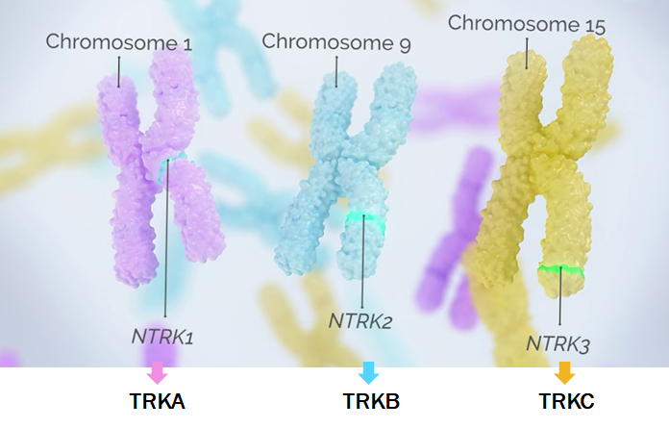
Epidemiology of ntrk fusions tumours
NTRK genes family
MASC, mammary analogue secretory carcinoma; NTRK, neurotrophic tyrosine receptor kinase; TRK, tropomyosin receptor kinase
Figure source: Cocco E, et al. Nat Rev Clin Oncol. 2018;15:731-7

Slide 5
Initial Efficacy results of APPROVED trk inhibitors Responses by tumour type
Larotrectinib¹
Entrectinib²
Data cutoff: 17 July 2017
Data cutoff: 31 May 2018
Objective responses with larotrectinib are seen in
multiple tumour types and in most of the patients:
Objective responses with entrectinib are seen in multiple tumour types and in most of the patients:
80%, 95% CI: 67-90
57%, 95% CI: 43.2-70.8
CI, confidence interval; CRC, colorectal cancer; GIST, gastrointestinal stromal tumour; IFS, infantile fibrosarcoma; MASC, mammary analogue secretory carcinoma;
NSCLC, non-small-cell lung cancer; TRK, tropomyosin receptor kinase
1. Drilon A, et al. N Engl J Med. 2018;378:731-9; 2. Doebele RC, et al. Lancet Oncol 2020;21:271-82

Slide 6
Long-term outcomes of patients with TRK fusion cancer treated with Larotrectinib
Drilon A. et al. AACR 2021, CT020
TRK, tropomyosin receptor kinase

Slide 7
2-year efficacy follow-up for larotrectinib
Adult Phase 1
Advanced solid tumours
NCT02122913
Paediatric Phase 1/2
Advanced solid tumours
SCOUT: NCT02637687
Adult/adolescent Phase 2
Advanced solid tumours
NAVIGATE: NCT02576431
Data cutoff: 17 July 2017¹
Patients:
8
12
35
Total of 55 patients with TRK fusion solid tumour
Data cutoff: July 2019
This analysis reports a 2-year efficacy follow-up for larotrectinib for the original patients in this primary analysis cohort (N=55)
TRK, tropomyosin receptor kinase
1. Drilon A, et al. N Engl J Med. 2018;378:731-9

Slide 8
Baseline demographics and disease characteristics in the primary analysis set
Characteristics | Primary analysis set (N=55)
Age, median (range), years Paediatric (<18 years), n (%) Adult (≥18 years), n (%) | 45 (0.3-76) 12 (22) 43 (78)
Female, n (%) Male, n (%) | 26 (47) 29 (53)
ECOG performance status, n (%) 0 1 2 | 24 (44) 27 (49) 4 (7)
Prior cancer treatments, n (%) Surgery Systemic therapy Radiotherapy | 48 (87) 44 (80) 27 (49)
Number of prior systemic therapies, n (%) 0 1 2 3 or more | 11 (20) 16 (29) 9 (16) 19 (35)
Median prior systemic therapies, n (range) | 2 (0-10)
Primary tumours type, n (%) | Primary analysis set (N=55)
Salivary gland Soft tissue sarcoma* IFS Thyroid Melanoma Lung Colon GIST Cholangiocarcinoma Pancreas Appendix Breast | 12 (22) 11 (20) 7 (13) 5 (9) 4 (7) 4 (7) 4 (7) 3 (5) 2 (4) 1 (2) 1 (2) 1 (2)
NTRK gene fusions
NTRK1
45%
NTRK2
2%
NTRK3
53%
Distribution of primary tumours type is very similar to real world data
*Subtypes of soft tissue sarcoma include myopericytoma (n=2), peripheral-nerve sheath tumour (n=2), spindle-cell tumour (n=3), infantile myofibromatosis (n=1), inflammatory myofibroblastic tumour of the kidney (n=1), and sarcoma that was not otherwise specified (n=2).
ECOG, Eastern Cooperative Oncology Group; GIST, gastrointestinal stromal tumour; IFS, infantile fibrosarcoma; NTRK, neurotrophic tyrosine receptor kinase; TRK, tropomyosin receptor kinase
1. Drilon A, et al. N Engl J Med. 2018;378:731-9

Slide 9
Robust and Durable response of larotrectinib
Response rates of the primary analysis set (N=55) | Primary analysis set (N=55)
 | Original analysis (July 2017)¹ | 2-year follow up (July 2019)
Best overall response CR, n (%) PR, n (%) SD, n (%) PD, n (%) | 9 (16) 35 (64) 5 (9) 6 (11) | 13 (24) 31 (56) 5 (9) 6 (11)
ORR, n (%) 95% CI | 44 (80) 67-90 | 44 (80) 67-90
DOR
100
75
DoR (%)
50
25
Median 35.2 months
(95% CI 19.8-NE)
0
0
6
12
18
24
30
36
42
48
54
Months from start to response
Number at risk
44
35
29
25
20
11
5
3
0
0
 | Patients with objective response (N=44)
24-month DoR, % (95% CI) | 61 (45-77)
Median follow-up | 29.3 months
Over 2 years’ follow-up, the best overall response of
4 patients (7%) improved from a PR to a CR
CI, confidence interval; CR, complete response; DoR, duration of response; NE, not estimable; PD, progressive disease; PR; partial response; SD, stable disease
1. Drilon A, et al. N Engl J Med. 2018;378:731-9

Slide 10
Safety profile of larotrectinib
Larotrectinib has a favourable safety profile with no new or unexpected safety findings over longer follow-up
Understanding the on-target AEs with TRK inhibition is key:
AE, adverse event; TRK, tropomyosin receptor kinase
Source figure: Liu D. et al. Ann Oncol. 2020;31:1207-15

Slide 11
Long-term efficacy and genomic characteristics of patients with
TRK fusion lung cancer treated with larotrectinib
Moreno V. et al. J Thorac Oncol. 2021;16(Suppl_4):S748-S802
European Lung Cancer Congress (ELCC) 2021. Abstract #162P
TRK, tropomyosin receptor kinase

Slide 12
2-year efficacy follow-up for Larotrectinib in TRK fusion lung tumours
Adult Phase 1
Advanced solid tumours
NCT02122913
Paediatric Phase 1/2
Advanced solid tumours
SCOUT: NCT02637687
Adult/adolescent Phase 2
Advanced solid tumours
NAVIGATE: NCT02576431
Data cutoff: 17 July 2017¹
Patients:
8
12
35
Total of 55 patients with TRK fusion solid tumour
Data cutoff: July 2019
This analysis reports long-term efficacy and safety of 14 patients
with TRK fusion lung cancer
TRK, tropomyosin receptor kinase
1. Drilon A, et al. N Engl J Med. 2018;378:731-9

Slide 13
Durable antitumour responses of larotrectinib in patients with or without CNS metastases
Maximum change in tumour size following treatment in patients with TRK fusion lung cancer
ORR was 71% (95% CI 42-92)
ORR for the patients with baseline CNS metastases was 57% (95% CI 18-90)
One patient with intracranial measurements had 100% reduction in CNS lesions by cycle 4
 | All patients (N=14) | Patients with CNS metastases (n=7)
Objective response rate, % (95% CI) | 71 (42-92) | 57 (18-90)
Best response, n (%) Complete response Partial response Stable disease Progressive disease | 1 (7) 9 (64) 3 (21) 1 (7) | 0 4 (57) 2 (29) 1 (14)
50
40
30
20
10
0
−10
−20
Maximum change in tumour size (%)
−30
−40
−50
−60
−70
−80
*
−90
−100
Without CNS metastases
With CNS metastases
* Patient had 100% reduction in CNS lesions
CI, confidence interval; CNS, central nervous system; ORR, objective response rate; TRK, tropomyosin receptor kinase

Slide 14
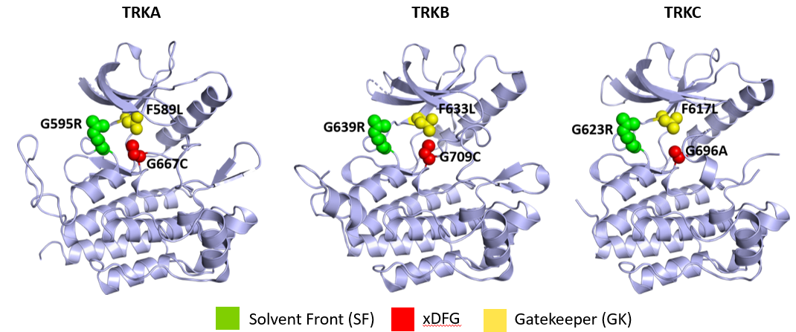




Mechanisms of resistance need further evaluation after disease progression
Co-occurring genomic alterations at baseline
Type of alteration | Genes affected
Loss of function | CDKN2A/B (n=3) MTAP (n=1)
Amplification | HGF, PIK3C2B, CDK6, MDM4, ZNF217 CNV (n=1 each)
Mutation | TP53 (n=3) CTNNB1 (n=2) FANCL, RB1, TERT promoter, IRF1, MTOR, NRAS, SP3B1, PIK3C2B, MAP2K4 (n=1 each)
Genomic profiling of NSCLC patients who progressed on larotrectinib
Patient number | Best response | On-target NTRK mutations | Other genomic alterations
Patient 1 | Stable disease | NTRK1 SF G595R xDFG G667S | KRAS D57N and amplifications in BRAF, MET and EGFR
Patient 2 | Partial response | NTRK1 SF G595R GK F589L | None
Patient 3 | Progressive disease | NTRK1 GK F589L | KRAS G12D
Patient 4 | Stable disease | None | None
CNV, copy number variation; EGFR, epidermal growth factor receptor; NSCLC, non-small-cell lung cancer; NTRK, neurotrophic tyrosine receptor kinase; TRK, tropomyosin receptor kinase
Source figure: Hyman D, et al. AACR2019, CT127

Slide 15
NTRK1 fusion detection from clinical cfDNA NGS using a de novo fusion caller
Yablonovitch A. et al. AACR 2021, #537
cfDNA, circulating free DNA; NGS, next-generation sequencing; NTRK, neurotrophic tyrosine receptor kinase

Slide 16
Background: Testing algorithm for TRK fusion cancer
Tumour sample
Histological evaluation
Tumours with high frequency
of NTRK fusions e.g. CMN,
IFS, MASC, SBC
Tumours with low frequency
of NTRK fusions e.g. thyroid,
lung or colon cancer
FISH
Pan-TRK IHC
NGS routinely performed
e.g. thyroid or NSCLC
NGS NOT routinely performed
e.g. histotype or institutional
Negative
Positive
Consider NGS panel
including NTRK and
non-NTRK alterations
Yes
No
NGS
Positive
Pan-TRK IHC
Negative
Positive
Negative
Positive
Discuss treatment options
Negative
No additional TRK/NTRK
testing
CMN, congenital mesoblastic nephroma; FISH, Fluorescent in situ hybridization; IHC, immunohistochemistry; IFS, infantile fibrosarcoma; NSCLC, non-small-cell lung cancer; MASC, mammary analogue secretory carcinoma; NGS, next-generation sequencing; NTRK, neurotrophic tyrosine receptor kinase; SBC, Secretory breast carcinoma;
TRK, tropomyosin receptor kinase
Penault-Llorca F, et al. J Clin Pathol. 2019;72(7):460-7

Slide 17
de novo fusion caller:
Background-methods
Cohort of 23’280 patients
276 healthy samples (control)
1’199 patients with ERBB2 amps (negative control)
NTRK rearrangements =
clinically actionable targets
Tested with Guardant360 (liquid biopsy NGS-based array)
Reanalysed using the novel algorithm
De novo fusion caller exhibits high specificity
Negative control cohort | Sample # | #NTRK1 fusions | Specificity
Healthy controls | 276 | 0 | 100%
ERBB2 amp+ patients | 1’199 | 3 | >99%
Amps, amplifications; ERBB2, Erb-B2 Receptor Tyrosine Kinase 2; NGS; next-generation sequencing; NTRK, neurotrophic tyrosine receptor kinase

Slide 18
NTRK1 fusion detection using a de novo fusion caller: Results
Patients with NTRK1 fusions have co-occuring known driver and resistance mutations
NTRK1 fusions prevalence is comparable to tissue
and most partners are unique to individual patients
NTRK1 fusion co-occurring mutations
NTRK1 fusion patients with co-occurring
driver and resistance variants
2.50
0.15
NTRK1 G595R
▲ G595R
32 patients
14 patients
2.25
EGFR S465R
NTRK1
resistance
▲ F589L
2.00
EGFR S464L
Adj. p-val
=0.01
exon19del
0.10
EGFR S441G
EGFR
driver
L858R
9 patients
1.75
▲ G465R
Detection rate (%)
1.50
▲ S464L
-log10 (adj. p-value)
KRAS G12D
EGFR
resistance
LMNA
1.25
V441G
0.05
11 patients
ARHGEP11
LMNA
BRAF V600E
G12D
LMNA
NTRK1
TPM3
1.00
TP53
TFR
IRP2BP2
EGFR L858R
KRAS
G12A
TP53
LMNA
0.75
KRAS G12A
KRAS/BRAF
(driver or
resistance)
G12V
TPM3
TPM3
TPM3
KRAS Q12V
Q61H
0.00
0.50
KRAS G12V
EGFR exon19del
BRAF
V600E
Partner list-based
fusion caller
De novo
fusion caller
MSK-IMPACT
TCGA
0
2
4
6
8
10
Patient
N=23,820
N=9,739
N=10,967
log2 (odds ratio)
▲ Variants with significant enrichment in
NTRK1 fusion+ population
Plasma
Tissue
Conclusion: de novo fusion caller assay can increase the yield for the detection of NTRK1 fusions in cfDNA
EGFR, epidermal growth factor receptor; MSK-IMPACT, Memorial Sloan Kettering-Integrated Mutation Profiling of Actionable Cancer Targets; NTRK, neurotrophic tyrosine receptor kinase; TCGA, The Cancer Genome Atlas

Slide 19
Immunohistochemical Detection of pan-TRK Expression in Solid Tumor Specimens: Inter-Laboratory and Inter-Reader Agreement in NGS-confirmed NTRK Fusion-Positive and Fusion-Negative Cases
Stratton S. et al. USCAP 2021, #420
NGS, next-generation sequencing; NTRK, neurotrophic tyrosine receptor kinase; TRK, tropomyosin receptor kinase

Slide 20
Pan-trk ihc staining in different tumours
Colorectal carcinoma
(TPM3-NTRK1)
Secretory carcinoma of salivary gland (ETV6-NTRK3)
NSCLC
(fusion negative)
Sample images demonstrating variable patterns of VENTANA pan-TRK (EPR17341) Assay in different tumours types
ETV6, ETS Variant Transcription Factor 6; IHC, immunohistochemistry; NSCLC, non-small-cell lung cancer; NTRK, neurotrophic tyrosine receptor kinase; TPM3, tropomyosin 3; TRK, tropomyosin receptor kinase

Slide 21
Conclusions
Overall agreement between readers was high (overall OPA=92.6%), but varied based on fusion partner and staining pattern observed with this analytic assay
Staining tissue location did not contribute to variance in reader scoring
Conclusions regarding concordance and cutoffs should not be drawn from this data as this limited study was not designed to determine a cutoff
IHC; immunohistochemistry; ETV6, ETS Variant Transcription Factor 6; NGS, next-generation sequencing; NSCLC, non-small-cell lung cancer;
NTRK, neurotrophic tyrosine receptor kinase; OPA, Overall Percent Agreement; ROC, receiver operating characteristic; TRK, tropomyosin receptor kinase

Slide 22
In summary
Larotrectinib continues to demonstrate a robust and durable response rate with extended survival benefits in adult and paediatric patients with TRK fusion cancer regardless of tumour type
Mechanisms of resistance should be further understood in order to develop the next-generation TRK inhibitors
These data highlight the importance of identifying NTRK gene fusions in patients
with cancer
Need to test, test, test → to identify those patients with TRK fusion positive tumours
NTRK, neurotrophic tyrosine receptor kinase; TRK, tropomyosin receptor kinase

Slide 23
REACH NTRK CONNECT VIA
TWITTER, LINKEDIN, VIMEO & EMAIL
OR VISIT THE GROUP’S WEBSITE http://www.ntrkconnect.info
Follow us on Twitter
@ntrkconnectinfo
Follow the
NTRK CONNECT
group on LinkedIn
Watch us on the
Vimeo Channel
NTRK CONNECT
Email
froukje.sosef
@cor2ed.com

