Slide 2
Highlights in Lymphoma
New Agents in diffuse large B-Cell lymphoma and Follicular Lymphoma
Tycel Jovelle Phillips, MD
University of Michigan Rogel Cancer Center
Ann Arbor, MI, USA
JULY 2021

Slide 3
Conflict of Interest and Funding
This LYMPHOMA & MYELOMA CONNECT programme is supported through an independent educational grant from Bayer. The programme is therefore independent, the content is not influenced by the supporters and is under the sole responsibility of the experts.
Please note: The views expressed within this presentation are the personal opinions of the authors.
They do not necessarily represent the views of the author’s academic institution, or the rest of the LYMPHOMA & MYELOMA CONNECT group.
Dr. Tycel Phillips has received financial support/sponsorship for research support, consultation, or speaker fees from the following companies:
Advisory Board: ADCT, Incyte, AbbVie, Pharmacyclics, Genentech, BMS, AstraZeneca, Bayer, Beigene, TG Therapeutics
Research: Abbvie, BMS, Genentech, Bayer, Incyte

Slide 4
Background
Diffuse large B-cell lymphoma (DLBCL) and follicular lymphoma (FL) are the two most common lymphomas in the US and Western Europe
  DLBCL and FL account for >50% of diagnosed cases of non-Hodgkin lymphoma (NHL)
The two subtypes of NHL are on opposite ends of the clinical spectrum
  FL is an indolent, slow growing, incurable lymphoma that does not have a standard of care induction regimen
  DLBCL is aggressive, curable and generally treated with R-CHOP
Frequency of NHL subtypes in adults
Mantle cell
lymphoma (6%)
Peripheral
T-cell (6%)
Follicular lymphoma (22%)
Other subtypes
with a frequency
≤2% (9%)
Small lymphocytic lymphoma (6%)
Composite
lymphomas
(13%)
Marginal zone
B-cell lymphoma
MALT type (5%)
Marginal zone
B-cell lymphoma
nodal type (1%)
Diffuse large
B-cell (31%)
Lymphoplasmacytic lymphoma (1%)
DLBCL, diffuse large B-cell lymphoma; FL, follicular lymphoma; MALT, mucosa-associated lymphoid tissue; NHL, non-Hodgkin lymphoma; R-CHOP, rituximab, cyclophosphamide, doxorubicin, vincristine, and prednisone
Armitage JO, et al. J Clin Oncol. 1998;16:2780-95

Slide 5
Background
Given the incurable nature of FL, there are several approved agents and numerous others in development to attempt to extend the life of those afflicted with this cancer
DLBCL, while curable in some, still has a large percentage of patients who will relapse or have primary refractory disease
  Second-line and beyond therapy for this population has diminishing returns, especially in refractory patients. New treatments are desperately needed for these patients
In this slide deck some of the recent FDA approvals in both DLBCL and FL are reviewed as well as where they fit in the current treatment landscape
DLBCL, diffuse large B-cell lymphoma; FDA, Food and Drug Administration; FL, follicular lymphoma
Davids MS, et al. J Clin Oncol. 2017;35(8):826-33; Paulus A, et al. Br J Haematol. 2014;164(3):352-65

Slide 6
Loncastuximab Tesirine

Slide 7
Loncastuximab Tesirine in the LOTis-2 study
Loncastuximab tesirine (Lonca) is a CD19 drug-antibody conjugate¹
  The antibody is connected through a cathepsin-cleavable valine-alanine linker to a pyrrolobenzodiazepine (PBD) dimer toxin (SG3199)
  The payload binds irreversibly to DNA to create highly potent intrastrand cross-links that block DNA strand separation preventing DNA replication. This differs from the more commonly recognized drug antibody conjugate MMAE
LOTIS-2 is a single-arm open-label phase 2 study of Lonca in relapsed/refractory DLBCL after ≥2 therapies²
LOTIS-2 study design²
30-minute infusion of Lonca Q3W for up to 1 year
Q12W for up to 3 years
150 µg/kg
75 µg/kg
Follow-up
First 2 cycles
After 2 cycles
CD19, cluster of differentiation 19; Lonca, loncastuximab tesirine; MMAE, monomethyl auristatin E; PBD, pyrrolobenzodiazepine; Q3W, every 3 weeks; Q12W, every 12 weeks
1. Zammarchi F, et al. Blood. 2018;131(10):1094-105; 2. Caimi PF, et al. Lancet Oncol. 2021;22(6):790-800

Slide 8
Lotis-2 Efficacy Results
Overall response rate (ORR)
100
Lonca ORR:
48.3%
(95% CI: 39.9, 56.7)
Complete response
90
Partial response
80
70
60
Response (%)
50
40
24.1
Lonca CRR:
24.1%
(95% CI: 17.4, 31.9)
30
20
24.1
10
0
All patients (N=145)
Most responders had a response after 2 cycles; median time to first response was 41.0 days (IQR 38-44)
Median Lonca cycles: 3.0 (IQR 2-5)
ORR was assessed by independent reviewer
CI, confidence interval; CRR, complete response rate; IQR, interquartile range; Lonca, loncastuximab tesirine; ORR, overall response rate
Caimi PF, et al. Lancet Oncol. 2021;22(6):790-800

Slide 9
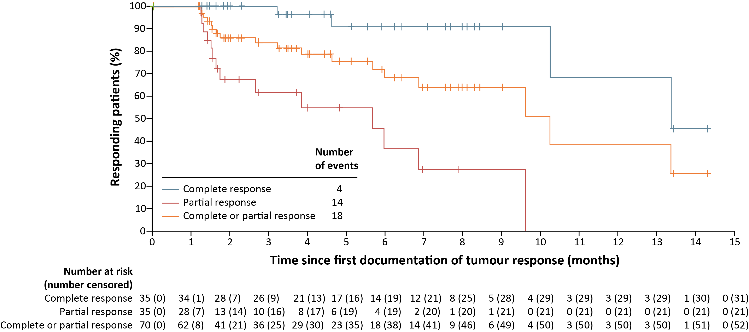
Lotis-2 Efficacy Results
Duration of response (DoR)
Median DoR
10.3 months
(95% CI: 6.9, NE)
Median DoR for patients with a CRª
13.4 months
(95% CI: 10.3, NE)
The probability of responders maintaining responses for 9 months or longer was 64%
ªmDoR for patients with a PR: 5.7 months (95% CI: 1.7-NE)
CI, confidence interval; CR complete response; (m)DoR, (median) duration of response; PR, partial response; NE, not estimable
Caimi PF, et al. Lancet Oncol. 2021;22(6):790-800

Slide 10
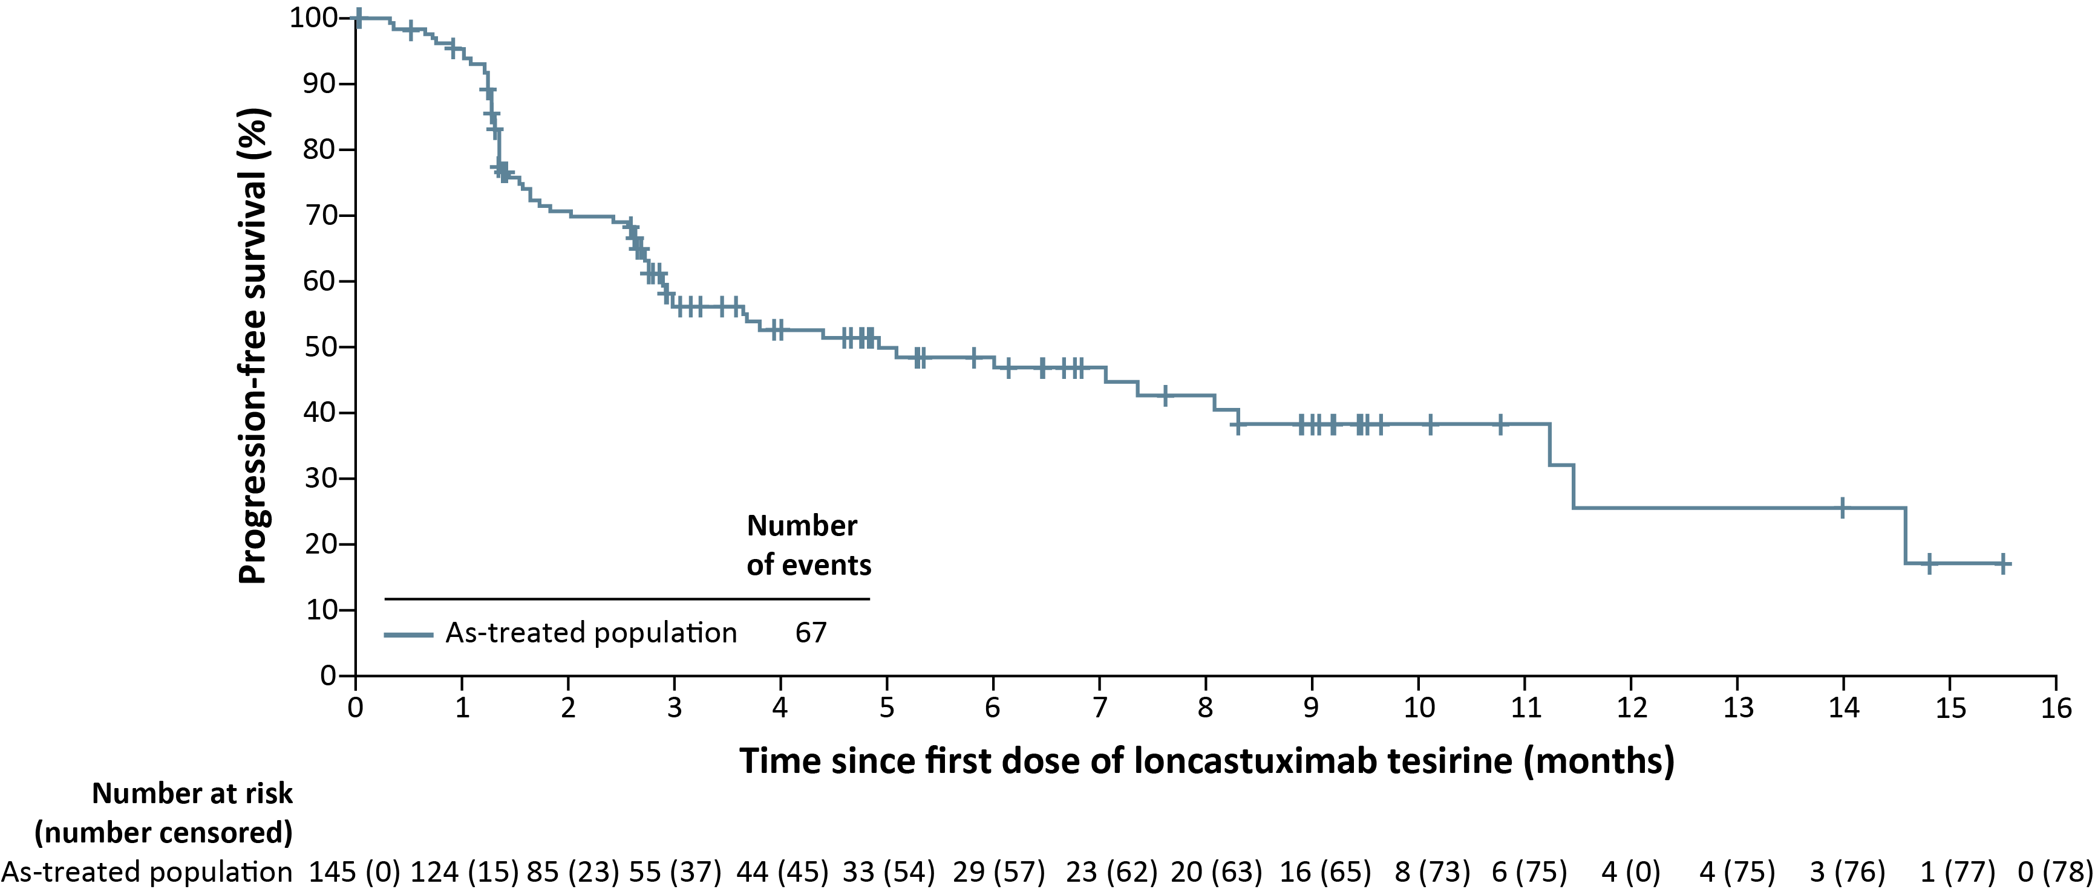
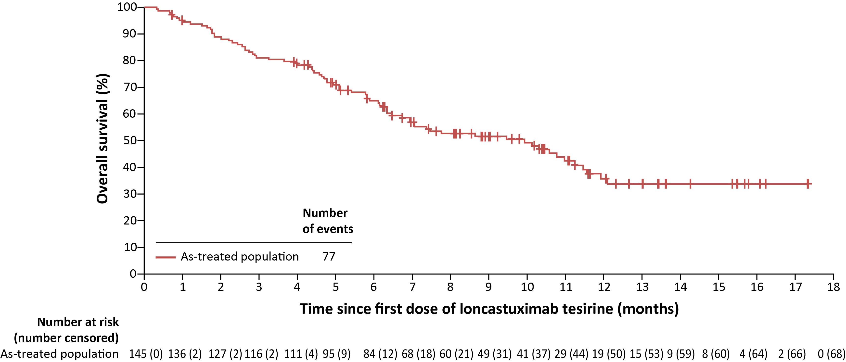
Lotis-2 Efficacy Results
PFS, OS, and Subsequent Treatment
Median PFS: 4.9 months (95% CI: 2.9-8.3)
Median OS: 9.9 months (95% CI: 6.7-11.5)
Subsequent Treatment
15 patients received CD19-directed CAR-T therapy with an investigator-assessed ORR of 47% (6 CR; 1 PR)
9 patients proceeded to SCT as consolidation after Lonca response
CAR-T, chimeric antigen receptor T-cell; CD19, cluster of differentiation 19; CI, confidence interval; CR, complete response; Lonca, loncastuximab tesirine; ORR, overall response rate; OS, overall survival; PFS, progression-free survival; PR, partial response; SCT, stem cell transplant
Caimi PF, et al. Lancet Oncol. 2021;22(6):790-800

Slide 11
Lotis-2 Safety Results
TEAEs in ≥20% of the total population
Most common grade ≥3 TEAEs were:
Neutropenia (37 patients; 26%)
Thrombocytopenia (26 patients; 18%)
GGT increased (24 patients; 17%)
TEAE | All patients | Age subgroup
 | All ages (N=145) | <65 years (N=65) | ≥65 to <75 years (N=59) | ≥75 years (N=21)
Any TEAE | 143 (98.6) | 65 (100) | 58 (98.3) | 20 (95.2)
Hematologic TEAEs
Neutropenia | 57 (39.3) | 33 (50.8) | 20 (33.9) | 4 (19.0)
Thrombocytopenia | 48 (33.1) | 28 (43.1) | 17 (28.8) | 3 (14.3)
Anaemia | 38 (26.2) | 23 (35.4) | 9 (15.3) | 6 (28.6)
Fatigue | 40 (27.6) | 21 (32.3) | 15 (25.4) | 4 (19.0)
Nausea | 34 (23.4) | 17 (26.2) | 13 (22.2) | 4 (19.0)
Cough | 32 (22.1) | 19 (29.2) | 9 (15.3) | 4 (19.0)
Peripheral oedema | 29 (20.0) | 11 (16.9) | 14 (23.7) | 4 (19.0)
Gamma-glutamyl transferase increased | 59 (40.7) | 33 (50.8) | 23 (39.0) | 3 (14.3)
Blood alkaline phosphatase increased | 29 (20.0) | 18 (27.7) | 10 (16.9) | 1 (4.8)
Treatment-related TEAEs leading to treatment discontinuation:
GGT increased (15 patients; 10%)
Peripheral oedema (4 patients; 3%)
Localised oedema (3 patients; 2%)
Pleural effusion (3 patients; 2%)
No increase in toxicity was seen in patients aged ≥65 years compared with younger patients
TEAEs were reported for the as-treated population
GGT, gamma-glutamyl transferase; TEAE, treatment-emergent adverse event
Caimi PF, et al. Lancet Oncol. 2021;22:790-800

Slide 12
Summary Loncastuximab Tesirine
Loncastuximab tesirine is a CD19 drug-antibody conjugate¹
that has been approved for ≥3rd-line treatment of DLBCL
based on results from LOTIS-2
In LOTIS-2 the reported ORR was 48.3% with a CR rate of 24.1%. The median DoR was 10.3 months²
CD19, cluster of differentiation 19; CR, complete response; DLBCL, diffuse large B-cell lymphoma; DoR, duration of response; ORR, overall response rate
1. Zammarchi F, et al. Blood. 2018;131(10):1094-105; 2. Caimi PF, et al. Lancet Oncol. 2021;22(6):790-800

Slide 13
Tafasitamab-cxix + Lenalidomide

Slide 14
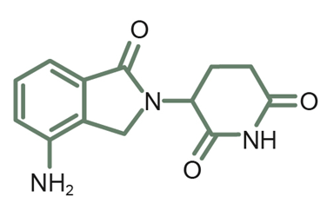
Tafasitamab-cxix + Lenalidomide as an Immunologic Combination
Tafasitamab-cxix (CD19-directed cytolytic mAb)¹⁻⁶
ADCC ↑
ADCP ↑
Direct cell death
Phase 2a study showed single-agent activity in patients with R/R DLBCL and iNHL
Affinity-matured
CD19-binding site
LEN
LEN^{4,5}
Enhanced Fc portion
Direct cytotoxicity
(CD19-binding site)¹
NK cell
Malignant
Macrophage
B-cell
T-cell and NK-cell activation/expansion
Direct cytotoxic and immunomodulatory effects
Well-studied as an antilymphoma agent, alone or in combination
Enhanced ADCC
(Fc portion)¹
CD19
Enhanced ADCP (Fc portion)¹
ADCC, antibody-dependent cellular cytotoxicity; ADCP, antibody-dependent cellular phagocytosis; CD19, cluster of differentiation 19; Fc, fragment crystallisable;
iNHL, indolent non-Hodgkin lymphoma; LEN, lenalidomide; mAb, monoclonal antibody; NK, natural killer; R/R DLBCL, relapsed/refractory diffuse large B-cell lymphoma
1. Horton HM, et al. Cancer Res. 2008;68(19):8049-57; 2. Woyach JA, et al. Blood. 2014;124(24):3553-60; 3. Jurczak W, et al. Ann Oncol. 2018;29(5):1266-72; 4. Witzig TE, et al. Ann Oncol. 2015;26(8):1667-77; 5. Czuczman MS, et al. Clin Cancer Res. 2017;23(15):4127-37; 6. MONJUVI (tafasitamab-cxix) Prescribing Information. June 2021

Slide 15
L-MIND Study design
Phase 2 Study of Tafasitamab-cxix + LEN
N=81
Aged >18 years
R/R DLBCL
Not eligible for HDT + ASCT
1-3 prior regimens
Primary refractory patients
were excludedª
ECOG PS 0-2
Primary data analysis: November 2018¹
Updated long-term outcomes:
November 2019²
October 2020³
Cycles 1-3
Cycles 4-12
Cycles 12+
Tafasitamab-cxix
12 mg/kg IV
day 1, 8, 15, 22 q4w^{b}
Tafasitamab-cxix
12 mg/kg IV
day 1, 15 q4w
Tafasitamab-cxix
12 mg/kg IV
day 1, 15 q4w
If ≥SD
+
+
LEN
25 mg/d PO
day 1-21 q4w
Treatment with
tafasitamab-cxix
until progression
Primary end point:
ORR (ORR = CR + PR)
Select secondary end points included:
PFS, DoR, OS, safety, exploratory, and biomarker-based analyses
ªPrimary refractory defined as no response to or progression/relapse during or within 6 months of front-line therapy
^{b}Loading dose on day 4 of cycle 1 only
ASCT, autologous stem-cell transplantation; CR, complete response; DoR, duration of response; ECOG PS, Eastern Cooperative Oncology Group performance status; HDT, high-dose therapy; IV, intravenous; LEN, lenalidomide; ORR, overall response rate; OS, overall survival; PFS, progression-free survival; PO, orally; PR, partial response; q4w, every 4 weeks; R/R DLBCL, relapsed/refractory diffuse large B-cell lymphoma; SD, stable disease
1. Salles G, et al. Lancet Oncol. 2020;21(7):978-88; 2. Salles G, et al. EHA 2020. Abstract EP1201; 3. Data on file, IA_MOR208C203_Toplines_Tables_08JAN2021, MorphoSys US Inc

Slide 16
L-MIND results
Durable Activity After ≥35 Months
 | 12-Month Analysisª | 24-Month Analysis^{b} | 35-Month Analysis^{c}
 | N=80 (FAS)¹ | N=80 (FAS)² | N=80 (FAS)³
ORR, % | 60 | 57.5 | 57.5
CR, % | 42.5 | 40.0 | 40.0
PR, % | 17.5 | 17.5 | 17.5
mDoR (95% CI), months | 21.7 (21.7-NR) | 34.6 (26.1-NR) | 43.9 (26.1-NR)
mPFS (95% CI), months | 12.1 (5.7-NR) | 12.1 (6.3-NR) | 11.6 (6.3-45.7)
mOS (95% CI), months | NR (18.3-NR) | 31.6 (18.3-NR) | 33.5 (18.3-NR)
The US PI includes efficacy data on a subset of patients with centrally confirmed diagnoses of DLBCL⁴: N=71; ORR=55%; mDoR=21.7 months after 12-month analysis
ªData cutoff: November 30, 2018
^{b}Data cutoff: November 30, 2019
^{c}Data cutoff: October 30, 2020
CI, confidence interval; CR, complete response; DLBCL, relapsed/refractory diffuse large B-cell lymphoma; FAS, full analysis set; LEN, lenalidomide; mDoR, median duration of response; mOS, median overall survival; mPFS, median progression-free survival; NR, not reached; ORR, overall response rate; PI, prescribing information; PR, partial response
1. Salles G, et al. Lancet Oncol. 2020;21(7):978-88; 2. Data on file, MOR208C203 EMA Analysis Tables_21Oct2020, MorphoSys US Inc.; 3. Data on file, IA_MOR208C203_Toplines_Tables_08JAN2021, MorphoSys US Inc.; 4. MONJUVI (tafasitamab-cxix) Prescribing Information. June 2021

Slide 17
L-MIND results mDoR of 43.9 Months After ≥35 Months of Follow-up
1.0
Tafasitamab-cxix + LEN censoring times
0.9
Tafasitamab-cxix + LEN (N = 80)
0.8
0.7
0.6
Proportion of patients in remission
0.5
0.4
0.3
0.2
0.1
Kaplan-Meier median (95% CI), months
0.0
mDoR: 43.9 (26.1-NR) months
0
1
3
6
12
18
24
30
36
42
48
Number of patients still at risk
Months
Tafasitamab + LEN
46
44
39
33
26
25
21
15
5
4
0
CI, confidence interval; LEN, lenalidomide; mDoR, median duration of response; NR, not reached; R/R DLBCL, relapsed/refractory diffuse large B-cell lymphoma
1. Salles G, et al. Lancet Oncol. 2020;21(7):978-88; 2. Data on file, MOR208C203 EMA Analysis Tables_21Oct2020, MorphoSys US Inc.; 3. Data on file, IA_MOR208C203_Toplines_Tables_08JAN2021, MorphoSys US Inc.; 4. MONJUVI (tafasitamab-cxix) Prescribing Information. June 2021

Slide 18
L-MIND results mPFS of 11.6 Months After ≥35 Months of Follow-up
1.0
12-month PFS (95% CI), % | 50.0 (37.8-61.0)
18-month PFS (95% CI), % | 46.6 (34.5-57.9)
24-month PFS (95% CI), % | 43.1 (31.1-54.5)
30-month PFS (95% CI), % | 41.1 (29.1-52.7)
36-month PFS (95% CI), % | 41.1 (29.1-52.7)
0.9
0.8
0.7
0.6
Probability of PFS
0.5
0.4
0.3
0.2
Tafasitamab-cxix + LEN censoring times
0.1
Kaplan-Meier median (95% CI), months
Tafasitamab-cxix + LENª
0.0
mPFS: 11.6 (6.3-45.7) months
0
1
3
6
12
18
24
30
36
42
48
Number of patients still at risk
Months
Tafasitamab + LEN
80
72
56
42
30
27
24
20
11
7
1
Note: Data presented is exploratory. No formal conclusion can be drawn.
CI, confidence interval; LEN, lenalidomide; (m)PFS, (median) progression-free survival; R/R DLBCL, relapsed/refractory diffuse large B-cell lymphoma
1. Salles G, et al. Lancet Oncol. 2020;21(7):978-88; 2. Data on file, MOR208C203 EMA Analysis Tables_21Oct2020, MorphoSys US Inc.; 3. Data on file, IA_MOR208C203_Toplines_Tables_08JAN2021, MorphoSys US Inc.; 4. MONJUVI (tafasitamab-cxix) Prescribing Information. June 2021

Slide 19
L-MIND results
After 3 Years of Follow-Up, 47.3% of all Patients Were Alive
73.7% alive at 1 year
100
57.2% alive at 2 years
51.6% alive at 2.5 years
75
47.3% alive at 3 years
OS, %
50
25
33.5-month mOS
0
0
3
6
9
12
15
18
21
24
27
30
33
36
39
42
45
48
51
Months
Number of patients still at risk
80
69
64
57
54
47
45
42
41
38
37
35
28
25
21
15
10
5
1
Note: Data presented is exploratory. No formal conclusion can be drawn.
FAS, full analysis set; LEN, lenalidomide; (m)OS, (median) overall survival
Data on file, IA_MOR208C203_Overall_Tables_24FEB2021, MorphoSys US Inc

Slide 20
Long-term Safety Profile After ≥35 Months of Follow-up (N=81)
Grade 1 & 2
Grade ≥3 (>1 patient)
Diarrhoea
Peripheral oedema
Hypokalaemia
Nonhaematological TEAEs
in ≥10% of patients
Respiratory tract infection
LEN, lenalidomide; TEAEs, treatment-emergent adverse events
Data on file:IA_MOR208C203_Overall_Tables_24FEB2021, MorphoSys US Inc

Slide 21
Summary Tafasitamab-cxix + Lenalidomide
Tafasitamab-cxix + lenalidomide was FDA approved in 2020 for relapsed/refractory DLBCL, ineligible for ASCT
Place in clinical practice (expert opinion):
It is difficult to make true comparison to Pola-BR given differences in study design, patient population, etc. but it would fit same patient population
  Post-CAR-T relapse, although no data on efficacy after another C19-directed therapy
  Patients who are ineligible for ASCT or CAR-T
  Given lack of data about how a CD19-directed therapy might impact CAR-T, this treatment as of now should not be considered as a bridge therapy to CAR-T
ASCT, autologous stem-cell transplantation; CAR-T, chimeric antigen receptor T-cell; CD19, cluster of differentiation 19; DLBCL, diffuse large B-cell lymphoma; FDA, Food and Drug Administration; Pola-BR, polatuzumab vedotin with bendamustine and rituximab

Slide 22
axicabtagene ciloleucel

Slide 23
ZUMA-5
Study Design
Multicentre, single-arm phase 2 trial
Patients with R/R FL (Grade 1-3a)
or MZL (nodal or extranodal),
≥2 prior lines of therapy including anti-CD20 monoclonal antibody (mAb) + alkylating agent
(N=146: 124 FL, 22 MZL)
Conditioning chemotherapy
CAR-T Cells
Fludarabine 30 mg/m² +
Cyclophosphamide 500 mg/m²
Days -5, -4, -3
Axi-Cel
2 × 10⁶ cells/kg
Day 0
Followed for safety up to
15 years
  Patients with SD but no relapse >1 year from completion of last therapy ineligible. Single-agent anti-CD20 mAb not counted as line of therapy for eligibility. Median time to delivery of axi-cel: 17 days following leukapheresis.
Primary endpoint: Objective response rate (IRRC-assessed per Lugano classification)
Key secondary endpoints: CR rate (IRRC-assessed), DoR, PFS, OS, AEs, CAR T cell, and cytokine levels
AE, adverse event; Axi-Cel, axicabtagene ciloleucel; CAR-T, chimeric antigen receptor T cell; CR, complete response; DoR, duration of response; FL, follicular lymphoma;
IRRC, Independent Radiology Review Committee; MZL, marginal zone lymphoma; OS, overall survival; R/R, relapsed/refractory; SD, stable disease
Jacobson C, et al. Oral presentation at ASH 2020. Abstract #700; NCT03105336

Slide 24
ZUMA-5
Baseline Patient Characteristics
Characteristic | FL (n = 124) | MZL (n = 22) | Overall (N = 146)
Median age (range), years | 60 (34 – 79) | 66 (48 – 77) | 61 (34 – 79)
≥ 65 years, n (%) | 38 (31) | 13 (59) | 51 (35)
Male, n (%) | 73 (59) | 10 (45) | 83 (57)
ECOG PS score 1, n (%) | 46 (37) | 9 (41) | 55 (38)
Stage III-IV disease, n (%) | 106 (85) | 20 (91) | 126 (86)
≥ 3 FLIPI, n (%) | 54 (44) | 14 (64) | 68 (47)
High tumor bulk (GELF criteria), n (%)ª | 64 (52) | 8 (36) | 72 (49)
Median no. of prior therapies (range) | 3 (1 – 10)^{b} | 3 (2 – 8) | 3 (1 – 10)^{b}
≥ 3, n (%) | 78 (63) | 15 (68) | 93 (64)
Prior PI3Ki therapy, n (%) | 34 (27) | 9 (41) | 43 (29)
Refractory disease, n (%)^{c} | 84 (68) | 16 (73) | 100 (68)
POD24 from first anti-CD20 mAb-containing therapy, n (%)^{d} | 68 (55) | 11 (52) | 79 (55)
Prior ASCT, n (%) | 30 (24) | 3 (14) | 33 (23)
a Disease burden, as defined by GELF criteria: involvement of ≥ 3 nodal sites (≥ 3 cm diameter each); any nodal or extranodal tumor mass with ≥ 7 cm diameter; B symptoms; splenomegaly; pleural effusions or peritoneal ascites; cytopenias; or leukemia. b Enrollment of 3 patients with FL who had 1 prior line of therapy occurred before a protocol amendment requiring ≥ 2 prior lines of therapy. c Patients with iNHL who progressed within 6 months of completion of the most recent prior treatment. d POD24 defined as 24 months from initiation of the first line of anti-CD20–containing immunochemotherapy to progression. Percentages are based on the number of patients who ever received anti-CD20–chemotherapy combination therapy.
ASCT, autologous stem cell transplantation; Axi-Cel, axicabtagene ciloleucel; CD20, cluster of differentiation 20; ECOG PS, Eastern Cooperative Oncology Group Performance Status; FL, follicular lymphoma;
FLIPI, Follicular Lymphoma International Prognostic Index; GELF, Groupe d’Etude des Lymphomes Folliculaires; mAb, monoclonal antibody; MZL; marginal zone lymphoma; PD, progressive disease; PI3K, phosphoinositide 3-kinase; POD24, progression of disease within 24 months; tx, treatment
Jacobson C, et al. Oral presentation at ASH 2020. Abstract #700

Slide 25
ZUMA-5
IRRC-Assessed objective response rate
92% ORR
94% ORR
CR
PR
SD
ND
Best response, %
76% CR
(n=79)
80% CR
(n=67)
3%
(n=3)
5%
(n=5)
4%
(n=3)
3%
(n=2)
25% PR
(n=5)
16% PR
(n=17)
14% PR
(n=12)
ª
All Patients (N=96)
FL (n=80)
MZL (n=20)
Median time to first response: 1 month (range: 0.8-3.1)
13/25 (52%) patients with FL and initial PR converted to CR after a median of 2.2 months (range: 1.9-11.2)
ªFor the 5 patients reported as ND, 4 (1 FL; 3 MZL) had no disease at baseline and postbaseline per IRRC but were considered with disease by the investigator; 1 patient with FL died before the first disease assessment
CR, complete response; FL, follicular lymphoma; IRRC, independent radiology review committee; MZL, marginal zone lymphoma; ND, undefined/not done; ORR, objective response rate; PR, partial response; SD, stable disease
Jacobson C, et al. Oral presentation at ASH 2020. Abstract #700

Slide 26
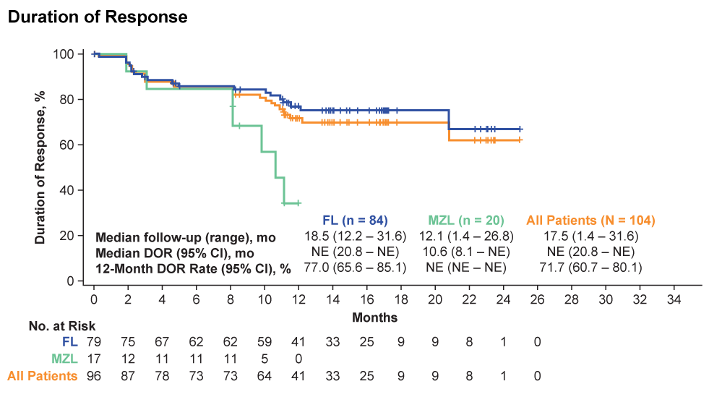
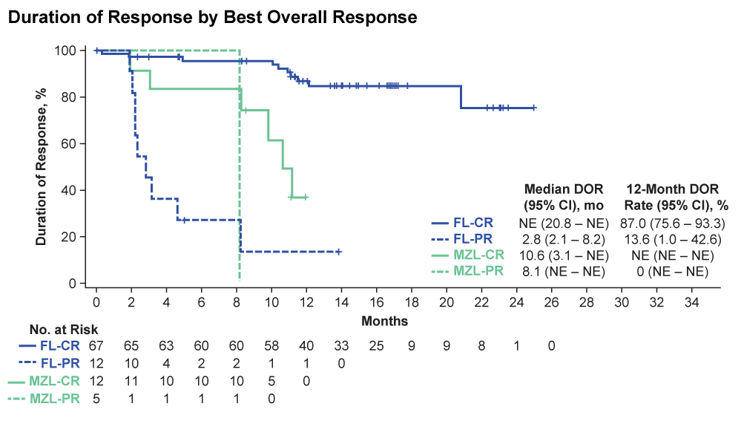
ZUMA-5
Duration of Response
Duration of Response
Duration of Response by Best Response
With a median follow-up of 17.5 months, the estimated median DoR was not reached for all patients with iNHL; 64% of patients with FL had an ongoing response
  12-month DOR rate: 71.7% (95% CI, 60.7 – 80.1)
  Responses were ongoing in 78% of patients with FL with CR and in 17% of patients with PR
CI, confidence interval; CR, complete response; DoR, duration of response; FL, follicular lymphoma; MZL, marginal zone lymphoma; NE, not estimable; NR, not reached;
PR, partial response
Jacobson C, et al. Oral presentation at ASH 2020. Abstract #700

Slide 27
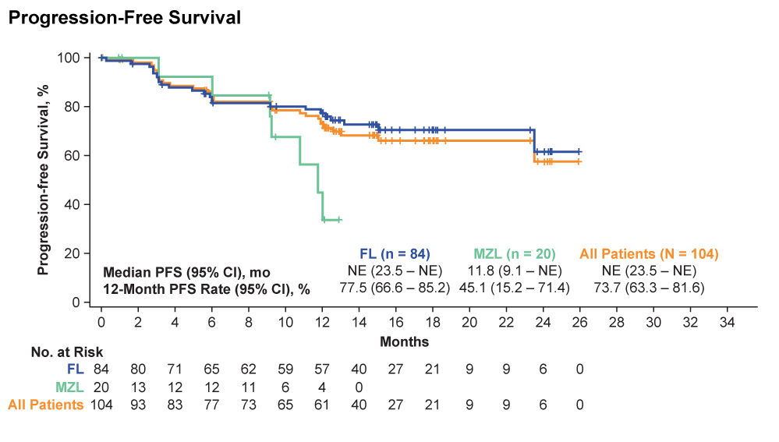
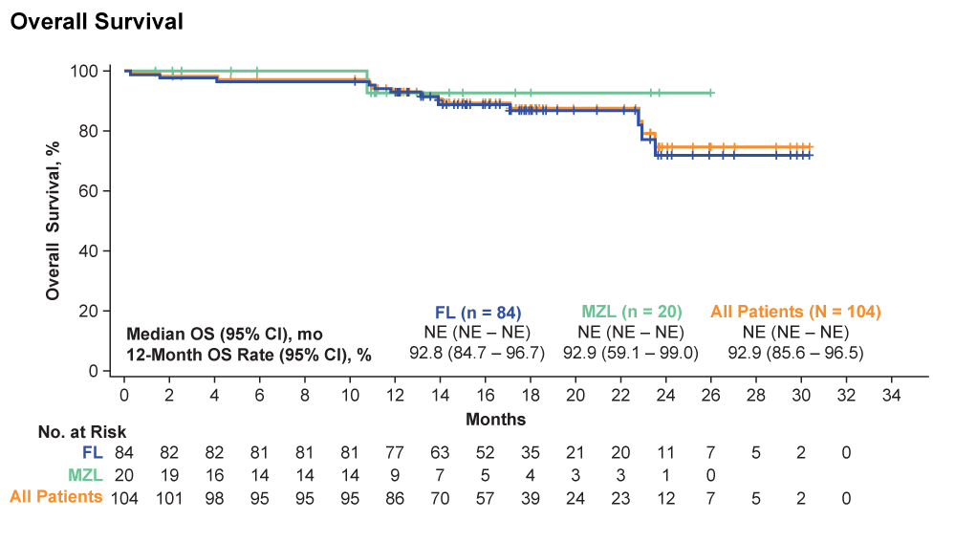
ZUMA-5
Survival
Progression-free survival
Overall survival
With a median follow-up of 17.5 months, median PFS and OS were not reached
  12-month PFS: 73.7% (95% CI, 63.3 – 81.6) for all patients
  12-month OS: 92.9% (95% CI, 85.6 – 96.5) for all patients
CI, confidence interval; FL, follicular lymphoma; MZL, marginal zone lymphoma; NE, not estimable; OS, overall survival; PFS, progression-free survival
Jacobson C, et al. Oral presentation at ASH 2020. Abstract #700

Slide 28
ZUMA-5
Treatment-Emergent Adverse Events
AE, n (%)ª | FL (n = 124) | MZL (n = 22) | Overall (N = 146)
Any AE | 123 (99) | 22 (100) | 145 (99)
Pyrexia | 103 (83) | 20 (91) | 123 (84)
Neutropenia^{b} | 79 (64) | 15 (68) | 94 (64)
Hypotension | 59 (48) | 13 (59) | 72 (49)
Headache | 54 (44) | 11 (50) | 65 (45)
Fatigue | 51 (41) | 13 (59) | 64 (44)
Nausea | 45 (36) | 13 (59) | 58 (40)
Anemia | 44 (35) | 11 (50) | 55 (38)
Sinus tachycardia | 41 (33) | 7 (32) | 48 (33)
Tremor | 36 (29) | 9 (41) | 45 (31)
Chills | 33 (27) | 9 (41) | 42 (29)
Constipation | 35 (28) | 6 (27) | 41 (28)
Diarrhea | 33 (27) | 8 (36) | 41 (28)
Decreased appetite | 28 (23) | 8 (36) | 36 (25)
Grade ≥ 3 AEs occurred in 126 patients (86%)
  The most common Grade ≥ 3 AEs were cytopenias (70%) and infections (16%)
Grade 5 AEs occurred in 3 patients
  Related to axi-cel: multisystem organ failure in the context of CRS (n = 1, Day 7)
  Unrelated to axi-cel: aortic dissection
  (n = 1, Day 399); coccidioidomycosis
  infection (n = 1, Day 327)
ªTreatment-emergent AEs shown are those that occurred in ≥25% of patients;
^{b}Neutropenia includes preferred terms of neutropenia, neutrophil count decreased, and febrile neutropenia
AE, adverse event; axi-cel, axicabtagene ciloleucel; CRS, cytokine release syndrome; FL, follicular lymphoma; MZL, marginal zone lymphoma
Jacobson C, et al. Oral presentation at ASH 2020. Abstract #700

Slide 29
ZUMA-5
Cytokine-Release Syndrome
Parameter | FL (n = 124) | MZL (n = 22) | Overall (N = 146)
CRS, n (%)ª | 97 (78) | 22 (100) | 119 (82)
Grade ≥ 3 | 8 (6) | 2 (9) | 10 (7)
Most common symptoms of any grade, n/n (%)
Pyrexia | 94/97 (97) | 20/22 (91) | 114/119 (96)
Hypotension | 39/97 (40) | 10/22 (45) | 49/119 (41)
AE management, n (%)
Tocilizumab | 56 (45) | 15 (68) | 71 (49)
Corticosteroids | 19 (15) | 6 (27) | 25 (17)
Median time to onset (range), days | 4 (1 – 15) | 4 (1 – 9) | 4 (1 – 15)
Median duration of events (range), days | 6 (1 – 27) | 6 (2 – 14) | 6 (1 – 27)
Patients with resolved events, n/n (%) | 96/97 (99)^{b} | 22/22 (100) | 118/119 (99)^{b}
ªCRS was graded per Lee DW, et al. Blood. 2014;124:188‑195. Individual symptoms of CRS were graded per National Cancer Institute’s Common Terminology Criteria for Adverse Events version 4.03. ^{b}One patient with FL died of multisystem organ failure in the context of CRS (Day 7) prior to the resolution of CRS.
AE, adverse event; FL, follicular lymphoma; MZL, marginal zone lymphoma
Jacobson C, et al. Oral presentation at ASH 2020. Abstract #700

Slide 30
ZUMA-5
Neurologic Events
Parameter | FL (n = 124) | MZL (n = 22) | Overall (N = 146)
Neurologic events, n (%)ª | 70 (56) | 17 (77) | 87 (60)
Grade ≥ 3 | 19 (15) | 9 (41) | 28 (19)
Most common events of any grade, n/n (%)
Tremor | 36/70 (51) | 9/17 (53) | 45/87 (52)
Confusional state | 28/70 (40) | 7/17 (41) | 35/87 (40)
AE management, n (%)
Corticosteroids | 38 (31) | 14 (64) | 52 (36)
Tocilizumab | 7 (6) | 2 (9) | 9 (6)
Median time to onset (range), days | 7 (1 – 177) | 7 (3 – 19) | 7 (1 – 177)
Median duration of events (range), days | 14 (1 – 452) | 10 (2 – 81) | 14 (1 – 452)
Patients with resolved events, n/n (%) | 67/70 (96) | 14/17 (82) | 81/87 (93)
ª Neurologic events were graded per National Cancer Institute’s Common Terminology Criteria for Adverse Events version 4.03.
FL, follicular lymphoma; MZL, marginal zone lymphoma
Jacobson C, et al. Oral presentation at ASH 2020. Abstract #700

Slide 31
Summary Axi-Cel
Axi-cel is a chimeric antigen receptor T-cell therapy that demonstrated high rates of durable responses
ORR of 93% in patients with iNHL (95% in FL) and a CR rate of 80% (81% in FL)
With a median follow-up of 15.3 months, responses were ongoing in 68% of patients with FL (80% of patients who achieved a CR)
The safety profile was manageable and appeared favourable in patients with FL compared with that previously reported in DLBCL
No Grade 5 neurologic events occurred; 1 Grade 5 CRS event occurred
Axi-cel, axicabtagene ciloleucel; CR, complete response; FL, follicular lymphoma; iNHL, indolent non-Hodgkin lymphoma; ORR, objective response rate

Slide 32
REACH LYMPHOMA & MYELOMA CONNECT
VIA TWITTER, LINKEDIN, VIMEO & EMAIL
OR VISIT THE GROUP’S WEBSITE http://www.lymphomaconnect.info
Follow us on Twitter
@LYM_MM_CONNECT
Follow the
LYMPHOMA & MYELOMA CONNECT
group on LinkedIn
Watch us on the
Vimeo Channel
LYMPHOMA & MYELOMA CONNECT
Email
froukje.sosef
@cor2ed.com

