Slide 1
1

Slide 2
Experts Knowledge Share
Appropriate selection of patients for 1st line monotherapy in advanced or unresectable HCC and treatment management in relation with AEs
Prof. Richard Finn (USA)
Dr. Mohamed Bouattour (France)
Prof. James J. Harding (USA)
Dr. Su Pin Choo (Singapore)
Friday January 28th 2022

Slide 3
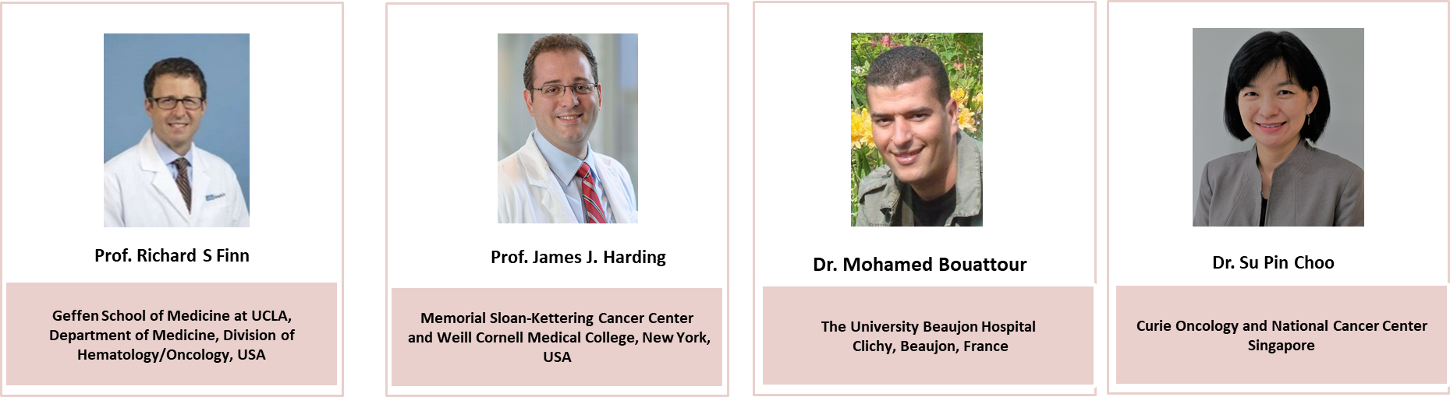
Introducing the scientific committee

Slide 4
Disclaimer
This meeting is supported by an independent medical educational grant from Eisai Europe Limited. The programme is therefore independent; the content is not influenced by Eisai Europe Limited and is the sole responsibility of the experts
Please note:
The views expressed within this presentation are the personal opinions of the experts. They do not necessarily represent the views of the experts’ academic institutions or the rest of the faculty

Slide 5
EXPERTS KNOWLEDGE SHARE
Educational objectives
Explore the patient-profile who could benefit from VEGFR-TKI monotherapy 1st line in advanced or unresectable HCC
Interpret the real-world data and understand the implications for clinical practice
Understand the safety profile of the monotherapies, be able to recognise the cause of toxicities and know the appropriate dosing strategies to manage side effects
A look into the future, the potential of combination therapies in the treatment of HCC
HCC, hepatocellular carcinoma

Slide 6
Experts Knowledge share Agenda
Appropriate selection of patients for 1st line monotherapy in
advanced or unresectable HCC and treatment management in relation with AEs
Topic | Facilitator
Welcome and introductions | COR2ED
Who can benefit from VEGFR-TKIs monotherapy today? | Richard Finn
Treating patients with VEGFR-TKIs monotherapy: What are the treatment related adverse events and how to manage them? | James Harding
What did we learn from the real-world data? What can we translate into clinical practice? | Mohamed Bouattour
A review of relevant data presented at ASCO GI and a look to future treatments | Su Pin Choo
A look to future treatments and closing remarks | Richard Finn
Discussion and Question and Answers Session | All
Close | COR2ED

Slide 7
Who Can Benefit from VEGFR-TKI Monotherapy Today?
Richard S. Finn, MD
Professor of Clinical Medicine
Division of Hematology/Oncology
Director, Signal Transduction and Therapeutics Program
Jonsson Comprehensive Cancer Center
Geffen School of Medicine at UCLA, California, USA

Slide 8
Disclosures
Consultant: AstraZeneca, CStone Pharmaceuticals, Bayer, Bristol Myers Squibb, Eisai, Eli Lilly, Exelixis, Merck, Novartis, Pfizer, Roche/Genentech

Slide 9
Barcelona Clinic Liver Cancer (BCLC)
Staging and Treatment Strategy¹
HCC
Very early stage (0)
Single ≤2 cm
Child–Pugh A, PS 0
Early stage (A)
Single or 3 nodules ≤3 cm
Child–Pugh A-B, PS 0
Intermediate stage (B)
Multinodular,
Child–Pugh A-B, PS 0
Advanced stage (C)
Portal invasion, Extrahepatic spread, Child‑Pugh A-B, PS 1-2
Terminal stage (D)
Child–Pugh C
PS 3-4
Candidate for liver transplantation
Single
3 nodules ≤3 cm
No
Yes
Portal pressure; bilirubin
Normal
Increased
Associated
diseases
Ablation
TACE
Systemic Therapy
Best Supportive Care
No
Yes
Resection
Liver transplantation
Ablation
5-yr survival: 60% to 80%
RCTs (50%); 3-yr survival:
10% to 40%
Symptomatic (20%); survival <3 mo
HCC, hepatocellular carcinoma; mo, months; PS, performance status; RCT, randomised controlled trial; TACE, transarterial chemoembolisation; yr, year
Bruix J, et al. Gastroenterology. 2016;150:835-53

Slide 10
Pivotal Trials Demonstrated OS Benefit with Sorafenib in HCC
Sorafenib consistently increased OS in different patient populations
across geographic regions
SHARP OS¹
ASIA-PACIFIC OS²
1.0
1.0
Median OS (months)
━ Sorafenib (n=150): 6.5
━ Placebo (n=76): 4.2
HR: 0.68; 95% CI, 0.50-0.93
p=0.014
0.8
0.8
0.6
0.6
Survival Probability
Survival Probability
0.4
0.4
Median OS (months)
━ Sorafenib (n=299): 10.7
━ Placebo (n=303): 7.9
HR: 0.69; 95% CI, 0.55-0.87
p<0.001
0.2
0.2
0.0
0.0
0
3
6
9
12
15
18
0
3
6
9
12
15
18
21
Months Since Randomisation
Months Since Randomisation
CI, confidence interval; HCC, hepatocellular carcinoma; HR, hazard ratio; OS, overall survival; SHARP, Sorafenib Hepatocellular Carcinoma Assessment Randomized Protocol
1. Llovet J, et al. N Engl J Med. 2008;359:378-90. 2. Cheng A-L, et al. Lancet Oncol. 2009;10:25-34

Slide 11
FDA-Approved Systemic Therapy for Advanced HCC
2007
2008
2009
2010
2011
2012
2013
2014
2015
2016
2017
2018
2019
2020
Sorafenib
First Line
lenvatinib
atezolizumab + bevacizumab
Second Line and Beyond
regorafenib
nivolumab*#
pembrolizumab*
cabozantinib
ramucirumab
nivolumab + ipilimumab*
*Accelerated approval, #Accelerated approval withdrawn
FDA, Food and Drug Administration; HCC, hepatocellular carcinoma

Slide 12
Lenvatinib: REFLECT Study
Comparison of kinase inhibitory effect on targeted molecule between lenvatinib and sorafenib¹⁰
lenvatinib is an oral multikinase inhibitor that targets VEGFR^{1–3}, FGFR^{1–4}, PDGFRα^{1,3-4}, RET³⁻⁴, and KIT^{1–4}
There have been 4 failed phase 3 trials in front-line HCC in the past 10 years^{5–8}
In a global, randomised, open-label phase 3 non-inferiority study, lenvatinib was non-inferior to sorafenib for OS, and significantly improved PFS, TTP, and ORR in patients with untreated advanced HCC⁹
IC₅₀ (nmol/L) | lenvatinib | sorafenib
VEGFR1 | 4.7 | 21
VEGFR2 | 3.0 | 21
VEGFR3 | 2.3 | 16
FGFR1 | 61 | 340
FGFR2 | 27 | 150
FGFR3 | 52 | 340
FGFR4 | 43 | 3400
RET | 6.4 | 15
KIT | 85 | 140
PDGFRα | 29 | 1.6
PDGFRβ | 160 | 27
BRAF | 8700 | 310
RAF1 | 1600 | 46
In vitro kinase inhibitory profiles³
BRAF, B-Raf proto-oncogene; FGFR, fibroblast growth factor receptor; HCC, hepatocellular carcinoma; IC₅₀, half-maximal inhibitory concentration; ORR, objective response rate; OS, overall survival; PDGFR, platelet-derived growth factor receptor; PFS, progression-free survival; TTP, time to progression; VEGFR, vascular endothelial growth factor receptor
1. Matsui J, et al. Int J Cancer. 2008;122:664-71; 2. Matsui J, et al. Clin Cancer Res. 2008;14:5459-65; 3. Tohyama O, et al. J Thyroid Res. 2014;2014:638747; 4. Yamamoto Y, et al. Vasc Cell. 2014;6:18; 5. Cheng A-L, et al. J Clin Oncol. 2013;31:4067-75; 6. Johnson PJ, et al. J Clin Oncol. 2013;31:3517-24; 7. Cainap C, et al. J Clin Oncol. 2015;33:172-9; 8. Zhu AX, et al. J Clin Oncol. 2015;33:559-66; 9. Cheng A-L, et al. J Clin Oncol. 2017:35, no. 15_suppl:4001-4001 (ASCO 2017 poster presentation); 10. Kudo M. Liver Cancer. 2021;10(2):85-93.

Slide 13
REFLECT Study- Study design
Global, randomised, open-label, phase 3 non-inferiority study
Patients with unresectable HCC (N=954)
No prior systemic therapy for unresectable HCC
≥1 Measurable target lesion per mRECIST
BCLC stage B or C
Child-Pugh A
ECOG PS ≤1
Adequate organ function
Patients with ≥ 50% liver occupation, clear bile duct invasion, or portal vein invasion at the main portal vein were excluded
Primary endpoint:
OS
Secondary endpoints:
PFS
TTP
ORR
Quality of life
PK lenvatinib exposure parameters
Tumour assessments were performed according to mRECIST by the investigator
lenvatinib
(n=478)
8 mg (BW <60 kg) or
12 mg (BW ≥60 kg)
once daily
Stratification
Region:
  (Asia-Pacific or Western)
MPVI and/or EHS:
  (yes or no)
ECOG PS:
  (0 or 1)
Body weight:
  (<60 kg ≥60 kg)
Randomisation 1:1
sorafenib
(n=476)
400 mg twice daily
BCLC, Barcelona Clinic Liver Cancer; BW, body weight; ECOG PS, Eastern Cooperative Oncology Group performance status; EHS, extrahepatic spread; HCC, hepatocellular carcinoma; MPVI, macroscopic portal vein invasion; mRECIST, modified Response Evaluation Criteria In Solid Tumors; ORR, objective response rate; OS, overall survival; PFS, progression-free survival; PK, pharmacokinetic
Kudo M, et al. Lancet. 2018;391:1163-73

Slide 14
REFLECT Study- overall survival
Primary Endpoint: Kaplan-Meier Estimate of OS
1.0
Median (months) (95% CI)
lenvatinib: 13.6 (12.1 ̶ 14.9)
sorafenib: 12.3 (10.4 ̶ 13.9)
HR (95% CI): 0.92 (0.79 ̶ 1.06)
0.9
0.8
0.7
0.6
Probability
0.5
0.4
0.3
0.2
0.1
0.0
0
3
6
9
12
15
18
21
24
27
30
33
36
39
42
Number of patients at risk
Time (months)
lenvatinib
478
436
374
297
253
207
178
140
102
67
40
21
8
2
0
sorafenib
476
440
348
282
230
192
156
116
83
57
33
16
8
4
0
CI, confidence interval; HR, hazard ratio; OS, overall survival
Kudo M, et al. Lancet. 2018;391:1163-73

Slide 15
REFLECT Study- patients characteristics
Characteristic | Subgroup | Events/Patients |  |  | HR (95% CI) | Median (months)
 |  | Lenvatinib | Sorafenib |  | Lenvatinib vs Sorafenib | Lenvatinib | Sorafenib
Overall |  | 351/478 | 350/476 |  | 0.92 (0.79–1.06) | 13.6 | 12.3
Age | < 65 y | 203/270 | 204/283 |  | 0.94 (0.77–1.15) | 12.4 | 11.4
 | ≥ 65 y | 148/270 | 146/193 |  | 0.84 (0.66–1.07) | 14.6 | 13.4
Sex | Male | 293/405 | 293/401 |  | 0.91 (0.77–1.07) | 13.4 | 12.4
 | Female | 58/73 | 57/75 |  | 0.84 (0.56–1.26) | 15.3 | 11.4
Region | Asia-Pacific | 243/321 | 248/319 |  | 0.86 (0.72–1.02) | 13.5 | 11.0
 | Western | 108/157 | 102/157 |  | 1.08 (0.82–1.42) | 13.6 | 14.2
ECOG-PS | PS = 0 | 221/304 | 223/301 |  | 0.88 (0.73–1.06) | 14.6 | 12.8
 | PS = 1 | 130/174 | 127/175 |  | 0.97 (0.76–1.25) | 10.7 | 10.3
Body weight | <60 kg | 110/153 | 113/146 |  | 0.85 (0.65–1.11) | 13.4 | 10.3
 | ≥ 60 kg | 241/325 | 237/330 |  | 0.95 (0.79–1.14) | 13.7 | 12.5
MVI, EHS, or both | Yes | 250/329 | 259/336 |  | 0.87 (0.73–1.04) | 11.5 | 9.8
 | No | 101/149 | 91/140 |  | 1.05 (0.79–1.40) | 18.0 | 18.0
AFP at baseline | < 200 ng/mL | 167/255 | 193/286 |  | 0.91 (0.74–1.12) | 19.5 | 16.3
 | ≥ 200 ng/mL | 183/222 | 154/187 |  | 0.78 (0.63–0.98) | 10.4 | 8.2
Etiology | HBV | 196/259 | 186/244 |  | 0.83 (0.68–1.02) | 13.4 | 10.2
 | HCV | 75/103 | 97/135 |  | 0.91 (0.65–1.28) | 15.3 | 14.1
BCLC staging | Stage B | 71/104 | 65/92 |  | 0.91 (0.66–1.26) | 18.5 | 17.3
 | Stage C | 280/374 | 285/384 |  | 0.92 (0.77–1.08) | 11.8 | 10.3
Posttreatment anticancer therapy | Yes | 143/206 | 175/243 |  | 0.84 (0.67–1.06) | 19.5 | 17.0
 | No | 208/272 | 175/233 |  | 0.91 (0.74–1.11) | 10.5 | 7.9
Favors Lenvatinib
Favors Sorafenib
0.5
21
1
2
AFP, α-fetoprotein; BCLC, Barcelona Clinic Liver Cancer; CI, confidence interval; ECOG PS, Eastern Cooperative Oncology Group; EHS, extrahepatic spread; HBV, hepatitis B virus; HCV, hepatitis C virus; MVI, macroscopic portal vein invasion; PS, performance status; y, year
Kudo M, et al. Lancet. 2018;391:1163-73

Slide 16
REFLECT Study - PFS
Secondary Endpoint: Kaplan-Meier Estimate of PFS by mRECIST
1.0
Median (months) (95% CI)
lenvatinib: 7.4 (6.9 ̶ 8.8)
sorafenib: 3.7 (3.6 ̶ 4.6)
HR (95% CI): 0.66 (0.57 ̶ 0.77)
Log-rank test: p value: <0.0001
0.9
0.8
0.7
0.6
Probability
0.5
0.4
0.3
0.2
0.1
0.0
0
3
6
9
12
15
18
21
24
27
30
33
36
39
42
Number of patients at risk
Time (months)
lenvatinib
478
345
223
172
106
69
44
28
14
9
4
2
0
0
0
sorafenib
476
262
140
94
56
41
33
22
14
9
4
2
2
0
0
CI, confidence interval; HR, hazard ratio; mRECIST, modified Response Evaluation Criteria In Solid Tumors; PFS, progression-free survival
Kudo M, et al. Lancet. 2018;391:1163-73

Slide 17
Tumor assessments: Lenvatinib
Parameter | mRECIST by investigator | mRECIST by independent review | RECIST v1.1 by independent review
lenvatinib (n=478)
ORR, n (%) | 115 (24.1) | 194 (40.6) | 90 (18.8)
95% CI | 20.2–27.9 | 36.2–45.0 | 15.3–22.3
Odds ratio (95%CI)ª | 3.13 (2.15–4.56) | 5.01 (3.59–7.01) | 3.34 (2.17–5.14)
BOR, n (%)
Complete response | 6 (1) | 10 (2) | 2 (<1)
Partial response | 109 (23) | 184 (38) | 88 (18)
Stable disease | 246 (51) | 159 (33) | 258 (54)
Durable stable disease^{b} | 167 (35) | 84 (18) | 163 (34)
Progressive disease | 71 (15) | 79 (17) | 84 (18)
Not evaluable/unknown | 46 (10) | 46 (10) | 46 (10)
ªlenvatinib vs sorafenib
^{b}Stable disease lasting ≥23 weeks
BOR, best overall response; CI, confidence interval; mRECIST, modified RECIST; ORR, objective response rate; RECIST, Response Evaluation Criteria in Solid Tumors
Kudo M, et al. Lancet. 2018;391:1163-73

Slide 18
Tumor assessments: Sorafenib
Parameter | mRECIST by investigator | mRECIST by independent review | RECIST v1.1 by independent review
sorafenib (n=476)
ORR, n (%) | 44 (9.2) | 59 (12.4) | 31 (6.5)
95% CI | 6.6–11.8 | 9.4–15.4 | 4.3–8.7
BOR, n (%)
Complete response | 2 (<1) | 4 (1) | 1 (<1)
Partial response | 42 (9) | 55 (12) | 30 (6)
Stable disease | 244 (51) | 219 (46) | 250 (53)
Durable stable diseaseª | 139 (29) | 90 (19) | 118 (25)
Progressive disease | 147 (31) | 152 (32) | 152 (32)
Not evaluable/unknown | 41 (9) | 46 (10) | 43 (9)
ªStable disease lasting ≥23 weeks
BOR, best overall response; CI, confidence interval; mRECIST, modified RECIST; ORR, objective response rate; RECIST, Response Evaluation Criteria in Solid Tumors
Kudo M, et al. Lancet. 2018;391:1163-73

Slide 19
OS by OR for the Overall REFLECT Population
1.0
Median OS (months) (95% CI)
Response: 22.4 (19.7 ̶ 26.0)
Non-response: 11.4 (10.3 ̶ 12.3)
HR (95% CI): 0.61 (0.49 ̶ 0.76)
Mantel-Byar test: p value: <0.001
0.9
0.8
0.7
0.6
Probability
0.5
0.4
0.3
0.2
0.1
0.0
0
3
6
9
12
15
18
21
24
27
30
33
36
39
42
Number of patients at risk
Time From Randomisation (months)
Response
159
155
151
138
121
108
93
76
56
41
22
11
6
1
0
Nonresponse
795
721
571
441
362
291
241
180
129
83
51
26
10
5
0
CI, confidence interval; HR, hazard ratio; OR, objective response; OS, overall survival
Kudo M, et al. J Clin Oncol. 2019;37, no. 4_suppl:186-186 (ASCO 2019 Gastrointestinal Cancers Symposium - poster presentation)

Slide 20
REFLECT Study – Most frequent TEAEs (>15%)
Adverse event, n (%) | lenvatinib (n=476) |  | sorafenib (n=475)
 | Any grade | Grade 3/4 | Any grade | Grade 3/4
Hypertension | 201 (42) | 111 (23) | 144 (30) | 68 (14)
Diarrhea | 184 (39) | 20 (4) | 220 (46) | 20 (4)
Decreased appetite | 162 (34) | 22 (5) | 127 (27) | 6 (1)
Decreased weight | 147 (31) | 36 (8) | 106 (22) | 14 (3)
Fatigue | 141 (30) | 18 (4) | 119 (25) | 17 (4)
Palmar-plantar erythrodysesthesia | 128 (27) | 14 (3) | 249 (52) | 54 (11)
Proteinuria | 117 (25) | 27 (6) | 54 (11) | 8 (2)
Dysphonia | 113 (24) | 1 (<1) | 57 (12) | 0 (0)
Nausea | 93 (20) | 4 (1) | 68 (14) | 4 (1)
Decreased platelet count | 87 (18) | 26 (6) | 58 (12) | 16 (3)
Abdominal pain | 81 (17) | 8 (2) | 87 (18) | 13 (3)
Hypothyroidism | 78 (16) | 0 (0) | 8 (2) | 0 (0)
Vomiting | 77 (16) | 6 (1) | 36 (8) | 5 (1)
Constipation | 76 (16) | 3 (1) | 52 (11) | 0 (0)
Elevated aspartate aminotransferase | 65 (14) | 24 (5) | 80 (17) | 38 (8)
Rash | 46 (10) | 0 (0) | 76 (16) | 2 (0)
Alopecia | 14 (3) | 0 (0) | 119 (25) | 0 (0)
TEAE, treatment-emergent adverse event
Kudo M, et al. Lancet. 2018;391:1163-73

Slide 21
REFLECT:
Adverse Events and Outcome
In patients treated with lenvatinib, the occurrence of hypertension, diarrhea, proteinuria, or hypothyroidism was generally associated with longer OS
Diarrhea
Hypertension
10
Median (month) (95% CI)
Yes: 17.7 (13.8, 20.2)
No: 11.6 (9.9, 13.7)
HR(95% CI): 0.72 (0.58, 0.90)
Log-rank Test: P-value: 0.003
10
Median (month) (95% CI)
Yes: 18.0 (14.4, 22.3)
No: 11.5 (9.9, 13.1)
HR(95% CI): 0.64 (0.52, 0.80)
Log-rank Test: P-value: <0.001
0.9
0.9
0.8
0.8
0.7
0.7
0.6
0.6
Probability
Probability
0.5
0.5
0.4
0.4
0.3
0.3
0.2
0.2
0.1
0.1
0.0
0.0
0
3
6
9
12
15
18
21
24
27
30
33
36
39
42
0
3
6
9
12
15
18
21
24
27
30
33
36
39
42
Time (month)
Time (month)
Number of subjects at risk:
Number of subjects at risk:
Yes
No
184
294
177
259
161
213
135
162
119
134
98
109
87
91
68
72
48
54
37
30
22
18
11
10
3
5
2
0
0
Yes
No
201
277
190
246
169
205
147
150
127
126
111
96
97
81
81
59
60
42
39
28
23
17
12
9
4
4
1
1
0
0
Hyporhyroidism
Proteinuria
Median (month) (95% CI)
Yes: 18.6 (14.1, 21.2)
No: 12.3 (10.9, 13.9)
HR(95% CI): 0.76 (0.60, 0.98)
Log-rank Test: P-value: 0.030
10
Median (month) (95% CI)
Yes: 19.8 (11.9, 24.5)
No: 13.4 (11.5, 14.1)
HR(95% CI): 0.72 (0.54, 0.96)
Log-rank Test: P-value: 0.024
10
0.9
0.9
0.8
0.8
0.7
0.7
0.6
0.6
Probability
Probability
0.5
0.5
0.4
0.4
0.3
0.3
0.2
0.2
0.1
0.1
0.0
0.0
0
3
6
9
12
15
18
21
24
27
30
33
36
39
42
0
3
6
9
12
15
18
21
24
27
30
33
36
39
42
Time (month)
Time (month)
Number of subjects at risk:
Number of subjects at risk:
Yes
No
78
400
75
360
71
303
61
236
48
205
45
162
40
198
32
108
25
77
16
51
10
30
5
16
1
7
1
1
0
0
Yes
No
117
361
113
323
100
274
92
205
77
176
66
141
55
123
44
96
36
66
24
43
43
27
8
13
3
5
1
1
0
0
CI, confidence interval; HR, hazard ratio; OS, overall survival
Sung MW, et al. J Clin Oncol. 2019;37, no. 4_suppl:317-317 (ASCO 2019 Gastrointestinal Cancers Symposium - poster presentation)

Slide 22
REFLECT: association between AEs of interest and OS
Preferred Term | lenvatinib (n=478) n (%) |  | HR for OS |  | 95% CI | p value
 | AEI | No AEI
Hypertension | 201 (42) | 277 (58) | 0.64 |  | 0.52–0.80 | 0.001
Diarrhea | 184 (38) | 294 (62) | 0.72 |  | 0.58–0.90 | 0.003
Proteinuria | 117 (24) | 361 (76) | 0.76 |  | 0.60–0.98 | 0.030
Dysphonia | 113 (24) | 365 (76) | 0.86 |  | 0.68–1.11 | 0.247
Hypothyroidism | 78 (16) | 400 (84) | 0.72 |  | 0.54–0.96 | 0.024
AEI, adverse event of interest; CI, confidence interval; HR, hazard ratio; OS, overall survival
Sung MW, et al. J Clin Oncol. 2019;37, no. 4_suppl:317-317 (ASCO 2019 Gastrointestinal Cancers Symposium - poster presentation)

Slide 23
REFLECT: Pharmacodynamic serum Biomarkers
VEGF
ANG2
FGF23
90
20
40
80
10
30
70
0
20
60
Median percentage
change from baseline
Median percentage
change from baseline
Median percentage
change from baseline
-10
10
50
40
-20
0
30
-30
-10
20
-40
-20
10
-30
0
-50
C1D1
C1D1
C1D5
C2D1
C3D1
C4D1
C5D1
C6D1
C7D1
C8D1
C9D1
C1D1
C1D5
C2D1
C3D1
C4D1
C5D1
C6D1
C7D1
C8D1
C9D1
C1D5
C2D1
C3D1
C4D1
C5D1
C6D1
C7D1
C8D1
C9D1
Visit
Visit
Visit
FGF19
FGF21
PIVKA-II
120
70
250
110
60
100
200
90
50
80
40
70
Median percentage
change from baseline
Median percentage
change from baseline
Median percentage
change from baseline
150
60
30
50
20
40
100
30
10
20
0
10
50
0
-10
-10
-20
-20
0
C1D1
C1D5
C2D1
C3D1
C4D1
C5D1
C6D1
C7D1
C8D1
C9D1
C1D1
C1D1
C1D5
C2D1
C3D1
C4D1
C5D1
C6D1
C7D1
C8D1
C9D1
C1D5
C2D1
C3D1
C4D1
C5D1
C6D1
C7D1
C8D1
C9D1
Visit
Visit
Visit
Lenvatinib
Sorafenib
ANG2, angiopoietin-2; C, Cycle; D, Day; FGF, fibroblast growth factor; PIVKA-II, protein induced vitamin K absence/antagonist II; VEGF, vascular endothelial growth factor
Finn RS, et al. Clin Cancer Res. 2021;28:4848-58

Slide 24
IMbrave150 - Study Design
IMbrave150 (NCT03434379): Randomized phase 3 trial assessing combination therapy with the PD-L1 inhibitor atezolizumab and the VEGF inhibitor bevacizumab versus standard-of-care sorafenib in first line for advanced HCC
Key eligibility
Locally advanced or metastatic and/or unresectable HCC
No prior systemic therapy
ECOG PS 0-1
Child-Pugh class A liver function
Stratification
  Region (Asia excluding Japanª/Rest of world)
  ECOG (0/1)
  Macrovascular invasion and/or extrahepatic spread (Presence/Absence)
  Baseline AFP
  (<400/≥400 ng/mL)
atezolizumab
1200 mg IV q3w
+
bevacizumab
15 mg/kg q3w
(n=336)
Until loss of clinical benefit or unacceptable toxicity^{b}
Survival follow‑up
R
2:1
sorafenib 400 mg bid
(n=165)
(open-label)
N = 501
Co-primary endpoints
OS
IRF-assessed PFS per RECIST 1.1
Secondary endpoints included:
IRF-assessed ORR, DoR per RECIST 1.1 and HCC mRECIST^{b}
PROs: TTD^{c} of QoL, physical and role functioning (EORTC QLQ-C30)
Safety and tolerability assessed based on the nature, frequency and severity of adverse events per NCI CTCAE version 4.0
a Japan is included in rest of world. b Tumour assessment by computed tomography or magnetic resonance imaging was done at baseline and every 6 weeks until 54 weeks, then every 9 weeks thereafter.
c Time from randomization to first decrease from baseline of ≥10 points maintained for two consecutive assessments, or one assessment followed by death from any cause within 3 weeks
AFP, α-fetoprotein; CTCAE, Common Terminology Criteria for Adverse Events; DoR, duration of response; ECOG PS, Eastern Cooperative Oncology Group performance status; EORTC QLQ-C30, European Organization for Research and Treatment of Cancer quality-of-life questionnaire for cancer; HCC, hepatocellular carcinoma; IRF, independent review facility; IV, intravascular; mRECIST, modified RECIST; NCI, National Cancer Institute; PRO, patient-reported outcomes; q3w, every 3 weeks; QoL, quality of life; RECIST, response evaluation criteria in solid tumours; TTD, time to deterioration
Finn RS, et al. N Engl J Med. 2020;382(20):1894-905

Slide 25
IMbrave150 - Baseline patient characteristics (ITT)ª
n (%) | atezo + bev (n = 336) | sorafenib (n = 165)
Median age (range), years | 64 (56-71) | 66 (59-71)
Male | 277 (82) | 137 (83)
Asia excluding Japan│rest of world^{b} | 133 (40) │203 (60) | 68 (41) │97 (59)
ECOG PS 0 │1 | 209 (62) │127 (38) | 103 (62) │62 (38)
Child-Pugh score A5│A6^{c} | 239 (72) │94 (28) | 121 (73) │44 (27)
Barcelona Clinic Liver Cancer stage B│C | 52 (15) │276 (82) | 26 (16) │133 (81)
AFP at baseline ≥ 400 ng/mL | 126 (38) | 61 (37)
MVI present | 129 (38) | 71 (43)
EHS present | 212 (63) | 93 (56)
MVI and/or EHS present | 258 (77) | 120 (73)
Varices at baseline | 88 (26) | 43 (26)
Varices treated at baseline | 36 (11) | 23 (14)
HCC etiology
Hepatitis B | 164 (49) | 76 (46)
Hepatitis C | 72 (21) | 36 (22)
Non-viral^{d} | 100 (30) | 53 (32)
a All randomised patients. b Includes United States, Australia, New Zealand, and Japan. c three patients data not included. d Includes alcohol, other and unknown non–hepatitis B and C causes
AFP, α-fetoprotein; atezo, atezolizumab; bev, bevacizumab; ECOG PS, Eastern Cooperative Oncology Group performance status; EHS, extrahepatic spread; HCC, hepatocellular carcinoma; ITT, intention to treat; MVI, macrovascular invasion
Finn RS, et al. N Engl J Med. 2020;382(20):1894-905

Slide 26
IMbrave150 Trial
Key Efficacy Data: Updated OS and PFS
100
6-mo OS
100
85%
80
12-mo OS
80
72%
67%
6-mo PFS
60
18-mo OS
60
55%
Overall survival (%)
56%
52%
Progression-free survival (%)
12-mo PFS
40
40%
40
38%
35%
18-mo PFS
24%
20
20
21%
0
0
12%
0
1
2
3
4
5
6
7
8
9
10
11
12
13
14
15
16
17
18
19
20
21
22
23
24
25
26
27
28
29
0
1
2
3
4
5
6
7
8
9
10
11
12
13
14
15
16
17
18
19
20
21
22
23
24
25
26
27
28
Time (months)
Time (months)
29
Updated OS | atezo + bev (n = 336) | sorafenib ( n = 165)
OS events, n (%) | 180 (54) | 100 (61)
Median OS, mo (95% CI) | 19.2 (17.0, 23.7) | 13.4 (11.4, 16.9)
Stratified HR (95%CI) | 0.66 (0.52, 0.85) P = 0.0009
  Median follow-up: 15.6 mo (vs 8.6 mo in primary analysis)
Updated PFS | atezo + bev (n = 336) | sorafenib ( n = 165)
PFS events, n (%) | 257 (76) | 130 (79)
Median PFS, mo (95% CI) | 6.9 (5.7, 8.6) | 4.3 (4.0, 5.6)
Stratified HR (95%CI) | 0.65 (0.53, 0.81) P = 0.0001
  Primary analysis HR (OS): 0.58
  Primary analysis HR (PFS): 0.59
CI, confidence interval; HR, hazard ratio; mo, month; OS, overall survival; PFS, progression-free survival
Finn RS, et al. N Engl J Med. 2020;382(20):1894-905; Finn RS, et al. J Clinical Oncol. 39, no. 3_suppl. 267-267 (presented at ASCO 2021)

Slide 27
Updated response and duration of response
 | Updated analysisª
 | RECIST 1.1 |  | HCC mRECIST
 | atezo + bev (n = 326) | sorafenib (n = 159) | atezo + bev (n = 325) | sorafenib (n = 158)
Confirmed ORR (95% CI), % | 30 (25, 35) | 11 (7, 17) | 35 (30, 41) | 14 (9, 20)
CR, n (%) | 25 (8) | 1 (< 1) | 39 (12) | 4 (3)
PR, n (%) | 72 (22) | 17 (11) | 76 (23) | 18 (11)
SD, n (%) | 144 (44) | 69 (43) | 121 (37) | 65 (41)
DCR, n (%) | 241 (74) | 87 (55) | 236 (73) | 87 (55)
PD, n (%) | 63 (19) | 40 (25) | 65 (20) | 40 (25)
Ongoing response, n (%) | 54 (56) | 5 (28) | 58 (50) | 6 (27)
Median DoR (95% CI), mo^{b} | 18.1 (14.6, NE) | 14.9 (4.9, 17.0) | 16.3 (13.1, 21.4) | 12.6 (6.1, 17.7)
Clinical cutoff: August 31, 2020; median follow-up: 15.6 mo
ª Only patients with measurable disease at baseline were included in the analysis of ORR. ^{b} Only confirmed responders were included in the analysis of ORR and DoR
atezo, atezolizumab; bev, bevacizumab; CI, confidence interval; CR, complete response; DCR, disease control rate; DoR, duration of response; HCC, hepatocellular carcinoma; mo, month; mRECIST, modified RECIST; NE, not estimable; ORR, objective response rate; PD, progressive disease; PR, partial response; RECIST, response evaluation criteria in solid tumours
Finn RS, et al. J Clinical Oncol. 39, no. 3_suppl. 267-267 (presented at ASCO 2021)

Slide 28
Adverse Events From Any Cause
Median duration of treatment:
  7.4 months with atezolizumab
  6.9 months with bevacizumab
  2.8 months with sorafenib
  Mean (±SD) dose intensity and median (range) dose intensities:
  95±7% and 98% (54–104%) for atezolizumab
  93±10% and 97% (44–104%) for bevacizumab
  84±20% and 96% (27–100%) for sorafenib
No specific events were responsible for the increased SAE rate in the atezolizumab + bevacizumab group
There were no SAEs with a ≥ 2% difference between treatment groups
 | atezolizumab + bevacizumab (n = 329)ª | sorafenib (n = 156)ª
Patients with an adverse event from any cause, n (%) | 323 (98.2) | 154 (98.7)
Grade 3 or 4 events^{b} | 186 (56.5) | 86 (55.1)
Grade 5 events^{c} | 15 (4.6) | 9 (5.8)
Serious adverse events | 125 (38.0) | 48 (30.8)
Adverse events leading to withdrawal from any study drug | 51 (15.5) | 16 (10.3)
Withdrawal from atezolizumab + bevacizumab | 23 (7.0) | –
Adverse events leading to dose modification or interruption of any study drug | 163 (49.5) | 95 (60.9)
Dose interruption of any study treatment | 163 (49.5) | 64 (41.0)
Dose modification of sorafenib^{d} | – | 58 (37.2)
ª Received one dose of study treatment and included in safety population. ^{b} Represents the highest grades assigned. ^{c} Gastrointestinal haemorrhage (in 3 patients), pneumonia (in 2 patients), empyema, gastric ulcer perforation, abnormal hepatic function, liver injury, multiple-organ dysfunction syndrome, oesophageal varices haemorrhage, subarachnoid haemorrhage, respiratory distress, sepsis, and cardiac arrest (in 1 patient each) in the atezolizumab + bevacizumab group; and death (in 2 patients), hepatic cirrhosis (in 2 patients), cardiac arrest, cardiac failure, general physical health deterioration, hepatitis E, and peritoneal haemorrhage (in 1 patient each) in the sorafenib group. ^{d} Dose modification of atezolizumab or bevacizumab was not permitted
SAE, serious adverse event; SD, standard deviation
Finn RS, et al. N Engl J Med. 2020;382(20):1894-905

Slide 29
All-cause AEs: ≥ 10% frequency in either arm and > 5% difference between arms
atezo + bev (n = 329)
sorafenib (n = 156)
Diarrhoea
Palmar-plantar erythrodysesthesia
Decreased appetite
Hypertension
Abdominal pain
Alopecia
Asthenia
Pyrexia
ALT increased
All-grade AEs
All-grade AEs
Proteinuria
Grade 3-4 AEs
Grade 3-4 AEs
Infusion-related reaction
60%
50%
40%
30%
20%
10%
0
10%
20%
30%
40%
50%
60%
Other than hypertension, most high-grade AEs were infrequent
AE, adverse event; ALT, alanine aminotransferase; atezo, atezolizumab; bev, bevacizumab
Finn RS, et al. N Engl J Med. 2020;382(20):1894-905

Slide 30
TRAEs: ≥ 10% any grade in either arm
atezo + bev (n = 329)
sorafenib (n = 156)
Hypertension
Proteinuria
Fatigue
AST increase
Pruritus
Infusion-related reaction
Diarrhoea
ALT increase
Decreased appetite
Rash
Nausea
Asthenia
All-grade AEs
All-grade AEs
Alopecia
Grade 3-4 AEs
Grade 3-4 AEs
Palmar-plantar erythrodysesthesia
50%
40%
30%
20%
10%
0
10%
20%
30%
40%
50%
AE, adverse event; atezo, atezolizumab; bev, bevacizumab; TRAE, treatment-related adverse event
Finn RS, et al. N Engl J Med. 2020;382(20):1894-905 (Supplementary Appendix)

Slide 31
Serious AEs ≥ 2% in Either Arm
n (%) | atezo + bev (n = 329) |  |  | sorafenib (n = 156)
 | Any grade | Grade 3-4 | Grade 5 | Any grade | Grade 3-4 | Grade 5
Gastrointestinal haemorrhage | 8 (2.4) | 4 (1.2) | 3 (0.9) | 3 (1.9) | 3 (1.9) | 0
Oesophageal varices haemorrhage | 8 (2.4) | 6 (1.8) | 1 (0.3) | 1 (0.6) | 1 (0.6) | 0
atezo, atezolizumab; bev, bevacizumab
Finn RS, et al. N Engl J Med. 2020;382(20):1894-905 (Supplementary Appendix)

Slide 32
Bleeding events
All-cause AESIs by medical concept and preferred term, n (%)ª | atezolizumab + bevacizumab (n = 329) |  | sorafenib (n = 156)
 | All grade | Grade 3-4 | All grade | Grade 3-4
Bleeding/hemorrhage | 83 (25.2) | 21 (6.4) | 27 (17.3) | 9 (5.8)
Bleeding events in > 1% of either group
Epistaxis | 34 (10.3) | 0 | 7 (4.5) | 1 (0.6)
Haematuria | 10 (3.0) | 1 (0.3) | 0 | 0
Gingival bleeding | 9 (2.7) | 0 | 0 | 0
Oesophageal varices haemorrhage | 8 (2.4) | 6 (1.8) | 1 (0.6) | 1 (0.6)
Gastrointestinal haemorrhage | 8 (2.4) | 4 (1.2) | 3 (1.9) | 3 (1.9)
Rectal haemorrhage | 5 (1.5) | 1 (0.3) | 3 (1.9) | 0
Upper gastrointestinal haemorrhage | 4 (1.2) | 2 (0.6) | 2 (1.3) | 2 (1.3)
Haemoptysis | 3 (0.9) | 0 | 5 (3.2) | 0
Peritoneal haemorrhage | 0 | 0 | 2 (1.3) | 1 (0.6)
a Grouped Medical Dictionary for Regulatory Activities (MedDRA) preferred terms
AESIs, adverse events of special interest;
Finn RS, et al. N Engl J Med. 2020;382(20):1894-905 (Supplementary Appendix)

Slide 33
Median OS of 26 Months From First Sorafenib
Dose to Death in RESORCE study
This analysis examined characteristics and outcomes of patients with HCC who were treated with regorafenib after they had disease progression during sorafenib treatment
n | (CI)
120 | (17.5 – 25.9) | Rest of the world
231 | (23.3 – 29.1)
73 | (12.2 – 24.9) | Asia
143 | (19.6 – 27.8)
193 | (16.3 – 22.8) | All Patients
374 | (22.6 – 28.1)
20.1
26.8
15.6
21.5
19.2
26
0
5
10
15
20
25
30
Regorafenib
Placebo
AE, adverse event; atezo, atezolizumab; bev, bevacizumab; CI, confidence interval; HCC, hepatocellular carcinoma; OS, overall survival
Finn RS, et al. J Hepatol. 2018;69:353-58
Finn RS et al J Hep 2018

Slide 34
Treatment Strategy in the Management of HCC in 2021
HCC
Stages
Very early stage (BCLC 0)
Single nodule ≤2 cm
Child-Pugh A ECOG 0
Very early stage (BCLC A)
Single or ≤3 nodule ≤3 cm
Child-Pugh A-B, ECOG 0
Intermediate stage (BCLC B)
multinodular
Child-Pugh A-B, ECOG 0
Advanced stage (BCLC C)
Portal invasion, N1, M1
Child-Pugh A-B, ECOG 1-2
Terminal stage (BCLC D)
Child-Pugh Acª
ECOG >2
Solitary
2-3 nodules nodule ≤3 cm
Yes
Optimal surgical candidate^{b}
No
Systemic therapy
First: atezolizumab + bevacizumab^{c}
First/second: sorafenib, lenvatinib^{c}
Third: regorafenib, cabozantinib, ramucirumab (AFP >400 ng/ml)
(US: nivolumab, pembrolizumab, nivolumab + ipilimumab)
Primary
treatments
Transplant candidate
Yes
No
Ablation
Resection
Transplantation
(DDLT.LDLT)
Ablation
Chemoembolization
Best supportive care
Expected
outcomes
Median OS: 10 years of transplantation:
>6 years for resection/ablation
Median OS:
>26-30 months
First-line: median OS 19.2 months
Second-line: 13-15 months
Third-line: 8-12 months
Median OS:
>3 months
AFP, α- fetoprotein; BCLC, Barcelona Clinic Liver cancer; DDLT, deceased- donor liver transplantation; ECOG, Eastern Cooperative Oncology Group; HCC, hepatocellular carcinoma; LDLT, living- donor liver transplantation; M1, distant metastasis; N1, lymph node metastasis; OS, overall survival; RCT, randomised controlled trial; TACE, transarterial chemoembolisation
Llovet JM, et al. Nat Rev Dis Primers. 2021;7:6

Slide 35
Conclusions
Substantial progress has been made in improving survival in advanced HCC
Atezolizumab and bevacizumab is the standard of care for most patients in the front-line setting
  COSMIC-312 recently presented (Kelley ESMO Asia 2021)
    PFS HR 0.63 (99% CI 0.44–0.91), P=0.0012 (6.8 vs 4.2 mos)
    OS HR 0.90 (96% CI 0.69–1.18), P=0.438 (15.4 vs 15.5 mos)
    ORR 11% vs 3.7%
  Awaiting result of HIMALAYA (press release met primary endpoint)
For patients with a contraindication to combination therapy, single agent TKIs would be appropriate
  At progression consider single-agent PD-1 inhibitor
Ultimately, sequencing active agents in patients with well-preserved liver function will continue to improve overall survival
HCC, hepatocellular carcinoma; PD-1, programmed cell death protein; TKI, tyrosine kinase inhibitor

Slide 36
Acknowledgements
Ronald Busuttil MD, PhD
Saeed Sadeghi, MD
Seong Kim, NP
Hepatology (Choi, Durazo, Han, Saab, Tong)
IR (Gomes, Lu, McWilliams, Padia, Raman)
Surgery (Agopian, DiNorcia, Farmer, Kaldas)
Liver Cancer Research Team: Brandon Brooks, Lia Ethridge, Tierney Olafson, Lillia Gonzalez, Rose Estrada

Slide 37
What did we learn from the real-world data? What can we translate into clinical practice?
Dr Mohamed Bouattour, MD
Department of Hepatology
Department of Oncology
The University Beaujon Hospital
Clichy, Beaujon, France

Slide 38
Disclosures
Consultant fees: Bayer, Ipsen, Eisai, Bristol Myers Squibb, Roche/Genentech, Sirtex Medical, MSD
Advisory Board: Bayer, Ipsen, Eisai, Roche/Genentech, Sirtex Medica, Servier

Slide 39
Systemic therapy for advanced HCC: a new paradigm a new first-line of standard of care
IMBrave150: Phase 3 trial of first line with Atezolizumab and Bevacizumab¹
Overall Survival
100
90
80
Atezolizumab–Bevacizumab
 | No of Events/ No of Patients (%) | Median Overall Survival (95% CI) months | Overall Survival at 6 months (%)
Atezolizumab–Bevacizumab | 96/336 (28.6) | NE | 84.8
Sorafenib | 65/165 (39.4) | 13.2 (10.4–NE) | 72.2
 | Stratified hazard ratio for death, 0.58 (95% CI, 0.42–0.79) P<0.001
70
60
Survival (%)
50
40
Sorafenib
30
20
10
0
0
1
2
3
4
5
6
7
8
9
10
11
12
13
14
15
16
17
No. at Risk
Atezolizumab–
Bevacizumab
Sorafenib
Months
336
329
320
312
302
288
275
255
222
165
118
87
64
40
20
11
3
NE
165
157
143
132
127
118
105
94
86
60
45
33
24
16
7
3
1
NE
Updated OS following additional 12 months of follow-up (2)
Median OS: 19.2 months vs. 13,4 months ; HR = 0,66
Median PFS : 6.9 months vs. 4.3 months ; HR 0,65
CI, confidence interval; HR, hazard ratio; OS, overall survival; PFS, progression-free survival;
1.Finn RS, et al. N Engl J Med. 2020;382:1894-905
2.Finn RS, et al. J Clin Oncol. 2021;39(3_suppl):267 267

Slide 40
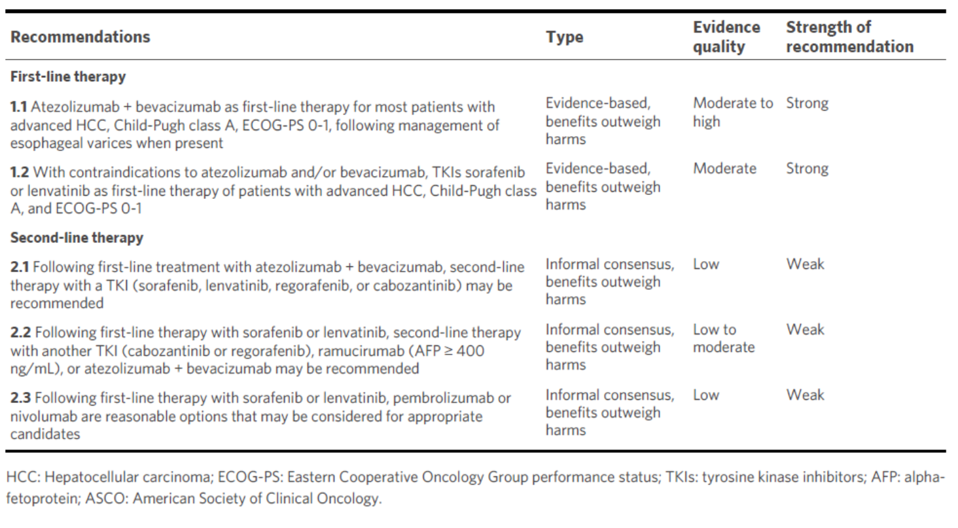
The ASCO recommend to use sorafenib or Lenvatinib for patients who cannot be treated with atezolizumab + bevacizumab¹
Very restrictive criteria for treatment with ICI in clinical trials
Italian Liver Cancer (ITA.LI.CA) database First-line scenario
When the same Inclusion/Exclusion criteria of RCTs with ICI were applied, less than 30% of patients will be considered potential candidate to treatment with ICI in the real-life clinical practice^{2,3}
ICI, immune checkpoint inhibitor; RCT, randomized clinical trial
1. Gordan JD, et al. ASCO Guideline. J Clin Oncol 2020;38:4317-45 2. Giannini EG,et al. Cancers (Basel) 2019;11:1689 3. Tovoli F,et al. Vaccines (Basel) 2020;8:578 Source table: Pelizzaro et al. Hepatoma Res 2021;7:36

Slide 41
TKIs in the treatment of patients with HCC, including sorafenib and lenvatinib, still have room in the therapeutic arsenal in patients with advanced hcc

Slide 42
TKIs for advanced HCC
Advanced HCC (vascular invasion and/or extrahepatic spread)
Intermediate HCC failed or progressive after loco-regional therapies
Sorafenib * (SHARP Study) (Less restrictive criteria) | Lenvatinib ** (REFLECT Study)
OS HR = 0.69 (vs. Placebo) | OS HR = 0.92 (vs. sorafenib)
CHILD A ECOG-PS ≤ 2 | CHILD A ECOG-PS ≤ 1
Region: European + Australasia: 88 % Cause of disease: Hepatitis B: 19%; hepatitis C : 29%, Alcohol: 26% BCLC B/C : 18%/82%ª MVI, extrahepatic spread or both : present 70% | Region: Asia-Pacific 67% Cause of disease: Hepatitis B : 53%; hepatitis C: 19%; alcohol: 8% BCLC B/C : 22%/78% No main portal vein invasion < 50 % of liver involvement MVI, extrahepatic spread or both : present 69%
Fatigue, HFS, Diarrhea, skin reaction, hypophosphatemia | Fatigue, HFS, Diarrhea, hypertension, proteinuria
Study design Double-blind, placebo-controlled trial | Study design Open-label Trial, Non-inferior study
FDA and EMA Approval | FDA and EMA Approval
Higher benefit for hepatitis C patients?*** | Higher benefit for hepatitis B patients?***
ªOne patient in the sorafenib group had a BCLC score of D and a Child–Pugh class of C. *Llovet Jel al. N Engl J Med 2008;359:378-90. **Kudo M et al, Lancet 2018;391(10126):1163-1173. ***Bouattour M et al, Liver Cancer 2019;8(5):341-358

Slide 43
Learning from several years of experience with sorafenib in advanced HCC
Overall Survival (OS)
Learning from 7 years of experience with sorafenib in advanced HCC : Improved median OS in clinical trials over time⁵
SOFIA
(n=296) 2008-2010¹
16
2005-2007
2008-2012
10.5 months
15
14
BCLC study
(n = 147) 2008-2011²
13
12.7 months
12
11
10
SHARP
Median overall survival (months)
GIDEON
(n = 3202) 2009-2012³
12.7 months
9
8
7
INSIGHT
(n=782) 2008 to 2014⁴
15.1 months
6
Asia-Pacific
5
4
Vs sunitinib
Vs linifanib
GIDEON
3
Vs brivanitib
Western patients
Eastern patients
Western + Eastern patients
1. Iavarone M, et al. Hepatology 2011;54(6):2055-63 - 2. Reig M, et al. J Hepatol. 2014;61(2):318-24 - 3. Geschwind J-F, et al. Radiology 2016;279(2):630-40
4. Ganten TM, et al. Clin Cancer Res 2017;23(19):5720-5728 - 5. Faivre S, Target Oncol 2016;11(4):565-7

Slide 44
Real world data of sorafenib: the international prospective phase IV trial GIDEON
 | Child-Pugh A N = 1,968 | Child-Pugh B N = 666 | Child-Pugh C N = 74
Median treatment duration weeks | 17.6 | 9.9 | 5.6
Initial dose n (%) 800 mg 400 mg | 1,415 (72) 482 (25) | 464 (70) 173 (26) | 46 (62) 21 (28)
Dose reduction rate, n (%) | 784 (40) | 194 (29) | 19 (26)
AEs (All grades), n (%) | 1,653 (84) | 590 (89) | 68 (92)
All grade 3 or 4 AEs, n (%) | 638 (33) | 210 (32) | 13 (18)
Patients enrolled in Gideon trial (N =3371)
Safety population, n = 3202
Patients with known Child-Pugh, n = 2708
AEs, adverse events
Marrero J et al. J Hepatol. 2016;65(6):1140-1147

Slide 45
Sorafenib results according to the Child-Pugh scores: data from the Gideon Study
OS by Child-Pugh Status*
1.0
0.8
Median OS (months)
Child-Pugh A: 13.6; 95% C: (12.8-14.7)
Child-Pugh B: 5.2; 95% C: (4.6-6.3)
Child-Pugh C: 2.6; 95% C: (1.5-4.0)
0.6
Survival distribution function
0.4
0.2
0.2
0
200
400
600
800
1000
1200
Time since start of statement (days)
*Child-Pugh A: n=1975; Child-Pugh B: n=669; Child-Pugh C: n=73
OS, overall survival
Marrero J et al. J Hepatol. 2016;65(6):1140-1147

Slide 46
Sorafenib as first-line in Child-Pugh B – HCC patients:
Meta-analysis results
Records identified through database search: Mideline, Embase and Cochrane Central register database search (n = 1601)
Additional records identified through other sources (ASCO/ECCO/ESMO)
(n = 54)
Median OS under sorafenib In Child-B patients: 4.6 months
Identification
Records after duplicates removed
(n = 1601)
Screening
Records screened
(n = 1601)
Records excluded
(n = 1563)
Full-text articles assessed for eligibility
(n =38)
Full-text articles excluded, with reasons:
2 studies – no data on patients with Child-Pugh B status.
2 studies – more complete data presented in a later manuscript
1 study – included patients with human immunodeficiency virus.
3 studies – data split by alpha-fetoprotein responders, development of skin toxicity, and age respectively.
(n = 8)
Eligibility
Studies included in qualitative synthetise
(n =30)
Included
Studies included in qualitative synthetis (meta-analysis)
(n =30)
Major pronostic factor, no added toxicities
McNamara, Eur J Cancer 2018;105:1-9

Slide 47
Real-world effectiveness of first-line lenvatinib for advanced HCC
Retrospective real-world study, 233 patients, median follow-up (9.1 months)
Patients characteristics %
Race White | 52.4
ECOG score, 1 | 63.1
BCLC stage A B C D Unknown | 11.2 28.8 43.8 8.2 8.2
Child-Pugh class A B | 44.6 39.1
Etiology Hepatitis C Alcohol related | 36.1 28.3
Presence of portal thrombosis: VP4 | 7.0
Lenvatinib treatment characteristics | All patients ( n = 233) | Child-Pugh A ( n = 104) | Child-Pugh B ( n = 91)
Dose reduction, % | 9 | 7.7 | 8.8
Median duration of treatment, months | 6.7 | 6.6 | 7.3
Subsequent lines, % | 13.7 | 16.4 | 9.9
Complete or partial response, %
 | 69.6* | 58.7 | 70.3
3 months
6 months
9 months
12 months
100
95
90
85
80
75
70
65
60
50
Real-world PFS (%)
40
30
20
10
0
Lenvatinib first line (n = 233)
3 months
6 months
9 months
12 months
100
100
92
90
84
80
73
70
60
50
Real-world overall survival (%)
40
* RECIST 1.1 available for 125 patients
30
20
10
0
Lenvatinib first line (n = 233)
ECOG, Eastern Cooperative Oncology Group; HCC, hepatocellular carcinoma; PFS, progression-free survival; RECIST, response evaluation criteria in solid tumours; VP, grade of portal vein thrombosis
Singal A, et al. Future Oncol 2021; 17: 2759–68

Slide 48
The Real-life Practice Experts for HCC (RELPEC) Study Group and HCC: Lenvatinb in Japanese patients
Efficacy of lenvatinib in patients with NAFLD/NASH-related unresectable-HCC
PFS
OS
HCC patients treated with lenvatinib
%
%
100
100
(n = 557)
80
80
Cryptogenic
60
60
(n = 27)
40
40
20
20
NAFLD/NASH
Viral/Alcoholic
NAFKD/NASH
NAFKD/NASH
0
Viral/Alcohol
0
Viral/Alcohol
(n = 103)
(n = 427)
0
10
6
30
0
10
6
30
Progression-free survival (months)
Progression-free survival (months)
NAFKD/NASH
Viral/Alcohol
103
127
42
120
14
42
5
15
NAFKD/NASH
Viral/Alcohol
103
127
65
253
32
94
11
35
PFS : Progression-free survival, OS : overall survival
 | NAFLD/NASH | Viral/Alcoholic | p
Median PFS | 9.3 months, 95% CI 7.8–13.5 | 7.5 months, 95% CI 6.8–8.0 | 0.012
Median OS | 20.5 months, 95% CI 16.8–29.5 | 16.9 months, 95% CI 14.5–18.6 | 0.057
Hiraoka A el al. Scientific Reports 2021;11(1):14474

Slide 49
Real-World effectiveness of lenvatinib in patients with advanced HCC in Korean patients
92 patients with advanced HCC treated with lenvatinib
100
First line
median 4.6 months (95% CI, 3.1-6.1)
100
100
Second or later line
median 4.1 months (95% CI, 3.1-5.1)
75
75
75
Child-Pugh A
(n=74)
Child-Pugh B
(n=18)
50
50
50
Overall survival %
Survival %
Progression-free survival %
25
25
First line
median 4.6 months (95% CI, 3.1-6.1)
25
Overall survival
median 5.3 months (95% CI, 2.0-8.5)
Second or later line
median 4.1 months (95% CI, 3.1-5.1)
Progression-free survival
median 2.6 months (95% CI, 0.6-4.6)
0
0
0
0
3
6
9
12
0
3
6
9
12
0
3
6
9
12
months
months
months
First line
median 4.6 months (95% CI, 3.1–6.1)
Second or later lines
median 4.1 months (95% CI, 3.1–5.1)
First line
median 10.7 months (95% CI, 4.8–16.5)
Second or later lines
median 6.4 months (95% CI, 5.1–7.7)
Overall survival
median 5.3 months (95% CI, 2.0–8.5)
Progression-free survival
median 2.6 months (95% CI, 0.6–4.6)
Cheon J et al. Liver Cancer 2020;9:613–624

Slide 50
Real-World lenvatinib versus sorafenib in patients with advanced HCC – overall survival
210 patients : (70 treated with Lenvatinib - 140 patients treated with Sorafenib)
Propensity Score Matching Analysis
Before Propensity Score -matched
After Propensity Score-matched
100
Treatment
100
Treatment
Lenvatinib (n=81),OS: 13.3 months
Lenvatinib (n=70),OS: 13.3 months
80
Sorafenib (n=241),OS: 12.3 months
Log-rank p-value=0.593
80
Sorafenib (n=140),OS: 11.8 months
Log-rank p-value=0.593
60
60
Survival probability (%)
Survival probability (%)
40
40
20
20
0
0
0
6
12
18
24
30
36
42
0
6
12
18
24
30
36
42
Patients at risk
Lenvatinib
Sorafenib
Follow-up (months)
Patients at risk
Lenvatinib
Sorafenib
Follow-up (months)
81
241
53
150
12
103
1
66
-
25
-
12
-
2
-
-
81
241
53
150
12
103
1
66
-
25
-
12
-
2
-
-
The Lenvatinib group had similar OS to the Sorafenib group, no matter for either before or after PS matching analysis
Kuo YH el al. Front. Oncol 2021;11:737767

Slide 51
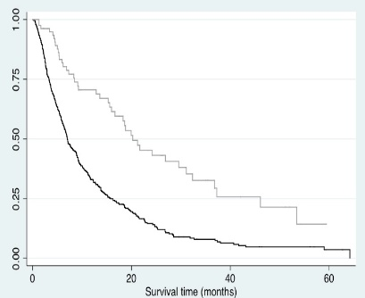
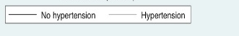
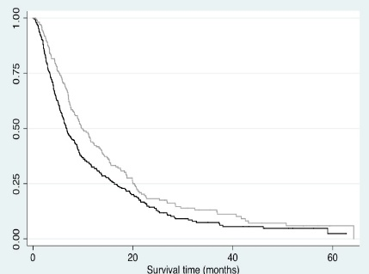
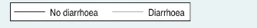
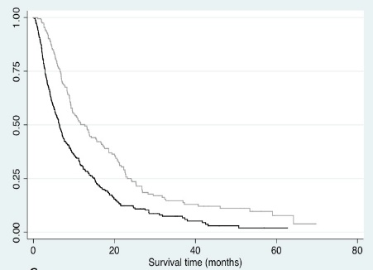
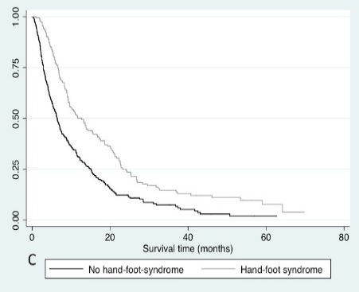
Effect of toxicity on prognosis in patients treated with sorafenib
1.00
Prospective multicentre cohort study (n = 634)
Hypertension
0.75
Sorafenib toxicity
No toxicity
0.50
Diarrhoea
0.25
0.00
0
20
40
60
80
Survival time (months)
Survival between pts who developed toxicity and pts who did not:
- hypertension (20.3 vs 7.0 months)
- diarrhoea (9.7 vs 6.7 months)
- and HFS ( 12.7 vs 6.4 months)
Survival between pts who developed sorafenib toxicity
(any severity), compared with pts who did not develop sorafenib toxicity (8.8 months vs. 5.4 months)
HFS
Howell J et al. Aliment Pharmacol Ther. 2017;45:1146–1155

Slide 52








Multidisciplinary tumor board
Interventional Radiologist
Radiologist
Hepatologsit
Medical Secretary
Nuclerar Medcine Physician
Radiation Oncologist
Coordinator Nusrses
Liver Surgeon
Medical Oncologist
Pathologist
Multidisciplinary decision for individualized treatment decision and strategies

Slide 53
conclusions
Sorafenib and lenvatinib in the treatment of HCC patients, still have room in the therapeutic arsenal in patients with advanced hepatocellular carcinoma
  Contraindications to atezolizumab and bevacizumab
  Recurrence after liver transplantation
  Patients preference (oral versus intravenous administration)
Sorafenib and lenvatinib should be used in patients with well conserved liver function and preserved performance status
Caution for patients Child Pugh B patients
When, they are well selected, patients treated in the Real-world setting, benefit from sorafenib/lenvatinib as well as those treated in clinical trials
Sides effects may reflect an appropriate dose-intensity, should be adequately managed, since they are frequently associated with better outcome
Unmet need : to identify patients who are more likely to benefit from TKI rather than ICI in first line

Slide 54
Treating patients with VEGFR-TKI monotherapy: What are the treatment related Aes and how to manage them?
James J. Harding MD
Assistant Attending
Gastrointestinal Oncology Service
Early Drug Development Service
Department Of Medicine
Memorial Sloan Kettering Cancer Centre, New York, USA

Slide 55
Disclosures
Research Support: Bristol Myers Squibb, Boehringer Ingelheim, Calithera, CytomX, Genoscience, Eli Lilly, Loxo Oncology, Novartis, Pfizer, Yiviva, Zymeworks
Consulting Fees: Adaptiimune, Bristol Myers Squibb, CytomX, Eisai, Exelexis, Merck, QED, Zymeworks

Slide 56
Rapidly Evolving Treatment Landscape for Advanced HCC
Tyrosine
Kinases
Inhibitors
First-line
Sorafenib
2007
Second-line
Regorafenib
2017
Second-line
Cabozantinib
2017
First-line
Lenvatinib
2018
2010
2020
Immunotherapy
Second-line*^ pembrolizumab
Second-Line*
nivolumab + ipilimumab
First-line atezolizumab + bevacizumab
First-line** durvalumab + tremelimumab
Second-line
ramucirumab
(AFP ≥400mg/dL)
VEGF Monoclonal
FDA approval based on single arm Phase 2 with durable ORR; ^ 1 subsequent confirmatory Phase 3 NEGATIVE, 2nd confirmatory Phase 3 study POSITIVE; ** Top line positive
AFP, alpha-fetoprotein; FDA, Food and Drug Administration; HCC, hepatocellular carcinoma; ORR, objective response rate; VEGF, vascular endothelial growth factor

Slide 57
Available TKI/Antiangiogenics FOR Advanced HCC Patients
0
Treatment-naïve
study population
sorafenib experienced
study population
sorafenib
SHARP // ASIA-PACIFIC¹
regorafenib
RESORCE³
lenvatinib
REFLECT²
cabozantinib
CELESTIAL⁴
Donafenib^{6*}
ramucirumab
REACH 1 and REACH 2⁵
AFP ≥400 ng/dL
TKI, tyrosine kinase inhibitor
1. Lovett JM, et al. N Eng J Med. 2007;359:378-90; 2. Kudo M, et al. Lancet. 2018;391:1163-73; 3. Bruix J, et al. Lancet. 2017;389:56-66; 4. Abou-Alfa GK, et al. N Eng J Med. 2018;379:54-63; 5. Zhu AX, et al. Lancet. 2019;20:282-96; Qin et al. JCO; 2021; 39: 3002-3011.* Studied and approved in China, Apatinib has also demonstrated improve OS over BSC in second-line.

Slide 58
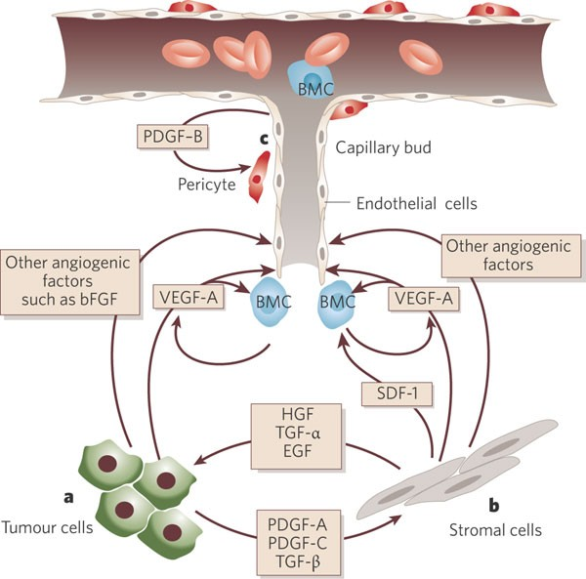
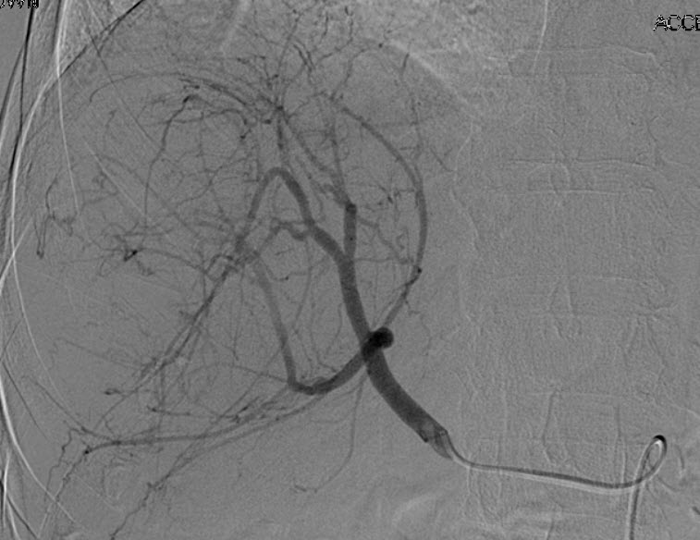
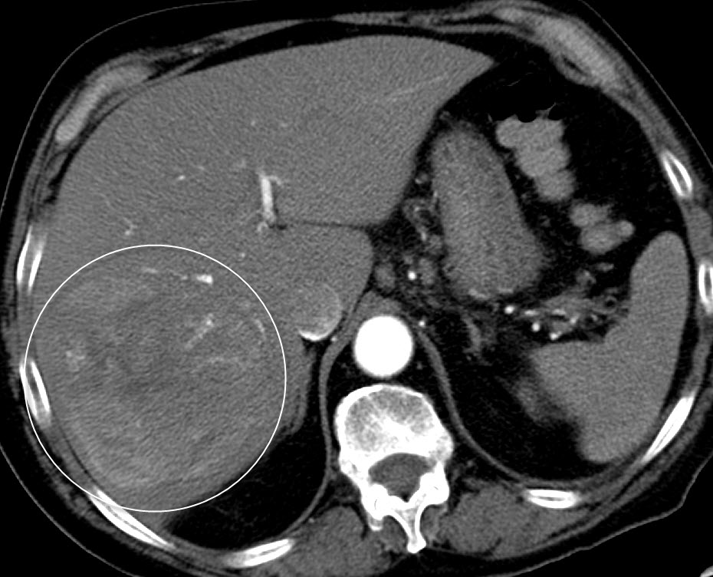
Angiogenesis as a Therapeutic Target in HCC
Neoangiogenesis is a hallmark of cancer
HCC is dependent on VEGF/VEGFR axis
bFGF, basic fibroblast growth factor; BMC, bone marrow-derived angiogenic cells; EGF, epidermal growth factor; HCC, hepatocellular carcinoma; HGF, hepatocyte growth factor; PDGF, platelet-derived growth factor; TGF-α, transforming growth factor alpha; VEGF, vascular endothelial growth factor; VEGFR, VEGF receptor
Adapted from Ferrara N and Kerbel RS. Nature. 2005;438:967-74

Slide 59
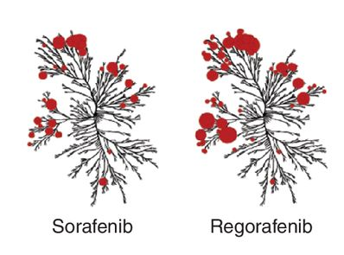
Drug Class Adverse Effects
Variable frequency of adverse events given differential inhibition of various receptor tyrosine kinases inhibitors
Dermatologic
Cardiovascular
Digestive
Renal
Haemorrhage
Lovett JM, et al. N Eng J Med. 2007;359:378-90; Bruix J, et al. Lancet. 2017;389:56-66;

Slide 60
Common Aes of Antiangiogenic Treatment in HCC
Treatment Related Event | REFLECT¹ N = 475 (%) | REFLECT¹ N = 476 (%) | RESORCE² N = 374 (%) | CELESTIAL³ N = 467 (%) | REACH-2⁴ N = 197 (%)
 | sorafenib lenvatinib |  | regorafenib | cabozantinib | ramucirumab
Any Grade | 95 | 94 | 93 | 99 | NR
Grade ≥3 | 49 | 57 | NR | 68 | NR
Fatigue | 25 | 30 | 29 | 45 | 14
Weight Loss | 22 | 31 | 7 | 17 | NR
Alopecia | 25 | 3 | NR | NR | NR
Hand-Foot | 52 | 27 | 52 | 46 | NR
Rash | 16 | 10 | NR | 12 | NR
Anorexia | 27 | 34 | 24 | 48 | 11
Diarrhea | 46 | 39 | 33 | 54 | 7
HTN | 30 | 42 | 23 | 29 | 16
Proteinuria | 11 | 25 | NR | NR | 14
Dermatologic
GI
Vascular
GI, gastrointestinal; HCC, hepatocellular growth factor; HTN, hypertension
1. Kudo M, et al. Lancet. 2018;391:1163-73; 2. Bruix J, et al. Lancet. 2017;389:56-66; 3. Abou-Alfa GK, et al. N Eng J Med. 2018;379:54-63; 4. Zhu AX, et al. Lancet. 2019;20:282-96

Slide 61
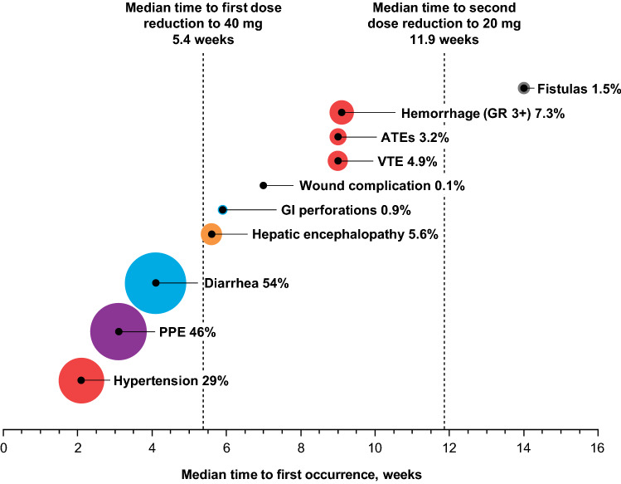
Time Course of TKI Associated AEs
cabozantinib
AE, adverse event; ATE, arterial thrombotic event; GI, gastrointestinal; GR, grade; HCC, hepatocellular carcinoma; PPE, palmar-plantar erythrodysesthesia; TKI, tyrosine kinase inhibitor; VTE, venous thrombotic event
Schwartz G, et al. Target Oncol. 2020;15:549-65
Notes:
Rates (%) and timing of select AEs in patients with HCC receiving cabozantinib during the CELESTIAL trial. The size of the circle is proportional to the AE rate. AEs are color coded by system: blue: gastrointestinal; purple: skin and subcutaneous tissue; green: constitutional; orange: hepatic disorders; red: cardiovascular/hematological disorders; black: general/other. AE adverse event, ATE arterial thrombotic event, GI gastrointestinal, GR grade, HCC hepatocellular carcinoma, PPE palmar-plantar erythrodysesthesia, VTE venous thrombotic event

Slide 62
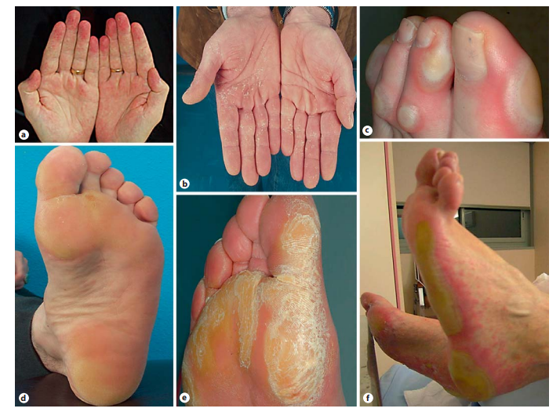
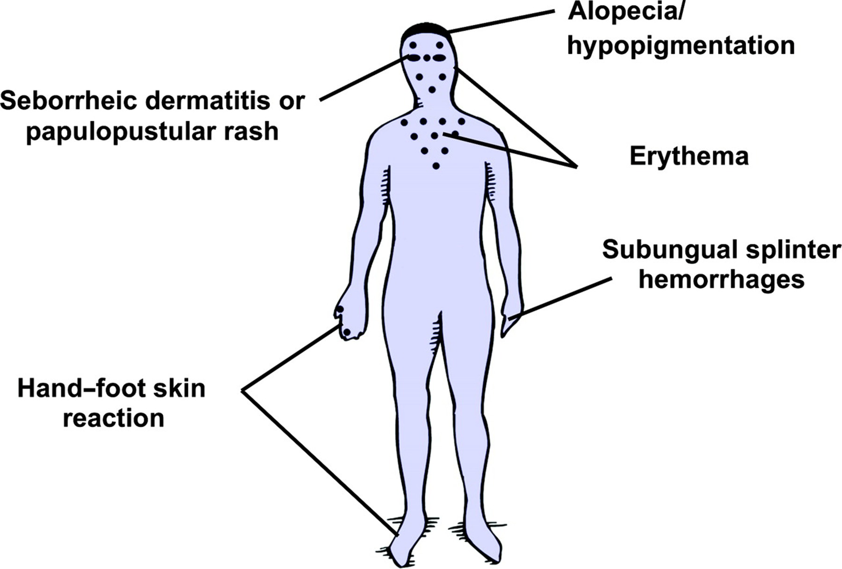
TKI-Associated Dermatologic Toxicity
Common dermatological toxicitities associated with TKIs¹
Hand Foot Skin Reaction²
Time to onset: 2-4 weeks
TKI, tyrosine kinase inhibitor
1. Lacouture ME, et al. Oncologist. 2008;13:1001-11; 2. Lipworth AD, et al. Oncology. 2009;77:257-71

Slide 63
Key Management Options
HFSR Severity
Intervention
No HFSR
Maintain frequent with physician to ensure early diagnosis of HFSR
Prophylaxis
Lifestyle Modification
Keratolytic Agents
Corticosteroids
Topical Analgesia
Systemic Analgesia
Dose Reduction
Therapy initiation
Full-body skin exam, pedicure, evaluation by orthotist; wear thick cotton gloves and/or socks; avoid hot water, constrictive footwear, and excessive friction
If symptoms develop at 2-week clinical evaluation or within first month, proceed to next step
Grade 1
Maintain current dose of MKI; monitor for change in severity
Numbness
Tingling
Dysesthesia
Paraesthesia
Painless swelling
Erythema
Discomfort of hands
or feet
No interference in ADL
Avoid hot water; Use moisturizing creams for relief; Wear thick cotton gloves and/or socks; 20%-40% urea
If symptoms worsen after clinical evaluation at 2weeks, proceed to next step
Grade 2
Dose reduction to 50% of dose for 7-28 days
(additional details in table 3)
Painful erythema
Swelling of hands and/or feet
Interferes with patient’s ADL
Treat as with grade 1 toxicity, with the following additions:
clobetasol 0.05% ointment, 2% lidocaine, codeine, pregabalin for pain. Follow dose modifications listed in Table 3.
If symptoms worsen after clinical evaluation at 2weeks, proceed to next step
Grade 3
Interrupt treatment for 7 days and until improvement to grade 0-1
Moist desquamation
Ulceration
Blistering
Sever pain of hands and/or feet
Patient unable to perform ADL
Treat as with grades 1 and 2; follow dose modifications listed in Table 3
ADL, activities of daily living; HFSR, hand-foot skin reaction; NSAID, non-steroidal anti-inflammatory drug
1. Lacouture ME, et al. Oncologist. 2008;13:1001-11

Slide 64
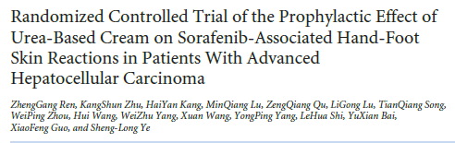
Prophylactic effect of urea-based cream on sorafenib-associated HFSR
Prevalence of any-grade hand-foot skin reaction
60
Urea cream + BSC
50
BSC
40
Percent
30
Randomized, open-label
N = 871 patients with advanced HCC treated with sorafenib
10% Urea cream TID + BSC (BSC; n = 439)
BSC alone excluding all creams (n = 432),
20
10
0
0
2
4
6
8
10
12
14
Time (weeks)
p
0.1445
0.0081
<0.001
<0.001
<0.001
<0.001
0.0445
BSC, best supportive care; HCC, hepatocellular carcinoma; HFSR, hand-foot skin reaction; TID, three times per day
Ren Z, et al. J Clin Oncol. 2015;33:894-900

Slide 65
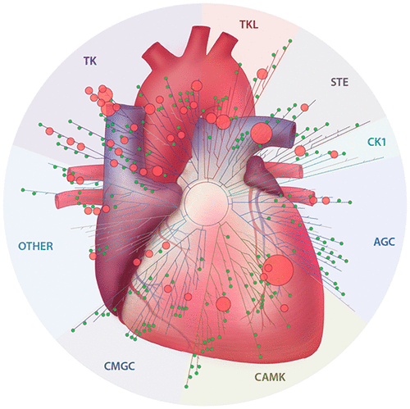
TKI Associated Cardiovascular Complications
Hypertension
QTc prolongation
Arrhythmia
Myocardial infarction/ischaemia
Cardiomyopathy/LV dysfunction
CVA
PRES
AGC, PKA, PKG, and PKC kinases; CAMK, Ca2+/calmodulin-dependent protein kinase; CK1, casein kinase 1; CMGC, containing CDK, MAPK, GSK3, CLK families; CVA, cerebrovascular accident; LV, left ventricle; PRES, posterior reversible encephalopathy syndrome; QTc, corrected QT; STE, serine-threonine kinase; TK, tyrosine kinase; TKI, tyrosine kinase inhibitor; TKL, tyrosine kinase-like
Lamore SD, et al. Chem Res Toxicol. 2020;33:125-36; Force T, et al. Nat Rev Cancer. 2007;7:332-44

Slide 66
Management Considerations
CARDIOVASCULAR HEALTH ASSESSMENT
History: CVD, DM, hyperlipidaemia, age, tobacco, family history
Exam: BP, weight
Assessment: Cr, urine protein, ECG
SBP <140 / DBP <90
Controlled cardiac comorbidities
SBP >140 / DBP >90
Uncontrolled cardiac comorbidities
TKI based treatment
Control HTN / comorbid issues
Specific considerations
Drug-drug interactions
Cirrhotic
Monitor office
Home BP
Uncontrolled
Do not start TKI
Dose TKI decrease
Discontinue
HTN/Cardiac toxicity
BP, blood pressure; Cr, creatinine; CVD, cardiovascular disease; DBP, diastolic blood pressure; ECG, electrocardiogram; DM, diabetes mellitus; HTN, hypertension; SBP, systolic blood pressure; TKI, tyrosine kinase inhibitor
Adapted from Agarwal et al. Curr. Oncol. Rep. 2018 Jun 21;20(8):65

Slide 67
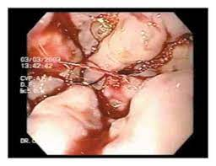
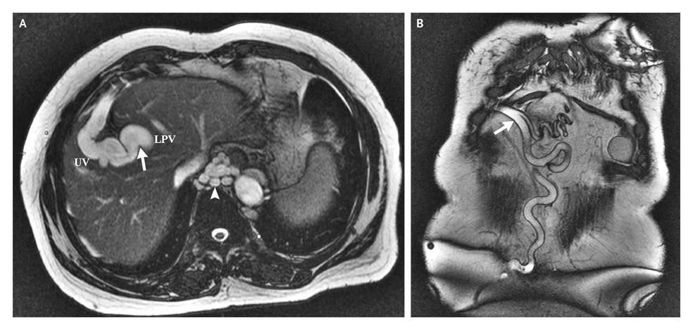
Treatment-Emergent Bleeding with TKIs
HCC patients may be
at risk for bleeding
 | Grade ≥3*
lenvatinib | 2-5%
cabozantinib | 5%
sorafenib | 1-2.4%
regorafenib | 3%
ramucirumab | 2-5%
HCC, hepatocellular carcinoma
*Rates FDA Package Insert for each agent. Grade ≥ 3 haemorrhagic events across cancer types.
Images sources: Torrazza-Perez et al. N Engl J Med. 2010;362(5):e13; Young et al. N Engl J Med 2007; 357:e17

Slide 68
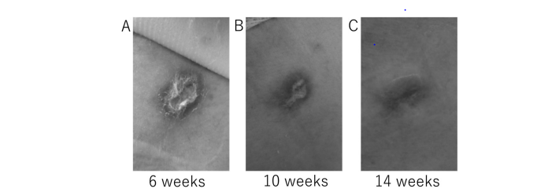
Delayed Wound Healing, Perforation, or Fistula
Delayed wound healing in a patient with a thoracic drain placed for pneumothorax*
Drug | Activity | Half-life
regorafenib | VEGFR1-3, KIT, PDGFR, FGFR, RAF, RAS, RET | ~24 hours
sorafenib | VEGFR1-3, KIT, PDGFR, RAF, RAS | ~28 hours
lenvatinib | VEGFR1-3, PDGFRα, FGFR, KIT, RET | ~35 hours
cabozanentib | MET, VEGFR-1-3, AXL | ~4 days
ramucirumab | VEGFR-2 | 8 days
bevacizumab | VEGF-A | 20 days
*Extent of healing at 6, 10 and 14 weeks after removal of the catheter
PIGF, placenta growth factor; VEGF, vascular growth factor; VEGFR, vascular growth factor receptor
Adapted from Toda S, et al. Mol Clin Oncol. 2021;14:81,

Slide 69
Gastrointestinal Toxicity with TKI
Dysgeusia
Stomatitis
Anorexia
Weight loss
Nausea/Vomiting
Diarrhea
Hepatic dysfunction
Agent | Diarrhea
 | Any Grade | Grade ≥3
lenvatinib¹ | 49% | 6%
cabozantinib² | 62% | 10%
sorafenib³ | 55% | 10%
regorafenib⁴ | 41% | 3%
ramucirumab⁵ | 15% | 1%
1. Kudo M, et al. Lancet. 2018;391:1163-73; 2. Abou-Alfa GK, et al. N Eng J Med. 2018;379:54-63; 3. Lovett JM, et al. N Eng J Med. 2007;359:378-90; 4. Bruix J, et al. Lancet. 2017;389:56-66; 5. Zhu AX, et al. Lancet. 2019;20:282-96;

Slide 70
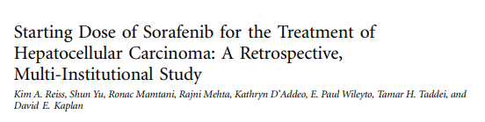
Investigational Dose Titrations or Dose Attenuation Strategies
Reasons for sorafenib cessation after propensity score matching
Reason for sorafenib cessation | SDS (n = 1,675) | RDS (n = 1,675) | p
Any adverse event | 375 (22.4) | 329 (19.6) | 0.056
GI adverse effects | 180 (10.75) | 145 (8.66) | 0.047
Hand-foot skin reaction | 75 (4.48) | 55 (3.28) | 0.088
Fatigue | 83 (4.96) | 102 (6.09) | 0.172
NOTE: Data are presented as No. (%)
A
Unmatched score
B
Propensity score matched
1.0
Legend
1.0
Legend
0.8
RDS
0.8
RDS
SDS
SDS
0.6
0.6
Survival Probability
Survival Probability
0.4
0.4
0.2
0.2
0
20
40
60
80
100
0
20
40
60
80
100
Number at risk
Time (weeks)
Number at risk
Time (weeks)
RDS
1,809
275
61
15
3
0
RDS
1,675
248
53
13
3
0
SDS
3,094
562
158
48
14
3
SDS
1,675
250
61
17
5
0
GI, gastrointestinal; RDS, reduced starting dose; SDS, standard starting dose
Reiss KA, et al. J Clin Oncol. 2017;35:3575-81

Slide 71
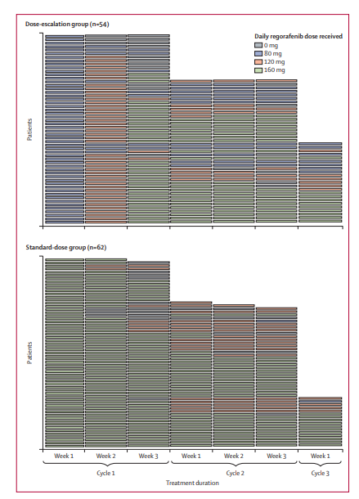
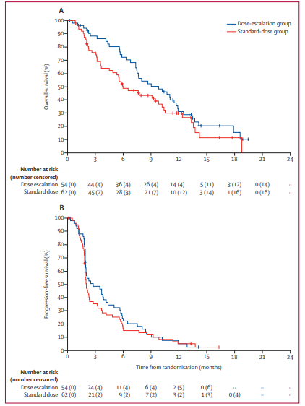
Example of PROSPECTIVE Dose titration strategy in Colorectal cancer with regorafenib
Bekaii-Saab et al. Lancet Oncology 2019

Slide 72
Conclusions
Multiple antiangiogenic treatments extend overall survival in the first and second-line for patients with advanced HCC
Spectrum of adverse events for VEGFR TKI based treatment is well characterized
Common class effect adverse events include fatigue, weight loss, diarrhoea, hand foot syndrome, hypertension
Multiple management guidelines are in place to prevent or mitigate toxicity
Dose titration strategies and up front dose attenuation remain investigational in nature in advanced HCC population
HCC, hepatocellular carcinoma; TKI, tyrosine kinase inhibitor; VEGFR, vascular endothelial growth factor receptor

Slide 73
Latest updates in HCC from ASCO GI 2022
- HIMALAYA study
- KN 394 trial
- LAUNCH study
Dr. Su Pin Choo
Medical Oncologist, Curie Oncology Singapore,
National Cancer Centre Singapore

Slide 74
HIMALAYA study design
HIMALAYA was an open-label, multicenter, global, Phase 3 trial
Single priming dose of Tremelimumab
Study population
Patients aged ≥18 years
with uHCC
BC:C stage B (not eligible for locoregional therapy) and stage C
No prior systemic therapy
ECOG PS –1
Child-Pugh A
No main portal vein thrombosis
EGD was not required
STRIDE (n=393)
Tremelimumab 300 mg x 1 dose + durvalumab 1500 mg Q4W*
durvalumab (n=389)
Durvalumab monotherapy 1500 mg Q4W*
R
N=1,324
sorafenib (n=476)
Tremelimumab 300 mg × 1 dose + durvalumab 1500 mg Q4W*
T75+D (n=153): arm closed†
Tremelimumab 75 mg Q4W × 4 doses + durvalumab Q4W*
Stratification factors
Macrovascular invasion: yes vs no
Etiology of liver disease: HBV vs HCV vs others
Performance status: ECOG 0 vs 1
* Treatment continued until disease progression. Patients with progressive disease who, in the investigator’s opinion, continued to benefit from treatment and met the criteria for treatment in the setting of progressive disease continue treatment. † The T75+D arm was closed following a preplanned analysis of a Phase 2 study. Patients randomized to this arm (n=153) could continue treatment following arm closure. Results from this arm are not reported in this presentation. BID, twice a day; EGD, esophagogastroduodenoscopy; Q4W, every 4 weeks; STRIDE, Single Tremelimumab Regular Intervl Durvalumab

Slide 75
HIMALAYA objectives and statistical design
Multiple testing procedure
Primary objective
OS for STRIDE vs sorafenib
Key secondary objective
OS for durvalumab vs sorafenib
Additional secondary objectives
PFS, ORR and DoR as assessed by investigator per RECIST v1.1
Safety
OS superiority for STRIDE
vs sorafenib
Non-inferiority margin: 1.08
Noninferiority was met if the
CI upper bound for the
hazard ratio was ≤1.08
OS noninferiority for
durvalumab vs sorafenib
OS superiority for
durvalumab vs sorafenib
CI, confidence interval; DoR, duration of response; ORR, objective response rate; OR, overall survival; PFS, progression-free survival;
RECIST, Response Evaluation Criteria in Solid Tumours; STRIDE, Single Tremelimumab Regular Interval Durvalumab

Slide 76
Baseline characteristics
Characteristic | STRIDE (n=393) | Durvalumab (n=389) | Sorafenib (n=389)
Male sex, n (%) | 327 (83.2) | 323 (83.0) | 337 (86.6)
Median age (range), years | 65.0 (22-86) | 64.0 (20-86) | 64.0 (18-88)
Region, n (%) Asia (excluding Japan) Rest of world (including Japan) | 156 (39.7) 237 (60.3) | 167 (42.9) 222 (57.1) | 156 (40.1) 233 (59.9)
Viral etiology,*,† n (%) HBV HCV Nonviral | 122 (31.0) 110 (28.0) 161 (41.0) | 119 (30.6) 107 (27.5) 163 (41.9) | 119 (30.6) 104 (26.7) 166 (42.7)
ECOG PS, n (%) 0 1 | 244 (62.1) 148 (37.7) | 237 (60.9) 150 (38.6) | 241 (62.0) 147 (37.8)
MVI,† n (%) | 103 (26.2) | 94 (24.2) | 100 (25.7)
EHS,† n (%) | 209 (53.2) | 212 (54.5) | 203 (52.5)
PD-L1 positive, n (%) | 148 (37.7) | 154 (39.6) | 148 (38.0)
AFP ≥400 ng/ml,† n (%) | 145 (36.9) | 137 (35.2) | 124 (31.6)
Biomarker evaluable samples were collected for all but 20 patients across all treatment arms * HBV: patients who tested positive for HBsAg or anti-HBc with detectable HBV DNA; HCV: patients who tested positive for HCV or had history of HCV infection; Nonviral: no active viral hepatitis identified. † Determined at screening
AFP, alfa-fetoprotein; ECOG, Eastern Cooperative Oncology Group; EHS, extrahepatic spread; HBc, hepatitis B core; HBsAg, hepatitis B surface antigen;
HBV, hepatitis B virus; HCV, hepatitis C virus; MVI macrovascular invasion; PD-L1, programmed cell death ligand-1; PS, performance status;
STRIDE, Single Tremelimumab Regular Interval Duravalumab

Slide 77
Subsequent anticancer therapies
Subsequent therapy type,* n (%) | STRIDE (n=393) | Durvalumab (n=389) | Sorafenib (n=389)
Any therapy | 160 (40.7) | 168 (43.2) | 175 (45.0)
Immunotherapy | 15 (3.8) | 20 (5.1) | 89 (22.9)
Cytotoxic chemotherapy | 20 (5.1) | 18 (4.6) | 25 (6.4)
Targeted therapy | 147 (37.4) | 155 (39.8) | 108 (27.8)
Antiangiogenic therapy | 11 (2.8) | 20 (5.1) | 19 (4.9)
Homeopathic therapy | 0 | 1 (0.3) | 2 (0.5)
Other | 3 (0.8) | 1 (0.3) | 9 (2.3)
* Includes anticancer therapies received post discontinuation of study treatment. Patients may have taken ≥1 subsequent therapy
STRIDE, Single Tremelimumab Regular Interval Duravalumab

Slide 78
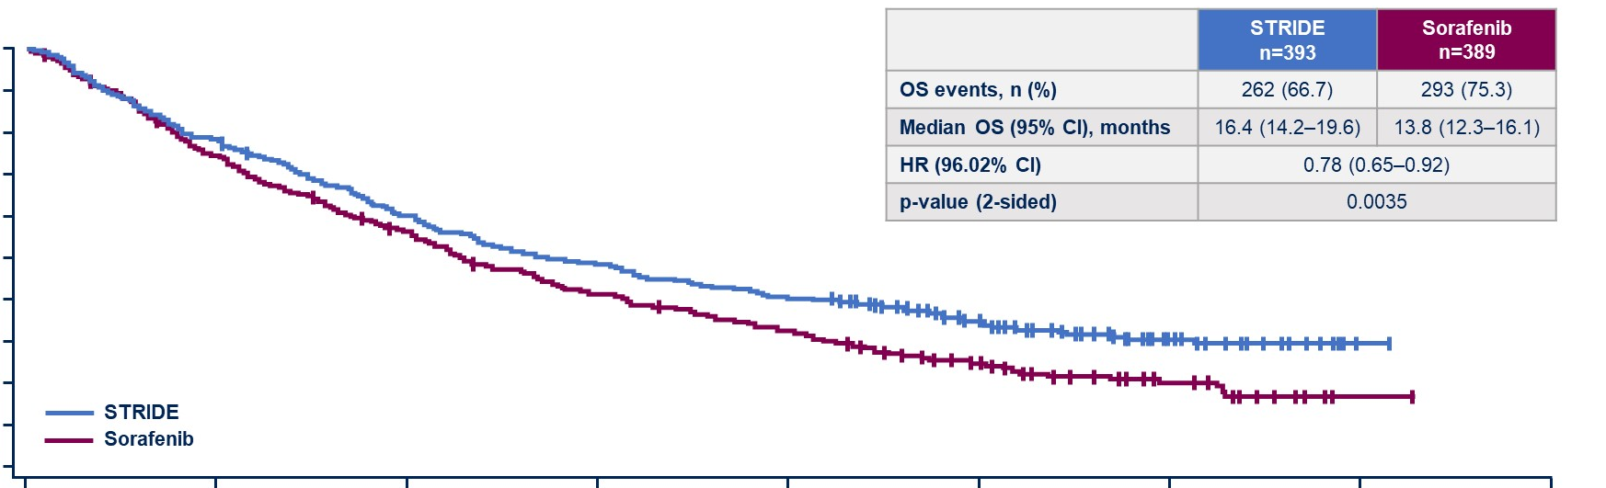
Primary objective: overall survival for STRIDE vs sorafenib
 | STRIDE N=393 | Sorafenib N=389
OS events, n (%) | 262 (66.7) | 293 (75.3)
Median OS (95% CI, months | 16.4 (14.2-19.6) | 13.8 (12.3-16.1)
HR (96.02% CI) | 0.78 (0.65-0.92)
P-value (2-sided) | 0.0035
1.0
0.9
0.8
0.7
0.6
Probability of overall survival
0.5
Landmark analysis: At 36 months,
30% vs 20% alive
0.4
0.3
0.2
0.1
STRIDE
Sorafenib
0.0
0
6
12
18
24
30
36
42
48
No. at risk
STRIDE
Sorafenib
Time from randomisation (months)
393
389
308
283
235
211
190
155
158
121
98
62
32
21
1
1
0
1
Data cut-off: August 27, 2021. Median duration of follow-up was 33.18 (95% CI, 31.74-34.53) months for STRIDE and 32.23 (95% CI, 30.42-33.71) months for sorafenib
CI, confidence interval; HR, hazard ratio; OS, overall survival; STRIDE, Single Tremelimumab Regular Interval Durvalumab

Slide 79
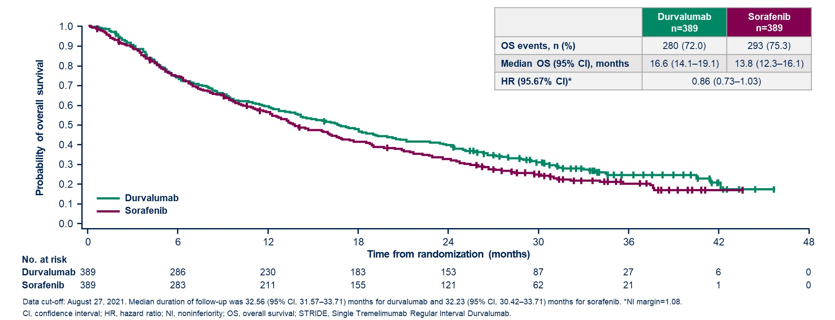
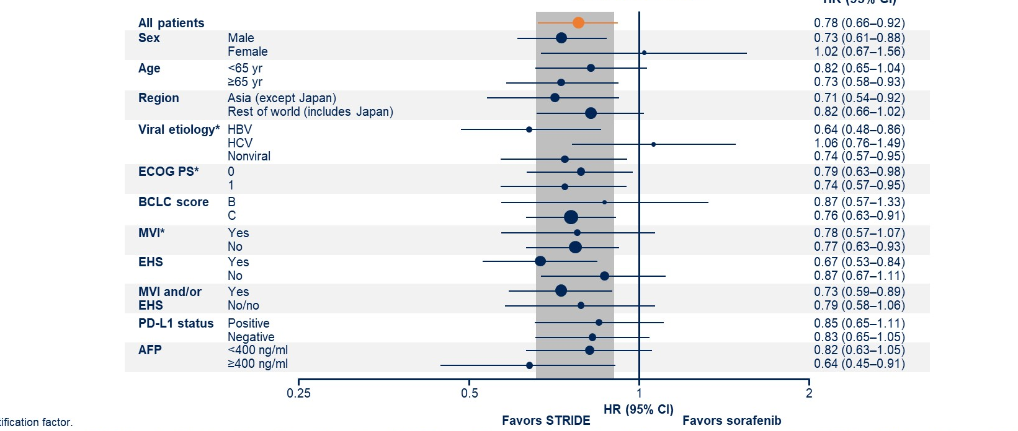
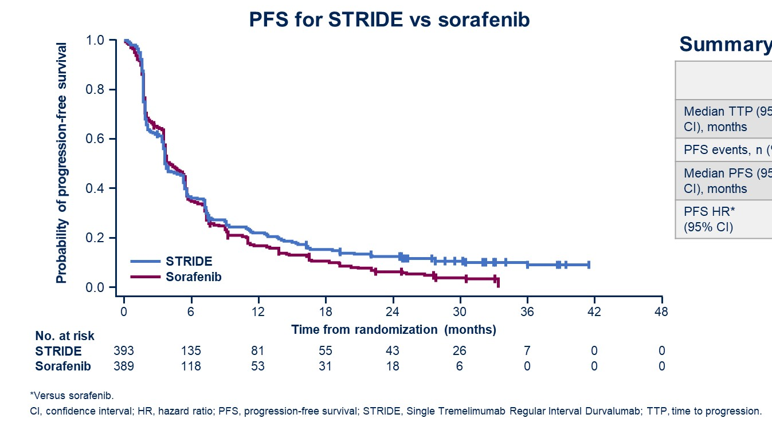
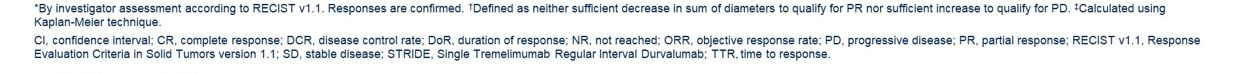
Secondary objective: overall survival for
durvalumab vs sorafenib
OS for STRIDE vs sorafenib
in patient subgroups
 | durvalumab (N=389) | sorafenib (N=389)
OS events, n (%) | 280 (72.0) | 293 (75.3)
Median OS (95% CI), months | 16.6 (14.1-19.1) | 13.8 (12.3-16.1)
HR (95.67% CI)* | 0.86 (0.73-1.03)
Tumour response
Progression-free survival
 | STRIDE (N=393) | Durvalumab (N=389) | Sorafenib (N=389)
ORR,* % CR, n (%) PR, n (%) SD,† n (%) PD, n (%) | 20.1 12 (3.1) 67 (17.0) 157 (39.9) 157 (39.9) | 17.0 6 (1.5) 60 (15.4) 147 (37.8) 176 (45.2) | 5.1 0 20 (5.1) 216 (55.5) 153 (39.3)
DCR, % | 60.1 | 54.8 | 60.7
Median DoR,‡ months 25th percentile 75th percentile | 22.34 8.54 NR | 16.82 7.43 NR | 18.43 6.51 25.99
Median TTR (95% CI), months | 2.17 (1.84-3.98) | 2.09 (1.87-3.98) | 3.78 (1.89-8.44)
Remaining in response,‡ % 6 months 12 months | 82.3 65.8 | 81.8 57.8 | 78.9 63.2
PFS for STRIDE vs sorafenib
Summary of PFS
 | STRIDE (N=393) | Durvalumab (N=389) | Sorafenib (N=389)
Median TTP (95% CI), months | 4.52 (3.81-5.62) | 3.75 (3.68-5.42) | 5.55 (5.13-5.75)
PFS events, n (%) | 335 (85.2) | 345 (88.7) | 327 (84.1)
Median PFS (95% CI), months | 3.78 (3.68-5.32) | 3.65 (3.19-3.75) | 4.07 (3.75-5.49)
PFS HR* (95% CI) | 0.90 (0.77-1.05) | 1.02 (0.88-1.19) | –

Slide 80
Safety and tolerability
Event, n (%) | STRIDE (n=388) | Durvalumab (n=388) | Sorafenib (n=374)
Any AE | 378 (97.4) | 345 (88.9) | 357 (95.5)
Any TRAE* | 294 (75.8) | 202 (52.1) | 317 (84.8)
Any grade 3/4 AE | 196 (50.5) | 144 (37.1) | 196 (52.4)
Any grade 3/4 TRAE | 100 (25.8) | 50 (12.9) | 138 (36.9)
Any serious TRAE | 68 (17.5) | 32 (8.2) | 35 (9.4)
Any TRAE leading to death | 9 (2.3^{)†} | 0 | 3 (0.8)‡
Any TRAE leading to discontinuation | 32 (8.2) | 16 (14.1) | 41 (11.0)
Any grade 3/4 hepatic SMQ TRAE | 23 (5.9) | 20 (5.2) | 17 (4.5)
Any grade 3/4 hemorrhage SMQ TRAE | 2 (0.5) | 0 | 4 (1.1)
Any grade 3/4 immune-mediated TRAE | 49 (12.6) | 24 (6.2) | 9 (2.4)
Any immune-mediated AE requiring treatment with high-dose steroids | 78 (20.1) | 37 (9.5) | 7 (1.9)
Any immune-mediated AE leading to discontinuation of study treatment | 22 (5.7) | 10 (2.6) | 6 (1.6)
Includes AEs with onset or increase in severity on or after the date of the first dose through 90 days following the date of the last dose or the date of the initiation of the first subsequent therapy. * Treatment-related was assessed by investigator. † Nervous system disorder (n=1), acute respiratory distress syndrome (n=1), hepatitis (n=1), myocarditis (n=1), immune-mediated hepatitis (n=2), pneumonitis (n=1), hepatic failure (n=1), myasthenia gravis (n=1), ‡ Hematuria (n=1), cerebral hematoma (n=1), hepatic failure (n=1)
AE, adverse event; SMQ, Standardised MedDRA Query; STRIDE, Single Tremelimumab Regular Interval Durvalumab; TRAE, treatment-related adverse event

Slide 81
Treatment-related hepatic or hemorrhage smq events
Event, n (%) | STRIDE (n=388) |  | Durvalumab (n=388) |  | Sorafenib (n=374)
 | All grades | Grade ≥3 | All grades | Grade ≥3 | All grades | Grade ≥3
Patients with hepatic SMQ TRAE | 66 (17.0) | 27 (7.0) | 55 (14.2) | 20 (5.2) | 46 (12.3) | 18 (4.8)
Patients with hemorrhage SMQ TRAE | 7 (1.8) | 2 (0.5) | 3 (0.8) | 0 | 18 (4.8) | 6 (1.6)
Alanine aminotransferase increased | 18 (4.6) | 4 (1.0) | 22 (5.7) | 5 (1.3) | 8 (2.1) | 3 (0.8)
Aspartate aminotransferase increased | 22 )5/7) | 9 (2/3) | 25 (6/4) | 9 (2.3) | 10 (2.7) | 6 (1.6)
Blood bilirubin increased | 6 (1.5) | 1 (0.3) | 6 (1.5) | 0 | 10 (2.7) | 2 (0.5)
Ascites | 1 (0.3) | 0 | 0 | 0 | 2 (0.5) | 0
Hepatic encephalopathy | 0 | 0 | 0 | 0 | 2 (0.5) | 1 (0.3)
Activated partial thromboplastin time prolonged | 1 (0.3) | 0 | 0 | 0 | 0 | 0
International normalized ratio increased | 4 (1.0) | 1 (0.3) | 0 | 0 | 0 | 0
Esophageal varices hemorrhage | 0 | 0 | 0 | 0 | 0 | 0
Includes adverse events with onset or increase in severity on or after the date of the first dose through 90 days following the date of the last dose or the date of initiation of the first subsequent therapy. Treatment-related was as assessed by investigator
SMQ, Standardised MedDRA Query; STRIDE, Single Tremelimumab Regular Interval Durvalumab; TRAE, treatment-related adverse event

Slide 82
Immune-mediated adverse events
Event, n (%) | STRIDE (n=388) |  |  |  | Durvalumab (n=388)
 | All grades | Grade 3 or 4 | Received high-dose steroids | Leading to discontinuation | All grades | Grade 3 or 4 | Received high-dose steroids | Leading to discontinuation
Patients with immune-mediated event | 139 (35.8) | 49 (12.6) | 78 (20.1) | 22 (5.7) | 64 (16.5) | 25 (6.4) | 37 (9.5) | 10 (2.6)
Pneumonitis | 5 (1.3) | 0 | 4 (1.0) | 1 (0.3) | 3 (0.8) | 1 (0.3) | 3 (0.8) | 2 (0.5)
Hepatic events | 29 (7.5) | 16 (4.1) | 29 (7.5) | 9 (2.3) | 26 (6.7) | 17 (4.4) | 25 (6.4) | 5 (1.3)
Diarrhea/colitis | 23 (5.9) | 14 (3.6) | 20 (5.2) | 5 (1.3) | 3 (0.8) | 1 (0.3) | 2 (0.5) | 1 (0.3)
Adrenal insufficiency | 6 (1.5) | 1 (0.3) | 1 (0.3) | 0 | 6 (1.5) | 3 (0.8) | 3 (0.8) | 0
Hyperthyroid events | 18 (4.6) | 1 (0.3) | 2 (0.5) | 0 | 4 (1.0) | 0 | 0 | 0
Hypophysitis | 4 (1.0) | 0 | 1 (0.3) | 0 | 1 (0.3) | 0 | 0 | 0
Hypothyroid events | 42 (10.8) | 0 | 1 (0.3) | 0 | 19 (4.9) | 0 | 0 | 0
Thyroiditis | 6 (1.5) | 0 | 1 (0.3) | 0 | 2 (0.5) | 0 | 0 | 0
Renal events | 4 (1.0) | 2 (0.5) | 3 (0.8) | 2 (0.5) | 0 | 0 | 0 | 0
Dermatitis/rash | 19 (4.9) | 7 (1.8) | 12 (3.1) | 2 (0.5) | 3 (0.8) | 1 (0.3) | 3 (0.8) | 1 (0.3)
Pancreatic events | 9 (2.3) | 7 (1.8) | 7 (1.8) | 0 | 2 (0.5) | 1 (0.3) | 2 (0.5) | 0
Includes adverse events with onset or increase in severity on or after the date of the first dose through 90 days following the start of the last dose or the date of initiation of the first subsequent therapy. Patients may have had >1 event. Events include those that occurred in ≥1% of patients in either treatment arm.
STRIDE, Single Tremelimumab Regular Interval Durvalumab

Slide 83
Conclusions
The HIMALAYA study was a large, Phase 3 study that included a global heterogeneous population of patients with uHCC
A single priming dose of tremelimumab plus regular interval durvalumab with the STRIDE regimen statistically significantly improved overall survival versus sorafenib
  STRIDE appeared to provide a long-term survival benefit, with a landmark 36-month overall survival of 30.7% vs 20.2% for sorafenib
Overall survival for durvalumab monotherapy was noninferior to sorafenib, with a favorable benefit-risk profile
Both STRIDE and durvalumab monotherapy had manageable safety profiles, with lower rates of grade 3/4 TRAEs leading to discontinuation than sorafenib and no increase in liver toxicity or bleeding risk
Overall, the STRIDE regimen now represents another first-line treatment option in uHCC
STRIDE, Single Tremelimumab Regular Interval Duravalumab; TRAE, treatment-related adverse event; uHCC, unresectable hepatocellular carcinoma

Slide 84
1st Line combination therapies in advanced HCC
 | HIMALAYA: T300 + durvalumab | COSMIC 312: Atezolizumab + cabozantinib | IMBRAVE150: Atezolizumab + bevacizumab | ORIENT: Sintilimab + biosimilar bevacizumab | Checkmate 459: Nivolumab
Level of evidence | Phase III vs sorafenib (vs durvalumab) | Phase III vs cabozantinib | Phase III vs sorafenib | Phase III vs sorafenib | Phase III vs sorafenib
Asia-Pacific Rest of the world | 39.7% 60.3% | 28% 72% | 40% 60% | Chinese patients only | 40% 60%
ECOG 0 ECOG 1 | 62% 38% | 64% 36% | 62% 38% | 48.2% 51.8% | 73% 27%
HBV HCV Other | 31% 28% 41% | 29% 31% 39% | 49% 21% 30% | 94% 1.6% - | 31% 23% 45%
AFP >400 | 36.9% | 38% | 38% | 43.4% | 335 ( >400)
Macrovascular Invasion Extrahepatic disease | 26.2% 53.2% | 31% 54% | 38% 63% | 73.4% | 75%
Stage A Stage B Stage C | - | 0 32 68 | 2 15 82 | 0 14.7 85.3 | 4 14 82
Prior anti-cancer treatment | - | 32% (prior TACE) | 48% (39% prior TACE) | 65.8% (prior TACE) | >50%
Subsequent anti-cancer therapy Including IO | 40.7% vs 45% (22.9% IO) | 20% vs 37% (17% IO) | 36% vs 52% (26% IO) | -

Slide 85
1st Line Combination therapies for advanced HCC: outcomes
 | HIMALAYA: T300 + durvalumab vs sorafenib ( vs durvalumab) | COSMIC 312: Atezolizumab + cabozantinib vs sorafenib (vs cabozantinib) | *Atezolizumab + bevacizumab vs sorafenib | Sintilimab + biosimilar bevacizumab vs sorafenib | Nivolumab (CM459) vs sorafenib
Median OS | 16.4m vs 13.8m HR 0.85 , p 0.035 | 15.4m vs 15.5m HR 0.9, p=.438 | 19.2m vs 13.2m HR 0.66 p0.0009 | NR vs 10.4m HR 0.56 | 16.4 vs 14.7m HR 0.85
Median PFS | 3.78m vs 4.07m HR 0.9 | 6.8m vs 4.2m HR 0.63 p 0.0012 | 6.9m (vs 4.3m) HR 0.65 p0.0001 | 4.5m vs 2.8m HR 0.56 | 3.7m (vs 3.8m)
ORR (RECIST) | 20% vs 5.1% | 11% v 3.7% | 30% vs 11% | 20.3% vs 4.1 | 15% vs 7% (RECIST)
DCR | 60% vs 60% | 78% vs 65% | 74 vs 55% | - | 55% vs 58%
Median Duration of Rx | 22.3m vs 18.4m | 10.6m vs 8.8m | 18.1m vs 14.9m | NR vs 9.8m | 23.3m vs 23.4m
G3/4 AE |  | 53.1% vs 31% | 43% vs 46% | - | -
G3/4 irAE | irAE only 12.6% | - |  | - | -
Discontinuation due to toxicities | 8.2% | 6.1%; 14% withdrew 1 drug | 7% : 16% withdrew 1 drug | 13.7%; 5.5% dose reduction | 9% vs 11%
Use of steroids for irAE | 20.1% | 7.2%
1. Llovet J, et al. N Engl J Med. 2008;359:378-90; 2. Cheng A, et al. Lancet Oncol. 2009;10:25-34; 3. Kudo M, et al. Lancet 2018;391:1163-73
4. Finn R, et al. N Engl J Med. 2020;382:1894-905; 5. Cheng A, et al. ESMO Asia 2019 (Abstract LBA3); 6. T Yau Annals Oncol Oct. 2019

Slide 86
My thoughts
HIMALAYA is a positive trial
The STRIDE combination is an alternative option in the 1st line therapy of advanced HCC with improved OS, better ORR with durable responses
As seen with other IO-IO combinations , expect more irAEs requiring steroids
The choice for 1st line at this point will have to take toxicities into consideration
Further biomarkers or clinical markers are needed to help us choose best treatment for the
individual patient

Slide 87
Pembrolizumab Plus Best Supportive Care Vs Placebo Plus Best Supportive Care as 2nd -line Therapy in Patients in Asia With Advanced hcc: Phase 3 KEYNOTE-394 Study
Shukui Quin, et al.
Jinling Hospital, Nanjing University of Chinese Medicine, Nanjing, China

Slide 88
KEYNOTE-394 Study Design (NCT03062358) and Statistical Considerations
Key Eligibility Criteria
Confirmed HCCª
Measurable disease per RECIST v1.1^{b}
Progression during or after or intolerance to sorafenib or oxaliplatin-based chemotherapy
Child-Pugh class A
BCLC stage C or B not amenable or refractory to locoregional therapy, and not amenable to curative treatment
ECOG PS 0 or 1
Overall Type I error = 0.025 controlled across testing of OS, PFS, and ORR¹
  Initial allocation PFS = 0.002; OS = 0.023
  Re-allocated per multiplicity strategy specified in the protocol among
  3 endpoints above
Per protocol, there were 2 interim and 1 final analysis for OS and 1 interim and 1 final analysis for PFS and ORR
  Interim analysis for PFS and ORR at the time of OS 1st interim analysis
  Final analysis at the time of OS 2nd interim analysis
Efficacy boundaries
  P=0.0193 for OS (final analysis cutoff, June 30, 2021, based on 350 observed events)
  P=0.0134 for PFS and P=0.0091 for ORR (at 2nd interim cutoff, June 30, 2020; only if OS criteria met)
n=300
Pembrolizumab 200 mg Q3W + BSC for up to
35 cycles
R (2:1)
N=453
Placebo Q3W
+ BSC for up to 35 cycles
n=153
Stratification Factors
Prior treatment (sorafenib vs chemotherapy)
Macrovascular invasion (yes vs no)
HCC etiology (HBV vs other [HCV
or non-infection])
End Points
Primary: OS
Secondary: PFS, ORR, DoR, DCR, TTP
(all assessed by BICR per RECIST v1.1),
and safety/tolerability
ª Histologically, cytologically, or radiographically confirmed HCC. ^{b} Based on investigator assessment
1. Maurer W, Bretz F. Stat Biopharm Res. 2013;5(4):311-20; 2. Finn RS, et al. J Clin Oncol. 2020;38:193-202
Median time from randomisation to data cutoff for the final analysis was 33.8 months (range 18.7-49.0) and 21.8 months (range 6.7-37.0) for the 2nd interim analysis

Slide 89
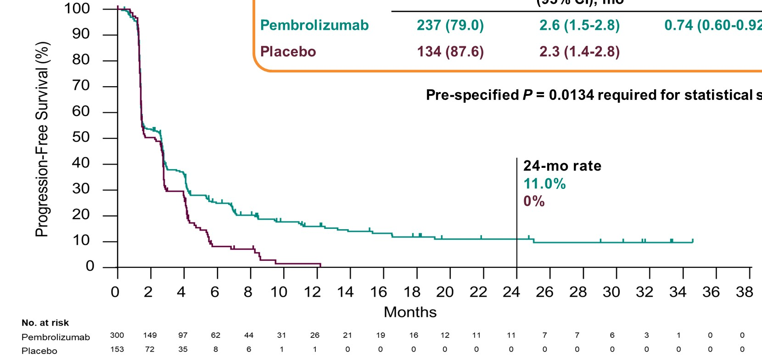
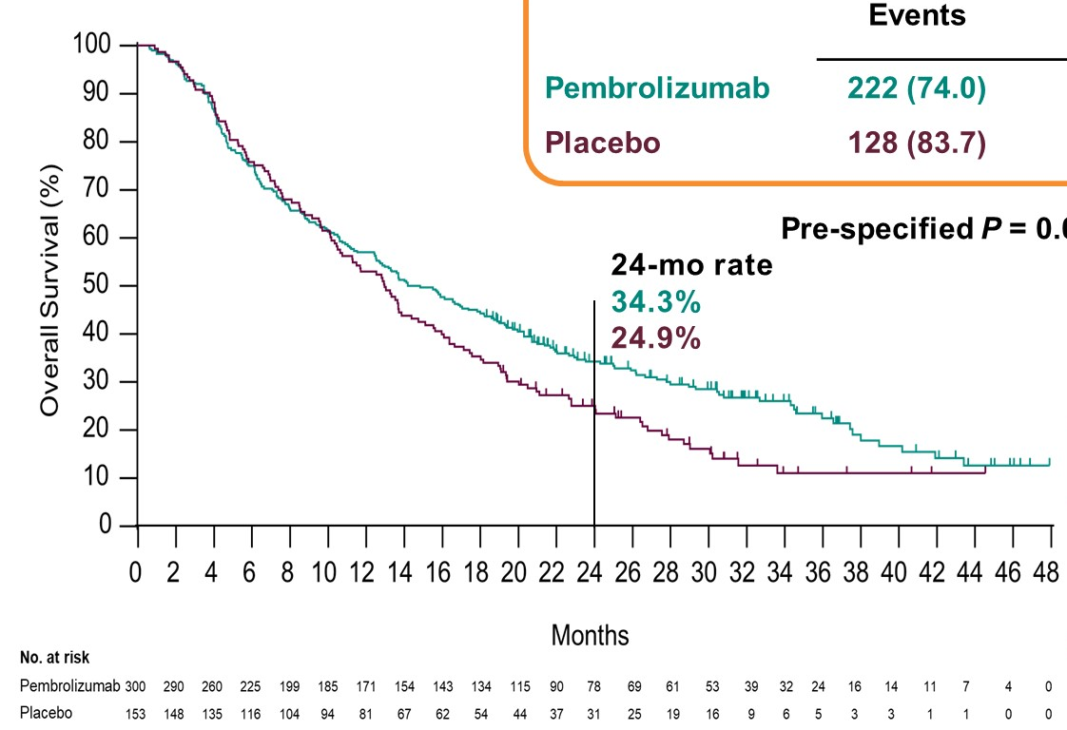
Baseline demographics and clinical characteristics
Progression-free survival
 | pembrolizumab (N=300) | placebo (N=153)
Age, median (range), years | 54 (22-82) | 54 (22-78)
≥65 years, n (%) | 69 (23.0) | 29 (19.0)
Male | 257 (85.7) | 126 (82.4)
Region
China | 255 (85.0) | 132 (86.3)
Ex-China | 45 (15.0) | 21 (13.7)
ECOG PS 1 | 176 (58.7) | 93 (60.8)
Child-Pugh Class A | 300 (100.0) | 153 (100.0)
ɑ-fetoprotein ≥200 ng/mL | 169 (56.3) | 78 (51.0)
Extrahepatic spread | 232 (77.3) | 120 (78.4)
Macrovascular invasion | 33 (11.0) | 17 (11.1)
BCLC stage C | 277 (92.3) | 146 (95.4)
 | pembrolizumab (N=300) | placebo (N=153)
Hepatitis B status
Positiveb | 236 (78.7) | 124 (81.0)
Hepatitis C status
Posivivec | 5 (1.7) | 1 (0.7)
Prior first-line treatment
Sorafenib | 272 (90.7) | 139 (90.8)
Oxaliplatin-based chemotherapy | 28 (9.3) | 14 (9.20
 | Events | PFS, median (95% CI), mo | HR (95% CI) | Pª
pembrolizumab | 237 (79.0) | 2.6 (1.5-2.8) | 0.74 (0.60-0.92 | 0.0032
placebo | 134 (87.6) | 2.3 (1.4-2.8)
 | Pre-specified p=0.0134 required for statistical significance
pembrolizumab
placebo
n (%) unless otherwise specified. Percentages may not equal 100 because of rounding. ª Region for China includes China Mainland, Hong Kong, and Taiwan; region for ex-China includes Republic of Korea and Malaysia. ^{b} Hepatitis B status was collected from the electronic case report form and positive was defined as hepatitis B surface antigen positive and/or detectable HBV DNA based on investigator assessment. ^{c} Hepatitis C was collected from the electronic case report form and positive was defined as anti–hepatitis C antibody positive and detectable HCV RNA based on investigator assessment
ª One-sided p for testing difference. Data cutoff: June 30, 2020 (second-interim analysis)
Overall survival
Objective response
 | Events | OS, median (95% CI), mo | HR (95% CI) | Pª
pembrolizumab | 222 (74.0) | 14.6 (12.6-18.0) | 0.79 (0.63-0.99) | 0.0180
placebo | 128 (83.7) | 13.0 (10.5-15.1)
 | Pre-specified p=0.0193 required for statistical significance
 | pembrolizumab (N=300) | placebo (N=153)
ORR (CR + PR), % (95% CI) | 12.7 99.1-17.0) | 1.3 (0.2-4.6)
Estimated treatment difference, (95% CI; pª) | 11.4 (6.7-16.0); <0.0001
Best overall response, n (%)
CR | 6 (2.0) | 1 (0.7)
PR | 32 (10.7) | 1 (0.7)
SD | 115 (38.3) | 70 (45.8)
Sustained SD^{b} | 26 (8.7) | 8 (5.2)
PD | 129 (43.0) | 72 (47.1)
Not evaluable | 10 (3.3) | 1 (0.7)
Not assessable^{c} | 8 (2.7) | 8 (5.2)
DoR,^{d} median (range), mo | 23.9 (2.8 to 32.0+) | 5.6 (3.0+ to 5.6)
Pre-specified p=0.0091 required for statistical significance
pembrolizumab
Post-study systemic anticancer therapy
 | pembrolizumab (N=300) | placebo (N=153)
Any post-study systemic anticancer therapy | 152 (50.7) | 102 (66.7)
PD-1 inhibitor or PD-L1 inhibitor^{b} | 62 (20.7) | 43 (28.1)
placebo
ª One-sided p for testing difference. ^{b} Duration of stable disease ≥23 weeks (stable disease within 24-week scan window or later). ^{c} Includes patients
with a baseline assessment (by investigator or blinded independent central review) but no postbaseline assessment on the data cutoff date, including discontinuation or death before the first postbaseline scan. ^{d} Assessed in the 38 patients in the pembrolizumab group and 2 patients in the placebo
group who had a confirmed complete response or partial response. Data cutoff: June 30, 2020 (second-interim analysis)
ª One-sided p for testing difference. Data cutoff: June 30, 2021 (final analysis)
^{b} Includes both with/without prior exposure to other post-study systemic anticancer therapies

Slide 90
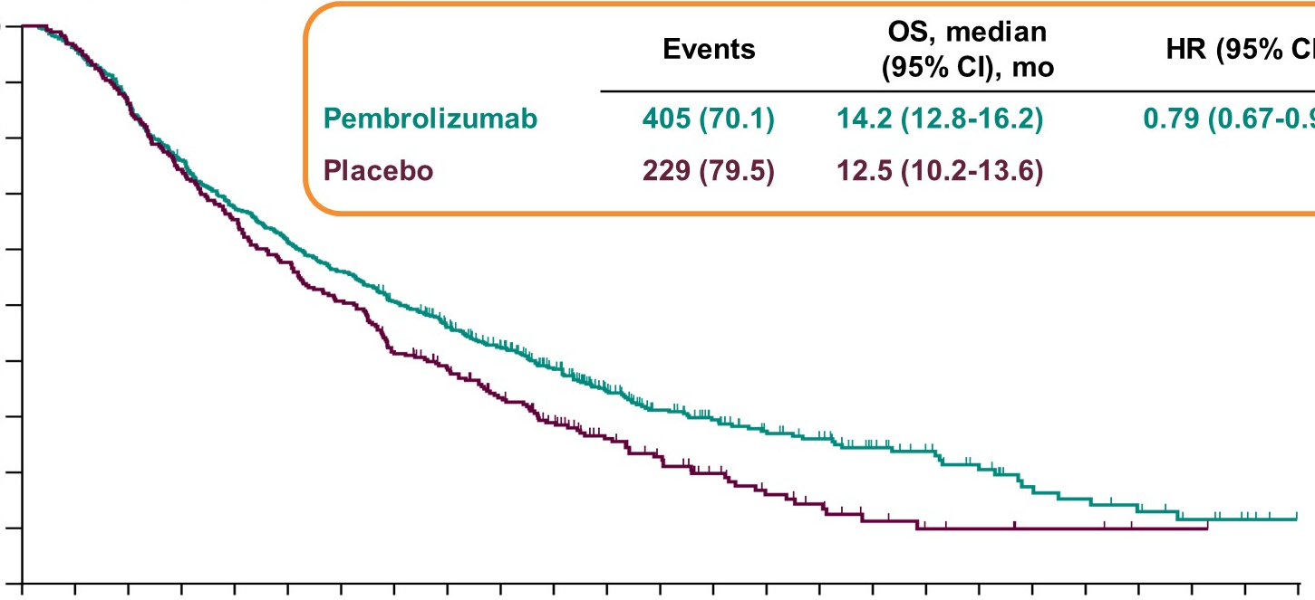
Overall Survival Based on Meta-Analysis of KEYNOTE-394 and KEYNOTE-240
100
90
 | Events | OS, median (95% CI, mo | HR (95% CI)
Pembrolizumab | 405 (70.1) | 14.2 (12.8-16.2) | 0.79 (0.67-0.93)
Placebo | 229 (79.5) | 12.5 (10.2-13.6)
80
70
60
Overall survival (%)
50
40
30
20
Pembrolizumab
10
Placebo
0
0
2
4
6
8
10
12
14
16
18
20
22
24
26
28
30
32
34
36
38
40
42
44
46
48
Months
No. at risk
Pembrolizumab
Placebo
578
288
555
278
497
248
438
214
389
188
354
166
323
146
289
118
253
104
220
84
172
67
123
50
94
39
76
28
62
20
54
16
39
9
32
6
24
5
16
3
14
3
11
1
7
1
4
0
0
0
Meta-analysis of pooled OS data from KEYNOTE-240 and KEYNOTE-394 was performed using all the patients receiving pembrolizumab or placebo in the intent-to-treat populations of each study
Data cutoff KEYNOTE-240: January 2, 2019 (final analysis; Finn RS, et al. J Clin Oncold 2020;38:1923-202); KEYNOTE-394: June 30, 2021 (final analysis)

Slide 91
Adverse Event Summary
N (%) | Pembrolizumab (N=299) | Placebo (N=153)
All-cause AEs Any Grade 3-5 Led to discontinuation Led to death | 283 (94.6) 157 (52.5) 38 (12.7) 10 (3.3) | 147 (96.1) 50 (32.7) 12 (7.8) 2 (1.3)
Treatment-related AEs Any Grade 3-5ª Led to discontinuation Led to death | 200 (66.9) 43 (14.4) 12 (4.0) 3 (1.0) | 76 (49.7) 9 (5.9) 1 (0.7) 0
Immune-mediated AEs^{b} Any Grade 3-5 Led to discontinuation Led to death^{c} | 54 (18.1) 9 (3.0) 5 (1.7) 1 (0.3) | 16 (10.5) 0 0 0
Immune-mediated hepatitis^{c,d} | 5 (1.7) | 0
ª 3 treatment-related deaths (as determined by the investigator) occurred in the pembrolizumab group (gastrointestinal hemorrhage, n=1; autoimmune hepatitis [confounded by metastasis to both lungs and lymphatic metastasis with chylous ascites resulting in circulatory failure], n=1; soft tissue infection, n=1). No treatment-related deaths occurred in the placebo group. ^{b} Includes immune-mediated events and infusion-related reactions of any attribution. ^{c} (0.3%) patient died from autoimmune hepatitis. ^{d} Based on sponsor assessment Data cutoff: June 30, 2021 (final analysis)

Slide 92
Summary and Conclusions
In KEYNOTE-394, pembrolizumab showed statistically significant and clinically meaningful improvement in OS, PFS, and ORR in patients from Asia with previously treated advanced HCC compared with placebo
  The use of post-study anticancer therapy at progression may have attenuated the observed treatment effect
A meta-analysis of KEYNOTE-240 and KEYNOTE-394 showed pembrolizumab therapy provided a consistent treatment effect and clinically meaningful improvement in OS compared to placebo in patients with advanced HCC
The AE profile of pembrolizumab was manageable and consistent with previous reports in this
patient population
These data reinforce the benefit-risk balance for pembrolizumab observed in globally conducted studies in the second-line treatment of advanced HCC and provide support for the generalizability of the data worldwide

Slide 93
2L immune checkpoint blockers in advanced HCC
 | CheckMate 040: nivolumab + ipilimumab^{1,3} | KEYNOTE-240: pembrolizumab⁵ | KEYNOTE-394: Pembrolizumab | RESORCE: Regorafenib | CELESTIAL: Cabozantinib | REACH2: Ramucirumab
Phase | Phase I/II (NIVO1+IPI3) | Phase III | Phase III | Phase III | Phase III | Phase III
Asia Pacific Rest of World | 74% 26% | 24.1 % + 14.4 % Japan 61.5% | 100% (incl Japan) 0% | 41% 59% | 25% 75% | 27.9% 72.1%
HBV HCV Non-viral | 56% 14% 26% | 29.9% 15.5% 54.6% | 79% 1.7% 19.3% | 41% 38% 21% | 38% 22% 40% | 36% 24.4% 39.6%
Prior sorafenib | 100% | 100% | 90.7% | 100% tolerated sorafenib | Include 28% who had 2 or more prior systemic tx | 100% and all AFP >400
OS, months | 22.2 | 13.9 | 14.6 | 10.6 | 10.2 | 8.5
PFS, months | NA | 3.3 | 2.6 | 3.1 | 5.2 | 2.8
ORR, % | 32 | 18 | 12.7 | 11 | 4 | 5
Grade ≥3 AEs, % | 55^{b} | 52^{b} | 14.4 | 50 | 68 | NA
Median DOR, months | 16.5 | 13.8 | 23.9 | 3.6 | 3.8 | 3.5
2L, second-line; AE, adverse event; BCLC, Barcelona Clinic Liver Cancer; DOR, duration of response; ESC, dose-escalation phase; EXP, dose-expansion phase; HCC hepatocellular carcinoma; NA, not available; ORR, overall response rate; OS, overall survival; PFS, progression-free survival ª Treatment related; ^{b} Grade 3/4
1. El-Khoueiry A, et al. Lancet 2017;389:2492-502. 2. Crocenzi T, et al. ASCO 2017 (Abstract 4013).
3. Yau T, et al. ASCO 2019 (Abstract 4012). 4. Zhu A, et al. Lancet Oncol 2018;19:940-52.
5. Finn R, et al. J Clin Oncol 2020;38:193-202
Notes:
References
Crocenzi et al. ASCO 2017. Abstract 4013
Yau et al. ASCO 2019. Abstract 4012
Zhu et al. Lancet Oncol 2018
Finn et al. ASCO 2019. Abstract 4004
Pishvaian et al. ESMO 2018. Abstract 1151P
Qin et al. ESMO 2018. Abstract LBA27
Xu et al. ASCO 2018. Abstract 4075
Wainberg et al. ASCO 2017. Abstract 4071
Kelley et al. ASCO 2017. Abstract 4073

Slide 94
My thoughts
KN394 results in Asian patients are consistent with what has been seen in KN240.
Pembrolizumab is very manageable toxicity wise
In the 2nd line setting after TKI, we have many treatment options including pembrolizumab
However, with combination therapies in the 1st line setting, the role of monotherapy IO in the 2nd line setting is questionable

Slide 95
Lenvatinib plus TransArterial Chemoembolization versUs Lenvatinib alone as 1st-line treatmeNt for Primary AdvanCed Hcc:
A Phase 3, Multicenter, Randomized Controlled Trial (LAUNCH)
Zhenwei Peng¹, Wenzhe Fan¹, Bowen Zhu¹, Jiping Wang²,
Jiaping Li¹, Ming Kuang¹
¹ Cancer center, First Affiliated Hospital, Sun Yat-sen University, China
² Brigham and Women’s Hospital, Harvard Medical School, USA

Slide 96
Schematic Diagram
Overall Type I error = 0.025 controlled across testing of OS, PFS, and ORR¹
  Initial allocation PFS = 0.002; OS = 0.023
  Re-allocated per multiplicity strategy specified in the protocol among
  3 endpoints above
Per protocol, there were 2 interim and 1 final analysis for OS and 1 interim and 1 final analysis for PFS and ORR
  Interim analysis for PFS and ORR at the time of OS 1st interim analysis
  Final analysis at the time of OS 2nd interim analysis
Efficacy boundaries
  P=0.0193 for OS (final analysis cutoff, June 30, 2021, based on 350 observed events)
  P=0.0134 for PFS and P=0.0091 for ORR (at 2nd interim cutoff, June 30, 2020; only if OS criteria met)
TACE + lenvatinib
(N=168)
TACE starts 1 day after lenvatinib
lenvatinib: 8 mg (BW <60 kg) or
12 mg (BW ≥60 kg)
once daily
Primary study endpoints:
OS
Secondary study endpoints:
PFS*
TTP*
ORR*
Quality of life
* Investigaors assess the tumour based on mRECIST
Pembrolizumab 200 mg Q3W + BSC for up to
35 cycles
Advanced primary HCC without any previous treatment or initial recurrent advanced HCC after radical resection without any postoperative treatment
At least one measurable lesion in the liver based on mRECIST criteria
Single lesion size <10 cm or number of multiple lesions <10, tumour burden <50%
n=300
R
(1:1)
Stratification Factors
ECOG performance status (0 vs 1)
Tumour thrombus: yes vs no
Body weight (<60 vs ≥60 kg
Trial site
Randomisation 1:1
Placebo Q3W
+ BSC for up to 35 cycles
n=153
lenvatinib
(N=168)
8 mg (BW <60 kg) or
12 mg (BW ≥60 kg)
once daily
HCC, hepatocellular carcinoma; BCLC, Barcelona Clinic Liver Cancer; ECOG PS, Eastern Cooperative Oncology Group performance status; TACE, transarterial chemoembolization; BW, body weight; OS, overall survival; PFS, progression-free survival; TTP, time to progression; ORR, objective response rate;
mRECIST, modified response evaluation criteria in solid tumours

Slide 97
Baseline Characteristics
In general, the two groups had balanced baseline characteristic (all p values >0.05)
Characteristics | LEN-TACE Group (N=170) | LEN Group (N=168)
Age (y), median (IQR) ≤60 (n, %) >60 (n, %) | 54 (46-64) 113 (66.5) 57 (33.5) | 56 (48-63) 117 (69.6) 51 (30.4)
Sex, n (%) Male Female | 139 (81.8) 31 (18.2) | 132 (78.6) 36 (21.4)
Bodyweight (kg), n (%) <60 ≥60 | 60 (35.3) 110 (64.7) | 65 (38.7) 103 (61.3)
Aetiology, n (%) Hepatitis B Hepatitis C Other | 148 (87.1) 4 (2.4) 18 (10.6) | 144 (85.7) 6 (3.6) 18 (10.7)
ECOG-PS score, n (%) 0 1 | 89 (52.4) 81 (47.6) | 99 (58.9) 69 (41.1)
Characteristics | LEN-TACE Group (N=170) | LEN Group (N=168)
Intrahepatic tumours, n (%) Single Multiple | 30 (17.6) 140 (82.4) | 38 (22.6) 130 (77.4)
Main tumour size (cm), median (IQR) <5 cm, n (%) ≥5 cm, n (%) | 8.4 (4.5-9.5) 47 (27.6) 123 (72.4) | 7.4 (4.1-9.7) 58 (34.5) 110 (65.5)
Macroscopic portal vein invasion, n (%) Yes No | 122 (71.8) 48 (28.2) | 117 (69.6) 51 (30.4)
Extrahepatic spread, n (%) Yes No | 94 (55.3) 74 (44.7) | 95 (56.5) 73 (43.5)
AFP (ng/mL), mean (SD) <400, n (%) ≥400, n (%) | 55,979 (224,434) 87 (51.2) 83 (48.8) | 31,753 (119,316) 81 (48.2) 87 (51.8)
ALBI score, mean (SD) | −2.38 (0.33) | −2.46 (0.40)
LEN, lenvatinib; TACE, transarterial chemoembolization; CI, confidence interval; IQR, interquartile range; ALBI, albumin-bilirubin score

Slide 98
Tumor Response
The ORR and DCR were both higher in LEN-TACE group than in the LEN group
Variable | RECIST 1.1 |  |  | mRECIST
 | Group, No (%) |  | p value | Group, No (%) |  | p value
 | LEN-TACE group (N=170) | LEN group (N=168) |  | LEN-TACE group (N=170) | LEN group (N=168)
Complete response | 1 (0.6) | 1 (0.6) | 0.993 | 5 (2.9) | 1 (0.6) | 0.102
Partial response | 77 (45.3) | 34 (20.2) | <0.001 | 87 (51.2) | 41 (24.4) | <0.001
Stable disease | 79 (46.5) | 87 (51.8) | 0.328 | 68 (40.0) | 81 (48.2) | 0.128
Progressive disease | 13 (7.6) | 46 (27.4) | <0.001 | 10 (5.9) | 45 (26.8) | <0.001
Objective response rate | 78 (45.9) | 35 (20.8) | <0.001 | 92 (54.1) | 42 (25.0) | <0.001
Disease control rate | 157 (92.4) | 122 (72.6) | <0.001 | 160 (94.1) | 123 (73.2) | <0.001
LEN, lenvatinib; TACE, transarterial chemoembolization; ORR, objective response rate; DCR, disease control; RECIST, response evaluation criteria in solid tumours, mRECIST, modified RECIST

Slide 99
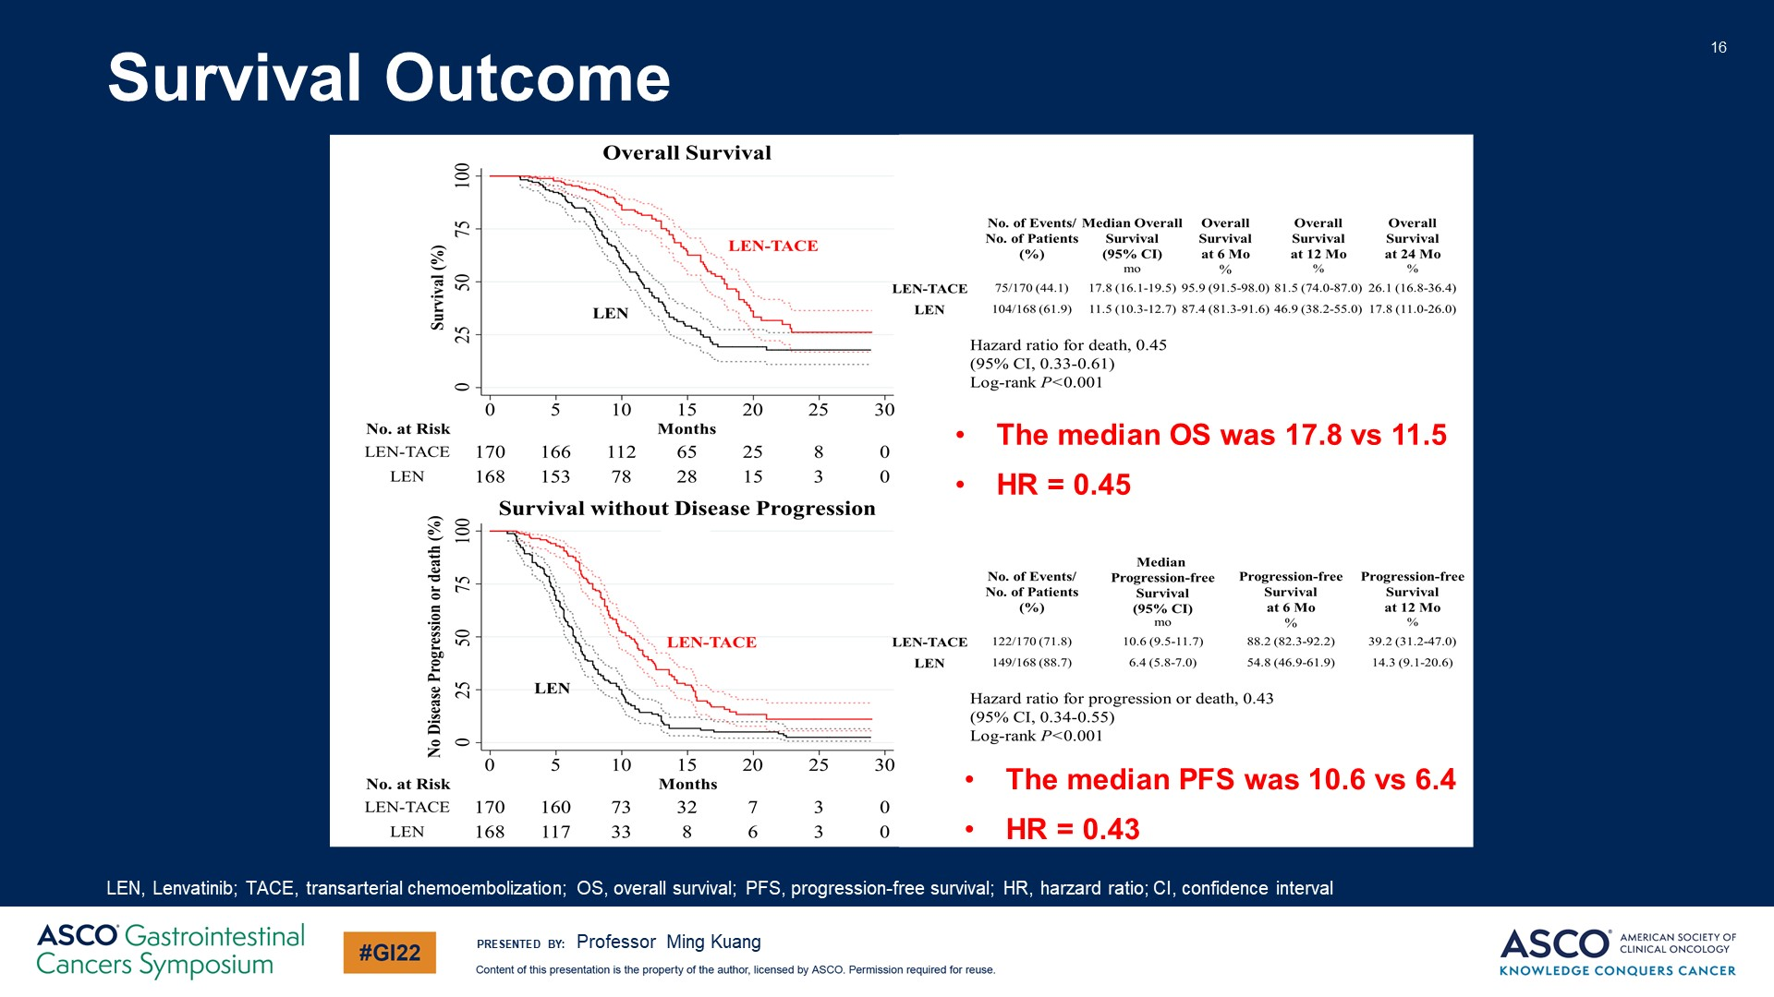
Survival Outcome
Overall Survival
100
 | No. of events/ No. of patients % | Median overall survival (95% CI) mo | Overall survival at 6 mo % | Overall survival at 12 mo % | Overall survival at 24 mo %
LEN-TACE | 75/170 (44.1) | 17.8 (16.1-19.5) | 95.9 (91.5-98.0) | 81.5 (74.0-87.0) | 26.1 (16.8-36.4)
LEN | 104/168 (61.9) | 11.5 (10.3-12.7) | 87.4 (81.3-91.6) | 46.9 (38.2-55.0) | 17.8 (11.0-26.0)
75
LEN-TACE
50
Survival (%)
LEN
25
Hazard ratio for death, 0.45
(95% CI, 0.33-0.61)
Log-rank p<0.001
0
0
5
10
15
20
25
30
The median OS was 17.8 vs 11.5
HR = 0.45
No. at risk
LEN-TACE
LEN
Months
170
168
166
153
112
78
65
28
25
15
8
3
0
0
Survival without Disease Progression
100
 | No. of events/ No. of patients % | Median progression- free survival (95% CI) mo | Progression-free survival at 6 mo % | Overall survival at 12 mo %
LEN-TACE | 122/170 (71.8) | 10.6 (9.5-11.7) | 88.2 (82.3-92.2) | 39.2 (31.2-47.0)
LEN | 149/168 (88.7) | 6.4 (5.8-7.0) | 54.8 (46.9-61.9 | 14.3 (9.1-20.6)
75
No disease progression or death (%)
LEN-TACE
50
25
LEN
Hazard ratio for progression or death, 0.43
(95% CI, 0.34-0.55)
Log-rank p<0.001
0
0
5
10
15
20
25
30
The median PFS was 10.6 vs 6.4
HR = 0.43
No. at risk
LEN-TACE
LEN
Months
170
168
160
117
73
33
32
8
7
6
3
3
0
0
LEN, lenvatinib; TACE, transarterial chemoembolization; OS, overall survival; PFS, progression-free survival; HR, hazard ratio; CI, confidence interval

Slide 100
Adverse Event
LEN-TACE group
LEN group
Adverse Events | p value
 | All grade | Grade 3-4
Hand-foot skin reaction | 0.849 | 0.749
Abdominal pain | <0.001 | 0.058
Nausea | <0.001 | 0.993
Diarrhea | 0.737 | 0.626
Fever | <0.001 | 0.319
Hypertension | 0.792 | 0.828
Alopecia | 0.272 | 0.320
Ascites | 0.004 | 0.418
Vomiting | <0.001 | 0.555
Fatigue | 0.607 | 0.533
Dysphonia | 0.851 | 0.555
Decreased appetite | 0.498 | 0.981
Proteinuria | 0.402 | 0.774
Weight decreased | 0.844 | 0.859
Rash | 0.966 | 0.418
ALT increased | <0.001 | <0.001
AST increased | <0.001 | <0.001
Hyperbilirubinemia | 0.029 | 0.014
Hypoalbuminemia | 0.001 | 0.993
Constipation | 0.928 | 0.643
All grade
Grade 3-4
120
100
80
60
40
20
0
20
40
60
80
100
120
AE, adverse events; AST, aspartate aminotransferase; ALT, alanine aminotransferase; TACE, transarterial chemoembolization

Slide 101
TACE Administration
Patients in the LEN-TACE group were treated with a total of 560 times of TACE, and the median TACE session per patient was 3 (ranged 1 to 6)
 | DEB-TACE (N=117) | cTACE (N=53)
TACE times Mean (SD) Median (IQR) | 306 2.6 (0.7) 3 (2-3) | 254 4.8 (0.9) 5 (3-5)
Reasons for TACE discontinuation Disease progression Hepatic resection Disappearance of any intratumoral arterial enhancement in all intrahepatic lesion Unacceptable AEs Other reasons | 78 17 4 2 0 | 44 9 1 2 2
TACE delay related to AEs | 35 | 30
LEN, Lenvatinib; TACE, transarterial chemoembolization; IQR, interquartile range; SD, standard deviation; AE, adverse events

Slide 102
My thoughts
This study is a positive study
It emphasizes the safety and tolerability of using TACE after Lenvatinib in advanced HCC
However, it remains to be seen which are the right patients to be selected for this sequence as these patients are heterogenous

Slide 103
A look to future treatments and closing remarks
Richard S. Finn, MD
Professor of Clinical Medicine
Division of Hematology/Oncology
Director, Signal Transduction and Therapeutics Program
Jonsson Comprehensive Cancer Center
Geffen School of Medicine at UCLA, California, USA

Slide 104
Treatment Strategy in the Management of HCC 2021 and Beyond
HCC
Stages
Very early stage (BCLC 0)
Single nodule ≤2 cm
Child-Pugh A ECOG 0
Very early stage (BCLC A)
Single or ≤3 nodule ≤3 cm
Child-Pugh A-B, ECOG 0
Intermediate stage (BCLC B)
multinodular
Child-Pugh A-B, ECOG 0
Advanced stage (BCLC C)
Portal invasion, N1, M1
Child-Pugh A-B, ECOG 1-2
Terminal stage (BCLC D)
Child-Pugh Acª
ECOG >2
Solitary
2-3 nodules nodule ≤3 cm
Yes
Optimal surgical candidate^{b}
No
Systemic therapy
First: atezolizumab + bevacizumab^{c}
First/second: sorafenib, lenvatinib^{c}
Third: regorafenib, cabozantinib, ramucirumab (AFP >400 ng/ml)
(US: nivolumab, pembrolizumab, nivolumab + ipilimumab)
Primary
treatments
Transplant candidate
Yes
No
Ablation
Resection
Transplantation
(DDLT.LDLT)
Ablation
Chemoembolization
Best supportive care
Expected
outcomes
Median OS: 10 years of transplantation:
>6 years for resection/ablation
Median OS:
>26-30 months
First-line: median OS 19.2 months
Second-line: 13-15 months
Third-line: 8-12 months
Median OS:
>3 months
Adjuvant RCTs (vs placebo)
CheckMate 9DX: nivolumab
KEYNOTE-937: pembrolizumab
IMbrave050: atezolizumab + bevacizumab
EMERALD 2: durvalumab + bevacizumab
Intermediate RCTs (vs TACE)
EMERALD 1: TACE + durvalumab + bevacizumab
LEAP 012: TACE + Lenvatinib + pembrolizumab
CheckMate 74W: TACE + nivolumab + ipilimumab
Regorafenib + nivolumab
TACE 3: TACE + nivolumab
Advanced RCTs (vs sorafenib or lenvatinib)
LEAP 002: Lenvatinib + pembrolizumab
COSMIC 312: atezolizumab + cabozantinib
CheckMate 9DW: nivolumab + ipilimumab
HIMALAYA: durvalumab + tremelinumab
Camrelizumab + apatinib
RATIONALE-301: tislelizumab
STOP-HCC: Y90 + sorafenib
Main ongoing phase IIIrcts
AFP, α- fetoprotein; BCLC, Barcelona Clinic Liver cancer; DDLT, deceased- donor liver transplantation; ECOG, Eastern Cooperative Oncology Group; HCC, hepatocellular carcinoma; LDLT, living- donor liver transplantation; M1, distant metastasis; N1, lymph node metastasis; OS, overall survival; RCT, randomised controlled trial; TACE, transarterial chemoembolisation
Llovet JM, et al. Nat Rev Dis Primers. 2021;7:6

Slide 105




REACH HCC CONNECT VIA
TWITTER, LINKEDIN, VIMEO & EMAIL
OR VISIT THE GROUP’S WEBSITE https://hccconnect.cor2ed.com/
Follow us on Twitter
@hccconnectinfo
Follow the
HCC CONNECT
group on LinkedIn
Watch us on the
Vimeo Channel
HCC CONNECT
Email
froukje.sosef@cor2ed.com

