Slide 2
Practical guidance on use of immunohistochemistry for the detection of TRK fusion-positive cancer
Prof. Frédérique Penault-Llorca
Pathologist, University of Clermont-Ferrand, France

Slide 3
Entrectinib & Larotrectinib: TRK inhibitors
The discovery of NTRK fusions led to the recent development of therapeutic agents that inhibit TRK fusion proteins
Two TRK inhibitors are approved by the US Food and Drug Administration for use in patients with unresectable or metastatic NTRK fusion-positive cancers, agnostic of tumour type
ENTRECTINIB
INDICATION FOR USE: (extracted from the USPI)
1.2 NTRK Gene Fusion-Positive Solid Tumors
Indicated for the treatment of adult and pediatric patients 12 years of age and older with solid tumors that:
have a neurotrophic tyrosine receptor kinase (NTRK) gene fusion without a known acquired resistance mutation,
are metastatic or where surgical resection is likely to result in severe morbidity, and
have either progressed following treatment or have no satisfactory alternative therapy.
This indication is approved under accelerated approval based on tumor response rate and durability of response [see Clinical Studies (14.2)]. Continued approval for this indication may be contingent upon verification and description of clinical benefit in the confirmatory trials.
LAROTRECTINIB
INDICATION FOR USE: (extracted from the USPI)
Indicated for the treatment of adult and pediatric patients with solid tumors that:
have a neurotrophic receptor tyrosine kinase (NTRK) gene fusion without a known acquired resistance mutation,
are metastatic or where surgical resection is likely to result in severe morbidity, and
have no satisfactory alternative treatments or that have progressed following treatment.
Select patients for therapy based on an FDA-approved test [see Dosage and Administration (2.1)].
This indication is approved under accelerated approval based on overall response rate and duration of response [see Clinical Studies (14)]. Continued approval for this indication may be contingent upon verification and description of clinical benefit in confirmatory trials.
NTRK, Neurotrophic Tyrosine Receptor Kinase; TRK, tropomyosin receptor kinase; USPI, United-States product information
USPI Larotrectinib dated 25 March 2021, USPI entrectinib dated 5 November 2021 (source: https://www.accessdata.fda.gov/scripts/cder/daf/index.cfm)

Slide 4
Advantages and disadvantages of IHC
Advantages of IHC for Testing
for NTRK Fusions
Disadvantages of IHC for Testing for NTRK Fusions
  Widely available
  Relatively inexpensive, with a rapid turnaround time
  Less dependent on tumour purity compared with other biomarker testing methodologies
  Only detects the TRK protein expression without distinction between wild-type TRK and TRK fusion protein. As a result, a confirmatory test is needed to confirm the presence of a NTRK gene fusion if a positive IHC (≥1% positive cell) is observed
  Cytoplasmic staining alone without nuclear, peri-nuclear, or membranous staining may be simple background staining. Confirmation of fusion by a second assay should be conducted as NTRK fusions are extremely rare
IHC, Immunohistochemistry; TRK, tropomyosin receptor kinase

Slide 5
pan-TRK antibodies
Clone EPR17341 is the most frequently used IHC antibody (purchased either as an in vitro diagnostic product or by itself):
  Rabbit monoclonal antibody
  Reactive to a homologous region of Trk-A, -B, and –C near the C terminus
Clone A7H6R (purchased by itself)
  Rabbit monoclonal antibody
  Detects TrkA, TrkB and TrkC
  May preferentially detect TrkA over TrkB, and TrkB over TrkC
When an other solution than the IVD is chosen a validation for clinical use within a lab is mandatory, as they are laboratory-developed tests
IHC, Immunohistochemistry; IVD, In vitro diagnostic; Trk, tropomyosin receptor kinase

Slide 6
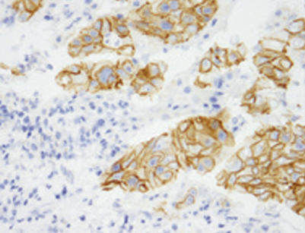
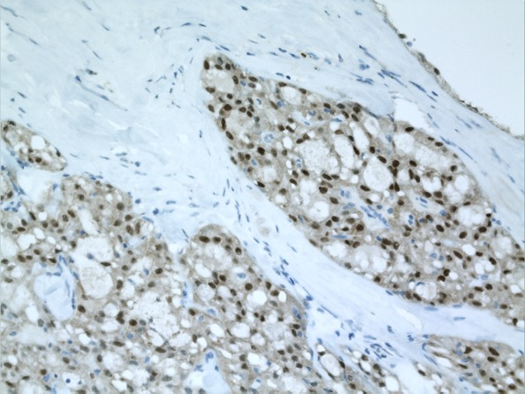
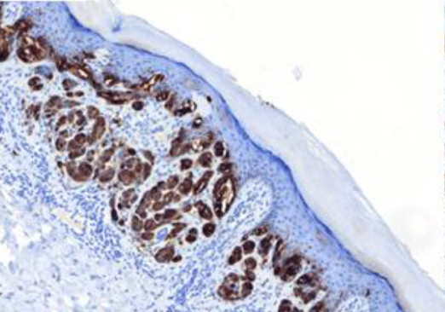
Different patterns of TRK IHC staining
Cytoplasmic staining EPR17341
Spitz tumour
NTRK1 fusion
Membranous staining EPR17341 Intrahepatic cholangiocarcinoma PLEKHA6-NTRK1 fusion
Nuclear staining
EPR17341
Salivary gland tumour
ETV6-NTRK3 fusion
IHC, Immunohistochemistry; NTRK, Neurotrophic Tyrosine Receptor Kinase; TRK, tropomyosin receptor kinase
Images courtesy Pr A Uguen (Spitz and Cholangiocarcinoma) and F Penault-Llorca (Salivary Gland Tumour)

Slide 7
Exquisite sensitivity to fixation
Secretory breast carcinoma
Centre of the tumour
TRK staining in ≥1%
of tumour cells
is considered
TRK fusion-positive
Ventana EPR17341 prediluted
Border of the tumour
NTRK, Neurotrophic Tyrosine Receptor Kinase; TRK, tropomyosin receptor kinase
Images courtesy Pr F Penault-Llorca

Slide 8
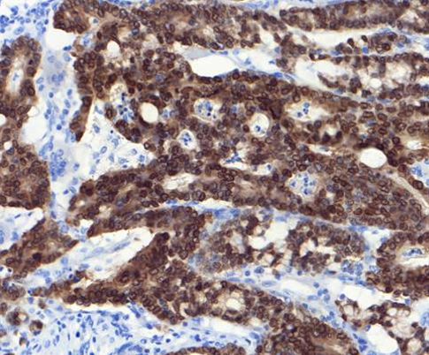
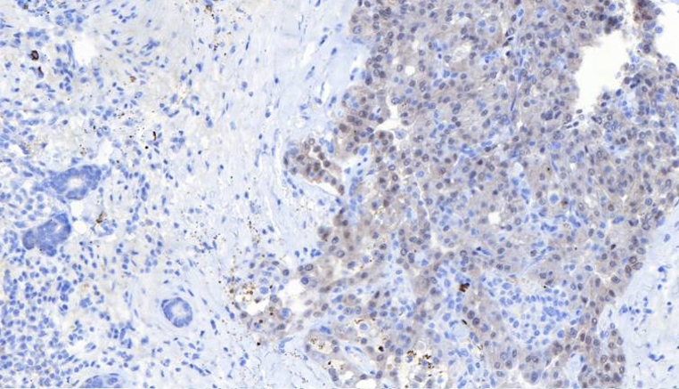
Pan-TRK IHC has high sensitivity for NTRK1-2 fusions and lower sensitivity for NTRK3
Pan-TRK IHC has demonstrated a sensitivity of:
  96.2% for NTRK1 fusions
  100% for NTRK2 fusions
  79.4% for NTRK3 fusions
Colorectal carcinoma
NTRK1 rearrangement
Colorectal carcinoma
NTRK3 rearrangement
IHC, Immunohistochemistry; NTRK, Neurotrophic Tyrosine Receptor Kinase; TRK, tropomyosin receptor kinase
Images courtesy Pr A Uguen

Slide 9
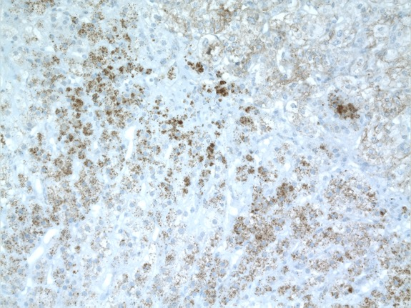
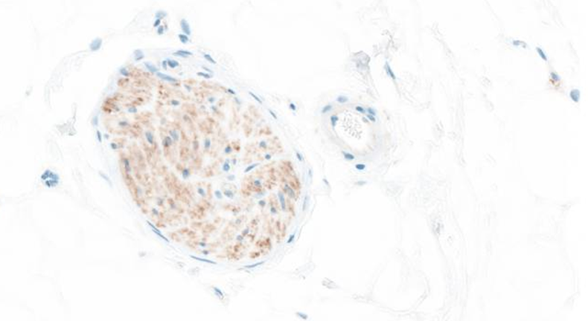
TRK proteins are physiologically expressed in non-neoplastic neural and smooth-muscle tissue
Adrenal gland cortex
Clone EPR17341
Ganglioneuronal cell
Clone EPR17341
TRK, tropomyosin receptor kinase
Images courtesy Pr A Uguen

Slide 10
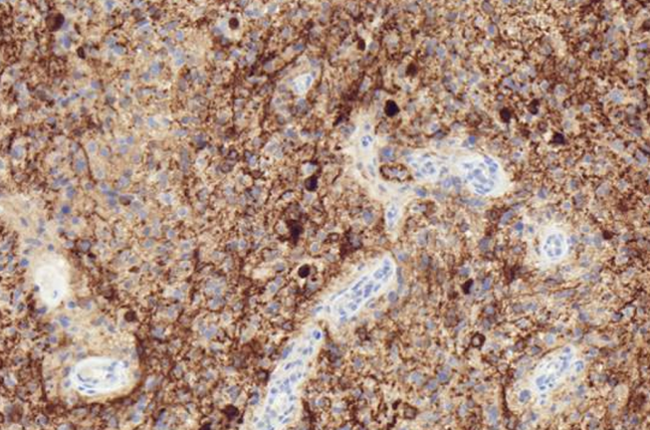
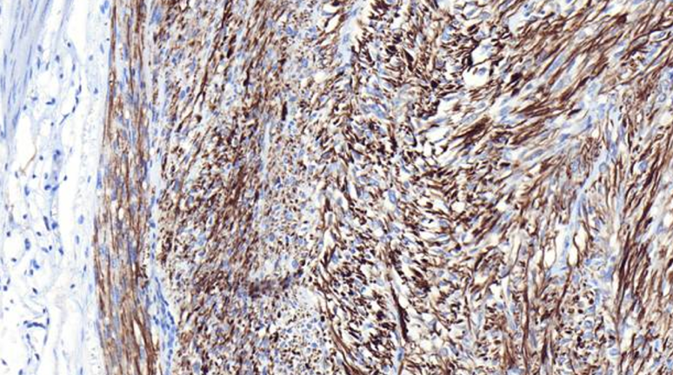
Other methods of NTRK fusion testing should be considered for sarcomas, CNS tumours, neuroendocrine tumours as false positive staining may occur
Glioblastoma
Clone EPR17341
Lack of NTRK fusion
GIST
Clone A7H6R
Lack of NTRK fusion
CNS, central nervous system; GIST, gastrointestinal stromal tumour; NTRK, Neurotrophic Tyrosine Receptor Kinase
Images courtesy Pr A Uguen

Slide 11
conclusions
IHC is a good screening tool, but it is not enough
Confirmatory testing with nucleic acid-based analysis should be performed in case of a positive IHC staining
Pathologists need to be aware of the limitations of IHC
They have to keep in mind that a negative IHC result does not equal an absence of NTRK gene fusion
IHC, Immunohistochemistry; NTRK, Neurotrophic Tyrosine Receptor Kinase;

Slide 12
REACH NTRK CONNECT VIA
TWITTER, LINKEDIN, VIMEO & EMAIL
OR VISIT THE GROUP’S WEBSITE https://ntrkconnect.cor2ed.com/
Follow us on Twitter
@ntrkconnectinfo
Follow the
NTRK CONNECT
group on LinkedIn
Watch us on the
Vimeo Channel
NTRK CONNECT
Email
Iain.murdoch
@cor2ed.com

