Slide 2
The role and place of genetic testing in prostate cancer Ask the Expert MARCH 2021
Dr Daniel Keizman, MD Tel Aviv Sourasky Medical Center, Israel
Dr Neal Shore, MD, FACS Carolina Urologic Research Center, SC, USA
Dr Roberto Iacovelli MD, PhD Fondazione Policlinico Gemelli IRCCS, Rome, Italy
Dr Elena Castro, MD, PhD Malaga Biomedical Research Institute, Spain
Prof. Gert Attard, MD, PhD, FRCP University College London Cancer Institute, UK

Slide 3
DISCLAIMER AND DISCLOSURES
Please note: The views expressed within this presentation are the personal opinions of the author. They do not necessarily represent the views of the author’s academic institution or the rest of the GU CONNECT group.
This content is supported by an Independent Educational Grant from Bayer.
Faculty members have received financial support/sponsorship for research support, consultation, or speaker fees from the following companies:
Dr Daniel Keizman: Astellas, AstraZeneca, Bayer, BMS, Janssen, MSD, Neopharm, Novartis, Pfizer, Roche, Sanofi, Teva
Dr Gert Attard: Abbott Laboratories, Astellas Pharma, AstraZeneca, Bayer Healthcare Pharmaceuticals, Essa Pharmaceuticals, Innocrin Pharma, Janssen-Cilag, Millennium Pharmaceuticals, Novartis, Pfizer, Roche/Ventana, Sanofi-Aventis, Takeda, Veridex,
Dr Neal Shore: Abbvie, Amgen, Astellas, AstraZeneca, Bayer, BMS, Clovis Oncology, Dendreon, Ferring, Foundation Medicine, Janssen, Merck, Myovant, Nymox, Pfizer, Sanofi-Genzyme, Tolmar
Dr Elena Castro: Astellas, AstraZeneca, Bayer, Clovis Oncology, Janssen, Merck, Pfizer, Roche.
Dr Roberto Iacovelli: Astellas, BMS, Janssen, Ipsen, Merck, MSD, Pfizer, Sanofi-Genzyme

Slide 4
introduction
Prostate cancer (PC) is a highly heritable disease
57% of the individual risk is attributable to genetic factors¹
Genomics is evolving rapidly and paving the way for precision medicine in oncology^{2,3}
In the era of poly (ADP-ribose) polymerase (PARP) inhibition and immunotherapy, genetic testing may guide therapeutic choices, as well as inform the patient about their personal and familial risk⁴⁻⁶
Multiple guidelines now recommend germline genetic testing for men with PC⁷⁻⁹
1. Mucci L, et al. JAMA 2016; 315: 68-76; 2. Seyhan AA, et al. J Transl Med. 2019;17:114; 3. Roos A, et al. Cancer Treat Res. 2019;178:137-69; 4. Zhang H, et al. Genome Med. 2019;11:9; 5. Sachdev JC, et al. Cancer Treat Res. 2019;178:45-80; 6. Carlo MI, et al. JCO Precis Oncol. 2018. DOI: 10.1200/PO.18.00060; 7. Mohler JL, et al. J Natl Compr Canc Netw. 2020;17:479-505; 8. Giri VN, et al. J Clin Oncol. 2018;36:414-24; 9. Sanda MG, et al. J Urol. 2018;199:683-90

Slide 5
Germline vs Somatic Genetic Testing
Germline mutations – heritable
Genetic change in single or multiple genes which can affect PC risk and cancer biology
Germline genetic testing
Normal, non-cancer samples (blood or saliva) used for testing
Information may be relevant for assessment of familial risk and may guide treatment decision-making
Should involve a genetic counsellor
Somatic mutations – not heritable
Acquired mutations or genetic alterations in multiple genes within prostate tissue which can result in a malignant growth or altered outcome
Somatic genetic testing
Tumour tissue and/or plasma (ctDNA) used for testing
Used to guide treatment options in the advanced setting
Repeat testing of tumour DNA may be useful during the disease course as somatic mutations may change over time
Germline Mutations
Somatic Mutations
Variant present in gamete
Variant absent in gamete
Variation can occur during fetal development or any time after birth in any cell of the body, except those of the germline
Variation present in every cell in the body, including those of the germline
Variants can be passed on to offspring
Variants are not passed on to offspring
ctDNA, circulating tumour DNA
Cheng HH, et al. J Natl Compr Canc Netw. 2019;17:515-21; Pritchard CC, et al. N Engl J Med. 2016;375:443-53
Figure adapted from: https://www.genomicseducation.hee.nhs.uk/cancer-genomics/ Accessed 28-Feb-2021

Slide 6
NCCN Guidelines (V3.2020) for Genetic Testing
Germline testing | Somatic tumour testing
Germline genetic testing is recommended for patients with PC and any of the following: High-risk, very high-risk, regional, or metastatic PC Ashkenazi Jewish ancestry Family history of high-risk germline mutations (e.g. BRCA1/2, Lynch mutation) A positive family history of cancer A strong family history of PC Brother, father, or multiple family members diagnosed with PCª at <60 years of age or who died from PC | Recommend evaluating tumour for alterations in homologous recombination DNA repair genes, such as BRCA1, BRCA2, ATM, PALB2, FANCA, RAD51D, CHEK2, and CDK12 in patients with metastatic PC Can be considered in men with regional PC Testing for microsatellite instability-high or mismatch repair deficient status is recommended in patients with metastatic castration-resistant prostate cancer (mCRPC), and can be considered in patients with regional or castration-naïve metastatic PC
ª Not including clinically localised Grade Group 1
NCCN, National Comprehensive Cancer Network

Slide 7
Traditional medicine vs precision medicine
Traditional medicine
Precision medicine
All patients receive standard therapy
Treatment dependent upon
biomarker profile of tumour
Benefit
No benefit
Adverse effects
Tailored therapy
Each patient benefits

Slide 8
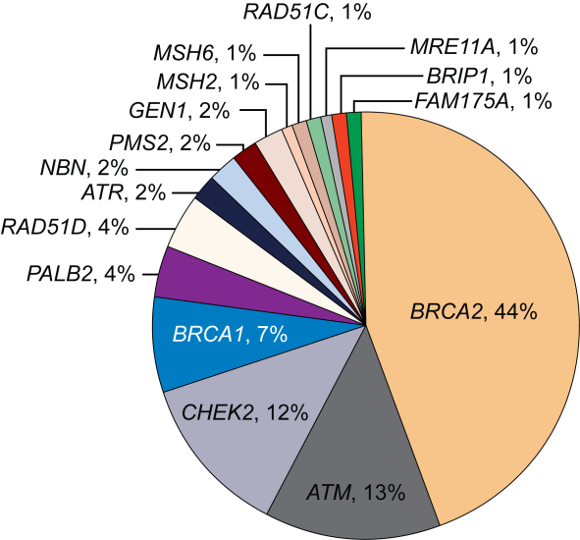
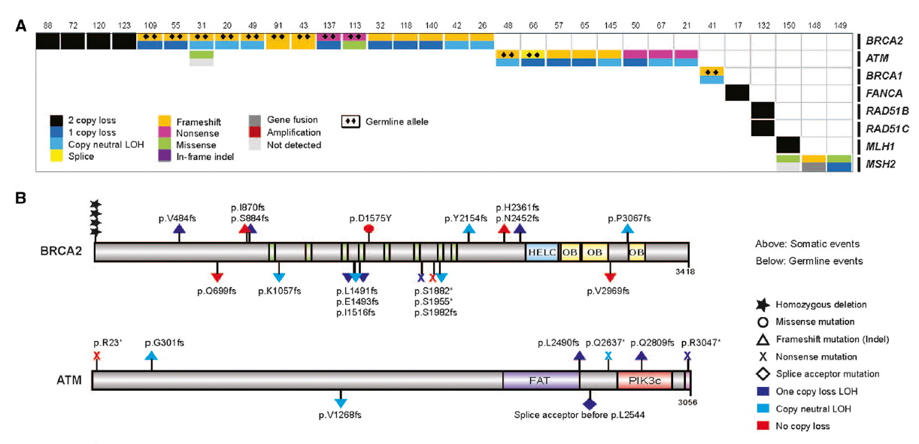
DNA Repair Gene Alterations (Somatic and Germline) Are Common in Metastatic prostate cancer
Somatic
Germline²
~23% of men with mCRPC have homologous recombination DNA repair deficiency¹
The incidence of DNA repair alterations is higher in men with metastatic prostate cancer than those with localised disease^{1,2}
~12% of men with metastatic prostate cancer have germline mutations in one or more of the 16 DNA repair genes³
LOH, loss of heterozygosity; mCRPC, metastatic castration-resistant prostate cancer; PC, prostate cancer
1. Robinson D, et al. Cell. 2015;161:1215-28; 2. Pritchard CC, et al. N Engl J Med. 2016;375:443-53; 3. Antonakaris ES, et al. Eur Urol. 2018;74:218-25

Slide 9
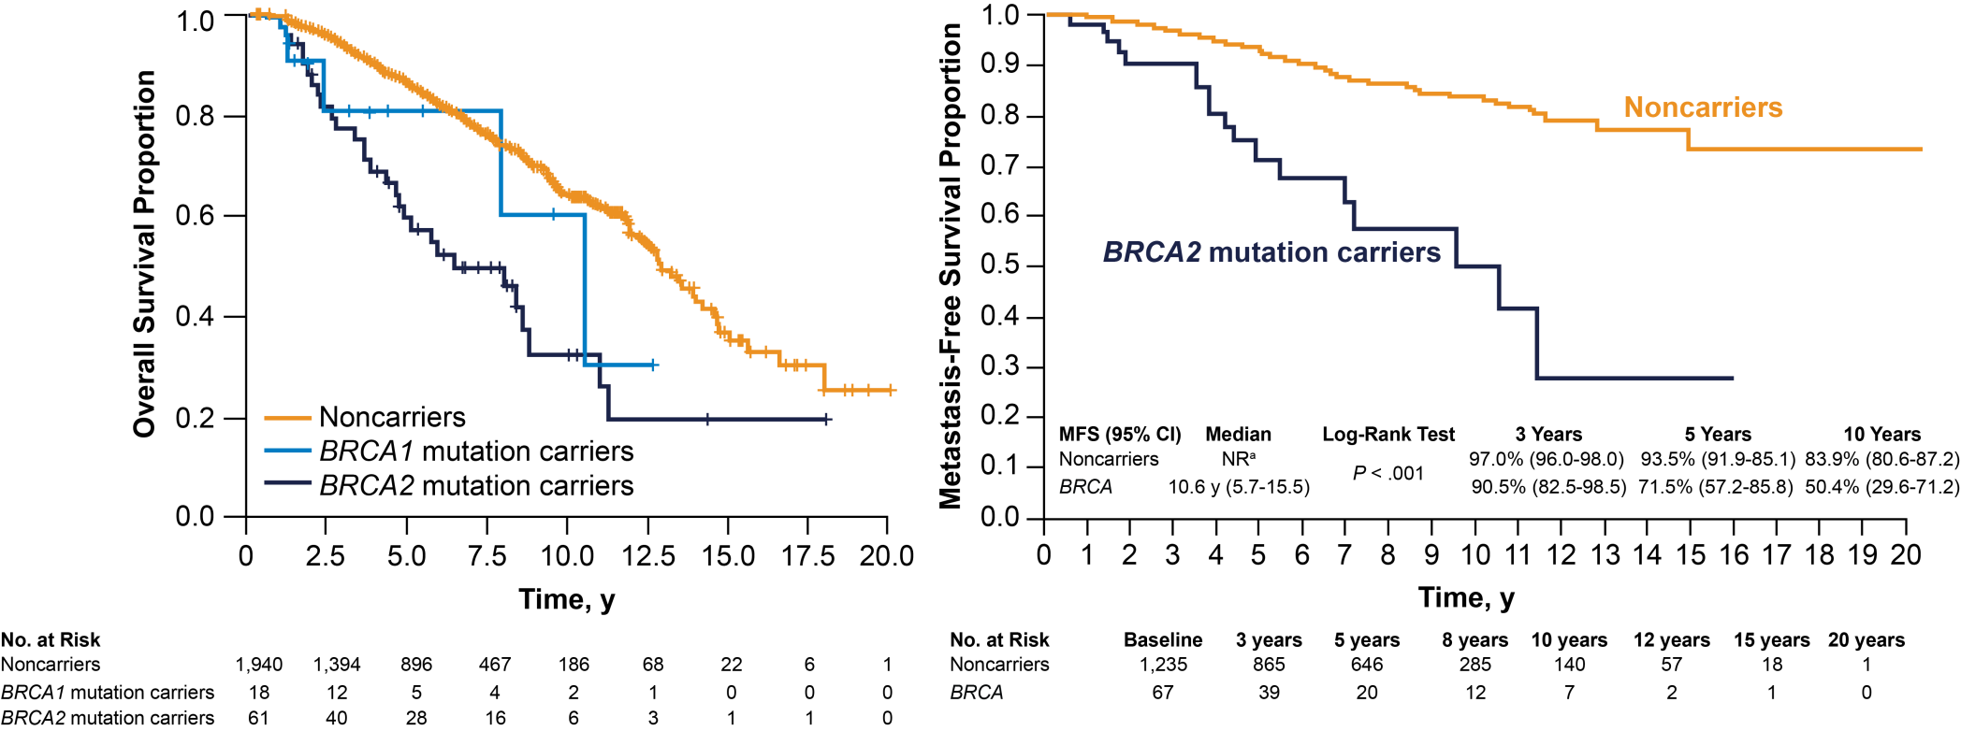
BRCA2 Carriers With Prostate Cancer Have Worse Prognosis^{1,2}
Noncarriers
ª Median survival not reached after a median of 64 months of follow-up
NR, not reached; y, years
1. Castro E, et al. J Clin Oncol. 2013;31:1748-57; 2. Castro E, et al. Eur Urol. 2015;68:186-93

Slide 10
Family History of cancer Is a Real Risk Factor
A father or brother with PC doubles a man’s risk of PC
A mother or sister with breast cancer can affect a man’s risk of PC
Ovarian cancer in a mother or sister triples a woman’s risk of ovarian cancer
A mother or sister with breast cancer diagnosed before age 50 significantly increases a woman’s risk of breast cancer
Chen Y-C, et al. Prostate. 2008;68:1582-91; Colditz GA, et al. Breast Cancer Treat Res. 2012;133:1097-104; Amos CI, et al. Cancer. 1993;71:566-72.
Notes:
4907

Slide 11
Cascading Impact
Tailored screening and risk-reduction
Full family history should be collected:
3 or 4 generation pedigree
Ancestry and consanguinity information
Any prior genetic testing
Family history:
Guides choice of broad vs narrow gene panel
Determines a patient's criteria for testing
Identifies the most appropriate family members for testing
Informs screening if test is negative
~50% chance of inheriting same DNA repair mutation
↑ risk of PC, more aggressive
~23% of men with mCRPC have HR DNA repair deficiency
Tailored screening, risk-reduction
~12% of men with PC carry an inherited DNA repair gene mutation – implications for cancer screening and for their relatives
Treatment opportunities
PARP inhibitors, platinum-based chemotherapy, etc.
↑ risk of PC, more aggressive
HR, homologous recombination; mCRPC, metastatic castration-resistant prostate cancer; PARP, poly (ADP-ribose) polymerase
Cheng HH, et al. J Natl Compr Canc Netw. 2019;17:515-21; Pritchard CC, et al. N Engl J Med. 2016;375:443-53; Szymaniak B, et al. JCO Oncol Pract. 2020;16:811-9 Figure adapted from Cheng H. https://www.ustoo.org/Pathways-Seattle-Webcast

Slide 12
New Molecular Taxonomy for Prostate Cancer
AR-variant (i.e. AR-V7)-driven CRPC: AR degraders, cofactor inhibitors, taxanes Inhibition of enhanced androgen synthesis AR N-terminal or DNA-BD inhibitors GR or PR inhibition
AR-driven mCRPC
HRD⁺ CRPC (BRCA1/2, ATM, PALB2, etc.)
PARP inhibitor-based therapy, immuno-oncologic combinations
Metastatic PC
MSI^{high} or MMRD mCRPC
PD-1-based immunotherapy
CDK12 biallelic loss mCRPC
PD-1-based immunotherapy
AR-independent CRPC (NEPC, ‘double negative’ mCRPC)
DLL3 inhibition, combinations Immunotherapy Platinum-based chemotherapy
AR, androgen receptor; (m)CRPC, (metastatic) castration-resistant prostate cancer; DLL3, delta-like ligand 3; DNA-BD, DNA binding domain; GR, glucocorticoid receptor; HRD, homologous recombination deficiency; MMRD, mismatch repair deficient; MSI, microsatellite instability; NEPC, neuroendocrine prostate cancer; PARP, poly (ADP-ribose) polymerase; PD-1, programmed cell death protein 1; PR, progesterone receptor
Courtesy of E. Antonarakis, MD, Johns Hopkins University
Notes:
12
12

Slide 13
High Quality tumour tissue is key to success
PROfound TRIAL¹
STAMPEDE TRIAL²
Tissue testing success rates by sample age
Time between obtaining the biopsy and sequencing influences the sequencing success rate:
Cohort 1 (samples up to 7 years old): 65% success rate
Cohort 2 (samples < 8 months old): 92% success rate
It is feasible to perform sequencing using archival samples, but the highest success rates are observed using biopsies within 8 months of fixation
Proportion of samples with successful test (%)
<1 Year (N=368)
1-3 Years (N=1,133)
3-5 Years (N=1,139)
5-10 Years (N=1,446)
>10 Years (N=727)
Of 4,047 patients who submitted tumour samples, 2,792 (69%) were successfully sequenced and yielded a biomarker status
The proportion of samples on which somatic testing can successfully be performed declines over time, as tissue quality is likely compromised
1. Hussain M, et al. J Clin Oncol. 2020;38:195 (Poster presentation); 2. Gilson C, et al. JCO Precis Oncol. 2020;4:882-97

Slide 14
Recent Fda Parp INHIBITOR APPROVALS for prostate cancer
Drug | FDA approval data | Approved indication | Biomarkers
Rucaparib | 15 May 2020 | Adult patients with a deleterious BRCA mutation (germline and/or somatic)-associated mCRPC who have been treated with AR-directed therapy and a taxane-based chemotherapy | BRCA1, BRCA2 (germline or somatic)
Olaparib | 19 May 2020 | Adult patients with deleterious or suspected deleterious germline or somatic HRR-mutated mCRPC who have progressed following prior treatment with enzalutamide or abiraterone | Germline mutation in BRCA1 or BRCA2 or somatic mutation in: ATM, BRCA1, BRCA2, BARD1, BRIP1, CDK12, CHEK2, FANCL, PALB2, RAD51B, RAD51C, RAD51D, RAD54L
AR, androgen receptor; mCRPC, metastatic castration-resistant prostate cancer; PARP, poly (ADP-ribose) polymerase

Slide 15
Conclusions
DDR alterations are a therapeutic target in metastatic PC
Both somatic and germline mutations related to DNA damage response are common in metastatic PC
Somatic and germline testing is recommended for all patients with metastatic PC, and for some patients with high-risk regional or locally advanced PC
Cascade testing for family members is essential
Close collaboration with genetic counsellors is required
PC, prostate cancer

Slide 16
REACH GU CONNECT VIA TWITTER, LINKEDIN, VIMEO & EMAIL OR VISIT THE GROUP’S WEBSITE http://www.guconnect.info
Follow us on Twitter @guconnectinfo
Follow the GU CONNECT group on LinkedIn
Watch us on the Vimeo Channel GU CONNECT
Email sam.brightwell@cor2ed.com

