Slide 2
Overview of Safety Considerations for Next-Generation Androgen Receptor Inhibitors for nmCRPC: The Role of the Nurse Jennifer Sutton, RN, BS, CCRC Director of Nursing and Administration Carolina Urologic Research Center (CURC), Myrtle Beach, SC, USA MARCH 2021
nmCRPC, non-metastatic castration-resistant prostate cancer

Slide 3
Disclaimer and disclosures
Please note: The views expressed within this presentation are the personal opinions of the author. They do not necessarily represent the views of the author’s institute or the rest of the GU Nurses CONNECT group.
This content is supported by an independent educational grant from Bayer.
Disclosures: Jennifer Sutton has received financial support/sponsorship for research support, consultation, or speaker fees from the following companies:
Bayer, Ferring Pharmaceuticals

Slide 4
nmCRPC: What do we know?
Non-metastatic castration-resistant prostate cancer (nmCRPC) is the earliest form of castration-resistant disease
nmCRPC is characterised by a prostate-specific antigen (PSA) concentration of ≥2 ng/mL (≥25%) over the nadir, despite castrate levels of testosterone (<50 ng/dL), in patients with no radiographic evidence of metastatic disease
Patients with nmCRPC have a significant risk of progressing to metastatic CRPC
Metastatic CRPC carries a poor prognosis, with shorter overall survival (OS) and reduced health-related quality of life (QoL)
Since nmCRPC patients are mostly asymptomatic from their disease, treatment should delay development of metastases as well as maintaining QoL
Therapeutic benefit should be balanced against the potential risk of adverse events (AEs)
Olivier KM, et al. Int J Urol Nurs. 2021. DOI: 10.1111/ijun.12263

Slide 5
nmCRPC treatment landscape
The nmCRPC treatment landscape has been transformed by the approval of three next-generation oral androgen receptor (AR) inhibitors:ª
Apalutamide
Approved in 2018 based on the Phase 3 SPARTAN trial¹
Enzalutamide
Approved in 2018 based on the Phase 3 PROSPER trial²
Darolutamide
Approved in 2019 based on the Phase 3 ARAMIS trial³
ª Androgen deprivation therapy (ADT) should be given in conjunction with next-generation AR inhibitors
nmCRPC, non-metastatic castration-resistant prostate cancer
1. Smith MR, et al. Eur Urol. 2021;79:150-8; 2. Sternberg CN, et al. N Engl J Med. 2020;382:2197-206; 3. Fizazi K, et al. N Engl J Med. 2019;380:1235-46

Slide 6
Study Designs: SPARTAN, PROSPER, ARAMIS
Patients
nmCRPC
PSADT ≤10 months
Stratification
PSADT (≤6 months vs > 6 months)
Osteoclast-targeted therapy (yes or no)
Local or regional nodal disease (N0 vs N1)
Apalutamide (240 mg/day) + ADT (n=806)
SPARTAN:
Apalutamide vs placebo^{1,2}
N=1,207
Primary analysis: MFS
Final analysis: OS
R
unblindingª
Placebo + ADT (n=401)
2:1
May 19, 2017
February 1, 2020
ª 76 patients randomised to placebo crossed over to apalutamide treatment after unblinding⁸
Patients
nmCRPC
PSADT ≤10 months
Stratification
PSADT (≤6 months vs > 6 months)
Osteoclast-targeted therapy (yes or no)
Enzalutamide (160 mg/day) + ADT (n=933)
PROSPER:
Enzalutamide vs placebo^{3,4}
N=1,401
Primary analysis: MFS
Final analysis: OS
R
unblinding^{b}
Placebo + ADT (n=468)
2:1
June 28, 2017
October 15, 2019
^{b} 87 patients randomised to placebo crossed over to enzalutamide treatment after unblinding⁸
Patients
nmCRPC
PSADT ≤10 months
Stratification
PSADT (≤6 months vs > 6 months)
Osteoclast-targeted therapy (yes or no)
Darolutamide
(1,200 mg/day) + ADT
(n=955)
ARAMIS:
Darolutamide vs placebo⁵⁻⁷
N=1,509
Primary analysis: MFS
Final analysis: OS
R
unblinding^{c}
Placebo + ADT (n=554)
2:1
September 3, 2018
November 15, 2019
^{c} 170 patients randomised to placebo crossed over to darolutamide treatment after unblinding⁸
ADT, androgen deprivation therapy; b.i.d., twice daily; ECOG PS, Eastern Cooperative Oncology Group Performance Status; MFS, metastasis-free survival; nmCRPC, non-metastatic castration-resistant prostate cancer; N, node; OS, overall survival; PSADT, prostate-specific antigen doubling time; R, randomisation
1. Small EJ, et al. J Clin Oncol. 2018;36(6_suppl):161; 2. Smith MR, et al. N Engl J Med. 2018;378:1408-18; 3. Hussain M, et al. J Clin Oncol. 2018;36(6_suppl):3; 4. Hussain M, et al. N Engl J Med. 2018;378:2465-74; 5. Fizazi K, et al. J Clin Oncol. 2019;37(7_suppl):140; 6. Fizazi K, et al. N Engl J Med. 2019;380:1235-46; 7. Fizazi K, et al. N Engl J Med. 2020;383:1040-9; 8. Olivier KM, et al. Int J Urol Nurs. 2021. DOI: 10.1111/ijun.12263
Notes:
R = randomization
PFS = progression-free survival
ABI = abiraterone
PRED = prednisone

Slide 7
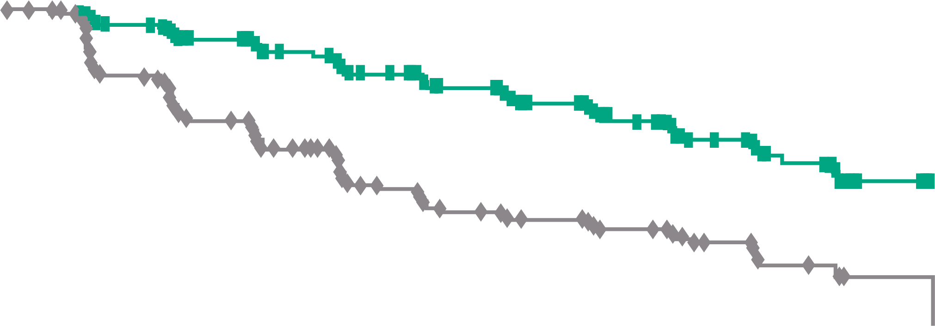
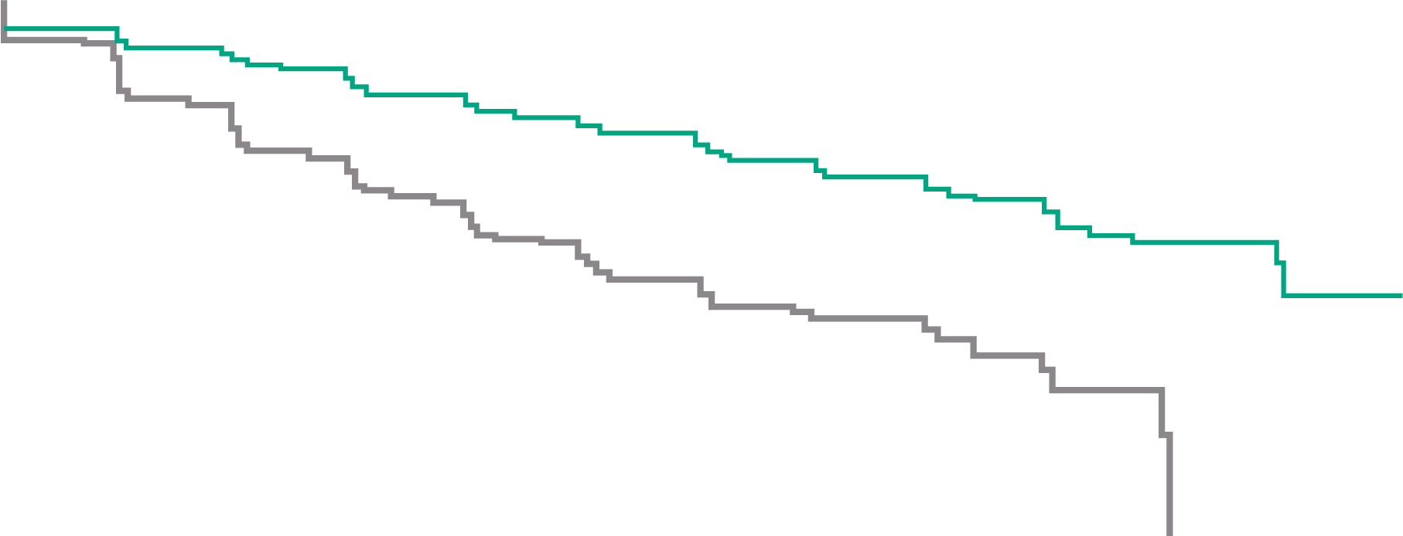
Primary Endpoint: Metastasis-Free Survival
SPARTAN:¹
Apalutamide
PROSPER:²
Enzalutamide
ARAMIS:³
Darolutamide
100
Apalutamide
Placebo
100
Enzalutamide
Placebo
1.0
Darolutamide
Placebo
80
90
0.9
80
0.8
60
70
0.7
Patients alive without metastasis (%)
60
0.6
Patients alive without metastasis (%)
MFS probability
40
50
0.5
40
0.4
20
30
0.3
HR 0.28 (95% CI 0.23-0.35) p<0.001
20
HR 0.29 (95% CI 0.24-0.35) p<0.001
0.2
HR 0.41 (95% CI 0.34-0.50) p<0.001
10
0.1
0
0
4
8
12
16
20
24
28
32
36
40
44
0
0
3
6
9
12
15
18
21
24
27
30
33
36
39
42
0
0
4
8
12
16
20
24
28
32
36
40
44
48
No. at risk
Apalutamide Placebo
Time since randomisation (months)
No. at risk
Enzalutamide Placebo
Time (months)
No. at risk
Darolutamide Placebo
Time (months)
806
401
713
291
652
220
514
153
398
91
282
58
180
34
96
13
36
5
16
1
3
0
0
0
933
468
865
420
759
296
637
212
528
157
431
105
418
98
328
64
237
49
159
31
87
16
77
11
31
5
4
1
0
0
955
554
817
368
675
275
506
180
377
117
262
75
189
50
116
29
68
12
37
4
18
0
2
0
0
0
 | SPARTAN |  | PROSPER |  | ARAMIS
 | APA (n=806) | PBO (n=401) | ENZA (n=933) | PBO (n=468) | DARO (n=955) | PBO (n=554)
Median follow-up | 20.3 months |  | 18.5 months | 15.1 months | 17.9 months
Median MFS, months | 40.5 | 16.2 | 36.6 | 14.7 | 40.4 | 18.4
HR (95% CI) | 0.28 (0.23-0.35) |  | 0.29 (0.24-0.35) |  | 0.41 (0.34-0.50)
p value | <0.001 |  | <0.001 |  | <0.001
APA, apalutamide; CI, confidence interval; DARO, darolutamide; ENZA, enzalutamide; HR, hazard ratio; MFS, metastasis-free survival; No., number; PBO, placebo
1. Smith MR, et al. N Engl J Med. 2018;378:1408-18; 2. Hussain M, et al. N Engl J Med. 2018;378:2465-74; 3. Fizazi K, et al. N Engl J Med. 2019;380:1235-46

Slide 8
Secondary Endpoint: Final Overall Survival
SPARTAN:¹
Apalutamide
PROSPER:²
Enzalutamide
ARAMIS:³
Darolutamide
100
100
Enzalutamide
Placebo
100
Darolutamide
Placebo
90
90
80
Apalutamide Median 73.9 months
80
80
60
70
70
60
60
Patients alive (%)
Patients alive (%)
Patients alive (%)
Placebo Median 59.9 months
50
 | Enzalutamide (n=933) | Placebo (n=468)
Median (95% CI), months | 67.0 (64.0-NR) | 56.3 (54.4-63.0)
HR (95% CI) | 0.73 (0.61-0.89)
 | p=0.001
50
40
Apalutamide
Placebo
40
40
30
30
20
HR for death 0.78 (95% CI 0.64-0.96) p=0.016
20
20
HR 0.69 (95% CI 0.53-0.88) p=0.003
10
10
0
0
4
8
12
16
20
24
28
32
36
40
44
48
52
56
60
64
68
72
76
0
0
4
8
12
16
20
24
28
32
36
40
44
48
52
56
60
64
68
72
0
0
4
8
12
16
20
24
28
32
36
40
44
48
52
56
60
No. at risk
Apalutamide Placebo
Time since randomisation (months)
No. at risk
Enzalutamide Placebo
Time (months)
No. at risk
Darolutamide Placebo
Time since randomisation (months)
806
401
791
392
774
385
758
373
739
358
717
339
691
328
658
306
625
286
593
263
558
240
499
204
376
156
269
114
181
82
100
38
47
21
19
6
4
2
0
0
933
468
926
467
910
459
897
444
874
428
850
404
822
381
782
363
700
321
608 274
517
219
424
177
327
140
244
106
169
64
89
30
33
16
4
3
0
0
955
554
932
530
908
497
863
460
816
432
771
394
680
333
549
261
425
182
293
130
214
93
129
54
69
28
37
16
12
4
0
0
 | SPARTAN |  | PROSPER |  | ARAMIS
 | APA (n=806) | PBO (n=401) | ENZA (n=933) | PBO (n=468) | DARO (n=955) | PBO (n=554)
Median follow-up, months | 52.0 |  | 48.0 |  | 29.0
Median OS, months | 73.9 | 59.9 | 67.0 | 56.3 | NR | NR
HR (95% CI) | 0.78 (0.64-0.96) |  | 0.73 (0.61-0.89) |  | 0.69 (0.53-0.88)
p value | 0.016 |  | 0.001 |  | 0.003
CI, confidence interval; HR, hazard ratio; ITT, intention to treat; NR, not reached; OS, overall survival
1. Smith MR, et al. Eur Urol. 2021;79:150-8; 2. Sternberg CN, et al. N Engl J Med. 2020;382:2197-206; 3. Fizazi K, et al. N Engl J Med. 2020;383:1040-9

Slide 9
Role of the Nurse in Managing Adverse Events
With the availability of new AR-targeted options for nmCRPC, oncology nurses play a crucial role in the decision-making process, educating and supporting patients in managing their prostate cancer, and ensuring that they receive the most appropriate treatment
Since nmCRPC patients are largely asymptomatic from their disease, maintaining QoL becomes a major objective
Oncology nurses educate patients on potential treatment-emergent adverse events (TEAEs) and their management, and serve as advocates to ensure that patients receive optimal care based on their individual therapeutic requirements
AR, androgen receptor; nmCRPC, non-metastatic castration resistant-prostate cancer; QoL, quality of life
Olivier KM, et al. Int J Urol Nurs. 2021. DOI: 10.1111/ijun.12263

Slide 10
SPARTAN:^{1,2} Apalutamide
ARAMIS:⁴
Darolutamide
Rash
Fatigue
Hot flush
Asthenic conditions^{h}
Seizure^{i}
Hypertension
Mental impairment disorders^{j}
Weight decreased
Depressed mood disorders^{j}
Bone fracture
Rash^{k}
Falls
Hot flush
Hypertension
Patients (%)
Cardiac arrhythmias^{j, l}
Coronary artery disorders^{j}
PROSPER:³
Enzalutamide
Heart failure^{j}
Weight decreased
Fatigue
Bone fracture^{m}
Falls
Asthenic conditions
Seizure
Patients (%)
Mental impairment disorders^{b}
Note: these data do not represent a head-to-head comparison of SPARTAN, PROSPER, and ARAMIS.
ª Data not reported in final analysis; ^{b} Includes disturbances in attention, cognitive disorders, amnesia, Alzheimer's disease, dementia, senile dementia, mental impairment, vascular dementia; ^{c} Includes maculopapular rash, generalised rash, macular rash, papular rash, pruritic rash; ^{d} Includes hypertensive retinopathy, increased blood pressure, systolic hypertension, hypertensive crisis; ^{e} Includes haemorrhagic CNS vascular conditions, ischaemic CNS vascular conditions, cardiac failure; ^{f} Includes myocardial infarction, other ischaemic heart disease; ^{g} Includes bone and joint injuries; ^{h} Combined term comprising of MedDRA terms of asthenic conditions, disturbances in consciousness, decreased strength and energy, malaise, lethargy, and asthenia; ^{i} One additional incidence of seizure occurred in the darolutamide group during the open-label period, in a patient with a history of epilepsy; ^{j} MedDRA High Level Group term; ^{k} MedDRA labelling grouping, including preferred terms of rash, rash macular, rash maculopapular, rash papular, rash pustular; ^{l} Although the incidence of the AE of cardiac arrhythmias was higher with darolutamide than with placebo, medical history of cardiac arrhythmia and electrocardiogram abnormalities were both present to a greater extent in the darolutamide group at baseline, as observed at primary analysis; ^{m} Combined term comprising MedDRA terms of any fractures and dislocations, limb fractures and dislocations, skull fractures, facial bone fractures and dislocations, spinal fractures and dislocations, thoracic cage fractures and dislocations
Rash^{c}
Hot flush
Hypertension^{d}
Cardiovascular events^{e}
Ischaemic heart disease^{f}
Bone fracture^{g}
Falls
Patients (%)
AE, adverse event; CNS, central nervous system; MedDRA, Medical Dictionary for Regulatory Activities, version 20.0; MI, myocardial infarction
1. Smith MR, et al. N Engl J Med. 2018;378:1408-18; 2. Smith MR, et al. Eur Urol. 2021;79:150-8; 3. Sternberg CN, et al. N Engl J Med. 2020;382:2197-206; 4. Fizazi K, et al. N Engl J Med. 2020;383:1040-9.
Figure adapted from: Olivier KM, et al. Int J Urol Nurs. 2021. DOI: 10.1111/ijun.12263

Slide 11
Managing Treatment-Emergent Adverse Events
Fatigue
Nurses should encourage regular exercise and eating a healthy diet
If severe or unmanageable, nurses should encourage prescribers to modify treatment strategy, including dose interruptions or reductions
Bone health
Evaluate bone health and fracture risk prior to ADT and throughout treatment (dual energy X-ray absorptiometry [DEXA], FRAX® Fracture Risk Assessment Tool)
Vitamin D and calcium supplementation and, where applicable, bisphosphonate or denosumab
Nurses should encourage weight-bearing exercise and implementation of lifestyle changes to prevent falls
ADT, androgen deprivation therapy
Olivier KM, et al. Int J Urol Nurs. 2021. DOI: 10.1111/ijun.12263

Slide 12
Managing Treatment-Emergent Adverse Events
Cognitive impairment
Screen for cognitive function at baseline and periodically throughout treatment
Nurses should elicit observations of cognitive changes from caregivers or responsible family members
Rash
Nurses should educate patients on the risk of developing rash
If rash is detected on physical examination, nurses should encourage prescribers to consider management with oral antihistamines and/or systemic corticosteroids (for Grade 3 or 4 rash) in addition to topical corticosteroids or dose interruption
Early intervention may lessen severity and recurrence of rash, and may prevent dose interruptions
Olivier KM, et al. Int J Urol Nurs. 2021. DOI: 10.1111/ijun.12263

Slide 13
Managing Treatment-Emergent Adverse Events
Metabolic changes
Monitor fasting glucose and liver function at baseline and throughout treatment
Nurses should educate patients on regular exercise and dietary modifications
Cardiovascular AEs
Monitor at baseline and throughout treatment
Nurses should educate patients on a heart-healthy diet
Nurses should educate patients on how to recognise, control, and prevent hypertension, deep vein thrombosis (DVT), and pulmonary embolism
AE, adverse event
Olivier KM, et al. Int J Urol Nurs. 2021. DOI: 10.1111/ijun.12263

Slide 14
Managing Treatment-Emergent Adverse Events
Hot flushes
Consider venlafaxine, gabapentin, or medroxyprogesterone acetate
Sexual health
Nurses can foster open communication between patients and their partners, and provide counselling on pharmacological and non-pharmacological options to reduce the burden of erectile dysfunction
Olivier KM, et al. Int J Urol Nurs. 2021. DOI: 10.1111/ijun.12263

Slide 15
In Summary
The treatment landscape in nmCRPC is evolving rapidly given the recent approvals of the three next-generation AR inhibitors
While no head-to-head comparisons of apalutamide, enzalutamide, and darolutamide have been conducted to date, all three have demonstrated comparable efficacy and maintained QoL in the SPARTAN, PROSPER, and ARAMIS trials, with differing AE profiles
Balancing treatment efficacy against the potential risk of TEAEs is an important clinical consideration in nmCRPC, since the incidence of cancer-related symptoms is low and pretreatment QoL scores are relatively high in this patient population
Oncology nurses can make a major contribution to successful therapeutic outcomes by educating patients with nmCRPC on their disease and available therapeutic options, recognising and managing specific TEAEs, and modifying treatment decisions accordingly
AE, adverse event; AR, androgen receptor; nmCRPC, non-metastatic castration resistant-prostate cancer; TEAE, treatment emergent adverse event; QoL, quality of life
1. Smith MR, et al. Eur Urol. 2021;79:150-8; 2. Sternberg CN, et al. N Engl J Med. 2020;382:2197-206; 3. Fizazi K, et al. N Engl J Med. 2020;383:1040-9; 4. Olivier KM, et al. Int J Urol Nurs. 2021. DOI: 10.1111/ijun.12263

Slide 16
REACH GU NURSES CONNECT VIA TWITTER, LINKEDIN, VIMEO & EMAIL OR VISIT THE GROUP’S WEBSITE https://gunursesconnect.info/
Follow us on Twitter @gunursesconnect
Follow the GUNURSESCOR2ED
Group on LinkedIn
Watch us on the Vimeo Channel GUNURSES CONNECT
Email sam.brightwell @cor2ed.com

