Slide 2
cholangiocarcinoma targeted therapies approaches Roniel Cabrera M.D., M.S. University of Florida Health Gainesville, FL, USA September 2020

Slide 3
DISCLAIMER
Please note: Views expressed within this presentation are the personal opinions of the author. They do not necessarily represent the views of the author’s academic institution or the rest of HCC CONNECT group.
This content is supported by an independent educational grant from Bayer.
Disclosures: Dr Roniel Cabrera has received honoraria from the following: Bayer, Eisai, Exelixsis.

Slide 4
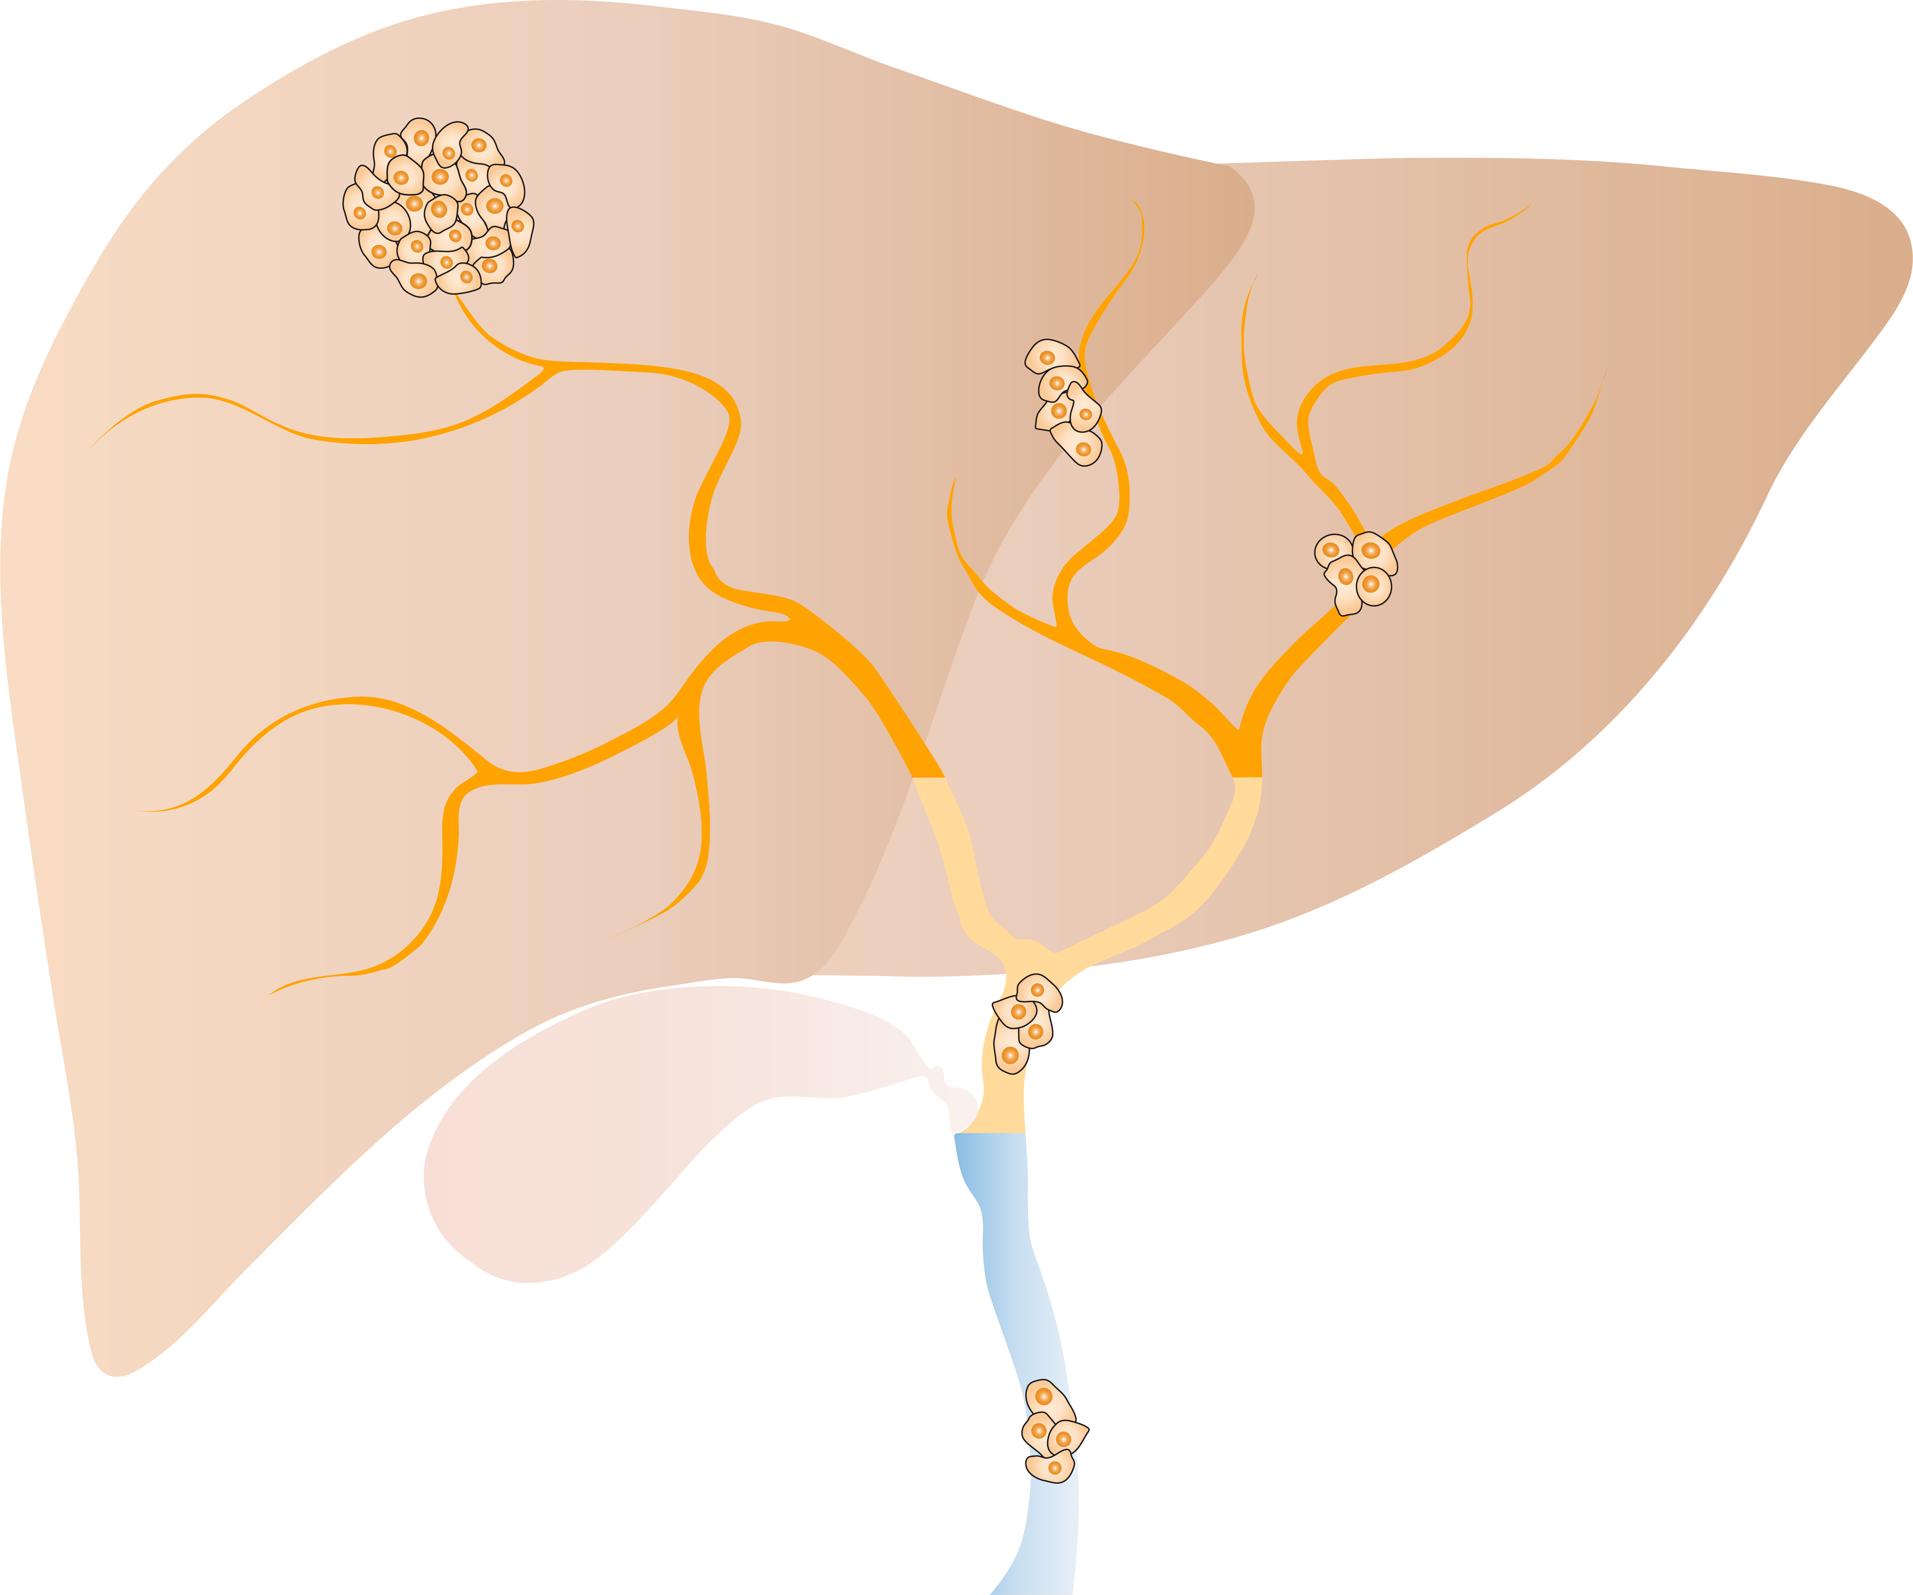
Cholangiocarcinoma
Cholangiocarcinoma is a biliary tract cancer type and includes:
Intrahepatic cholangiocarcinoma, iCCA (10-20%)¹:
Incidence is increasing
2nd most common primary liver cancer (after HCC)
Extrahepatic cholangiocarcinoma, eCCA (80-90%)¹:
Includes perihilar (pCCA) and distal (dCCA)
Incidence is decreasing
Prognosis remains poor with 5-year survival of around 5-15%²
Mass-forming
Periductal-infiltrating
Bile ductules
iCCA (10–20%)
Segmental ducts
Left, right, common hepatic ducts
pCCA (50–60%)
Intraductal-growing
Common bile duct
dCCA (20–30%)
dCCA, distal cholangiocarcinoma; eCCA, extrahepatic cholangiocarcinoma; HCC, hepatocellular carcinoma; iCCA, intrahepatic cholangiocarcinoma; pCCA, perihilar cholangiocarcinoma; OS, overall survival
1. Banales JM, et al. Nat Rev Gastroenterol Hepatol. 2020; Online ahead of print; 2. Lamarca A, et al. J Hepatol. 2020;73:170-85
Source figure: Banales JM, et al. Nat Rev Gastroenterol Hepatol. 2020; Online ahead of print

Slide 5
Cholangiocarcinoma: current treatments options
First-line treatment options:
Phase 3 UK ABC-02 trial established cisplatin + gemcitabine as a standard of care:¹
Median survival 11.7 months for cisplatin + gemcitabine vs 8.1 months for gemcitabine alone (HR, 0.64; 95% CI: 0.52-0.80; P<0.001)
The combination of gemcitabine + cisplatin well tolerated with similar AEs between the two groups
These results were supported by a Japanese randomised trial (BT22 study) showing that gemcitabine + cisplatin therapy was effective and well tolerated
Second-line treatment options:
There is no standard of care in second-line chemotherapy or targeted therapy²
One of the current strategies in 2L is based on immunotherapy based treatment with anti-PD1/PD-L1 and anti-CTLA-4 products
Recent publication demonstrated promising results with multikinase inhibitor (regorafenib) in 2L (as well as 3L) treatment³
Median PFS in the regorafenib group was 3.0 months (95% CI: 2.3-4.9) and 1.5 months (95% CI: 1.2-2.0) in the placebo group (HR 0.49; 95% CI: 0.29-0.81; P = 0.004)
Median overall survival was 5.3 months (95% CI: 2.7-10.5) and 5.1 months (95% CI: 3.0-6.4), respectively (P = 0.28).
There were no unexpected/new safety signals
There is an urgent need for novel therapeutic strategies: Promising data raised
with targeted therapy on molecularly defined subgroup of patients
2L, second-line; AEs, adverse events; CI, confidence interval; CTLA-4, cytotoxic T-lymphocyte-associated protein 4; HR, hazard ratio; PD1/PD-L1, programmed death/programmed death ligand 1; PFS; progression-free survival
1. Valle J, et al. New Engl J Med. 2010;362:1273-81; 2. Valle J, et al. Ann Oncol. 2016;27(suppl 5):v28-v37; 3. Demols A, et al. Ann Oncol. 2020;31:1169-77

Slide 6
Potentially Targetable genomic alterations in cholangiocarcinoma
Alterations | iCCA | eCCA | Current products under investigations
FGFR fusion | 15-20% | < 5% | derazantinib (ARQ-087), infigratinib (BGJ398), erdafitinib, TAS-120, pemigatinib, AZD4547
IDH1/2 mutation | ~20% | < 5% | ivosidenib (AG-120), enasidenib (AG-221), BAY-1436032, IDH305
ERBB2 (HER-2) amplification | < 5% | 10-15% | trastuzumab, lapatinib, TAS0728, A166, PRS-343, ZW25
BRAF mutation | ~5% | < 5% | dabrafenib + trametinib
DNA damage response gene mutation (ARID1A, BRCA1/2) | ~25% | 10-15% | PARP inhibitors: olaparib, rucaparib
Genomic sequencing of patients with CCA, should be performed early in order to identify those patients who harbour targetable aberrations
Therapies targeting alterations in FGFR, IDH1/2 will be discussed in this presentation
BRAF, proto-oncogene B-Raf; CCA, cholangiocarcinoma; eCCA, extrahepatic CCA; ERBB2, Erb-B2 receptor tyrosine kinase 2; FGFR, fibroblast growth factor receptor; HER‑2, human epidermal growth factor receptor 2; iCCA, intrahepatic CCA; IDH1/2, isocitrate dehydrogenase 1/2; PARP, poly(ADP-ribose) polymerase
Source table: Mizrahi JD and Shroff RT. Curr Treat Options Oncol. 2020;21:63

Slide 7
Clinical development overview with IDH inhibitors in cholangiocarcinoma*
IDH inhibitor | Mechanism of action | Current clinical trial phase | ClinicalTrials. gov identifier | Status
ivosidenib (AG-120) | Mutant IDH1 inhibitor | Phase 3 (ClarIDHy) | NCT02989857 | Active not recruiting
olutasidenib (FT 2102) | Mutant IDH1 inhibitor | Phase 1/2 | NCT03684811 | Focusing on glioma
enasidenib (AG-221/CC-90007) | Mutant IDH2 inhibitor | Phase 1/2 | NCT02273739 | Focusing on AML
IDH305 | Mutant IDH1 inhibitor | Phase 1 | NCT02381886 | Suspended
BAY1436032 | Mutant IDH1 inhibitor | Phase 1 | NCT02746081 | Focusing on AML
vorasidenib (AG-881) | Mutant IDH1/2 inhibitor | Phase 1 | NCT02481154 | Focusing on low-grade glioma
*Search done in ClinicalTrials.gov (as of 16 July 2020) for IDH inhibitor in cholangiocarcinoma disease and validated in the clinical development pipelines section of the company’s website
AML, acute myelogenous leukaemia; IDH1/2, isocitrate dehydrogenase 1/2

Slide 8
First Phase 3 results with IDH inhibitor in cholangiocarcinoma: ClarIDHy trial – design
ClarIDHy (NCT02989857): randomized phase 3 trial assessing ivosidenib (IDH1 inhibitor) vs placebo in patients with advanced cholangiocarcinoma harbouring an IDH1 mutation.
Key eligibility criteria
Histologically confirmed CCA
ECOG PS 0-1
1-2 prior therapies (at least 1 gemcitabine - or 5-FU- containing regimen)
Adequate hematologic, hepatic and renal function
(n=185)
Ivosidenib
500 mg QD orally
Continuous 28-day cycles
(n=124)
Eligible patients with mIDH1 CCA
R 2:1
Crossover permitted at disease progression
Placebo
(n=61)
Primary endpoint
PFS assessed by independent radiology centre review
Secondary endpoints include
Safety and tolerability
ORR
OS
DoR
TTR
PK/PD
QoL
Study period: between 20 February 2017 and 31 January 2019
5-FU, fluorouracil; CCA, cholangiocarcinoma; DoR, duration of response; ECOG PS, Eastern Cooperative Oncology Group performance status; IDH1, isocitrate dehydrogenase 1; mIDH1, mutation in isocitrate dehydrogenase 1; ORR, objective response rate; OS, overall survival; PD, pharmacodynamic; PFS, progression-free survival; PK, pharmacokinetic; QD, once a day; QoL, quality of life; R, randomized; TTR, time to response
Abou-Alfa GK, et al. Lancet Oncol. 2020;21:796-807

Slide 9
First Phase 3 results with IDH inhibitor in cholangiocarcinoma: ClarIDHy trial – efficacy
Data cut-off date: 31 January 2019
Baseline characteristics | Ivosidenib (n=124) | Placebo (n=61)
Previous line of therapy: One Two | 66 (53%) 58 (47%) | 33 (54%) 28 (46%)
ECOG PS 0 1 2 3 | 49 (40%) 74 (60%) 0 1 (1%) | 19 (31%) 41 (67%) 1 (2%) 0
Cholangiocarcinoma type of diagnosis Intrahepatic Extrahepatic Perihilar Unknown | 111 (90%) 1 (1%) 4 (3%) 8 (6%) | 58 (95%) 1 (2%) 0 2 (3%)
IDH1 mutation R132C R132L R132G R132S R132H | 84 (68%) 21 (17%) 17 (14%) 2 (2%) 0 | 45 (74%) 7 (11%) 6 (10%) 1 (2%) 2 (3%)
Primary endpoint: PFS by IRC review | Ivosidenib (n=124) | Placebo (n=61) | Placebo (n=61)
Median PFS, months (95% CI) | 2.7 (1.6-4.2) | 1.4 (1.4-1.6) | 1.4 (1.4-1.6
HR (95% CI), p value | 0.37 (0.25-0.54), p<0.0001
6-month PFS rate, % (95% CI) | 32 (23-42) |  | NE
12-month PFS rate, % (95% CI) | 22 (13-32) |  | NE
Secondary endpoints | Ivosidenib (n=124) | Placebo (n=61)
Median OS, months (95% CI) | 10.8 (7.7-17.6) | 9.7 (4.8-12.1)
HR (95% CI), p value | 0.69 (0.44-1.10), p=0.060
6-month OS rate, % (95% CI) | 67 (56-75) | 59 (44-71)
12-month OS rate, % (95% CI) | 48 (36-59) | 38 (22-54)
CI, confidence interval; ECOG PS, Eastern Cooperative Oncology Group performance status; HR, hazard ratio; IDH1, isocitrate dehydrogenase 1; IRC, independent radiology centre; NE, not estimable; OS, overall survival; PFS, progression-free survival
Abou-Alfa GK, et al. Lancet Oncol. 2020;21:796-807

Slide 10
First Phase 3 results with IDH inhibitor in cholangiocarcinoma: ClarIDHy trial – safety
Data cut-off date: 31 January 2019
Safety endpoints | Ivosidenib (n=121) | Placebo (n=59)
Most common AE grade ≥3 in both treatment arms = ascites | 9 (7%) | 4 (7%)
SAE | 36 (30%) | 13 (22%)
Treatment related SAE | 3 (2%) | 0
TEAE requiring dose reduction | 4 (3%) | 0
TEAE leading to treatment discontinuation | 7 (6%) | 5 (8%)
TRAE leading to treatment discontinuation | 2 (2%) | N/A
AE, adverse event; IDH, isocitrate dehydrogenase; N/A, not applicable; SAE, serious adverse event; TEAE, treatment emergent adverse event; TRAE, treatment-related adverse event
Abou-Alfa GK, et al. Lancet Oncol. 2020;21:796-807

Slide 11
First Phase 3 results with IDH inhibitor in cholangiocarcinoma: ClarIDHy trial – conclusion
ClarIDHy phase 3 trial met its primary endpoint: PFS (2.7 vs 1.4 months; p<0.0001)
It showed a favourable trend with OS and tolerable safety profile
Ivosidenib showed clinically relevant efficacy with a tolerable safety profile in advanced CCA harbouring IDH1 mutation
Genomic testing should become a standard of care procedure in order to find patient with advanced CCA harbouring IDH1 mutation who can then benefit from targeted therapy
CCA, cholangiocarcinoma; IDH1, isocitrate dehydrogenase 1; OS, overall survival; PFS, progression-free survival
Abou-Alfa GK, et al. Lancet Oncol. 2020;21:796-807

Slide 12
Clinical development overview with FGFR inhibitors in cholangiocarcinoma*
FGFR inhibitor | Genetic alterations in CCA population | Clinical trial phase | Trial Identifier | Status
pemigatinib | FGFR2 translocations | Phase 2 | NCT02924376 | Active, not recruiting
pemigatinib | FGFR2 rearrangement | Phase 2 | NCT04256980 | Recruiting
futibatinib (TAS-120) | FGFR2 gene rearrangements | Phase 3 | NCT04093362 | Not yet recruiting
E7090 | FGFR2 gene fusions | Phase 2 | NCT04238715 | Recruiting
Oral infigratinib (BGJ398) | FGFR2 gene fusions/translocations | Phase 3 | NCT03773302 | Recruiting
derazantinib (ARQ 087) | FGFR2 gene fusions/mutations/amplification | Phase 2 | NCT03230318 | Recruiting
infigratinib (BGJ398) | FGFR2 genetic alterations | Phase 2 | NCT02150967 | Recruiting
HMPL-453 | FGFR2 gene fusions | Phase 2 | NCT04353375 | Not yet recruiting
pemigatinib | FGFR2 rearrangement | Phase 3 | NCT03656536 | Recruiting
erdafitinib (JNJ-42756493) | FGFR translocations/mutations | Phase 2 | NCT02699606 | Active, not recruiting
infigratinib | FGFR mutations | Phase 2 | NCT04233567 | Recruiting
INCB062079 | FGF19/FGFR4 alterations | Phase 1 | NCT03144661 | Terminated
debio 1347 | FGFR1-2-3 gene fusions/rearrangements | Phase 2 | NCT03834220 | Active, not recruiting
*Search done in ClinicalTrials.gov (as of 16 July 2020) for FGFR inhibitor in cholangiocarcinoma disease
CCA, cholangiocarcinoma; FGFR, fibroblast growth factor receptor

Slide 13
FIGHT-202: FGFR inhibitor in cholangiocarcinoma – design
FIGHT-202 (NCT02924376): open-label, single arm, multi-cohort, phase 2 trial assessing pemigatinib (FGFR1-2-3 inhibitor) in patients with previously treated locally advanced or metastatic cholangiocarcinoma
Key eligibility criteria
Adult with local advanced or metastatic CCA
ECOG PS ≤2
Progression after ≥1 prior therapy
Adequate hepatic and renal function
Documented FGF/FGFR status
Cohort A
FGFR2 fusions/rearrangements (n=107)
Oral pemigatinib
13.5 mg once daily
2 weeks-on/1-week-off schedule
Cohort B
Other FGF/FGFR genetic alterations (n=20)
Cohort C
No FGF/FGFR genetic alterations (n=18)
Primary endpoint
ORR in patients with FGFR2 fusions or rearrangements assessed by ICR
Secondary endpoints include
ORR in patients with other FGF/FGFR alterations
ORR in all patients with FGF/FGRF alterations
ORR in patient with no FGF/FGFR alterations
DCR
DoR
PFS
OS
Safety
Study period: between 17 January 2017 and 22 March 2019
CCA, cholangiocarcinoma; DCR, disease control rate; DoR, duration of response; ECOG PS, Eastern Cooperative Oncology Group performance status; FGF, fibroblast growth factor; FGFR, FGF receptor; ICR, independent central review; ORR, objective response rate; OS, overall survival; PFS, progression-free survival
Abou-Alfa GK, et al. Lancet Oncol. 2020;21:671-84

Slide 14
FIGHT-202: FGFR inhibitor in cholangiocarcinoma – efficacy
Data cut-off date: 22 March 2019
Primary and secondary efficacy endpoints | FGFR2 fusions or rearrangements (n=107) | Other FGF/FGFR alterations (n=20) | No FGF/FGFR alterations (n=18)
ORR, % (95% CI) | 35.5 (26.5-45.4) | 0 | 0
Best overall responses, n (%) Complete response Partial response Stable disease Progressive disease Not evaluable | 3 (2.8%) 35 (32.7%) 50 (46.7%) 16 (14.9%) 3 (2.8%) | 0 0 8 (40.0%) 7 (35.0%) 5 (25.0%) | 0 0 4 (22.2%) 11 (61.1%) 3 (16.7%)
Median DoR, months (95% CI) | 7.5 (5.7-14.5) | – | –
DCR, % (95% CI) | 82 (74-89) | 40 (19-64) | 22 (6-48)
Median PFS, months (95% CI) | 6.9 (6.2-9.6) | 2.1 (1.2-4.9) | 1.7 (1.3-1.8)
Median OS, months (95% CI) | 21.1 (14.8- NE) | 6.7 (2.1-10.6) | 4.0 (2.3-6.5)
CI, confidence interval; DCR, disease control rate; DoR, duration of response; FGF, fibroblast growth factor; FGFR, FGF receptor; NE, not estimable; ORR, objective response rate; OS, overall survival; PFS, progression-free survival
Abou-Alfa GK, et al. Lancet Oncol. 2020;21:671-84

Slide 15
FIGHT-202: FGFR inhibitor in cholangiocarcinoma – safety
Data cut-off date: 22 March 2019
Safety endpoints | All patients (n=146) | FGFR2 fusions or rearrangements (n=107)* | Other FGF/FGFR alterations (n=20)* | No FGF/FGFR alterations (n=18)*
Discontinuation of treatment, n (%) | 115 (79) | 76 (71) | 20 (100) | 18 (100)
Most common AE: Hyperphosphatemia, n (%) | 88 (60)
AEs grade ≥3, n (%) Most frequent AEs grade ≥3: Hypophosphatemia, n (%) Arthralgia, n (%) Stomatitis, n (%) Hyponatremia, n (%) Abdominal pain, n (%) Fatigue, n (%) | 93 (64) 18 (12) 9 (6) 8 (5) 8 (5) 7 (5) 7 (5)
Discontinuation treatment owing to AEs | 13 (9)
AEs leading to dose reduction | 20 (14)
Dose interruptions due to AEs | 62 (42)
SAE | 65 (45)
*One patient with an undetermined FGF/FGFR alteration received pemigatinib and had discontinued by the cut-off date
AE, adverse event; FGF, fibroblast growth factor; FGFR, FGF receptor; SAE, serious adverse event
Abou-Alfa GK, et al. Lancet Oncol. 2020;21:671-84

Slide 16
FIGHT-202: FGFR inhibitor in cholangiocarcinoma – conclusion
Based on FIGHT-202 phase 2 trial, pemigatinib was approved by the United States FDA on April 17, 2020 for the treatment of previously treated, unresectable locally advanced or metastatic CCA with an FGFR2 fusion or other rearrangement
Promising efficacy results from other FGFR inhibitors presented at ASCO 2020:
FOENIX-CCA2¹: (NCT02052778) single-arm Phase 2 study: interim analysis presented on 67/103 patients with locally advanced/metastatic iCCA harbouring FGFR2 gene fusions or other rearrangements treated with futibatinib (FGFR1-4 inhibitor). ORR = 34.3% (all partial response n=23), DCR = 76.1%, median TTR=1.6 months (1.0-4.9)
Late phase trials (Phase 3) are ongoing:
FIGHT-302² : (NCT03656536): drug product under investigation: pemigatinib
Four patients enrolled as of 25 Sep 2019 (target: N=432).
Primary endpoint: PFS; secondary endpoints: ORR, OS, DoR, DCR, QoL, safety
PROOF³ : (NCT03773302) drug product under investigation: infigratinib
Study initiated in February 2019 and plan to enrol 350 patients.
Primary endpoint: PFS; secondary endpoints: ORR; OS, DoR, DCR, safety
ASCO, Association Society of Clinical Oncology; CCA, cholangiocarcinoma; DCR, disease control rate; DoR, duration of response; FDA, Food and Drug Administration; FGFR, fibroblast growth factor receptor; iCCA, intrahepatic CCA; ORR, objective response rate; OS, overall survival; PFS, progression-free survival; QoL, quality of life; TTR, time to response
1. Goyal L, et al. J Clin Oncol. 2020; 38, no. 15_suppl (May 20, 2020) 108-108; 2. Bekaii-Saab TS, et al. J Clin Oncol. 2020; 38, no. 4_suppl (Abstract # TPS592); 3. Javle MM, et al. J Clin Oncol. 2019; 37, no. 15_suppl (Abstract # TPS4155)

Slide 17
REACH HCC CONNECT VIA TWITTER, LINKEDIN, VIMEO & EMAIL OR VISIT THE GROUP’S WEBSITE http://www.hccconnect.info
Follow us on Twitter @hccconnectinfo
Follow the HCC CONNECT group on LinkedIn
Watch us on the Vimeo Channel HCC CONNECT
Email froukje.sosef@cor2ed.com

