Slide 2
Experts knowledge share
Selecting the appropriate treatment for indolent NHL: the now and the next
Prof. Alexey Danilov, MD, PhD
Assoc. Prof. Stefan K. Barta, MD, MRCP
Dr. Jessica Okosun, MD, PhD
Monday May 3rd, 2021

Slide 3
EXPERTS KNOWLEDGE SHARE
THE OBJECTIVE of this meeting is to discuss
Selecting the appropriate treatment for indolent NHL: the now and the next
Your opportunity to discuss and share learnings
A chance to hear the views of Experts and allow them to answer the questions that are important to you
Review and discuss Patient Case Studies using the questions that you have sent in advance of this event

Slide 4
Experts knowledge share educational objectives
You will learn more about and discuss:
The current and future treatment landscape in indolent non-Hodgkin lymphoma (NHL)
Considerations regarding treatment selection for patients with indolent NHL
Including the future use of targeted therapies, chimeric antigen receptor (CAR)-T cell therapy and bispecifics

Slide 5
Introducing the scientific committee
Prof. Alexey Danilov, MD, PhD
City of Hope National Medical Centre, Duarte, CA, USA
Assoc. Prof. Stefan K. Barta, MD, MRCP
University of Pennsylvania,
Philadelphia, PA, USA
Dr. Jessica Okosun, MD, PhD
Barts Cancer Institute and
St Bartholomew's Hospital, London, UK

Slide 6
funding
The LYMPHOMA & MYELOMA CONNECT programme is supported through independent educational grants from Bayer and Karyopharm Therapeutics
The programme is therefore independent, the content is not influenced by the supporters and is under the sole responsibility of the experts

Slide 7
EXPERTS KNOWLEDGE SHARE
Agenda
Selecting the appropriate treatment for indolent NHL: the now and the next
Time | Topic | Facilitator
5 minutes | Welcome and introductions | COR2ED
5 minutes | Overview and scene setting | Alexey Danilov
15 minutes | First-line treatment selection for indolent NHL | Stefan Barta
15 minutes | Treatment selection for relapsed/refractory indolent NHL | Jessica Okosun
5 minutes | Lead-in to breakout sessions | COR2ED
25 minutes | Three breakout groups Groups discussing questions and case studies and sharing experience | All (moderated by Faculty)
15 minutes | The future treatment landscape in indolent NHL | Alexey Danilov
5 minutes | Closing remarks | COR2ED

Slide 8
First-line treatment selection for indolent NHL
Stefan K. Barta, MD, MS, MRCP (UK)
Associate Professor of Medicine
University of Pennsylvania, Philadelphia, PA, USA

Slide 9
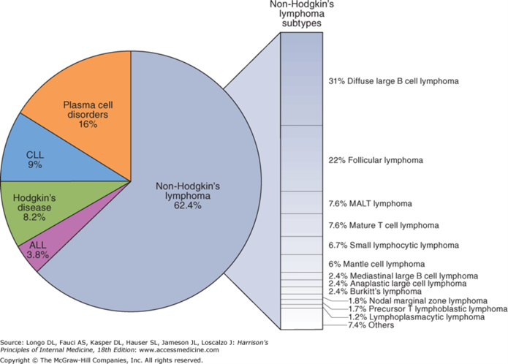
Indolent B-cell lymphomas – overview
Indolent lymphomas are generally considered incurable, but treatable lymphomas, with survival usually measured in the current era in “decades”
Most common indolent B-cell lymphomas are follicular lymphoma (FL) >> marginal zone lymphoma (MZL) (MALT [mucosa-associated lymphoid tissue], nodal, splenic) > small lymphocytic lymphoma (SLL)> lymphoplasmacytic lymphoma (LPL)
Median age of diagnosis 65, but can occur at much younger ages
Risk of transformation to an aggressive
B-cell malignancy varies by histology
(FL [2-3%/year] > SLL > MZL)
ALL, acute lymphocytic leukaemia.
Teras LR, et al. CA Cancer J Clin. 2016;66:443-59; Smith A, et al. Br J Cancer. 2015;112:1575-84

Slide 10
Initial assessment
Treatment depends largely on stage, disease “bulk”, and symptoms, therefore adequate staging
is paramount
  Staging with positron emission tomography/computed tomography (PET/CT) or computed tomography of chest, abdomen, pelvis (CT CAP) +/- neck
  Bone marrow biopsy in certain circumstances
Prognostic tools take into account mainly clinical factors, such as age, stage, lactate dehydrogenase (LDH), number of involved sites, bone marrow involvement +/- molecular information and response to initial therapy:
  Follicular Lymphoma International Prognostic Index (FLIPI); FLIPI2; PRIMA-PI; M7-FLIPI¹⁻⁴
  MALT Lymphoma prognosis index (MALT-IPI)⁵
  CLL-IPI⁶
  Positive PET after induction chemoimmunotherapy (CIT)⁷
  Early relapse after completion of initial CIT⁸
CLL, chronic lymphocytic leukaemia; IPI, International Prognostic Index; MALT, mucosa-associated lymphoid tissue
1. Solal-Celigny P, et al. Blood. 2004;104:1258-65; 2. Federico M, et al. J Clin Oncol. 2009;27:4555-62; 3. Bachy E, et al. Blood. 2018;132:49-58; 4. Huet S, et al. Lancet Oncol. 2018;19:549-61; 5. Thieblemont C, et al. Blood. 2017;130:1409-17; 6. International CLL-IPI working group. Lancet Oncol. 2016;17:779-90; 7. Trotman J. Lancet Oncol. 2018; 19: 1530-42; 8. Casulo C, et al. J Clin Oncol. 2015;33:2516-22; 9. Launonen A, et al. Blood. 2017;130 (suppl 1):1490

Slide 11
Focus on FL and nodal MZL – When to treat?
Early stage:
Select patients may be treated with local therapy with “curative intent”
Advanced disease:
Candidates for “watchful waiting”
Asymptomatic; low bulk, slowly progressive disease; no impending organ compromise
Indicators to initiate treatment
Groupe d'Etude des Lymphomes Folliculaires (GELF) criteria:
Tumour size: any site >7 cm or ≥3 sites >3 cm
B symptoms
Spleen: below umbilical line
Compressive symptoms
Pleural or peritoneal effusion
Other criteria:
Cytopenias
Impairment of major organ function
Marked blood lymphocytosis
Steady or rapid progression
Watch and wait:
No overall survival (OS) benefit of initiation of CIT at diagnosis over delayed initiation has been shown
Assumes that delay in exposure to therapy and its attendant side-effects results in an improved quality of life (QoL)
Average time from diagnosis to treatment: 30 months
At 10 years, ca. 20% still do not require therapy
CIT, chemoimmunotherapy; FL, follicular lymphoma, MZL, marginal zone lymphoma
Press OW, Palanca-Wessels MC. J Clin Oncol. 2013;31:1496-8; NCCN Guidelines V3.2021; Brice P, et al. J Clin Oncol. 1997;15:1110-7; Portlock CS, Rosenberg SA. Ann Intern Med. 1979;90:10-3; Horning SJ, Rosenberg SA. N Engl J Med. 1984;311:1471-5; Ardeshna KM, et al. Lancet. 2003;362:516-22

Slide 12
Proposed treatment algorithm for newly diagnosed follicular or nodal MZL requiring treatment
Radiotherapy
Limited diseaseª
Surveillance
Rituximab (alone or in combination with chemotherapy or radiotherapy)
Treatment naive
Surveillance
Low tumour burden
Rituximab
Advanced disease
CIT (including a CD20 antibody)
High tumour burden
Rituximab + lenalidomide (LEN+R)
Rituximab
ª Patients with limited disease but high tumour burden should be treated as per patients with advanced disease and high tumour burden
CD20, cluster of differentiation 20; CIT, chemoimmunotherapy; MZL, marginal one lymphoma
Modified from Matasar MJ, et al. Oncologist. 2019;24:e1236-50

Slide 13
“Watch and Wait” vs Rituximab in low tumour burden FL

Slide 14
Rituximab for low tumour burden FL
484 patients enrolled
21 excluded
7 not eligible
1 stage 1 disease
5 high tumour burden
1 reason not stated
3 physician started treatment
1 second malignancy discovered
1 consent withdrawn
1 diagnosis revised to MCL
8 reasons unknown
463 patients randomly assigned
187 patients assigned to watch and waitª
84 patients assigned to rituximab induction
192 patients assigned to maintenance rituximabª
2 stopped early because of toxicity
1 missing information
1 missing information
81 received four infusions
191 received four induction infusions
36 stopped early
156 received 12 maintenance infusions
187 included in intention-to-treat (ITT) population
84 included in ITT population
192 included in ITT population
ª Inclusive of the patients enrolled in the three-arm study (83 in the watch and wait group and 85 in the maintenance rituximab group)
FL, follicular lymphoma; MCL, mantle-cell lymphoma
Ardeshna KM, et al. Lancet Oncol. 2014;15:424-35

Slide 15
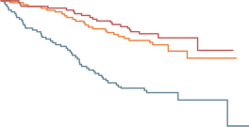
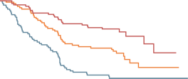

Rituximab for low tumour burden FL
Time to start of new treatment
Watch and wait
Rituximab induction
Maintenance rituximab
Progression-free survival (PFS)
100
100
Overall response rate (ORR) improved for rituximab maintenance vs rituximab induction:
  6 months 91% vs 77% (p=0.043)
  2 years 84% vs 57% (p=0.001)
QoL showed significant improvement in the Mental Adjustment to Cancer scale & Illness Coping Style scores for rituximab maintenance over “watch and wait”
  Only Mental Adjustment to Cancer scores better in rituximab maintenance vs rituximab induction
75
75
No new treatment (%)
PFS (%)
50
50
25
Rituximab induction vs watch and wait
HR 0.35 (95% CI 0.22-0.56); log-rank p<0.0001
Maintenance rituximab vs rituximab induction
HR 0.75 (95% CI 0.41-1.34); log-rank p=0.33
25
Rituximab induction vs watch and wait
HR 0.55 (95% CI 0.37-0.83); log-rank p=0.0034
Maintenance rituximab vs rituximab induction
HR 0.53 (95% CI 0.32-0.87); log-rank p=0.011
0
0
1
2
3
4
5
6
7
0
0
1
2
3
4
5
6
7
Number at risk:
Watch and wait
Rituximab induction
Maintenance rituximab
83
84
85
66
80
81
52
69
76
36
61
70
29
44
49
6
13
10
1
5
1
0
0
0
83
84
85
59
77
80
44
59
72
29
48
67
25
35
48
6
11
9
1
4
1
0
0
0
Overall survival
Time to histological transformation
100
100
75
75
50
No histological transformation (%)
OS (%)
50
25
Rituximab induction vs watch and wait
HR 1.04 (95% CI 0.39-2.80); log-rank p=0.93
Maintenance rituximab vs rituximab induction
HR 1.12 (95% CI 0.43-2.90); log-rank p=0.82
25
Rituximab induction vs watch and wait
HR 0.34 (95% CI 0.11-1.06); log-rank p=0.0052
Maintenance rituximab vs rituximab induction
HR 1.47 (95% CI 0.42-5.22); log-rank p=0.55
0
0
0
1
2
3
4
5
6
7
0
0
1
2
3
4
5
6
7
Number at risk:
Watch and wait
Rituximab induction
Maintenance rituximab
Years from randomisation
Years from randomisation
83
84
85
83
82
83
83
78
82
79
77
81
62
61
61
18
16
16
4
5
3
0
0
0
83
84
85
82
82
83
79
79
80
71
75
79
58
59
59
15
15
16
4
5
3
0
0
0
CI, confidence interval; FL, follicular lymphoma; HR, hazard ratio; OS, overall survival; QoL, quality of life
Ardeshna KM, et al. Lancet Oncol. 2014;15:424-35

Slide 16
Treatment options for advanced indolent B-cell lymphomas
Focus on FL and Nodal MZL
Does everyone need CIT?
What is the optimal chemotherapy backbone in CIT?
Does the type of CD20 monoclonal antibody matter?
Has the time for “chemo-free” therapy arrived?
Maintenance
or not?
CD20, cluster of differentiation 20; CIT, chemoimmunotherapy; FL, follicular lymphoma; MZL, marginal zone lymphoma

Slide 17




Rituximab alone for advanced indolent B-cell NHL
Retrospective analysis of 439 patients treated on
two prospective Nordic Lymphoma Group (NLG) trials with rituximab monotherapy or rituximab + IFNα-2a
  FL (Grade 1-3a): 84%; MZL 8%
  Median follow-up: 10.6 years (range 0.1-18.8)
OS rate since randomisation
  10-year OS rate 75% (LSS: 82%)
  15-year OS rate 65% (LSS: 77%)
36% never required chemotherapy during follow-up
Early progression of disease (POD) (≤2 years) associated with worse OS:
  10-year OS rates 62% vs 89%
  15-year OS rates 53% vs 78%
At 10 and 15 years after random assignment, the cumulative risk of transformation was 20% and 24% (slightly higher in non-FL group)
1.00
Rituximab monotherapy
Rituximab + interferon (IFN)
1.00
Rituximab monotherapy
R + IFN
0.75
0.75
OS (proportion)
LSS (proportion)
0.50
0.50
0.25
0.25
0
0
5
10
15
20
0
0
5
10
15
20
No. at risk:
R mono
R + IFN
Time (years)
No. at risk:
R mono
R + IFN
Time (years)
173
148
138
124
82
67
20
8
0
0
173
148
138
124
82
67
20
8
0
0
1.00
FL
Other
1.00
FLIPI low
FLIPI intermediate
FLIPI high
0.75
OS (proportion)
0.75
0.50
Time to failure (TTF) (proportion)
0.50
0.25
0.25
0
0
5
10
15
0
0
5
10
15
20
No. at risk:
FL
Other
Time (years)
No. at risk:
FLIPI low
FLIPI intermediate
FLIPI high
Analysis time (years)
269
52
220
42
128
21
24
4
58
101
108
24
33
32
13
17
11
8
2
0
FL, follicular lymphoma; FLIPI, Follicular Lymphoma International Prognostic Index; LSS, lymphoma-specific survival; NHL, non-Hodgkin’s lymphoma; OS, overall survival
Lockmer S, et al. J Clin Oncol. 2018;36:3315-23

Slide 18
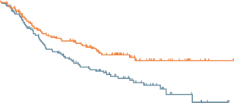
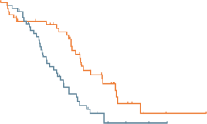
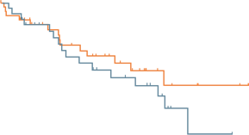
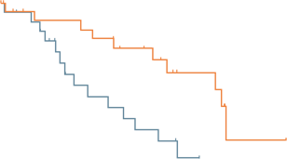
StiL study: B-R vs R-CHOP as first-line treatment in indolent and mantle-cell lymphomas
PFS by subtype
 | B-R (N=261) | R-CHOP (N=253)
Age (years) <60 61-70 >70 | 64 (34-83) 94 (36%) 107 (41%) 60 (23%) | 63 (31-82) 90 (36%) 105 (42%) 58 (23%)
Stage II III IV | 9 (3%) 50 (19%) 202 (77%) | 9 (4%) 47 (19%) 197 (78%)
Histology Follicular Mantle cell Marginal zone Lymphoplasmacyticª Small lymphocytic Low grade, unclassifiable | 139 (53%) 46 (18%) 37 (14%) 22 (8%) 10 (4%) 7 (3%) | 140 (55%) 48 (19%) 30 (12%) 19 (8%) 11 (4%) 5 (2%)
1.0
Median (IQR; months)
B-R Not reached (22.1 to not yet reached)
R-CHOP 40.9 (15.2 to not yet reached)
Median (IQR; months)
B-R 35.4 (28.8-54.9)
R-CHOP 22.1 (15.1-33.8)
0.9
0.8
0.7
0.6
Probability
0.5
MCL
0.4
FL
0.3
HR 0.49
(95% CI 0.28-0.79)
p=0.0044
0.2
HR 0.61 (95% CI 0.42-0.87)
p=0.0072
0.1
0
0
12
24
36
48
60
72
84
96
0
12
24
36
48
60
72
84
96
1.0
Median (IQR; months)
B-R 57.2 (20.9 to not yet reached)
R-CHOP 47.2 (20.3-65.7)
Median (IQR; months)
B-R 69.5 (36.6-73.0)
R-CHOP 28.1 (17.8-51.0)
0.9
0.8
0.7
0.6
ª WM
Probability
0.5
Responses B-R vs R-CHOP:
ORR 93% vs 91% (not significant)
Complete response (CR) rate 76% vs 40% (p=0.02)
0.4
MZL
WM
0.3
0.2
HR 0.70 (95% CI 0.34-1.43)
p=0.3249
HR 0.33 (95% CI 0.11-0.64)
p=0.0033
0.1
0
0
12
24
36
48
60
72
84
96
0
12
24
36
48
60
72
84
96
Time (months)
Time (months)
B-R, bendamustine plus rituximab; CI, confidence interval; FL, follicular lymphoma; IQR, interquartile range; HR, hazard ratio; MCL, mantle-cell lymphoma; MZL, marginal zone lymphoma; PFS, progression-free survival; R-CHOP, cyclophosphamide, doxorubicin, vincristine, prednisone plus rituximab; WM, Waldenstrom’s macroglobulinaemia
Rummel MJ, et al. Lancet. 2013;381:1203-10

Slide 19
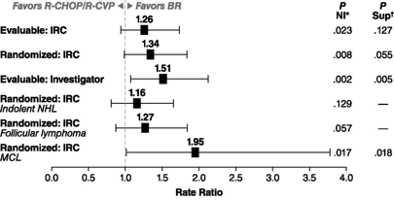
BRIGHT study: B-R or R-CHOP/R-CVP in first-line treatment of indolent NHL or MCL
Patient characteristics at baseline
Complete response rate (IRC) ratios as per treatment arm
Characteristic | BR (N=224) | R-CHOP/R-CVP (N=223)
Age, median, years (range) | 60 (28-84) | 58 (25-86)
Sex (male/female, %) | 61/39 | 59/41
Baseline ECOG PS, n (%) 0 1 ≥2 | 144 (64) 70 (31) 10 (4) | 143 (64) 69 (31) 10 (4)
Histologic classification Lymphoplasmacytic Marginal zone Mantle cell Follicular, Grade 1 Follicular, Grade 2 Missing | 5 (2) 28 (12) 36 (16) 84 (38) 70 (31) 1 (<1) | 6 (3) 18 (8) 38 (17) 70 (31) 90 (40) 1 (<1)
Independent review committee (IRC) assessment or response
Response category, n (%) | B-R (N=213) | R-CHOP/R-CVP (N=206) | CR-rate ratio | p (NI) | p (Sup)
CR 95% CI | 67 (31) (25.3-38.2) | 52 (25) (19-31.7) | 1.26 (0.93-1.73) | 0.0225 | 0.1269
Partial response (PR) Stable disease (SD) Progressive disease (PD) Unknown | 139 (65) 6 (3) 1 (<1) 0 | 135 (66) 18 (9) 0 1 (<1) | NA NA NA NA | NA NA NA NA | NA NA NA NA
Overall response (CR + PR) 95% CI | 206 (97) (93.3-98.7) | 187 (91) (86.0-94.4) | NA NA | NA NA | NA NA
B-R, bendamustine plus rituximab; CI, confidence interval; CR, complete response; ECOG PS, Eastern Cooperative Oncology Group Performance Status; MCL, mantle-cell lymphoma; NA, not applicable; NHL, non-Hodgkin’s lymphoma; NI, noninferiority; Sup, superiority; R-CHOP, cyclophosphamide, doxorubicin, vincristine, prednisone plus rituximab; R-CVP, rituximab plus cyclophosphamide, vincristine, prednisone
Flinn IW, et al. Blood. 2014;123:2944-52; Flinn IW, et al. J Clin Oncol. 2019;37:984-91

Slide 20
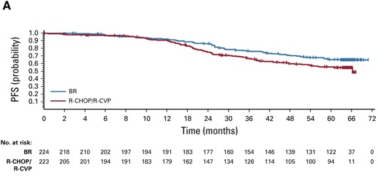
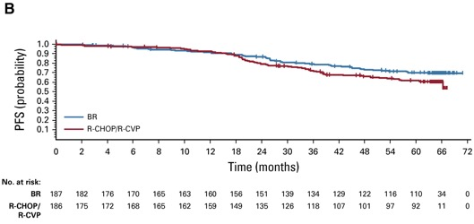
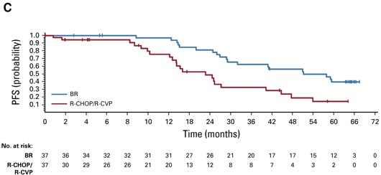
BRIGHT study: B-R or R-CHOP/R-CVP in first-line treatment of indolent NHL or MCL
5-year PFS 65.5% vs 55.8% (HR 0.61; p=0.0025)
HR 0.70; p=0.0582
All patients
Indolent B-cell NHL
HR 0.40; p=0.0035
MCL
B-R vs R-CHOP: HR 0.65 (95% CI 0.4-1.06)
B-R vs R-CVP: HR 0.59 (95% CI 0.38-0.90)
B-R, bendamustine plus rituximab; HR, hazard ratio; MCL, mantle-cell lymphoma; NHL, non-Hodgkin’s lymphoma; PFS, progression-free survival; R-CHOP, cyclophosphamide, doxorubicin, vincristine, prednisone plus rituximab; R-CVP, rituximab plus cyclophosphamide, vincristine, prednisone
Flinn IW, et al. Blood. 2014;123:2944-52; Flinn IW, et al. J Clin Oncol. 2019;37:984-91

Slide 21
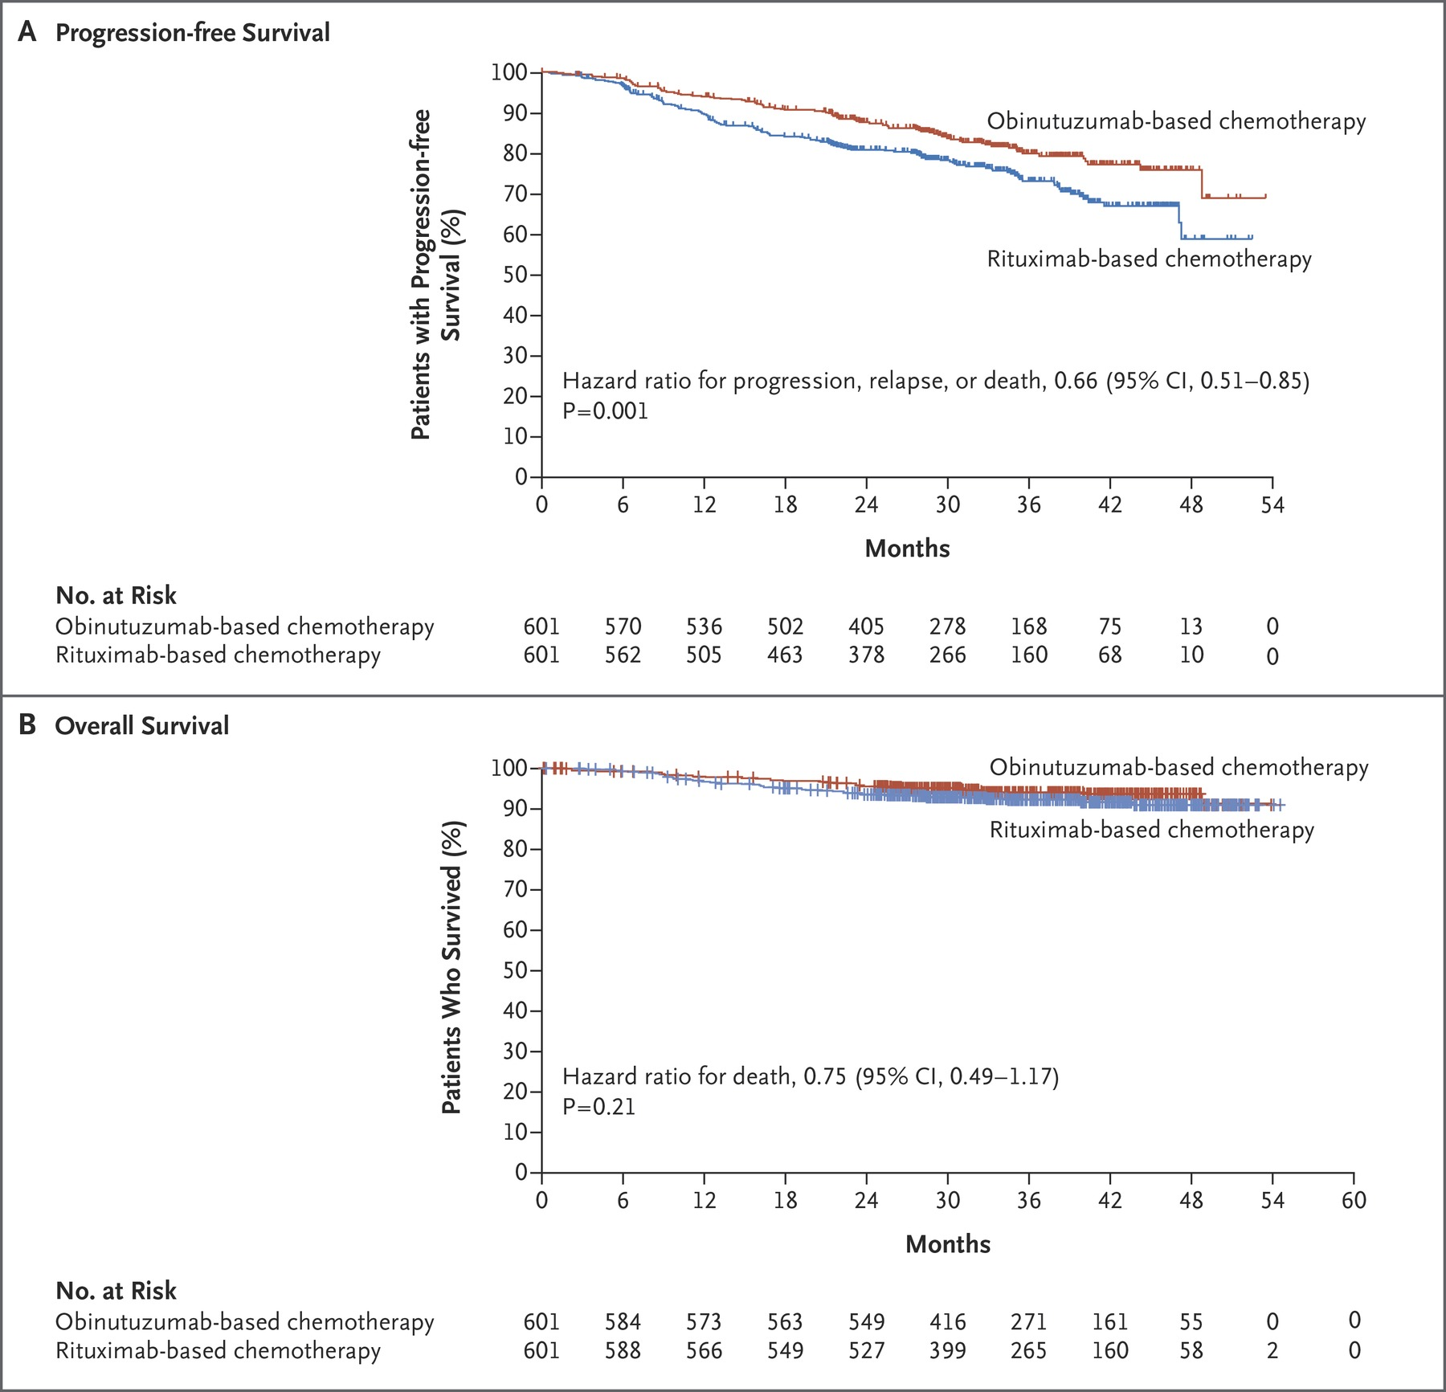
GALLIUM: Obinutuzumab- vs Rituximab-based CIT in FL
PFS
 | Obinutuzumab group | Rituximab group
IRC-assessed PFS
Patients with progression, relapse, or death, n (%) | 93 (15.5) | 125 (20.8)
Rate of estimated 3-year PFS (95% CI), % | 81 (77.9-85.2) | 77.9 (73.8-81.4)
HR for progression, relapse, or death (95% CI) | 0.71 (0.54-0.93)
p value by log-rank test | 0.01
Treatment response at end of induction phase
CR or PR | 532 (88.5) | 522 (86.9)
Difference (95% CI) – percentage points | 1.6 (−2.1 -5.5)
p value by Cochran–Mantel–Haenszel test | 0.33
CR | 117 (19.5) | 143 (23.8)
Difference (95% CI) – percentage points | −4.3 (−9.1 to 0.4)
p value by Cochran–Mantel–Haenszel test | 0.07
OS
CI, confidence interval; CIT, chemoimmunotherapy; CR, complete response; FL, follicular lymphoma; IRC, independent review committee; OS, overall survival; PFS, progression-free survival; PR, partial response
Marcus R, et al. N Engl Med. 2017;377:1331-44

Slide 22
GALLIUM: Obinutuzumab- vs Rituximab-based CIT in FL
Event | Induction phase |  | Maintenance and observation phases |  | Follow-up
 | Obinutuzumab | Rituximab | Obinutuzumab | Rituximab | Obinutuzumab | Rituximab
Infection Bendamustine CHOP CVP | 27/338 (8.0) 14/193 (7.3) 3/61 (4.9) | 26/338 (7.7) 13/203 (6.4) 4/56 (7.1) | 52/312 (16.7) 7/179 (3.9) 5/57 (8.8) | 39/305 (12.8) 11/187 (5.9) 1/43 (2.3) | 25/270 (9.3) 2/128 (1.6) 1/44 (2.3) | 6/263 (2.3) 2/143 (1.4) 2/45 (4.4)
Second neoplasm Bendamustine CHOP CVP | 0 0 0 | 0 0 0 | 21/312 (6.7) 8/179 (4.5) 0 | 18/305 (5.9) 8/187 (4.3) 1/43 (2.3) | 14/270 (5.2) 1/128 (0.8) 0 | 2/263 (0.8) 1/143 (0.7) 0
CIT, chemoimmunotherapy; CHOP, cyclophosphamide, doxorubicin, vincristine, prednisone; CVP, cyclophosphamide, vincristine, prednisone; FL, follicular lymphoma
Marcus R, et al. N Engl Med. 2017;377:1331-44

Slide 23
RELEVANCE trial: rituximab + lenalidomide (LEN+R) vs R-chemo
Baseline demographic and disease characteristics (ITT population)
Efficacy (ITT population)
Characteristic | LEN+R group (N=513) | R-chemo group (N=517) | Total (N=1,030)
Median age (range), years | 59 (30-89) | 59 (23-83) | 59 (23-89)
Age >70 years, n (%) | 80 (16) | 78 (15) | 158 (15)
Male sex, n (%) | 251 (49) | 251 (49) | 502 (49)
Ann Arbor stage, n (%) I or II III or IV | 30 (6) 483 (94) | 40 (8) 477 (92) | 70 (7) 960 (93)
Bulky disease, n (%) | 218 (42) | 199 (38) | 417 (40)
FL, Grade, n (%) 1 or 2 3a Unspecified or grade other than 1, 2 or 3a | 437 (85) 65 (13) 11 (2) | 443 (86) 63 (12) 11 (2) | 880 (85) 128 (12) 22 (2)
LDH >ULN, n (%) | 156 (30) | 137 (26) | 293 (28)
B symptoms, n (%) | 141 (27) | 134 (26) | 275 (27)
FLIPI score, n (%) 0 or 1 2 3 to 5 | 77 (15) 183 (36) 253 (49) | 76 (15) 191 (37) 250 (48) | 153 (15) 374 (36) 503 (49)
Variable | LEN+R group (N=513) | R-chemo group (N=517) | HR (95% CI) | p value
Response status at 120 weeks, as assessed by IRC
Overall response, n (% [95% CI]) | 312 (61 [56-65]) | 336 (65 [61-69])
Confirmed or unconfirmed CR, n (% [95% CI]) | 247 (48 [44-53]) | 274 (53 [49-57]) |  | 0.13
PR, n (%) | 65 (13) | 62 (12)
SD, n (%) | 2 (<1) | 0
PD or death, n (%) | 87 (17) | 79 (15)
Not evaluated or data missing, n (%) | 112 (22) | 102 (20)
PFS at 3 years
Rate, per IRC, % (95% CI) | 77 (72-80) | 78 (74-82) | 1.0 (0.85-1.43) | 0.48
Rate, per investigator, % (95% CI) | 77 (72-80) | 78 (74-81) | 0.94 (0.73-1.22) | 0.63
OS rate at 3 years, % (95% CI) | 94 (91-96) | 94 (91-96) | 1.16 (0.72-1.86)
R-chemo: 372 (72%) R-CHOP; 117 (23%) B-R; 28 (5%) R-CVP
B-R, bendamustine plus rituximab; CI, confidence interval; CR, complete response; ECOG PS, Eastern Cooperative Oncology Group Performance Status; FL, follicular lymphoma; FLIPI, Follicular Lymphoma International Prognostic Index; HR, hazard ratio; IRC, independent review committee; ITT, intention-to-treat; OS, overall survival; PD, progressive disease; PFS, progression-free survival; PR, partial response; LEN+R, rituximab plus lenalidomide; R-chemo, rituximab plus chemotherapy; R-CHOP, cyclophosphamide, doxorubicin, vincristine, prednisone plus rituximab; R-CVP, rituximab plus cyclophosphamide, vincristine, prednisone; SD, stable disease; ULN, upper limit of normal
Morschhauser F, et al. N Engl J Med. 2018;379:934-47

Slide 24
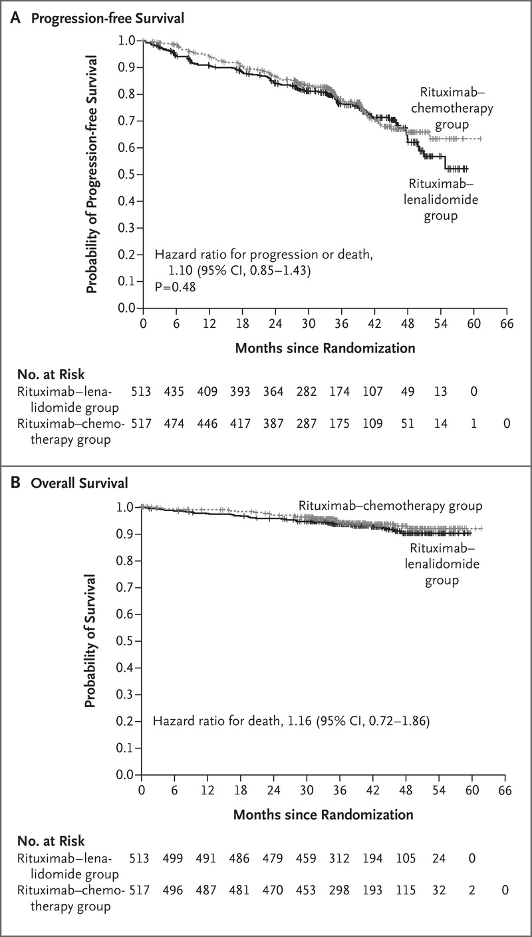
RELEVANCE: PFS and OS similar, but different toxicity profile
PFS
Adverse events (AEs) during the treatment period in the safety population
AE, n (%) | LEN+R group (N=507) |  | R-chemo group (N=503)
 | Any grade | Grade 3 or 4 | Any grade | Grade 3 or 4
Neutropenia | 381 (75) | 160 (32) | 386 (77) | 252 (50)
Anaemia | 333 (66) | 0 | 446 (89) | 0
Thrombocytopenia | 268 (53) | 11 (2) | 266 (53) | 8 (2)
Cutaneous reactions | 220 (43) | 36 (7) | 120 (24) | 5 (1)
Diarrhoea | 187 (37) | 10 (2) | 95 (19) | 6 (1)
Constipation | 178 (35) | 1 (<1) | 167 (33) | 5 (1)
Rash | 146 (29) | 20 (4) | 39 (8) | 1 (<1)
Fatigue | 115 (23) | 1 (<1) | 147 (29) | 4 (<1)
Nausea | 100 (20) | 0 | 209 (42) | 8 (2)
Abdominal pain | 78 (15) | 4 (<1) | 46 (9) | 4 (<1)
Myalgia | 73 (14) | 0 | 29 (6) | 1 (<1)
Arthralgia | 71 (14) | 3 (<1) | 70 (14) | 1 (<1)
Peripheral oedema | 69 (14) | 0 | 47 (9) | 1 (<1)
Muscle spasms | 68 (13) | 0 | 21 (4) | 0
Infusion-related reaction | 66 (13) | 7 (1) | 56 (11) | 1 (<1)
Upper respiratory tract infection | 47 (9) | 0 | 55 (11) | 0
Vomiting | 34 (7) | 2 (<1) | 94 (19) | 7 (1)
Peripheral neuropathy | 35 (7) | 1 (<1) | 79 (16) | 3 (<1)
Tumour flare reaction | 30 (6) | 7 (1) | 1 (<1) | 0
Leucopenia | 21 (4) | 8 (2) | 48 (10) | 30 (6)
Febrile neutropenia | 11 (2) | 11 (2) | 34 (7) | 33 (7)
Tumour lysis syndrome | 7 (1) | 6 (1) | 5 (1) | 3 (<1)
Alopecia | 5 (1) | 0 | 45 (9) | 3 (<1)
OS
OS, overall survival; PFS, progression-free survival; LEN+R, rituximab plus lenalidomide; R-chemo, rituximab plus chemotherapy
Morschhauser F, et al. N Engl J Med. 2018;379:934-47

Slide 25
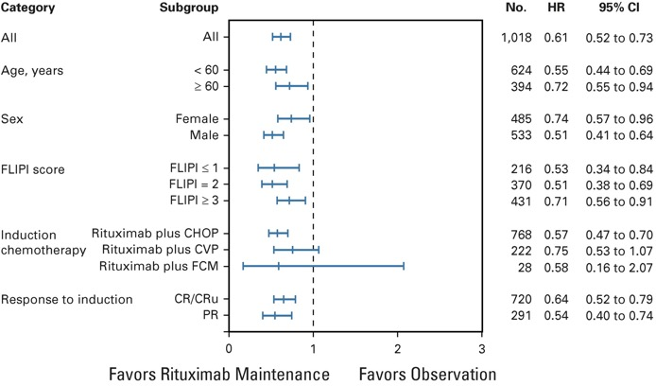
PRIMA Study – 10 year follow up
N=1,018
Observation vs rituximab maintenance
(every 8 weeks × 12)
Median duration of follow-up:
9.0 years (range 0.0-11.5)
Median PFS:
  Observation: 4.1 years
  Rituximab maintenance 10.5 years
  HR 0.61; 95% CI, 0.52-0.73; p<0.001
10-year OS rate estimates:
  Observation: 79.9%
  Rituximab maintenance: 80.1%
  HR 1.04; 95% CI 0.77-1.40; p=0.7948
CI, confidence interval; CR(u), (unconfirmed) complete response; FCM, fludarabine, cyclophosphamide, mitoxantrone; FLIPI, Follicular Lymphoma International Prognostic Index; HR, hazard ratio; OS, overall survival; PR, partial response
Bachy E, et al. J Clin Oncol. 2019;37:2815-24.

Slide 26
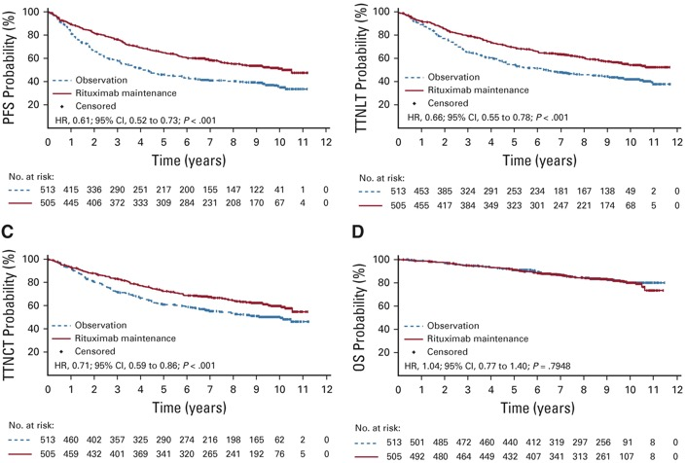
PRIMA Study – 10 year follow up¹
How about MZL?
StiL NHL7-2008 MAINTAIN²
  2-year PFS superior with rituximab maintenance vs observation
    Median PFS NR vs 92.2 months
    (HR 0.35; p=0.008)
  OS rate at 6 years 92% with rituximab maintenance vs 86% with observation
    HR 0.52 (95% CI 0.20-1.39)
Extended maintenance?
PFS numerically superior with 4 vs 2 years of rituximab maintenance³
  HR 0.75 (95% CI 0.45-1.24)
CI, confidence interval; HR, hazard ratio; PFS, progression-free survival; MZL, marginal zone lymphoma; NR, not reached; TTNCT, time to next chemotherapy treatment; TTNLT, time to next antilymphoma treatment
1. Bachy E, et al. J Clin Oncol. 2019;37:2815-24; 2. Rummel MJ, et al. J Clin Oncol 2018 36:15_suppl, 7515-7515; 3. Rummel MJ, et al. Clin Lym Myel Leuk 2018 18 (Sup1):S101-103.

Slide 27
What do the guidelines say?
NCCN
ESMO

Slide 28

NCCN guidelines for advanced FL
FIRST-LINE THERAPY
Preferred regimens (in alphabetical order) Bendamustine + obinutuzumab or rituximab CHOP (cyclophosphamide, doxorubicin, vincristine, prednisone) + obinutuzumab or rituximab CVP (cyclophosphamide, vincristine, prednisone) + obinutuzumab or rituximab Lenalidomide + rituximab Other recommended regimens Lenalidomide + obinutuzumab (category 2B) Rituximab (375 mg/m² weekly for 4 doses) (consider for low tumour burden)
NCCN Guidelines Version 3.2021
Follicular Lymphoma (grade 1-2)
NCCN Guidelines Index
Table of Contents
Discussion
STAGE
MANAGEMENT AND FOLLOW-UP^{O}
See monoclonal antibody and
viral reactivation (NHODG-B)
Clinical
H&P and labs every 3-6 mo for 5 y and
then annually or as clinically indicated
Surveillance imaging^{r}
Up to 2 y: C/A/P CT scan with contrast no more than every 6 mo
≥2 y: CT scan no more than annually
FIRST-LINE THERAPY FOR ELDERLY OR INFIRM (if none of the above are expected to be tolerable in the opinion of the treating physician)
Preferred regimens Rituximab (375 mg/m² weekly for 4 doses) Other recommended regimens Chlorambucil ± rituximab Cyclophosphamide ± rituximab Ibritumomab tiuxetan (category 2B)
No
indication
Observe
(category 1)
Progressive
disease^{n,p}
For transformation,
see (FOLL-6)
Indications for treatment:
Candidate for clinical trial
Symptoms
Threatened end-organ
function
Cytopenia secondary to
lymphoma
Bulky disease^{q}
Steady or rapid
progression^{p}
Stage
III, IV
Consider
PET/CT
scan^{p}
See suggested regimens (FOLL-B)
or
Clinical trial
and/or
Palliative ISRT^{i}
See End-of-
Treatment Response
(FOLL-5)
Indication
present
FIRST-LINE CONSOLIDATION OR EXTENDED DOSING (optional)
Preferred regimens following chemoimmunotherapy Rituximab maintenance 375 mg/m² one dose every 8-12 weeks for 2 years for patients initially presenting with high tumour burden (category 1) Obinutuzumab maintenance (1,000 mg every 8 weeks for 12 doses Other recommended regimens If initially treated with single-agent rituximab, consolidation with rituximab 375 mg/m² one dose every 8 weeks for 4 doses Ibritumomab tiuxetan (category 2B)
A/AP CT, computed tomographic chest abdomen pelvis; mo, months; PET/CT, positron emission tomography/computerized tomography; y, years
NCCN Guidelines v2.2021

Slide 29
ESMO Clinical Practice Guidelines
Evaluate
Low tumour burden
Prognosis:
Stage
FLIPI 1 or 2
Grade
Symptoms:
No symptoms
Mild symptoms
Life-/organ-threatening
Patient priority:
Long remission
Better QoL
Stage I/II
Stage III/IV
ISRT 24-30
+/- rituximab [II, B]
In selected cases:
Watch-and-wait
Rituximab monotherapy
INRT 2×2 Gy [II, B]
Watch-and-wait [I, A]
In selected cases:
Rituximab monotherapy [III, C]
Choose among
High tumour burden – Stage III/IV
Asymptomatic cases:
Watch-and-wait [I, A]
Mild symptoms:
Non-chemotherapy treatment (III, C)
Rituximab (III, B)
High tumour burden:
CIT
(G/R-B, G/R-CHOP, G/R-CVP) [I, A]
Consider:
Antibody maintenance (or radioimmunotherapy) [I, B]
In selected cases:
LEN+R [I, C]
<65 years
>65 years
CIT (G/R-B, G/R-CHOP, G/R-CVP) [I, A]
CR/PR: discuss antibody maintenance [I, B]
In selected cases:
Rituximab monotherapy [III, C]
LEN+R [I, C]
CIT (G/R-B, G/R-CHOP, G/R-CVP) [I, A]
CR/PR: discuss antibody maintenance [I, B]
In selected cases:
Rituximab monotherapy [III, C]
LEN+R [I, C]
B, bendamustine; CHOP, cyclophosphamide, doxorubicin, vincristine, prednisone; CIT, chemoimmunotherapy; FLIPI, Follicular Lymphoma International Prognostic Index; G/R, obinutuzumab/rituximab;
INRT, involved node radiotherapy; ISRT, involved-site radiation therapy; QoL, quality of life; LEN+R, rituximab plus lenalidomide; R-CHOP, cyclophosphamide, doxorubicin, vincristine, prednisone plus rituximab;
R-CVP, rituximab plus cyclophosphamide, vincristine, prednisone
Dreyling M, et al. Ann Oncol. 2021;32:298-308

Slide 30
How do you choose the right treatment for your patient?

Slide 31
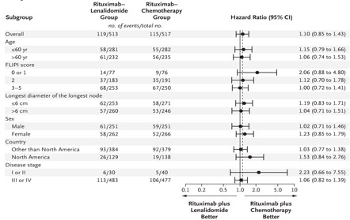
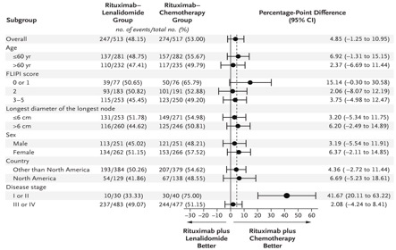
Can clinical factors guide us?
StiL study: B-R vs R-CHOP/R-CVP
 | HR (95% CI) | p value
Age (years) ≤60 (n=199) >60 (n=315) | 0.52 (0.33-0.79) 0.62 (0.45-0.84) | 0.002 0.002
LDH concentration Normal (n=319) Elevated (n=184) | 0.48 (0.34-0.67) 0.74 (0.50-1.08) | <0.0001 0.118
FLIPI subgroup Favourable (0-2 risk factors; n=143) Unfavourable (3-5 risk factors; n=127) | 0.56 (0.31-0.98) 0.63 (0.38-1.04) | 0.043 0.068
RELEVANCE study:
LEN+R vs R-chemo
PFS
Confirmed or unconfirmed CR at 120 weeks
B-R, bendamustine plus rituximab; CI, confidence interval; CR, complete response; FLIPI, Follicular Lymphoma International Prognostic Index; HR, hazard ratio; LDH, lactate dehydrogenase; PFS, progression-free survival; LEN+R, rituximab plus lenalidomide; R-chemo, rituximab plus chemotherapy; R-CHOP, cyclophosphamide, doxorubicin, vincristine, prednisone plus rituximab;
R-CVP, rituximab plus cyclophosphamide, vincristine, prednisone; yr, years
Rummel MJ, et al. Lancet. 2013;381:1203-10; Morschhauser F, et al. N Engl J Med. 2018;379:934-47

Slide 32
Questions to consider when choosing initial treatment
Does the patient need treatment?
Does the patient want treatment?
What is the goal of treatment?
What are the comorbidities?
→ In the upfront setting, we have multiple prognostic markers, but unfortunately there is a lack of predictive biomarkers
“As various therapeutic approaches may achieve durable responses in the vast majority of patients, the selection of optimal treatment is mainly based on clinical risk factors, symptoms and individual patient priorities. PET- and MRD-based tailored treatments are currently being evaluated in ongoing studies but are not yet routine clinical practice.” ESMO Guidelines, Dreyling M, et al. Ann Oncol. 2021;32:298-308
MRD, minimal residual disease; PET, positron emission tomography

Slide 33
Treatment selection for relapsed/refractory indolent NHL
Dr. Jessica Okosun, MD, PhD

Slide 34
Disclosures Jessica okosun
Gilead Sciences
BeiGene

Slide 35
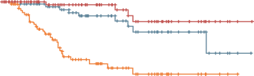
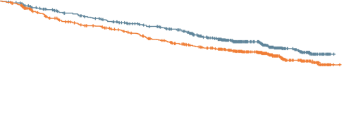
Most patients with indolent NHL will relapse
Despite the favourable outcomes for indolent NHL (FL and MZL)…
FL^{1,2}
Splenic MZL³
100
PFS: G-chemo vs R-chemo
90
5-year PFS: 70.5% vs 63.2% (G vs R) HR 0.76; p=0.0043
80
1.0
70
0.8
60
PFS: rituximab – 5-year PFS: 71%
Survival (%)
50
0.6
40
Endpoint | Patients/ events | 5-year | 10-year
LSS | 108/4 | 99% | 90%
OS | 108/9 | 93% | 85%
PFS | 108/26 | 71% | 64%
Probability of PFS
0.4
30
R-chemo (N=601)
G-chemo (N=601)
Censored
GALLIUM trial
20
0.2
10
0
0
0
6
12
18
24
30
36
42
48
54
60
66
72
78
84
90
96
0
1
2
3
4
5
6
7
8
9
10
11
12
13
14
15
No. of patients at risk
R-chemo
G-chemo
Time (months)
Time (years)
601
601
563
574
512
539
471
512
447
491
429
467
404
446
373
430
349
406
328
368
304
334
247
269
176
182
88
98
52
53
3
4
FL, follicular lymphoma; G-chemo, obinutuzumab plus chemotherapy; HR, hazard ratio; LSS, lymphoma-specific survival; MZL, marginal zone lymphoma; NHL, non-Hodgkin’s lymphoma; OS, overall survival; PFS, progression-free survival; R-chemo, rituximab plus chemotherapy
1. Marcus R, et al. N Engl J Med. 2017;377:1331-44; 2. Townsend W, et al. ASCO 2020. Abstract #8023; 3. Kalpadakis C, et al. Blood. 2018;132:666-70

Slide 36
Considerations and approach to relapsed FL (and INDOLENT NHL)
TAKE A BIOPSY! to exclude transformation (especially for FL)
Depends on:
Is treatment actually required?
Prior therapies (immunotherapy, chemotherapy)
Duration and quality of response – how well did they work?
Current clinical situation and risk factors at relapse
  Patient’s age, performance status, comorbidities
  Disease burden
Is the patient fit for a transplant? Auto/allo?
Patient’s goals
FL, follicular lymphoma; NHL, non-Hodgkin’s lymphoma

Slide 37
Timelines and key FDA drug approvals in FL/MZL
1st LINE
May 2018: CAR-T (Kymriah: Tisa-Cel) for transformed FL
Relapsed
FDA approval of rituximab
Oct 2017: CAR-T (Yescarta: Axi-Cel) for transformed FL
Mar 2021: CAR-T (Yescarta: Axi-Cel) for relapsed FL
1997
2011
2014
2016
2017
2018
2019
2020
2021
Sept 2018: duvelisib for
relapsed FL
July 2014: idelalisib for
relapsed FL
Feb 2016: obi-benda for
relapsed FL
May 2019: LEN+R for relapsed FL/MZL
Feb 2021: umbralisib for relapsed FL/MZL
Jan 2017: ibrutinib for
relapsed MZL
Sept 2017: copanlisib for
relapsed FL
Jun 2020: tazemetostat for
relapsed FL
Axi-Cel, axicabtagene lisoleucel; CAR-T, chimeric antigen receptor T cell; FL, follicular lymphoma; MZL, marginal zone lymphoma; Obi-benda, obinutuzumab + bendamustine; Tisa-Cel, tisagenlecleucel

Slide 38
Multiple treatment options for R/R FL (standard and novel)
Treatment Option
CIT
Allo transplant
(only subset of patients)
Clinical trials,
e.g. CAR-T, bispecifics, others
High-dose therapy +
auto transplant
Targeted therapies,
e.g. PI3K inhibitors, LEN+R, EZH2i
A standard approach for relapsed/refractory (R/R) FL remains challenging
Sequencing therapies is particularly important
CAR-T, chimeric antigen receptor T cell; CIT, chemoimmunotherapy; EZH2i, enhancer of zeste homologue 2 inhibitor; FL, follicular lymphoma; PI3K, phosphoinositide 3-kinase; LEN+R, rituximab plus lenalidomide

Slide 39
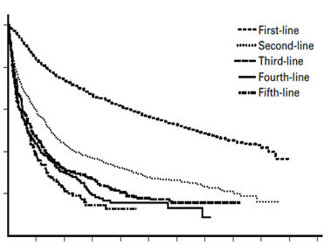
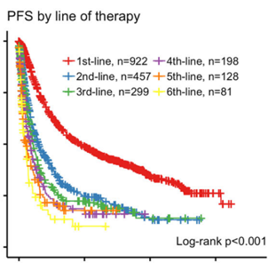
Outcomes for 2L+ of therapy needs improving
Data from National LymphoCare Study¹
Data from Memorial Sloan Kettering Cancer Center²
1.0
1st-line
2nd-line
3rd-line
4th-line
5th-line
Treatment line | Median PFS years (95% CI)
First | 6.62 (6.10-7.20)
Second Rituximab R-chemo | 1.50 (1.35-1.70) 1.50 (1.26-2.11) 1.48 (1.08-1.77)
Third | 0.83 (0.68-1.09)
Fourth | 0.69 (0.50-0.97)
Fifth | 0.68 (0.43-0.88)
PFS by line of therapy
0.8
1.00
1st-line, n=922
2nd-line, n=457
3rd-line, n=299
4th-line, n=198
5th-line, n=128
6th-line, n=81
Probability of PFS
0.6
0.75
0.4
Survival probability
0.50
0.2
0.25
0
0
1
2
3
4
5
6
7
8
9
10
11
0.00
Log-rank p<0.001
Years from beginning of treatment line
0
5
10
15
Years from treatment
After 2nd lines of treatment:
Median disease-free or progression-free period is 1 year or less (excl. transplants)
CI, confidence interval; PFS, progression-free survival; R-chemo, rituximab plus chemotherapy
1. Link BK, et al. Br J Haematol. 2019;184:660-3; 2. Batlevi CL, et al. Blood Cancer J. 2020;10:74

Slide 40
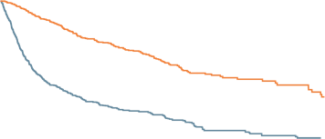
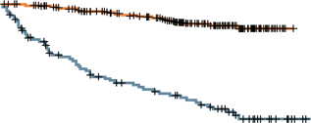
Not all FL relapses are the same: who are high-risk FL patients?
Early progression of disease (POD 24)¹
Transformation to aggressive lymphoma²
5-year OS post-transformed FL: 43%
(34% with early [≤1 year] transformation)
LymphoCare: 530 R-CHOP-treated patients
100
HR 2.82 (95% CI 2.47-3.22); p<0.0001
1.0
No POD24
5-year OS (95% CI): 90%
FL (n=503)
75
0.8
Cumulative survival
after re-biopsy (%)
5-year OS (95% CI): 50%
50
0.6
POD24
Survival (probability)
Transformed FL (n=509)
0.4
25
Early POD
Reference
Disease recurrence
Histological transformation
0.2
0
0
Number at risk
Disease recurrence
Histological transformation
0
1
2
3
4
5
7
7
8
9
10
0
12
24
36
48
60
72
84
96
503
509
453
323
394
252
344
201
290
147
227
108
157
74
105
53
78
46
58
33
49
24
Time from risk-defining events (months)
Applies to EFS12 and EFS24
Survival poor after transformation
CI, confidence interval; EFS 12/24, event-free survival at 12/24 months; FL, follicular lymphoma; HR, hazard ratio; OS, overall survival; POD(24), progression of disease (within 2 years); R-CHOP, cyclophosphamide, doxorubicin, vincristine, prednisone plus rituximab
1. Casulo C, et al. J Clin Oncol. 2015;33:2516-22; 2. Federico M, et al. Lancet Haematol. 2018;5:e359-67

Slide 41

What are the options for early progressed FL patients?
HOW DO WE IDENTIFY EARLY PROGRESSORS?
  Clinical tools:
    PRIMA-PI¹
    FLEX (FL Evaluation Index)²
  Molecular tools:
    M7-FLIPI (mutations)³
    Gene expression⁴
Is it ACTIONABLE?
Low prognostic ACCURACY
Is it widely ACCESSIBLE/AFFORDABLE?
  Future approaches:
  auto vs bispecifics vs CAR-T?
HOW TO TREAT EARLY PROGRESSORS?
  No treatment shown to be superior to another in this setting
  Options:
    High-dose therapy/stem cell transplantation for those who are fit
    CIT options
    Targeted therapies (lenalidomide, PI3K inhibitors)
    Clinical trials
CAR-T, chimeric antigen receptor T cell; CIT, chemoimmunotherapy FL, follicular lymphoma; FLIPI, Follicular Lymphoma International Prognostic Index; PI3K, phosphoinositide 3-kinase
1. Bachy E, et al. Blood. 2018;132:49-58; 2. Mir F, et al. Am J Hematol. 2020;95:1503-10; 3. Pastore A, et al. Lancet Oncol. 2015;16:1111-22;
4. Huet S, et al. Lancet Oncol. 2018;19:549-56

Slide 42
Comparison of Efficacy in Patients With POD24 FL
Agent | ORR, % | PFS | OS
LEN+R (n=43) | 48 | 50% at 1 year | NA
Lenalidomide-obinutuzumab (n=24) | 67 | 75% at 1 year | 87% at 1 year
Idelalisib (n=37) | 57 | 11 months (median) | NA
Copanlisib (n=93) | 58 | 11 months (median) | 43 months (median)
FL, follicular lymphoma; NA, not applicable; OS, overall survival; PFS, progression-free survival; POD24, progression of disease within 2 years; LEN+R, rituximab plus lenalidomide
Casulo C, Barr PM. Blood. 2019;133:1540-47

Slide 43
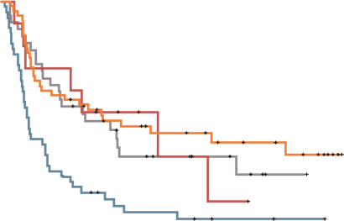

Value of high-dose therapy and ASCT for early progressors
Retrospective study (Center for International Blood and Marrow Transplant Research and National LymphoCare Study)¹
Failed to achieve PR or early relapse (≤2 years)
N=349 (175 ASCT and 174 non-ASCT)
Retrospective study (GLSG1996 and GLSG2000)²
162 patients with progression, in need of treatment
  POD24: n=113; POD>24: n=49
1.00
PFS
POD>24: ASCT
POD>24: no transplant/no cytoreduction-failure
POD24: ASCT
POD24: no transplant/no cytoreduction-failure
OS of patients receiving HCT <1 year of therapy failure vs no HCT
100
0.75
80
HCT
Survival (probability)
60
0.50
Probability (%)
No HCT
40
5-year OS 60% vs 73% (p=0.05)
0.25
20
p value at 5 years: 0.05
0
0.00
0
1
2
3
4
5
0
1
2
3
4
5
6
7
8
9
10
11
12
13
14
15
Years
Years after 2^{nd-}line treatment
ASCT, autologous stem cell transplant; HCT, haematopoietic stem cell transplantation; OS, overall survival; PFS, progression-free survival; PR, partial response; POD(24), progression of disease (within 2 years)
1. Casulo C, et al. Biol Blood Marrow Transplant. 2018;24:1163-71; 2. Jurinovic V, et al. Biol Blood Marrow Transplant. 2018;24:1172-9

Slide 44
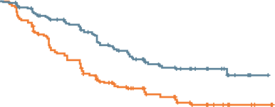
AUGMENT: Phase 3 study for R/R FL:
LEN+R vs R-placebo
PFS in R/R FL
2-year PFS 58% (LEN+R) vs 36% (R-placebo)
≤12 cycles or until relapse, progression, or intolerability
LEN+R
Rituximab 375 mg/m² on Days 1, 8, 15, 22 of cycle 1; Day 1 of cycles 2-5
Lenalidomide 20 mg/day† on Days 1-21/28 for 12 cycles
(n=178)
1.0
Median PFS: 39 vs 14 months
R/R Grade 1-3a
FL or MZL – not rituximab-refractory
(N=358)
0.9
5-year
follow-up
0.8
0.7
R-placebo
Rituximab 375 mg/m² on Days 1, 8, 15, 22 of cycle 1; Day 1 of cycles 2-5
Placebo matched capsules for 12 cycles
(n=180)
0.6
LEN+R
PFS probability
0.5
0.4
R-placebo
0.3
0.2
HR for progression or death 0.46 (95% CI 0.34-0.62)
p<0.0001
Primary endpoint:
IRC-assessed PFS (2007 IWG criteria without PET)
Secondary endpoint:
ORR, CR, OS
0.1
0
0
6
12
18
24
30
36
42
48
Time since random assignment (months)
Number at risk:
LEN+R
Placebo + rituximab
178
180
148
132
124
92
91
58
59
40
39
26
20
10
7
4
0
0
LEN+R is FDA-approved for previously treated FL
CI, confidence interval; CR, complete response; FL, follicular lymphoma; HR, hazard ratio IRC, independent review committee; IWG, International Working Group; MZL, marginal zone lymphoma;
OS, overall survival; ORR, overall response rate; PET, positron emission tomography; PFS, progression-free survival; LEN+R, rituximab plus lenalidomide; R-placebo, rituximab plus placebo; R/R, relapsed/refractory
Leonard JP, et al. J Clin Oncol. 2019;37:1188-99

Slide 45
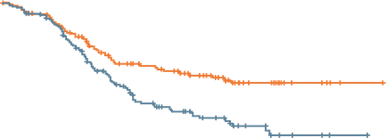
Bendamustine +/- Obinutuzumab in
Rituximab-refractory FL
GADOLIN – Randomized, international phase 3 trial
Up to 6
28-day cycles
For 2 years or
until PD
100
Obinutuzumab +
bendamustine
80
Median PFS: 29 vs 14 months
Rituximab-refractory CD20-positive indolent NHL
(N=413)
CR/
PR/
SD
Obinutuzumab
maintenance
1,000 mg IV every 2 months
PFS (%)
60
Bendamustine
40
20
Obinutuzumab plus bendamustine
Bendamustine monotherapy
Censored
0
Primary endpoint:
PFS assessed
0
6
12
18
24
30
36
42
48
54
Months
Obinutuzumab + bendamustine followed by obinutuzumab:
FDA-approved for patients with FL who have relapsed after or are refractory to
a rituximab-containing regimen
CD20, cluster of differentiation 20; CR, complete response; FL, follicular lymphoma; IV, intravenous; NHL, non-Hodgkin’s lymphoma; PD, progressive disease; PFS, progression-free survival; PR, partial response; SD, stable disease
Sehn LH, et al. Lancet Oncol. 2016;17:1081-93; Cheson BD, et al. J Clin Oncol. 2018;36:2259-66

Slide 46
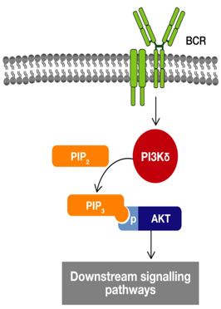
B-cell receptor signalling and PI3K inhibitors
4 FDA-approved PI3K inhibitors in relapsed FL; 1 in relapsed MZL
 | Idelalisib¹ | Copanlisib² | Duvelisib³ | Umbralisib⁴
Mechanism of action | Selective PI3Kδ | Pan-class I PI3K inhibitor | Dual inhibitor of PI3Kγδ | PI3Kδ and CK1-ε
Indication | Relapsed FL after ≥2 prior systemic therapies | Relapsed FL after ≥2 prior systemic therapies | R/R FL after ≥2 prior therapies | R/R FL after ≥3 prior therapies
Dosing | 150 mg orally (PO) twice daily (BID) | IV 60 mg on days 1, 8, and 15 of a 28-day cycle | 25 mg PO BID | Oral 800 mg once daily (QD)
Idelalisib (δ)
Duvelisib (γδ)
Copanlisib (αδ)
Umbralisib (δ)
ME-401 (δ)
PI3K
BCR, B-cell receptor; PI3K, phosphoinositide 3-kinase; FL, follicular lymphoma; MZL, marginal zone lymphoma; R/R, relapsed/refractory
1. Gopal AK, et al. N Engl J Med. 2014;370:1008-18; 2. Dreyling M, et al. J Clin Oncol. 2017;35:3898-905; 3. Flinn IW, et al. J Clin Oncol. 2019;37:984-91; 4. Fowler NH, et al. J Clin Oncol. 2021. DOI: 10.1200/JCO.20.03433

Slide 47
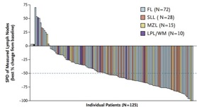
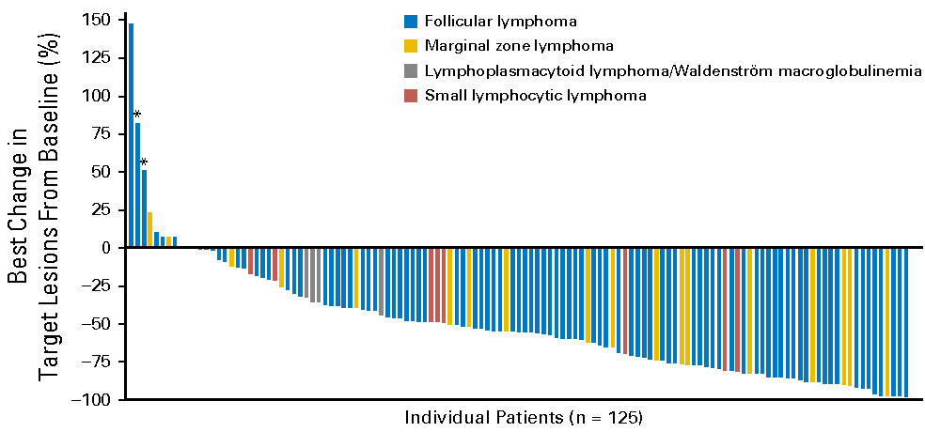
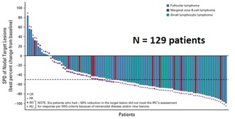
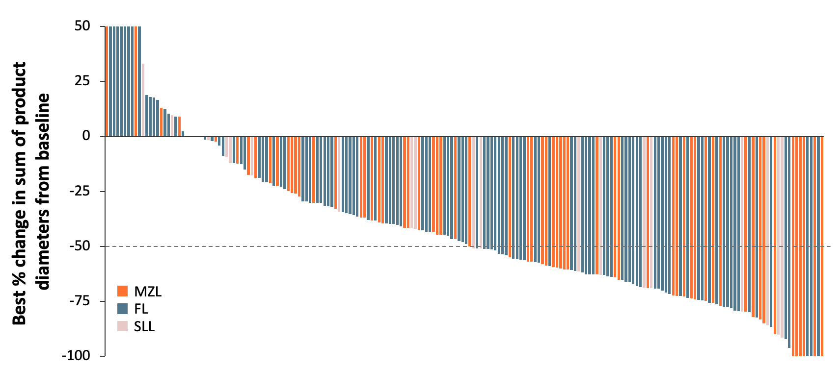
Clinical efficacy and safety of PI3K inhibitors in R/R INDOLENT NHL
Idelalisib
Copanlisib
Duvelisib
Umbralisib
Transaminitis, colitis, pneumonitis, infections
Hyperglycaemia, hypertension, pneumonitis, diarrhoea
Colitis, pneumonitis,
cutaneous reactions
Colitis, hepatotoxicity,
cutaneous reactions
TAKE-HOME:
ORR: 40-60%
Median DoR: 10-14 months
Median PFS: 9-12 months
Grade 3 or 4 AEs: 55-88%
AE, adverse event; CR, complete response; DoR, duration of response; FL, follicular lymphoma; LPL/WM, lymphoplasmacytic lymphoma/Waldenstrom’s macroglobulinemia; MZL, marginal zone lymphoma;
NHL, non-Hodgkin’s lymphoma; ORR, objective/overall response rate; PFS, progression-free survival; PR, partial response; R/R, relapsed/refractory; SD, stable disease; SLL, small lymphocytic lymphoma
1. Gopal AK, et al. N Engl J Med. 2014;370:1008-18; 2. Dreyling M, et al. J Clin Oncol. 2017;35:3898-905; 3. Flinn IW, et al. J Clin Oncol. 2019;37:984-91; 4. Fowler NH, et al. J Clin Oncol. 2021. DOI: 10.1200/JCO.20.03433

Slide 48
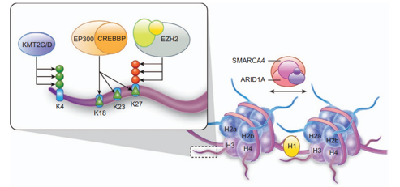
EZH2 mutations in FL
EZH2 is a histone methyltransferase, an epigenetic regulator
Oncogenic gain of function mutations in approx. 20% of FL and GCB-DLBCL
Tazemetostat, first-in-class, selective, oral inhibitor of EZH2 –
FDA approval
Archival
tissue
analysed for
EZH2 hot spot
activating
mutations
Tazemetostat 800 mg BID
Response assessed every 8 weeks using 2007 IWG-NHL criteria
FL,
EZH2 MT
(N=45)
KEY OBJECTIVES
Primary endpoint:
ORR
Secondary endpoint:
DoR
PFS
Safety
Pharmacokinetics
Screening
Eligibility, enrollment
Cohort assignment
End of trial follow-up
FL,
EZH2 WT
(N=54)
Treatment
continues until
progressive
disease or
withdrawal
DLBCL, diffuse large B-cell lymphoma; DoR, duration of response; EZH2, enhancer of zeste homologue 2; FL, follicular lymphoma; MT, mutated; ORR, objective response rate; WT, wild type
Morschhauser F, et al. Lancet Oncol. 2020;21:1433-42; Bödör C, et al. Blood. 2013;122:3165-8; Morin RD, et al. Nat Genet. 2010;42:181-5

Slide 49
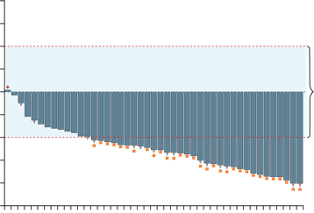
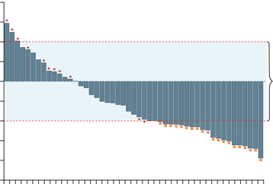
Tazemetostat (EZH2i)
First treatment targeting genetic mutations
100
Best response of PR or CR
Treatment ongoing
Best response of PD
 | EZH2^{mut} (N=45)
 | IRC-assessed | Investigator- assessed
Objective response rateª | 31 (69%; 53-82) | 35 (78%; 63-89)
Overall disease control rate^{b} | 44 (98%) | 45 (100%)
Best overall response CR PR SD PD Not estimable or unknown | 6 (13%) 25 (56%) 13 (29%) 1 (2%) 0 | 4 (9%) 31 (69%) 10 (22%) 0 0
75
50
PD
25
EZH2 MT
0
SD
Change in tumour volume from baseline (%)
-25
-50
PR
-75
-100
Safety:
Very well tolerated
-110
100
Patients (N=45)
75
 | EZH2^{wt} (N=54)
 | IRC-assessed | Investigator- assessed
Objective response rateª | 19 (35%; 23-49) | 18 (33%; 21-48)
Overall disease control rate^{b} | 37 (69%) | 34 (63%)
Best overall response CR PR SD PD Not estimable or unknown | 2 (4%) 17 (31%) 18 (33%) 12 (22%) 5 (9%) | 3 (6%) 15 (28%) 16 (30%) 16 (30%) 4 (7%)
50
PD
25
EZH2 WT
0
SD
Change in tumour volume from baseline (%)
-25
PR
-50
-75
-100
-110
Patients (N=49)
ª Objective response rate includes patients with CR or PR; ^{b} Overall disease control rate includes patients with a CR, PR, or SD
CR, complete response; EZH2i, enhancer of zeste homologue 2 inhibitor; IRC, independent review committee; PD, progressive disease; PR, partial response; SD, stable disease
Morschhauser F, et al. Lancet Oncol. 2020;21:1433-42

Slide 50
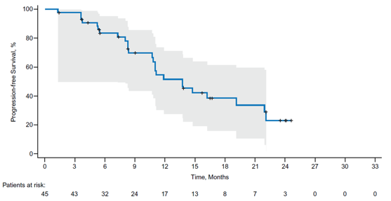
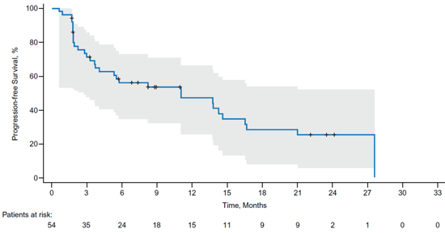
PFS, by IRC Assessment, in MT and WT EZH2 Cohorts
MT EZH2
WT EZH2
Endpoint | MT EZH2 INV (n=45) | MT EZH2 IRC (n=45) | WT EZH2 INV (n=54) | WT EZH2 IRC (n=54)
Median (95% CI) PFS, months | 13.8 (8.4, 16.4) | 13.8 (10.7, 22.0) | 5.6 (3.3, 11.1) | 11.1 (3.7, 14.6)
KM estimate of PFS (95% CI) at 6 months, % | 83.3 (68.0, 91.7) | 83.6 (68.6, 91.8) | 46.4 (32.2, 59.4) | 55.9 (40.7, 68.7)
KM estimate of PFS (95% CI) at 12 months, % | 53.2 (36.2, 67.6) | 51.7 (34.4, 66.6) | 35.8 (22.8, 49.0) | 47.1 (31.6, 61.1)
KM estimate of PFS (95% CI) at 18 months, % | 31.0 (16.4, 46.8) | 38.8 (22.7, 54.7) | 22.5 (11.8, 35.) | 28.3 (14.8, 43.4)
CI, confidence interval; IRC, independent review committee; INV, investigator-assessed; KM, Kaplan–Meier; MT, mutated; PFS, progression-free survival; WT, wild type
Morschhauser F, et al. Blood. 2019;134(suppl 1):123

Slide 51


What do the guidelines suggest for r/r FL?
Second-line and subsequent therapy
Preferred regimens (alphabetical order)
  Bendamustine + obinutuzumab or rituximab
  CHOP + obinutuzumab or rituximab
  CVP + obinutuzumab or rituximab
  LEN+R
Other recommended regimens (alphabetical order)
  Ibritumomab tiuxetan
  Lenalidomide (if not a candidate for anti-CD20
  monoclonal antibody therapy)
  Lenalidomide + obinutuzumab
  Obinutuzumab
  PI3K inhibitors (R/R after 2 prior therapies)
    Copanlisib
    Duvelisib
    Idelalisib
  Rituximab
  Tazemetostat
    EZH2 mutation positive R/R disease after 2 prior therapies
    EZH2 wild type R/R disease in patients who have no satisfactory alternative treatment
<65 years
>65 years
First relapse/progression
CIT [II-B]
CR/PR: discuss antibody maintenance [II, B]
In selected cases:
Rituximab monotherapy [III, C]
ASCT (early relapses, transformation) [II, B]
LEN+R (early relapses) [II, B]
CIT [II-B]
CR/PR: discuss antibody maintenance [II, B]
In selected cases:
Rituximab monotherapy [III, C]
Radioimmunotherapy
LEN+R (early relapses) [II, B]
Later relapse/progression
CIT (long prior remissions) [III-C]
Rituximab monotherapy [III, C]
LEN+R [II,B]
In selected cases:
ASCT (early relapses, transformation) [II, B]
Radioimmunotherapy [III, C]
Idelalisib (double refractory) [III, B]
alloSCT [III, C]
CIT (long prior remissions) [III-C]
Rituximab monotherapy [III, C]
LEN+R [II,B]
In selected cases:
Radioimmunotherapy [III, C]
Idelalisib (double refractory) [III, B]
ASCT, autologous stem cell transplant; CD20, cluster of differentiation 20; CHOP, cyclophosphamide, doxorubicin, vincristine, prednisone; CIT, chemoimmunotherapy; CR, complete response; CVP, cyclophosphamide, vincristine, prednisone; FL, follicular lymphoma; PI3K, phosphoinositide 3-kinase; PR, partial response; LEN+R, rituximab plus lenalidomide; R/R, relapsed/refractory
Rummel MJ, et al. Lancet. 2013;381:1203-10

Slide 52
Approach to treatment selection for r/r INDOLENT NHL
For FL
Consider a clinical trial as a first option
Early progressors (POD24) – younger patients – consider high-dose therapy and ASCT
In rituximab-refractory patients – Obinutuzumab-chemotherapy (obinutuzumab-bendamustine, obinutuzumab-CHOP)
In older patients – consider LEN+R, tazemetostat (in EZH2-mutated patients)
Double-refractory patients: consider PI3K inhibitors (BUT mindful of toxicities, comorbidities, QoL)
For MZL
Clinical trial as above
LEN+R, ibrutinib, umbralisib
ASCT, autologous stem cell transplant; CHOP, cyclophosphamide, doxorubicin, vincristine, prednisone; FL, follicular lymphoma; MZL, marginal zone lymphoma; NHL, non-Hodgkin’s lymphoma; POD24, progression of disease within 24 months; PI3K, phosphoinositide 3-kinase; LEN+R, rituximab plus lenalidomide; R/R, relapsed/refractory; QoL, quality of life

Slide 53
The future treatment landscape in indolent NHL
Prof. Alexey Danilov, MD, PhD

Slide 54
Disclosures Alexey danilov
AstraZeneca
Gilead Sciences
Takeda Oncology
Genentech
TG Therapeutics
Bayer Oncology
Bristol-Myers Squib
BeiGene
SecuraBio
Pharmacyclics

Slide 55
PI3K Inhibition: Rationale
The PI3K pathway is aberrantly activated in many cancers, including NHL, contributing to proliferation and resistance to therapy
The delta isoform of the p110 catalytic subunit is of particular interest in lymphoma
Several PI3K inhibitors approved for
R/R FL and ≥2 prior therapies
Targeting PI3K isoforms
FL, follicular lymphoma; NHL, non-Hodgkin’s lymphoma; PI3K, phosphoinositide 3-kinase; R/R, relapsed/refractory
Westin JR. Clin Lymphoma Myeloma Leuk. 2014;14:335-42; von Keudell G, Moskowitz AJ. Curr Hematol Malig Rep. 2019;14:405-13; Patel K, et al. Blood. 2019;134:1573-77

Slide 56
UNITY-NHL Study Design
MZL
R/R 1+ prior anti-CD20
Key eligibility criteria
Patients ≥18 years of age
Histologically confirmed R/R MZL, FL, or SLL requiring treatment
ECOG PS ≤2
Primary endpoint:​
IRC-assessed ORR​
Secondary endpoints:​
IRC-assessed
  DoR
  PFS
  Time to response (TTR)
Safety
FL
R/R 2+ prior Lines, including an anti-CD20 and an alkylating agent
Umbralisib
800mg PO QD
Until POD, unacceptable toxicity, or study withdrawal
SLL
R/R 2+ prior Lines, including an anti-CD20 and an alkylating agent
First response assessment was at the end of Cycle 3
CD20, cluster of differentiation 20; DoR, duration of response; ECOG PS, Eastern Cooperative Oncology Group Performance Status; FL, follicular lymphoma; IRC, independent review committee;
MZL, marginal zone lymphoma; ORR, overall response rate; PFS, progression-free survival; PO, orally; POD, progression of disease; QD, once daily; SLL, small lymphocytic lymphoma; R/R, relapsed/refractory
Zinzani PL, et al. ASH 2020. Abstract #2934

Slide 57
All Causality adverse events (>15%)
AE, n (%) (N=208) | Any Grade | Grade 1 | Grade 2 | Grade 3 | Grade 4 | Grade 5
Diarrhoea | 123 (59.1) | 64 (30.8) | 38 (18.3) | 21 (10.1) | 0 | 0
Nausea | 82 (39.4) | 52 (25.0) | 29 (13.9) | 1 (0.5) | 0 | 0
Fatigue | 64 (30.8) | 38 (18.3) | 19 (9.1) | 7 (3.4) | 0 | 0
Vomiting | 49 (23.6) | 29 (13.9) | 19 (9.1) | 1 (0.5) | 0 | 0
Cough | 43 (20.7) | 35 (16.8) | 8 (3.8) | 0 | 0 | 0
ALT increased | 42 (20.2) | 13 (6.3) | 15 (7.2) | 11 (5.3) | 3 (1.4) | 0
AST increased | 39 (18.8) | 19 (9.1) | 5 (2.4) | 15 (7.2) | 0 | 0
Decreased appetite | 39 (18.8) | 23 (11.1) | 12 (5.8) | 4 (1.9) | 0 | 0
Dizziness | 38 (18.3) | 29 (13.9) | 8 (3.8) | 1 (0.5) | 0 | 0
Neutropenia | 33 (15.9) | 5 (2.4) | 4 (1.9) | 10 (4.8) | 14 (6.7) | 0
Headache | 33 ( 15.9) | 22 (10.6) | 9 (4.3) | 2 (1.0) | 0 | 0
AE, adverse event; ALT, alanine aminotransferase; AST, aspartate aminotransferase
Zinzani PL, et al. ASH 2020. Abstract #2934

Slide 58
IRC-Assessed Overall Response
Primary Endpoint
60
49.3%
ORR
50.0%
ORR
45.3%
ORR
50
5% CR
16%
CR
5% CR
40
Cohort | DCR, % | Median TTR, months | Median follow-up, months
MZL | 82.6 | 2.8 | 27.8
FL | 79.5 | 4.6 | 27.5
SLL | 86.4 | 2.7 | 29.3
Response (%)
30
33%
PR
33%
SD
40%
PR
34%
SD
45%
PR
36%
SD
20
10
0
MZL
N=69
FL
N=117
SLL
N=22
Across entire indolent NHL population (n=208) umbralisib produced a 47.1% ORR and 81.3% DCR
CR, complete response; DCR, disease control rate (CR + PR + SD); FL, follicular lymphoma; IRC, independent review committee; MZL, marginal zone lymphoma; ORR, overall response rate; PR, partial response; SD, stable disease; SLL, small lymphocytic lymphoma; TRR, time to response
Zinzani PL, et al. ASH 2020. Abstract #2934

Slide 59
IRC-Assessed Response in Index Lesion Size
90.6%, 83.5%, and 89.5% of patients with MZL, FL, and SLL, respectively, experienced reduction of their disease
Best % change in sum of product
diameters from baseline
MZL
FL
SLL
Note: Waterfall plot includes all patients with an evaluable post-baseline scan (N=198)
FL, follicular lymphoma; IRC, independent review committee; MZL, marginal zone lymphoma; SLL, small lymphocytic lymphoma
Zinzani PL, et al. ASH 2020. Abstract #2934

Slide 60
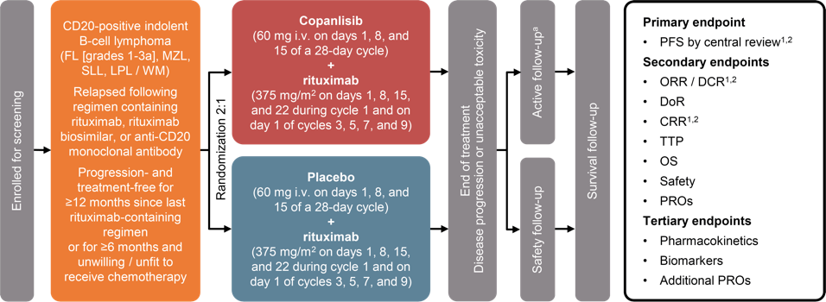
Chronos-3 study design
Median no. of prior treatments:³
1: ~50% | 2: ~25% | ≥3: ~25%
ª Patients who discontinued treatment for any reason other than progressive disease entered active follow-up
CRR, complete response rate; DCR, disease control rate; DoR, duration of response; LPL/WM, lymphoplasmacytic lymphoma/Waldenstrom’s macroglobulinemia; MZL, marginal zone lymphoma;
ORR, objective response rate; OS, overall survival; PFS, progression-free survival; PRO, patient-reported outcome; SLL, small lymphoplasmacytic lymphoma; TTP, time to progression
1. Cheson BD, et al. J Clin Oncol. 2007;25:579-86; 2. Owen RG, et al. Br J Haematol; 2013;160:171-6; 3. Matasar MJ, et al. Lancet Oncol. 2021:S1470-2045(21)00145-5

Slide 61
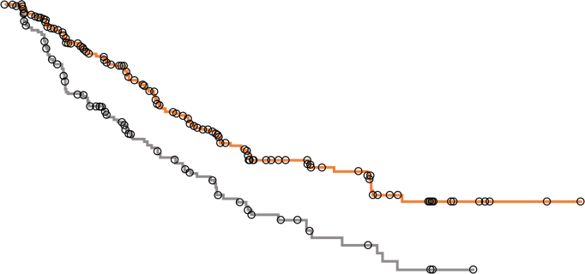
Chronos-3 Primary endpoint:
PFS in all patients with indolent NHL
1.0
 | Median PFS (95% CI) | HR (95% CI) | 1-sided p value
Copanlisib + rituximab | 21.5 months (17.8-33.0) | 0.520 (0.393-0.688) | <0.0001
Placebo + rituximab | 13.8 months (10.2-17.5)
0.9
0.8
0.7
0.6
PFS probability
Median follow-up
of 19.2 months
0.5
0.4
0.3
0.2
1.0
Censored
0.0
0
6
12
18
24
30
36
42
48
54
60
Months
No. of patients at risk (no. censored)
Copanlisib + rituximab
Placebo + rituximab
307 (0)
151 (0)
204 (67)
85 (25)
146 (97)
53 (41)
88 (125)
33 (49)
49 (149)
16 (56)
31 (164)
8 (60)
15 (175)
3 (61)
6 (183)
1 (63)
2 (187)
0 (64)
0 (189)
0 (64)
0 (189)
0 (64)
CI, confidence interval; HR, hazard ratio; NHL, non-Hodgkin’s lymphoma; PFS, progression-free survival
Matasar MJ, et al. Lancet Oncol. 2021:S1470-2045(21)00145-5

Slide 62
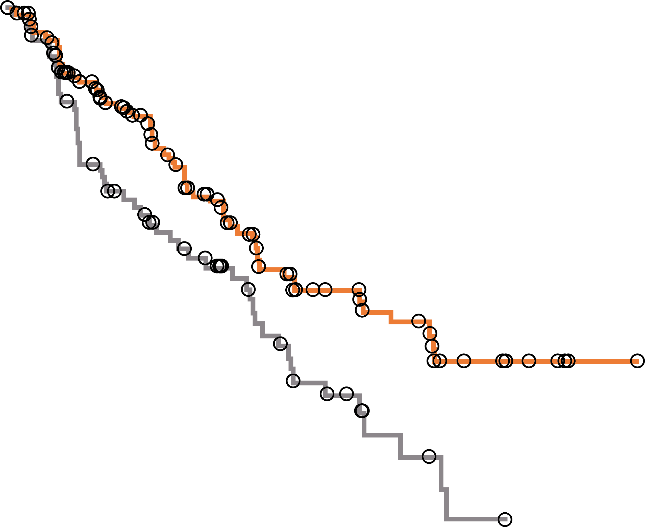
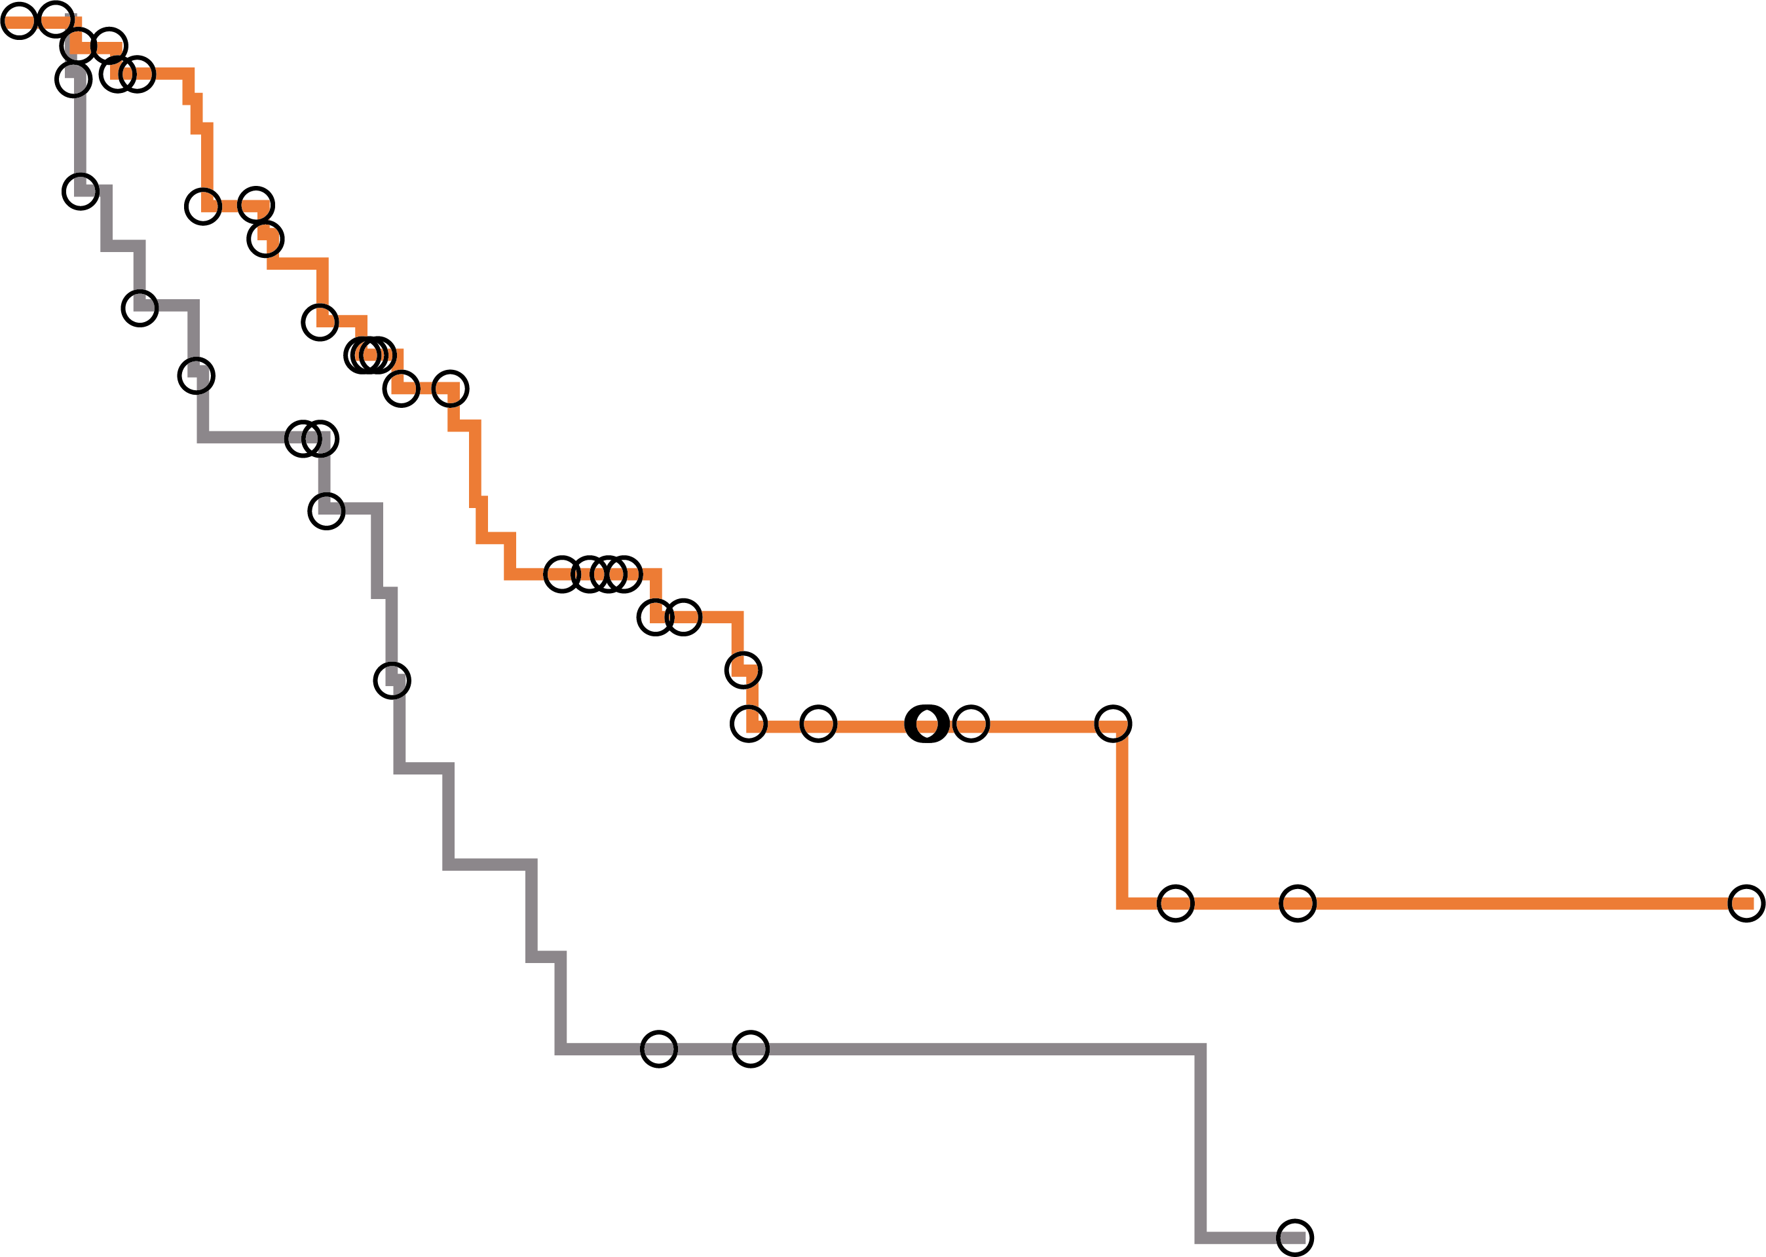
Chronos-3
PFS in subgroups
PFS in patients with FL
PFS in patients with MZL
1.0
 | Median PFS (95% CI) | HR (95% CI) | 1-sided p value
Copanlisib + rituximab | 22.2 months (17.8-33.1) | 0.58 (0.40-0.83) | 0.001
Placebo + rituximab | 18.7 months (10.2-21.1)
1.0
 | Median PFS (95% CI) | HR (95% CI) | 1-sided p value
Copanlisib + rituximab | 22.1 months (13.8-NE) | 0.48 (0.25-0.92) | 0.012
Placebo + rituximab | 11.5 months (5.6-16.3)
0.9
0.9
0.8
0.8
0.7
0.7
0.6
0.6
PFS probability
PFS probability
0.5
0.5
0.4
0.4
0.3
0.3
0.2
0.2
1.0
Censored
Median follow-up
of 19.2 months
1.0
Censored
Median follow-up
of 19.2 months
0.0
0.0
0
6
12
18
24
30
36
42
48
54
60
0
6
12
18
24
30
36
42
48
54
60
Months
Months
No. of patients at risk (no. censored)
Copanlisib + rituximab
Placebo + rituximab
184 (0)
91 (0)
121 (40)
56 (12)
87 (59)
37 (22)
53 (77)
25 (29)
30 (91)
12 (33)
20 (98)
5 (37)
9 (106)
1 (38)
4 (111)
0 (39)
1 (114)
0 (39)
0 (115)
0 (39)
0 (115)
0 (39)
66 (0)
29 (0)
44 (15)
15 (7)
29 (24)
7 (11)
20 (28)
4 (11)
10 (35)
2 (13)
5 (40)
2 (13)
2 (42)
1 (13)
1 (43)
0 (14)
1 (43)
0 (14)
0 (44)
0 (14)
0 (44)
0 (14)
CI, confidence interval; FL, follicular lymphoma; HR, hazard ratio; PFS, progression-free survival
Matasar MJ, et al. Lancet Oncol. 2021:S1470-2045(21)00145-5

Slide 63
Chronos-3
Objective response rate (independent review)
Copanlisib + rituximab | Placebo + rituximab
Objective response rate
Complete response rate
100
p<0.0001
p<0.0001
90
85%
p=0.00060
p<0.0001
81%
77%
p=0.23
80
76%
70
68%
60
54%
56%
Percentage response rate
48%
50
41%
40
30
20
34%
37%
39%
13%
10
15%
21%
17%
18%
10%
0
C + R
N=307
P + R
N=151
C + R
N=184
P + R
N=91
C + R
N=66
P + R
N=29
C + R
N=35
P + R
N=15
C + R
N=22
P + R
N=16
Overall
FL
MZL
SLL
LPL/WM
C, copanlisib; FL, follicular lymphoma; LPL/WM, lymphoplasmacytic lymphoma/Waldenstrom’s macroglobulinemia; MZL, marginal zone lymphoma; P, placebo; R, rituximab; SLL, small lymphocytic lymphoma
Matasar MJ, et al. Lancet Oncol. 2021:S1470-2045(21)00145-5

Slide 64
Chronos-3 - Treatment-emergent AEs leading to discontinuation
Treatment-emergent adverse event (TEAEs) leading to discontinuation, n (%) ª | Copanlisib + rituximab (N=307) |  |  | Placebo + rituximab (N=146)
 | All grades | Grades 1 or 2 | Grades 3 or 4 | All grades | Grades 1 or 2 | Grades 3 or 4
Any TEAE leading to discontinuation | 96 (31.3) | 37 (12.1) | 56 (18.2) | 12 (8.2) | 3 (2.1) | 8 (5.5)
MedDRA preferred term
Pneumonitis | 19 (6.2) | 11. (3.6) | 8 (2.6) | 0 | 0 | 0
Hyperglycaemia | 8 (2.6) | 1 (0.3) | 7 (2.3) | 0 | 0 | 0
Interstitial lung disease | 4 (1.3) | 1 (0.3) | 3 (1.0) | 0 | 0 | 0
Pneumocystis jirovecii pneumonia | 4 (1.3) | 2 (0.7) | 2 (0.7) | 0 | 0 | 0
Pneumonia | 4 (1.3) | 0 | 3 (1.0) | 1 (0.7) | 0 | 1 (0.7)
Bronchitis | 3 (1.0) | 3 (1.0) | 0 | 0 | 0 | 0
Cough | 2 (0.7) | 2 (0.7) | 0 | 0 | 0 | 0
Hypertension | 2 (0.7) | 0 | 2 (0.7) | 1 (0.7) | 0 | 1 (0.7)
Mucosal inflammation | 2 (0.7) | 0 | 2 (0.7) | 0 | 0 | 0
Pruritus | 2 (0.7) | 2 (0.7) | 0 | 0 | 0 | 0
Respiratory failure | 2 (0.7) | 0 | 2 (0.7) | 0 | 0 | 0
Dyspnoea | 0 | 0 | 0 | 2 (1.4) | 1 (0.7) | 1 (0.7)
Investigations | 13 (4.2) | 8 (2.6) | 5 (1.6) | 2 (1.4) | 0 | 2 (1.4)
Hyponatraemia | 3 (1.0) | 1 (0.3) | 2 (0.7) | 0 | 0 | 0
Increased amylase | 3 (1.0) | 1 (0.3) | 2 (0.7) | 0 | 0 | 0
Increased lipase | 3 (1.0) | 0 | 3 (1.0) | 0 | 0 | 0
Increased hepatitis B DNA | 2 (0.7) | 2 (0.7) | 0 | 0 | 0 | 0
Increased ALT | 2 (0.7) | 0 | 2 (0.7) | 0 | 0 | 0
Increased AST | 2 (0.7) | 0 | 2 (0.7) | 0 | 0 | 0
Decreased weight | 2 (0.7) | 2 (0.7) | 0 | 0 | 0 | 0
Increased blood creatinine phosphokinase | 0 | 0 | 0 | 2 (1.4) | 0 | 2 (1.4)
ª Includes events occurring in ≥2 patients in either treatment arm
ALT, alanine aminotransferase; AST, aspartate aminotransferase; MedDRA, Medical Dictionary for Regulatory Activities
Matasar MJ, et al. Lancet Oncol. 2021:S1470-2045(21)00145-5

Slide 65
ZUMA-5
Study Design
Multicentre, single-arm phase 2 trial
Patients with R/R FL (Grade 1-3a)
or MZL (nodal or extranodal),
≥2 prior lines of therapy including anti-CD20 monoclonal antibody (mAb) + alkylating agent
(N=146)
Conditioning chemotherapy
CAR-T Cells
Fludarabine 30 mg/m² +
Cyclophosphamide 500 mg/m²
Days -5, -4, -3
Axi-Cel
2 × 10⁶ cells/kg
Day 0
Followed for safety up to 15 years
  Patients with SD but no relapse >1 year from completion of last therapy ineligible. Single-agent anti-CD20 mAb not counted as line of therapy for eligibility. Median time to delivery of axi-cel: 17 days following leukapheresis.
Primary endpoint: Objective response rate (IRRC-assessed per Lugano classification)
Key secondary endpoints: CR rate (IRRC-assessed), DoR, PFS, OS, AEs, CAR T cell, and cytokine levels
AE, adverse event; Axi-Cel, axicabtagene ciloleucel; CAR-T, chimeric antigen receptor T cell; CR, complete response; DoR, duration of response; FL, follicular lymphoma; IRRC, Independent Radiology Review Committee; MZL, marginal zone lymphoma; OS, overall survival; R/R, relapsed/refractory; SD, stable disease
Jacobson C. ASH 2020. Abstract #700. NCT03105336

Slide 66
ZUMA-5
Baseline Patient Characteristics
Characteristic | Axi-Cel
 | FL (n=124) | MZL (n=22) | Overall (N=146)
Median age, years (range) ≥ 65 years, n (%) | 60 (34-79) 38 (31) | 66 (48-77) 13 (59) | 61 (34-79) 51 (35)
Male, n (%) | 73 (59) | 10 (45) | 83 (57)
ECOG PS 1, n (%) | 46 (37) | 9 (41) | 55 (38)
Stage III/IV disease, n (%) | 106 (85) | 20 (91) | 126 (86)
≥3 FLIPI, n (%) | 54 (44) | 14 (64) | 68 (47)
High tumour bulk by GELF, n (%)ª | 64 (52) | 8 (36) | 72 (49)
* Involvement of ≥3 nodal sites (≥3 cm each); any nodal or extranodal tumour mass ≥7 cm; B symptoms; splenomegaly; pleural effusions or peritoneal ascites; cytopenias; or leukaemia
Characteristic | Axi-Cel
 | FL (n=124) | MZL (n=22) | Overall (N=146)
Median prior tx, n (range) ≥3 PI3K inhibitor | 3 (1-10)ª 78 (63) 34 (27) | 3 (2-8) 15 (68) 9 (41) | 3 (1-10) 93 (64) 43 (29)
Refractory disease, n (%)^{b} | 84 (68) | 16 (73) | 100 (68)
POD24 from first anti-CD20 mAb tx, n (%)^{c} | 68 (55) | 11 (52) | 79 (55)
Prior ASCT, n (%) | 30 (24) | 3 (14) | 33 (23)
ª n=3 with 1 prior line of therapy before protocol amendment requiring ≥2. ^{b} PD within 6 months of most recent prior tx. ^{c} 24 months from start of first anti-CD20–containing immunochemotherapy to progression; % based on patients ever receiving this therapy.
ASCT, autologous stem cell transplantation; Axi-Cel, axicabtagene ciloleucel; CD20, cluster of differentiation 20; ECOG PS, Eastern Cooperative Oncology Group Performance Status; FL, follicular lymphoma;
FLIPI, Follicular Lymphoma International Prognostic Index; GELF, Groupe d’Etude des Lymphomes Folliculaires; mAb, monoclonal antibody; MZL; marginal zone lymphoma; PD, progressive disease; PI3K, phosphoinositide 3-kinase; POD24, progression of disease within 24 months; tx, treatment
Jacobson C. ASH 2020. Abstract #700

Slide 67
ZUMA-5
IRRC-Assessed objective response rate
IRRC-assessed response, n (%) ^{a,b} | Axi-Cel
 | FL (n=84) | MZL (n=20) | Overall (N=104)
ORR | 79 (94) | 17 (85) | 96 (92)
CR | 67 (80) | 12 (60) | 79 (76)
PR | 12 (14) | 5 (25) | 17 (16)
SD | 3 (4) | 0 | 3 (3)
ND | 2 (2) | 3 (15) | 5 (5)
ª For investigator-assessed response (N=104): ORR, 95%; CR rate, 77%. ^{b} n=4 (1 FL, 3 MZL) had no disease at or post baseline per IRRC but were considered to have disease by investigator; n=1 FL patient died before initial disease assessment
Median time to first response:
1.0 months (range: 0.8-3.1)
13/25 (52%) FL patients with initial PR converted to CR after median 2.2 months
(range: 1.9-11.2)
ORR was consistent across all subgroups analysed including by FLIPI score, high tumour burden, and previous treatment
Axi-Cel, axicabtagene ciloleucel; BL, baseline; CR, complete response; FL, follicular lymphoma; IRRC, Independent Radiology Review Committee; MZL, marginal zone lymphoma; ND, undefined/not done; ORR, objective response rate; PR, partial response; SD, stable disease
Jacobson C. ASH 2020. Abstract #700

Slide 68
ZUMA-5
Duration of Response
DoR | FL (n=84) | MZL (n=20) | Overall (N=104)
Median follow-up, months (range) | 18.5 (12.2-31.6) | 12.1 (1.4-26.8) | 17.5 (1.4-31.6)
Median DoR, months (95% CI) | NE (20.8-NE) | 10.6 (8.1-NE) | NE (20.8-NE)
12-month DoR rate, % (95% CI) | 77.0 (65.6-85.1) | NE (NE-NE) | 71.7 (60.7-80.1)
Ongoing response at cut-off, % | 64ª | 50 | NR
ª 78% in subset with CR; 17% in subset with PR
DoR by best response (95% CI) | FL |  | MZL
 | CR (n=67) | PR (n=12) | CR (n=12) | PR (n=5)
Median DoR, months | NE (20.8-NE) | 2.8 (2.1-8.2) | 10.6 (3.1-NE) | 8.1 (NE-NE)
12-month DoR rate, % | 87.0 (75.6-93.3) | 13.6 (1.0-42.6) | NE (NE-NE) | 0 (NE-NE)
CI, confidence interval; CR, complete response; DoR, duration of response; FL, follicular lymphoma; MZL, marginal zone lymphoma; NE, not estimable; NR, not reached; PR, partial response
Jacobson C. ASH 2020. Abstract #700

Slide 69
ZUMA-5
Survival
Outcome (95% CI) | FL (n=84) | MZL (n=20) | Overall (N=104)
Median PFS, months | NE (23.5-NE) | 11.8 (9.1-NE) | NE (23.5-NE)
12-month PFS rate, % | 77.5 (66.6-85.2) | 45.1 (15.2-71.4) | 73.7 (63.3-81.6)
Median OS, months | NE (NE-NE) | NE (NE-NE) | NE (NE-NE)
12-month OS rate, % | 92.8 (84.7-96.7) | 92.9 (59.1-99.0) | 92.9 (85.6-96.5)
CI, confidence interval; FL, follicular lymphoma; MZL, marginal zone lymphoma; NE, not estimable; OS, overall survival; PFS, progression-free survival
Jacobson C. ASH 2020. Abstract #700

Slide 70
ZUMA-5
Cytokine-Release Syndrome
Parameter | FL (n=124) | MZL (n=22) | Overall (N=146)
Cytokine-release syndrome (CRS), n (%) Any grade Grade ≥3 | 97 (78) 8 (6) | 22 (100) 2 (9) | 119 (82) 10 (7)a
Most common any-grade symptoms, n/N (%) Pyrexia Hypotension | 94/97 (97) 39/97 (40) | 20/22 (91) 10/22 (45) | 114/119 (96) 49/119 (41)
AE management, n (%) Tocilizumab Corticosteroids | 56 (45) 19 (15) | 15 (68) 6 (27) | 71 (49) 25 (17)
Median time to onset, days (range) | 4 (1-15) | 4 (1-9) | 4 (1-15)
Median duration of events, days (range) | 6 (1-27) | 6 (2-14) | 6 (1-27)
Patients with resolved events, n/N (%) | 96/97 (99)^{b} | 22/22 (100) | 118/119 (99)
No ongoing events at data cut-off. ª Grade 4/5, n=1 each. ^{b} n=1 death on Day 7 due to multisystem organ failure with CRS before CRS resolution
AE, adverse event; FL, follicular lymphoma; MZL, marginal zone lymphoma
Jacobson C. ASH 2020. Abstract #700

Slide 71
ZUMA-5
Neurologic Events
Parameter | FL (n=124) | MZL (n=22) | Overall (N=146)
Neurologic events, n (%) Any grade Grade ≥3 | 70 (56) 19 (15) | 17 (77) 9 (41) | 87 (60) 28 (19)ª
Most common any-grade symptoms, n/N (%) Tremor Confusional state | 36/70 (51) 28/70 (40) | 9/17 (53) 7/17 (41) | 45/87 (52) 35/87 (40)
AE management, n (%) Corticosteroids Tocilizumab | 38 (31) 7 (6) | 14 (64) 2 (9) | 52 (36) 9 (6)
Median time to onset, days (range) | 7 (1-177) | 7 (3-19) | 7 (1-177)
Median duration of events, days (range) | 14 (1-452) | 10 (2-81) | 14 (1-452)
Patients with resolved events, n/N (%) | 67/70 (96) | 14/17 (82) | 81/87 (93)
Ongoing events at data cut-off: Grade 1 memory impairment (n=2) and attention disturbance, intermittent paresthesia, and tremor (n=1 each); Grade 2 facial paresthesia (n=1). ª Grade 4, n=3; no Grade 5 events
FL, follicular lymphoma; MZL, marginal zone lymphoma
Jacobson C. ASH 2020. Abstract #700

Slide 72
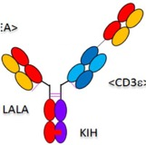







Bispecific antibodies in B-NHL under Development
CD19
CD20
BITE® (1:1)
Full-length IgG (1:1)
Full-length IgG (2:1)
IgM (10:1)
Blinatumomab
Mosunetuzumab
Glofitamab
IgM2323
Odronextamab
Epcoritamab
CD, cluster of differentiation; Ig, immunoglobulin; NHL, non-Hodgkin’s lymphoma

Slide 73
Mosunetuzumab Shows Promising Efficacy in Patients with Multiply Relapsed FL
Updated Clinical Experience from a Phase 1 Dose-Escalation Trial
Key inclusion criteria (FL cohort)
Cycle 1 D1/D8/D15 dose:
0.4/1.0/2.8–1/2/13.5 mg
R/R FL (Grades 1-3a; expected to express CD20)
≥2 prior systemic therapies
Age ≥18 years
ECOG PS ≤1
D15
D1
D1
D1
D8
D1
Cycle 1
Cycle 2
Cycle 3
Cycle 8
21 days
CD20, cluster of differentiation 20; D, Day; ECOG PS, Eastern Cooperative Oncology Group Performance Status; FL, follicular lymphoma; R/R, relapsed/refractory
Assouline S, et al. ASH 2020. Abstract #702

Slide 74
Mosunetuzumab response rates
(Investigator-assessed) in patients with R/R FL
100%
92.3%
Partial response
75.9%
67.7%
71.1%
Complete response
65.2%
Proportion of patients
with response (%)
Refractory
to last prior
Therapy
N=46
N=62
N=46
N=38
N=29
N=13
N=4
High and consistent complete response rates were observed in high-risk populations, including those with
double-refractory disease, POD24, PI3Ki refractory, and those who received prior CAR-T therapy
CAR-T, chimeric antigen receptor T cell; FL, follicular lymphoma; PI3Ki, phosphoinositide 3-kinase inhibitor; POD24, progression of disease within 2 years; R/R, relapsed/refractory
Assouline S, et al. ASH 2020. Abstract #702

Slide 75
Anti-CD20 Bispecific Antibodies show encouraging results in R/R FL
Study
 | Route | ORR | CR | Follow-up & DoR | Toxicities
Mosunetuzumab 0.4/1/2.8 -1/2/13.5 mg Assouline et al¹ | IV; Q21 days (C1: D1,8,15) If CR: up to 8 cycles If SD/PR: 17 cycles (N=62) | 67.7% | 51.6% | Follow-up 18.4 months, DoR 20.4 months (9.4-22.7) | CRS: 17.7 % (0 grade ≥3) ICANS: 0
Odronextamab 80-320mg Bannerji et al² | IV; Q7 days x 12 ➔ Q14 days (N=38) | 90%ª | 70% | Follow-up 21 months, 81% of CR ongoing | CRS: 65.8 % (2.6% grade ≥3) ICANS: 0
Glofitamab 2.5/10/16-30 mg Hutchings et al³ | Obinutuzumab x1 on day -7 IV; Q21 days x 12 (C1: D1,8) (N=24) | 66.7% | 54.2% | PFS: 11.8 months | CRS: 63.5% (3.8% grade ≥3) ICANS: 3.5% (1.2% grade ≥3)
Epcoritamab 0.76-48 mg Hutchings et al⁴ | SC; C1-2: Q1W ➔ C3-6: Q2W ➔ Q4W (N=12) | 80-90% | 50-60% | CR (5): 1 PD PR (4): 3 PD at 28 weeks | CRS: 58% (0 grade ≥3) ICANS: 0
ª Objective response rate
Ab, antibody; C, cycle; CD20, cluster of differentiation 20; CR, complete response; D, day; DoR, duration of response; CRS, cytokine release syndrome; FL, follicular lymphoma; ICANS, immune effector cell-associated neurotoxicity syndrome; ORR, overall response rate; PD, progressive disease; PFS, progression-free survival; Q, every; R/R, relapsed/refractory; SC, subcutaneous; W, week
Assouline S, et al. ASH 2020. Abstract #702; Bannerji R, et al. ASH 2020. Abstract #400; Hutchings M, et al. ASH 2020. Abstract #403; Hutchings M, et al. ASH 2020. Abstract #402

Slide 76
Take-Home Messages for FL
Non-chemotherapy options increasing!
Lenalidomide-obinutuzumab promising in 1st line; needs broader study
Multiple novel therapies coming in R/R FL
Non-chemotherapy options should be considered for early progressing (POD24) patients with FL early on
Newly approved therapies include EZH2 (tazametostat) and dual PI3K/CK inhibitors (umbralisib)
Copanlisib + rituximab leads to improved PFS vs rituximab alone
CAR-T cells are a highly active modality that recently received approval in the US
Bispecific antibodies show promising activity in FL
CAR, chimeric antigen receptor; EZH2, enhancer of zeste homologue 2; FL, follicular lymphoma; PI3K, phosphoinositide 3-kinase; POD24, progression of disease within 2 years; PFS, progression-free survival; R/R, relapsed/refractory

