Slide 2
Early Treatment Intensification for Metastatic Castration Sensitive Prostate Cancer: Optimising Patient Selection and Treatment
Prof. Evan Y. Yu, MD
Professor of Medicine and Oncology, Clinical Research Director,
Genitourinary Oncology
Medical Director, Clinical Research Services, Fred Hutch Cancer Consortium, USA
NOVEMBER 2022

Slide 3
Disclaimer and disclosures
Please note: The views expressed within this presentation are the personal opinions of the author.
They do not necessarily represent the views of the author’s academic institution, or the rest of the
GU CONNECT group.
This content is supported by an Independent Educational Grant from Bayer.
Prof. Evan Yu has received received financial support/sponsorship from the following companies:
Consulting: AbbVie, Advanced Accelerator Applications, Bayer, Clovis, Exelixis, Genzyme, Janssen, Merck, Oncternal
Research Funding to Institution: Bayer, Blue Earth, Daiichi-Sankyo, Dendreon, Lantheus, Merck, Seagen, Taiho

Slide 4
Educational objectives
Recognise how the mCSPC treatment landscape has evolved highlighting the need for treatment intensification
Understand the available data and how this can be applied to select the most appropriate treatment for mCSPC patients

Slide 5
Clinical Takeaways
ADT alone is no longer sufficient treatment for mCSPC patients
Treatment intensification with either doublet or triplet therapy should occur
Patients with de novo, high-volume disease who are fit for chemotherapy should be considered for triplet therapy with ADT + docetaxel + NHA
Patients who are unfit for chemotherapy or have low volume disease should be considered for doublet therapy with ADT + NHA
ADT, androgen deprivation therapy; mCSPC, metastatic castration sensitive prostate cancer; NHA, novel hormonal agents

Slide 6
mCSPC: evolving treatment landscape
mCSPC, metastatic castration sensitive prostate cancer

Slide 7
The Development of Novel Hormone Therapy and Chemotherapy in mCSPC
CHAARTED (docetaxel)
First patient in 2007
ASCO 2014¹
LATITUDE
(abiraterone)
First patient in 2013
ASCO 2017²
STAMPEDE
(abiraterone)
First patient in 2006
ESMO 2018 (arm G)³
TITAN
(apalutamide)
First patient in 2015
ASCO 2019⁴
ARCHES
(enzalutamide)
First patient in 2016
ASCO GU 2019⁵
ENZAMET
(enzalutamide)
First patient in 2014
ASCO 2019⁶
PEACE1
(abiraterone + docetaxel + RT)
First patient in 2013
ESMO 2021⁷
ARASENS
(darolutamide + docetaxel)
First patient in 2016;
ASCO GU 2022⁸
Treatment intensification: triplet therapy
ADT, androgen deprivation therapy; ARPI, androgen receptor pathway inhibitor; ASCO, American Society of Clinical Oncology; ESMO, European Society for Medical Oncology; GU, genitourinary; mCSPC, metastatic castration-sensitive prostate cancer; RT, radiation therapy
1. Sweeney C, et al. J Clin Oncol. 2014;32(5s):(suppl; abstr LBA2); 2. Fizazi K, et al. J Clin Oncol. 2017;35(suppl):LBA3; 3. Hoyle AP, et al. Ann Oncol. 2018;29(suppl 8):viii722 (abstract LBA4);
4. Chi KN, et al. J Clin Oncol. 2019;37(suppl):5006; 5. Armstrong AJ, et al. J Clin Oncol. 2019;37(suppl 7S):687; 6. Sweeney C, et al. J Clin Oncol. 2019;37(suppl):LBA2;
7. Fizazi K, et al. Abstract #LBA5_PR. ESMO 2021. Oral presentation; 8. Smith M, et al. J Clin Oncol 2022; 40, (suppl 6; abstr 13) (ASCO GU 2022, oral presentation)

Slide 8
CHAARTED study design
CHAARTED: Randomised phase 3 trial designed to determine whether docetaxel therapy at initiation of ADT in patients with mCSPC can increase overall survival compared with ADT alone
mCSPC (N=790)
On ADT <120 days
ECOG PS 0–2
Prior ADT allowed if:
  Prior adjuvant use, if duration was ≤24 mo
  and progression occurred >12 mo after completion
  of therapy
  Receiving ADT for metastatic disease with no evidence of progression and treatment commencing within 120 days prior to randomisation
Stratification
Age (<70 y vs ≥70 y)
ECOG PS (0 or 1 vs 2)
CAB > 30 days (yes vs no)
SRE prevention (yes vs no)
Prior ADT (<12 mo vs ≥12 mo)
Extent of metastasis (low vs high)
Primary Endpoint
Overall survival
Secondary Endpoints
Time to CRPC
Time to clinical progression
Percent patients with
PSACR at 6 months
Percentage of patients with PSACR at 12 months
QoL
ADT + docetaxel
R
1:1
ADT
ADT, androgen deprivation therapy; CAB, combined androgen blockade; CRPC, castration-resistant prostate cancer; ECOG PS, Eastern Cooperative Oncology Group performance status; mCSPC, metastatic castration sensitive prostate cancer; mo, month; PSACR, prostate-specific antigen complete response; QoL, quality of life;
R, randomisation; SRE, skeletal-related event; y, year
Sweeney CJ, et al. N Engl J Med. 2015;373:737-46

Slide 9
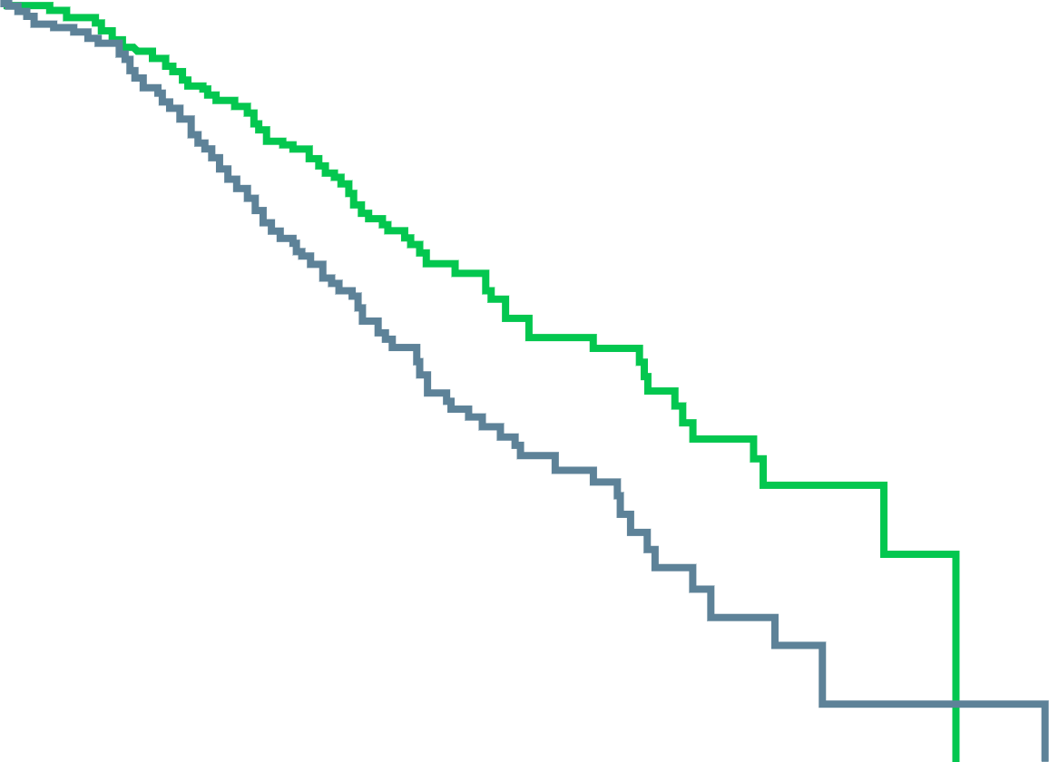
CHAARTED: Combination ADT + Docetaxel Resulted in Significantly Longer Overall Survival Than ADT Alone
Median Overall Survival – All Patients
Median Overall Survival – High-Volume Diseaseª
13.6 months longer with ADT + docetaxel
17.0 months longer with ADT + docetaxel
100
Hazard ratio for death with ADT + docetaxel,
0.61 (95% CI, 0.47-0.80) p<0.001
100
Hazard ratio for death with ADT + docetaxel,
0.60 (95% CI, 0.45-0.81) p<0.001
80
ADT + docetaxel
(n=397)
(median overall
survival, 57.6 mo)
80
ADT + docetaxel
(n=263)
(median overall
survival, 49.2 mo)
60
60
Patients surviving (%)
ADT alone
(n=393)
(median overall
survival, 44.0 mo)
Patients surviving (%)
40
40
ADT alone
(n=250)
(median overall
survival, 32.2 mo)
20
20
0
0
0
12
24
36
48
60
72
84
0
12
24
36
48
60
72
84
Months
Months
ª High-volume disease was defined as the presence of visceral metastases or ≥4 bone metastases lesions with ≥1 beyond the vertebral bodies and pelvis
ADT, androgen deprivation therapy; CI, confidence interval; mo, months
Sweeney CJ, et al. N Engl J Med. 2015;373:737-46
Notes:
No OS benefit for low volume disease!

Slide 10
TREATMENT INTENSIFICATION: CONSIDERATIONS

Slide 11
Treatment intensification – suitable FOR WHICH PATIENTS?
Fit for chemotherapy or not?
High-volume or low-volume disease?
Symptomatic or non-symptomatic?
Contraindications to particular treatments or not?

Slide 12
Considerations When Selecting Between Androgen Pathway Inhibitors
Abiraterone – liver function test abnormalities, hypokalaemia, oedema, hypertension, hyperglycaemia (from exogenous glucocorticoids)^{1,2}
Enzalutamide – fatigue, falls, restless leg syndrome^{3,4}
Apalutamide – rash^{5,6}
Darolutamide – only approved in combination with docetaxel by FDA (can start up to 6 weeks prior to starting docetaxel), fewer unfavourable drug-drug interactions^{7,8,9}
FDA, Food and Drug Administration; PI, Prescribing Information; SmPC, Summary of Product Characteristics
1. Abiraterone (Zytiga) PI (Aug 21); 2. Abiraterone (Zytiga) SmPC (08 Sep 22); 3. Enzalutamide (Xtandi) PI (Sep 22); 4. Enzalutamide (Xtandi) SmPC (08 Sep 22); 5. Apalutamide (Erleada) PI (Nov 22); 6. Apalutamide (Erleada) SmPC (13 Jul 22); 7. Darolutamide (Nubeqa) PI (Aug 22); 8. Darolutamide (Nubeqa) SmPC (27 Mar 22); 9. Olivier KM, et al. Int J Urol Nurs. 2021;15:47-58

Slide 13
Potential drug-drug Interactions of NHA’s with commonly used PC medications
Interaction | Substrate AR inhibitor increases plasma level of comedication May increase risk of AEs associated with comedication | Substrate AR inhibitor decreases plasma level of comedication May lead to a decrease in activity of comedication | Inducer Comedication decreases plasma level of AR inhibitor May lead to a decrease in activity of AR inhibitor |  | Inhibitor Comedication increases plasma level of AR inhibitor May increase risk of AEs associated with AR inhibitor
Medicinal product |  | Apalutamide | Enzalutamide |  | Darolutamide
Antithrombotics | Clopidogrel |  | ✘
 | Dabigatran | CAUTION | CAUTION
 | Rivaroxaban | ✘ | ✘
 | Warfarin | ✘ | ✘
Calcium channel blockers | Amlodipine | CAUTION | CAUTION
 | Diltiazem |  | ✓
 | Nifedipine, felodipine | ✘ | ✘
 | Verapamil |  | CAUTION
Cardiac glycosides | Digoxin | CAUTION | CAUTION
Proton pump inhibitor | Omeprazole | ✘ | ✘
Analgesics | Fentanyl | CAUTION | ✘
Hypnotics | Diazepam | ✘ | ✘
 | Midazolam | ✘ | ✘
Antipsychotics | Haloperidol | ✘ | ✘
Antibiotics | Clarithromycin | CAUTION |  |  | CAUTION
 | Rifampicin |  | ✘ |  | ✘
Anticonvulsants | Carbamazepine |  | ✘ |  | ✘
Statins | Rosuvastatin | CAUTION |  |  | ✘
Note: Recommendations provided in the US PI, EMA SPC, and NICE BNF. ✓ Comedication can be combined with AR inhibitor. ✘ Avoidance or substitution of comedication is recommended. CAUTION indicates comedication should be administered with caution and/or dose adjustment based on efficacy/tolerability is recommended.
AE, adverse event; AR, androgen receptor; BNF, British National Formulary; EMA, European Medicines Agency; NICE, National Institute for Health and Care Excellence; PC, prostate cancer; PI, prescribing information; SPC, summary of product characteristics
Olivier KM, et al. Int J Urol Nurs. 2021;15:47-58

Slide 14
mCSPC TRIPLET THERAPY TRIALS
mCSPC, metastatic castration sensitive prostate cancer

Slide 15
ENZAMET study design
STRATIFICATION
Volume of metastases*
High vs Low
Planned early docetaxel
Yes vs No
ECOG PS
0-1 vs 2
Anti-resorptive therapy
Yes vs No
Comorbidities
ACE-27: 0-1 vs 2-3
Study Site
R
A
N
D
O
MI
S
E
ARM A:
Testosterone Suppression
+ standard NSAA
CRPC therapy at investigator’s discretion at progression
Follow for time to progression and overall survival
Evaluate
every
12 weeks
ARM B:
Testosterone Suppression
+ enzalutamide (160 mg/d)
Evaluate
every
12 weeks
Prior to randomisation testosterone suppression up to 12 weeks and 2 cycles of docetaxel was allowed; intermittent ADT and cyproterone
were not allowed; NSAA: bicalutamide; nilutamide; flutamide
* High volume: visceral metastases and/or 4 or more bone metastases (at least 1 beyond pelvis and vertebral column);
ACE-27, adult comorbidity evaluation-27; ADT, androgen deprivation therapy; CRPC, castration resistant prostate cancer; d, day; ECOG PS, Eastern Cooperative Oncology Group performance status; NSAA, nonsteroidal antiandrogen
Sweeney C, et al. J Clin Oncol. 2019;37(suppl):LBA2; Davis I, et al. N Engl J Med. 2019; 381:121-31 (inc. protocol)

Slide 16
ENZAMET: Enzalutamide for mCSPC
Varied inclusion criteria: high and low volume, de novo vs metachronous metastasis, concurrent docetaxel, many permutations
CLINICAL PROGRESSION-FREE SURVIVAL
OVERALL SURVIVAL (Primary endpoint)
100
100
enzalutamide
75
enzalutamide
75
NSAA
50
Patients surviving (%)
Patients free of clinical progression (%)
50
Proportion alive at 36 months (95% CI)
NSAA
NSAA | enzalutamide
0.72 (0.68 to 0.76) | 0.80 (0.75 to 0.83)
25
25
Hazard ratio 0.40 (95% CI 0.33-0.49)
p<0.001 by log-rank test
Hazard ratio 0.67 (95% CI 0.52-0.86)
p=0.002 by log-rank test
0
0
0
6
12
18
24
30
36
42
48
0
6
12
18
24
30
36
42
48
Months
Months
CI, confidence interval; mCSPC, metastatic castration-sensitive prostate cancer; NSAA, nonsteroidal antiandrogen
Sweeney C, et al. J Clin Oncol. 2019;37(suppl):LBA2; Davis ID, et al. N Engl J Med. 2019;381:121-31

Slide 17
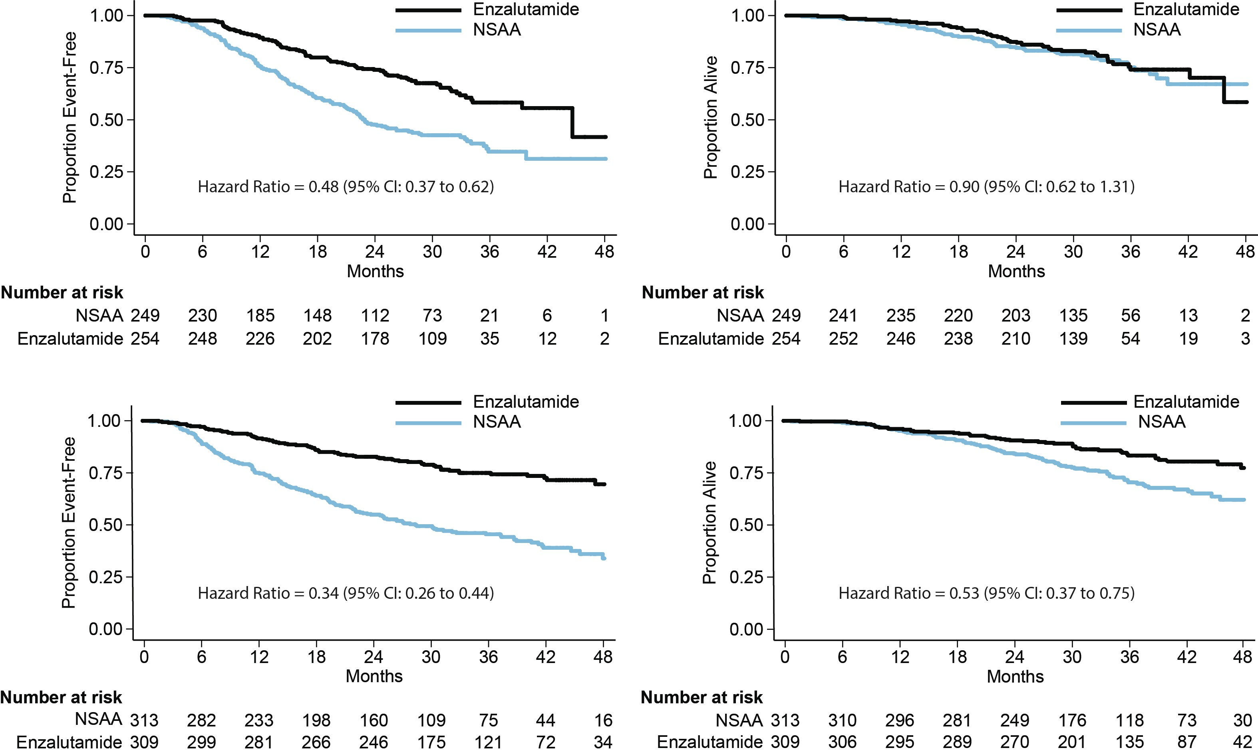
ENZAMET: Concurrent Docetaxel
CLINICAL PROGRESSION-FREE SURVIVAL
OVERALL SURVIVAL
Testosterone suppression
+
docetaxel
n=503
(71% high volume)
Testosterone suppression
+
no docetaxel
n=622
(37% high volume)
CI, confidence interval; NSAA, nonsteroidal antiandrogen
Sweeney C, et al. J Clin Oncol. 2019;37(suppl):LBA2; Davis ID, et al. N Engl J Med. 2019;381:121-31

Slide 18
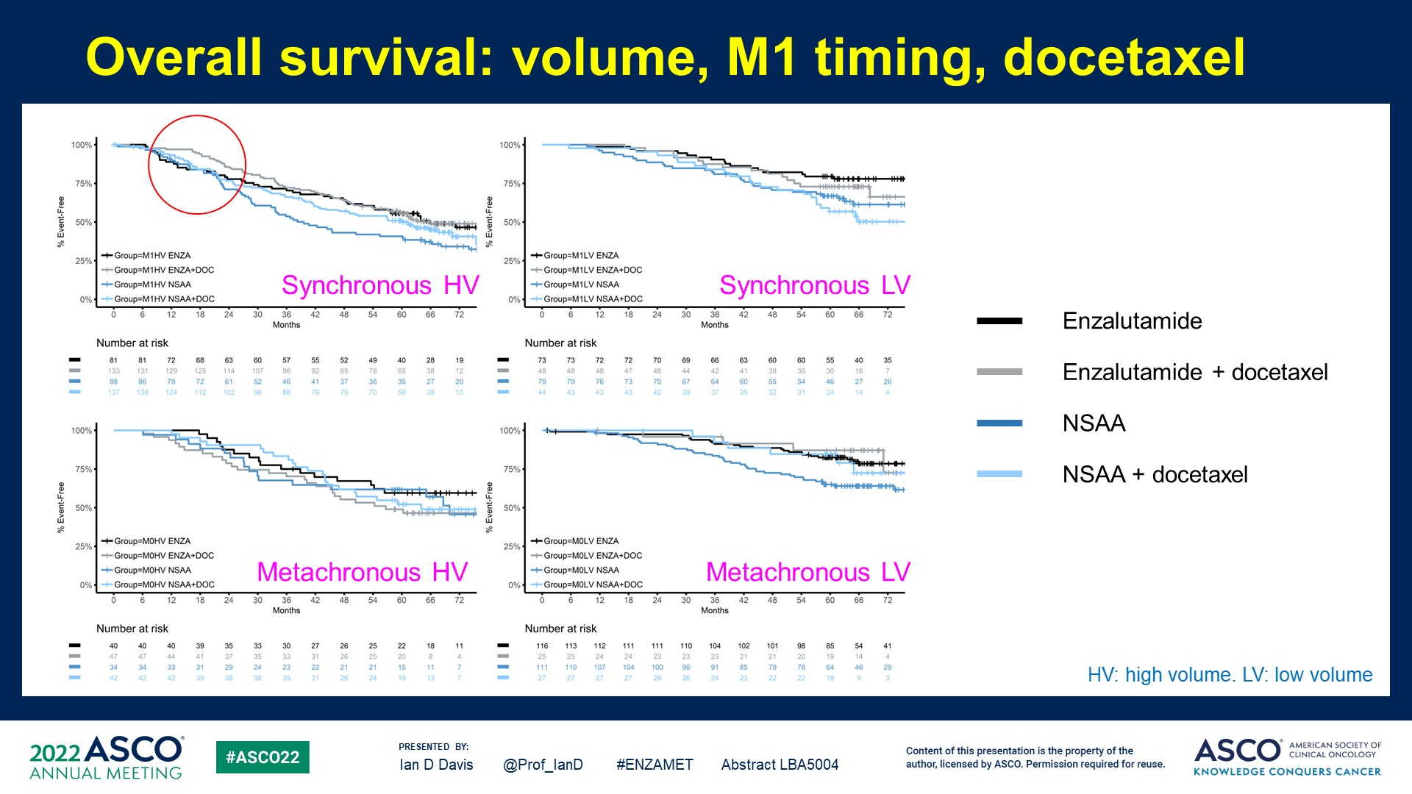
Enzamet: updated OVERALL SURVIVAL
EXPLORATORY ANALYSIS: Volume, m1 timing, docetaxel
% Event-free
% Event-free
Synchronous HV
Synchronous LV
Months
Months
81 | 81 | 72 | 68 | 63 | 60 | 57 | 55 | 52 | 49 | 40 | 28 | 19
133 | 131 | 129 | 125 | 114 | 107 | 96 | 92 | 85 | 78 | 65 | 38 | 12
88 | 86 | 79 | 72 | 61 | 52 | 46 | 41 | 37 | 36 | 35 | 27 | 20
137 | 130 | 124 | 112 | 102 | 96 | 88 | 79 | 75 | 70 | 59 | 35 | 10
73 | 73 | 72 | 72 | 70 | 69 | 66 | 63 | 60 | 60 | 55 | 40 | 35
48 | 48 | 48 | 47 | 46 | 44 | 42 | 41 | 39 | 35 | 30 | 16 | 7
79 | 79 | 76 | 73 | 70 | 67 | 64 | 60 | 55 | 54 | 46 | 27 | 26
44 | 43 | 43 | 43 | 42 | 39 | 37 | 35 | 32 | 31 | 24 | 14 | 4
% Event-free
% Event-free
Metachronous HV
Metachronous LV
Months
Months
40 | 40 | 40 | 39 | 35 | 33 | 30 | 27 | 26 | 25 | 22 | 18 | 11
47 | 47 | 44 | 41 | 37 | 35 | 33 | 31 | 26 | 25 | 20 | 8 | 4
34 | 34 | 33 | 31 | 29 | 24 | 23 | 22 | 21 | 21 | 15 | 11 | 7
42 | 42 | 42 | 39 | 38 | 38 | 35 | 31 | 26 | 24 | 19 | 13 | 7
116 | 113 | 112 | 111 | 111 | 110 | 104 | 102 | 101 | 98 | 85 | 54 | 41
25 | 25 | 24 | 24 | 23 | 23 | 23 | 21 | 21 | 20 | 19 | 14 | 4
111 | 110 | 107 | 104 | 100 | 96 | 91 | 85 | 79 | 76 | 64 | 46 | 29
27 | 27 | 27 | 27 | 26 | 26 | 24 | 23 | 22 | 22 | 18 | 9 | 3
HV, high volume; LV, low volume
Davis, IJ Clin Oncol 40, 2022 (suppl 17; abstr LBA5004)

Slide 19
Enzamet: selected aes All patients at anytime
Selected AEs* | TS + NSAA N=558 |  | TS + ENZA N=563
SAE rate per year of Rx exposure | 0.33 | 95% CI: 0.28-0.39 | 0.34 | 95% CI: 0.29-0.40
AEs of Interest | N | % | N | %
G3 Hypertension | 24 | 4 | 43 | 8
G2 Hypertension | 30 | 5 | 60 | 11
G3 Fatigue | 4 | 1 | 31 | 6
G2 Fatigue | 80 | 14 | 142 | 25
G3 Falls | 2 | <1 | 6 | 1
G2 Falls | 8 | 1 | 28 | 5
Syncope | 7 | 1 | 20 | 4
Concentration impairment (G1/2) | 6 | 1 | 24 | 4
Any seizure | 0 | 0 | 7 | 1
*Worst grade shown
NSAA, nonsteroidal antiandrogen; TS, testosterone suppression
Sweeney C, et al. J Clin Oncol. 2019;37(suppl):LBA2

Slide 20
Peace-1 study design
PEACE-1: A phase 3 trial with 2x2 factorial design investigating overall survival of abiraterone acetate + docetaxel + ADT in de novo mCSPC patients
Key eligibility criteria
De novo mCSPC
Distant metastatic disease by ≥1 lesion on bone scan and/or CT scan
ECOG PS 0-2
On-study requirement
Continuous ADT
Permitted
ADT ≤3 months
Stratification
ECOG PS (0 vs 1-2)
Metastatic sites (lymph node vs bone
vs visceral)
Type of castration (orchidectomy vs LHRH agonist vs LHRH antagonist)
Docetaxel (yes vs no)
Nov 2013–Dec 2018
SOC
(N=296)
SOC + AAP
(N=292)
Co-primary
Radiographic progression-free survival (rPFS)
OS
R
1:1:1:1
SOC + RT
(N=293)
N=1,173
SOC + AAP + RT
(N=292)
2x2 factorial design
SOC = ADT and docetaxel 75 mg/m² every 3 weeks for 6 cycles
AAP, abiraterone and prednisone; ADT, androgen deprivation therapy; CT, computed tomography; ECOG PS, Eastern Cooperative Oncology Group performance status; LHRH, luteinising hormone releasing hormone; mCSPC, metastatic castration-sensitive prostate cancer; OS, overall survival; PCWG 2, Prostate Cancer Working Group 2; PSA, prostate specific antigen; R, randomisation; rPFS, radiographic progression-free survival; RT, radiotherapy; SOC, standard of care
Fizazi K, et al. Abstract #LBA5_PR. ESMO 2021. Oral presentation; Fizazi K, et al. The Lancet 2022; 399 (103360): 1695-1707

Slide 21
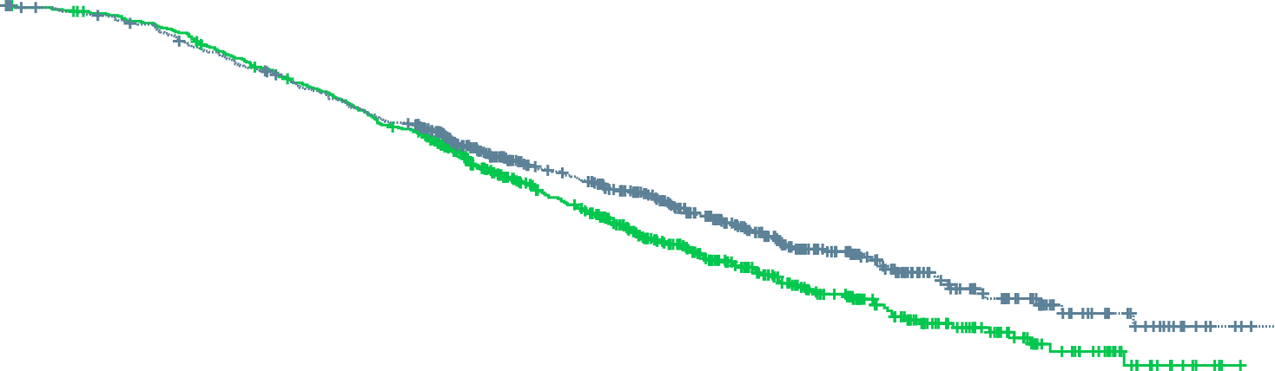
PEACE-1 Trial – Overall Survival for the Entire Population
 | SOC + Abi (n=583) | SOC (n=589)
Median, y (95% CI) | 5.7 (5.1-NE) | 4.7 (4.3-5.3)
Events | 228 | 268
HR (95% CI)* | 0.82 (0.69-0.98)
p value | 0.030
100
80
60
SOC + Abi
Overall survival (%)
40
SOC
20
0
0
1
2
3
4
5
6
7
Time from randomisation (years)
* Adjusted on stratification parameters
(RXT, PS, type of castration,
metastatic burden, docetaxel)
SOC
SOC + Abi
589
583
556
541
480
470
334
340
207
230
101
111
37
47
4
6
Abi, abiraterone; CI, confidence interval; HR, hazard ratio; NE, not estimable; OS, overall survival; PS, performance status; RXT, radiotherapy to primary tumour; SOC, standard of care; y, year
Fizazi K, et al. Abstract #LBA5_PR. ESMO 2021. Oral presentation
Notes:
All the patients for OS.
No real subgroups stand out, except URMs broad CI due to small numbers.

Slide 22
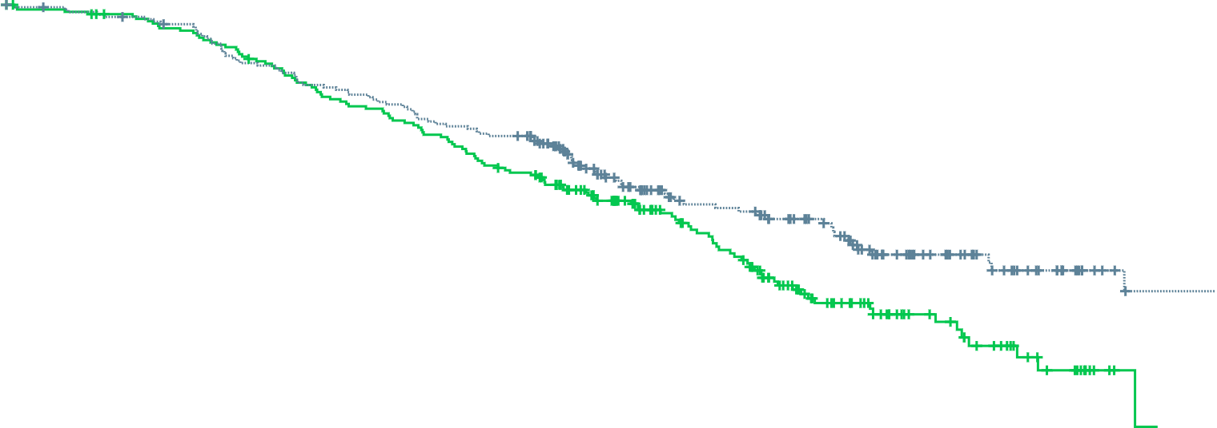
PEACE-1 Trial – Overall Survival with Abiraterone + ADT + Docetaxel (+/- RT) in High-Volume Patients
Abiraterone + ADT + docetaxel provides lifetime gain of more than 1.5 years in high-volume patients (5.1y vs 3.5y)
 | SOC + Abi (n=224) | SOC (n=232)
Median, y (95% CI) | 5.1 (3.8-NE) | 3.5 (3.2-4.0)
Events | 92 | 120
HR (95% CI) | 0.72 (0.55-0.95)
p value | 0.019
100
80
60
SOC + Abi
Overall survival (%)
40
20
SOC
0
0
1
2
3
4
5
Time from randomisation (years)
SOC
SOC+Abi
232
224
210
201
171
171
101
103
39
57
6
16
Abi, abiraterone; ADT, androgen deprivation therapy; CI, confidence interval; HR, hazard ratio; NE, not estimable; RT, radiotherapy; SOC, standard of care; y, year
Fizazi K, et al. Abstract #LBA5_PR. ESMO 2021. Oral presentation

Slide 23
PEACE-1: safety data
G3-5 Toxicity on study treatments (ADT + docetaxel safety population)
Toxicity, N (%) | SOC (+/- RXT) + Abiraterone (n=346) | SOC (+/- RXT) (n=350)
Neutropenia | 34 (10) | 32 (9)
Febrile neutropenia | 18 (5) | 19 (5)
Liver | 20 (6) | 2 (1)
Hypertension | 76 (22) | 45 (13)
Hypokalemia | 11 (3) | 1 (0)
Cardiac | 6 (2) | 5 (1)
Fatigue | 10 (3) | 15 (4)
Gastrointestinal | 14 (4) | 18 (5)
Grade 5 | 7 (2) | 3 (1)
Abi, abiraterone; ADT, androgen deprivation therapy; RXT, radiotherapy; SOC, standard of care
Fizazi K, et al. Abstract #LBA5_PR. ESMO 2021. Oral presentation

Slide 24
arasens study design
Randomised, double-blind, placebo-controlled, global, phase 3 study (NCT02799602)
Conducted at 286 centres in 23 countries
Docetaxel × 6
Endpoints
Primary: OS
Secondary
Time to CRPC
Time to progression
SSE-free survival
Time to first SSE
Time to initiation of subsequent systemic antineoplastic therapy
Time to worsening of disease-related physical symptoms
Time to initiation of opioid use for ≥7 consecutive days
Safety
Patients (N=1306)
mHSPC
ECOG PS 0 or 1
Candidates for ADT
and docetaxel
Stratification
Extent of disease:
M1a vs M1b vs M1c
ALP: < vs ≥ULN
Darolutamide 600 mg
twice daily + ADT
Randomise
1:1
Primary analysis
Placebo
twice daily + ADT
FAS N=1,305
SAF N=1,302
FPFV: Nov 2016
LPFV: June 2018
Docetaxel × 6
Data cut-off
Oct 25, 2021
The final analysis was conducted after 533 deaths
Secondary efficacy endpoints were
tested hierarchically
ADT, androgen deprivation therapy; ALP, alkaline phosphatase; CRPC, castration-resistant prostate cancer; ECOG PS, Eastern Cooperative Oncology Group performance status; FAS, full analysis set; FPFV, first patient first visit; LPFV, last patient first visit; M1a, nonregional lymph node metastases; M1b, bone metastases +/- lymph node metastases; M1c, visceral metastases +/- lymph node or bone metastases; mHSPC, metastatic hormone sensitive prostate cancer; OS, overall survival; SAF, safety analysis set; SSE, symptomatic skeletal event; ULN, upper limit of normal
Smith M, et al. J Clin Oncol 2022; 40, (suppl 6; abstr 13) (ASCO GU 2022, oral presentation); Smith M, et al. N Engl J Med. 2022; 386(12):1132-42

Slide 25
ARASENS: selected Clinical Characteristics at Baseline
Characteristic | Darolutamide–ADT– docetaxel (N=651) | Placebo–ADT– docetaxel (N=654)
Gleason score at initial diagnosis — no. (%) <8 ≥8 Data missing | 122 (18.7) 505 (77.6) 24 (3.7) | 118 (18) 516 (78.9) 20 (3.1)
Metastasis stage at initial diagnosis – no. (%) M1, distant metastasis M0, no distant metastasis MX, distant metastasis not assessed | 558 (85.7) 86 (13.2) 7 (1.1) | 566 (86.5) 82 (12.5) 6 (0.9)
Metastasis stage at screening — no. (%) M1a, nonregional lymph-node metastases only M1b, bone metastases with or without lymph-node metastases M1c, visceral metastases with or without lymph-node or bone metastases | 23 (3.5) 517 (79.4) 111 (17.1) | 16 (2.4) 520 (79.5) 118 (18.0)
Median serum PSA level (range) – ng/ml | 30.3 (0.0-9,219.0) | 24.2 (0.0-11,947.0)
Median serum ALP level (range) – U/liter | 148 (40-4,885) | 140 (36-7,680)
ALP category – no. (%) <ULN ≥ULN | 290 (44.5) 361 (55.5) | 291 (44.5) 363 (55.5)
ADT, androgen deprivation therapy; ALP, alkaline phosphatase; PSA, prostate specific antigen; ULN, upper limit of normal
Smith M, et al. N Engl J Med. 2022;386(12):1132-42

Slide 26
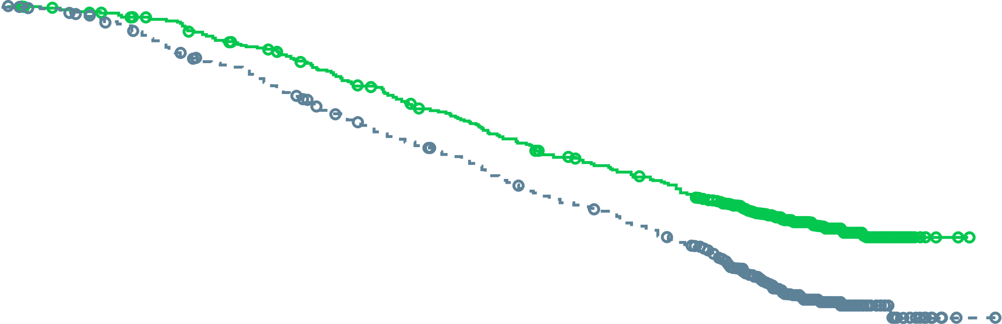
ARASENS: Overall Survival
1.0
0.9
Darolutamide + ADT + docetaxel
Median NE (95% CI, NE-NE)
0.8
0.7
62.7%
0.6
0.5
Survival probability
Placebo + ADT + docetaxel
Median 48.9 months (95% CI, 44.4-NE)
0.4
50.4%
0.3
0.2
Hazard ratio for overall survival,
0.68 (95% CI, 0.57-0.80)
p<0.001
0.1
0.0
0
3
6
9
12
15
18
21
24
27
30
33
36
39
42
45
48
51
54
57
60
Number of patients at risk
Darolutamide
Placebo
Months
651 | 645 | 637 | 627 | 608 | 593 | 570 | 548 | 525 | 509 | 486 | 468 | 452 | 436 | 402 | 267 | 139 | 56 | 9 | 0 | 0
654 | 646 | 630 | 607 | 580 | 565 | 535 | 510 | 488 | 470 | 441 | 424 | 402 | 383 | 340 | 218 | 107 | 37 | 6 | 1 | 0
ADT, androgen deprivation therapy; CI, confidence interval; NE, not estimable
Smith M, et al. N Engl J Med. 2022;386(12):1132-42; Smith M, et al. J Clin Oncol 2022; 40, (suppl 6; abstr 13) (ASCO GU 2022, oral presentation)

Slide 27
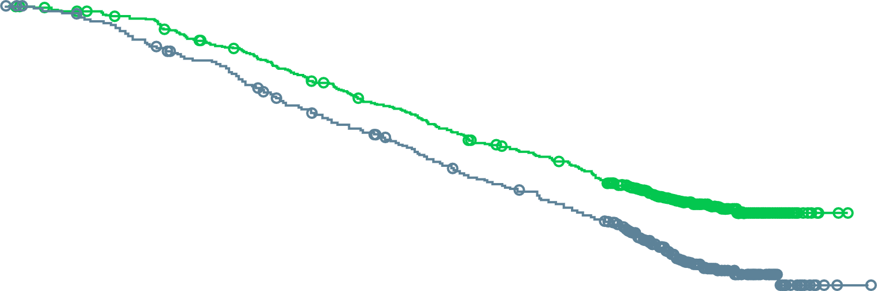
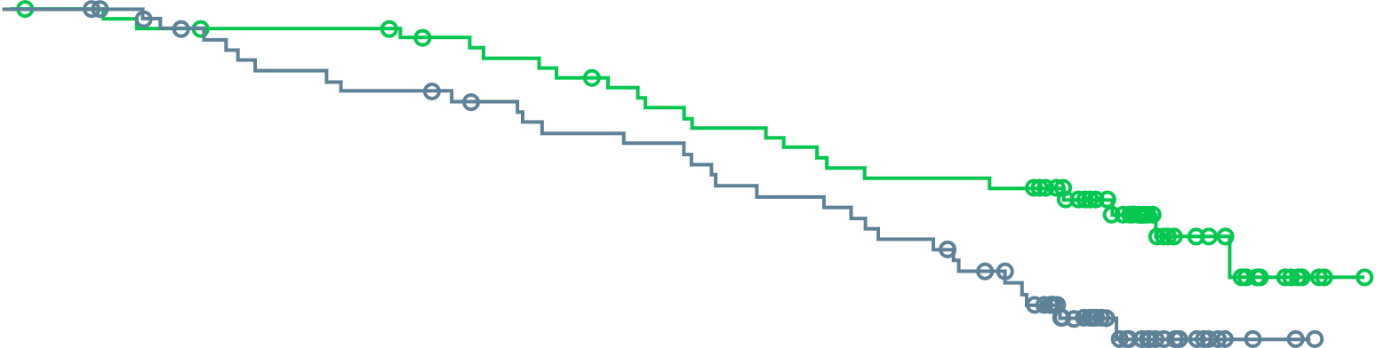
ARASENS: OS by De Novo and Recurrent Subsets
De novo mHSPC
(M1 at initial diagnosis; 86.1% of patients)
Recurrent mHSPC
(M0 at initial diagnosis; 12.9% of patients)
1.0
1.0
0.9
0.9
Darolutamide + ADT
+ docetaxel
0.8
Darolutamide + ADT
+ docetaxel
0.8
0.7
0.7
0.6
0.6
Survival probability
Survival probability
Placebo + ADT + docetaxel
0.5
0.5
0.4
Placebo + ADT + docetaxel
0.4
0.3
0.3
0.2
HR 0.71
(95% CI: 0.59, 0.85)
0.2
HR 0.61
(95% CI: 0.35, 1.05)
0.1
0.1
0.0
0.0
0
3
6
9
12
15
18
21
24
27
30
33
36
39
42
45
48
51
54
57
60
0
3
6
9
12
15
18
21
24
27
30
33
36
39
42
45
48
51
54
57
No. at risk
Darolutamide
Placebo
Months
No. at risk
Darolutamide
Placebo
Months
558
566
553
558
547
546
539
526
520
503
505
490
485
461
466
438
445
420
433
403
412
378
396
362
383
344
367
328
334
292
220
190
116
93
45
33
7
6
0
1
0
0
86
82
85
82
83
78
81
75
81
72
81
70
78
69
76
67
74
64
70
63
68
59
66
58
63
54
63
51
62
45
43
26
20
12
11
4
2
0
0
0
ADT, androgen deprivation therapy; CI, confidence interval; HR, hazard ratio; M0, non-metastatic; M1, metastatic; mHSPC, metastatic hormone sensitive prostate cancer; OS, overall survival
Smith M, et al. N Engl J Med. 2022;386(12):1132-42 (supplementary appendix); Fizazi K, et al. Ann Oncol. 2022;33 (suppl_7): S616-S652 (ESMO 2022, oral presentation)

Slide 28
ARASENS: Adverse Events of Interest
Adverse Event | Darolutamide + ADT + docetaxel (N=652) | Placebo + ADT + docetaxel (N=650)
 | No. of patients (%) | No. of patients (%)
Events commonly associated with ADT or ARPI therapy
Fatigue | 216 (33.1) | 214 (32.9)
Vasodilatation and flushing | 133 (20.4) | 141 (21.7)
Rash | 108 (16.6) | 88 (13.5)
Diabetes mellitus and hyperglycemia | 99 (15.2) | 93 (14.3)
Hypertension | 89 (13.7) | 60 (9.2)
Cardiac disorder | 71 (10.9) | 76 (11.7)
Cardiac arrhythmia | 52 (8.0) | 55 (8.5)
Coronary artery disorder | 19 (2.9) | 13 (2.0)
Heart failure | 4 (0.6) | 13 (2.0)
Bone fracture | 49 (7.5) | 33 (5.1)
Falls, including accident | 43 (6.6) | 30 (4.6)
Mental-impairment disorder | 23 (3.5) | 15 (2.3)
Weight decreased | 22 (3.4) | 35 (5.4)
Depressed-mood disorder | 21 (3.2) | 24 (3.7)
Breast disorders/gynecomastia | 21 (3.2) | 10 (1.5)
Cerebral ischemia | 8 (1.2) | 8 (1.2)
Seizure | 4 (0.6) | 1 (0.2)
Most AEs of interest were similar between the treatment arms except for rash and hypertension
ADT, androgen deprivation therapy; AE, adverse event; ARPI, androgen receptor pathway inhibitor
Smith M, et al. N Engl J Med. 2022; 386(12):1132-42

Slide 29
Summary
For patients fit for docetaxel with mCSPC, consideration should be given to add either darolutamide or abiraterone to ADT + docetaxel
  Especially for those patients with de novo, high-volume prostate cancer
As the above are a highly selected group of patients, this triple combination is not the only standard of care, yet treatment intensification for mCSPC patients of some sort needs to be strongly considered
Patient comorbidities, side effects of androgen pathway inhibitors and drug-drug interactions should be factored into appropriate agent selection
Further post-hoc information is forthcoming on high volume vs low volume disease subgroups
Do patients who present with metachronous, rather than synchronous metastatic hormone sensitive prostate cancer benefit from triple combination therapy?
ADT, androgen deprivation therapy; mCSPC, metastatic castration sensitive prostate cancer

Slide 30

REACH GU CONNECT VIA
TWITTER, LINKEDIN, VIMEO & EMAIL
OR VISIT THE GROUP’S WEBSITE https://guconnect.cor2ed.com/
Follow us on Twitter
@guconnectinfo
Follow the
GU CONNECT
group on LinkedIn
Watch us on the
Vimeo Channel
GU CONNECT
Email
sam.brightwell
@cor2ed.com

