Slide 2
Addressing diagnostic challenges of severe primary igf-I deficiency
Prof. Philippe Backeljauw, MD
Cincinnati Children’s Hospital Medical Center, USA
Prof. Peter Bang, MD PhD
Linköping University, Sweden
IGF-I, insulin-like growth factor I

Slide 3


This module has been developed by two international experts
Prof. Peter Bang
Linköping University, Sweden
Prof. Philippe Backeljauw
Cincinnati Children’s Hospital Medical Center, USA

Slide 4
Disclaimer and disclosures
This programme is supported by an independent medical educational grant from Ipsen.
The programme is therefore independent; the content is not influenced by Ipsen and is the sole responsibility of the experts
Please note: The views expressed within this presentation are the personal opinions of the experts. They do not necessarily represent the views of the experts’ academic institutions or the rest of the faculty
Prof. Philippe Backeljauw is a consultant for Ascendis Pharma, BioMarin Pharmaceutical, Cavalry Biosciences, Ipsen, Novo Nordisk, Novartis/Sandoz, and Tolmar Pharmaceuticals, and currently receives research support from Novo Nordisk, Novartis and Ipsen.
Prof. Peter Bang is a consultant for Ipsen and Lilly.

Slide 5
Educational objectives
Upon completion of this microlearning, you will:
Be able to differentiate Severe Primary IGF-I deficiency (SPIGFD) from other conditions of short stature
Understand how to diagnose patients with SPIGFD based on clinical presentation and biochemical assessment of the GH-IGF axis
Have an awareness of the challenges related to diagnosis of SPIGFD patients

Slide 6
Clinical takeaways
Severe primary IGF-I deficiency (SPIGFD) generally presents as classical Laron syndrome but non-classical cases with mild or moderate phenotypes should also be considered
An endocrine investigation should be conducted to assess the GH-IGF-I axis to ensure appropriate diagnosis
Diagnosis of severe primary IGF-I deficiency requires severe short stature, low serum IGF-I and normal or increased growth hormone secretion as well as lack of other pathology
An early and correct diagnosis is essential to allow children to achieve their full growth potential with appropriate treatment

Slide 7
Introduction to growth failure and the growth hormone/igf-I axis

Slide 8
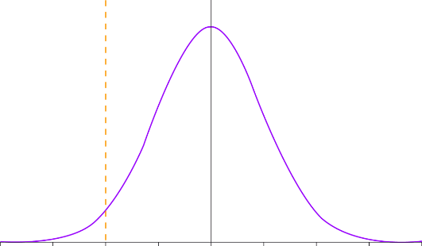



Introduction to Growth Failure
(Short Stature)
Short stature is caused by a variety of aetiologies – an early and correct diagnosis is essential¹
Children have a limited time to reach their growth potential with treatment before fusion of the physes²
Height for age
Increasing pathology
Short stature definition:
  Height <-2 SDS based on appropriate age/gender reference population ³
  May be due to dysregulation of the GH/IGF-I axis⁴
Short stature
-4
-3
-2
-1
0
1
2
3
4
SD from the mean
SD, Standard deviation; SDS, standard deviation score; GH, growth hormone; IGF-I, insulin-like growth factor-I
1. Rani D, et al. Short Stature. [Updated 2022 May 15]. In: StatPearls [Internet]. Treasure Island (FL): StatPearls Publishing; 2022 Jan. 2. Shim, KS. Ann Pediatr Endocrinol Metab. 2015 Mar; 20(1): 8–12; 3. Cohen P, et al. J Clin Endocrino Metab. 2008;93:4210-7; 4. Savage M, et al. Clinical Endocrinology 2010; 72: 721-728

Slide 9
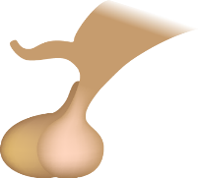
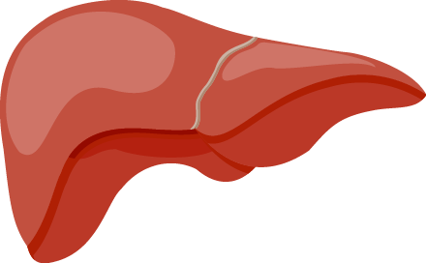

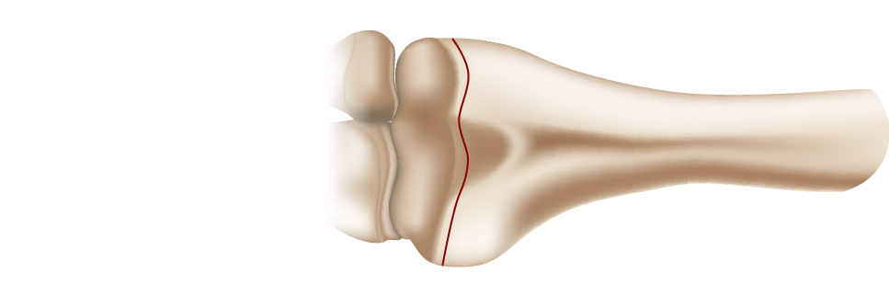
Diagram of the normal GH-IGF-I axis
Hypothalamus
Pituitary
Liver
Ternary complex
Growth plate
Circulation
LINEAR GROWTH
Cartilage cell
ALS
GH
GHR
STAT5b
Autocrine/paracrine actions in growth plate
PAPP-A2
IGFBP-3
Free IGF-I
IGF-IR
ALS, acid-labile subunit; GH, growth hormone; GHR, growth hormone receptor; GHRH, growth-hormone releasing hormone; IGF-I, insulin-like growth factor-I; IGF-IR, insulin-like growth factor receptor; IGFBP-3, insulin-like growth factor-binding protein 3; STAT5b, signal transducer and activator of transcription 5B
Adapted from Bang P, et al. Horm Res. 2001;55 Suppl 2:84-93

Slide 10
differentiating IGF-I deficiency from other conditions of short stature

Slide 11
Primary and secondary igf-I deficiency
Hypothalamus
Secondary IGF-I deficiency
Growth hormone deficiency
Pituitary
Liver
Primary IGF-I deficiency
GHR gene defects
(Laron syndrome)
Post-GHR signaling defects
(Stat5b deficiency)
IGF and ALS gene defects
PAPP-A2 gene defects
(decreased free IGF-I)
Ternary complex
Growth plate
Circulation
LINEAR GROWTH
Cartilage cell
ALS
GH
GHR
STAT5b
PAPP-A2
IGFBP-3
Free IGF-I
IGF-IR
ALS, acid-labile subunit; GH, growth hormone; GHR, growth hormone receptor; GHRH, growth-hormone releasing hormone; IGF-I, insulin-like growth factor-I; IGF-IR, insulin-like growth factor receptor; IGFBP-3, insulin-like growth factor-binding protein 3; STAT5b, signal transducer and activator of transcription 5B
Adapted from Bang P, et al. Horm Res. 2001;55 Suppl 2:84-93; Cohen J, et al. Drugs R D. 2014 Mar; 14(1): 25–29; Rosenfeld RG, et al. Horm Res. 2009; 71 Suppl 2:36-40; David A, et al. Endocrine Reviews 2011; 32: 472-497; Dauber A, et al. EMBO Mol Med. 2016; 8(4): 363-374

Slide 12
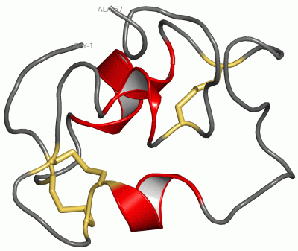
Acquired igf-I deficiency
(potentially reversible)
Diabetes type 1
Hypothyreosis
Delayed puberty, pubertal arrest or hypogonadism
GH
Stimulatory
Inhibitory
Malnutrition
(suppressed insulin)
Liver
Serum IGF-I
Stimulated
immune system
(IL1, IL6, TNFα)
Infection
Inflammation
IGF-I actions
GH, growth hormone; IGF-I, insulin-like growth factor-I; IL, interleukin; TNFα, tumour necrosis factor alpha
Adapted from Bogin B, et al. Int J Environ Res Public Health. 2015;12:4816-32; Blum W, et al. Endocrine Connections 2018; 7(6): R212-R222

Slide 13
Continuum of GH-IGF-I axis defects
Ranging from severe GHD to severe PIGFD
The continuum model of GH-IGF-I axis defects in the context of height SDS and IGF-I SDS ranges
Extreme cases are easier to diagnose due to well-studied physical and biochemical features
Milder cases of GHD and SPIGFD are separated from Idiopathic Short Stature (ISS) by arbitrary definitions of height deficit, IGF-I and GH concentrations
0
0
−2
−2
SIGFD
Idiopathic short
stature (ISS)
PIGFD
−4
−4
Height SDS
GH deficiency
GH resistance
with IGF-I
deficiency
IGF-I SDS
−6
−6
−8
−8
Laron
syndrome
−10
Continuum of GH–IGF-I axis defects
−10
GH, growth hormone; GHD, growth hormone deficiency; GHI, growth hormone insensitivity; IGF-I, insulin-like growth factor-I; ISS, idiopathic short stature; PIGFD, primary IGF-I deficiency; SIGFD, secondary IGF-I deficiency; SDS, standard deviation score
Savage M, et al. Rev Endocr Metab Disord 2021; 22(1): 91-99; Savage M, et al. Clinical Endocrinology 2010; 72: 721-728

Slide 14
Description of GH-IGF-I Axis Growth Disorders from International Consensus Guidelines
Secondary IGF-I Deficiency/ Growth Hormone deficiency (GHD)^{1[a],2[b],3}
Postnatal growth failure due to inadequate secretion/activity of endogenous GH
Congenital (mutations or structural brain defects), acquired, or idiopathic
Isolated or in combination with multiple pituitary hormone deficiency
Low GH secretion may be a result of downregulation of the GH secretion prior to puberty or in obese hyperinsulinaemic children with increased GHR signaling/GH sensitivity
Idiopathic short stature (ISS)^{4[c]}
In the absence of primary, secondary or acquired IGFD and other conditions that could explain short stature such as skeletal dysplasia (e.g. SHOX deficiency), systemic disease, or chromosomal abnormalities (e.g. Down syndrome) the default diagnosis is ISS
Children with ISS usually have normal birthweight and are IGF-I and GH sufficient
Primary IGF-I Deficiency (PIGFD)^{2,5}
Postnatal (may be combined with prenatal) growth failure due to IGF-I deficiency:
      Serum IGF-I concentrations for age and gender below an arbitrary defined threshold
      Normal/elevated GH
      Absence of acquired IGFD
Acquired IGFD due to impaired GHR signaling/
GH sensitivity with impaired IGF-I production in conditions such as malnutrition, hypothyroidism, inflammation, etc.
Growth failure can vary in severity from mild (height SDS ≤-2) to severe (Height SDS ≤-3)
In severe PIGFD dysmorphic signs and genetic defects are more likely observed
Diagnostic challenges often blur the distinction between GHD, PIGFD, and ISS
ª Consensus of the Growth Hormone Research Society, endorsed by the following international societies: the Councils and Drug and Therapeutics Committees of the European Society for Pediatric Endocrinology, the Lawson Wilkins Pediatric Endocrine Society, the Councils of the Australasian Pediatric Endocrinology Group, the Japanese Society for Pediatric Endocrinology, and the Sociedad Latinoamericana de Endocrinologia Pediatrica
^{b} Consensus guidelines were generated by a taskforce of seven pediatric endocrinologists from USA and Canada, and a pediatric bioethicist, and was supported by the pediatric endocrine society
^{c} Consensus statement from the Growth Hormone Research Society, the Lawson Wilkins Pediatric Endocrine Society, and the European Society for Paediatric Endocrinology
GH, growth hormone; GHD, growth hormone deficiency; GHR, growth hormone receptor; IGF-I, insulin-like growth factor-I; ISS, idiopathic short stature; (P)IGFD, (primary) insulin-like growth factor I deficiency; SDS, standard deviation score
1. Growth Hormone Research Society. J Clin Endocrino Metab. 2000;85:3990-3; 2. Grimberg A, et al. Horm Res Paediatr. 2016;86:361-97; 3. Berryman D, et al. Nature Reviews Endocrinology 2013; 9: 346-356; 4. Cohen P, et al. J Clin Endocrino Metab. 2008;93:4210-7; 5. David A, et al. Endocrine Reviews 2011; 32 (4): 472-497

Slide 15
How is severe primary igf-I deficiency defined?
IGF-I deficiency which is due to pathology downstream of growth hormone
SPIGFD is defined by:
SEVERE PRIMARY IGF-I DEFICIENCY DEFINITION:
Height ≤-3 SDS
Basal IGF-I ≤-3 SDS [FDA] or IGF-I <2.5th percentile (~-2 SDS) [EMA]
Normal or elevated growth hormone concentration
Exclude secondary and acquired IGFD
EMA, European Medicines Agency; FDA, Food and Drug Administration; IGF-I, insulin-like growth factor I; IGFD, insulin-like growth factor I deficiency; SDS, standard deviation score; SPIGFD, severe primary IGF-I deficiency
Mecasermin Prescribing Information and SmPC, December 2019

Slide 16
Severe primary Igf-I deficiency clinical presentation

Slide 17
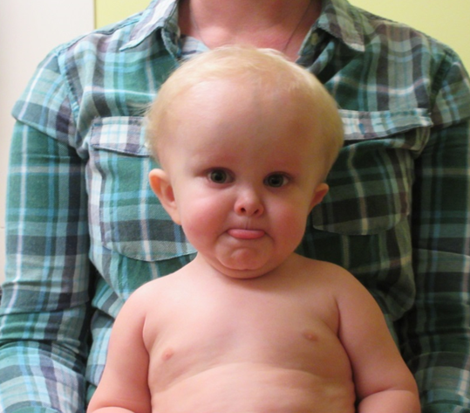
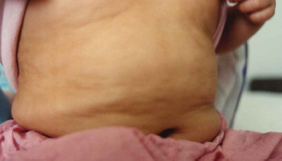
Case Presentation: Classic Growth hormone insensitivity (Laron Syndrome)
5-year-old boy with proportionate
short stature
Frontal bossing
Sparse, thin hair growth
Micrognathia
Acromicria
High-pitched voice
Increased weight/height ratio
Normal pregnancy
BW: 3 kg
BL: 47.8 cm
Postnatal growth failure
Height: -5.6 SDS
Weight: -3.5 SDS
Delayed BA
BA, bone age; BL, body length; BW, body weight; SDS, standard deviation score
Backeljauw P. Growth Hormone & IGF Research. 2020;51:22-6

Slide 18

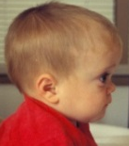
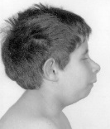





PRIMARY IGF-I DEFICIENCY:
Evidence for an evolving phenotype
Spectrum of Primary IGF-I Deficiency
Children with short stature and Severe Primary IGFD (N=70)¹
Height SDS
0
Milder IGFD
(without dysmorphic features – ‘Non-classical’)
-2
Primary IGFD
-4
More severe IGFD
(with dysmorphic features – classical ‘Laron syndrome’)
-6
-8
IGF-I, insulin-like growth factor I; IGFD, IGF-I deficiency
David A, et al. Endocrine Reviews. 2011; 32 (4): 472-497
Modified slide courtesy Martin Savage. Permission given for publication of photograph and results of all investigations
Notes:
18

Slide 19
Case Presentation: Non-classical growth hormone insensitivity
6.9-year-old boy with proportionate short stature
Naïve to growth promoting therapy
Pre-pubertal
Parental heights: +0.6 SDS/
-2.4 SDS
Normal pregnancy
GA 38 weeks
BW: 2.7 kg
BL: 47 cm
Postnatal growth failure
Height: -4.8 SDS
Weight: -4.2 SDS
BMI: +1.0 SDS
No dysmorphic features identified
BL, body length; BMI, body mass index; BW, body weight; GA, gestational age; SDS, standard deviation score
Data from EU-IGF registry

Slide 20
Insights to the Assessment of the gh-igf axis
Diagnosis, confirmatory tests and challenges

Slide 21
Algorithm for the investigation of short stature
Child with short stature: height <-2 SDS
General Assessment
Assessment of
GH-IGF-axis
Endocrine investigations
Medical history
Physical examination
Laboratory screening including thyroid level, bone age, IGF-I
IGF-I low
GH stimulation test
Peak GH <7 μg/L
Peak GH ≥7 μg/L
IGF-I normal/high
≥2.5th percentile
IGF-I low
IGF-I <2.5th percentile and height ≤-3 SDS (EU)
OR
IGF-I ≤3 SDS and height ≤-3 SDS (US)
GH deficiency
Test for additional
pituitary deficiencies
Idiopathic
short stature
(ISS)
Severe Primary IGF-I Deficiency
(GH insensitivity)
Confirm SPIGFD with assessment of
IGF system:
IGFBP-3, ALS, GHBP and genetic studies
ALS, acid labile subunit; GH, growth hormone; GHBP, growth hormone binding protein; IGFBP-3, IGF-I binding protein-3; IGF-I, insulin-like growth factor I; SDS, standard deviation score
Adapted from: Savage M, et al. Rev Endocr Metab Disord. 2021;22(1):91-9

Slide 22
Summary of phenotypic features of major forms of IGF-I deficiency
Phenotype | Gene defect
 | GHR | STAT5b | IGF-I | IGFALSª | Bioinactive GH | GH1 with anti-GH antibodies
Severe growth failure | +/- | + | + | - | - | +
Mild growth failure | -/+ | - | - | + | + | -
Mid-face hypoplasia | +/- | +/- | - | - | - | +
Other facial dysmorphism | - | - | + | - | - | -
Deafness | - | - | +/- | - | - | -
Microcephaly | - | - | + | - | - | -
Intellectual delay | - | - | + | - | - | -
Puberty delay | +/- | +/- | - | + | - | -
Immune deficiency | - | + | - | - | - | -
+ = positive - = negative +/- = predominantly positive -/+ = predominantly negative
ªIGFALS is the name of the gene that encodes the ALS protein
ALS , Acid Labile Subunit; GH, Growth Hormone; GHR, Growth Hormone Receptor; IGF-I, Insulin-like growth factor I; IGFALS, Insulin-like growth factor binding protein, STAT5b, Signal Transducer and Activator of Transcription 5b
David A, et al. Endocr Rev. 2011;32:472-97; El Kholy M, et al. Horm Res Paediatr. 2011;76:300-6

Slide 23
Short Stature investigations evaluating the GH-IGF-I axis
required
IGF-I concentrations - repeated on 2 or more occasions
GH stimulation test
General work up has excluded acquired IGFD
Recommended to support SPIGFD diagnosis
IGFBP-3
GH-binding protein (GHBP)
Acid-labile subunit (ALS)
IGF-I generation testing
Genetic analysis
Key diagnostic features of PIGFD
Short stature
Normal or increased GH
Deficiency of IGF-I
ALS , Acid Labile Subunit; GH, Growth Hormone; IGF-I, Insulin-like growth factor I; IGFBP-3, Insulin-like growth factor I binding protein-3; PIGFD, primary insulin-like growth factor I deficiency
Grimberg A, et al. Horm Res Paediatr. 2016;86:361-97; Savage M, et al. Rev Endocr Metab Disord. 2021;22(1):91-9; Blum WF, et al. Endocrine Connections. 2018;7:R212-R222; Collett-Solberg PF, et al. Horm Res Paediatr. 2019;92(1):1-14; Wit J, et al. Horm Res Paediatr 2021; 94: 81-104

Slide 24
required endocrine investigations
Test | Purpose | Considerations
IGF-I | Distinguishes short stature due to defects in the GH-IGF-axis Confirms IGFD | Use IGF-I assay you have experience with Reliable reference data, with normative ranges based on age, gender, and pubertal status Consider methodological issues How interference of IGFBPs is avoided eg. by using excess IGF-II Normative data should be established with that particular assay and preferably published Consider assay in reference laboratory or consult expertise Repeated measures should be obtained (at least two) Consider patient conditions that affect IGF-I concentration; malnutrition/malabsorption, systemic illness Low IGF-I in young children is difficult to interpret. An IGF-I >0 SDS at any age makes IGFD unlikely Correlates with the severity of the IGFD phenotype
GH stimulation test | Differentiates GH deficiency from PIGFD | Evaluation of GH secretion has low reproducibility and low sensitivity/specificity for SPIGFD diagnosis Normative references limited, cut-off for SPIGFD not defined Elevated baseline GH secretion is a characteristic of SPIGFD but difficult to evaluate in stimulation tests Should be performed, when: IGF-I is repeatedly low In children with features of growth failure without classical features of SPIGFD History and physical examination compatible with SPIGFD, low height velocity, or low IGF-I Not essential for diagnosis of SPIGFD in: Patients with a clearly classical presentation i.e. positive family history, consanguineous pedigree, severe short stature, clinical features of Laron syndrome, high baseline GH and low or undetectable serum IGF-I
GH, Growth Hormone; IGF-I/II, Insulin-like growth factor I/II; (SP)IGFD, (severe primary) IGF-I deficiency
Coutant R, et al. European Journal of Endocrinology. 2012;166:351-7; Blum WF, et al. Endocrine Connections. 2018;7:R212-R222;
Collett-Solberg PF, et al. Horm Res Paediatr. 2019;92(1):1-14; Grimberg A, et al. Horm Res Paediatr. 2016;86:361-97; Guevara-Aguirre J. et al. JCEM 1993;76:417-423; Storr H. https://www.bsped.org.uk/media/1866/uk-igf1-users-group-guidelines-2021.pdf, Accessed 09-Nov-22; Cohen J, et al. Drugs R D 2014; 14: 25-29

Slide 25
recommended endocrine investigations
Test | Purpose | Considerations
IGFBP-3 | Distinguishes short stature due to GH deficiency from other conditions | IGFBP-3 can provide confirmatory information Assays not widely available in all countries More reliable biomarker than IGF-I in children <3 yrs of age but less sensitive than IGF-I after 3 yrs Correlates with the severity of the SPIGFD phenotype Extremely low IGFBP-3 is also found in ALSD
IGF-I generation test | Valuable in diagnosis of severe IGFD (GHR, STAT5B defects) Value is unclear in less severe forms of IGFD | Clinical utility of this test in the diagnosis of SPIGFD has not been definitively demonstrated Evaluation of GH responsiveness by measuring IGF-I after a short course of GH (~3-10 days) Sensitivity and specificity of the IGF-GT are not high enough to appropriately identify SPIGFD in children with milder degrees of short stature No consensus on best protocol, normative data not established and lower cutoff not well established Dependent on IGF-I assay Association with growth response to rhIGF-1 therapy not established Should be performed, when: IGF-I is low Not essential for diagnosis of SPIGFD in: Patients with a clearly classical presentation i.e., positive family history, consanguineous pedigree, severe short stature, clinical features of Laron syndrome, high baseline GH and low or undetectable serum IGF-I
ALSD, acid-labile subunit deficiency; GH, Growth Hormone; IGF-I, Insulin-like growth factor I; (SP)IGFD, (severe primary) IGF-I deficiency
Coutant R, et al. European Journal of Endocrinology. 2012;166:351-7; Blum WF, et al. Endocrine Connections. 2018;7:R212-R222; Collett-Solberg PF, et al. Horm Res Paediatr. 2019;92(1):1-14; Grimberg A, et al. Horm Res Paediatr. 2016;86:361-97; Rosenfeld R, et al. Journal of Clinical Endocrinology. 1995;80:1532-40; Storr H. https://www.bsped.org.uk/media/1866/uk-igf1-users-group-guidelines-2021.pdf, Accessed 09-Nov-22; Burren CP, et al. Hormone Research, 55(3), 125-130; Domené H, et al. Best Pract Res Clin Endocrinol Metab. 2011; 25 (1): 101-13

Slide 26
recommended endocrine investigations
Test | Purpose | Considerations
GHBP | Most clinically relevant use is to confirm GH insensitivity due to GH receptor defect | Assays for GHBP are not widely available GHBP is low in children with defects in the extracellular part of the GH receptor SPIGFD is not limited to Laron syndrome with an extracellular defect in GHR gene and low GHBP Other forms of GH receptor insensitivity, may have normal or high GHBP If GHBP is very low or undetectable, mutation analysis of GHR gene is recommended Genetic analysis is easier, more specific, generally available and provides more information
Acid-labile subunit | Value in the characterization of individual patients with PIGFD Consider if ↓ IGF-I and ↓ IGFBP-3 with only moderate growth failure | Commercial ALS assays not generally available IGFBP-3 more pronounced low than IGF-I indicates ALSD Collaborate with specialised labs to determine ALS, if not genetics can provide evidence Correlates with the severity of the IGFD phenotype
GH, Growth Hormone; IGF-I, Insulin-like growth factor I; IGFBP-3, IGF-I binding protein-3; (SP)IGFD, (severe primary) IGF-I deficiency
Coutant R, et al. European Journal of Endocrinology. 2012;166:351-7; Blum WF, et al. Endocrine Connections. 2018;7:R212-R222;
Collett-Solberg PF, et al. Horm Res Paediatr. 2019;92(1):1-14; Grimberg A, et al. Horm Res Paediatr. 2016;86:361-97; Domené H, et al. Best Pract Res Clin Endocrinol Metab. 2011; 25 (1): 101-13

Slide 27
Summary of biochemical features of major forms of IGF-I deficiency
Biochemical feature | Gene defect
 | GHR | STAT5b | IGF-I | IGFALS | Bioinactive GH | GH1 with anti-GH antibodies
Hypoglycaemia | + | -/+ | - | - | - | -
Hyperinsulinaemia | - | - | +/- | + | - | -
IGF-I deficiency | + | + | +/- | + | + | +
IGFBP-3 deficiency | + | + | - | + | + | +
ALS deficiency | + | + | - | + | + | +
GH excess | + | + | +/- | + | - | -
GHBP deficiency | +/- | - | - | - | - | -
+ = positive - = negative +/- = predominantly positive -/+ = predominantly negative
ALS , Acid Labile Subunit; GH, Growth Hormone; GHBP, growth hormone binding protein; GHR, Growth Hormone Receptor; IGF-I, Insulin-like growth factor I; IGFALS, Insulin-like growth factor binding protein, IGFBP-3, Insulin-like growth factor I binding protein 3; STAT5b, Signal Transducer and Activator of Transcription 5b
David A, et al. Endocr Rev 2011;32:472-97

Slide 28
DiagnoStic outcomes patient cases

Slide 29
Case Presentation: Classic Growth hormone insensitivity (Laron Syndrome)
ENDOCRINE INVESTIGATIONS
Bone age = 2 years (chronological age of 5.2 years)
IGF-I = 3.0 ng/ml (<0.1 percentile; <-3 SDS)
IGFBP-3 = 0.2 mg/l (normal 1.2-5.2 mg/l)
GHBP = 40 pmol/l (normal 320-3820)
Basal GH = 29 to 51 ng/ml
Peak stimulated GH = >100 ng/ml
IGF-I generation test (0.1 mg GH SC daily x 4): IGF-I = 3.0 → 5.6 ng/ml
GENETIC TESTING
Homozygous for a GH receptor mutation c.723 C>T (exon 7)
Diagnosis of
SPIGFD
GH, Growth Hormone; GHBP, growth hormone binding protein; IGF-I, Insulin-like growth factor I; IGFBP-3, IGF-I binding protein-3; SC, subcutaneous; SDS, standard deviation scores; SPIGFD, severe primary IGF-I deficiency
Backeljauw P. Growth Hormone & IGF Research. 2020;51:22-6

Slide 30
Case Presentation: Non-classical growth hormone insensitivity
Endocrine investigations
Bone age not reported
IGF-I = 23 ng/ml (<-2 SD)
Basal GH = 34.6 ng/ml
Peak stimulated GH = 40 ng/ml
GENETIC TESTING
No mutations/defects reported in registry
Diagnosis of non-classical SPIGFD
No dysmorphic features identified
GH, Growth Hormone; GHBP, growth hormone binding protein; IGF-I, Insulin-like growth factor I; IGFBP-3, IGF-I binding protein-3; SPIGFD: severe primary IGF-I deficiency
Data from EU-IGF registry

Slide 31
Real-world data from the EU-IGFD registry
significant number of patients have milder forms of
primary igf-I deficiency
Baseline characteristics | NPP-LS (N=21) |  | NPP-non LS (N=117) |  | P value^{b}
 | Mean (SD) | 95% CI | Mean (SD) | 95% CI
Females |  | 24.5; 63.5 |  | 30.9; 48.4 | 0.76^{c}
Age at first injection, years | 6.07 (3.49) | 4.49; 7.66 | 8.44 (3.45) | 7.81; 9.07 | 0.006^{d}
Height, SDS | -5.62 (1.95) | -6.66; -4.58 | -3.46 (1.05) | -3.66; -3.26 | <0.001^{d}
Height velocity, cm/year | 5.67 (1.10) | 4.66; 6.69 | 4.74 (1.77) | 4.29; 5.19 | 0.174^{d}
Weight, SDS | -4.63 (1.35) | -5.32; -3.93 | -3.04 (1.12) | -3.26; -2.83 | <0.001^{d}
BMI, SDS | -0.24 (1.30) | -0.94; 0.45 | -0.80 (1.34) | -1.07; -0.53 | 0.126e
Mother’s height, cm | 156.0 (7.4) | 152.3; 159.7 | 157.8 (7.2) | 156.4; 159.2 | –
Father’s height, cm | 168.5 (7.6) | 164.7; 172.3 | 172.6 (8.1) | 171.0; 174.1 | –
IGF-I, ng/mL | 39.37 (16.25) | 26.89; 51.86 | 88.30 (67.89) | 75.04; 101.57 | 0.007^{d}
Peak stimulated GH level, ng/mL | 35.50 (20.53) | 23.10; 47.91 | 24.61 (24.87) | 19.22; 30.01 | 0.014^{d}
Primary diagnosis: SPIGFDª |  | 84.5; 100.0 |  | 83.9; 94.7 | –
History of hypoglycaemia |  | 7.7; 40.0 |  | 0.9; 7.3 | 0.011^{f}
  >50% of non-LS are responders and have a mean first year Ht SDS response to rhIGF-1 therapy not different from LS
ªIncluding LS, as reported by the investigator; ^{b} NPP-non-LS vs NPP-LS; ^{c} Chi-square test; ^{d} Wilcoxon test; ^{e} ANOVA; ^{f} Fisher’s test
BMI, body mass index; Ht, height; IGF-I, insulin-like growth factor I; IGFD, insulin-like growth factor I deficiency; LS, Laron Syndrome; non-LS, non-Laron Syndrome;
NPP, naïve to treatment and prepubertal; SDS, standard deviation score; SPIGFD, severe primary IGF-I deficiency
Bang et al. Eur J Endocrinol. 2021;184:267-76

Slide 32
summary

Slide 33
SUMMARY – diagnostic challenges of spigfD
Short stature can be caused by a variety of aetiologies and an early correct diagnosis
is essential
Diagnostic challenges often blur the distinction between GHD, PIGFD, and ISS
GH-IGF-I defects form a continuum ranging from severe GHD (SIGFD) to severe GHI (PIGFD)
Severe primary IGF-I deficiency (SPIGFD) generally presents as classical Laron syndrome but non-classical cases with mild or moderate phenotypes should also be considered
Diagnosis of SPIGFD requires severe short stature, measurement of serum IGF-I and the demonstration of normal or increased GH secretion as well as lack of other pathology in the general work-up of short stature
Once a diagnosis of SPIGFD is made, genetic analysis is recommended to confirm the clinical diagnosis prior to commencing treatment
GH, Growth Hormone; GHD growth hormone deficiency; IGF-I, Insulin-like growth factor I; IGFBP-3, IGF-I binding protein-3; SIGFD, severe IGF-I deficiency; (S)PIGFD: (severe) primary IGF-I deficiency
Rani D, et al. Short Stature. [Updated 2022 May 15]. In: StatPearls [Internet]. Treasure Island (FL): StatPearls Publishing; 2022 Jan.; Storr H, et al. Endocrine Reviews. 2019; 40: 476-505; Bang et al. Eur J Endocrinol. 2021; 184:267-27; Savage M, et al. Rev Endocr Metab Disord 2021; 22(1): 91-99; Grimberg A, et al. Horm Res Paediatr. 2016;86:361-97; Savage M, et al. Frontiers in Endcorinology 2021; 12: 781044

Slide 34
REACH PE CONNECT VIA TWITTER, LINKEDIN, VIMEO & EMAIL
OR VISIT THE GROUP’S WEBSITE https://peconnect.cor2ed.com/
Follow us on Twitter
@peconnect
Follow the
PE CONNECT
group on LinkedIn
Watch us on the
Vimeo Channel
PE CONNECT
Email
Iain.murdoch
@cor2ed.com

