Slide 1
GU CONNECT MICRO Learning The use of PARP inhibitors in prostate cancer treatment and the rationale behind combination treatment module two UPDATED DECEMBER 2023
mCRPC, metastatic castration-resistant prostate cancer; PARP, poly-ADP ribose polymerase

Slide 2
module two evolving landscape of parpi in mcrpc: combination with anti-androgens

Slide 3
This module has been developed by two international experts
Assoc. Prof. Alicia Morgans
GU Medical Oncologist, Dana-Farber Cancer Institute, Boston, USA
Dr Pasquale Rescigno
Clinical Senior Lecturer,
Translational and Clinical Research Institute, Faculty of Medical Sciences, Newcastle University, UK

Slide 4
Disclaimer and disclosures
Please note: The views expressed within this presentation are the personal opinions of the authors. They do not necessarily represent the views of the authors academic institutions, or the rest of the GU CONNECT group.
This content is supported by an Independent Educational Grant from AstraZeneca.
The experts have received financial support/sponsorship for research support, consultation, or speaker fees from the following companies:
Dr. Alicia Morgans: Astellas, AstraZeneca, AAA, Bayer, Exelixis, Janssen, Lantheus, Myovant, Novartis, Pfizer, Telix, Sanofi
Dr. Pasquale Rescigno: AZ, Janssen, MSD Italy, BMS and Gilead

Slide 5
Educational objectives
Understand the data of combination studies with PARP inhibitors
Recognise the rationale and mechanism of action of the combination of PARPi and anti-androgen therapies
Consider implementation of combination treatment in clinical practice
PARP, poly-ADP ribose polymerase

Slide 6
Clinical takeaways
PARP inhibitors are effective drugs as monotherapy in mCRPC patients with HRR alterations
Genetic testing is important to help with treatment decision making and for understanding inherited risk
BRCA mutations are associated with poor outcomes in mCRPC patients
Patients with tumours harbouring BRCA1/BRCA2 alteration appear to derive the greatest clinical benefit from PARPi, but patients with other HRR alterations also derive benefit
PARP inhibitors combined with novel hormonal agents are effective as a first line treatment option for mCRPC patients with a HRR mutation. Certain combinations such as olaparib plus abiraterone and talazoparib plus enzalutamide have also shown benefit in patients regardless of their HRR status

Slide 7
rationale for combination of PARPi with nht
NHT, novel hormonal therapy; PARPi, poly (ADP-ribose) polymerase inhibitor

Slide 8
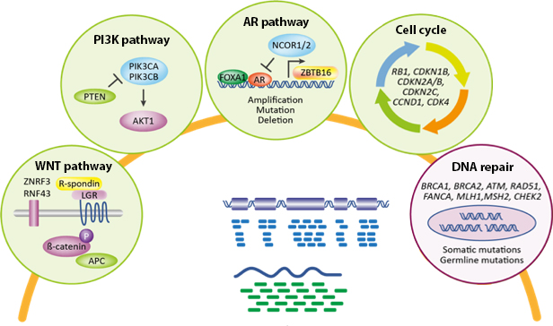
Metastatic prostate cancer is biologically heterogeneous
Multiple pathways have been identified with genomic alterations in association with advanced prostate cancer¹
Approximately 25% of patients with mCRPC have alterations associated with DNA repair pathways^{a,2}
PTEN/PI3K/AKT
Cell cycle
Epigenetic
DNA repair
WNT
MAP kinase
AR
ETS
TP53
PTEN
RB1
PIK3CA
KMT2C
FOXA1
KMT2D
BRCA2
APC
CDK12
ATM
SPOP
CDKN1B
CTNNB1
ZBTB16
RNF43
CDKN2A
PIK3R1
KMT2A
KDM6A
PIK3CB
FANCA
BRAF
BRCA1
AKT1
KRAS
HRAS
0
10
20
30
40
50
60
Alteration frequency
Homologous recombination repair (HRR) is a key mechanism for DNA repair^{3,4}
Tumour/ germline exomes
~23% of of mCRPC harbour
DNA repair aberrations¹
Mutation
Deep deletion
Amplification
Fusion
ª A multi-institutional study profiling 444 tumours from 429 mCRPC patients
AR, androgen receptor; ATM, ataxia telangiectasia mutated; BRCA1/2, breast cancer gene 1/2; mCRPC, metastatic castration-resistant prostate cancer; PI3K, phosphoinositide 3-kinase; WNT, wingless integration
1. Robinson D, et al. Cell. 2015;161:1215-28; 2. Abida W, et al. Proc Natl Acad Sci U S A. 2019;116:11428-36; 3. Lord CJ and Ashworth A. Nature. 2012;481:287-93; 4. O’Connor MJ. Mol Cell. 2015;60:547-60

Slide 9
Rationale for combining PARP inhibitors and NHAs
Interaction between PARP signalling and AR signalling pathways may explain the combined effect of agents observed in preclinical models
PARP inhibitor + NHA¹⁻³
PARP involved in AR-dependent transcription; PARP inhibition may increase activity of NHAs¹
NHA-induced HRR deficiency increasing susceptibility to PARP inhibition^{2,3}
Combined effect
Antitumour activity in HRR mutation and non HRR mutation prostate cancer¹⁻³
AR, androgen receptor; HRR, homologous recombination repair; NHA, novel hormonal agent; PARP, poly-ADP ribose polymerase
1. Schiewer MJ, et al. Cancer Discov. 2012;2:1134-49; 2. Polkinghorn WR, et al. Cancer Discov. 2013;3:1245-53; 3. Asim M, et al. Nat Commun. 2017;8:374;
Adapted from Saad F, et al. J Clin Oncol. 2022;40 Suppl: Abstract 11 (ASCO GU 2022 oral presentation)

Slide 10
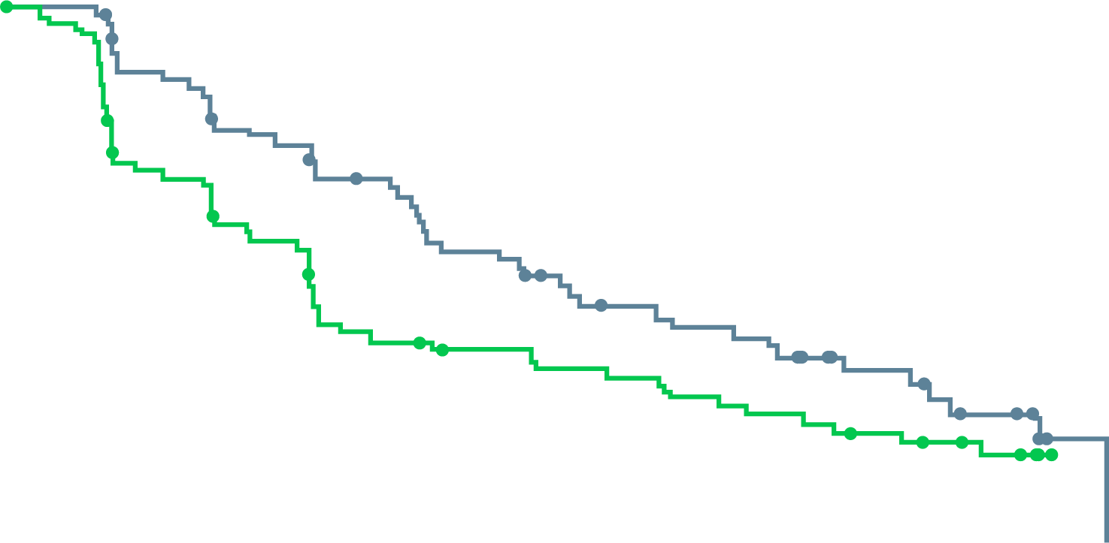
Study 8: A phase II study of Olaparib and abiraterone
Patients: mCRPC with progression on docetaxel, unselected by HRRm status
Randomised 1:1 to full dose of olaparib + abiraterone vs placebo + abiraterone†
Statistically significant improvement in rPFS with olaparib + abiraterone, irrespective of HRRm status
Investigator-assessed rpfs
rPFS BY HRRm SUBGROUP*
1.0
 | Ola + abi (N=71) | Abi (N=71)
Events, n (%) | 46 (65) | 54 (76)
 | HR 0.65 95% CI, 0.44-0.97; p=0.034
HRRm
N=23 (16%)
0.62
0.8
0.6
8.2
13.8
HRRm partially characterised
N=46 (32%)
0.95
Proportion of patients event-free
0.4
0.2
Non-HRRm
N=73 (51%)
0.54
∆=5.6
0.0
0
3
6
9
12
15
18
21
24
27
30
0.25
0.50
1.00
2.00
* Dashed line and shaded area show HR and 95% CI, respectively, for the intent to treat population; † Olaparib 300 mg bd, abiraterone 1000 mg od and all patients also received prednisone/prednisolone 5 mg bd
Time from randomisation (months)
HRR (95% CI)
Abi, abiraterone; bd, twice daily; CI, confidence interval; HR, hazard ratio; HRRm, homologous recombination repair mutation; mCRPC, metastatic castration-resistant prostate cancer; od, once daily; Ola, Olaparib; rPFS, radiographic progression-free survival
Clarke N, et al. Lancet Oncol. 2018;19:975-86; Carr T, et al. Cancers. 2021;13:5830. Adapted from: Saad F, et al. J Clin Oncol. 40, 2022 (suppl 6; abstr 11) (ASCO GU 2022 oral presentation)

Slide 11
Key parpi combination trials in 1L mCRPC
Which patient subgroups benefit?

Slide 12
PROpel: Study Design
a global, randomised, double-blind phase 3 trial
Key eligibility criteria
First-line mCRPC
Docetaxel allowed at mCSPC stage
No prior abiraterone
Other NHAs allowed if stopped ≥12 months prior to enrolment
Ongoing ADT
ECOG PS 0 or 1
Stratification Factors
Site of distant metastases: bone only vs visceral vs other
Prior taxane at mCSPC: yes vs no
Olaparib 300 mg BID + abiraterone 1,000 mg QDª (n=399)
Full dose of abiraterone
and olaparib used
Primary endpoint:
rPFS by investigator assessment (sensitivity analysis by BICR)
Key secondary endpoint:
OS (alpha control)
Additional endpoints:
TFST, ORR, PFS2
HRR gene mutation^{b} status (by tissue and ctDNA testing)
Health-related quality of life
Safety and tolerability
Randomise
1:1
Placebo + abiraterone 1,000 mg QDª (n=397)
Full dose of abiraterone
used
DCO1: 30 July 21
rPFS (primary)
DCO2: 14 March 22
OS (interim)
DCO3: 12 October 22
OS (final pre-planned OS)
NCT03732820
Analysis timeline:
First patient randomized: Nov 2018​; last patient randomised: Mar 2020
Multiple testing procedure is used in this study: 1-sided alpha of 0.025 fully allocated to rPFS; if the rPFS result is statistically significant, OS to be tested in a hierarchical fashion with alpha passed on to OS ª abiraterone used in combination with prednisone or prednisolone 5 mg BID; ^{b} HRR mutation, including 14-gene panel, using the FoundationOne®CDx test and FoundationOne®Liquid CDx test
ADT, androgen-deprivation therapy; BID, twice daily; ctDNA, circulating tumour DNA; DCO, data cut-off; ECOG PS, Eastern Cooperative Oncology Group performance status; HRR, homologous recombination repair; mCRPC, metastatic castration-resistant prostate cancer; mCSPC, metastatic castration-sensitive prostate cancer; NHA, novel hormonal agent; ORR, objective response rate; OS, overall survival; PFS2, time to second progression; QD, per day; rPFS, radiographic progression-free survival; TFST, time to first subsequent therapy or death
1. Clarke NW, et al. J Clin Oncol. 2019;37 Suppl: TPS340; 2. https://clinicaltrials.gov/ct2/show/NCT03732820; 3. Clarke N, et al. J Clin Oncol 41, 2023 (suppl 6; abstr LBA16) (ASCO GU 2023 oral presentation)

Slide 13
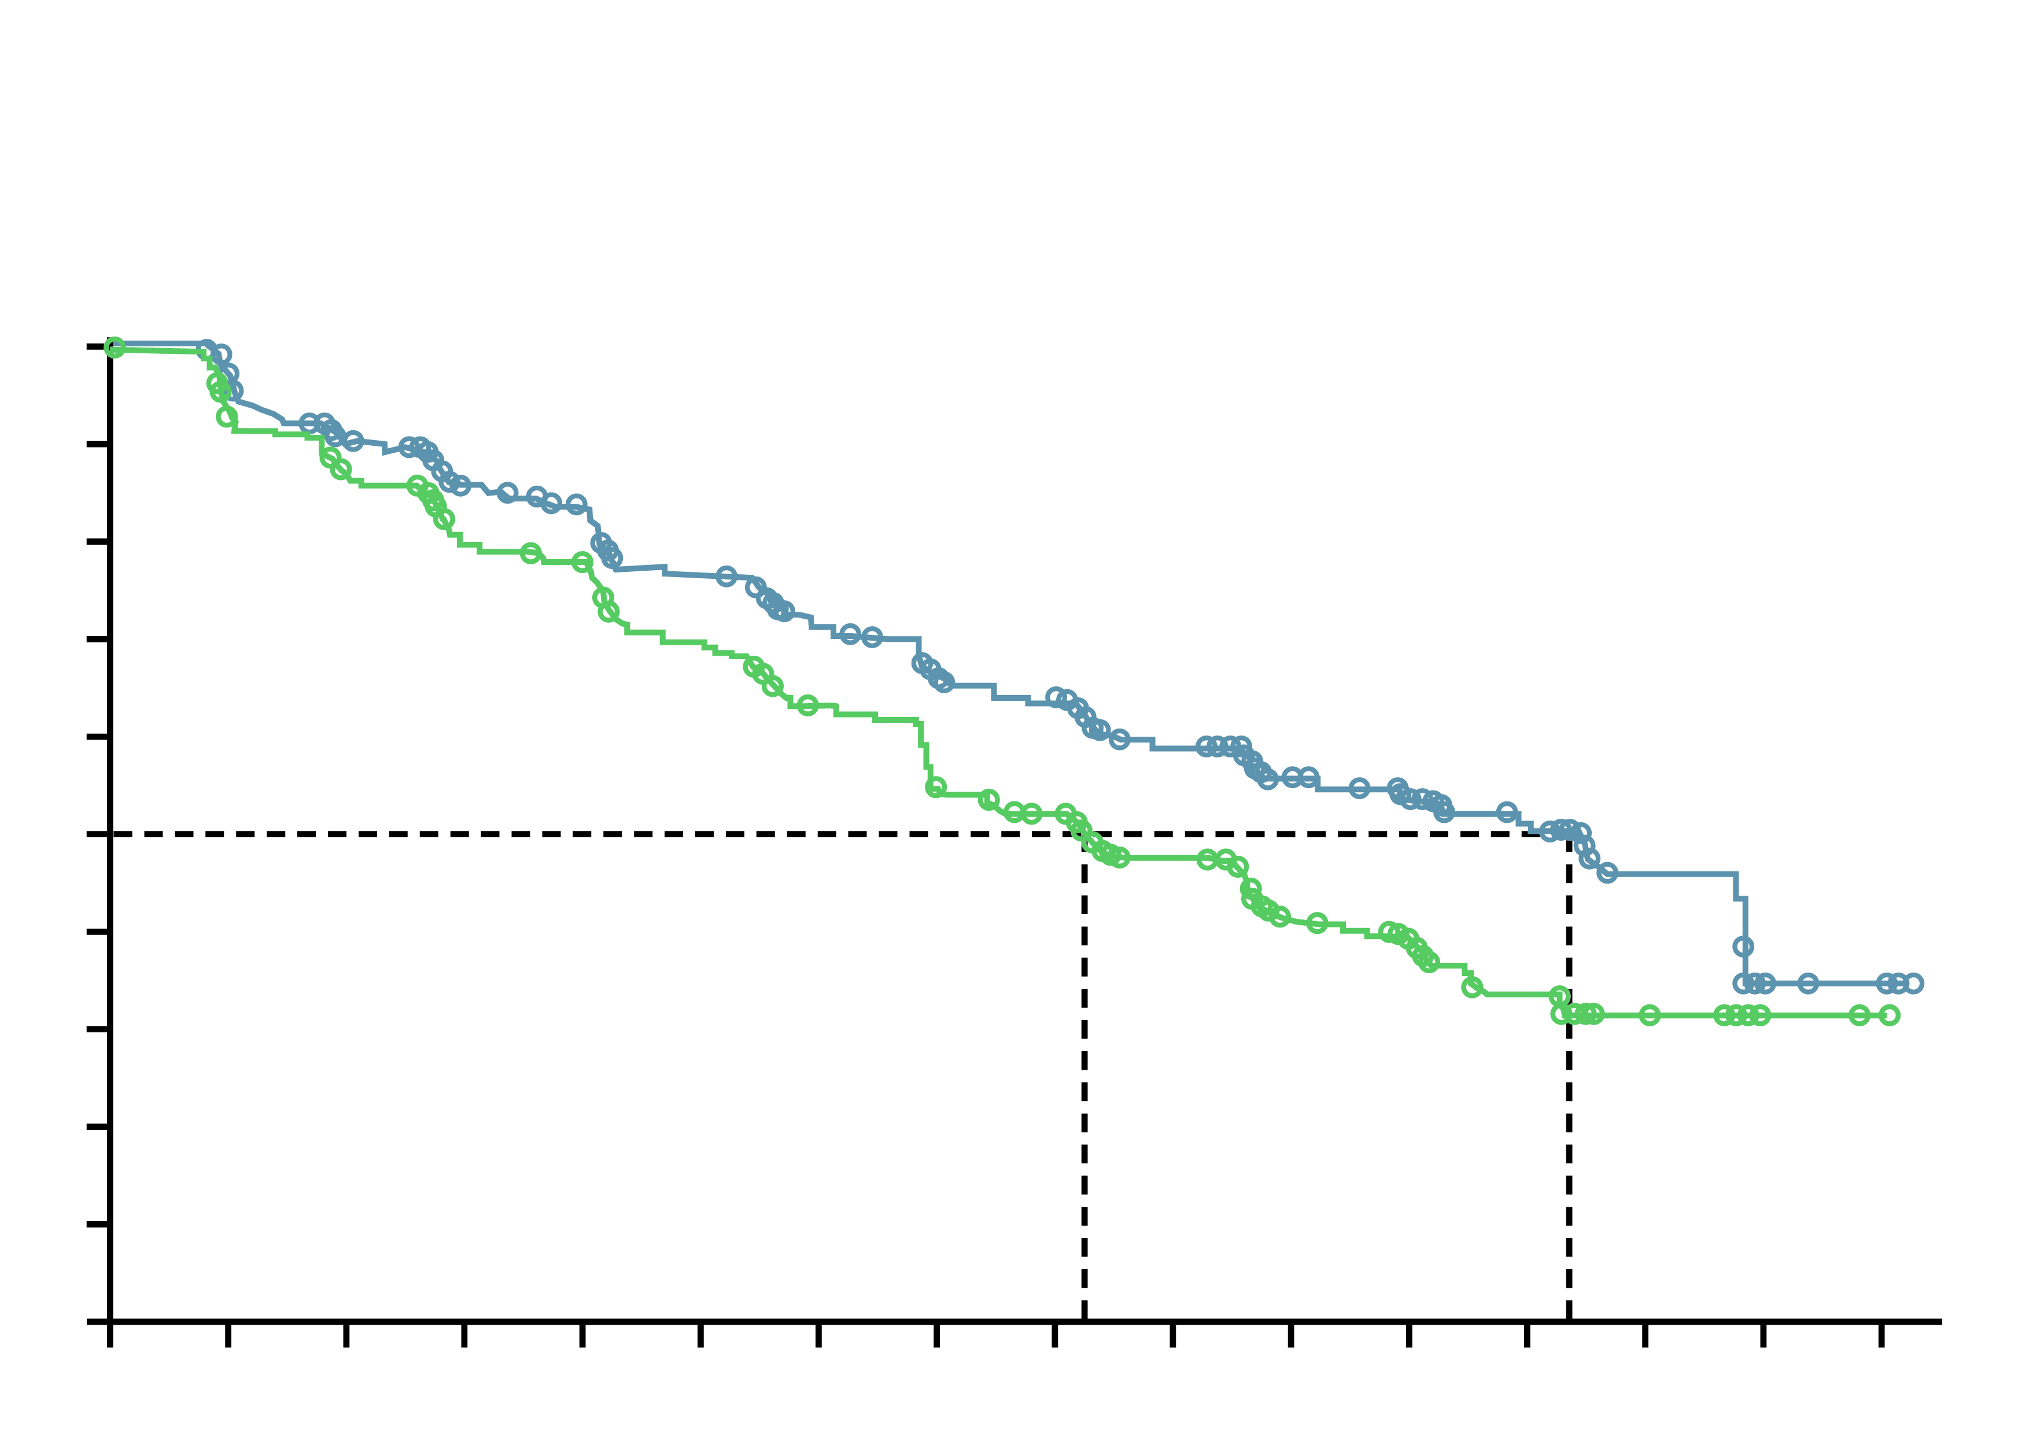
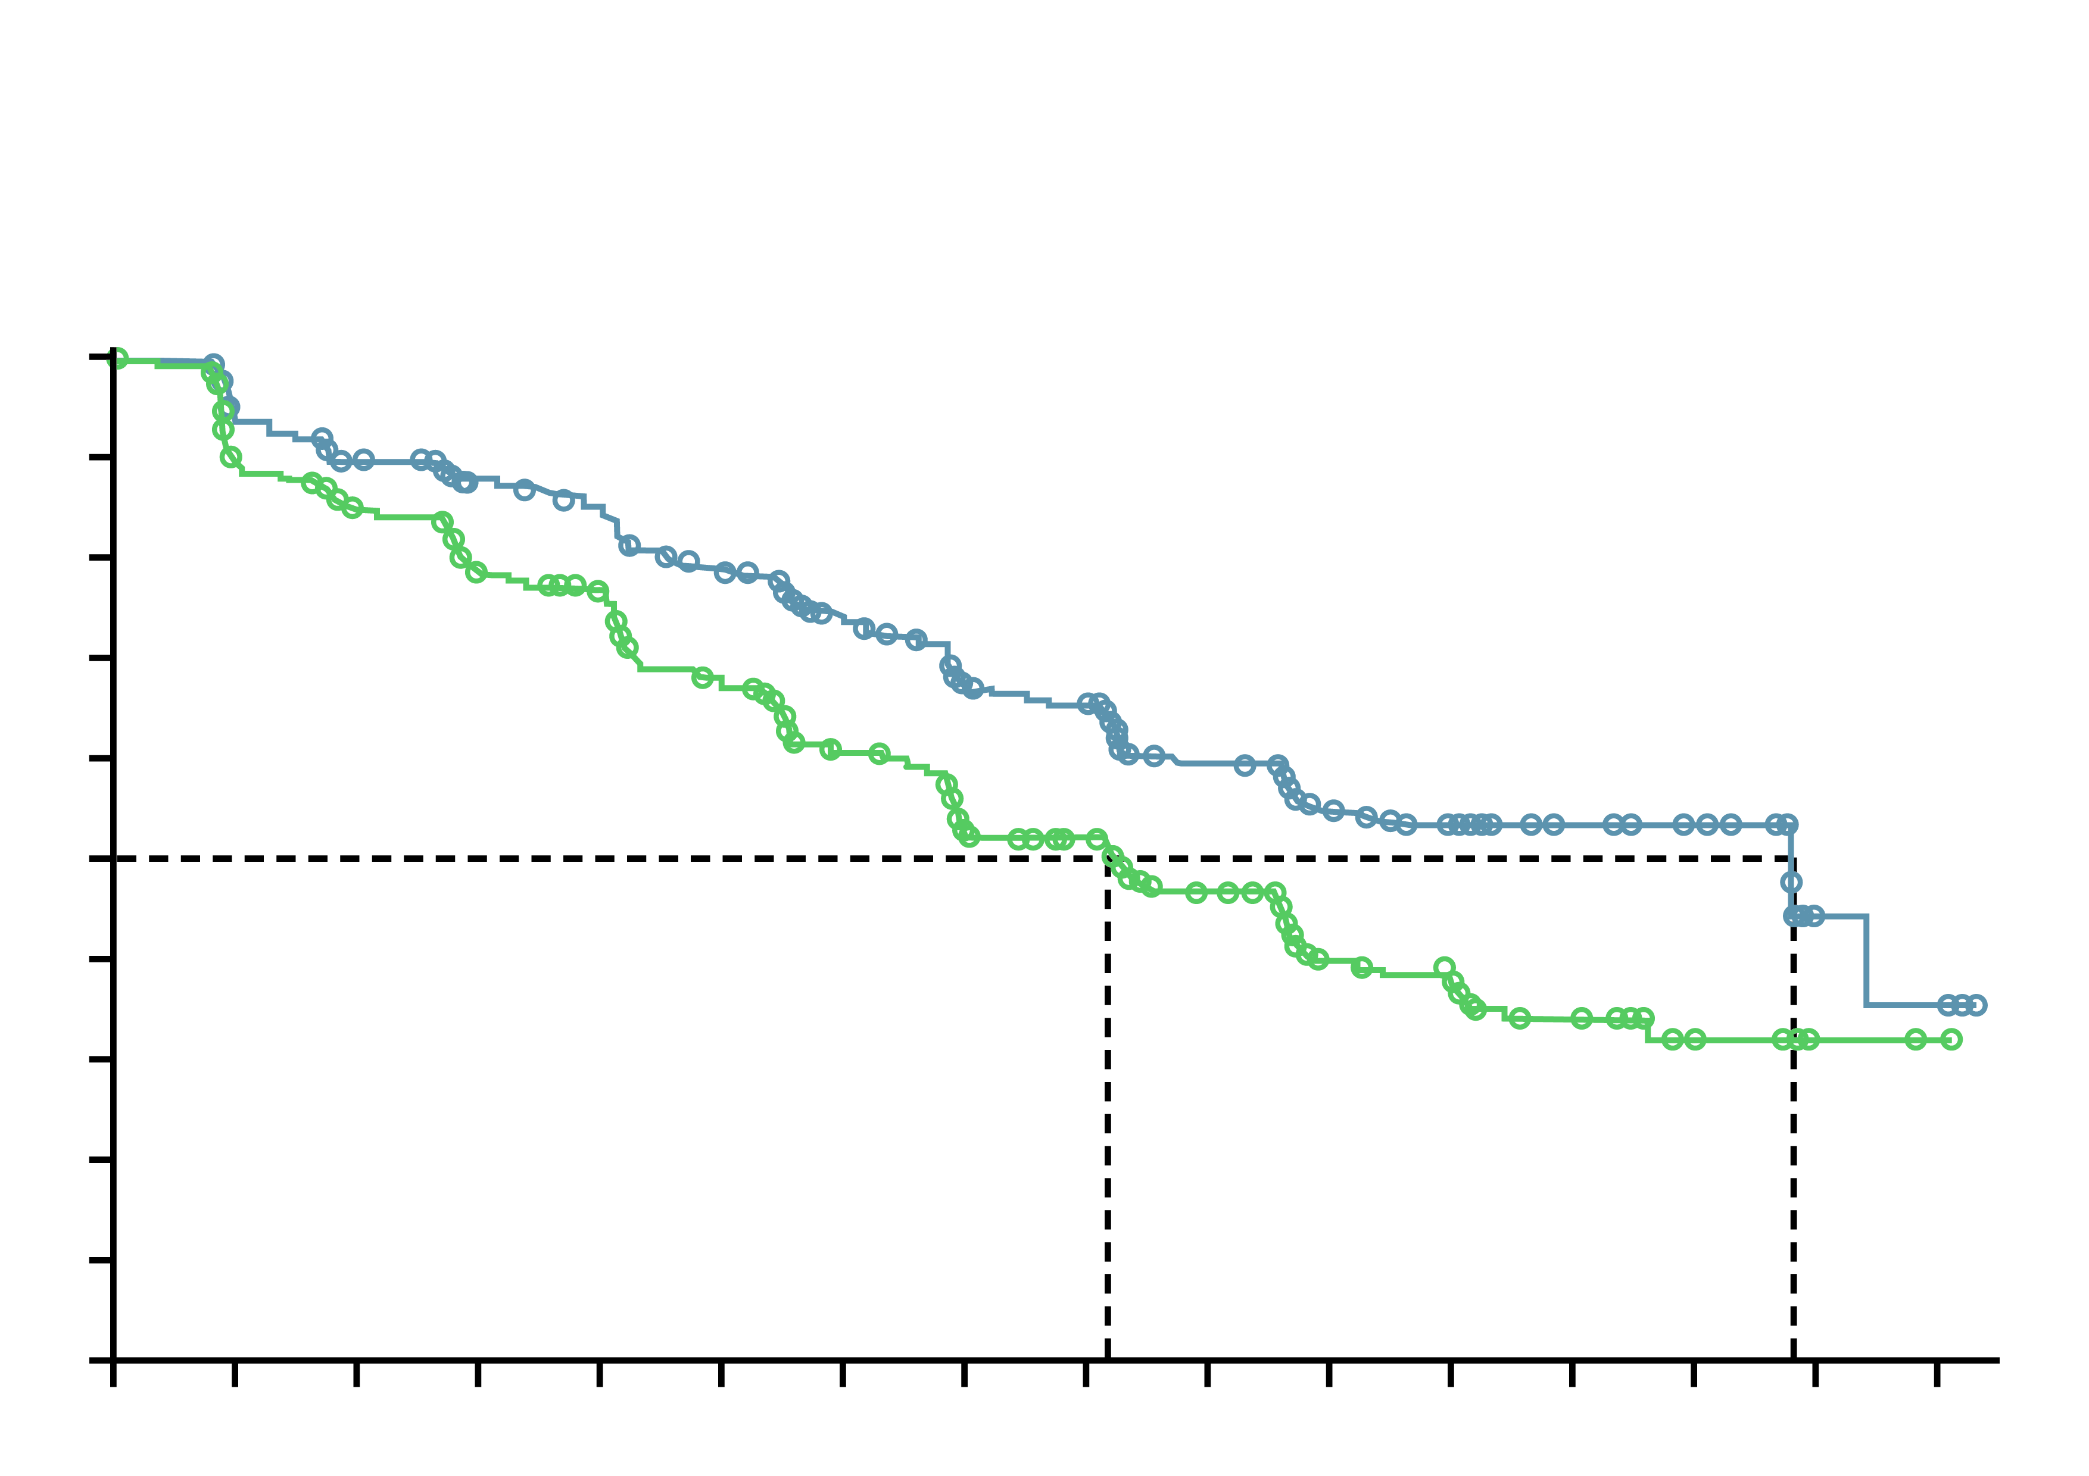
PROpel: primary rPFS results (DCO1)¹
Abiraterone + Olaparib significantly prolonged rpfs vs abiraterone + placebo in the itt population
rPFS by investigator assessment (INV)
rPFS by blinded independent central review (BICR)
 | Abi + Ola (N=399) | Abi + placebo (N=397)
Events, n (%) | 168 (42.1) | 226 (56.9)
Median, months | 24.8 | 16.6
 | HR 0.66 95% CI, 0.54-0.81; P<0.001
 | 2-sided boundary for significance 0.0324
 | Abi + Ola (N=399) | Abi + placebo (N=397)
Events, n (%) | 157 (39.3) | 218 (54.9)
Median, months | 27.6 | 16.4
 | HR 0.61 95% CI, 0.49-0.74; P<0.0001 (nominal)
1.0
1.0
0.9
0.9
0.8
0.8
0.7
0.7
0.6
0.6
0.5
0.5
Probability of rPFS
Probability of rPFS
0.4
0.4
0.3
0.3
0.2
0.2
0.1
∆=8.2 months
0.1
∆=11.2 months
0.0
0
2
4
6
8
10
12
14
16
18
20
22
24
26
28
30
0.0
0
2
4
6
8
10
12
14
16
18
20
22
24
26
28
30
Time from randomisation (months)
Time from randomisation (months)
Number of patients at risk:
Abi + Ola
Abi + placebo
Number of patients at risk:
Abi + Ola
Abi + placebo
399
397
367
359
340
338
313
306
301
297
274
264
251
232
227
198
219
186
167
141
104
87
87
73
57
43
26
17
5
2
4
1
399
397
353
345
332
322
314
294
303
282
275
245
249
209
221
177
215
168
161
126
96
73
80
62
53
38
28
16
5
2
4
1
DCO1: 30 July 2021
Median duration of follow-up for investigator-assessed rPFS for censored patients was 19.3 months in the abiraterone and olaparib arm, and 19.4 months in the abiraterone and placebo arm (19.3 and 19.2 months, respectively, for BICR)
Abi, abiraterone; CI, confidence interval; DCO1, first data cut-off; HR, hazard ratio; ITT, intention-to-treat; Ola, olaparib; rPFS, radiographic progression-free survival
Clarke N, et al. NEJM Evidence 2022;1(9): doi: https://doi.org/10.1056/EVIDoa2200043; Clarke N, et al. J Clin Oncol 41, 2023 (suppl 6; abstr LBA16) (ASCO GU 2023 oral presentation)

Slide 14
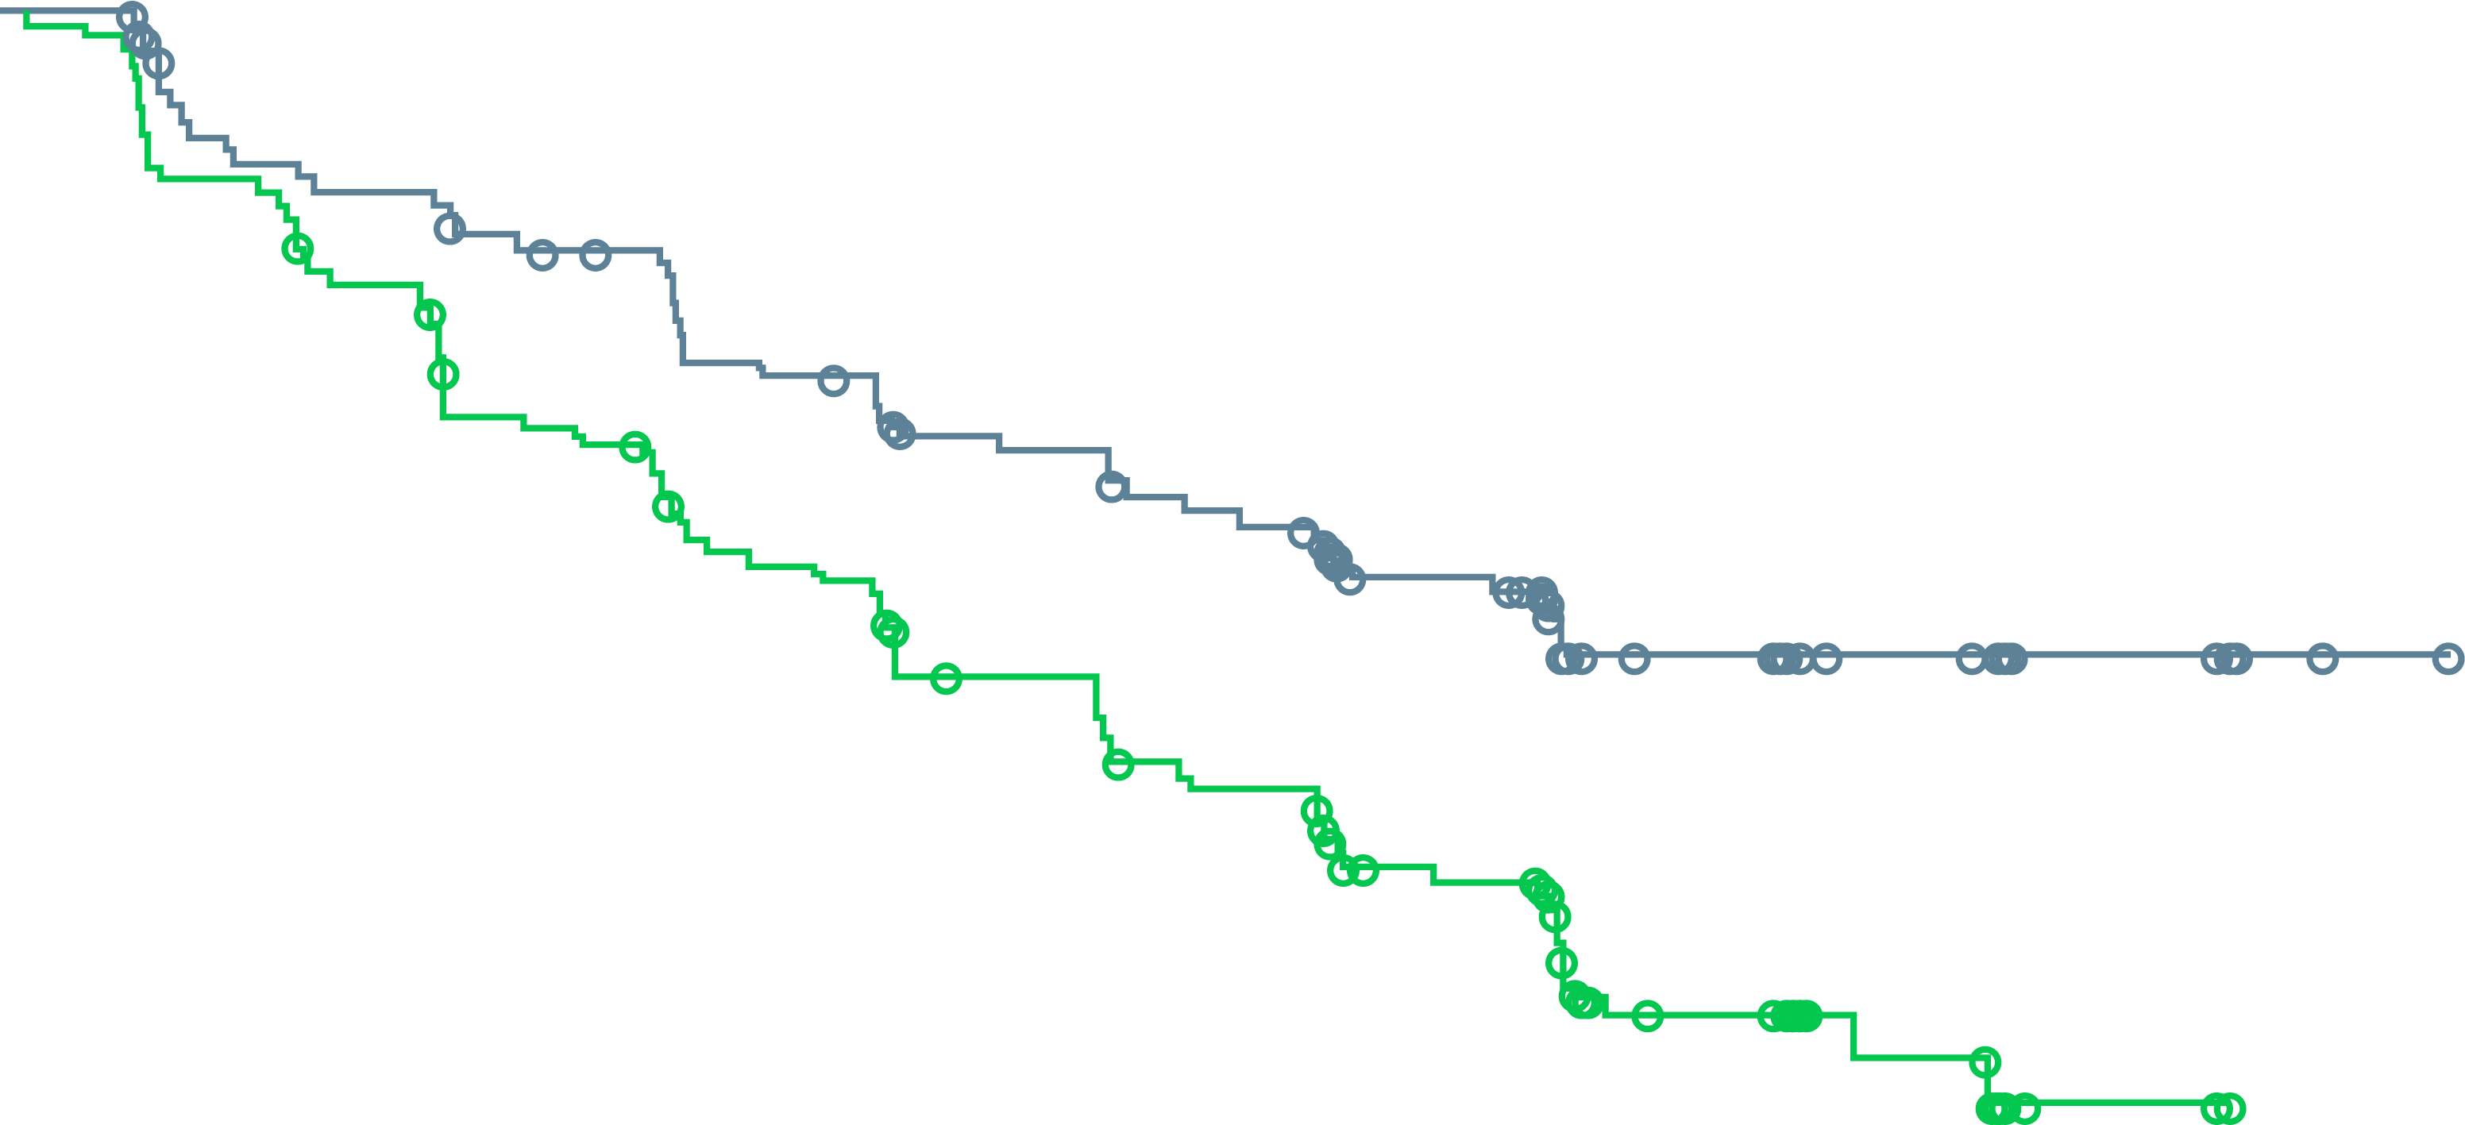
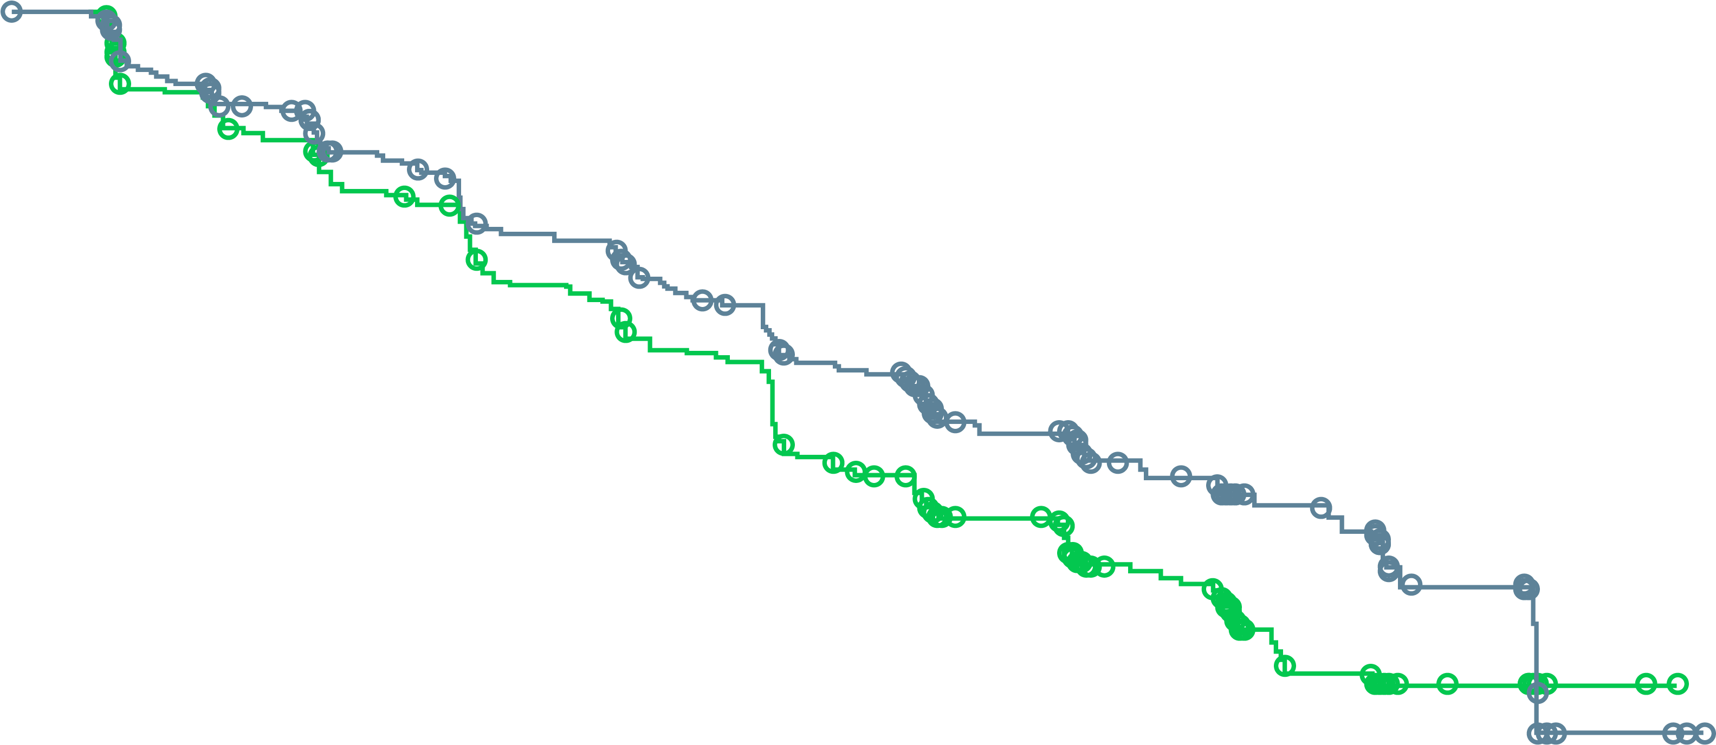
PROpel: rPFS for HRRm and non-HRRm subgroups
A benefit was observed with abiraterone + olaparib across HRRm and non-HRRm subgroups (DCO1)
HRRm subgroup (investigator assessment)
Non-HRRm subgroup (investigator assessment)
1.0
1.0
0.9
0.9
0.8
0.8
0.7
0.7
0.6
0.6
Probability of rPFS
0.5
0.5
0.4
 | Abiraterone + olaparib (n=111) | Abiraterone + placebo (n=115)
Events, n (%) | 43 (38.7) | 73 (63.5)
Median rPFS (months) | NR | 13.9
HR (95% CI) | 0.50 (0.34-0.73)
0.4
 | Abiraterone + olaparib (n=279) | Abiraterone + placebo (n=273)
Events, n (%) | 119 (42.7) | 149 (54.6)
Median rPFS (months) | 24.1 | 19.0
HR (95% CI) | 0.76 (0.60-0.97)
0.3
0.3
0.2
0.2
0.1
0.1
0.0
0.0
0
2
4
6
8
10
12
14
16
18
20
22
24
26
28
30
0
2
4
6
8
10
12
14
16
18
20
22
24
26
28
30
Time from randomisation (months)
Time from randomisation (months)
Number of patients at risk:
Abiraterone + olaparib
Abiraterone + placebo
111
115
103
103
94
94
90
81
87
78
78
68
72
58
66
51
64
49
52
39
34
22
28
20
14
11
8
2
2
0
1
0
279
273
255
248
238
236
216
218
207
212
190
190
175
169
157
143
151
133
112
100
69
64
59
52
43
31
18
15
3
2
3
1
Sensitivity analysis by blinded independent central review: Median 28.8 vs 13.8 months;
HR 0.45, 95% CI 0.31-0.65
Sensitivity analysis by blinded independent central review: Median 27.6 vs 19.1 months;
HR 0.72, 95% CI 0.56-0.93
Patient enrolment was not based on HRRm status; however, HRRm testing was prespecified. HRR status was determined after randomisation and before primary analysis using results from tumour tissue and plasma ctDNA HRRm tests. A total of 18 patients did not have a valid HRR testing result from either a tumour tissue or ctDNA test and were excluded from the subgroup analysis. This subgroup analysis is post-hoc exploratory analysis. A circle indicates a censored observation CI, confidence interval; ctDNA, circulating tumour DNA; DCO1, first data cut-off; HR, hazard ratio; HRRm, homologous recombination repair mutation; NR, not reached; rPFS, radiographic progression-free survival
Saad F, et al. Annals of Oncology 2022; 33 (suppl_7): S616-S652 (ESMO 2022 oral presentation)

Slide 15
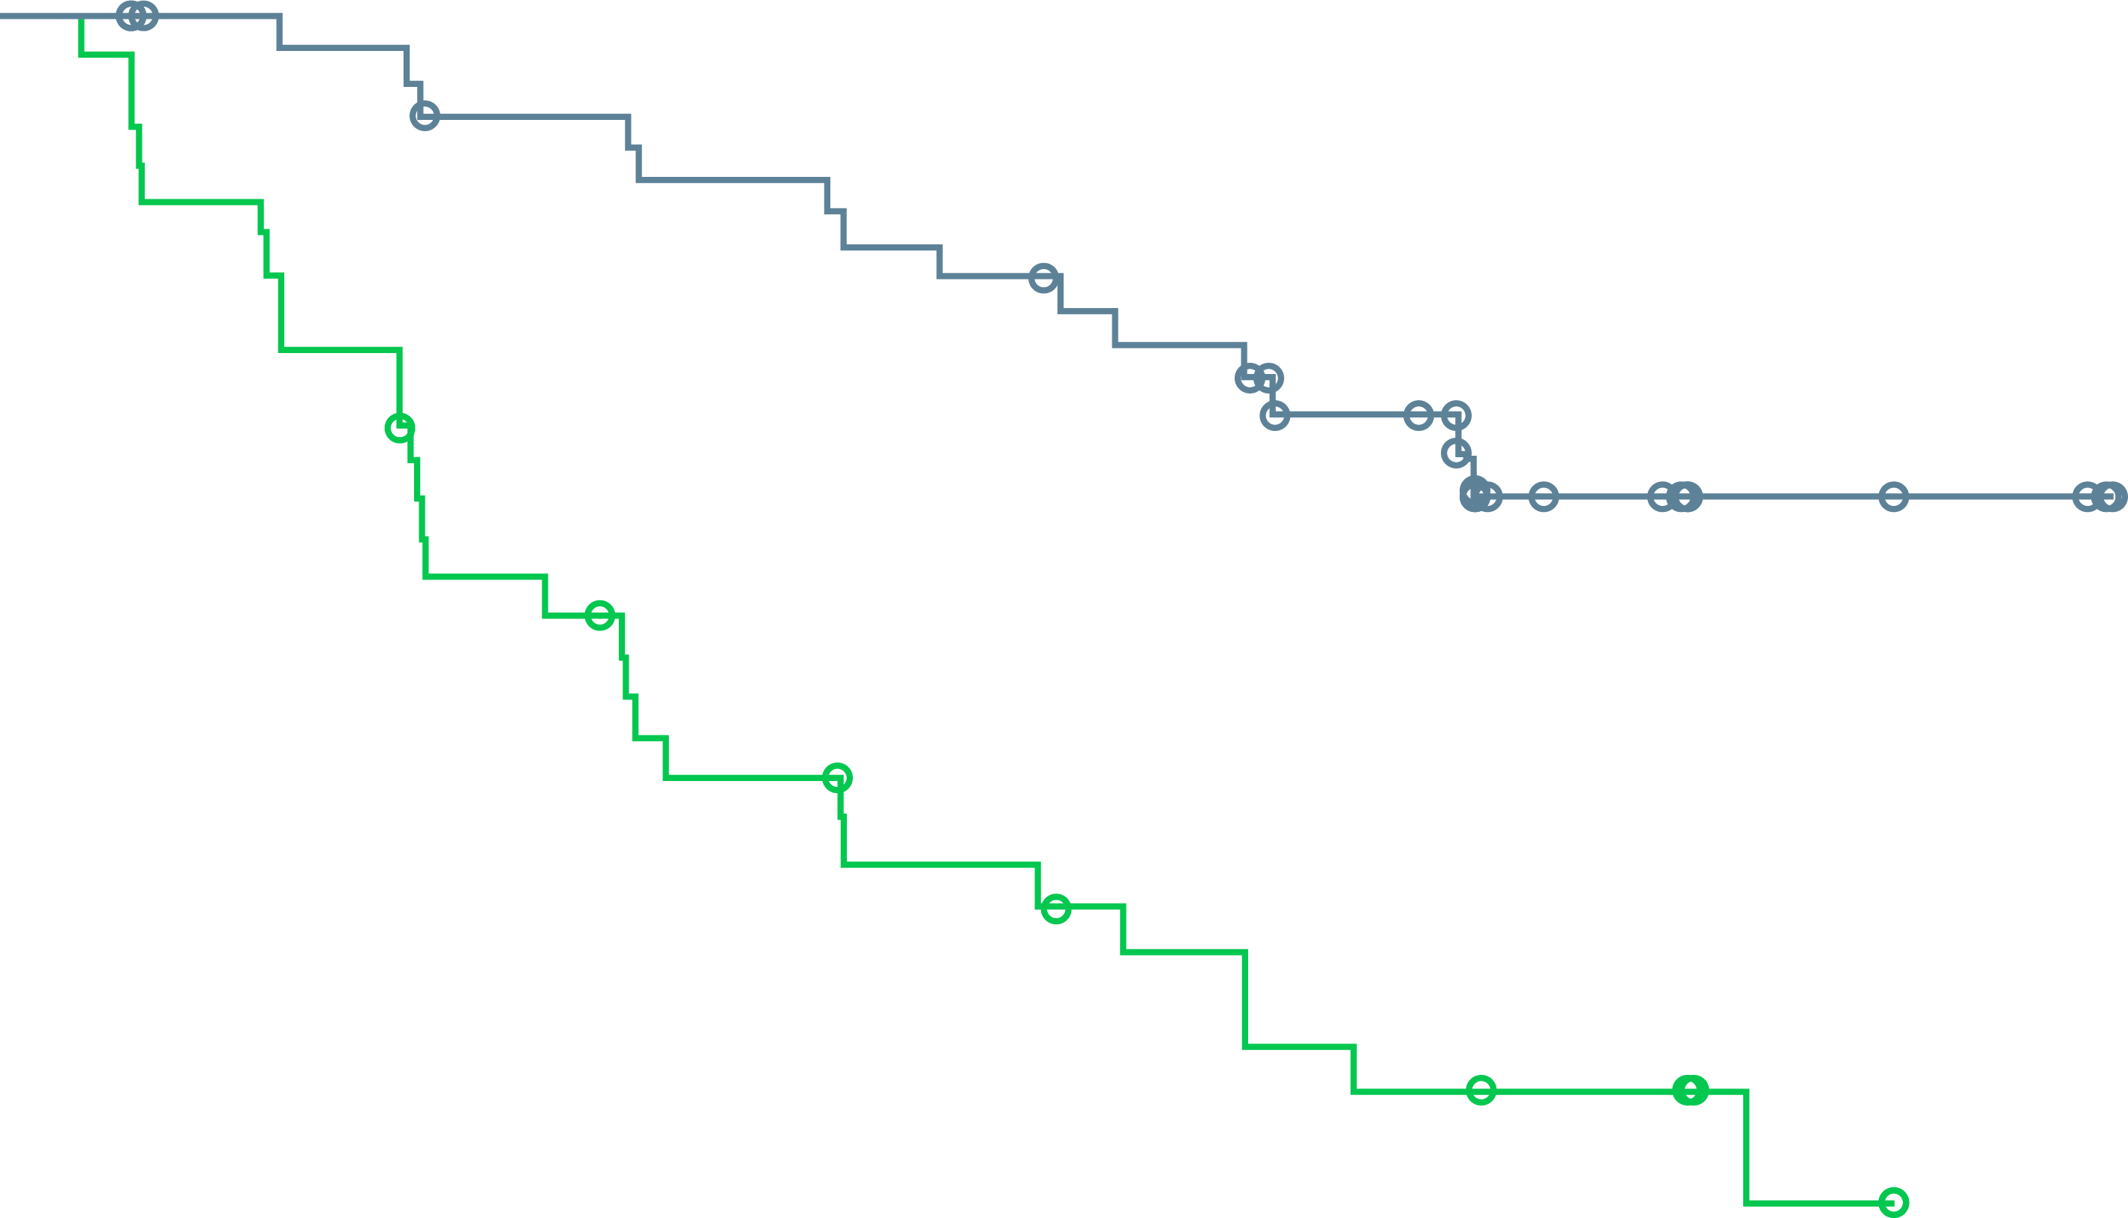
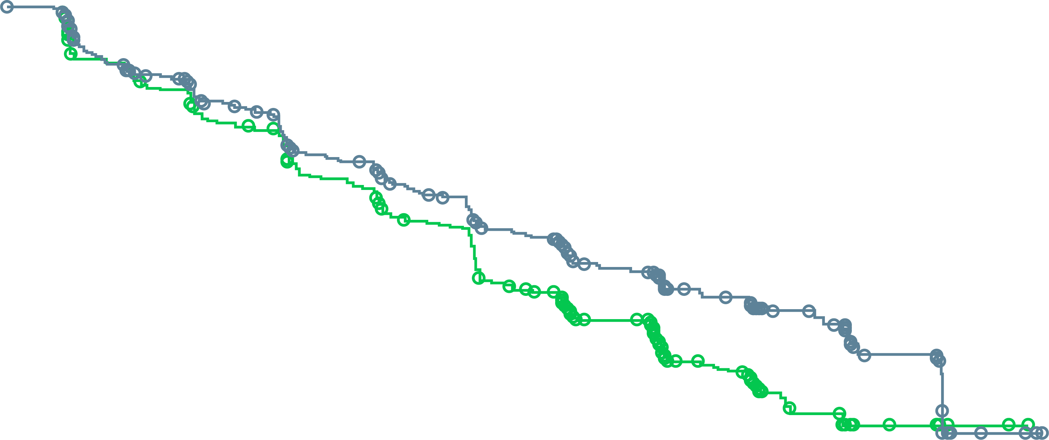
PROpel: rPFS for BRCAm and non-BRCAm subgroups
A benefit was observed with abiraterone + olaparib across BRCAm, non-BRCAm, BRCA2 and non-BRCA2 subgroups (DCO1)ª
BRCAm subgroup (investigator assessment)
Non-BRCAm subgroup (investigator assessment)
1.0
1.0
0.9
0.9
0.8
0.8
0.7
0.7
0.6
 | Abiraterone + olaparib (n=47) | Abiraterone + placebo (n=38)
Events, n (%) | 14 (29.8) | 28 (73.7)
Median rPFS (months) | NR | 8.4
HR (95% CI) | 0.23 (0.12-0.43)
0.6
Probability of rPFS
0.5
0.5
0.4
0.4
 | Abiraterone + olaparib (n=343) | Abiraterone + placebo (n=350)
Events, n (%) | 148 (43.1) | 194 (55.4)
Median rPFS (months) | 24.1 | 19.0
HR (95% CI) | 0.76 (0.61-0.94)
0.3
0.3
0.2
0.2
0.1
0.1
0.0
0.0
0
2
4
6
8
10
12
14
16
18
20
22
24
26
28
0
2
4
6
8
10
12
14
16
18
20
22
24
26
28
30
Time from randomisation (months)
Time from randomisation (months)
Number of patients at risk:
Abiraterone + olaparib
Abiraterone + placebo
343
350
314
318
289
301
266
277
254
270
230
242
211
214
190
183
183
172
137
132
87
80
73
66
50
40
21
17
5
2
4
1
47
38
44
33
43
29
40
22
40
20
38
16
36
13
33
11
32
10
27
7
16
6
14
6
7
2
5
0
0
0
Sensitivity analysis by blinded independent central review: Median NR vs 8.4 months;
HR 0.18, 95% CI 0.09-0.34
Sensitivity analysis by blinded independent central review: Median 27.6 vs 16.6 months;
HR 0.72, 95% CI 0.58-0.90
ª BRCA2m: HR 0.25, 95% CI 0.12-0.48. Non-BRCA2m: HR 0.74, 95% CI 0.60-0.92. Patient enrolment was not based on HRRm status; however, the HRRm and BRCAm status of patients in PROpel was determined after randomisation and before primary analysis using aggregated results from tumour tissue and plasma ctDNA HRRm tests. This subgroup analysis is post-hoc exploratory analysis. A circle indicates a censored observation
BRCA2, breast cancer gene 2; BRCAm, breast cancer gene mutation; CI, confidence interval; ctDNA, circulating tumour DNA; DCO1, first data cut-off; HR, hazard ratio; HRRm, homologous recombination repair mutation; NR, not reached; rPFS, radiographic progression-free survival
Saad F, et al. Annals of Oncology 2022; 33 (suppl_7): S616-S652 (ESMO 2022 oral presentation)

Slide 16
PROpel: subgroup analysis of rPFS
An rPFS benefit was observed across all patient subgroups, including patients with and without HRRm (DCO1)
 | Number of patients, n | Median rPFS, months |  |  |  | HR (95% CI)
All patients | 796 | 24.8 | 16.6 |  |  | 0.66 (0.54-0.81)
Age at randomisation, years
<65 | 227 | NR | 16.4 |  |  | 0.51 (0.35-0.75)
≥65 | 569 | 22.0 | 16.7 |  |  | 0.78 (0.62-0.98)
Site of distant metastases
Bone only | 434 | 27.6 | 22.2 |  |  | 0.73 (0.54-0.98)
Visceral | 105 | 13.7 | 10.9 |  |  | 0.62 (0.39-0.99)
Other | 257 | 20.5 | 13.7 |  |  | 0.62 (0.44-0.85)
Docetaxel treatment at mHSPC stage
Yes | 189 | 27.6 | 13.8 |  |  | 0.61 (0.40-0.92)
No | 607 | 24.8 | 16.8 |  |  | 0.71 (0.56-0.89)
HRRm statusª
HRRm | 226 | NR | 13.9 |  |  | 0.50 (0.34-0.73)
Non-HRRm | 552 | 24.1 | 19.0 |  |  | 0.76 (0.60-0.97)
BRCAm statusª
BRCAm | 85 | NR | 8.4 |  |  | 0.23 (0.12-0.43)
Non-BRCAm | 693 | 24.1 | 19.0 |  |  | 0.76 (0.61-0.94)
0.1
Abiraterone + olaparib better
1
10
Abiraterone + placebo better
ª The HRRm and BRCAm status of patients in PROpel was determined after randomisation and before primary analysis using aggregated results from tumour tissue and/or plasma ctDNA HRRm tests. Aggregate HRRm and BRCAm subgroup analyses are post-hoc exploratory analyses. Results shown are by investigator assessment
BRCAm, breast cancer gene mutation; CI, confidence interval; ctDNA, circulating tumour DNA; DCO1, first data cut-off; HR, hazard ratio; HRRm, homologous recombination repair mutation; mHSPC, metastatic hormone-sensitive prostate cancer; NR, not reached; rPFS, radiographic progression-free survival
Saad F, et al. Ann Oncol. 2022;33 (suppl_7): S616-S652 (ESMO 2022 oral presentation); Clarke N, et al. NEJM Evidence 2022;1(9): doi: https://doi.org/10.1056/EVIDoa2200043

Slide 17
PROpel: OS at final analysis (DCO3)
In the ITT population, median OS was >7 months longer in the abiraterone + olaparib arm
1.0
 | Abiraterone + olaparib (N=399) | Abiraterone + placebo (N=397)
Events, n (%) | 176 (44.1) | 205 (51.6)
Median, months | 42.1 | 34.7
 | HR 0.81 95% CI, 0.67-1.00; P=0.0544
 | 2-sided boundary for significance 0.0377
 | 47.9% maturity
0.9
0.8
0.7
0.6
Probability of OS
0.5
0.4
0.3
0.2
∆ 7.4
months
0.1
0.0
0
2
4
6
8
10
12
14
16
18
20
22
24
26
28
30
32
34
36
38
40
42
44
46
48
Number of patients at risk:
Time from randomisation (months)
Abiraterone + olaparib
Abiraterone + placebo
399
397
399
395
391
388
385
383
374
376
364
370
349
355
334
337
318
316
312
305
298
301
283
282
273
254
258
241
253
225
246
213
226
201
192
157
135
119
96
84
63
53
29
25
10
7
2
0
0
0
DCO3: 12 October 2022.
Median (range) duration of follow-up for censored patients at DCO3 was 36.6 months (8.3–47.0) in the abiraterone + olaparib arm and 36.5 months (2.9–45.3) in the abiraterone + placebo arm.
CI, confidence interval; DCO3, third data cut-off; HR, hazard ratio; ITT, intention-to-treat; OS, overall survival
Clarke N, et al. J Clin Oncol 41, 2023 (suppl 6; abstr LBA16) (ASCO GU 2023 oral presentation); Saad F, et al. Lancet Oncology 2023;24: 1094-1108

Slide 18
PROpel: OS in subgroups (DCO3)
Results across subgroups were generally consistent with the ITT population
 | Events/ Number of patients, n | Median OS, months |  |  |  | HR (95% CI)
All patients | 381/796 | 42.1 | 34.7 |  |  | 0.81 (0.67-1.00)
Age at randomization, years
<65 | 93/227 | NR | 33.9 |  |  | 0.60 (0.40-0.90)
≥65 | 288/569 | 35.9 | 36.2 |  |  | 0.95 (0.75-1.19)
Site of distant metastases
Bone only | 198/434 | NR | 38.3 |  |  | 0.85 (0.64-1.13)
Visceral | 56/105 | 34.0 | 26.1 |  |  | 0.89 (0.53-1.51)
Other | 127/257 | 40.4 | 31.9 |  |  | 0.74 (0.52-1.05)
Docetaxel treatment at mHSPC stage
Yes | 107/189 | 38.8 | 27.2 |  |  | 0.76 (0.52-1.11)
No | 274/607 | NR | 38.3 |  |  | 0.85 (0.67-1.07)
HRRm statusª
HRRm | 117/226 | NR | 28.5 |  |  | 0.66 (0.45-0.95)
Non-HRRm | 255/552 | 42.1 | 38.9 |  |  | 0.89 (0.70-1.14)
BRCAm statusª
BRCAm | 38/85 | NR | 23.0 |  |  | 0.29 (0.14-0.56)
Non-BRCAm | 334/693 | 39.6 | 38.0 |  |  | 0.91 (0.73-1.13)
0.1
Abiraterone + olaparib better
1
10
Abiraterone + placebo better
DCO3: 12 October 2022.
a HRRm and BRCAm status was determined after randomisation and before primary analysis using aggregated results from tumour tissue and plasma ctDNA tests. Aggregate subgroup analyses are post hoc and exploratory.
BRCAm, breast cancer gene mutation; CI, confidence interval; ctDNA, circulating tumour DNA; DCO3, third data cut-off; HR, hazard ratio; HRRm, homologous recombination repair mutation; ITT, intention-to-treat; mHSPC, metastatic hormone sensitive prostate cancer; NR, not reached; OS, overall survival
Clarke N, et al. J Clin Oncol 41, 2023 (suppl 6; abstr LBA16) (ASCO GU 2023 oral presentation); Saad F, et al. Lancet Oncology 2023;24: 1094-1108

Slide 19
PROpel: most common AEs (>10% patients; DCO3)
Consistent with the known safety profiles of abiraterone and olaparib
Abiraterone + olaparib (N=398)
Abiraterone + placebo (N=396)
*
Professor Noel Clarke
Grade ≥3
0.3
All grade
3.8
Grade ≥3
0.5
All grade
2.5
Proportion of patients (%)
Pulmonary embolism (7.3% vs 2.3%) and cardiac failure events (1.8% vs 1.8%) were similar to earlier data cut-offs
DCO3: 12 October 2022. Safety was assessed through the reporting of AEs according to NCI CTCAE v4.03 and laboratory assessments. *Grouped term anaemia category includes anaemia, decreased haemoglobin level, decreased red-cell count, decreased haematocrit level, erythropenia, macrocytic anaemia, normochromic anaemia, normochromic normocytic anaemia and normocytic anaemia.
AEs, adverse events; DCO3, third data cut-off
Clarke N, et al. J Clin Oncol 41, 2023 (suppl 6; abstr LBA16) (ASCO GU 2023 oral presentation); Saad F, et al. Lancet Oncology 2023;24: 1094-1108

Slide 20
PROpel: FACT-P quality of life over time
Quality of life comparable between treatment arms
Least-squares mean change from baseline in FACT-P total score*
20
15
Combination of olaparib and abiraterone was associated with similar in quality of life to single agent abiraterone and a majority of patients continued therapy
10
Olaparib + abiraterone (N=399)
Placebo + abiraterone (N=397)
5
Least-squares mean change from baseline in FACT-P total score*
0
-5
-10
-15
-20
5
9
13
17
21
25
29
33
37
41
45
49
53
61
69
77
85
93
101
109
117
Analysis visit (weeks)
* Plot includes 95% confidence limits. FACT-P total score change from baseline values can be a minimum of -156 and a maximum of 156. A clinically meaningful change in FACT-P total score is 10.
FACT-P, Functional Assessment of Cancer Therapy-Prostate
Saad F, et al. J Clin Oncol. 2022;40 (suppl 6; abstr 11) (ASCO GU 2022 oral presentation)
Notes:
Health-related quality of life, as determined by the FACT-P assessment, was not affected by the combination therapy.

Slide 21
MAGNITUDE: Randomised, Double-Blind, Placebo-Controlled Study
biomarker cohorts selected prior to randomisation designed to test HRR BM⁺ and HRR BM–
Study start: February 2019
Prescreening for
BM statusª
Allocation
to cohort
1:1
randomisation
Patient eligibility
First-line mCRPC
≤4 months prior AAP allowed for mCRPC
ECOG PS 0 or 1
BPI-SF worst pain score ≤3
Stratifications
Prior taxane-based chemotherapy for mCSPC
Prior AR inhibitor for nmCRPC or mCSPC
Prior AAP for first-line mCRPC
BRCA1/2 vs other HRR alterations (HRR BM⁺ cohort)
Niraparib 200 mg^{b} + abiraterone 1000 mg^{c}
Primary endpoint
rPFS by central review
HRR BM⁺
Planned N=400
HRR BM⁺ panel:
ATM
BRCA1
BRCA2 BRIP1 CDK12 CHEK2 FANCA HDAC2 PALB2
Secondary endpoints
Time to cytotoxic chemotherapy
Time to symptomatic progression
OS
Placebo + abiraterone 1000 mg^{c}
Other prespecified endpoints
Time to PSA progression
ORR
PFS2
Time to pain progression
Patient-reported outcomes
Niraparib 200 mg^{b} + abiraterone 1000 mg^{c}
HRR BM–
Planned N=600
Placebo + abiraterone 1000 mg^{c}
Note: Patients could request to be unblinded by the study steering committee and go on to subsequent therapy of the investigator's choice
Clinical data cut-off was October 8, 2021 for the final rPFS analysis.
ª Tissue and plasma assays: FoundationOne tissue test (FoundationOne®CDx), Resolution Bioscience liquid test (ctDNA), AmoyDx blood and tissue assays, Invitae germline testing (blood/saliva), local lab biomarker test results demonstrating a pathogenic germline or somatic alteration listed in the study biomarker gene panel
^{b} Dose of niraparib used was lower than the usual monotherapy dose as a result of data obtained from the BEDIVERE trial
^{c} Abiraterone given in combination with prednisone or prednisolone 5 mg BID
AAP, abiraterone acetate and prednisone/prednisolone; AR, androgen receptor; BM, biomarker; BPI-SF, Brief Pain Inventory–Short Form; ctDNA, circulating tumour DNA; ECOG PS, Eastern Cooperative Oncology Group performance status; HRR, homologous recombination repair; L1, first line; mCRPC, metastatic castration-resistant prostate cancer; mCSPC, metastatic castration-sensitive prostate cancer; nmCRPC, nonmetastatic castration-resistant prostate cancer; ORR, overall response rate; OS, overall survival; PFS, progression-free survival; PFS2, progression-free survival on first subsequent therapy; PSA, prostate-specific antigen; rPFS, radiographic progression-free survival
Chi K, et al. J Clin Oncol. 2022;40 Suppl: Abstract 12 (ASCO GU 2022 oral presentation)

Slide 22
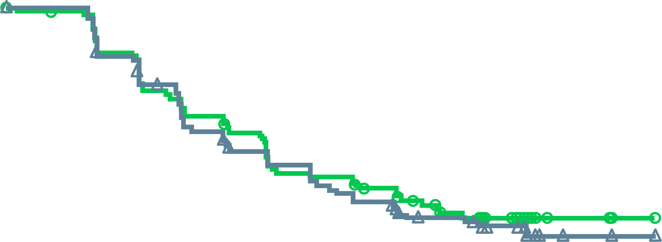
MAGNITUDE HRR BM–: Prespecified Early Futility Analysis
No Benefit of NIRA + AAP in HRR BM– Patients
Composite progression endpointª
100
Additional grade 3/4 toxicity was observed using NIRA + APP vs PBO + AAP
With added toxicity and no added efficacy in patients with HRR BM⁻ mCRPC, the IDMC recommend stopping enrollment in this cohort
80
60
PBO + AAP
Patients without events (%)
40
NIRA + AAP
20
HR = 1.09^{b} (95% CI 0.75-1.59)
0
0
3
6
9
12
15
Time from randomisation (months)
No. at risk
NIRA + AAP | 117 | 92 | 68 | 51 | 4 | 0
PBO + AAP | 116 | 91 | 68 | 56 | 8 | 0
ª Composite endpoint: rPFS or PSA progression, whichever occurred first;
^{b} Breakdown of composite endpoint events: 83 PSA events (HR = 1.03, 95% CI 0.67-1.59); 65 rPFS events (HR = 1.03, 95% CI 0.63-1.67)
AAP, abiraterone acetate + prednisone/prednisolone; AE, adverse event; BM, biomarker; CI, confidence interval; HR, hazard ratio; HRR, homologous recombination repair; IDMC, independent data monitoring committee; mCRPC, metastatic castration-resistant prostate cancer; NIRA, niraparib; PBO, placebo; PSA, prostate antigen, rPFS, radiographic progression free survival
Chi K, et al. J Clin Oncol 2022; 40, (suppl 6; abstr 12); Chi K, et al. Journal of Clinical Oncology 2023; 41: 3339-3351

Slide 23
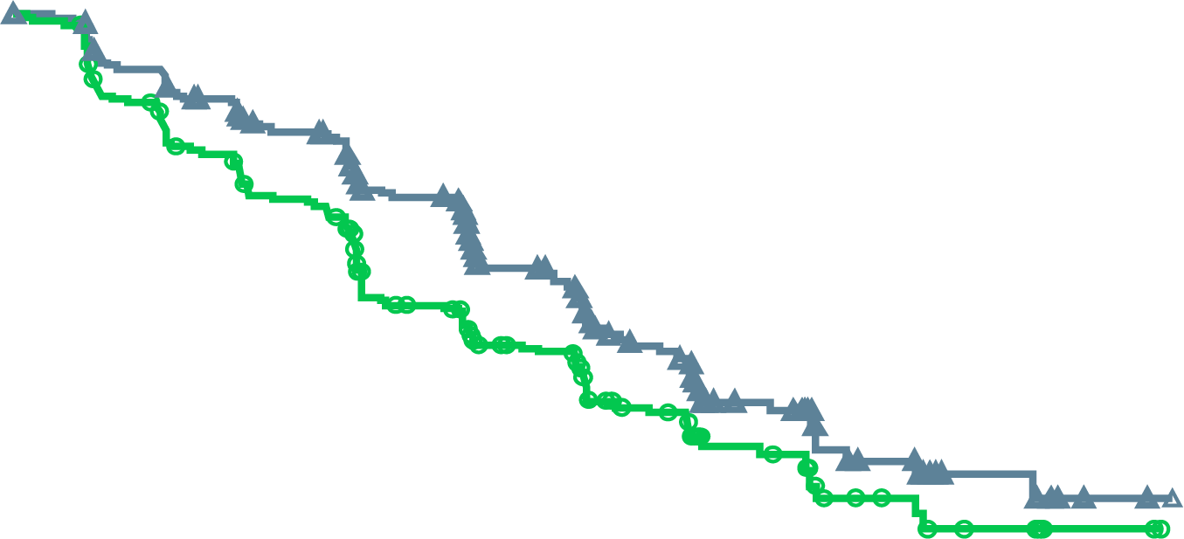
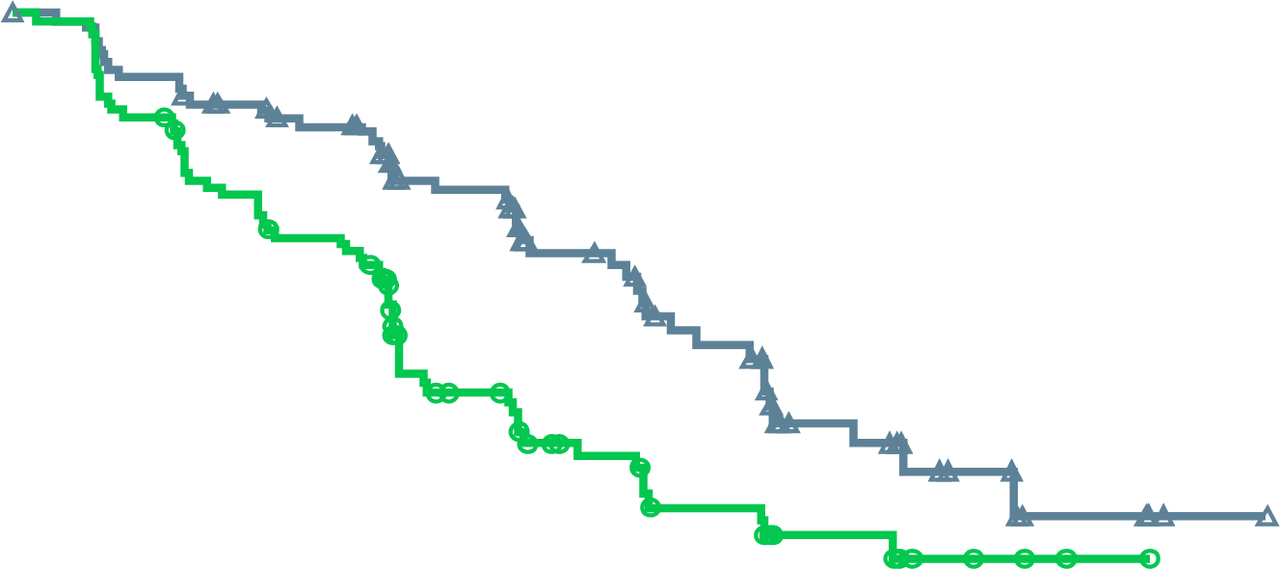
MAGNITUDE: Primary Endpoint rPFS (BICR)
rPFS WAS 2.8 MONTHS GREATER FOR ABIRATERONE + NIRAPARIB VERSUS ABIRATERONE + PLACEBO in HRR BM+ PATIENTS
All HRR BM+ patients
BRCA1/2-Mutated patients
NIRA + AAP: 16.6 mo
NIRA + AAP: 16.5 mo
HR: 0.73 (95% CI, 0.56-0.96)
p=0.0217
PBO + AAP: 13.7 mo
PBO + AAP: 10.9 mo
HR: 0.53 (95% CI, 0.36-0.79)
p=0.0014
No. at risk
NIRA + AAP | 212 | 192 | 167 | 129 | 96 | 64 | 45 | 21 | 10 | 2 | 0
PBO + AAP | 211 | 182 | 149 | 102 | 78 | 53 | 35 | 15 | 9 | 2 | 0
No. at risk
NIRA + AAP | 113 | 103 | 90 | 65 | 45 | 31 | 18 | 9 | 4 | 1 | 0
PBO + AAP | 112 | 97 | 77 | 43 | 28 | 20 | 11 | 5 | 2 | 0 | 0
Median follow-up 18.6 months
Median follow-up 16.7 months
AAP, abiraterone acetate + prednisone/prednisolone; BICR, blinded independent central review; CI, confidence interval; HR, hazard ratio; NIRA, niraparib; PBO, placebo; rPFS, radiographic progression-free survival
Chi K, et al. J Clin Oncol. 2022;40 (suppl 6; abstr 12) (ASCO GU 2022 oral presentation); Chi K, et al. Journal of Clinical Oncology 2023; 41: 3339-3351

Slide 24
MAGNITUDE All HRR BM+: Subgroup Analysis of rPFS
rPFS benefit was similar across all patient subgroups
Median (months)
Events/N
Median (months)
Events/N
Variable
Subgroup
niraparib
control
HR (95% CI)
niraparib
control
Variable
Subgroup
niraparib
control
HR (95% CI)
niraparib
control
All HRR+ patients
All
16.5
13.7
0.74 (0.57–0.97)
100/212
117/211
Past taxane–based chemotherapy
Yes
13.4
10.9
0.89 (0.48–1.66)
20/40
21/41
Age group
<65
13.9
13.9
1.01 (0.61–1.66)
32/61
30/62
No
16.6
13.8
0.71 (0.53–0.96)
80/172
96/170
≥65-74
19.4
13.6
0.58 (0.38–0.89)
34/88
57/100
Past androgen receptor-targeted
therapyª
Yes
NE
4.3
0.19 (0.03–1.23)
2/8
3/4
≥75
16.4
10.9
0.76 (0.46–1.24)
34/63
30/49
No
16.5
13.8
0.76 (0.58-1.00)
98/204
114/207
Race group
Asian
22.0
10.9
0.48 (0.22–1.05)
9/29
22/41
Prior AAP use^{b}
Yes
13.9
14.6
0.95 (0.54–1.67)
23/47
26/45
White
14.4
13.8
0.83 (0.61–1.13)
82/160
83/153
No
16.7
12.7
0.71 (0.52–0.96)
77/165
91/166
Other
18.4
9.0
0.47 (0.20–1.14)
9/23
12/17
Presence of visceral metastases
Yes
11.0
8.1
1.03 (0.60–1.77)
34/51
22/39
Baseline ECOG performance
status
0
19.5
13.9
0.65 (0.46–0.92)
53/130
76/146
No
19.4
13.8
0.64 (0.47–0.87)
66/161
95/172
1
13.1
10.5
0.84 (0.55–1.28)
47/82
41/65
Bone only metastasis at entry
Yes
19.4
15.4
0.72 (0.45–1.14)
32/78
41/85
Baseline BPI-SF#3 Score
0
16.7
16.8
0.75 (0.51–1.12)
47/108
53/103
No
14.8
10.9
0.73 (0.53–1.02)
68/134
76/126
1 to 3
13.9
10.5
0.78 (0.52–1.17)
46/88
50/86
Number of bone lesions at baseline
≤10
19.4
15.4
0.76 (0.53–1.10)
54/127
65/128
>3
13.7
13.7
0.68 (0.26–1.79)
6/14
14/22
>10
13.8
8.4
0.69 (0.47–1.04)
46/85
52/83
Region
Asia Pacific
19.5
13.8
0.64 (0.35–1.17)
17/43
27/52
Baseline PSA above median
Yes
15.7
8.3
0.58 (0.40–0.82)
56/110
66/101
Europe
14.4
13.7
0.82 (0.58–1.14)
68/128
71/120
No
16.7
18.2
0.93 (0.62–1.40)
44/102
51/110
North and South America
16.6
16.4
0.60 (0.30–1.18)
15/41
19/39
Gene mutation type
BRCA
16.6
10.9
0.55 (0.38–0.81)
45/113
64/112
Other HRR
14.8
16.4
0.99 (0.68–1.45)
55/99
53/99
0.1
1
0.1
1
Favoring Niraparib
Favoring Control
Favoring Niraparib
Favoring Control
ªPast AR-targeted therapy was considered prior novel anti-androgen therapy, such as enzalutamide, apalutamide, or darolutamide.
^{b}Prior AAP use was up to 4 months prior to study start.
AAP, abiraterone acetate + prednisone/prednisolone; AR, androgen receptor; BM, biomarker; BPI-SF, Brief Pain Inventory–Short Form; CI, confidence interval; ECOG PS, Eastern Cooperative Oncology Group performance status; HR, hazard ratio; HRR, homologous recombination repair; NE, not estimable; PSA, prostate-specific antigen; rPFS, radiographic progression-free survival.
Chi K, et al. J Clin Oncol. 2022;40 (suppl 6; abstr 12) (ASCO GU 2022 oral presentation); Chi K, et al. Journal of Clinical Oncology 2023; 41: 3339-3351

Slide 25
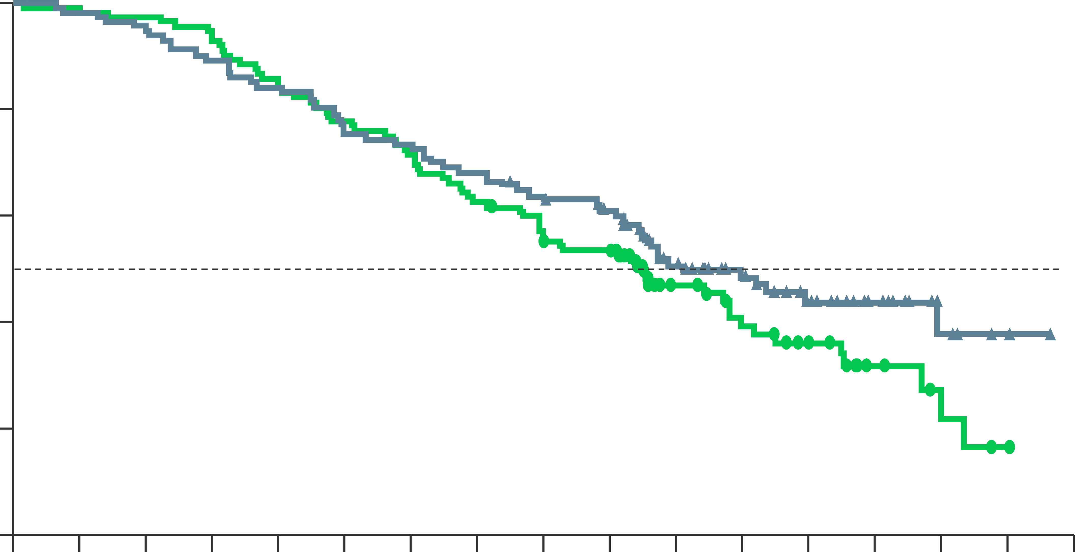
Magnitude: final os analysis (BRCA+ pts)
Os favoured nira + aAp over pbo + aap in brca+ patients
100
OS at final analysis (unadjusted)
80
60
NIRA + AAP mOS: 30.4 months
Patients without event (%)
40
PBO + AAP mOS: 28.6 months
20
HR = 0.788 (95% CI, 0.554-1.120)
Nominal P = 0.1828
0
0
3
6
9
12
15
18
21
24
27
30
33
36
39
42
45
48
No. at risk
NIRA + AAP
PBO + AAP
Months from randomisation
113
112
111
110
107
109
101
104
95
94
86
87
83
80
77
70
70
60
65
58
47
33
35
25
24
18
14
8
6
5
3
1
0
0
Does not account for baseline imbalances
AAP, abiraterone acetate + prednisone/prednisolone; CI, confidence interval; HR, hazard ratio; (m)OS, (median) overall survival; NIRA, niraparib; PBO, placebo; PTS, patients
Chi K, et al. Annals of Oncology 2023; 34 (suppl_2): S1254-S1335. DOI: 10.1016/annonc/annonc1358; (ESMO 2023, oral presentation)

Slide 26
MAGNITUDE: overall response rate
ABIRATERONE + NIRAPARIB Improves orr Consistently Across Gene Alterations
All HRR BM+ Patients
BRCA1/2-mutated
Relative risk, 2.13 nominal P<0.001
Relative risk, 1.66 nominal P=0.035
60% (55/92)
52% (29/56)
28% (23/82)
31% (15/48)
Note: Relative risk >1 favours niraparib and AAP treatment. Percent of responder is based on the number of subjects with measurable disease at baseline
AAP, abiraterone acetate plus prednisone; CR, complete response; HRR, homologous recombination repair, NIRA, niraparib; ORR, overall response rate PBO, placebo; PR, partial response
Chi K, et al. J Clin Oncol. 2022;40 (suppl 6; abstr 12) (ASCO GU 2022 oral presentation); Chi K, et al. Journal of Clinical Oncology 2023; 41: 3339-3351

Slide 27
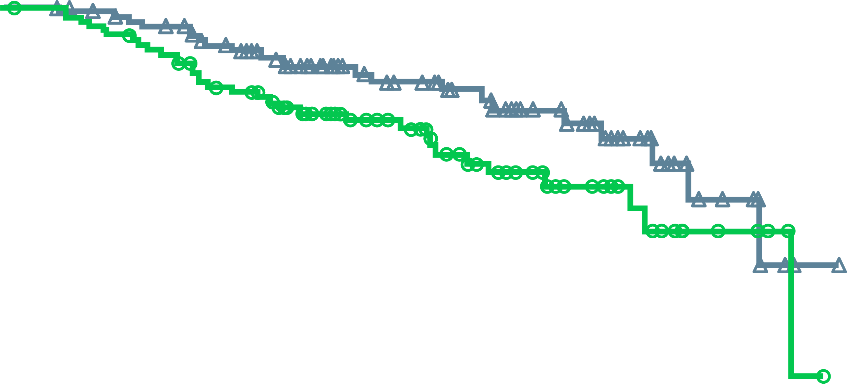
MAGNITUDE: Time to Cytotoxic Chemotherapy
ABIRATERONE + NIRAPARIB prolongs time to chemotherapy Across Gene Alterations
All HRR BM+
BRCA1/2-mutated
100
100
NIRA + AAP: NE
NIRA + AAP: NE
80
80
60
60
Patients without events (%)
Patients without events (%)
40
PBO + AAP: 26.0 mo
40
20
HR: 0.59 (95% CI, 0.39-0.89)
P=0.0108
20
HR: 0.58 (95% CI, 0.33-1.01)
nominal P=0.0495
PBO + AAP: 26.0 mo
0
0
0
3
6
9
12
15
18
21
24
27
30
0
3
6
9
12
15
18
21
24
27
30
Time from randomisation (months)
Time from randomisation (months)
No. at risk
NIRA + AAP | 212 | 205 | 196 | 169 | 127 | 98 | 74 | 44 | 18 | 3 | 0
PBO + AAP | 211 | 200 | 184 | 161 | 118 | 90 | 61 | 32 | 16 | 4 | 0
No. at risk
NIRA + AAP | 113 | 109 | 104 | 86 | 61 | 44 | 33 | 18 | 7 | 1 | 0
PBO + AAP | 112 | 107 | 97 | 81 | 53 | 41 | 26 | 14 | 6 | 1 | 0
AAP, abiraterone acetate + prednisone/prednisolone; BM, biomarker; CI, confidence interval; HR, hazard ratio; HRR, homologous recombination repair, NE, not estimable; NIRA, niraparib; PBO, placebo
Chi K, et al. J Clin Oncol. 2022;40 (suppl 6; abstr 12) (ASCO GU 2022 oral presentation); Chi K, et al. Journal of Clinical Oncology 2023; 41: 3339-3351

Slide 28
MAGNITUDE: HRR BM+ TEAEs occurring at >15% in NIRA arm or of clinical interest (IA2)
TEAEs consistent with the known safety profile for each therapy
NIRA + AAP
PBO + AAP
Grade ≥3
All grade
Pulmonary embolism occurred in four (1.9%) patients treated with niraparib plus AAP compared with two (0.9%) patients treated with placebo plus AAP
No cases of myelodysplastic syndrome or acute myeloid leukemia occurred in the niraparib plus AAP group versus one (0.5%) in the placebo plus AAP group
No cases of posterior reversible encephalopathy syndrome were observed in either group
33.0
17.9
0.5
Proportion of patients (%)
ªIncludes 1 Grade 5 event; ^{b}Includes 3 Grade 5 events
AAP, abiraterone acetate + prednisone / prednisolone; AML, acute myeloid leukaemia; BM, biomarker; HRR, homologous recombination repair; IA2, interim analysis 2; MDS, myelodysplastic syndrome; NIRA, niraparib; PBO, placebo; TEAE, treatment-emergent adverse event
Chi K, et al. Annals of Oncology 2023; 34 (9): 772-782

Slide 29
MAGNITUDE All HRR BM+: FACT-P QUALITY OF LIFE OVER TIME
Quality of life comparable between treatment arms
15
Clinically meaningful change
10
Better HRQoL
5
FACT-P total score (change from baseline)
NIRA + AAP
0
-5
Worse HRQoL
PBO + AAP
-10
Clinically meaningful change
-15
2
3
4
5
6
7
9
11
13
15
17
19
21
23
No. at risk
NIRA + AAP
PBO + AAP
Cycle
Note: The threshold for definition of FACT-P total score deterioration is ≤10.
190
184
175
179
176
180
170
167
162
159
164
152
151
146
136
129
115
104
94
83
85
64
66
50
54
37
39
24
AAP, abiraterone acetate + prednisone/prednisolone; BM, biomarker; FACT-P, Functional Assessment of Cancer Therapy-Prostate; HRR, homologous recombination repair; HRQoL, health-related quality of life; NIRA, niraparib; PBO, placebo.
Chi K, et al. J Clin Oncol. 2022;40 (suppl 6; abstr 12) (ASCO GU 2022 oral presentation); Chi K, et al. Journal of Clinical Oncology 2023; 41: 3339-3351

Slide 30
Design and Baseline Comparison of PROpel and MAGNITUDE trials
 | PROpel^{1,2} N=796 | MAGNITUDE^{3,4} N=423
Dose of PARPi | olaparib 300 mg bid | niraparib 200 mg QD
Primary endpoint | rPFS in unselected patients (investigator view) | rPFS in selected and unselected patients (central view)
Prior NHA in mCSPC | Allowed as long as stopped at least 12 mos before enrollment (abiraterone not allowed) 1 (0.3%) | 13 (3.0%)ª
Prior Docetaxel in mCSPC | 179 (22.5%) | 85 (20%)ª
HRR status required at randomisation | No | Yes
HRR analysis | Tissue and/or ctDNA | Tissue or ctDNA or germline
HRRm status
HRRm | 226 (28.4%) | 423 (100%)
Non-HRRm | 552 (69.3%) | -
HRRm unknown | 18 (2.3%) | -
BRCAm prevalence
BRCA1 | 12 (1.5%) | 16 (3.8%)
BRCA2 | 73 (9.2%) | 174 (41%)
ªincludes prior therapy for nmCRPC/mCSPC; ctDNA, circulating tumour DNA; HRRm, homologous recombination repair mutation; mCSPC, metastatic castration sensitive prostate cancer; NHA, new hormonal agent; rPFS, radiographic progression free survival. Please note that these studies cannot be directly compared. This data is presented for information purposes only
1. Clarke N, et al. NEJM Evidence 2022: DOI: 10.1056/EVIDoa2200043; 2. Clarke N, et al. Lancet Oncol. 2018;19:975-86; 3. Chi K, et al. J Clin Oncol. 2022;40 (suppl 6; abstr 12) (ASCO GU 2022 oral presentation); 4. Chi K, et al. Journal of Clinical Oncology 2023; 41: 3339-3351

Slide 31
TALAPRO-2: A Randomised, Double-blind, Placebo‑Controlled Study
Patient population:
First-line mCRPC
ECOG performance status (PS) 0 or 1
Stratification factors:
Prior abirateroneª or docetaxel in castration-sensitive setting (yes vs no)
HRR gene alteration status (deficient vs nondeficient or unknown)
Talazoparib 0.5 mg* + enzalutamide 160 mg, once daily
(n=402)
(*0.35 mg daily if moderate renal impairment)
Primary endpoint:
Radiographic progression-free survival (rPFS) by blinded independent central review (BICR)
Key secondary endpoint:
Overall survival (alpha protected)
Other secondary endpoints:
Time to cytotoxic chemotherapy
PFS2 by investigator assessment^{b}
Objective response rate (ORR)
Patient-reported outcomes
Safety
(Data cut-off: August 16, 2022)
R
1:1
(N=805)
Placebo + enzalutamide 160 mg, once daily
(n=403)
All comers (Cohort 1), N=805
Nondeficient or unknown N=636
HRRm N=169
HRRm N=230
Samples prospectively assessed for HRR gene alterations (BRCA1, BRCA2, PALB2, ATM, ATR, CHEK2, FANCA, RAD51C, NBN, MOH1, MRE11A, CDK12) using FoundationOne®CDx and/or FoundationOne®Liquid CDx
HRRm only (Cohort 2), N=399
Results are reported only from the all-comers cohort of men unselected for HRR gene alterations
To maintain the overall type I error at or below 1-sided 0.025, alpha for rPFS by BICR was split equally between the all-comers and forthcoming molecularly selected cohort (1-sided alpha of 0.0125 for each). If the rPFS showed statistically significant improvement, overall survival was tested in the hierarchical stepwise procedure to preserve the overall type I error
ª Two patients in each treatment arm received prior orteronel ^{b} Time from randomisation to the date of documented progression on the first subsequent antineoplastic therapy or death from any cause, whichever occurred first
ATM, ataxia-telangiectasia gene; ATR, ataxia telangiectasia and Rad3 related; BICR, blinded independent central review; BRCA, breast cancer gene; CDK12, cyclin dependent kinase 12; CHEK2, checkpoint kinase 2; ECOG, Eastern Cooperative Oncology Group; HRR, homologous recombination repair; HRRm, HRR mutation; NBN, nibrin; ORR, objective response rate; PALB2, partner and localizer of BRCA2; PFS2, time to second progression; rPFS, radiographic progression-free survival
Agarwal N, et al. J Clin Oncol 41, 2023 (suppl 6; abstr LBA17) (ASCO GU 2023 oral presentation); Agarwal A, et al. Lancet 2023;402: 291-303

Slide 32
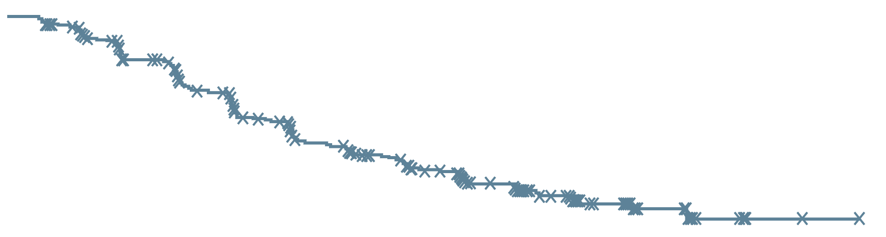
TALAPRO-2 Primary Endpoint: rPFS by BICR
Treatment with talazoparib plus enzalutamide resulted in a 37% reduced risk of progression or death
1.0
0.8
 | TALA + ENZA (N=402) | PBO + ENZA (N=403)
Events, n | 151 | 191
Median (95% CI), months | NR (27.5-NR) | 21.9 (16.6-25.1)
 | HR 0.63 95% CI, 0.51-0.78; P<0.001
0.6
Talazoparib + Enzalutamide
Probability of rPFS
0.4
0.4
Placebo + Enzalutamide
Median follow-up for rPFS was 24.9 and 24.6 months, respectively
0.0
0
2
4
6
8
10
12
14
16
18
20
22
24
26
28
30
32
34
36
38
40
42
Months
No. at risk
TALA + ENZA
PBO + ENZA
402
403
379
346
353
311
326
279
318
272
285
237
256
200
234
185
226
179
209
154
193
140
175
124
136
96
97
68
67
43
61
42
29
14
13
3
2
1
2
1
1
1
0
0
A consistent treatment effect was seen for investigator-assessed rPFS: HR 0.64 (95% CI, 0.50-0.81); P<0.001
Stratified hazard ratios (HRs) and 2-sided p values are reported throughout this presentation unless otherwise stated
BICR, blinded independent central review; CI, confidence interval; ENZA, enzalutamide; HR, hazard ratio; NR, not reached; PBO, placebo; rPFS, radiographic progression-free survival; TALA, talazoparib
Agarwal A, et al. J Clin Oncol 41, 2023 (suppl 6; abstr LBA17) (ASCO GU 2023 oral presentation); Agarwal A, et al. Lancet 2023;402: 291-303

Slide 33
TALAPRO-2: Subgroup Analysis of rPFS by BICR
A consistent treatment effect with talazoparib plus enzalutamide was seen in prespecified subgroups
 |  | Talazoparib + Enzalutamide | Placebo + Enzalutamide |  | HR (95% CI) | 2-sided p value
Subgroup |  | Events/N
Overall |  | 151/402 | 191/403 |  | 0.63 (0.51-0.78) | <0.001
Age, years | ≥70 | 93/240 | 109/240 |  | 0.67 (0.51-0.89) | 0.005
 | <70 | 58/162 | 82/163 |  | 0.61 (0.44-0.86) | 0.004
ECOG PS | 0 | 100/259 | 130/271 |  | 0.67 (0.51-0.86) | 0.002
 | 1 | 51/143 | 61/132 |  | 0.62 (0.43-0.90) | 0.01
Gleason score | <8 | 34/117 | 49/113 |  | 0.60 (0.39-0.93) | 0.02
 | ≥8 | 115/281 | 137/283 |  | 0.67 (0.52-0.86) | 0.001
Stage at diagnosis | M0 | 64/172 | 92/185 |  | 0.61 (0.44-0.84) | 0.002
 | M1 | 86/226 | 98/215 |  | 0.69 (0.51-0.92) | 0.01
Site of metastasis | Bone only | 52/169 | 63/154 |  | 0.59 (0.41-0.86) | 0.005
 | Soft tissue only | 15/48 | 29/57 |  | 0.57 (0.30-1.07) | 0.07
 | Bone and soft tissue | 82/180 | 98/188 |  | 0.71 (0.53-0.95) | 0.02
HRR status | Deficient | 37/85 | 49/84 |  | 0.48 (0.31-0.74) | <0.001
 | Non-deficient/unknown | 114/317 | 142/319 |  | 0.69 (0.54-0.89) | 0.004
Prior abirateroneª or docetaxel | Yes | 42/109 | 58/110 |  | 0.56 (0.38-0.83) | 0.004
 | No | 109/293 | 133/293 |  | 0.68 (0.53-0.88) | 0.003
0.25
0. 5
1
1.25
Talazoparib + Enzalutamide better
Placebo + Enzalutamide better
The HR for all patients was based on a Cox model stratified by the randomisation stratification factors. For all subgroups, the HR was based on an unstratified Cox model with treatment as the only covariate
ª Includes two patients in each treatment arm who received prior orteronel
BICR, blinded independent central review; CI, confidence interval; ECOG PS, Eastern Cooperative Oncology Group performance status; HR, hazard ratio; HRR, homologous recombination repair; rPFS, radiographic progression-free survival
Agarwal A, et al. J Clin Oncol 41, 2023 (suppl 6; abstr LBA17) (ASCO GU 2023 oral presentation); Agarwal A, et al. Lancet 2023;402: 291-303

Slide 34
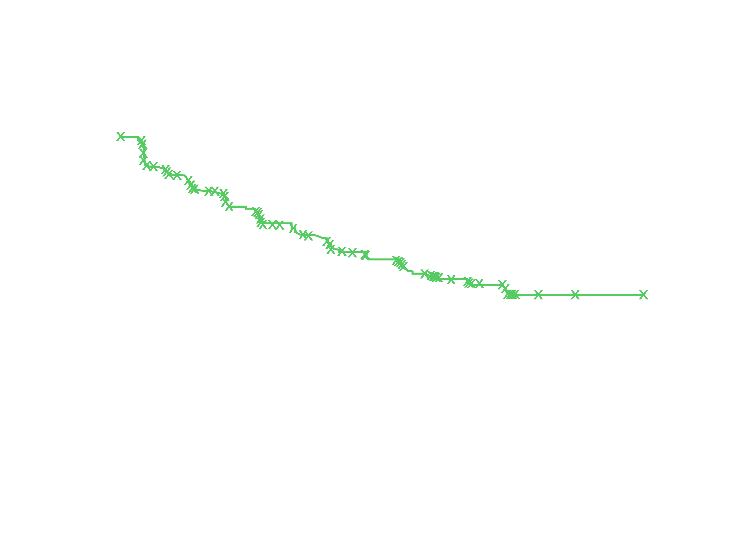
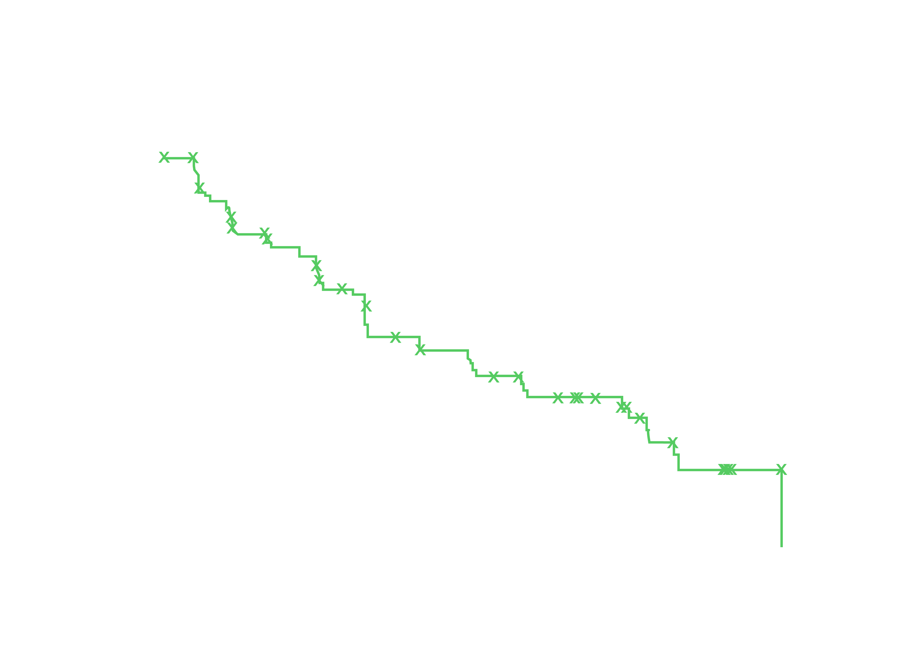
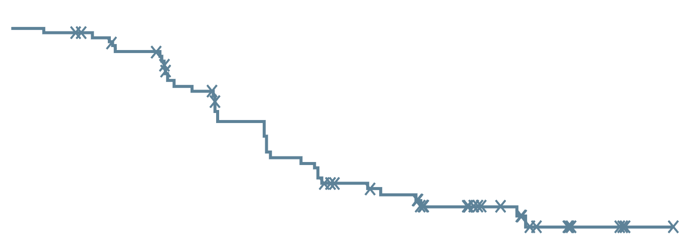
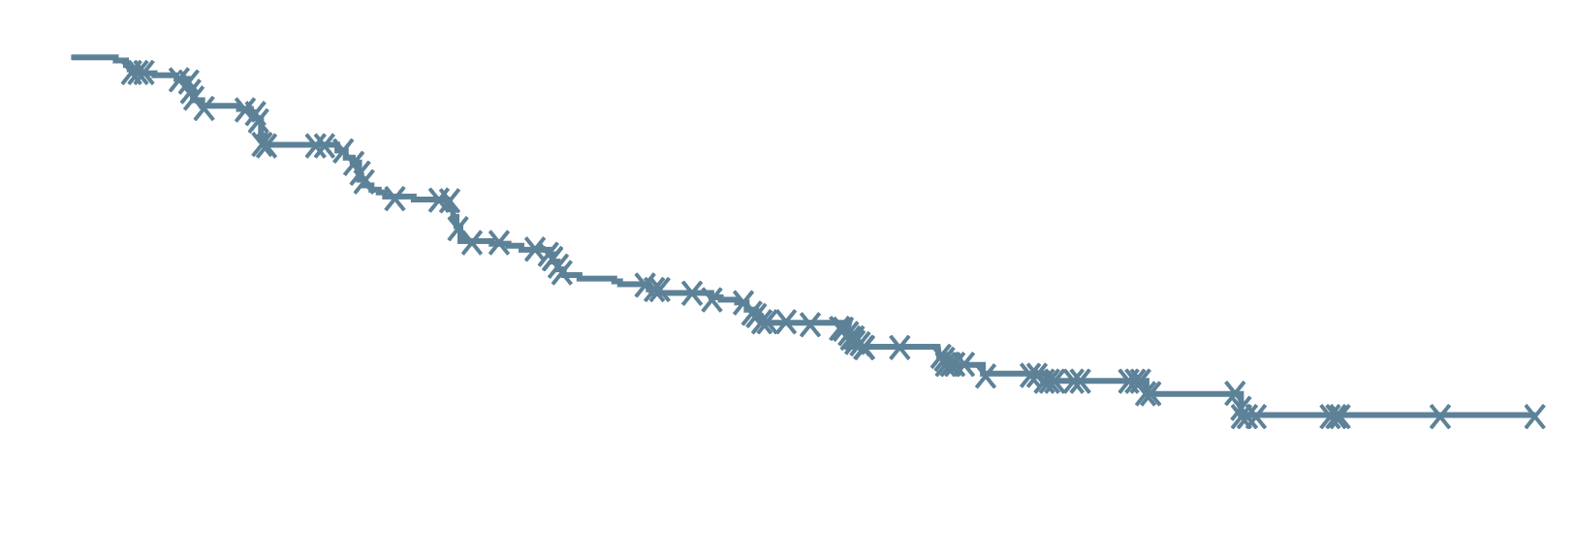
TALAPRO-2: rPFS by BICR by HRR Status
A clinically meaningful reduction in risk of progression or death was seen regardless of HRR status
HRR-deficient
HRR-nondeficient or unknown
1.0
 | TALA + ENZA (N=85) | PBO + ENZA (N=84)
Events, n | 37 | 49
Median (95% CI), months | 27.9 (16.6-NR) | 16.4 (10.9-24.6)
 | HR 0.46 95% CI, 0.30-0.70; P<0.001
1.0
0.8
0.8
Talazoparib + Enzalutamide
0.6
0.6
Probability of rPFS
Probability of rPFS
0.4
Talazoparib + Enzalutamide
0.4
 | TALA + ENZA (N=317) | PBO + ENZA (N=319)
Events, n | 114 | 142
Median (95% CI), months | NR (27.5-NR) | 22.5 (19.1-30.5)
 | HR 0.70 95% CI, 0.54-0.89; P=0.004
Placebo + Enzalutamide
0.2
0.2
Placebo + Enzalutamide
0.0
0.0
0
2
4
6
8
10
12
14
16
18
20
22
24
26
28
30
32
34
36
38
40
42
0
2
4
6
8
10
12
14
16
18
20
22
24
26
28
30
32
34
36
38
40
42
Months
Months
No. at risk
TALA + ENZA
PBO + ENZA
85
84
83
72
81
61
76
55
75
54
65
43
57
34
51
30
49
30
42
25
40
21
37
20
30
17
23
11
17
6
15
6
6
2
3
0
0
0
0
0
0
0
0
0
No. at risk
TALA + ENZA
PBO + ENZA
317
319
296
274
272
250
250
224
243
218
220
194
199
166
183
155
177
149
167
129
153
119
138
104
106
79
74
57
50
37
46
36
23
12
10
3
2
1
2
1
1
1
0
0
HRR gene alteration status (deficient vs nondeficient or unknown) as a stratification factor
BICR, blinded independent central review; CI, confidence interval; ENZA, enzalutamide; HR, hazard ratio; HRR, homologous recombination repair; NR, not reached; PBO, placebo; rPFS, radiographic progression-free survival; TALA, talazoparib
Agarwal A, et al. J Clin Oncol 41, 2023 (suppl 6; abstr LBA17) (ASCO GU 2023 oral presentation); Agarwal A, et al. Lancet 2023;402: 291-303

Slide 35
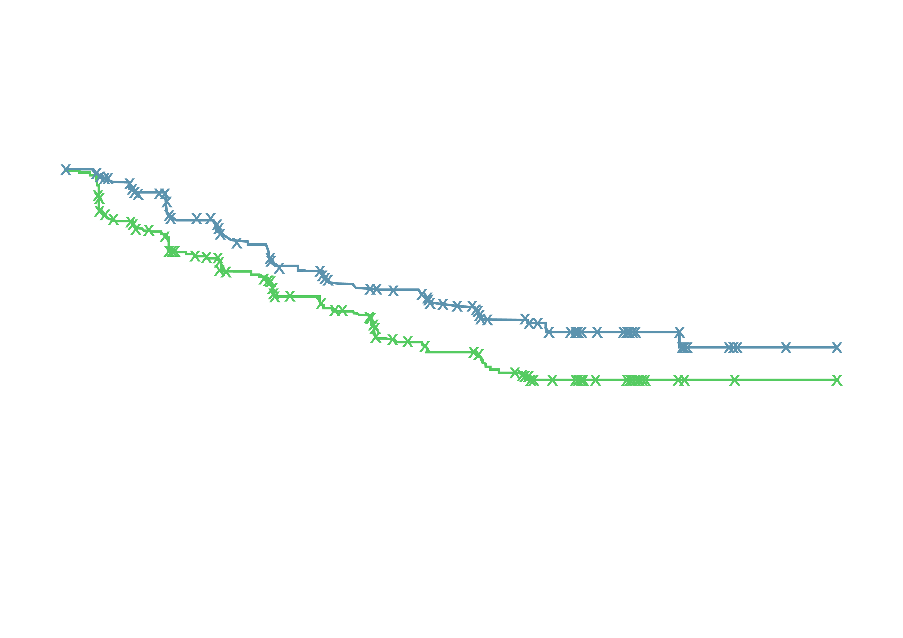
TALAPRO-2: rPFS by BICR in HRR-nondeficient by Prospective TumoUr Tissue Testing
34% risk reduction in patients without HRR gene alterations detected by prospective tumoUr tissue testing
1.0
0.8
 | TALA + ENZA (N=198) | PBO + ENZA (N=214)
Events, n | 70 | 96
Median (95% CI), months | NR (25.8-NR) | 22.1 (16.6-NR)
 | HR 0.66 95% CI, 0.49-0.91; P=0.009
Talazoparib + Enzalutamide
0.6
Probability of rPFS
0.4
Placebo + Enzalutamide
0.4
0.0
0
2
4
6
8
10
12
14
16
18
20
22
24
26
28
30
32
34
36
38
40
42
Months
No. at risk
TALA + ENZA
PBO + ENZA
198
214
184
179
170
162
152
143
148
138
132
123
119
107
109
100
104
95
100
78
91
71
83
65
63
50
43
34
31
23
28
22
18
8
7
2
2
1
2
1
1
1
0
0
Exploratory endpoint analysis based on HRR gene alteration status derived from the clinical database (unstratified analysis)
BICR, blinded independent central review; CI, confidence interval; ENZA, enzalutamide; HR, hazard ratio; HRR, homologous recombination repair; NR, not reached; PBO, placebo; rPFS, radiographic progression-free survival; TALA, talazoparib
Agarwal A, et al. J Clin Oncol 41, 2023 (suppl 6; abstr LBA17) (ASCO GU 2023 oral presentation); Agarwal A, et al. Lancet 2023;402: 291-303

Slide 36
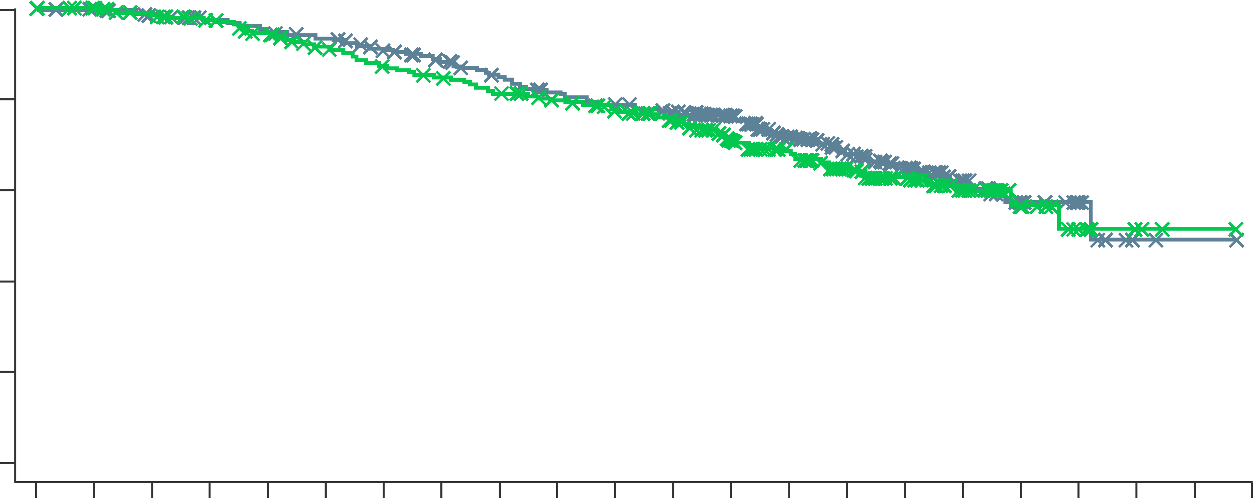
Talapro-2: interim overall survival
OS in the all-comer itt population
 | TALA + ENZA (N=402) | PBO + ENZA (N=403)
Events, n | 123 | 129
Median (95% CI), months | 36.4 (33.5-NR) | NR (33.7-NR)
 | HR 0.89 95% CI, 0.69-1.14; P=0.35
100
Talazoparib + Enzalutamide
80
60
Placebo + Enzalutamide
Overall survival (%)
40
20
0
0
2
4
6
8
10
12
14
16
18
20
22
24
26
28
30
32
34
36
38
40
42
No. at risk (number censored
TALA + ENZA
PBO + ENZA
Months
402
(0)
403
(0)
398
(3)
399 (4)
388
(7)
387
(10)
377
(13)
376
(16)
368
(13)
360
(20)
360
(15)
344
(26)
344
(21)
326
(28)
331
(26)
315
(29)
313
(31)
301
(30)
298
(33)
290
(35)
288
(33)
280
(39)
277
(37)
260
(51)
223
(89)
200
(97)
167
(133)
146
(144)
136
(156)
117
(165)
104
(182)
86
(193)
59
(224)
42
(234)
26
(254)
16
(259)
10
(270)
6
(268)
2
(277)
3
(271)
1
(278)
1
(273)
0
(279)
0
(274)
CI, confidence interval; HR, hazard ratio; ITT, intention-to-treat; OS, overall survival
Agarwal A, et al. Lancet 2023;402: 291-303 (supplementary appendix)

Slide 37
Talapro-2: Most common all-cause teaes
Talazoparib + Enzalutamide (N=398)
Placebo + Enzalutamide (N=401)
In the talazoparib arm:
Most common TEAEs leading to a dose reduction of talazoparib were:
Anaemia (43.2%)
Neutropenia (15.1%)
Thrombocytopenia (5.5%)
49.0% had grade 1-2 anaemia at baseline
Grade 3-4 anaemia
Median time to onset was 3.3 months
Reported in 46.5% of men
8.3% discontinued talazoparib due to anaemia
The median relative dose intensity of talazoparib remained >80%
Anaemia
65.8
17.5
Neutropenia
35.7
1.3
7.0
(0.5/1.0/5.5)
Fatigue
33.7
29.4
Thrombocytopenia
24.6
2.3
3.5
(0.2/0.7/2.5)
Leukopenia
22.1
4.5
Back pain
22.1
18.0
Decreased appetite
Grade 4
Grade 4
Grade 3
21.6
15.7
Grade 3
Nausea
Grade 1-2
20.6
12.5
Grade 1-2
Proportion of patients (%)
TEAEs, treatment emergent adverse events
Agarwal A, et al. J Clin Oncol 41, 2023 (suppl 6; abstr LBA17) (ASCO GU 2023 oral presentation); Agarwal A, et al. Lancet 2023;402: 291-303

Slide 38
Other parpi and anti-androgen combination trials
PARPi, poly (ADP-ribose) polymerase inhibitor

Slide 39
CASPAR: First-line Rucaparib + Enzalutamide in mCRPC
Ongoing, Randomised, open-label, phase 3 trial
Primary endpoint:
rPFS, OS
Key Secondary endpoints:
rPFS and OS by HRR mutation status, ORR, safety, QoL
Correlative endpoints:
Prevalence of germline and somatic HRR mutations; prevalence of AR aberrations pre- and posttherapy; prevalence of HRR reversion mutations posttherapy in PARPi arm; prevalence of “BRCAness” or NEPC transcriptional signature, or SLFN11 expression in tumour-derived exosomes and archival tissue
Rucaparib 600 mg BID +
Enzalutamide 160 mg/day + ADTª
Patient eligibility
Patients with mCRPC and no prior therapy for mCRPC
prior treatment for mHSPC or nmCRPC allowed
no screening for mutated HRR genes required for trial entry
Treat until PD, then long-term follow up
R
1:1
N=984
Enzalutamide 160 mg/day + PBO + ADTª
ClinicalTrials.gov identifier:
NCT04455750
ªOnly patients who did not undergo bilateral orchiectomy will receive ADT
ADT, androgen-deprivation therapy; AR, androgen receptor; BID, twice daily; BRCA, breast cancer gene; EORTC QLQ-C30, European Organisation for Research and Treatment of Cancer Core Quality of Life Questionnaire; HRR, homologous recombination repair; mCRPC, metastatic castration-resistant prostate cancer; mHSPC, metastatic hormone-sensitive prostate cancer; NEPC, neuroendocrine prostate cancer; nmCRPC, nonmetastatic castration-resistant prostate cancer; ORR, overall response rate; OS, overall survival; PARPi, poly-ADP ribose polymerase inhibitor; PBO, placebo; PD, progressive disease; QoL, quality of life; rPFS, radiographic progression-free survival.
CASPAR. ClinicalTrials.gov identifier: NCT04455750. Accessed October 11, 2022. https://clinicaltrials.gov/ct2/show/NCT04455750; Rao A, et al. J Clin Onc 2022; 40: no.6_suppl. TPS194

Slide 40
Select PARPi Combination Trials in mCRPC and mCSPC
Study | Phase | Treatment arms | Patient population
mCRPC
QUEST (NCT03431350) | 1b/2 | Niraparib + cetrelimab (anti-PD1) or AAP | mCRPC (N=140)
BRCAAway (NCT03012321) | 2 | AAP vs olaparib vs olaparib + AAP | mCRPC with DDR (N=70)
mCSPC
NCT04734730 | 2 | Talazoparib + abiraterone acetate+ ADT | mCSPC (N=70)
ZZ First (NCT04332744) | 2 | Talazoparib + enzalutamide +ADT vs enzalutamide +ADT only | Locally advanced or metastatic hormone-naive PC, no prior systemic tx (N=54)
AMPLITUDE (NCT04497844) | 3 | Niraparib plus abiraterone acetate vs Placebo plus abiraterone acetate | mCSPC (N=788) Deleterious germline or somatic HRR gene-mutated
TALAPRO-3 (NCT04821622) | 3 | Talazoparib plus enzalutamide vs Enzalutamide plus placebo | mCSPC (N=550) DDR gene-mutated
AAP, abiraterone acetate plus prednisone; ADT, androgen-deprivation therapy; DDR, DNA damage repair; HRR, homologous recombination repair; mCRPC, metastatic castration-resistant prostate cancer; mCSPC, metastatic castration-sensitive prostate cancer; PARPi, PARP inhibitor; PC, prostate cancer; tx, treatment
www.clinicaltrials.gov

Slide 41
Implementing parpi combination treatment in clinical practice
PARPi, poly (ADP-ribose) polymerase inhibitor

Slide 42
PARP inhibitors are approved in prostate cancer
Olaparib FDA-approved indication¹
Indicated as monotherapy for the treatment of adult patients with mCRPC and HRRm, who have progressed on enzalutamide or abiraterone acetate
In combination with abiraterone and prednisone or prednisolone for the treatment of adult patients with BRCAm mCRPC
Olaparib EMA-approved indication²
Indicated as monotherapy for the treatment of adult patients with mCRPC and a BRCAm, who have progressed on prior therapy, including an NHA
In combination with abiraterone and prednisone or prednisolone for the treatment of adult patients with mCRPC in whom chemotherapy is not clinically indicated
Niraparib FDA-approved indication³
Indicated as a fixed-dose combination of niraparib/abiraterone acetate with prednisone for the treatment of adult patients with BRCAm mCRPC
Niraparib EMA-approved indication⁴
Indicated as a fixed-dose combination of niraparib/abiraterone acetate with prednisone or prednisolone for the treatment of adult patients with mCRPC and BRCA1/2 gene mutations (germline and/or somatic) in whom chemotherapy is not clinically indicated
Rucaparib FDA-approved indication⁵
Indicated as monotherapy for the treatment of adult patients with BRCAm mCRPC who have progressed on AR-directed therapy and a taxaneª
ªRucaparib has no current approval in prostate cancer in Europe
Talazoparib FDA-approved indication⁶
In combination with enzalutamide for the treatment of adult patients with HRRm mCRPC^{b}
^{b}Talazoparib has no current approval in prostate cancer in Europe
AR, androgen receptor; BRCAm, breast cancer gene mutation; EMA, European Medicines Agency; FDA, US Food and Drug Administration; HRRm, homologous recombination repair mutation; LHRH, luteinising hormone-releasing hormone; mCRPC, metastatic castration-resistant prostate cancer; NHA, new hormonal agent; PARP, poly-ADP ribose polymerase
1. Lynparza (olaparib) US prescribing information (Sep-2023); 2. Lynparza (olaparib) summary of product characteristics (Mar 2023); 3. FDA approves niraparib and abiraterone acetate plus prednisone for BRCA-mutated metastatic castration-resistant prostate cancer | FDA; 4. https://www.esmo.org/oncology-news/ema-recommends-granting-a-marketing-authorisation-for-akeega-fixed-dose-combinations-of-niraparib-abiraterone-acetate; 5. Rubraca (rucaparib) US prescribing information (Jun 2022); 6. Talzenna (talazoparib) summary of product characteristics (Jun 2023)

Slide 43
There are multiple trials investigating the use of PARP inhibitors in prostate cancer¹⁻¹¹
Primary
Adjuvant
Biochemical Recurrence (BCR)
mHSPC
(incl de novo)
1L mCRPC
2L mCRPC
3L mCRPC
nmCRPC
PROpel¹
P3 Olaparib + abi vs abi
Primary endpoint: rPFS unselected pts
PROfound²*
P3 Olaparib vs abi/enza, HRRm, post-NHA Primary endpoint: rPFS BRCA/ATMm
TALAPRO-3³
P3 Talazoparib + enza
Primary endpoint: rPFS HRRm
TALAPRO-2⁴
P3 Talazoparib + enza vs. enza
Primary endpoint: rPFS unselected pts/HRRm
TALAPRO-1⁵
P2 Talazoparib
HRRm
Post-NHA, post-taxane
Primary endpoint: ORR HRRm
AMPLITUDE⁶
P3 Niraparib + abi
Primary endpoint: rPFS HRRm
MAGNITUDE⁷
P3 Niraparib + abi vs abi
Primary endpoint: rPFS BRCAm/HRRm
GALAHAD⁸
P2 Niraparib, HRRm
Post-NHA, post-taxane
Primary endpoint: ORR BRCAm
Prostate Specific Antigen
TRITON-3⁹
P3 Rucaparib vs abi/enza/docetaxel BRCAm / ATM, post-NHA
TRITON-2¹⁰ P2 Rucaparib HRRm/BRCAm†
Post-NHA, post-taxane
Primary endpoint: ORR and PSA HRRm
Met
CASPAR¹¹
P3 Rucaparib + enza vs. enza Primary endpoint rPFS & OS
Unselected patients
Time
Non-metastatic
Metastatic
Hormone-sensitive
Castration-resistant
Asymptomatic
Symptomatic
Please see slide notes for references. ª As a result of the data from PROfound, olaparib monotherapy was approved for treatment of mCRPC in patients with HRR mutations (FDA approval) or for patients with mutations in only BRCA1/2 (EMA approval) after progression on a NHA ^{b} As a result of the data from TRITON2, rucaparib monotherapy was approved by the FDA only for the treatment of mCRPC in patients with a BRCA1/2m who have disease progression after treatment with prior AR-directed therapy and prior taxane
Abi, abiraterone; BCR, biochemical recurrence; Enza, enzalutamide; FDA, US Food and Drug Administration; HRR, homologous recombination repair; mCRPC, metastatic castration-resistant prostate cancer; mHSPC, metastatic hormone-sensitive prostate cancer; NHA, new hormonal agent; nmCRPC, non-metastatic castration-resistant prostate cancer; Ola, olaparib; P, phase; PSA, prostate-specific antigen
Notes:
References:
1. Study NCT03732820. Available at ClinicalTrials.gov; 2. Study NCT02987543. Available at ClinicalTrials.gov; 3. Study NCT04821622. Available at ClinicalTrials.gov; 4. Study NCT03395197. Available at ClinicalTrials.gov; 5. Study NCT03148795. Available at ClinicalTrials.gov; 6. Study NCT04497844. Available at ClinicalTrials.gov; 7. Study NCT03748641. Available at ClinicalTrials.gov; 8. Study NCT02854436. Available at ClinicalTrials.gov; 9. Study NCT02975934. Available at ClinicalTrials.gov; 10. Study NCT02952534. Available at ClinicalTrials.gov; 11. Study NCT04455750. Available at ClinicalTrials.gov

Slide 44
Available PARP inhibitors and their current tumour indications
 | Olaparib | Rucaparib | Niraparib | Talazoparib
Single-agent dose (approved for olaparib, rucaparib, niraparib, and talazoparib) | 300 mg BID | 600 mg BID | 200/300^{d} mg QD | 1 mg QD
Tumour indications | Ovarian cancer, breast cancer, pancreatic cancer, prostate cancer^{1,2,a,b} | Ovarian cancer,^{3,4} prostate cancer^{4,c} | Ovarian cancer,^{5,6} prostate cancer^{7,8,e} | Breast cancer, prostate cancer^{9,10,f}
ª Olaparib is FDA-approved for the treatment of adult patients with deleterious or suspected deleterious germline or somatic HRR mutation-positive mCRPC who have progressed following prior treatment with enzalutamide or abiraterone; and in combination with abiraterone and prednisone/prednisolone for the treatment of adult patients with BRCAm mCRPC¹ ^{b} Olaparib is EMA-approved as monotherapy for the treatment of adult patients with mCRPC and BRCA1/2 mutations (germline and/or somatic) who have progressed following prior therapy that included an NHA and is approved by the EMA in combination with abiraterone and prednisone or prednisolone for the treatment of adult patients with mCRPC in whom chemotherapy is not clinically indicated² ^{c} Rucaparib is FDA-approved for the treatment of adult patients with a deleterious BRCA mutation-associated mCRPC who have been treated with AR-directed therapy and a taxane-based chemotherapy (no current approval in prostate cancer in Europe)⁴
^{d} Niraparib FDA-approved dose is 300 mg QD and EMA approved dose is either 200 or 300 mg QD depending on weight and other factors.
^{e}Approved as a fixed dose combination of niraparib/abiraterone acetate with prednisone by the FDA for: the treatment of adult patients with deleterious or suspected deleterious BRCAmutated (BRCAm) metastatic castration-resistant prostate cancer; and by the EMA for the treatment of adult patients with mCRPC and BRCA1/2 gene mutations (germline and/or somatic) in whom chemotherapy is not clinically indicated
^{f} Talazoparib is approved by the FDA in combination with enzalutamide for the treatment of adult patients with HRRm mCRPC (no current approval in prostate cancer in Europe)
AR, androgen receptor; BID, twice daily; CHMP, Committee for Medicinal Products for Human Use; EMA, European Medicines Agency; QD, once daily; EMA, European Medicines Agency; FDA, Food and Drug Administration; HRR, homologous recombination repair; mCRPC, metastatic castration-resistant prostate cancer; NHA, new hormonal agent; PARP, poly-ADP ribose polymerase
1. Olaparib PI; 2. Olaparib SmPC; 3. Rucaparib SmPC; 4. Rucaparib PI; 5. Niraparib PI; 6. Niraparib SmPC; 7. Akeega PI; 8. Akeega SmPC; 9. Talazoparib SmPC; 10. Talazoparib PI. All accessed November 2023.

Slide 45
Conclusions
Combination treatments of NHAs and PARPi may provide combination benefit in mCRPC patients
Combinations appear effective in HRR selected patients and may be effective in all-comer populations
In first line mCRPC, treatment with:
olaparib and abiraterone is associated with longer rPFS than abiraterone alone. This occurred in patients with and without HRR mutations
talazoparib and enzaluamide is associated with longer rPFS than enzalutamide alone. This occurred in patients with and without HRR mutations
niraparib and abiraterone is also associated with longer rPFS than abiraterone alone. This occurred in patients with HRR mutations only
Ongoing trials will demonstrate whether other PARPi/NHA combinations will benefit patients with advanced prostate cancer
Genetic testing is important to help with treatment decision making and for understanding inherited risk
HRR, homologous recombination repair; mCRPC, metastatic castration resistant prostate cancer; NHA, novel hormonal agents; OS, overall survival; PARPi, poly-ADP ribose polymerase inhibitors; rPFS, radiographic progression-free survival

Slide 46
REACH GU CONNECT VIA TWITTER, LINKEDIN, VIMEO & EMAIL OR VISIT THE GROUP’S WEBSITE https://cor2ed.com/ connects/gu-connect/
Follow us on Twitter @guconnectinfo
Follow the GU CONNECT group on LinkedIn
Watch us on the Vimeo Channel GU CONNECT
Email info@cor2ed.com

