Slide 2
Virtual experts knowledge share
Optimising the management of multiple myeloma in the early relapsed/refractory setting
Thursday 30th May 2024

Slide 3

Developed by lymphoma & myeloma COnnect
This programme is developed by LYMPHOMA & MYELOMA CONNECT,
an international group of experts in the field of hematological malignancies.
Acknowledgement and disclosures
This LYMPHOMA & MYELOMA CONNECT programme is supported through an independent educational grant from Menarini Stemline Oncology. The programme is therefore independent, the content is not influenced by the supporter and is under the sole responsibility of the experts.
Please note: The views expressed within this programme are the personal opinions of the experts. They do not necessarily represent the views of the experts’ institutions, or the rest of the LYMPHOMA & MYELOMA CONNECT group.
Expert disclaimers:
Assoc. Prof. Karthik Ramasamy, has received financial support/sponsorship for research support, consultation, or speaker fees from the following companies: AbbVie, Adaptive Biotechnologies, Amgen, Celgene (BMS), EUSA Pharma, GSK, Janssen, Karyopharm, Oncopeptides, Pfizer, Sanofi, Takeda, Menarini Stemline and Takedax
Prof. Aurore Perrot, has received financial support/sponsorship for research support, consultation, or speaker fees from the following companies: Abbvie, Amgen, BMS, GSK, Janssen, Menarini Stemline, Pfizer, Sanofi and Takeda
Prof. Hermann Einsele, has received financial support/sponsorship for research support, consultation, or speaker fees from the following companies: BMS/Celgene, Janssen, Amgen, Takeda, Sanofi, GSK, Novartis and Roche
Assoc. Prof. Joshua Richter, has received financial support/sponsorship for research support, consultation, or speaker fees from the following companies: Janssen, BMS, Pfizer, Karyopharm, Sanofi, Takeda, Genentech, Abbvie, Regeneron, Forus, Menarini, Adaptive Technologies

Slide 4



Meeting objectives
To educate learners on how to incorporate the latest scientific and clinical insights on the treatment of MM into clinical practice, focusing on the relapsed/refractory setting:
Knowing the MoA and how this translates into the efficacy profile of novel drugs
Learning from best practices on treatment sequencing, treatment combinations and dosing
Knowing the safety profiles of novel drugs and understanding the best strategies to prevent or manage side effects

Slide 5
Agenda
Optimising the management of multiple myeloma in the early relapsed/refractory setting
Timings | Topic | Facilitator
5 mins | Welcome, introductions and scene setting: Challenge of optimising treatment for early RRMM in the era of multiple novel therapies | Karthik Ramasamy
15 mins | Current treatments for early RRMM*: Linking mechanism of action and efficacy | Aurore Perrot
15 mins | Best practices in combining and sequencing therapies for optimal outcomes | Hermann Einsele
15 mins | Insights from clinical practice on how to manage tolerability and safety | Joshua Richter
20 mins | Patient case study presentation and discussion | All
15 mins | Q&A discussion | Facilitated by Joshua Richter
5 mins | Summary & a look to the future | Joshua Richter
RRMM, Relapsed refractory multiple myeloma
*After 1-3 prior lines of therapy

Slide 6


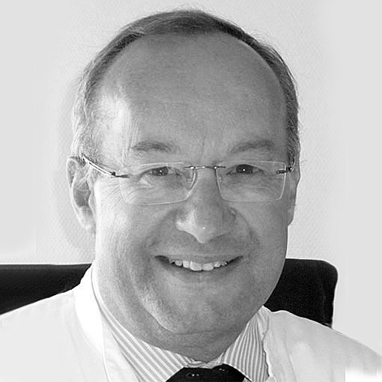

Introducing the scientific committee
Assoc. Prof. Karthik Ramasamy
Hematologist-Oncologist
Oxford University Hospitals
NHS Trust, UK
Prof. Aurore Perrot
Hematologist
University of Toulouse,
France
Prof. Hermann Einsele
Hematologist-Oncologist
University of Würzburg, Germany
Assoc. Prof. Joshua Richter
Hematologist-Oncologist
Icahn School of Medicine at Mount Sinai, USA

Slide 7
Challenge of optimising treatment for early RRMM in the era of multiple novel therapies
Assoc. Prof. Karthik Ramasamy
Hematologist-Oncologist
Oxford University Hospitals NHS Trust, UK

Slide 8
Development of multiple, genetically distinct subclones in Multiple myeloma
Subclones develop over time due to selective pressures from the microenvironment and treatment^{1,2}
Clonal evolution can lead to disease progression and treatment resistance³
Diagnosis
Relapse
Minor
clone
Ancestral
clones
Linear
Dominant
clone
Tumour
initiating cell
Stable
Subclones with unique
nonlinear branching mutations
Subclones with linearly
derived mutations
Adapted from Bahlis NJ, et al. 2012¹
Genetically
distinct
1. Bahlis NJ. Blood. 2012;120:927-928; 2. Bolli N, et al. Nat Commun. 2014;5:2997; 3. Brioli N, et al. Br J Haematol. 2014;165:441-454

Slide 9
prevalence of early refractoriness is growing
Real-world assessment of refractoriness patterns in 413 patients
treated in an Italian haematological tertiary care centre
Refractoriness after two lines of therapy
Refractoriness after three lines of therapy
<2019
≥2019
≥2021
<2019
≥2019
≥2021
Lenalidomide
Daratumumab
Lenalidomide + daratumumab
Double-refractory
Triple-refractory
Quad-refractory
Penta-refractory
Morè S, et al. Br J Haematol. 2023; 201:432-442

Slide 10
Challenges in selecting treatments at relapse: adverse events by line of therapy
Patient chart reviewª: All-grade comorbidities and toxicities
by most recently completed line of therapy
First line
n=1,802
Second line
n=1,380
Third line
n=1,329
Fourth line
n=354
Fifth line
n=132
60
40
Patients (%)
20
0
Peripheral
neuropathy
Anaemia
Neutropenia
Thrombo-
cytopenia
URI
Deep vein
thrombosis
Myalgia
Cardiac
dysfunction
None
The proportion of patients with toxicities or comorbidities tended to increase with line of therapy.
Both are more likely to affect planned treatment in later vs earlier lines
ª Retrospective and cross-sectional review of 4,997 patient charts (1L: n=1,802; 2L: n=1,380; ≥3L: n=1,815) in Belgium, Germany, Italy, Spain, Switzerland, and UK
1L, first line; 2L, second line; 3L, third line; URI, upper respiratory infection
Yong K, et al. Br J Haematol. 2016;175:252-264

Slide 11
Health-related quality of life decreased significantly with treatment line
Mean EORTC QLQ-C30 global health status scores decreased from 63.0 at first line to 59.7 at second line, 52.6 at third line, 53.6 at fourth line or later, and 32.8 for patients receiving supportive care
P<0.0001 for the effect of line on scores
100
80
60
EORTC QLQ-C30
(global health status score)
40
20
0
First line
Second line
Third line
Fourth line
or later
Supportive care
 | Difference between second and first line | Difference between third and second line | Difference between fourth line or later and third line | Difference between supportive care and fourth line or later
Mean difference in global health status score | -3.3 | -7.1 | 1.0 | -20.8
Observation, cross-sectional, multicentre study conducted in France. Data presented are means, first quartiles, third quartiles, and minimums and maximums. Open circles denote extreme values. Higher scores for EORTC QLQ-C30 Global Health Status score indicate higher quality of life
EORTC, European Organisation for Research and Treatment of Cancer; QLQ-C30, Core Quality of Life questionnaire
Despiégel N, et al. Clin Lymphoma Myeloma Leuk. 2019;19:e13-e28
Notes:
French data : EORTC QLQ-C30 Global Health Status Scores. Data Presented are Means, First Quartiles, Third Quartiles, and Minimums andMaximums. Open Circles Denote Extreme Values. Higher Scores for EORTC QLQ-C30 Global Health Status Score IndicatedHigher Quality of Life. Excluding Supportive Care, Effect of Line on QLQ-C30 Global Health Status Score WasP[.0005 byANOVA

Slide 12
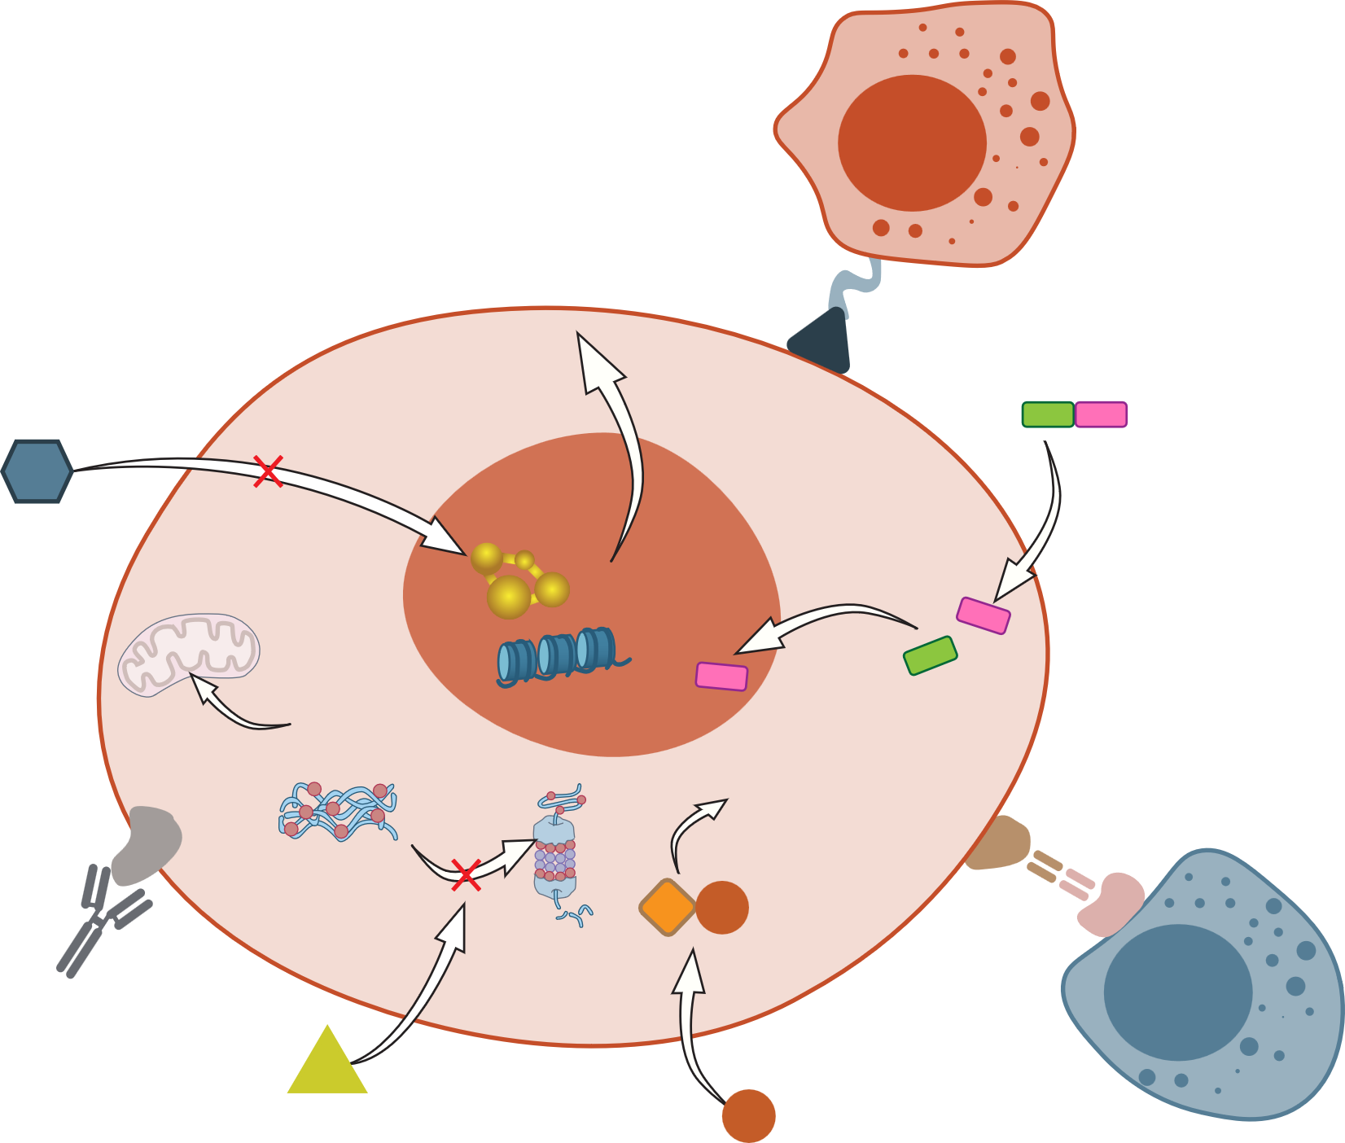
Multiple drug classes are approved for the treatment of RRmm
CAR-T
CAR-T
cell
Peptide-drug conjugate
HDAC inhibitor
XPO1
inhibitor
p53
Nucleus
Myeloma cell
Histones
Degradation of
transcription factors
and cell death
Ubiquitinated
protein aggregates
CRBN
BiTE
Monoclonal antibody
Protein
degradation
T cell
PI inhibitor
IMiD
Figure adapted from Dimopoulos et al.
BiTE, bispecific T-cell engager; CAR T, chimeric antigen receptor T cell; HDAC, histone deacetylase; IMiD, immunomodulatory drug; PI, proteasome inhibitor; RRMM, relapsed/refractory multiple myeloma; SLAMF7, signalling lymphocyte activation molecule family 7; XPO1, exportin 1
Dimopoulos M-A, et al. Clin Lymphoma Myeloma Leuk. 2022;22:460-473.

Slide 13
Considerations for treatment decisions
Patient
Disease
Age
Comorbidities
Performance status
Bone marrow reserve
Preference
Duration of prior remission
Disease burden
End-organ function
Standard vs high risk disease
Considerations for treatment decisions^{1–4}
Therapy
Socio-economic
€
Response to prior therapy
Toxicity of prior therapy
Time from prior therapy
Clinical trials available
Support system
Treatment centre accessibility
.
RRMM, relapsed/refractory multiple myeloma
1. Nijhof IS, et al. Drugs 2018;78:19-37; 2. Orlowski RZ, et al. Clin Cancer Res. 2016;22:5443-5452; 3. Baz R, et al. Support Care Cancer. 2015;23:2789-2797;
4. Goodwin JA, et al. Cancer Nurs. 2013;36:301-308

Slide 14

Case study: Patient profile
Age 71 years, retired
ECOG PS: 1
PMH: Hypertension, paroxysmal atrial fibrillation
Presented with bone pain
and fatigue
Diagnosis: June 2021
IgG kappa multiple myeloma
Hb:117 g/L, normal renal function
Vertebral collapse
MM FISH – 1p deletion
R-ISS I standard risk
Educational case study
ECOG, Eastern Cooperative Oncology Group; FISH, fluorescence in situ hybridisation; Hb: haemoglobin; IgG: immunoglobulin; MM, multiple myeloma; PMH, previous medical history;
PS, performance status; R-ISS, revised International Staging System

Slide 15

Case study: Treatment
June 2021
Front-line treatment: Dara VTd – VGPR grade 1 neuropathy
HDM ASCT – complete remission. Dara VTd consolidation
Lenalidomide maintenance
Biochemical progression on lenalidomide: Further treatment?
November 2021
March 2022
March 2024
Educational case study
ASCT, autologous stem cell transplant; Dara, daratumumab; HDM, high-dose melphalan; VTd, bortezomib, thalidomide, dexamethasone; VGPR, very good partial response

Slide 16
POLLING QUESTION
WHAT treatment would you choose at 2nd line
Daratumumab, bortezomib, dexamethasone
Daratumumab/isatuximab, carfilzomib, dexamethasone
Daratumumab, pomalidomide, dexamethasone
Selinexor, bortezomib, dexamethasone
Pomalidomide, bortezomib, dexamethasone
Carfilzomib, dexamethasone

Slide 17

Current treatments for early RRMM: Linking mechanism of action and efficacy
Prof. Aurore Perrot
Hematologist
University of Toulouse, France

Slide 18
Drugs approved for the treatment of RRmm
Drugs approved by the EMA for the treatment of
early RRMM (1-3 prior therapies)²
CAR-T
Ciltacabtagene autoleucelª
Idecabtagene vicleucel^{b}
CAR-T
cell
Peptide-drug conjugate
Melphalan flufenamide
HDAC inhibitor
Panobinostat
XPO1 inhibitor
Selinexor
p53
Nucleus
Myeloma cell
Histones
Degradation of
transcription factors
and cell death
Ubiquitinated
protein aggregates
CRBN
Elranatamab
Talquetamab
Teclistamab
Protein
degradation
BiTE
Elranatamab
Talquetamab
Teclistamab
Monoclonal antibody
Daratumumab (anti-CD38)
Elotuzumab (anti-SLAMF7)
Isatuximab (anti-CD38)
T cell
PI inhibitor
Bortezomib
Carfilzomib
Ixazomib
IMiD
Lenalidomide
Pomalidomide
Thalidomide
Figure adapted from Dimopoulos et al.¹
ª Ciltacabtagene autoleucel has received a positive opinion from the CHMP to expand the indication to patients who have received ≥1 prior therapy.^{3 b} Idecabtagene vicleucel is approved for the treatment of patients who have received ≥2 prior therapies
BiTE, bispecific T-cell engager; CAR T, chimeric antigen receptor T cell; CHMP, Committee for Medicinal Products for Human Use; EMA, European Medicines Agency; HDAC, histone deacetylase; IMiD, immunomodulatory drug; PI, proteasome inhibitor; RRMM, relapsed/refractory multiple myeloma; SLAMF7, signalling lymphocyte activation molecule family 7; XPO1, exportin 1
1. Dimopoulos M-A, et al. Clin Lymphoma Myeloma Leuk. 2022;22:460-473; 2. Summary of Product Characteristics are available from: https://www.ema.europa.eu/en/medicines. Last accessed 4 April 2024. 3. https://www.ema.europa.eu/en/medicines/human/variation/carvykti

Slide 19
Pis disrupt the unfolded protein response pathway and induce apoptosis
Ubiquitin depletion
1
Regulatory
domain
↑ER stress due to ↑misfolded proteins
2
α
BORTEZOMIB
Catalytic
domain
𝝱1
𝝱2
𝝱5
𝝱1
𝝱5
CARFILZOMIB
𝝱2
NFκB downregulation
α
IXAZOMIB
3
Regulatory
domain
Activation of pro-apoptotic pathways
4
ER, endoplasmic reticulum; NFκB, nuclear factor kappa B; PI, proteasome inhibitor
Kegyes D, et al. Blood Rev. 2023;61:101100

Slide 20
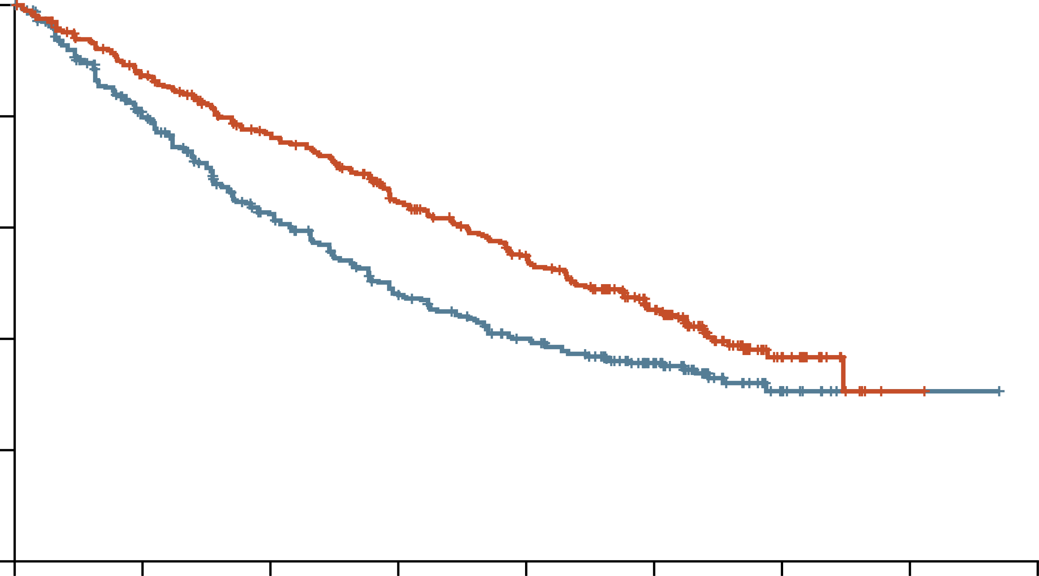
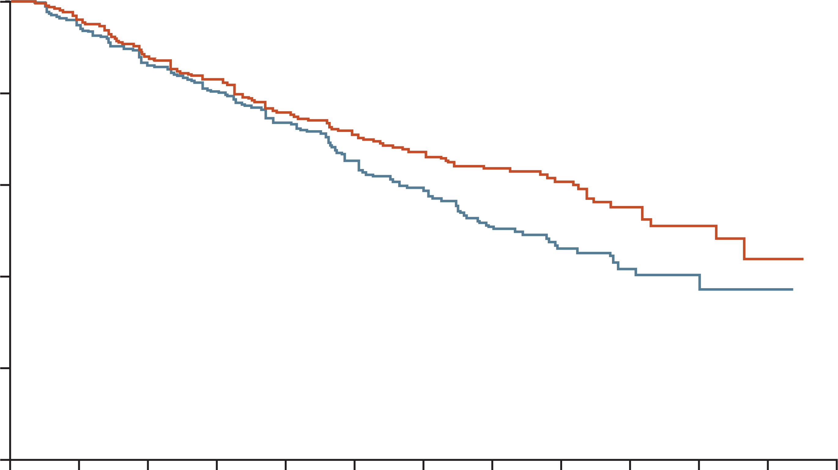
CARFILZOMIB and Ixazomib increased PFS in patients with rrmm and 1-3 prior treatments
ASPIRE: Carfilzomib¹
TOURMALINE-MM1: Ixazomib²
1.0
100
0.8
80
IRd mPFS: 20.6 months
0.6
60
Proportion of patients with PFS
KRd mPFS: 26.3 months
Progression-free survival (%)
0.4
40
Rd mPFS: 17.6 months
Rd mPFS: 14.7 months
0.2
HR (95% CI) for KRd vs Rd:
0.69 (0.57, 0.83); p=0.0001
20
HR (95% CI) for IRd vs Rd:
0.74 (0.59, 0.94); p=0.01
0.0
0
0
6
12
18
24
30
36
42
48
0
2
4
6
8
10
12
14
16
18
20
22
24
No. at risk
KRd:
Rd:
Months since randomisation
No. at risk
IRd:
Rd:
Months since randomisation
396
396
332
287
279
206
222
151
179
117
112
72
24
18
1
1
360
362
332
325
298
288
270
254
233
218
206
188
145
130
111
85
72
58
44
31
26
15
9
3
0
0
CI, confidence interval; d, dexamethasone; HR, hazard ratio; I, ixazomib; K, carfilzomib; (m)PFS; (median) progression-free survival; R, lenalidomide; RRMM, relapsed/refractory multiple myeloma
1. Stewart AK, et al. New Engl J Med. 2015;372:142-152; 2. Moreau P, et al. New Engl J Med. 2016;374:1621-1634

Slide 21
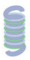
IMiDs bind to crbn and exert pleiotropic effects
CUL4
DDB1
RBX1
CRBN
E2
IKZF1/3
IRF4
MYC
IMiDs
Ub
IKZF1/3
IKZF1/3
Proteasome
Multiple myeloma growth
inhibition
Substrate
degradation
Adapted from Wang S, et al. (2021)¹ and Krönke J, et al. (2014)²
IMiDs hijack the CRL4 E3 ligase via CBRN to ubiquitinate and degrade the lymphoid transcription factors, IKZF1 and IKZF3
This results in the downregulation of IRF4 and MYC and the inhibition of MM cell proliferation
CRBN, cereblon; CRL4, Cullin–RING ubiquitin ligase complex 4; CUL4, cullin-4; DDB1, DNA damage-binding protein 1; E2, ubiquitin-conjugating enzymes; IKZF1 and 3, IKAROS family zinc finger 1 and 3; IMiD, immunomodulatory drug; IRF4, interferon regulatory factor 4; RBX1, small RING protein; Ub, ubiquitin
1. Wang S, et al. Biomarker Res. 2021;9:43; 2. Krönke J, et al. Oncoimmunology. 2014;3(7):e941742

Slide 22
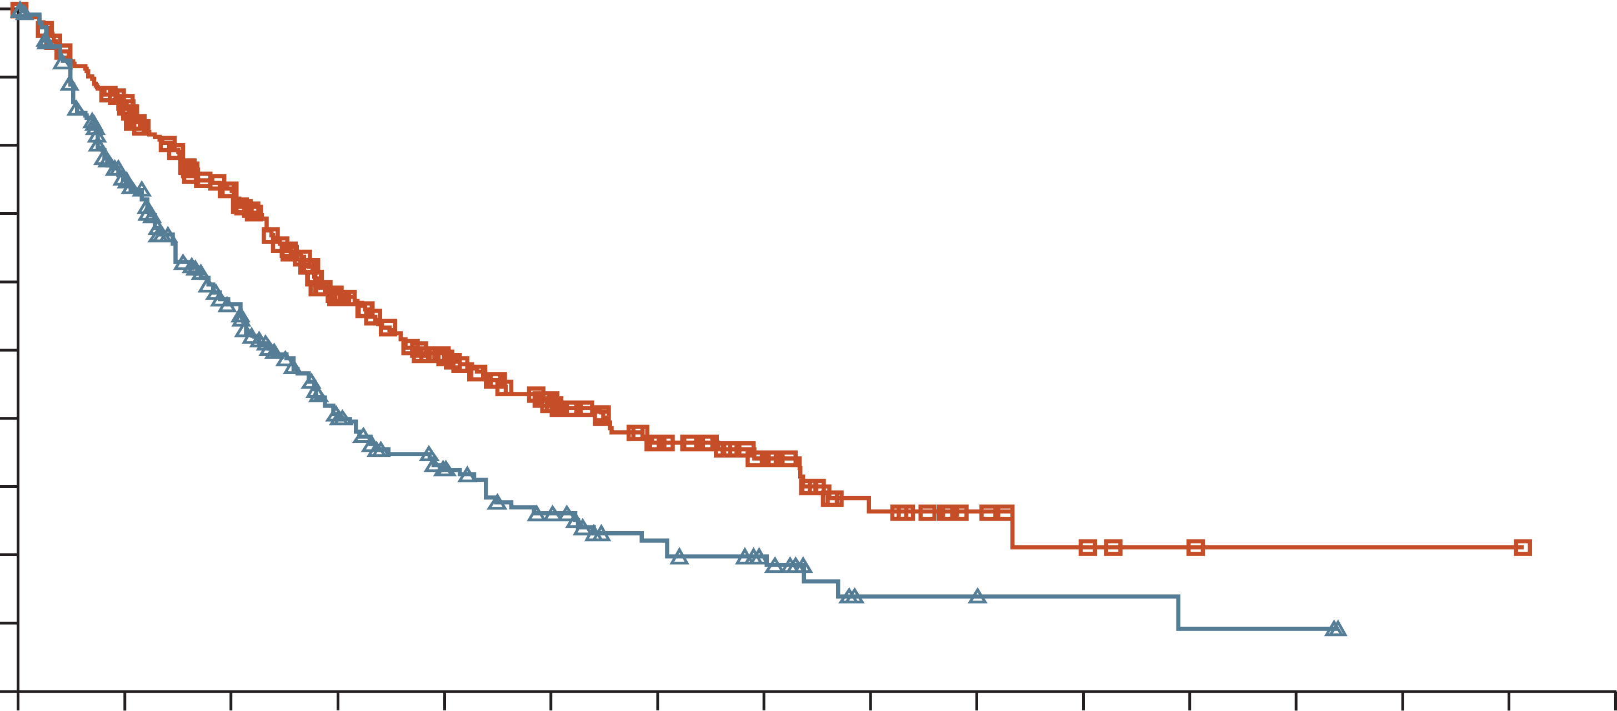
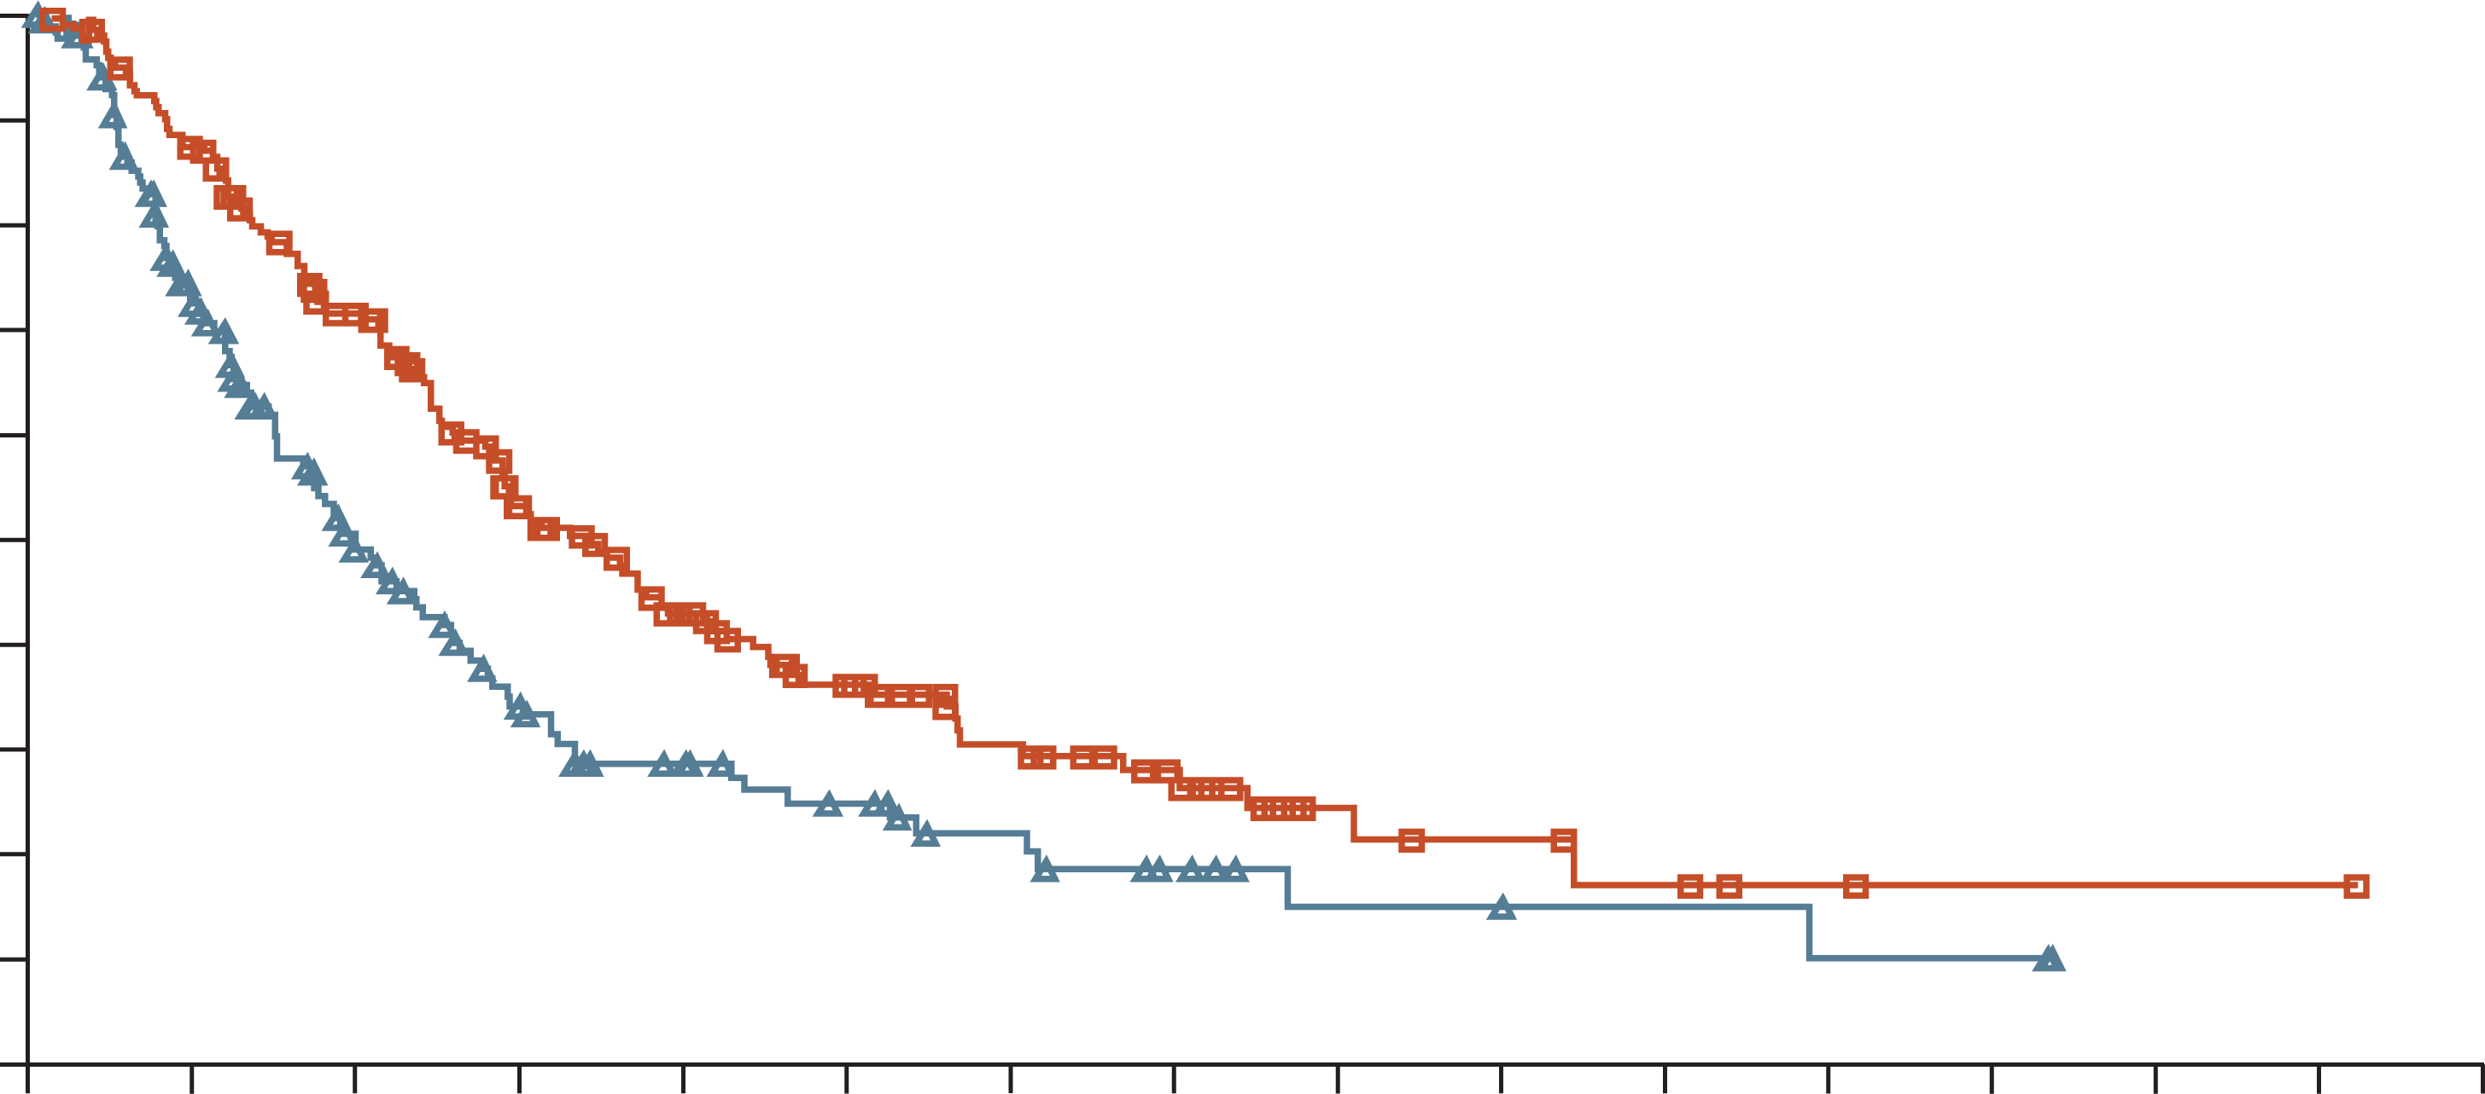
OptimisMM: Pomalidomide increased PFS in patients with rrmm previously treated with lenalidomide
ITT population
Lenalidomide-refractory patients
100
100
90
90
80
80
70
70
60
60
Progression-free survival (%)
PVd mPFS: 11.2 months
Progression-free survival (%)
50
50
40
40
PVd mPFS: 9.5 months
30
30
20
Vd mPFS: 7.1 months
20
10
10
Vd mPFS: 5.6 months
0
0
0
3
6
9
12
15
18
21
24
27
30
33
36
39
42
45
0
3
6
9
12
15
18
21
24
27
30
33
36
39
42
45
Number at risk
PVd
Vd
Time since randomisation (months)
Number at risk
PVd
Vd
Time since randomisation (months)
281
278
233
176
182
112
128
66
94
42
67
30
47
20
28
14
13
4
7
4
4
3
2
2
1
2
1
0
1
0
0
0
200
191
162
113
119
63
77
37
54
25
37
19
25
13
16
8
7
4
6
4
4
3
2
2
1
2
1
0
1
0
0
0
HR (95% CI) for PVd vs Vd:
0.61 (0.49, 0.77); p<0.0001
HR (95% CI) for PVd vs Vd:
0.65 (0.50, 0.84); p=0.0008
All patients had received 1-3 prior therapies including lenalidomide
CI, confidence interval; d, dexamethasone; HR, hazard ratio; ITT, intent to treat; (m)PFS, (median) progression-free survival; P, pomalidomide; RRMM, relapsed/refractory multiple myeloma; V, bortezomib
Richardson PG, et al. Lancet Oncol. 2019;20:781-794

Slide 23
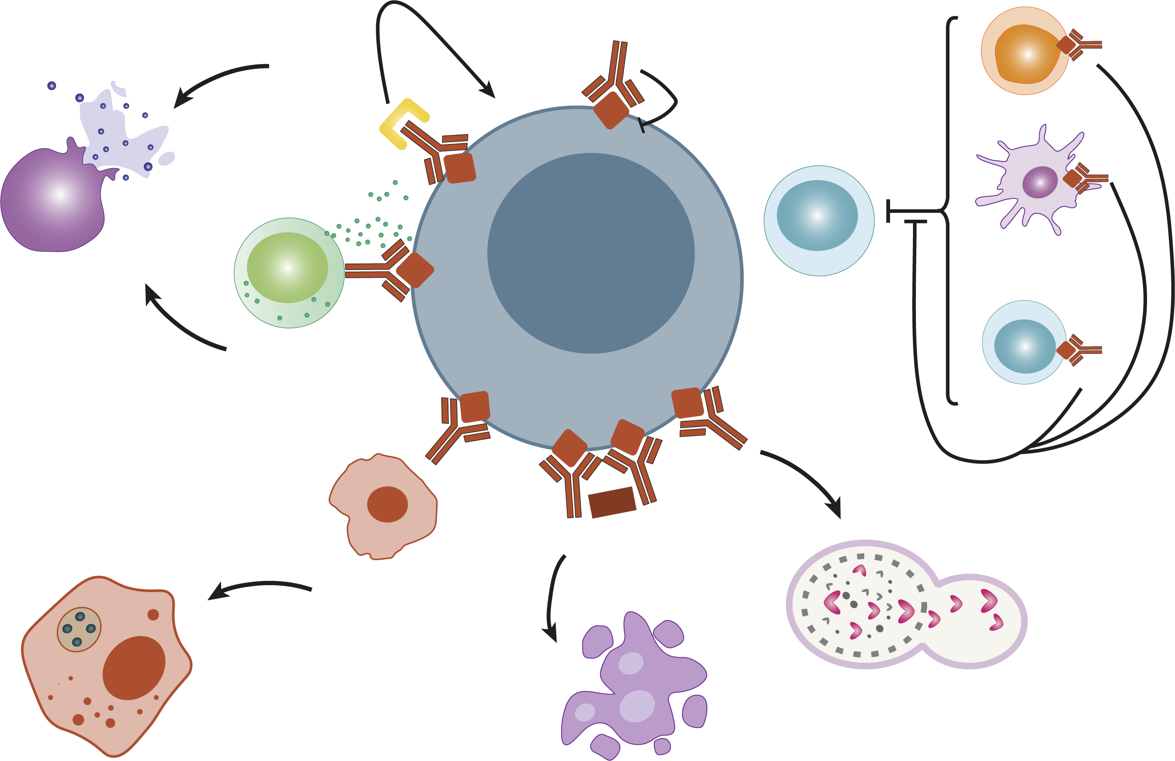
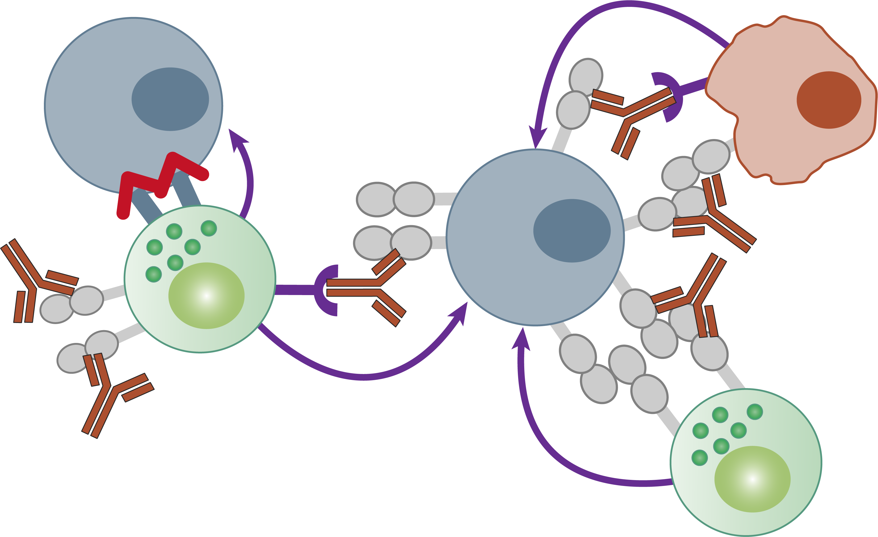

mAbs targeting cd38 and slamf7 induce myeloma cell death via cytotoxic and phagocytic pathways
CD38¹
SLAMF7²
MAC
Myeloma cell
ADCP
Macrophage
CDC
Cytotoxic T cells
Natural
cytotoxicity
NK cells
Lysis
Myeloma cell
Immunomodulation
ADCC
T reg cells
Crosslinking
NK cell
ADCP
NK cell
ADCC
Autophagy
Natural
cytotoxicity
Phagocytosis
Apoptosis
Anti-CD38 (daratumumab
or isatuximab)
Ligands
for
NKp46
Primary
signalling
(ITAM)
Co-stimulation
(ITSM)
CD38
Elotuzumab
SLAMF7
CD16
NKp46
ADCC, antibody-dependent cell-mediated cytotoxicity; ADCP, antibody-dependent cellular phagocytosis; CDC, complement-dependent cytotoxicity;
ITAM, immunoreceptor tyrosine-based activation motifs; ITSM, immunoreceptor tyrosine-based switch motifs; mAb, monoclonal antibody; MAC, membrane attack complex; NK, natural killer; SLAMF7, signalling lymphocyte activation molecule family member 7
1. Gozzetti A, et al. Hum Vaccin Immunother. 2022;18:2052658; 2. Campbell KS, et al. Front Immunol. 2018;9:2551

Slide 24
mAbs targeting cd38 and slamf7 induce myeloma cell death via cytotoxic and phagocytic pathways
CD38¹
SLAMF7²
MAC
Myeloma cell
ADCP
Macrophage
CDC
Cytotoxic T cells
Natural
cytotoxicity
NK cells
Lysis
Myeloma cell
Immunomodulation
ADCC
T reg cells
Crosslinking
NK cell
ADCP
NK cell
ADCC
Autophagy
Natural
cytotoxicity
Phagocytosis
Apoptosis
Anti-CD38 (daratumumab
or isatuximab)
Ligands
for
NKp46
Primary
signalling
(ITAM)
Co-stimulation
(ITSM)
CD38
Elotuzumab
SLAMF7
CD16
NKp46
ADCC, antibody-dependent cell-mediated cytotoxicity; ADCP, antibody-dependent cellular phagocytosis; CDC, complement-dependent cytotoxicity;
ITAM, immunoreceptor tyrosine-based activation motifs; ITSM, immunoreceptor tyrosine-based switch motifs; mAb, monoclonal antibody; MAC, membrane attack complex; NK, natural killer; SLAMF7, signalling lymphocyte activation molecule family member 7
1. Gozzetti A, et al. Hum Vaccin Immunother. 2022;18:2052658; 2. Campbell KS, et al. Front Immunol. 2018;9:2551

Slide 25
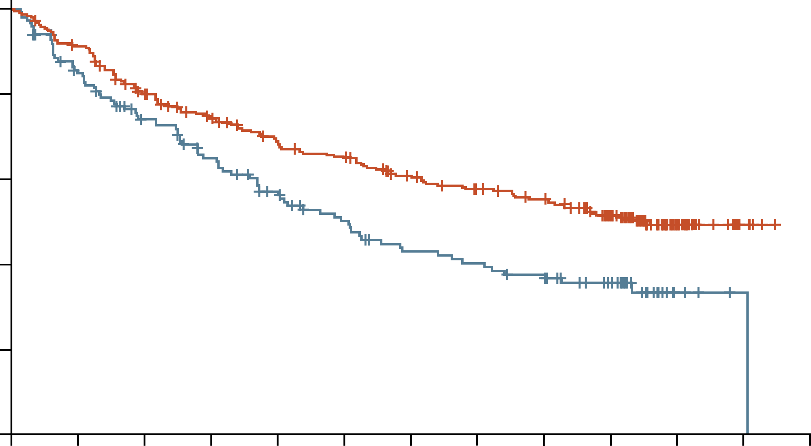
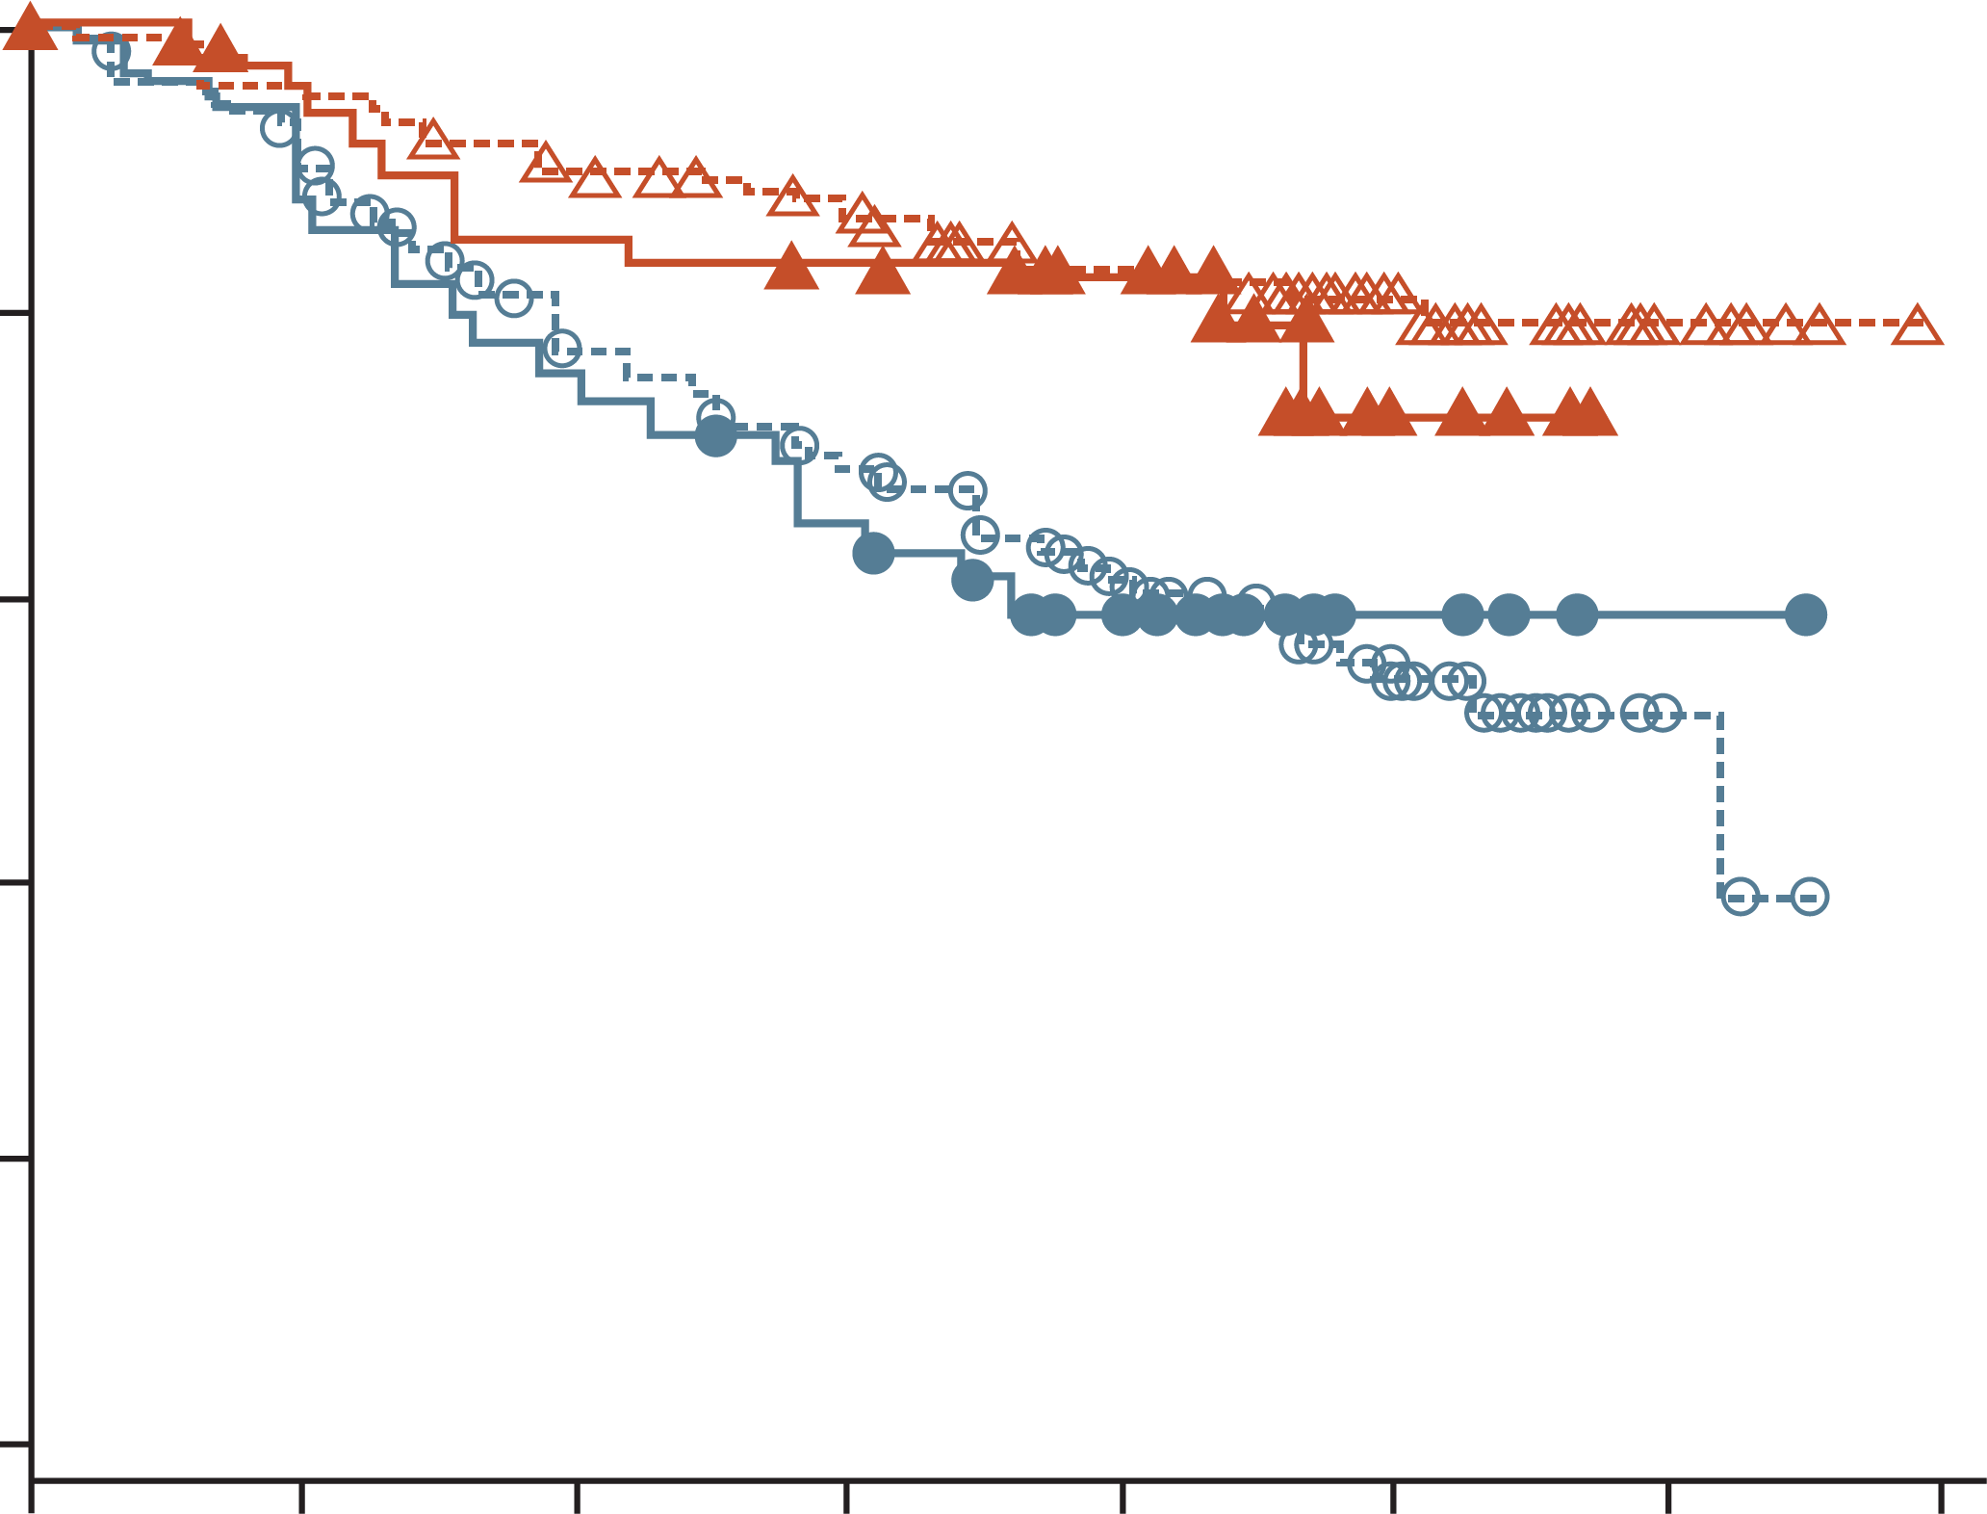
pfs benefit with daratumumab in patients with rrmm and 1-3 prior treatments
CANDOR¹
POLLUX²
100
1.0
80
0.8
60
DKd mPFS: 28.6 months
0.6
Progression-free survival (%)
Proportion without PFS
40
0.4
Kd mPFS: 15.2 months
0.2
Rd (prior R)
DRd (prior R)
Rd (no prior R)
DRd (no prior R)
20
0
0.0
0
3
6
9
12
15
18
21
24
27
30
33
36
0
3
6
9
12
15
18
21
No. at risk
DKd:
Kd:
Time since randomisation (months)
Months
312
154
279
120
235
99
210
83
189
69
178
57
159
47
146
44
136
39
105
28
30
4
6
1
0
0
No. at risk
Rd (prior R):
DRd (prior R):
Rd (no prior R):
DRd (no prior R):
50
50
233
236
43
44
206
222
37
40
169
208
31
38
148
94
23
28
116
161
5
5
31
50
1
0
4
8
0
0
0
0
HR (95% CI) for DKd vs Kd:
0.59 (0.45, 0.78); p<0.0001
HR (95% CI) for DRd vs Rd:
No prior lenalidomide: 0.36 (0.25, 0.52); p<0.001
Prior lenalidomide: 0.42 (0.19, 0.90); p=0.02
CI, confidence interval; d, dexamethasone; D, daratumumab; HR, hazard ratio; K, carfilzomib; (m)PFS, (median) progression-free survival;
R, lenalidomide; RRMM, relapsed/refractory multiple myeloma
1. Usmani SZ, et al. Lancet Oncol. 2022;23:65-76; 2. Dimopoulos MA, et al. New Engl J Med. 2016;375:1319-1331

Slide 26
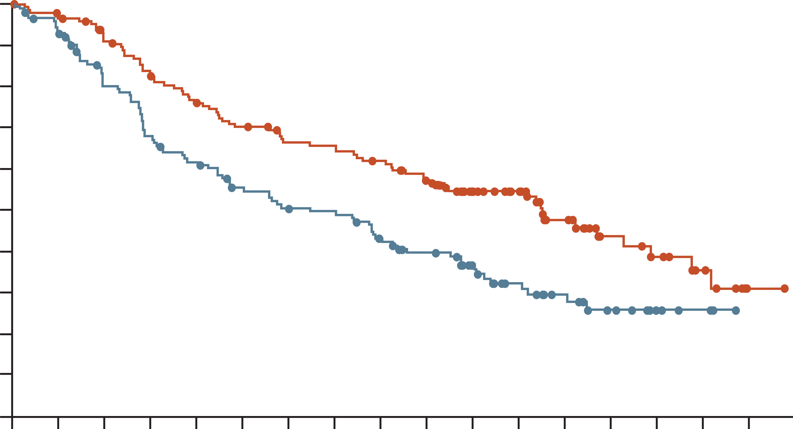
addition of isatuximab to Pd improved pfs in patients with RRmm
ICARIA enrolled patients who had previously received treatment with lenalidomide and a PI
93% of patients were refractory to lenalidomide, and 71% were refractory to both lenalidomide and a PI
A PFS benefit was observed with isatuximab in patients with refractoriness to lenalidomide
and/or a PI
100
90
80
70
60
IPd mPFS: 11.5 months
Progression-free survival (%)
50
40
30
20
HR (95% CI) for IPd vs Pd:
0.60 (0.44, 0.81); p=0.001
Pd mPFS: 6.5 months
10
0
0
1
2
3
4
5
6
7
8
9
10
11
12
13
14
15
16
Follow-up months
IPd:
Pd:
154
153
129
105
106
80
89
63
81
51
52
33
30
17
14
5
1
0
CI, confidence interval; d, dexamethasone; HR, hazard ratio; I, isatuximab; (m)PFS, (median) progression-free survival; P, pomalidomide; PI, proteasome inhibitor; RRMM, relapsed/refractory multiple myeloma
Attal M, et al. Lancet. 2019;394:2096-2107

Slide 27
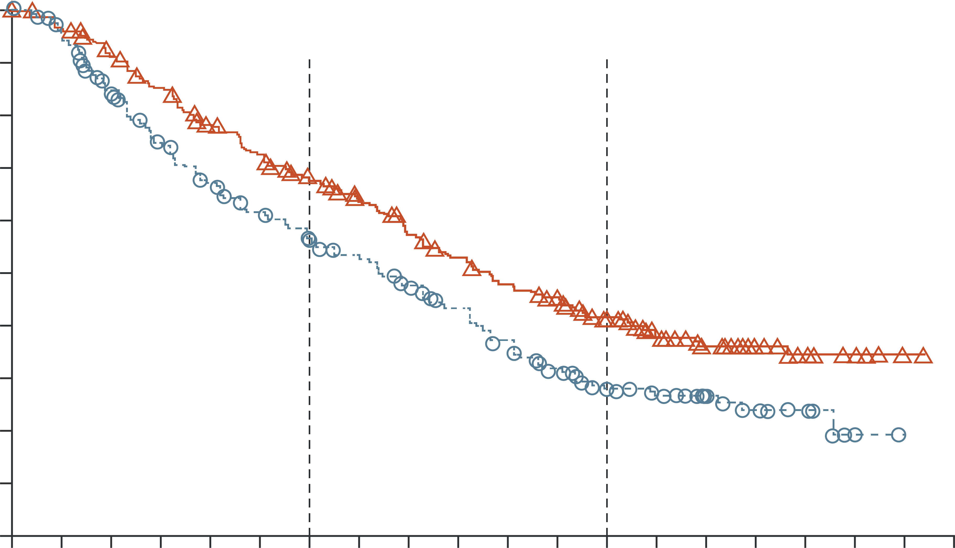
pfs benefit with elotuzumab in patients with rrmm and 1-3 prior treatments in ELOQUENT-2
1.0
0.9
0.8
0.7
0.6
0.5
Probability of progression-free survival
ERd mPFS: 19.4 months
0.4
0.3
0.2
0.1
HR (95% CI) for ERd vs Rd:
0.70 (0.57, 0.85); p<0.001
Rd mPFS: 14.9 months
0.0
0
2
4
6
8
10
12
14
16
18
20
22
24
26
28
30
32
34
36
38
Number at risk
ERd
Rd
Time (months)
321
325
303
295
279
249
259
216
232
192
215
173
195
158
178
141
157
123
143
106
128
89
117
72
85
48
59
36
42
21
32
13
12
7
7
2
1
0
0
0
CI, confidence interval; d, dexamethasone; E, elotuzumab; HR, hazard ratio (m)PFS, (median) progression-free survival;
R, lenalidomide; RRMM, relapsed/refractory multiple myeloma
Lonial S, et al. New Engl J Med. 2015;373:621-631

Slide 28


Selinexor is a first in class oral XPO1 inhibitor with a unique mechanism of action
XPO1:
XPO1 is a nuclear export protein that transports nuclear proteins to the cytoplasm via nuclear pore complexes
XPO1 is overexpressed in many tumour types, including MM
It exports TSPs to the cytoplasm, where they are unable to function and elevates cytosolic levels of pro-survival proteins
This results in dysregulation of growth signalling and increased anti-apoptotic signalling
Selinexor:
Blocks XPO1 so that it cannot carry cargo out of the nucleus
TSPs accumulate in the nucleus, causing cell cycle arrest and apoptosis
Traps oncoprotein mRNA in the nucleus, so they cannot be translated
MYELOMA CELL
Cytoplasm
Oncoprotein
mRNAs
Nucleus
XPO1
XPO1
Cargo
proteins
Cargo Proteins
(TSPs, oncoprotein
mRNAs, growth
regulators)
Nuclear Pore
MM, multiple myeloma; TSP, tumour suppressor protein; XPO1, exportin 1
Mo CC, et al. EJHaem. 2023;4:792-810

Slide 29
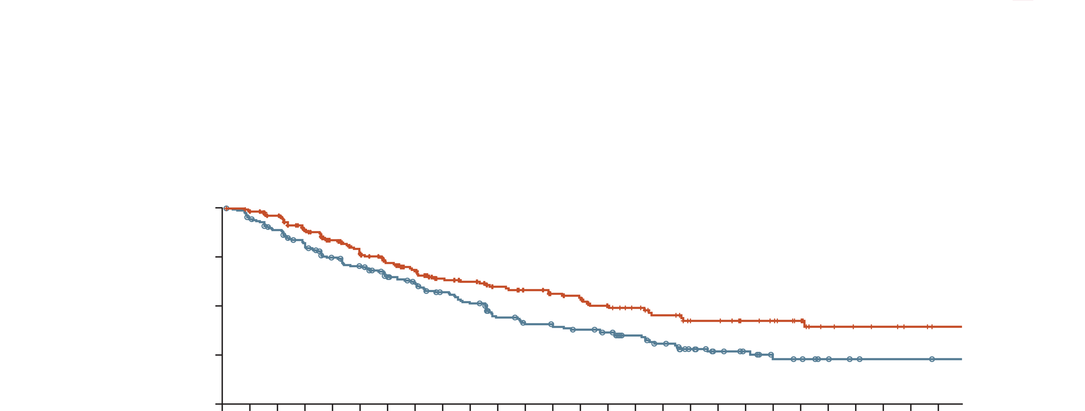
A statistically significant improvement in mPFS with Svd vs Vd including in pi-naïve patients
BOSTON investigated SVd vs Vd in patients with RRMM treated with 1-3 prior therapies
ITT population¹
Subgroup analyses²
1.00
 | 1 prior LOT |  | PI-naïve |  | Bortezomib-naïve
 | SVd (n=99) | Vd (n=99) | SVd (n=47) | Vd (n=48) | SVd (n=61) | Vd (n=62)
Median PFS, mo (95% CI) | 21.0 (13.2-NR) | 10.7 (7.3-16.4) | 29.5 (27.5-NR) | 9.7 (8.4-23.7) | 29.5 (24.8-NR) | 9.7 (8.4-17.5)
HR (95% CI); two-sided p-value | 0.62 (0.41-0.95); 0.028 |  | 0.29 (0.14-0.63); <0.001 |  | 0.35 (0.18-0.68); 0.002
0.75
Probability of
progression-free survival
SVd mPFS: 13.9 months
0.50
0.25
Vd mPFS: 9.5 months
0
0
2
4
6
8
10
12
14
16
18
20
22
24
26
Number at risk
SVd
Vd
Time (months)
195
207
175
175
135
138
106
111
79
90
69
66
57
56
45
49
35
35
26
20
19
10
9
5
6
3
2
2
HR (95% CI) for SVd vs Vd:
0.70 (0.53, 0.93); p=0.0075
CI, confidence interval; d, dexamethasone; HR, hazard ratio; ITT, intent to treat; LOT, line of therapy; mPFS, median progression-free survival; NR, not reached; PI, proteasome inhibitor; RRMM, relapsed/refractory multiple myeloma; S, selinexor; V, bortezomib
1. Grosicki S, et al. Lancet. 2020;396:1563-1573; 2. Mateos M-V, et al. Hemasphere. 2023;7(Suppl):e7454106

Slide 30
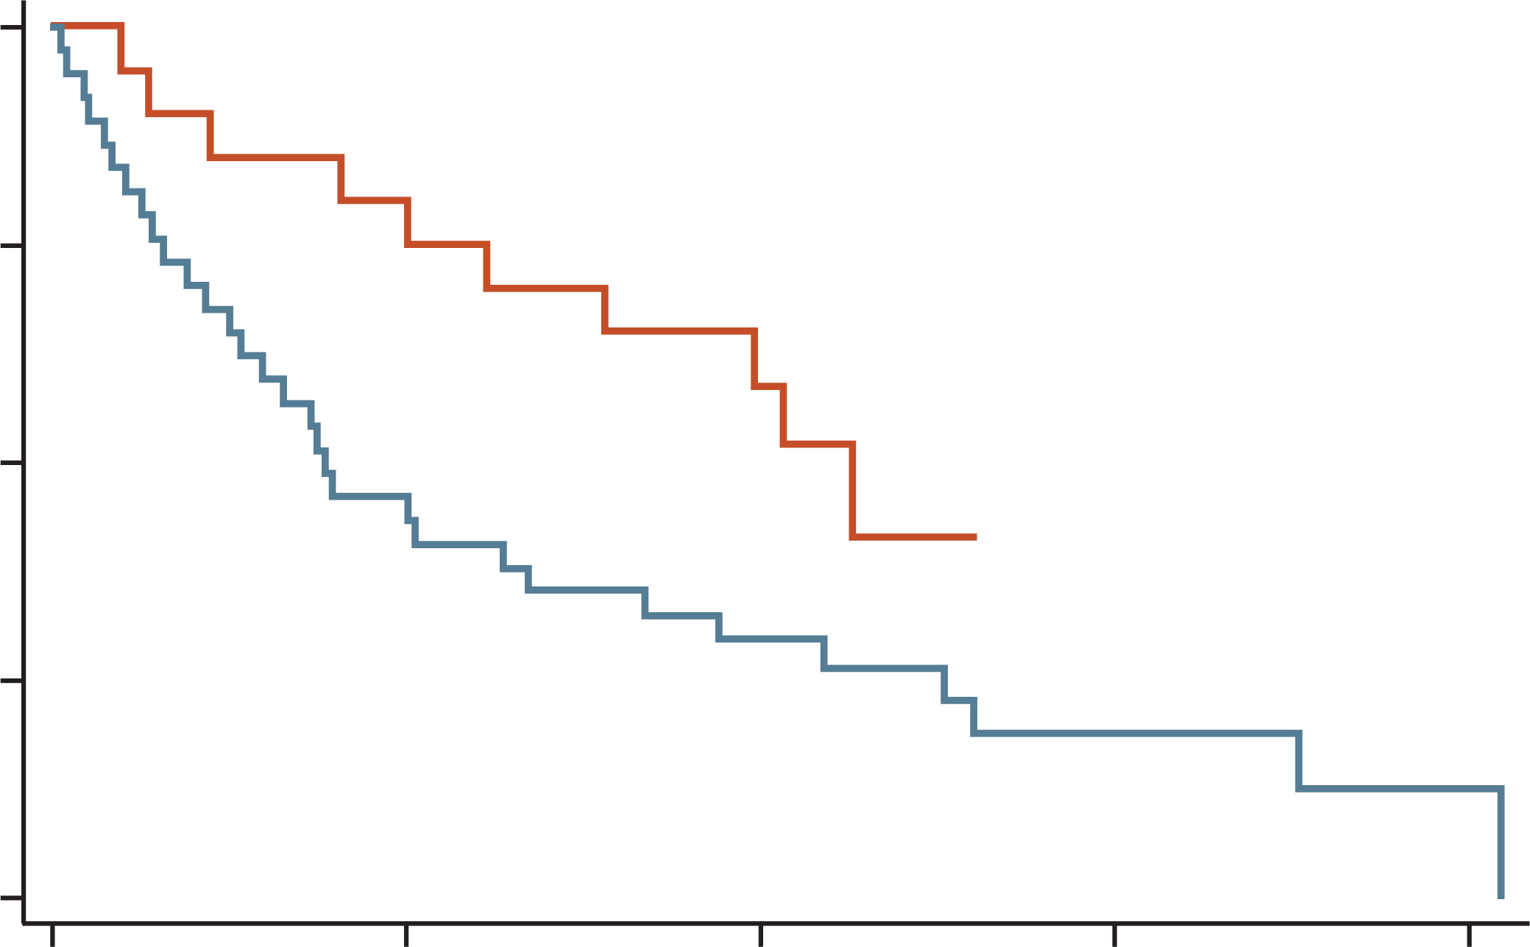
Efficacy and safety of quadruplet therapy with S‑DVd in the phase 2 gem-selibordara trial
ORR
88.9%
mPFS by prior lines
Overall: 25.1 months
1 PL: 27.5 months
2 PL: 31.6 months
3 PL: 12.3 months
ORR
81.8%
ORR
73.3%
1.00
0.75
0.50
Proportion of patients (%)
Proportion with PFS
1 PL
0.25
0.00
2 or more PL
0
1
2
3
4
Analysis time (month)
Most common grade ≥3 AEsª: Thrombocytopenia (39.4%), infection (30.3%), neutropenia (21.2%),
asthenia/fatigue (18.2%), nausea/vomiting (9.1%), anaemia (6.1%)
The study comprised two parts: Part 1 included 24 patients with ≥3 prior therapies, and Part 2 included 33 patients with ≥1 prior therapies. Data are presented here for Part 2
ª Affecting ≥5% of patients
AE, adverse event; CR, complete response; d, dexamethasone; D, daratumumab; len-ref, lenalidomide-refractory; mPFS, median progression-free survival; ORR, overall response rate; PL, prior line; PR, partial response; S, selinexor; V, bortezomib; VGPR, very good partial response
González-Calle V, et al. Haematologica. 2024; Online ahead of print (doi: 10.3324/haematol.2023.284089)

Slide 31


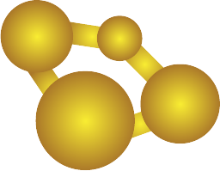
Panobinostat and Pis act synergistically to inhibit removal of misfolded proteins
DACi
(e.g. panobinostat)
Overexpression of HDACs is a marker of poor prognosis in patients with MM
HDACs mediate epigenetic silencing of tumour suppressor genes in MM cells and removal of misfolded proteins by the aggresome
Dual targeting of the proteasome and aggresome pathways through PIs and DACi may be effective in patients with RRMM
HDAC
Activation of tumour
suppressor genes
Accumulation
of misfolded proteins
HDAC6
HDAC1,2,3
HDAC1,2
Aggresome
Histones
Tubulin
HSP90
p53
Deacetylase inhibition
leads to myeloma cell death
Histone (epigenetic) pathway
Nonhistone pathway
DACi, deacetylase inhibitors; HDAC, histone deacetylase; HSP90, heat-shock protein 90; PI, proteasome inhibitor; (RR)MM, (relapsed/refractory) multiple myeloma
Cornell RF and Kassim AA. Bone Marrow Transplant. 2016;51:479-491

Slide 32
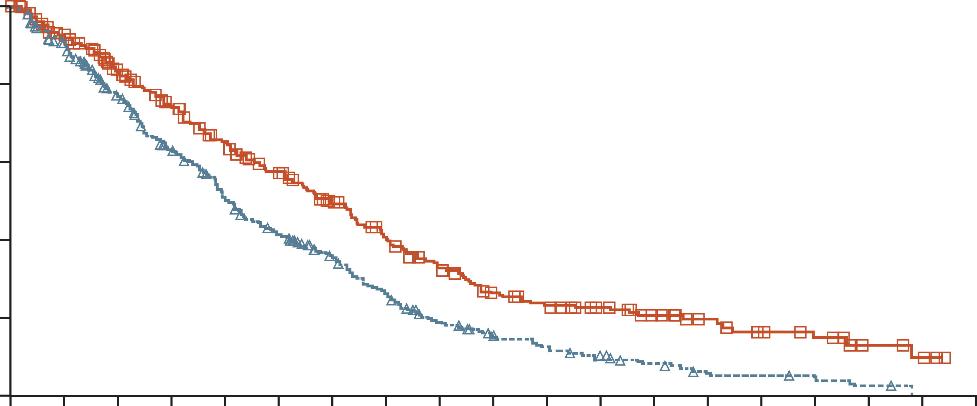
Addition of Panobinostat to bortezomib and dexamethasone improved PFS in patients with rrmm
The PANORAMA1 phase 3 trial investigated Pano-Vd vs Vd in patients
who had received 1-3 previous treatment regimens
100
HR (95% CI) for PanoVd vs Vd:
0.63 (0.52, 0.76); p<0.0001
80
60
Progression-free survival (%)
40
Pano-Vd mPFS: 12.0 months
20
Vd mPFS: 8.1 months
0
0
2
4
6
8
10
12
14
16
18
20
22
24
26
28
30
32
34
36
Number at risk
Pano-Vd
Vd
Time (months)
387
381
288
296
241
235
202
185
171
143
143
114
113
89
89
64
69
42
52
32
44
24
35
18
26
12
18
5
13
5
10
3
5
2
3
0
0
0
CI, confidence interval; d, dexamethasone; HR, hazard ratio; (m)PFS, (median) progression-free survival; pano, panobinostat; RRMM, relapsed/refractory multiple myeloma; V, bortezomib
San-Miguel JF, et al. Lancet Oncol. 2014;15:1195-1206

Slide 33
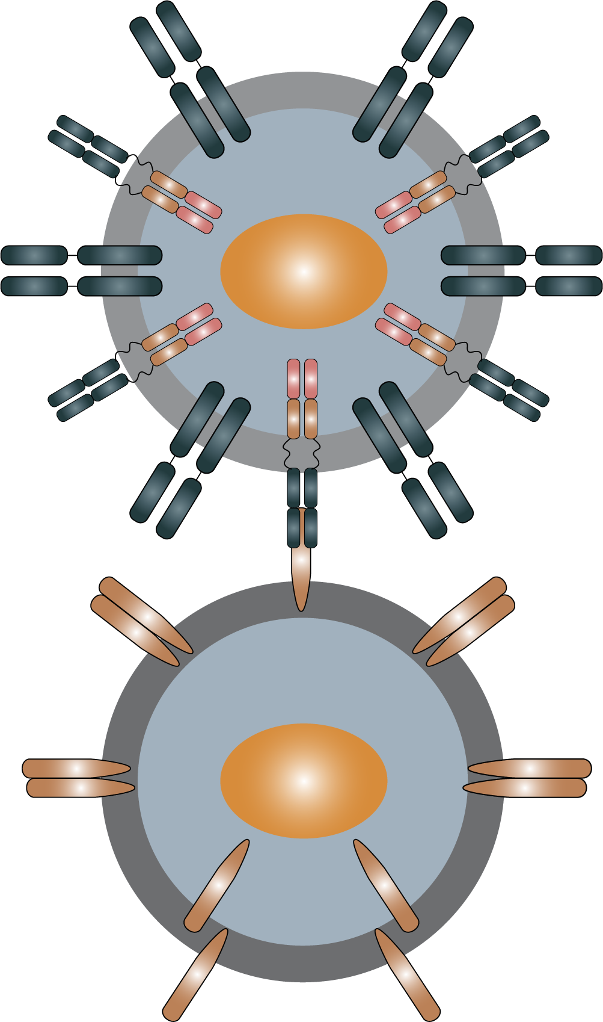
Emerging evidence supports the use of CAR-T therapies in patients with early rrmm
Mechanism of action¹
 | KarMMa-1² (n=140) | KarMMa-3³ (n=254) | CARTITUDE-1⁵ (n=113) | CARTITUDE-4⁷ (n=208)
Treatment | ide-cel |  | cilta-cel
Patient population | ≥3 prior lines of therapyª | 2-4 prior lines of therapy | ≥3 prior lines of therapy^{a,b} | 1-3 prior lines of therapy^{d}
ORR | 73% | 71% | 97% | 85%
mPFS, months | 8.8 | 13.8 | 34.9⁶ | NR^{e}
mOS, months | 19.4 | 41.4⁴ | NR^{6,c} | NR^{e}
CAR-T cell
Tumour-
antigen
directed CAR
Native TCR
Tumour
antigen
Tumour
cell
Tumour cell death
ª Including a PI, IMiD and an anti-CD38 antibody. ^{b} Or were double-refractory to a PI and IMiD. ^{c} mOS was not reached after a median follow-up of 33.4 months. ^{d} All patients had lenalidomide resistance and had received a PI and IMiD. ^{e} mOS and mPFS were not reached after a median follow-up of 15.9 months
CAR-T, chimeric antigen receptor T-cell; cilta-cel, ciltacabtagene autoleucel; ide-cel, idecabtagene vicleucel; IMiD, immunomodulatory agent; mOS, median overall survival; mPFS, median progression-free survival; NR, not reported; ORR, overall response rate; PI, proteasome inhibitor; RRMM, relapsed/refractory multiple myeloma; TCR, T-cell receptor
1. Cornell RF and Kassim AA. Bone Marrow Transplant. 2016;51:479-491. 2. Munshi NC, et al. New Engl J Med. 2021;384:705-716; 3. Rodriguez Otero P, et al. Blood. 2023;142 (suppl 1):1028; 4. BMS Press Release. Available from: https://shorturl.at/dhBE7 (last accessed: April 2024); 5. Berdeja JG, et al. Lancet. 2021;398:314-324; 6. Munshi N, et al. Hemasphere. 2023;7(Suppl):e6102468; 7. San-Miguel J, et al. New Engl J Med. 2023;389:335-347

Slide 34
conclusions
PIs, IMiDs and mAbs form the backbone of treatment for MM based on their proven efficacy
However, most patients ultimately become resistant to these agents and require a
switch to treatment with a different MoA
Selinexor is the first selective nuclear export inhibitor approved for the treatment of
RRMM and has demonstrated efficacy in patients with early relapse (1-3 prior therapies)
CAR-T therapies are efficacious and are approved in heavily pretreated patients and have recently been approved in patients with early relapse
CAR-T, chimeric antigen receptor T-cell; IMiD, immunomodulatory drug; mAbs, monoclonal antibodies; MoA, mechanism of action; PI, proteasome inhibitor; (RR)MM, (relapsed/refractory) multiple myeloma

Slide 35
Best practices in combining and sequencing therapies for optimal outcomes
Prof. Hermann Einsele
Hematologist-Oncologist
University of Würzburg, Germany

Slide 36
Role of Daratumumab and lenalidomide in 1L treatment
Lenalidomide and daratumumab-based regimens have become part of the SoC for 1L treatment of NDMM
Induction:
4-drug regimens
DVTd
DVRd²
200 mg/m² melphalan
followed by ASCTª
Maintenance:
Lenalidomide (Daratumumab/Isatuximab)
Yes
Eligibility for ASCT
Option 1:
DaraRd, DaraVMP, VRd
Option 2:
VCd, MPT, VMP, Rd
Other options:
BP, CTd, MP
No
Figure adapted from Dimopoulos et al.¹
ª Tandem for high-risk disease or suboptimal response consolidation.
1L, first line; ASCT, autologous stem cell transplantation; B, bendamustine; C, cyclophosphamide; d, dexamethasone; D, daratumumab; M, melphalan; NDMM, newly diagnosed multiple myeloma; P, prednisone; R, lenalidomide; SoC, standard of care; T, thalidomide; V; bortezomib
1. Dimopoulos MA, et al. Ann Oncol. 2021;32:309-322; 2. Sonneveld P, et al. New Engl J Med 2024;390:301-313;

Slide 37
IMPACT of administration of lenalidomide and daratumumab-based regimens at 1L
Administration of lenalidomide and
daratumumab-based regimens at 1L could lead to:
A growing population of PI-naïve patients at 2L¹
An increasing need for more effective options in patients with MM refractory to lenalidomide^{1,2}
A growing population of patients with MM refractory to anti-CD38-based therapies in earlier lines of treatment³
1L, first line; 2L, second line; d, dexamethasone; D, daratumumab; (ND)MM, (newly diagnosed) multiple myeloma; PI, proteasome inhibitor; R, lenalidomide
1. Dimopoulos MA, et al. Ann Oncol. 2021;32:309-322; 2. de Arriba de la Fuente F, et al. Cancers (Basel) 2022;15:155; 3. Kastritis E, et al. Hemasphere 2023;7:e975

Slide 38
Median PFS is Suboptimal in Lenalidomide-Exposed or refractory patients
 | CANDOR¹ |  | CASTOR² |  | IKEMA³ |  | ENDEAVOR⁴ |  | POLLUX⁵ |  | ELOQUENT-2^{6,7} |  | OPTIMISMM^{8a} |  | APOLLO^{9a} |  | EMNO2^{10a} | BOSTON^{11,12}
 | DKd | Kd | DVd | Vd | IKd | Kd | Kd | Vd | DRd | Rd | ERd | Rd | PVd | Vd | DPd | Pd | KPd | SVd | Vd
mPFS, months
ITT | 28.6 | 15.2 | 16.7 | 7.1 | NC | 19.2 | 18.7 | 9.4 | 44.5 | 17.5 | 19.4 | 14.9 | 11.2 | 7.1 | 12.4 | 6.9 | 19.1 | 13.9 | 9.5
Lena-exposed | 25.9 | 11.1 | - | - | NC | 16.1 | 12.9 | 7.3 | 38.8 | 18.6 | 24.9 | 7.4 | 11.2 | 7.1 | 12.4 | 6.9 | 19.1 | - | -
Lena-refractory | 28.1 | 11.1 | 7.8 | 4.9 | NC | 15.7 | 8.6 | 6.6 | - | - | - | - | 9.5 | 5.6 | 9.9 | 6.5 | - | 10.2 | 7.1
In IKEMA, the MRD negativity rate was 33.5% in the ITT population and 29.8% in the lenalidomide-refractory population¹³
ª All patients in OPTIMISMM, APOLLO and EMNO2 were previously exposed to lenalidomide
d, dexamethasone; D, daratumumab; E, elotuzumab; I, isatuximab; ITT, intention to treat; K, carfilzomib; Lena, lenalidomide; mPFS, median progression-free survival; MRD, minimal residual disease; NC, not calculated; P, pomalidomide; R, lenalidomide; S, selinexor; V, bortezomib
1. Usmani S, et al. Lancet Oncol. 2022;23:65-76; 2. Mateos M-V, et al. Clin Lymphoma, Myeloma Leuk. 2020;20:509-518;
3. Moreau P, et al. Lancet. 2021;397:2361-2371; 4. Moreau P, et al. Leukemia. 2017;31:115-122; 5. Bahlis N, et al. Leukemia. 2020;34:1875-1884;
6. Lonial S, et al. N Engl J Med. 2015:373:621-631; 7. Lonial S, et al. J Clin Oncol. 2016;34(suppl 15):8037; 8. Richardson P, et al. Lancet Oncol. 2019;20:781-794; 9. Dimopoulos MA, et al. Lancet Oncol. 2021;22:801-812; 10. Sonneveld P, et al. Hemasphere. 2022;6:e786; 11. Grosicki S, et al. Lancet 2020;396:1563-73; 12. Lelou X, et al. J Clin Oncol 2021;39(15_suppl):8024; 13. Martin T et al. Blood Cancer J 2023;13:72.

Slide 39
outcomes are poor for patients previously exposed to CD38 monoclonal antibodies (Triple Class Exposed)
Study | Treatment history | mOS, months | Response to subsequent treatment
 |  |  | mPFS, months | ORR, %
MAMMOTH^{1a} | Double refractory | 11.2 | 3.4 | 38
 | Triple or quad-refractory | 9.2 |  | 29
 | Penta-refractory | 5.6 |  | 30
LocoMMotion^{2b} | Triple class exposed | 12.4 | 4.6 | 30
Connect MM registry^{3c} | 1-3 prior lines | 16.8 | 5.6 | 28
 | ≥4 prior lines | 10.0 | 3.0
ª All patients are refractory to a CD38 mAb plus PIs and/or IMiDs; ^{b} Received ≥1 PI, IMiD and CD38 mAb; ^{c} Including lenalidomide and a CD38 mAb
IMiD, immunomodulatory drug; mAb, monoclonal antibody; MM, multiple myeloma; mOS, median overall survival; mPFS, median progression-free survival;
ORR, overall response rate; PI, proteasome inhibitor
1. Gandhi UH, et al. Leukemia. 2019;33:2266-2275; 2. Mateos M-V, et al. Leukemia. 2022;36:1371-1376; 3. Abonour R, et al. Hemasphere. 2023;7(Suppl):e52503e2

Slide 40
ESMO guidelines: second-Line treatment options
Second-line options after VRd
Second-line options after DaraRd^{b,c}
Second-line options after
DaraVMP^{b,c} or DaraVTd^{b,c}
Lenalidomide-
sensitive
Lenalidomide-
refractory
Bortezomib-
sensitive
Lenalidomide
and bortezomib-
refractory
Lenalidomide-
sensitive
Lenalidomide-
refractory
Bortezomib-
sensitive
Bortezomib-
refractory
KRd [I, A]
DaraRd [I, A]
EloRd [I, A]
PomVd [I, A]
DaraKd [I, A]
IsaKd [I, A]
IxaRd [I, A]
SVd [I, A]
PomVd [I, A]
DaraKd [I, A]
IsaKd [I, A]
SVd [I, A]
KRd [I, A]
DaraRd [I, A]
EloRd [I, A]
PomVd [I, A]
DaraKd [I, A]
DaraVd [I, A]
IsaKd [I, A]
SVd [I, A]
VenVdª [I, A]
DaraKd [I, A]
IsaKd [I, A]
PomVd
Kd
EloRd
KRd
IxaRd
SVd
VenVdª
PomVd
Kd
SVd
VenVdª
EloRd
KRd
IxaRd
VRd
SVd
Kd
VenVdª
EloRd
ª Patients with t(11;14)
^{b} Patients who progress while on monthly daratumumab are considered as daratumumab-refractory
^{c} All recommendations for patients who receive front-line therapy with daratumumab-based therapies are based on panel consensus as there are no trials evaluating regimens in second-line therapy that include patients who are refractory or exposed to daratumumab
d, dexamethasone; Dara, daratumumab; Elo, elotuzumab; Isa, isatuximab; Ixa, ixazomib; K, carfilzomib; M, melphalan; P, prednisone; Pom, pomalidomide; R, lenalidomide; S, selinexor; V, bortezomib; Ven, venetoclax
Dimopoulos MA, et al. Ann Oncol. 2021;32(3):309-322

Slide 41
SVd is the only approved triplet therapy allowing double class switch in DRd-exposed patients
 | ESMO treatment recommendations after DRd (based on panel consensus)^{a,b} |  |  | Class switch
 | Triplet/doublet combination
Lenalidomide-sensitive | – | Carfilzomib | Dexamethasone | Single
 | Pomalidomide | Bortezomib | Dexamethasone | Single
 | Lenalidomide | Carfilzomib | Dexamethasone | Single
 | Lenalidomide | Elotuzumab | Dexamethasone | Single
 | Lenalidomide | Isatuximab | Dexamethasone | None
 | Selinexor | Bortezomib | Dexamethasone | Double
Lenalidomide-refractory | – | Carfilzomib | Dexamethasone | Single
 | Pomalidomide | Bortezomib | Dexamethasone | Single
 | Selinexor | Bortezomib | Dexamethasone | Double
ª Venetoclax-based combinations are an option for patients with t(11;14)
^{b} Patients who progress while on monthly daratumumab are considered as daratumumab-refractory
d, dexamethasone; D, daratumumab; R, lenalidomide; S, selinexor; V, bortezomib
Table created from information in Dimopoulos MA, et al. Ann Oncol. 2021;32(3):309-322

Slide 42
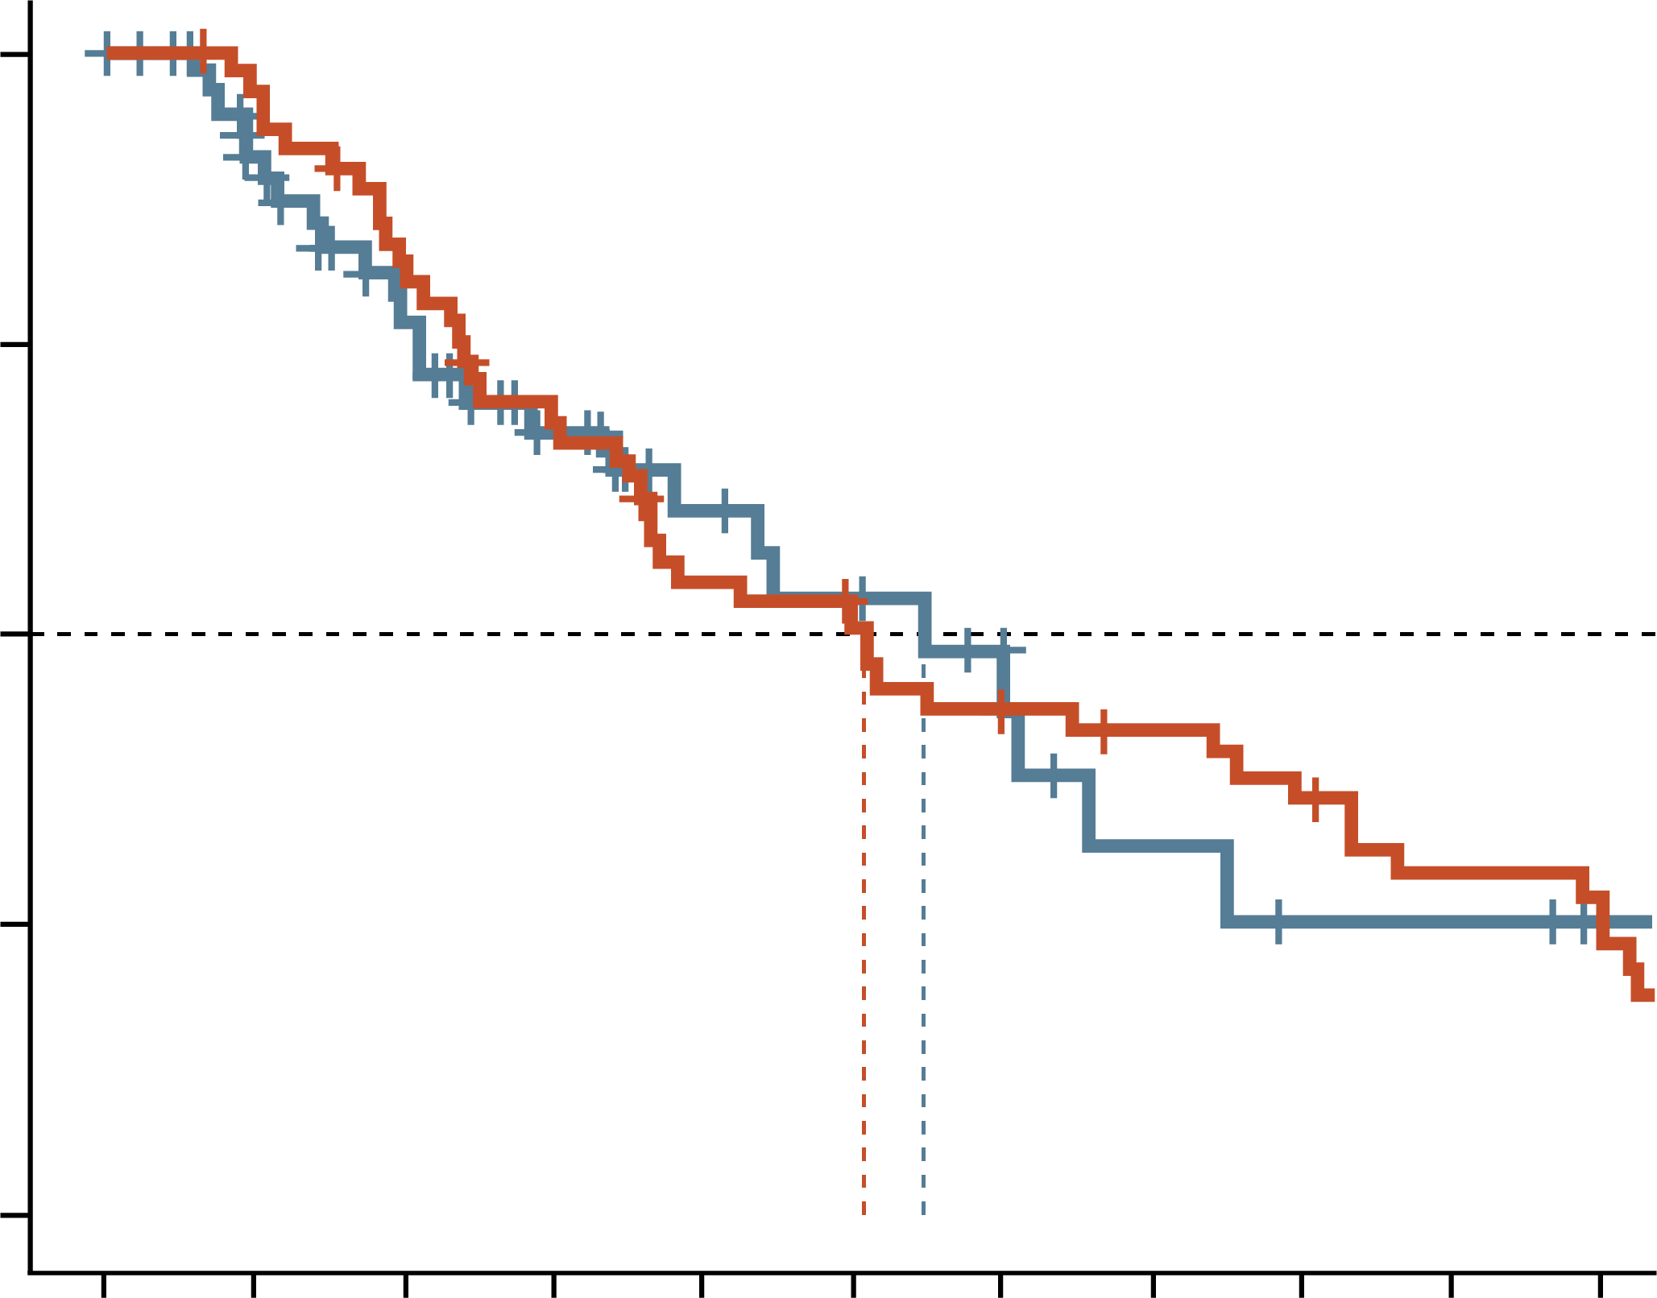
selinexor-based triplets in patients previously treated with CD38 mab
Sd-based triplets vs prior 𝛂-CD38 mAb
Efficacy and safety of SPd, SVd and SKd was analysed in a subset of patients (n=62) from STOMP and BOSTON previously treated with a CD38 mAb
  74% refractory to lenalidomide; 85% refractory to daratumumab
ORR and mPFS were comparable between the selinexor-based treatment and prior CD38 mAb treatment:
  ORR: 58.1% vs 63.8%
  mPFS: 10.9 vs 10.2 months
  mOS: 20.4 months with a selinexor-based triplet
Adverse events were generally manageable with standard supportive care and dose modifications
A Phase 3 RCT is ongoing to compare SPd vs EloPd in patients previously treated with an IMiD, PI and CD38 mAb (NCT05028348)
1.00
Median (95% CI) PFS
Sd-based triplets: 10.9 (7.6, NE)
Prior 𝛂-CD38 mAb: 10.2 (7.3, 16.6)
0.75
Probability of PFS
0.50
0.25
0.00
0
2
4
6
8
10
12
14
16
18
20
Number at risk
Sd-based triplets
Prior 𝛂-CD38 mAb
Months
62
62
47
59
35
49
24
40
17
31
14
28
8
23
5
21
3
18
3
14
1
12
d, dexamethasone; Elo, elotuzumab; IMiD, immunomodulatory drug; K, carfilzomib; mAb, monoclonal antibody; mOS, median overall survival; (m)PFS, (median) progression-free survival; NE, not evaluable; ORR, overall response rate; P, pomalidomide; PI, proteasome inhibitor; RCT, randomised controlled trial; S, selinexor; V, bortezomib
Schiller GJ, et al. Clin Lymphoma Myeloma Leuk. 2023;23:e286-e296.e4

Slide 43
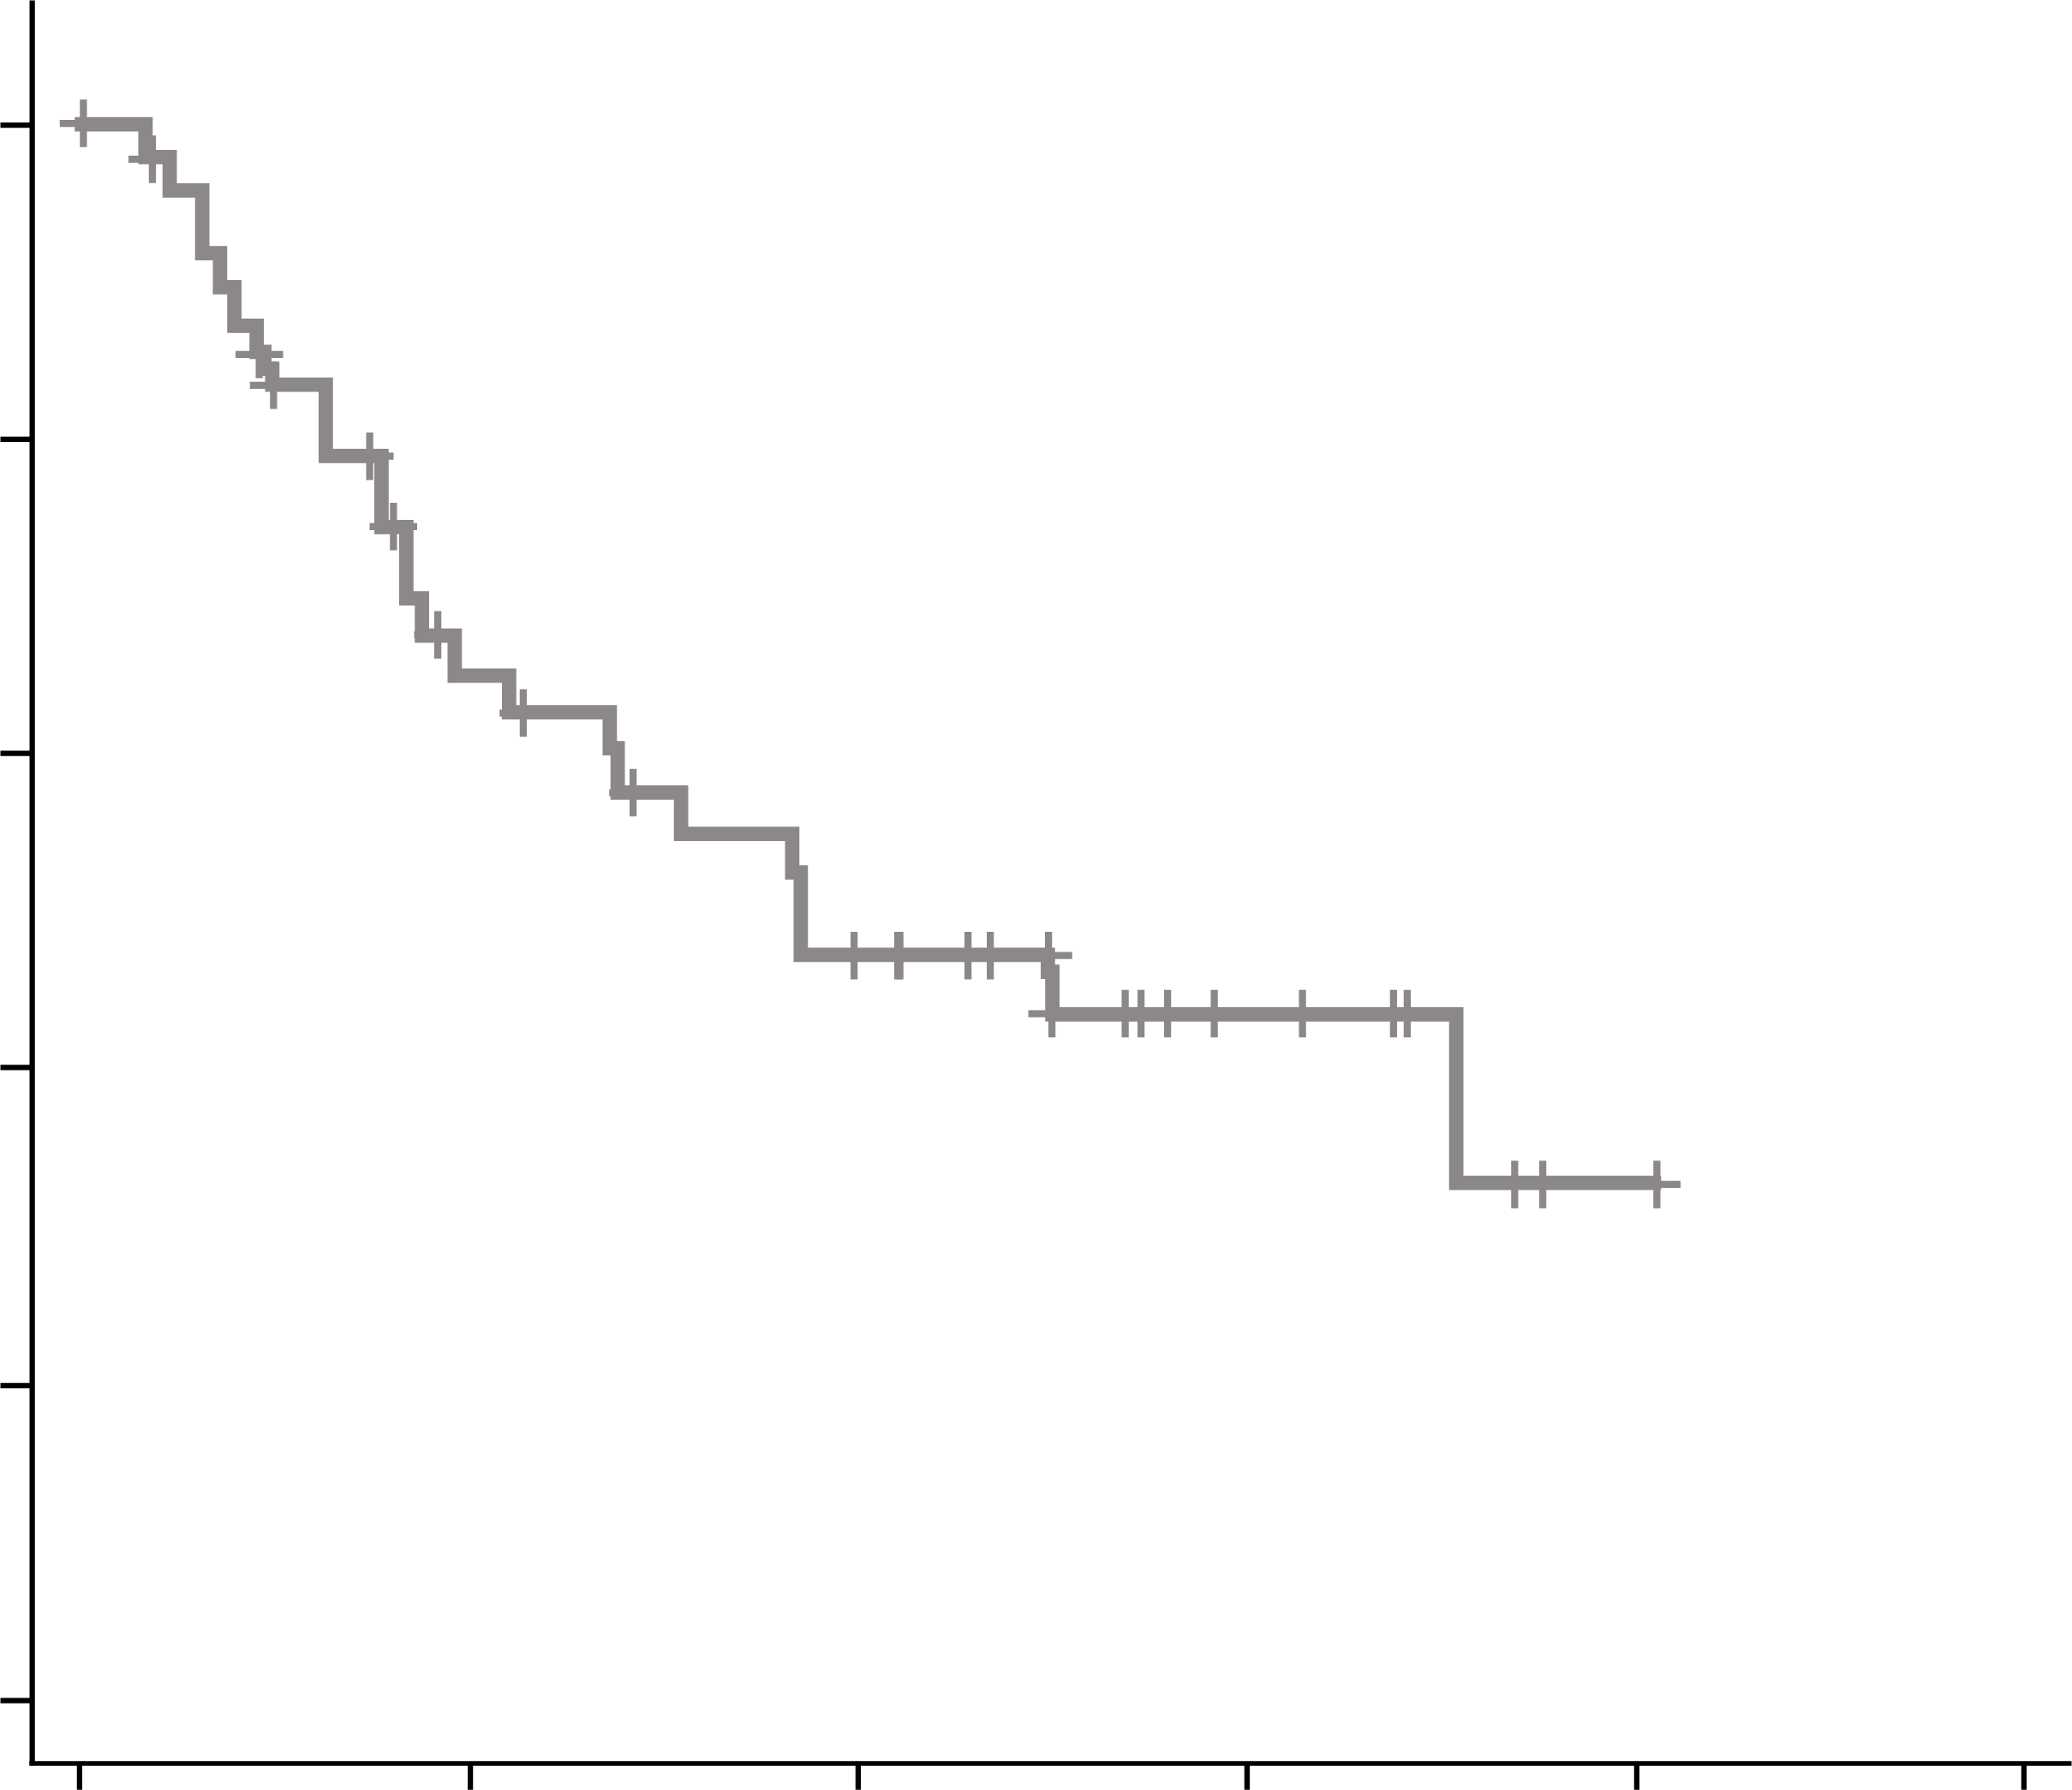
KPd for lenalidomide refractory patients
SELECT phase 2 study enrolled 52 patients with early RRMM
  100% were lenalidomide-refractory
  75% were lenalidomide and daratumumab-refractory
All patients were treated with KPd
  ORR: 58% (primary endpoint not met)
  mPFS: 11.1 months
  mOS: 18.8 months
Adverse events were consistent with the known safety profile of these agents
1.0
KPd (N=52)
Progression/death, n (%) 25 (48.1%)
Median (90% CI) PFS, months 11.1 (6.5, NE)
0.8
0.6
Probability of PFS
0.4
KPd
0.2
0.0
0
6
12
18
24
30
Number at risk
KPd
Months from enrolment
52
27
18
7
1
0
CI, confidence interval; d, dexamethasone; K, carfilzomib; mOS, median overall survival; m(PFS), (median) progression-free survival; NE, not evaluable; ORR, overall response rate; P, pomalidomide; RRMM, relapsed/refractory multiple myeloma
Perrot A, et al. Leuk Lymphoma. 2024; Online ahead of print (doi: 10.1080/10428194.2024.2322030)

Slide 44
current treatment options for triple class refractory patients
XPO1 inhibitor: Selinexor¹
Peptide-drug conjugate: Melflufen²
Non-T-cell-directed therapies
CAR-T therapy
  Idecabtagene vicleucel³
  Ciltacabtagene autoleucel⁴
Bispecific antibodies
  Teclistamab⁵
  Talquetamab⁶
  Elranatamab⁷
T-cell-directed therapies
CAR-T, chimeric antigen receptor T-cell; IMiD, immunomodulatory drug; mAb, monoclonal antibody; PI, proteasome inhibitor; SmPC, Summary of Product Characteristics; XPO1, exportin 1
1. Nexpovio® (selinexor). SmPC (August 2023). Stemline Therapeutics B.V.; 2. Pepaxti ® (melphalan flufenamide). SmPC (March 2024). Oncopeptides AB (publ); 3. Abecma® (idecabtagene vicleucel). SmPC (July 2023). Bristol-Myers Squibb Pharma EEIG; 4. Carvykti® (ciltacabtagene autoleucel). SmPC (December 2023). Janssen-Cilag International NV; 5. Tecvayli® (teclistamab) SmPC (February 2024). Janssen-Cilag International NV; 6. Talvey® (talquetamab). SmPC (March 2024). Janssen-Cilag International NV;
7. Elrexfio® (elranatamab). SmPC (January 2024). Pfizer Europe MA EEIG. All available from https://www.ema.europa.eu/en/medicines. Last accessed 21 March 2024

Slide 45
CAR-T therapy and bispecific antibodies: challenges
Both CAR-T therapy and bispecific antibodies have significantly improved outcomes for patients with ≥3 prior lines of therapy¹⁻⁵
Both are associated with challenges:
CAR-T THERAPY | BISPECIFIC ANTIBODIES
Complex logistics and high cost can be a barrier to widespread use⁶ Risk of adverse reactions including CRS, infections, ICANS and secondary cancers^{7,8} CAR-T cell exhaustion can lead to relapse⁹ | Require ongoing treatment¹⁰ Risk of adverse reactions including CRS, infections and ICANS⁷ Continuous exposure to a bispecific can lead to T-cell exhaustion and treatment resistance¹¹
Timing and sequencing strategies for optimal efficacy and safety remain unclear
CAR-T, chimeric antigen receptor T-cell; CRS, cytokine release syndrome; ICANS; immune effector cell-associated neurotoxicity syndrome
1. Berdeja JG, et al. Lancet. 2021;398:314-324; 2. Munshi NC, et al. New Engl J Med. 2021;384:705-716; 3. Moreau P, et al. New Engl J Med. 2022;387:495-505;
4. Chari A, et al. New Engl J Med. 2022;387:2232-2244; 5. Lesokhin AM, et al. Nat Med. 2023;29:2259-2267; 6. Gajra A, et al. Pharmaceut Med. 2022;36:163-171;
7. Khanam R, et al. J Clin Med. 2023;12:5539; 8. Verdun N and Marks P. New Engl J Med. 2024;390:584-586; 9. Zhu X, et al. Front Cell Dev Biol. 2022;10:1034257; 10. Lancman G, et al. Blood Cancer Discov. 2021;2:423-433; 11. Philipp N, et al. Blood. 2022;140:1104-1118

Slide 46
can treatment sequencing maximise the potential of T-cell directed therapies?
Use of bridging therapies
Earlier use of BCMA-TT
Optimal sequencing of BCMA-TT
Use of T-cell sparing agents
BCMA-TT, B-cell maturation antigen targeted therapies

Slide 47
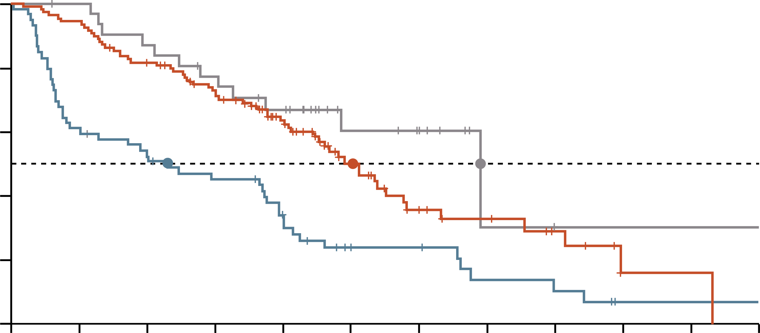
Impact of bridging therapy on disease burden, efficacy and safety
PFS by change in disease burden
during bridging therapy
In the KarMMA-3 phase 3 trial, 213 patients received bridging therapyª prior to ida-cel infusion
Change in disease burden after bridging:
28% increased, 51% no change, 15% decreased
Patients with decreased or no change in disease burden achieved a numerically longer PFS and higher ORRs with ida-cel vs those with increased disease burden
The decreased disease burden group had the lowest incidence of high-grade CRS and iiNT events
Median (95% CI) PFS
6.9 (2.4-11.8) months
15.1 (12.4-17.3) months
20.7 (11.2-NR) months
Increased disease
No change in disease
Decreased disease
100
80
60
Progression-free
survival (%)
40
20
0
0
3
6
9
12
15
18
21
24
27
30
33
Patient at risk
Increased disease
No change in disease
Decreased disease
Months since randomisation
59
109
32
36
103
31
31
88
27
25
74
23
17
54
18
9
27
9
8
15
7
4
10
1
3
6
0
0
1
0
0
1
0
0
0
0
Patients with increased disease burden were more likely to have triple class refractory disease:
Less pretreatment prior to CAR-T therapy may result in more effective and safer bridging options
ª Either DPd, DVd, IRd, Kd or EloPd
CAR-T, chimeric antigen receptor T-cell; CI, confidence interval; CRS, cytokine release syndrome; d, dexamethasone; D, daratumumab; Elo, elotuzumab; I; ixazomib; ida-cel, idecabtagene vicleucel; iiNT, investigator-identified neurotoxicity; K, carfilzomib; NR, not reached; ORR, overall response rate; P, pomalidomide; PFS, progression-free survival; R, lenalidomide; V, bortezomib
Einsele, H, et al. Presented at the 2023 International Myeloma Society Annual Meeting. 27-30 September 2023; Athens, Greece. Abstract P008

Slide 48
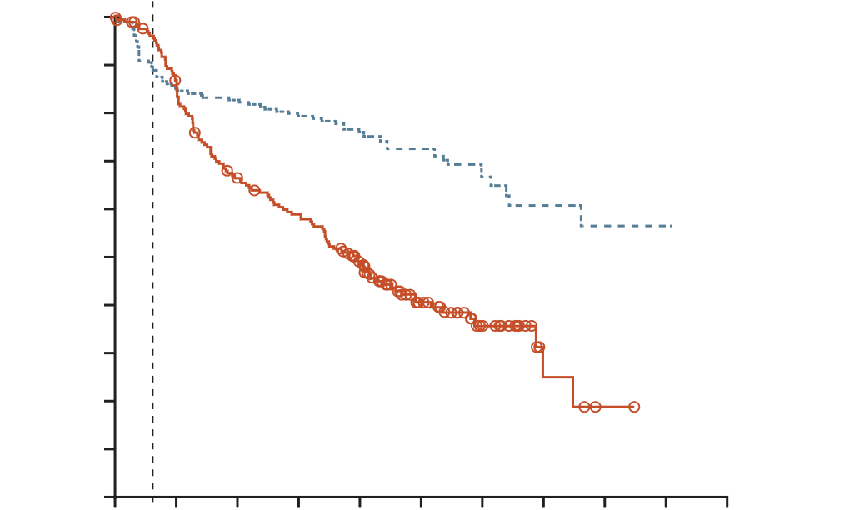
Cartitude-4: cilta-cel in earlier treatment lines
Patients who had received 1-3 lines of therapy were randomised to cilta-cel (n=208) or standard care (n=211ª)
All patients were refractory to lenalidomide; 14.4% of cilta-cel group and 15.6% of standard care group were triple class refractory
Cilta-cel resulted in a significantly lower risk of disease progression or death than standard care (HR, 0.26; 95% CI, 0.18 to 0.38; p<0.001)
ORRs were 84.6% in the cilta-cel group vs 67.3% in the standard care group
Cilta-cel may have a better side effect profile when used earlier in treatment
Progression-free survival
Wk 8
100
90
80
70
Cilta-cel group
60
Patients surviving without
disease progression (%)
50
40
30
20
10
Standard care group
0
0
3
6
9
12
15
18
21
24
27
30
Number at risk
Cilta-cel group
Standard-care
group
Months
208
211
177
176
172
133
166
116
146
88
94
46
45
20
22
4
9
1
1
0
0
0
ª 87% received daratumumab, pomalidomide and dexamethasone and 13% received daratumumab, bortezomib and dexamethasone
cilta-cel, ciltacabtagene autoleucel; CI, confidence interval; HR, hazard ratio; ORR, overall response rate
San-Miguel J, et al. New Engl J Med. 2023;389:335-347

Slide 49
CAR-t THERAPY: responses may be suboptimal in patients previously exposed to a bcma-tt
Real-world experience¹
CARTITUDE-2 cohort C²
1.00
No prior BCMA-TT
Median PFS: 9.0 months
100
0.75
80
Probability of PFS
PFS (%)
60
0.50
40
0.25
Prior BCMA-TT
Median PFS: 3.2 months
20
0.00
Log-rank p=0.0002
0
0
5
10
15
0
3
6
9
12
15
Months
Months
Number at risk
No prior BCMA-TT
Prior BCMA-TT
153
50
73
14
7
1
0
0
Patients at risk
20
13
12
8
3
0
Patients with prior BCMA-TT experienceª (n=50) or no prior BCMA-TT experience (n=153) were treated with ida-cel
Prior BMCA-TT cohort had a lower ORR (74% vs 88% and lower mPFS (3.2 vs 9.0 months) than the cohort without prior BMCA-TT
Cohort C is evaluating cilta-cel in 20 patients
with heavily pretreated RRMM, previously
exposed to BCMA-TT^{b}
ORR and mPFS were lower than in CARTITUDE-1³ where patients had no prior BCMA-TT experience (60.0% vs 98% and 9.1 vs 34.9 months)
ª 38 antibody-drug conjugate, seven bispecific, five CAR-T
^{b} 13 antibody-drug conjugate, seven bispecific
BCMA-TT, B-cell maturation antigen-targeted therapy; CAR-T, chimeric antigen receptor T-cell; cilta-cel, ciltacabtagene autoleucel; ida-cel, idecabtagene vicleucel; (m)PFS, (median) progression-free survival; ORR, overall response rate; RRMM, relapsed/refractory multiple myeloma
1. Ferreri CJ, et al. Blood Cancer J. 2023;13:117; 2. Cohen AD, et al. Blood. 2023;141:219-230; 3. Lin Y, et al. J Clin Oncol. 2023;41(16_Suppl):8009

Slide 50
Bispecifics: Similar Response in patients with or without prior exposure to A bcma-tt
Overall response rate^{1,2}
The MajesTEC-1 phase 1/2 study enrolled 165 patients who were BCMA-TT naïve (cohort A) and 40 patients with prior BCMA-TT exposure (cohort C)ª
ORR was similar between cohorts A and C (63.0 vs 52.5%)
ORR was also similar between patients exposed to ADCs or CAR-T therapy (55.2% vs 53.3%)
Patients with response (%)
PR
VGPR
CR
sCR
ORR: 63.0%
(104/165)
ORR: 55.2%
(16/29)
ORR: 53.3%
(8/15)
ORR: 52.5%
(21/40)
≥CR
39.4
≥VGPR
58.8
≥VGPR
48.3
≥VGPR
46.7
≥VGPR
47.5
No prior BCM-TT
N=165
ADC-exposed
(n=29)
CAR-T-exposed
(n=15)
ADC and/or
CAR-T-exposed
(n=40)
Cohort A
Cohort C
ª 29 ADC, 15 CAR-T
ADC, antibody-drug conjugate; BCMA-TT, B-cell maturation antigen targeted therapy; CAR-T, chimeric antigen receptor T cell; CR, complete response; ORR, overall response; PR, partial response; sCR, stringent complete response; VGPR, very good partial response
1. Moreau P, et al. N Engl J Med. 2022;387:495-505; 2. Touzeau C, et al. Hemasphere. 2022;6:85-86 (presented during the European Hematology Association 2022 Congress; Oral abstract #S184); 3. https://multiplemyelomahub.com/medical-information/teclistamab-for-relapsedrefractory-multiple-myeloma-updated-phase-iii-majestec-1-results. Last accessed April 2024

Slide 51

Use of T-cell sparing agents to improve t-cell fitness
T-cell exhaustion can limit the effectiveness of T-cell-directed therapies such as CAR-T therapies and bispecific antibodies
Multiple factors can contribute to T-cell exhaustion including age, disease burden and
prior cancer treatments
Use of T-cell-sparing rather than T-cell-depleting agents prior to T-cell-directed therapies
has the potential to improve treatment responses
T-cell-sparing | T-cell-depleting
XPO1 inhibitors IMiDs E3 ligase modulators Checkpoint inhibitors | PIs Alkylating agents IgG1 antibody therapies
CAR-T, chimeric antigen receptor T-cell; IgG, immunoglobulin G; IMiD, immunomodulatory drug; PI, proteasome inhibitor, XPO1, exportin 1
Binder AF, et al. Front Immunol 2023;14:1275329

Slide 52
Conclusions
Increasing numbers of patients with MM are lenalidomide and/or daratumumab-refractory at early relapse; the prognosis for these patients is poor
Class switch is recommended to improve outcomes for these patients
  Double class switch can be achieved if patients switch from DRd to SVd
Once patients are refractory to an IMiD, PI and CD38 mAb (triple class refractory),
treatment options include an XPO1 inhibitor, ADC or T-cell-directed therapy
T-cell-directed therapies have improved the prognosis for triple class refractory patients,
but there are still challenges to be overcome
Optimisation of treatment sequencing with T-cell sparing treatments, such as IMiDs and XPO1 inhibitors, after early relapse may maximise the potential of T-cell-directed therapies
ADC, antibody-drug conjugate; d, dexamethasone; D, daratumumab; IMiD, immunomodulatory drug; mAb, monoclonal antibody; MM, multiple myeloma; PI, proteasome inhibitor; R, lenalidomide; S, selinexor; V, bortezomib; XPO1, exportin 1

Slide 53



Many thanks for your kind attention!

Slide 54
Insights from clinical practice on how to manage tolerability and safety
Assoc. Prof. Joshua Richter
Haematologist-Oncologist
Icahn School of Medicine at Mount Sinai, USA

Slide 55
proteasome inhibitors: Most common grade ≥3 side effects reported in pivotal trials
For adverse events with more than one value, the highest value was used. 21% of patients in one of the Vd (SC) studies received bortezomib IV. Cardiac disease included cardiac failure and ischemic heart disease
IV, intravenous; IxaRd, ixazomib plus lenalidomide plus dexamethasone; Kd, dexamethasone; KRd, carfilzomib plus lenalidomide plus dexamethasone; KRd, carfilzomib plus lenalidomide plus dexamethasone; PN, peripheral neuropathy; SC, subcutaneous; Vd, bortezomib plus dexamethasone
Delforge M and Ludwig H. Blood. 2017;129:2359-2367

Slide 56
IMIDs: Most common grade ≥3 side effects reported in pivotal trials
b
a
For adverse events with more than one value, the highest value was used.
ª Listed as a combined event of somnolence/fatigue/dizziness in the original publication
^{b} 6% sensory and 7% motor peripheral neuropathy
IMID, immunomodulatory drug; MPR, melphalan plus prednisone plus lenalidomide for 9 cycles; MPR-R, MPR followed by lenalidomide maintenance; MPT, melphalan plus prednisone plus thalidomide; NR, not reported; PN, peripheral neuropathy; Pom-dex, pomalidomide plus weekly dexamethasone; RD, lenalidomide plus high-dose dexamethasone; Rd18, lenalidomide plus weekly dexamethasone for 18 cycles; Rdcont, lenalidomide plus weekly dexamethasone until progression; Thal-Dex, thalidomide plus high-dose dexamethasone
Delforge M and Ludwig H. Blood. 2017;129:2359-2367

Slide 57
CD38 mAb: Most common grade ≥3 side effects reported in pivotal trials
Grade 3 or 4 AEs, ª n (%) | CASTOR¹ DVd (N=243) | POLLUX² DRd (N=283) | IKEMA³ IKd (N=177)
Common hematologic AEs
Thrombocytopenia | 110 (45) | 36 (13) | 53 (30)
Anaemia | 35 (14) | 35 (12) | 39 (22)
Neutropenia | 31 (13) | 147 (52) | 34 (19)
Lymphopenia | 23 (10) | 15 (5) | NR
Febrile neutropenia | NR | 16 (6) | NR
Common non-hematologic AEs
Pneumonia | 20 (8) | 22 (8) | 37 (21)
Hypertension | 16 (7) | NR | 36 (20)
Peripheral sensory neuropathy | 11 (5) | NR | NR
Fatigue | 11 (5) | 18 (6) | 6 (3)
Diarrhea | 9 (4) | 15 (5) | 5 (3)
Dyspnea | 9 (4) | 9 (3) | 9 (5)
Insomnia | 0 | 1 (0.4) | 9 (5)
ª Grade 3-4 AEs (preferred term) reported in ≥5% of safety population.
AE, adverse event; d, dexamethasone; D, daratumumab; I, isatuximab; mAb, monoclonal antibody; NR, not reported; R, lenalidomide; V, bortezomib
1. Palumbo A, et al. New Engl J Med. 2016;375:754-766; 2. Dimopoulos M, et al. New Engl J Med. 2016;375:1319-1931; 3. Moreau P, et al. Lancet. 2021;397:2361-2371

Slide 58
Prevention and management of side effects associated with IMiDs, Pis and mabs
Types of side effect | Prevention | Management
Infections
Herpes Zoster | Antiviral prophylaxis with aciclovir or derivative | Aciclovir, valaciclovir, famciclovir, penciclovir at therapeutic doses
Influenza | Vaccination | Oseltamivir, zanamivir
Bacterial infections | Vaccination against pneumococci, H influenzae. Antibacterial prophylaxis only in patients with high‑risk infections | B-Lactam antibiotics, macrolides, fluoroquinolones
Gastrointestinal disorders
Nausea/emesis | Domperidone, alizapride, metoclopramide in case of severe nausea: 5-HT3 antagonists, neurokinin-1 antagonists w/o 5-HT3 antagonists | Alizapride, metoclopramide in case of severe nausea/emesis: 5-HT3 antagonists, neurokinin-1 antagonists w/o 5-HT3 antagonists, dexamethasone
Constipation | Fibre-rich diet, adequate fluid intake, physical exercise, macrogol | Osmotic laxatives, stimulant laxatives; in case of opioid-induced bowel atony: naltrexone or naloxone, distigmin, pyridostigmin
Diarrhoea | Normal diet | Loperamide, diphenoxylate + atropine, probiotics; in case of severe symptoms: long-acting somatostatin; in case of bile acid malabsorption, cholesevelam
Neuromusculoskeletal disorders and pain
Peripheral neuropathy | Regular and careful monitoring of symptoms of PN | Dose reduction, regimen modification or discontinuation of neurotoxic drugs; in case of painful PN: gabapentin, pregabalin, amitriptyline, duloxetine, venlafaxine, opioids; lidocaine patches/cream, acupuncture, TENS
Orthostatic dysregulation, hypotonia | Regular and careful monitoring of symptoms, adequate fluid intake, physical exercise | Dose reduction and/or discontinuation of neurotoxic drugs or blood pressure–lowering drugs; midodrine, mineralocorticoids, physical exercise
Redraw table
5-HT3, 5-hydroxytryptamine receptor subtype 3; IMiD, immunomodulatory agent; mAb, monoclonal antibody; PI, proteasome inhibitor; PN, peripheral neuropathy; TENS, transcutaneous electrical nerve stimulation; w/o, without
Adapted from Delforge M and Ludwig H. Blood. 2017;129:2359-2367

Slide 59
selinexor: Most common grade ≥3 side effects reported in boston study
Percentage of patients experiencing nausea events
per month in the SVd arm of BOSTON trial^{2,b}
Grade 3-4 AEs, ª n (%)¹ | SVd (N=195)
Hematological AEs
Thrombocytopenia | 77 (39)
Anaemia | 31 (16)
Neutropenia | 17 (9)
Non-hematological AEs
Fatigue | 26 (13)
Pneumonia | 24 (12)
Cataract | 17 (9)
Nausea | 15 (8)
Asthenia | 16 (8)
Diarrhea | 12 (6)
Peripheral neuropathy | 9 (5)
100%
90%
SVd treatment-related nausea was transient,
with decreasing incidence after the first month of therapy
Percentage of patients
80%
70%
60%
Grade 1
Grade 2
Grade 3
50%
1/3
of patients experienced nausea in the first month of treatment with selinexor
40%
33.8%
30%
20%
13.1%
10%
8.6%
5.2%
7.5%
5.0%
0%
Month 1
N=195
92.4%
Month 2
N=191
80%
Month 3
N=185
100%
Month 4
N=173
100%
Month 5
N=160
100%
Month 6
N=141
100%
Evaluable patients
Percentage of patient with ≥1 event whose nausea resolved/resolving
ª Grade 3-4 AEs (preferred term) reported in ≥5% of safety population
^{b} Patients in the BOSTON trial were administered 5-HT3 receptor antagonists and other anti-nausea agents prior to and during treatment with selinexor
5-HT3, 5-hydroxytryptamine (receptor) subtype 3; AE, adverse event; d, dexamethasone S, selinexor; V, bortezomib
1. Grosicki S, et al. Lancet. 2020;396:1563-1573; 2. Nooka AK, et al. Clin Lymphoma Myeloma Leuk. 2022;22:e526-e531

Slide 60
Selinexor: USE oF Prophylactic Antiemetics
A 5-HT3 receptor antagonist and/or other antinausea agents should be provided prior to and during treatment with selinexor¹
Selinexor supportive care guidelines²
Adverse event | Management | Dose
Thrombocytopenia | Platelet transfusions | Per institutional guidelines
 | TPO agonist: Romiplostim | 5-10 µg/kg SC QW
 | TPO agonist: Eltrombopag | 100-50 mg PO QD
Nausea and vomiting | 5-HT3 antagonist: Ondansetron | 8 mg PO or equivalent Q8H before selinexor and for 2 days following.
 | Olanzapine | 2.5-5.0 mg PO QHS starting C1D1
 | NK1R antagonist: Rolapitant | 180 mg PO within 2 hours prior to each dose
 | NK1R antagonist: Aprepitant | 125 mg PO d1, 80 mg PO d2, 3
Weight loss/ anorexia | Olanzapineª | 2.5-5.0 mg (low dose) PO QHS
 | Megestrol acetateª | 400 mg PO QD
Fatigue | Methylphenidate | 5-10 mg PO QAM
 | Dexamethasone | Supportive dose care
ª Continue until weight is within 5 pounds of goal weight.
5-HT3, 5-hydroxytryptamine (receptor subtype 3); C1D1, cycle 1 day 1; d, day; NK1R, neurokinin 1 receptor antagonist; PO, by mouth; Q8H, once every 8 hours; QAM, every morning; QD, once daily; QHS, every night at bedtime; QW, once per week; SC, subcutaneous
1. Nexpovio (selinexor), Summary of Product Characteristics (August 2023). Stemline Therapeutics B.V.; 2. Mo C, et al. Exp Rev Hematol. 2021;14:697-706

Slide 61
selinexor Dose was reduced without compromising efficacy in boston
mPFS: 16.6 months with selinexor dose reduction vs 9.2 months without selinexor dose reduction
Dosage-adjusted incidenceª of AEs of clinical interest in ≥25% of patients in the SVd arm
PR VGPR
CR
sCR
ORR: 81.7%
Treatment-emergent adverse event | On or before first dose reduction in selinexor (N=195) | After first dose reduction in selinexor (N=126)
Thrombocytopenia | 62.5 | 47.6
Anaemia | 17.9 | 10.3
Nausea | 31.6 | 7.3
Fatigue | 28.1 | 9.9
Decreased appetite | 21.5 | 6.4
Vomiting | 14.4 | 3.8
Diarrhoea | 12.9 | 5.2
Weight decrease | 9.0 | 5.9
Peripheral neuropathy | 7.9 | 5.2
ORR, proportion of patients (%)
ORR: 66.7%
≥VGPR
51.6%
≥VGPR
31.9%
With Dose Reduction
SVd (n=126)
Median selinexor dose: 71.4 mg/week
Without Dose Reduction
SVd (n=69)
Selinexor dose:
100 mg/week
A Dosage-adjusted incidence is defined as the average number of events per 100 patients during a 4-week treatment period. AE, adverse event; CR, complete response; mPFS, median progression free survival; ORR, overall response rate; PR, partial response; sCR, stringent complete response; SVd, selinexor + bortezomib + dexamethasone; VGPR, very good partial response
Jagannath S, et al. Clin Lymphoma Myeloma Leuk. 2023;23:917-923.e3

Slide 62
Car-t therapies: Most common grade ≥3 side effects reported in pivotal trials
Grade 3 or 4 AEs,ª n (%) | KarMMa¹ Ide-cel (N=128) | CARTITUDE-1² Cilta-cel (N=97)
Any AE | 127 (99) | 91 (94)
Hematologic event
Neutropenia | 114 (89) | 92 (95)
Anaemia | 77 (60) | 66 (68)
Thrombocytopenia | 67 (52) | 58 (60)
Leukopenia | 50 (39) | 59 (61)
Lymphopenia | 34 (27) | 48 (50)
Febrile neutropenia | 20 (16) | NR
Other
Hypophosphatemia | 20 (16) | 7 (7)
Hypocalcemia | 10 (8) | 3 (3)
Cytokine release syndrome | 7 (5)^{b} | 4 (4)
Hyponatremia | 7 (5) | 4 (4)
Neurotoxic effect | 4 (3)^{c} | 9 (9)^{d}
Fatigue | 2 (2) | 5 (5)
Aspartate aminotransferase increased | 2 (2) | 5 (5)
ª Grade 3-4AEs (preferred term) reported in ≥5% of participants. ^{b} The clustered term includes the preferred term. Included is one patient who had progression to a grade 5 event. ^{c} KarMMa: Investigator-identified neurotoxicity was the preferred term. ^{d} CARTITUDE-1: ICANS reported in 16 (17%) patients, with grade 3–4 events in 2 (2%); other neurotoxicities (events not reported as ICANS [i.e., onset after a period of recovery from cytokine release syndrome and ICANS]) were reported in 12 (12%) patients, eight (8%) with grade 3–4; note that ICANS and other neurotoxicities are not mutually exclusive as eight (8%) of 97 patients had both ICANS and other neurotoxicity of any grade
AE, adverse event; CAR-T, chimeric antigen receptor T-cell; Cilta-cel, ciltacabtagene autoleucel; ICANS; immune effector cell–associated neurotoxicity syndrome; Ide‑cel, idecabtagene vicleucel; NR, not reported
1. Munshi N, et al. New Engl J Med. 2021;384:705-716; 2. Berdeja J, et al. Lancet. 2021;398:314-324

Slide 63
BISPECIFIC antibodies: Most common grade ≥3 side effects reported in pivotal trials
Grade 3 or 4 AEs,ª n (%) | MagenetisMM-3¹ Elranatamab (N=123) | MonumenTAL-1² SC talquetamab 405 µg weekly (N=30) | MonumenTAL-1² SC talquetamab 800 µg every 2 wk (N=44) | MonumenTAL-1² IV Talquetamab All doses (N=102) | MajestTEC-1³ Teclistamab (N=165)
Any AE | 87 (71) | 26 (87) | 38 (86) | 92 (90) | 156 (95)
Hematologic event
Anaemia | 46 (37) | 9 (30) | 10 (23) | 34 (33) | 61 (37)
Neutropenia | 60 (49) | 18 (60) | 14 (32) | 27 (26) | 106 (64)
Thrombocytopenia | 29 (24) | 7 (23) | 5 (11) | 13 (13) | 35 (21)
Lymphopenia | 31 (25) | 12 (40) | 17 (39) | 48 (47) | 54 (33)
Leukopenia | NR | 9 (30) | 6 (14) | 16 (16) | 12 (7)
Non-hematologic event
Hypophosphatemia | NR | 5 (17) | 3 (7) | 14 (14) | NR
Rash-related event^{b} | NR | 0 | 7 (16) | 1 (1) | NR
COVID-19 related | 19 (15) | NR | NR | NR | 20 (12)
Pneumonia | NR | NR | NR | NR | 21 (13)
Hypokalemia | 13 (11) | NR | NR | NR | NR
Increased alanine aminotransferase | NR | 1 (3) | 3 (7) | 2 (2) | NR
Increased aspartate aminotransferase | NR | 0 | 3 (7) | 2 (2) | NR
Increased 𝛾-glutamyltransferase | NR | 1 (3) | 3 (7) | 3 (3) | NR
Cytokine release syndrome^{c} | 0 | 1 (3) | 0 | 5 (5) | 1 (1)
ª Grade 3-4 AEs (preferred term) reported in ≥5% of participants. ^{b} Included contact dermatitis, dermatitis, erythematous rash, generalized exfoliative dermatitis, maculopapular rash, and rash. ^{c} In MajesTEC-1, events associated with cytokine release syndrome were graded according to the criteria of the American Society for Transplantation and Cellular Therapy
AE, adverse event; IV, intravenous; NR, not reported; SC, subcutaneous; wk, weeks
1. Lesokhin A, et al. Nat Med. 2023;29:2259-2267; 2. Chari A, et al. New Engl J Med. 2022;387:2232-2244; 3. Moreau P, et al. New Engl J Med. 2022;387:495-505

Slide 64
infection prevention strategies for t-cell redirection therapies (1/2)
Intervention | Indication/duration
 | CAR-T | BsAb
Bacterial
Levofloxacin (or cefdinir or augmentin if allergy/intolerance to fluoroquinolone) | Start when ANC <500 or per physician discretion and continue until neutrophil recovery | Start with onset of therapy and administer during the first month
Immunoglobulin replacement | Day +30 through 1 year. After 1 year continue until serum IgG >400 mg/dLª | From second month of therapy until end of therapy or serum IgG >400 mg/dLª (whichever is longer)
Pneumococcus conjugated vaccine (PCV) | Revaccination can begin 3–6 months after therapy. CDC recommends 1 dose of PCV20 or 1 dose of PCV15 followed by 1 dose of PPSV23 at least 1 year later | Update vaccination status prior to starting BsAb
Herpes Simplex Virus/Varicella Zoster Virus
Acyclovir or valacyclovir | Universal and indefinite prophylaxis, irrespective of vaccination status
Cytomegalovirus (CMV)
Pharmacological prophylaxis not recommended | Routine monitoring not recommended. Monitoring of viral load and CMV-directed therapy recommended in patients with suspected CMV-related disease or otherwise unexplained fever and/or cytopenias or in high-risk patients
COVID-19
Immunisation | Follow health authorities' recommendations for immunosuppressed patients. Revaccination 3-6 months after CAR-T therapy
ª Discount monoclonal component that may be responsible for IgG elevation
ANC, absolute neutrophil count; BsAb, bispecific antibody; CAR-T, chimeric antigen receptor T cell; CDC, Centers for Disease Control and Prevention; CMV, cytomegalovirus;
COVID-19, coronavirus Disease 2019; PCV(15/20), pneumococcus conjugated vaccine(, 15/20-valent); PPSV23, pneumococcal polysaccharide vaccine, 23-valent
Mohan M, et al. Br J Haematol. 2023;203:736-746

Slide 65
infection prevention strategies for t-cell redirection therapies (2/2)
Intervention | Indication/duration
 | CAR-T | BsAb
Influenza
Immunisation | Seasonal
Hepatitis B virus
Entecavir or tenofovir | Carriers of HBV (HBs Ag-positive) or patients with a previous history of HBV infection (HBs Ag-negative, anti-HBc Ab-IgG positive)
Yeast and mould
Fluconazole | Start when ANC <500 and continue until neutrophil recovery, consider ongoing prophylaxis with anti-mould azole in high-risk patientsª
Pneumocystis jirovecii
Trimethoprim/sulfamethoxazole or dapsone or atovaquone suspension or pentamidine | Start on Day +30 through 6 months, or until CD4 ≥200/mm³ (whichever is longer) | Start with therapy and continue for its duration or until CD4 ≥200/μL (whichever is longer)
ª High-risk candidates such as recipients of >1 dose of tocilizumab, use of second line agents such as anakinra or siltuximab for management of CRS and ICANS, prolonged and or high dose steroid use (requiring >3 days of ≥10 mg dexamethasone per day with a 7-day period or receiving ≥doses of methylprednisolone ≥1 g per day) should be considered for a more intensive azole based anti-mould prophylaxis
ANC, absolute neutrophil count; BsAb, bispecific antibody; CAR-T, chimeric antigen receptor T cell; HBc Ab, hepatitis B core antibody; HBs Ag, hepatitis B surface antigen; HBV, hepatitis B virus
Mohan M, et al. Br J Haematol. 2023;203:736-746

Slide 66
cardiac monitoring
Baseline evaluation (prior to initiation or any change in MM treatment regimen)
Age Comorbidities and CV risk factors (smoking, HTN, DM, CHF, CAD, valvular HD, renal insufficiency, among others) CGA for elderly patients | ECG for all patients TTE advised for all patients (required for high-risk patients) Biomarkers (troponin and NT-proBNP among others)
Risk stratify patients according to these factors and specific treatment for risk of CV toxicity Optimise pre-existing conditions
Low-risk (consider cardiology referral) | High-risk (cardiology/cardio-oncology referral is recommended) Consider dose reduction as needed
Monitoring during treatment For all agents monitor fluid balance/weight, check for new symptoms (dyspnoea, oedema, chest pain among others), frequent evaluation of concurrent medications Monitor blood pressure prior to every new treatment cycle
Carfilzomib: electrolytes/ECG, troponin/BNP prior to each cycle; TTE at least every 3 months and prior to reinitiation in case of interruption (required in case symptomatic HF or decrease by 10% or more in EF (to <50%-55%)) | Bortezomib/lenalidomide/thalidomide: ECG, troponin and BNP every 3-6 cycles and consider TTE at least once per year and as clinically indicated Novel therapies including bispecific agents/CAR-T: ECG, troponin/BNP and TTE as clinically indicated
BNP, brain natriuretic peptide; CAD, coronary artery disease; CAR-T, chimeric antigen receptor T-cell therapy; CGA, comprehensive geriatric assessment; CHF, congestive heart failure; CV, cardiovascular; DM, diabetes mellitus; ECG, electrocardiogram; EF, ejection fraction; HD, heart disease; HF, heart failure; HTN, hypertension; MM, multiple myeloma; NT-proBNP, N-terminal pro-B-type natriuretic peptide; TTE, transthoracic echocardiogram
El-Cheikh J, et al. Blood Cancer J. 2023;13:83

Slide 67

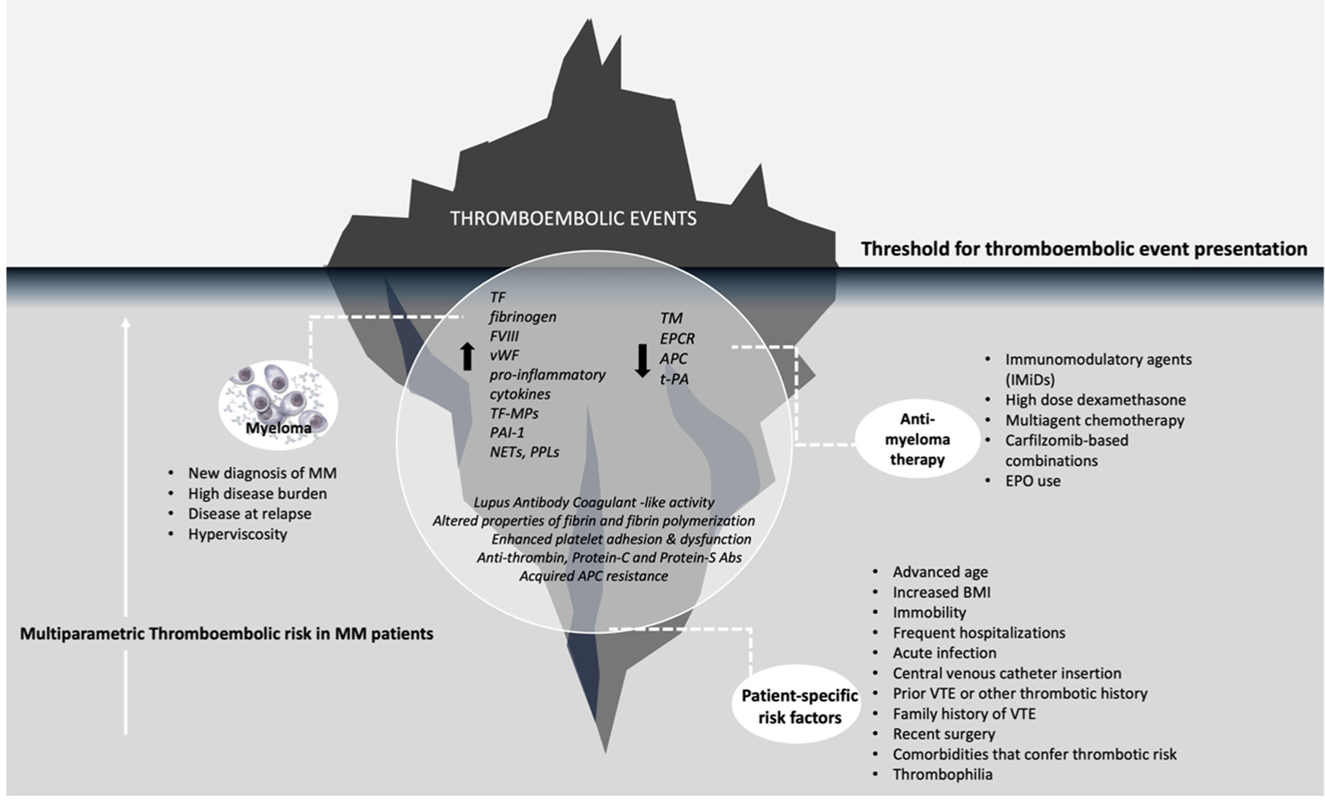


risk assessment for THROMBOSIS
THROMBOEMBOLIC EVENTS
Threshold for thromboembolic event presentation
Myeloma
IMiDs
High dose dexamethasone
Multiagent chemotherapy
Carfilzomib-based combinations
EPO use
Anti-
myeloma
therapy
New diagnosis of MM
High disease burden
Disease at relapse
Hyperviscosity
Advanced age
Increased BMI
Immobility
Frequent hospitalisations
Acute infection
Central venous catheter insertion
Prior VTE or other thrombotic history
Family history of VTE
Recent surgery
Comorbidities that confer thrombotic risk
Thrombophilia
Patient-specific risk factors
Multiparametric thromboembolic risk in MM patients
BMI, body mass index; EPO, recombinant erythropoietin; IMiD, immunomodulatory agent; MM, multiple myeloma; VTE, venous thromboembolism
Fotiou D, et al. Cancers (Basel). 2022;14:6216

Slide 68
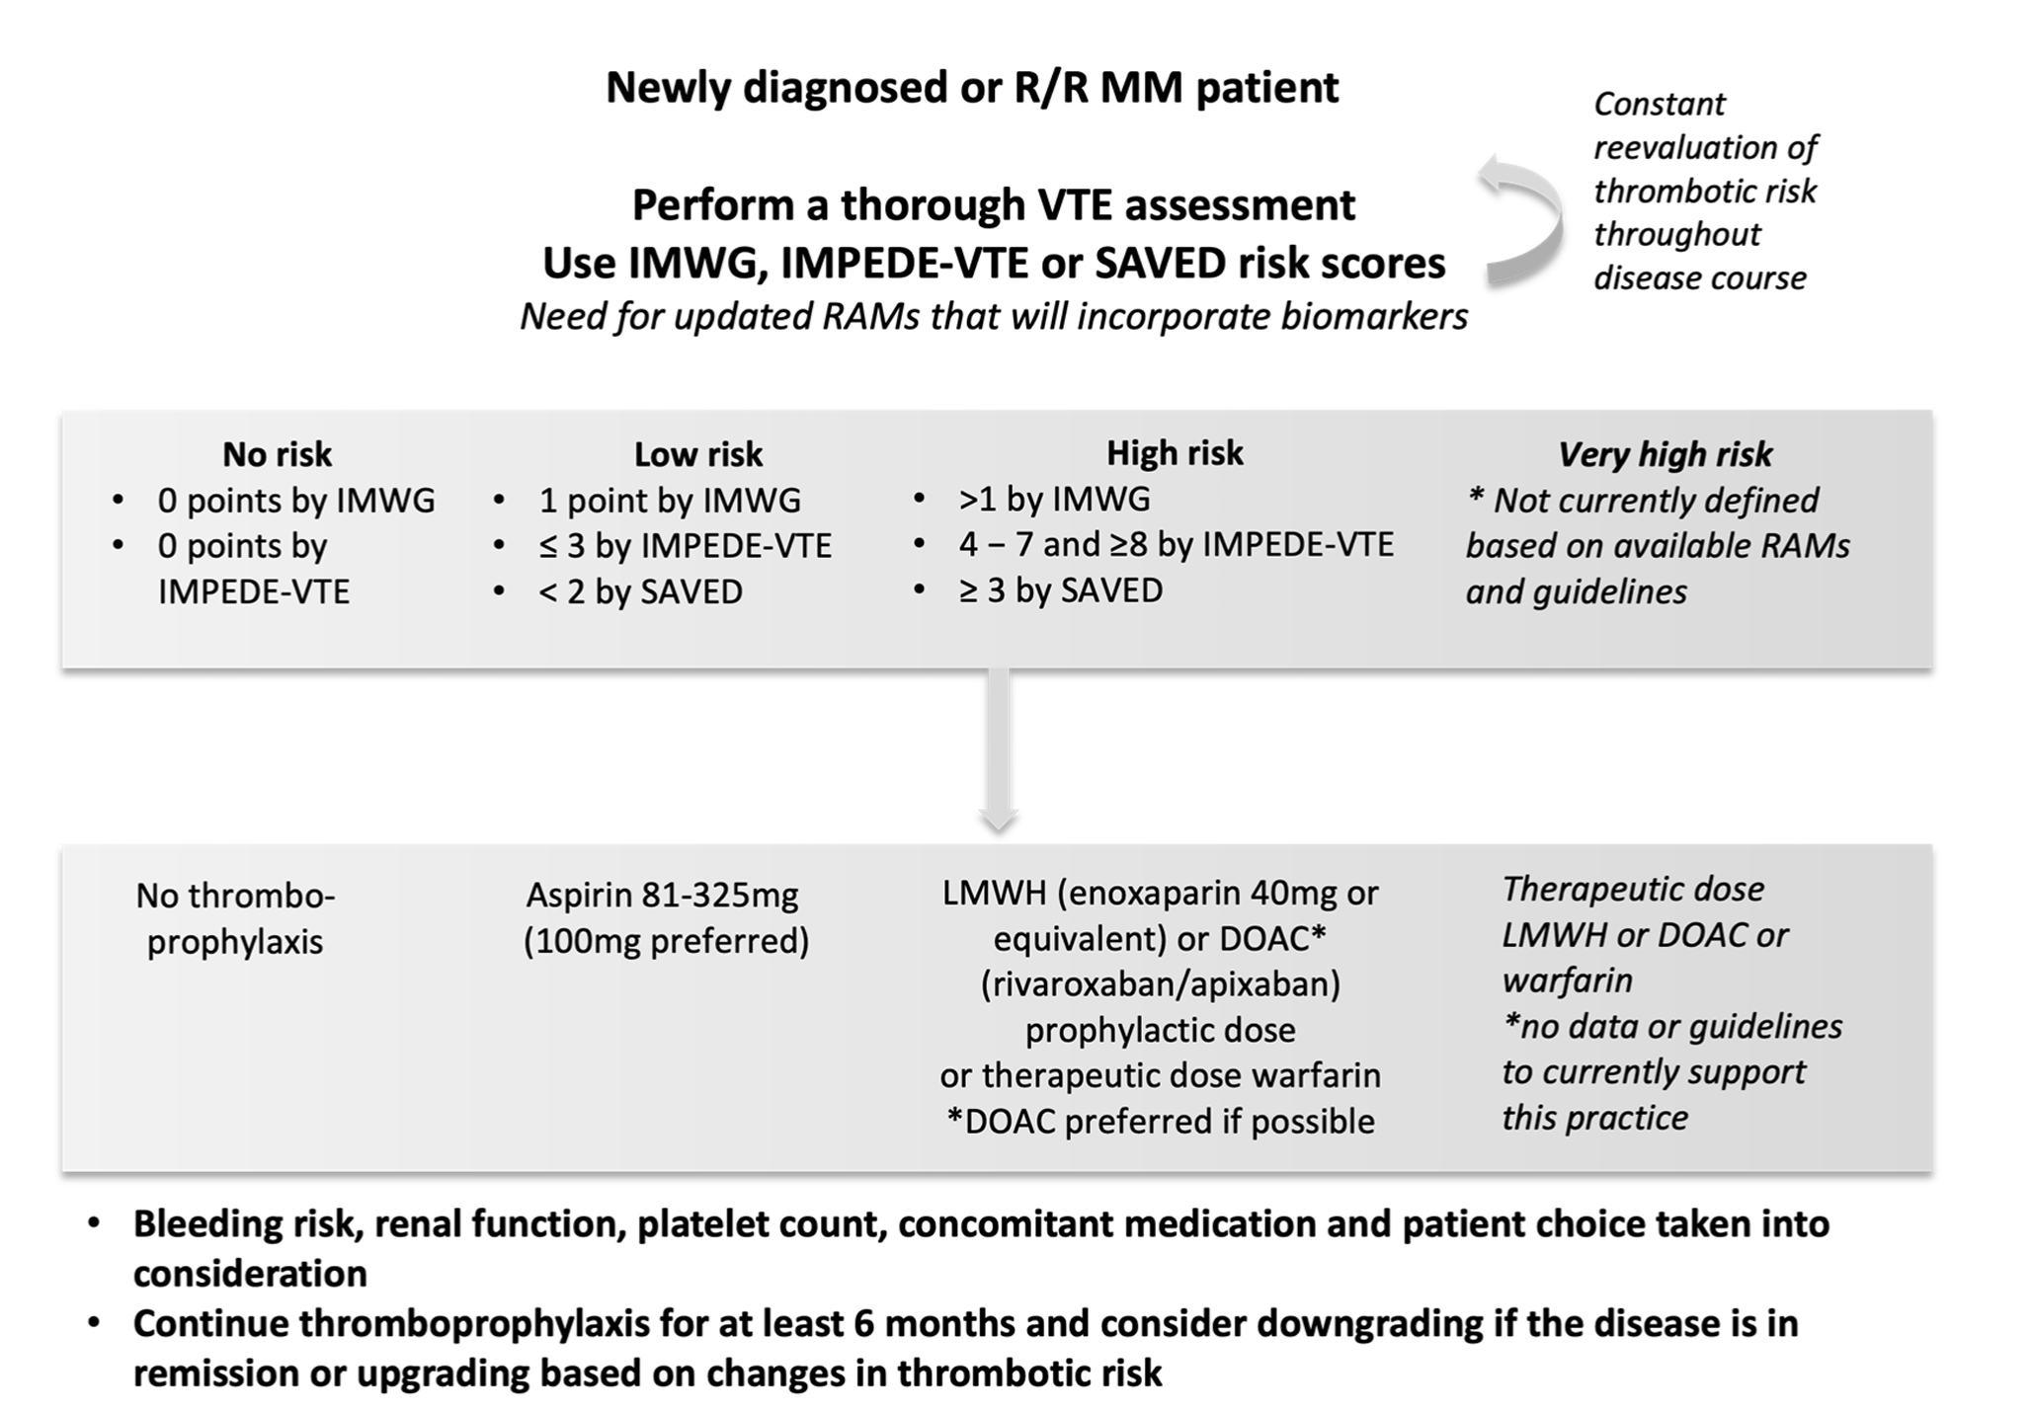
Thrombosis: risk assessment AND Management
Newly diagnosed or RRMM patient
Perform a thorough VTE assessment
Use IMWG, IMPEDE-VTE or SAVED risk scores
Constant re-evaluation of
thrombotic risk throughout
disease course
No risk | Low risk | High risk | Very high risk
0 points by IMWG 0 points by IMPEDE-VTE | 1 point by IMWG ≤3 by IMPEDE-VTE <2 by SAVED | >1 by IMWG 4-7 and ≥8 by IMPEDE-VTE ≥3 by SAVED | Not currently defined based on available RAMs and guidelines
No thromboprophylaxis | Aspirin 81-325 mg (100 mg preferred) | LMWH (enoxaparin 40 mg or equivalent) or DOAC* (rivaroxaban/apixaban) Prophylactic dose or therapeutic dose warfarin | Therapeutic dose LMWH or DOAC or warfarin No data or guidelines to currently support this practice
Bleeding risk, renal function, platelet count, concomitant medication and patient choice taken into consideration Continue thromboprophylaxis for at least 6 months and consider downgrading if the disease is in remission or upgrading based on changes in thrombotic risk
ª DOAC preferred. DOAC, direct oral anticoagulant; IWMG, International Myeloma Working Group; LMWH, low molecular weight heparin; RAM, risk assessment model; RRMM, relapsed/refractory multiple myeloma; VTE, venous thromboembolism
Adapted from Fotiou D, et al. Cancers (Basel). 2022;14:6216

Slide 69
Frailty assessment
IMWG FRAILTY SCORE
Age
Comorbidities:
  CCI
Patient-reported functional status
  Katz Index of Independence in Activities of Daily Living
  Lawton Instrumental Activities of Daily Living
Fit = score 0
Intermediate fit = score 1
Frail = score ≥2
INCL. PROGNOSTIC FEATURES
INCL. OBJECTIVE PARAMETERS
SIMPLIFIED ASSESSMENTS
R-MCI SCORE
Age
Comorbidities
  Renal function
  Pulmonary function
Frailty evaluation
Karnofsky performance status
Cytogenetics
MRP score
Age
WHO performance status
ISS stage
Circulating CRP levels
MAYO CLINIC SCORE
Age
ECOG performance status
Circulating NT-proBNP levels
EVALUATION OF SARCOPENIA
Muscle mass: CT 3rd lumbar vertebra area
Muscle function: grip strength
Physical performance: gait speed, etc.
SENESCENCE BIOMARKERS
SIMPLIFIED FRAILTY SCORE
Age
Comorbidities
  CCI
ECOG performance status
QUALITY-OF-LIFE QUESTIONNAIRE
Patient-reported functional status
  EORTC QoL questionnaire C30
Stage I
score 0
Stage II
score 1
Stage III
score 2
Stage IV
score 3
None-frail
score 0-1
Frail
score ≥2
Fit
score ≤3
Intermediate fit
score 4-6
Frail
score >6
Low risk
Medium risk
High risk
CCI, Charlson Comorbidity Index; CRP, C-reactive protein; CT, computed tomography; ECOG, Eastern Cooperative Oncology Group; EORTC QoL, European Organisation for Research and Treatment of Cancer quality of life; IMWG, International Myeloma Working Group; ISS, International Staging System for Multiple Myeloma; MRP, UK Myeloma Research Alliance Risk Profile; NT-proBNP, N-terminal pro-B-type natriuretic peptide; R-MCI, Revised Myeloma Comorbidity Index; WHO, World Health Organization
Adapted from Bonello F, et al. Cancers (Basel). 2020;12:3106

Slide 70
Dose Modifications for frail patients
Drug | Fit | Intermediate | Frail
Pls Bortezomib Carfilzomib Ixazomib | 1.3 or 1.5 mg/m² 27, 36, 56 or 70 mg/m² 4 mg | 1 mg/m² 20 or 27 mg/m² 3 mg | 0.7 or 1 mg/m² 15 mg/m² 2.3 mg
IMIDs Lenalidomide Pomalidomide Thalidomide | 25 mg 4 mg 100 or 200 mg | 15 mg 3 mg 50 or 100 mg | 10 mg 2 mg 50 mg
Alkylating agents Cyclophosphamide Bendamustine Melphalan | 300 mg/m² 90 or 100 mg/m² 0.25 mg/kg | 150 or 225 mg/m² 70, 75 or 80 mg/m² 0.18 mg/kg | 75 or 150 mg/m² 25, 50 or 60 mg/m² 0.13 mg/kg
Antibodies Daratumumab Elotuzumab | 16 mg/kg 10 mg/kg | No adjustment No adjustment | No adjustment No adjustment
XPO1 inhibitors² Selinexor (in SVd regimen) | 100 mg/week | 80-100 mg/week | 60-80 mg/week
Histone deacetylase inhibitor Panobinostat | 20 mg | 15 mg | 10 mg
d, dexamethasone; IMID, immunomodulatory drug; PI, proteasome inhibitor; S, selinexor; V, bortezomib; XPO1 exportin 1
Table adapted from Leng S, et al. Hematology Am Soc Hematol Educ Program. 2019;2019:125-136

Slide 71
dose modification for patients with renal dysfunction
Agents | Mechanism of action | CrCl | Dose adjustment
Ixazomib | PI | ≥30 mL/min <30 mL/minª | 4 mg on Day 1, 8 and 15 3 mg on Day 1, 8 and 15
Lenalidomide | IMiD | >60 mL/min 30-59 mL/min 15-29 mL/min <15 mL/minª | 25 mg daily 10-15 mg daily 10 mg daily or 15 mg every other day 5 mg daily
Pomalidomide | IMiD | ≥45 mL/min <45 mL/min | No dose adjustment Further studies needed for safety/efficacy
Melphalan | Alkylating agent | >60mL/min 15-59 mL/min <15 mL/minª | No dose adjustment 25% reduction 50% reduction
No dose adjustment required for bortezomib, carfilzomib, dexamethasone, cyclophosphamide, thalidomide, doxorubicin, selinexor, daratumumab, elotuzumab, and panobinostat in patients with renal impairment
ª Or ESRD on HD
CrCl, creatinine clearance; ESRD, end-stage renal disease; HD, haemodialysis; IL-6, interleukin-6; IMiD, immunomodulatory agent; mAb, monoclonal antibody; PI, proteasome inhibitor
George LL, et al. Clin Lymphoma Myeloma Leuk. 2021;21:812-822

Slide 72
CONCLUSIONS
PIs, IMiDs and mAbs are the mainstay of treatment for RRMM but are associated with a range of both hematological and non-hematological side effects
Prevention and management of side effects is critical to improve safety and tolerability and long-term adherence to treatments
Selinexor is associated with nausea during initial treatment, but this is often transient and can be minimised through dose reduction and the use of anti-emetics
Infection prevention strategies are important for the safe use of T-cell directed therapies
Cardiac monitoring, venous thromboembolism risk assessment and dose adjustments for frailty and renal dysfunction also need to be considered as part of the holistic management of patients with MM
IMiD, immunomodulatory agent; mAb, monoclonal antibody; MM, multiple myeloma; PI, proteasome inhibitor; RRMM, relapsed/refractory multiple myeloma

Slide 73
Patient case study presentations & discussion

Slide 74
Case study 1: Patient profile
Age 78 years
ECOG PS: 1
PMH: Hypertension, mild obesity, T2DM
Presented with hip pain
and fatigue
Diagnosis: November 2021
IgG lambda multiple myeloma
Hb:103 g/L, mild renal impairment
Lesions in left hip
MM FISH – No high-risk chromosomal abnormality
R-ISS I standard risk
Educational case study
ECOG, Eastern Cooperative Oncology Group; FISH, fluorescence in situ hybridisation; Hb, haemoglobin; IgG: immunoglobulin; MM, multiple myeloma;
PMH, previous medical history; PS, performance status; R-ISS, revised International Staging System; T2DM, type 2 diabetes mellitus

Slide 75

Case study 1: Treatment
November 2021
Front-line treatment: DaraRd – complete remission
Patient reported increasing bone pain and multiple new lesions were detected
November 2023
Educational case study
DaraRd, daratumumab, lenalidomide, dexamethasone.

Slide 76
CASE study 1: POLLING QUESTION
In your country WHAT treatment would be offered at 2nd line?
Pomalidomide, bortezomib, dexamethasone
Carfilzomib, dexamethasone
Elotuzumab, lenalidomide, dexamethasone
Selinexor, bortezomib, dexamethasone
Other

Slide 77
Case study 1: Treatment
November 2021
Front-line treatment: DaraRd – complete remission
Patient reported increasing bone pain and multiple new lesions were detected
Second-line treatment: SVd
  Patient developed Grade 2 nausea after the first dose despite prophylactic Akynzeo (NK₁ receptor antagonist/5-HT₃ receptor antagonist)
  Selinexor dose was reduced from 100 to 80 mg per week and the patient was prescribed olanzapine
  Nausea resolved and patient continued with the lower dose of selinexor
Patient achieved a VGPR and is continuing to receive SVd
  Anti-nausea drugs were successfully tapered off
November 2023
December 2023
February 2024
Educational case study
DaraRd, daratumumab, lenalidomide, dexamethasone; VGPR, very good partial response; SVd, selinexor, bortezomib, dexamethasone

Slide 78

Case study 2: Patient profile
Age 59 years
ECOG PS: 0
PMH: None of note
Presented with back pain
Diagnosis: March 2021
IgG kappa multiple myeloma
Hb:112 g/L, normal renal function
Small vertebral lesions
MM FISH – t(4;14), gain 1q21
R-ISS II intermediate risk
Educational case study
ECOG, Eastern Cooperative Oncology Group; FISH, fluorescence in situ hybridisation; Hb, haemoglobin; IgG: immunoglobulin; MM, multiple myeloma;
PMH, previous medical history; PS, performance status; R-ISS, revised International Staging System

Slide 79
Case study 2: Treatment
March 2021
Front-line treatment: VRd followed by ASCT and lenalidomide maintenance
January-July 2023
1st relapse: DaraKd; 2nd relapse: IsaPd
October 2023
3rd relapse: Ide-cel
  Day 2: Patient developed grade 1 CRS
  Day 5: Persistent fever treated with tocilizumab
  Day 6: Patient developed hesitant speech and reported headache
  Day 7: Patient experienced seizures and was diagnosed with grade 3 ICANS (ICE score 2)
Educational case study
ASCT, autologous stem cell transplant; CRS, cytokine release syndrome; DaraKd, daratumumab, carfilzomib, dexamethasone; ICANS, immune effector cell-associated neurotoxicity syndrome; ICE, immune effector cell-associated encephalopathy; ide-cel, idecabtagene vicleucel; IsaPd, isatuximab, pomalidomide, dexamethasone; VRd, bortezomib, lenalidomide, dexamethasone

Slide 80
CASE study 2: POLLING QUESTION
How would you treat this patient (select all that apply)?
Supportive care only
Dexamethasone
Methylprednisolone
Tocilizumab
Anakinra

Slide 81
Case study 2: Treatment
Front-line treatment: VRd followed by ASCT and lenalidomide maintenance
March 2021
January-July 2023
1st relapse: DaraKd; 2nd relapse: IsaPd
October 2023
3rd relapse: Ide-cel
  Day 2: Patient developed grade 1 CRS
  Day 5: Persistent fever treated with tocilizumab
  Day 6: Patient developed hesitant speech and reported headache
  Day 7: Patient experienced seizures and was diagnosed with grade 3 ICANS (ICE score 2)
  Treatment: Patient was transferred to the ICU and treated with dexamethasone, tocilizumab, lorazepam and levetiracetam
  Day 10: ICANS resolved
Patient achieved a CR
Educational case study
ASCT, autologous stem cell transplant; CRS, cytokine release syndrome; DaraKd, daratumumab, carfilzomib, dexamethasone; ICANS, immune effector cell-associated neurotoxicity syndrome; ICE, immune effector cell-associated encephalopathy; ICU, intensive care unit; ide-cel, idecabtagene vicleucel; IsaPd, isatuximab, pomalidomide, dexamethasone; VRd, bortezomib, lenalidomide, dexamethasone

Slide 82
Q&A discussion

Slide 83
Summary and look to the future
Assoc. Prof. Joshua Richter
Hematologist-Oncologist
Icahn School of Medicine at Mount Sinai, USA

Slide 84
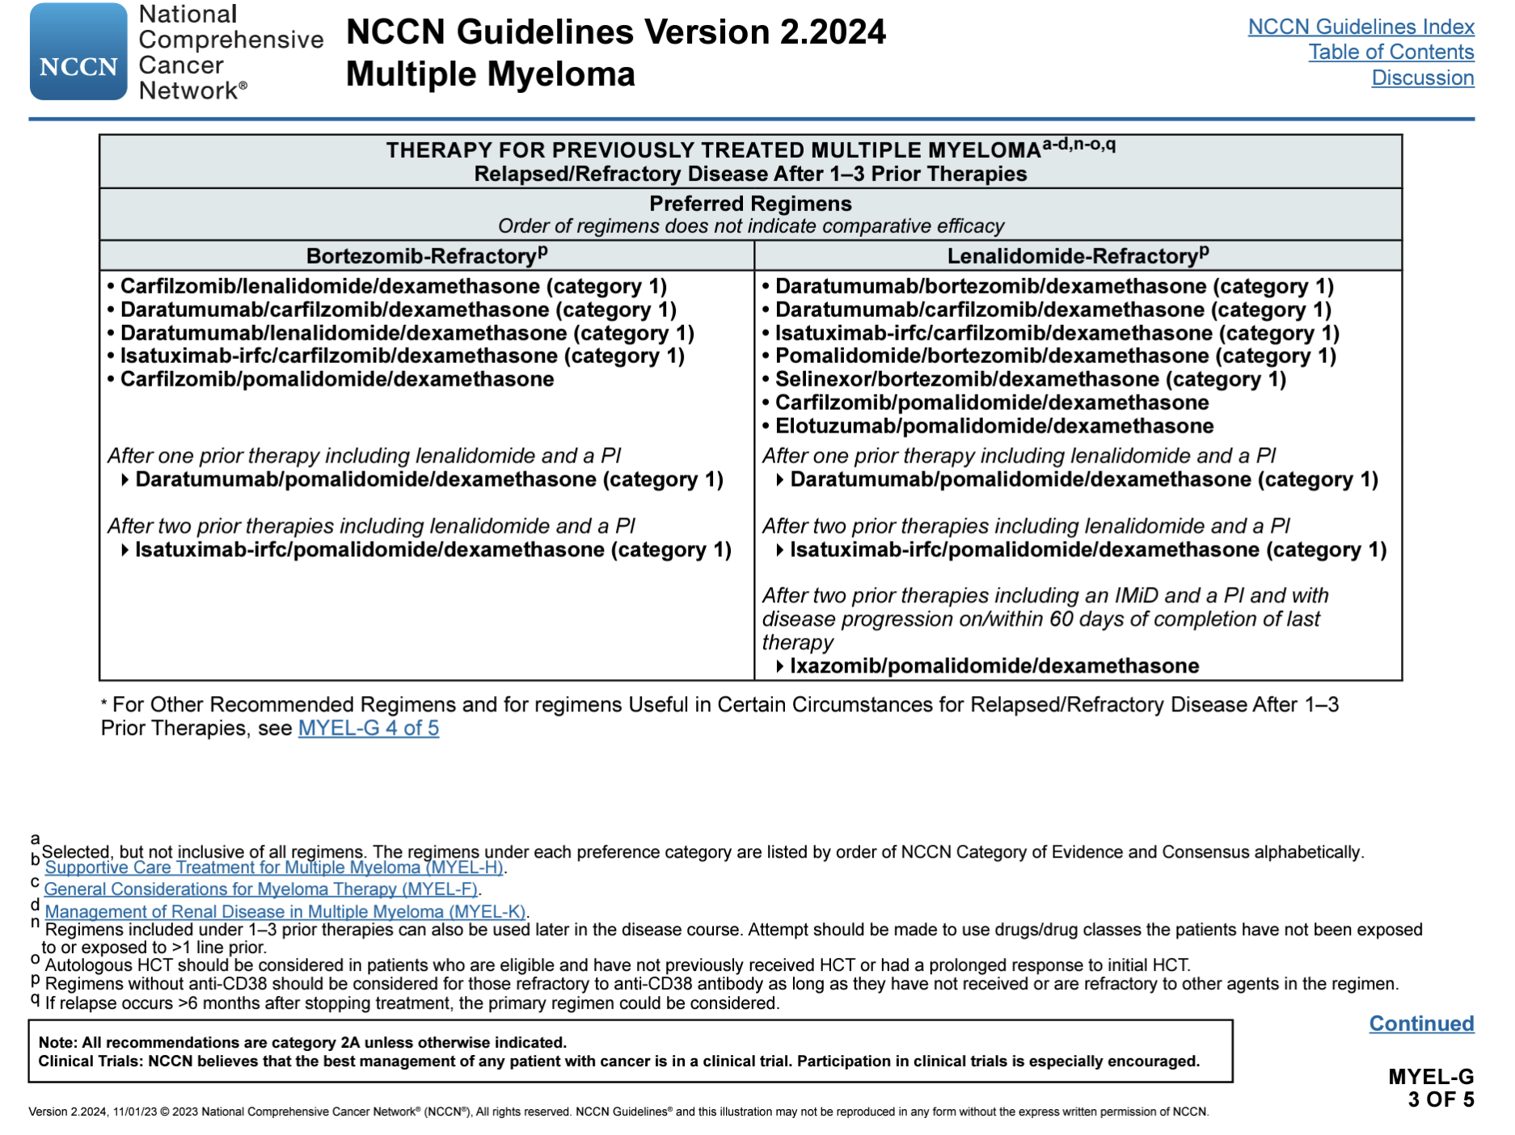
NCCn guidelines for early RRmm
HCT, haematopoietic stem cell transplantation; IMiD, immunomodulatory drug; MM, multiple myeloma; PI, proteasome inhibitor
Kumar SK, et al. J Natl Compr Cancer Netw. 2023;21:1281-1301

Slide 85
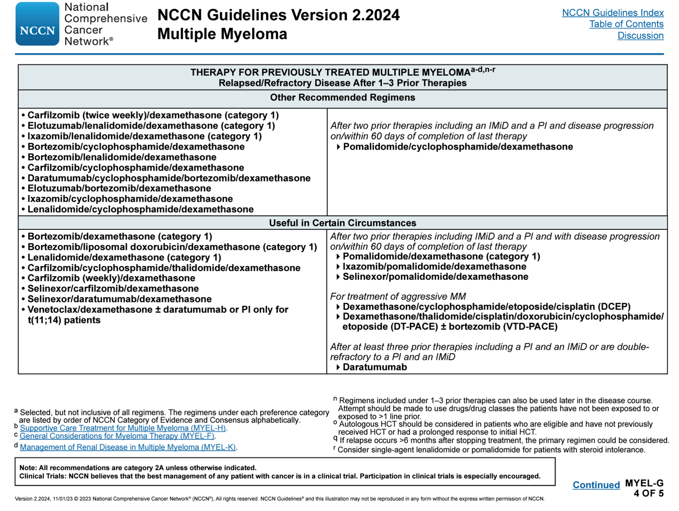
NCCn guidelines for early mm
HCT, haematopoietic stem cell transplantation; IMiD, immunomodulatory drug; MM, multiple myeloma; PI, proteasome inhibitor
Kumar SK, et al. J Natl Compr Cancer Netw. 2023;21:1281-1301

Slide 86
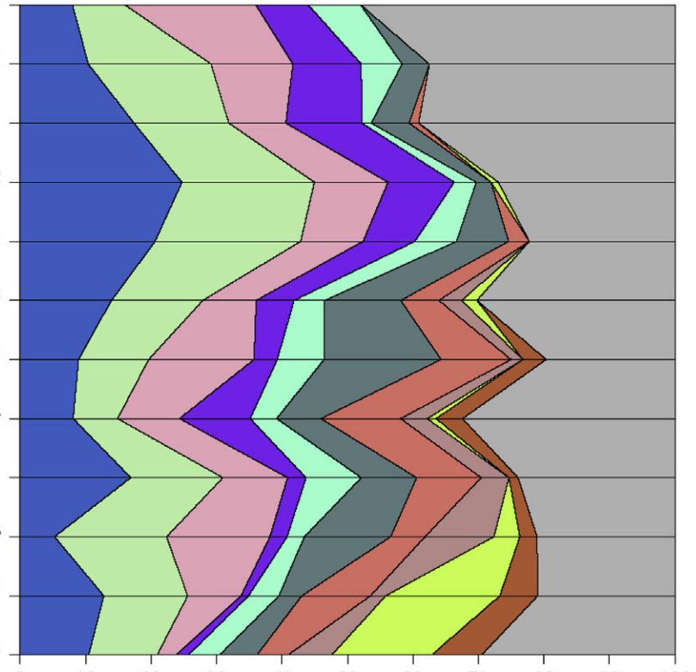
Second line Treatment Patterns in the Connect MM Registry from 2010 to 2016
Prior to 2010
Bortezomib
Thalidomide
Lenalidomide
Doxorubicin
Jul-Dec 2010
(n=25)
Vd
Jan-Jun 2011
(n=48)
Rd
Jul-Dec 2011
(n=69)
RVd
Jan-Jun 2012
(n=89)
V
Jul 2012:
Carfilzomib
Jul-Dec 2012
(n=63)
R
Feb 2013:
Pomalidomide
Jan-Jun 2013
(n=86)
CyVd
Jul-Dec 2013
(n=56)
Kd
Jan-Jun 2014
(n=74)
Pd
Jul-Dec 2014
(n=71)
RKd
Feb 2015:
Panobinostat
Jan-Jun 2015
(n=76)
PKd
Nov 2015
Daratumumab
Ixazomib
Elotuzumab
Jul-Dec 2015
(n=86)
Other
Jan-Jun 2016
(n=105)
0
10
20
30
40
50
60
70
80
90
100
Proportion of patients
Cy, cyclophosphamide; d, dexamethasone; K, carfilzomib; MM, multiple myeloma; P, pomalidomide; R, lenalidomide; V, bortezomib
Jagannath S, et al. Clin Lymphoma Myeloma Leuk. 2018;18:480-485.e3

Slide 87
Treatment Duration and Treatment-Free Intervals in Real‐World Practice
Proportion of patients reaching this line of therapy (%)
100%
Treatment-free interval
Diagnosis
Active treatment
Maintenance treatment
95%
1 m
6 m
6 m
Median duration in months shown
1L
Start
1L
End 1L
induction
End 1L
maintenance
2L
61%
10 m
7 m
Start
2L
End2L
38%
5 m
6 m
3L
Start
3L
End3L
15%
3 m
5 m
4L
Start
4L
End4L
1 m
4 m
5L
1%
Start
5L
End5L
Data from 4997 patient charts in Belgium, France, Germany, Italy, Spain, Switzerland, and the UK. The proportion of patients who had received each line are from a cross-sectional review; data on durations of treatment and treatment-free intervals are from a retrospective review.
1L-5L, first line-fifth line treatment; m, month
Yong K, et al. Br J Haematol. 2016;175:252-264
Notes:
Treatment duration and treatment‐free intervals. Data on the proportion of patients who had received each line are from the cross‐sectional review; data on durations of treatment and treatment‐free intervals are from the retrospective review. 1L–5L, first line–fifth line; CI, confidence interval; m, month.
Yong. 2016. 257-figure 2

Slide 88
prevalence of TRIPLE CLASS refractoriness is growing
Real-world assessment of refractoriness patterns in 413 patients
treated in an Italian hAematological tertiary care centre
% of patients developing triple class refractoriness after 2 or 3 lines of therapy
After 3 lines of therapy
After 2 lines of therapy
<2019
≥2019
≥2021
Morè S, et al. Br J Haematol. 2023; 201:432-442

Slide 89
Suggested approach to the Treatment of Triple class refractory early RRmm
CAR-T eligible
and available?
Selinexor-based
combination
t(11;14), not
Venetoclax refractory
Not carfilzomib
refractory
Not pomalidomide
refractory
Good general health and prospect of future CAR-T/TCE
Not
K-refractory
Not
K-refractory
Not
P-refractory
Not
K-refractory
Yes
Treat with CAR-T cells
Hematopoietic cells in storage
S-Kd
Ven-Kd
KPd
KPd
No
Not
P-refractory
No recent
anti-CD38 mAb
No recent
anti-CD38 mAb
No recent
anti-CD38 mAb
Yes
No
S-Pd
D-Ven-d
Ikd/DKd
IPd/DPd
Autologous
HCT
Good hematologic
function
No recent
anti-CD38 mAb
Not
E-refractory
DSd
Ven-d
KCd
EPd
Yes
No
Sd
Combination
chemotherapy
Consider other
options, BSC with no MM-directed therapy
BSC, best supportive care; C, cyclophosphamide; CAR-T, chimeric antigen receptor T cell (therapy); d, dexamethasone; D, daratumumab; E, elotuzumab; HCT, hematopoietic cell transplantation; I, isatuximab; K, carfilzomib; mAb, monoclonal antibody; MM, multiple myeloma; P, pomalidomide; S, selinexor; TCE, T-cell engager; Ven, venetoclax
Adapted from Costa LJ, et al. Br J Haematol. 2022;198:244-256

Slide 90
Prediction: How will we treat RRMM in 5 years' time?
Newly
Diagnosed
MYELOMA
Plateau
remission
  EARLY
  RELAPSE
  LATE
  RELAPSE
100
2nd RELAPSE
M protein (g/L)
1st RELAPSE
50
20
Induction
QUAD: No transplant
Early relapse (1-3 prior lines)
XPO1 inhibitor
Novel CAR T (Different Ag)
Novel Ab: ADC-combination vs. bi-/trivalent Ab
Late relapse
Third party cellular therapy (NK + T cell)
CRISPR gene editing strategies
Bispecific combinations
Consolidation
MRD+: CAR T (TE) vs. Bispecific (TI)
Maintenance
MRD-: Maintenance: Lenalidomide/mAb vs. Bispecific
ADC, antibody-drug conjugate; Ag, antigen; CAR T, chimeric antigen receptor T cell; CRISPR, clustered regularly interspaced short palindromic repeats; (m)Ab, (monoclonal) antibody; M protein, monoclonal protein (or M spike); MRD, minimal residual disease; NK, natural killer; QUAD, quadruplet; RRMM, relapsed/refractory multiple myeloma; TE, transplant eligible; TI, transplant ineligible; XPO1, exportin 1
Slide adapted from presentation at ASCO 2020 (Tom Martin).

Slide 91
Key Clinical Takeaways
Myeloma is a continually evolving field with modern day induction regimens yielding near 100% response rates in the front-line setting with typically durable remissions
This has been achieved through triplets and quadruplets comprised of the 3 classic MOAs: IMiD, PI, mAb
In the relapsed/refractory space it is important to embrace novel MOAs/targets to optimally manage recurrent disease: XPO1, BCMA, GPRC5d
T-cell health is an important long-term consideration for patients to maximise efficacy of T-cell redirection therapy
Treatments that are T-cell-sparing, such as XPO1 inhibitors and IMiDs, have the potential to preserve T-cell health
BCMA, B-cell maturation antigen; GPRC5D, G protein–coupled receptor class C group 5 member D; IMiD, immunomodulatory drug; mAb, monoclonal antibody; MOA, mechanism of action; PI, proteasome inhibitor; XPO1, exportin 1

