Slide 2
Precision oncology connect the evolving role of liquid biopsy
Assoc. Prof. Umberto Malapelle, PhD
Molecular Pathologist, Department of Public Health,
University of Naples Federico II, Naples, Italy
JULY 2023

Slide 3

Developed by PRECISION ONCOLOGY COnnect
This programme is developed by PRECISION ONCOLOGY CONNECT,
an international group of experts in the field of oncology.
Acknowledgement and disclosures
This PRECISION ONCOLOGY CONNECT programme is supported through an independent educational grant from Bayer. The programme is therefore independent, the content is not influenced by the supporter and is under the sole responsibility of the experts.
Please note: The views expressed within this programme are the personal opinions of the experts. They do not necessarily represent the views of the experts’ institutions, or the rest of the PRECISION ONCOLOGY
CONNECT group.
Expert disclosures – the experts have received financial support/sponsorship for research support, consultation, Travel or speaker fees from the following companies:
Assoc. Prof. Umberto Malapelle, PhD: Amgen, AstraZeneca, Boehringer Ingelheim, Diaceutics, Diatech, Eli Lilly, GSK, Hedera, Janssen, Merck, MSD, Novartis, Roche, Thermo Fisher Scientific.

Slide 4
Educational objectives
Upon completion of this activity, the learner will:
Know the latest developments and practical recommendations on the role of liquid
biopsy in precision oncology, and how to apply this across the patient journey

Slide 5
Clinical takeaways
Liquid biopsies offer a less invasive alternative to traditional tissue biopsies in patients with solid tumours, to examine molecular features
The role of liquid biopsy should be seen as a complementary testing method to tissue-based assays and the information derived should be reviewed in combination with tissue results
The clinical application of liquid biopsies ranges from screening and diagnosis, treatment guidance, monitoring minimal residual disease to assessing chemotherapy resistance

Slide 6










What is a liquid biopsy?
A liquid biopsy can be derived from the blood and other body fluids, e.g., saliva, ascites fluid, urine, cerebrospinal and pleural fluid
LIQUID BIOPSY
PERSONALISED MEDICINE
Enrichment and detection from plasma/serum of:
Circulating tumour cells
Circulating tumour nucleic acids
(cell-free DNA, microRNA, mRNA, IncRNA)
Circulating tumour microvesicles/exosomes
lncRNA, long non-coding RNA; mRNA, messenger RNA
Raimondi L, et al. Oncotarget. 2017;8:100831-100851; Nikanjam M, et al. J Hematol Oncol. 2022;15:131

Slide 7
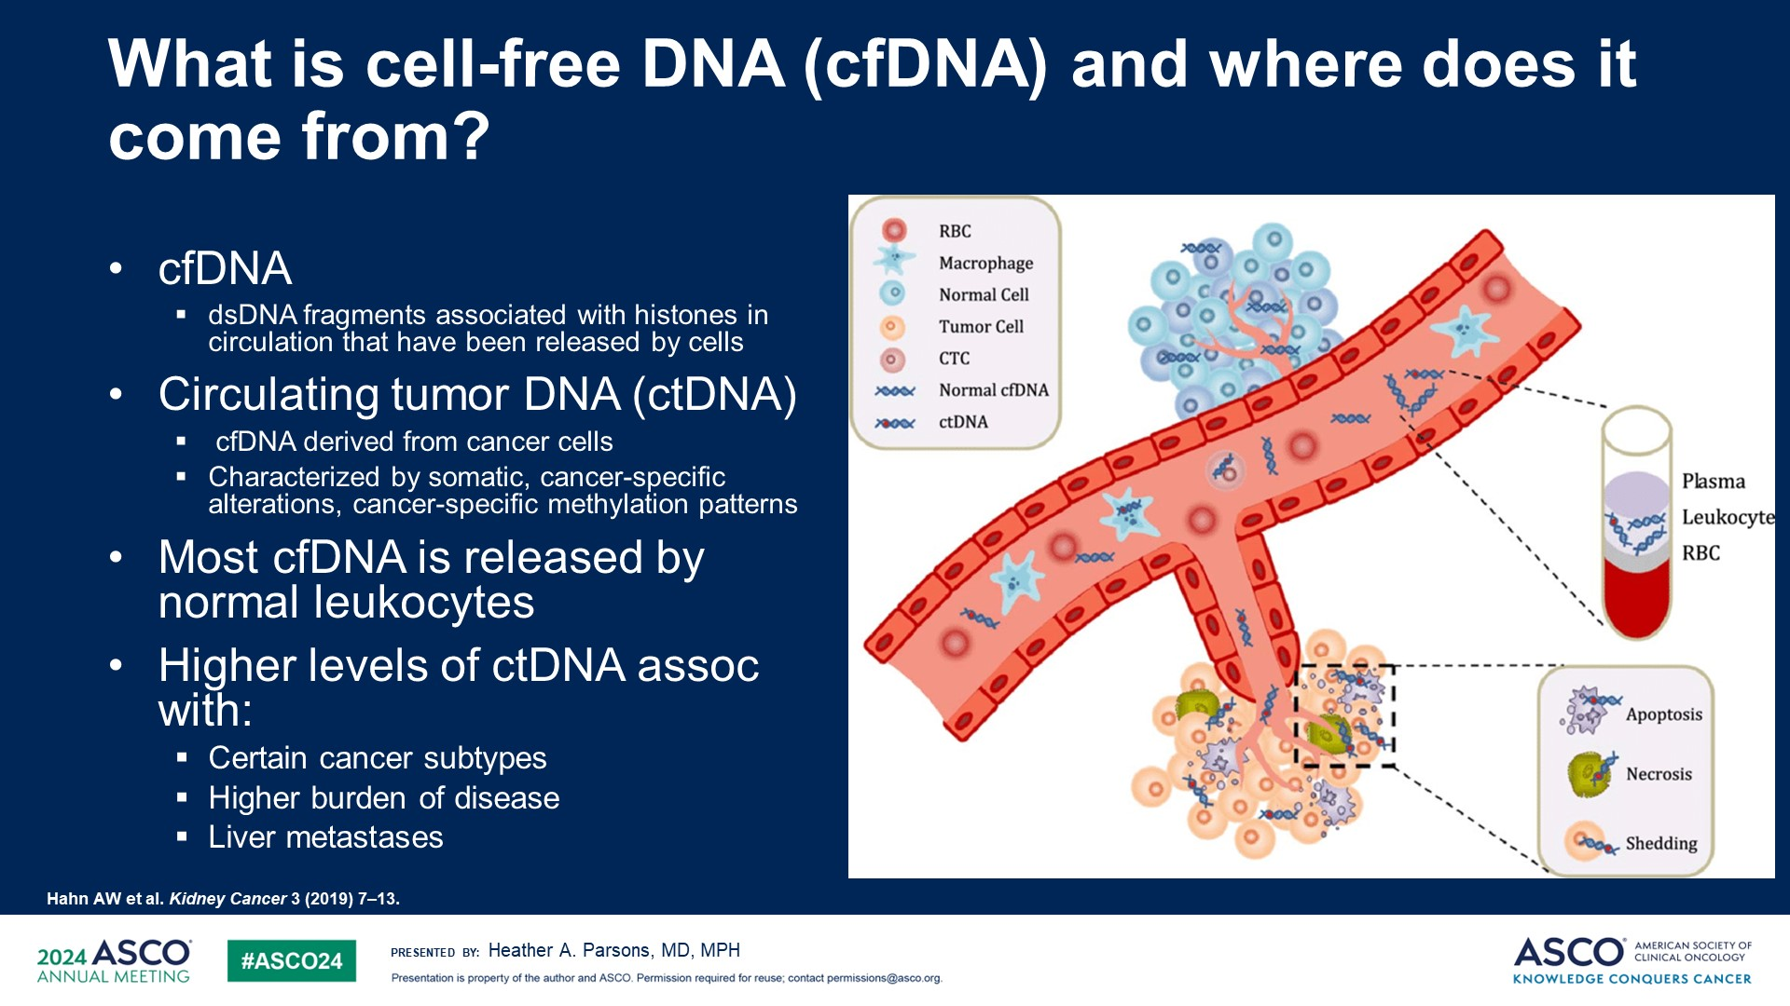
What is cell-free DNA (cfDNA) and circulating tumour dna (ctDNA)
cfDNA
  dsDNA fragments associated with histones in circulation that have been released by cells
Circulating tumour DNA (ctDNA)
  cfDNA derived from cancer cells
  Characterised by somatic, cancer-specific alterations, cancer-specific methylation patterns
Most cfDNA is released by normal leukocytes
Higher levels of ctDNA associated with:
  Certain cancer subtypes
  Higher burden of disease
  Liver metastases
RBC
Macrophage
Normal cell
Tumour cell
CTC
Normal cfDNA
ctDNA
Plasma
Leucocyte
RBC
Apoptosis
Necrosis
Shedding
cfDNA, cell-free DNA, CTC, circulating tumour cell; ctDNA, circulating tumour DNA, dsDNA, double-stranded DNA; RBC, red blood cell
Hahn AW, et al. Kidney Cancer 3, 2019;7-13; Qi T, et al. Int J. Mol Sci. 2023; 24: 1503; Sanchez-Herrero E, et al. Front. Oncol. 2022; 12: 943253; Parsons HA. ASCO 2024

Slide 8
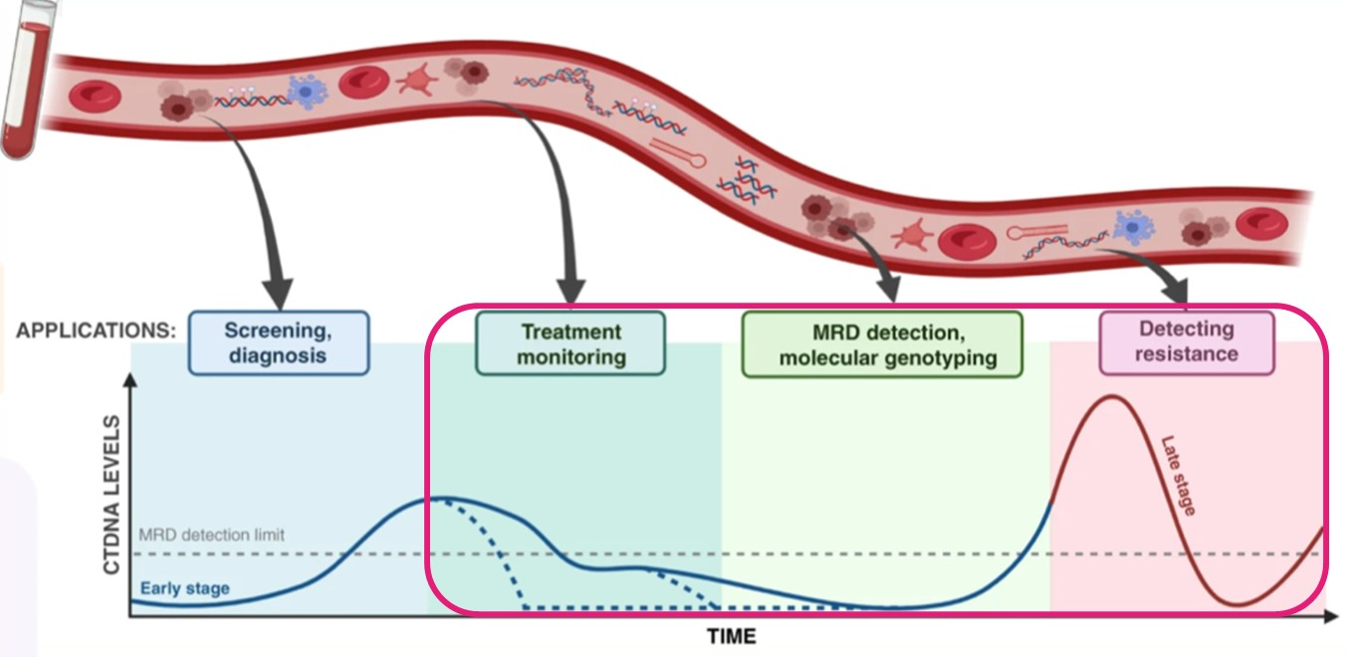
ctDNA may have utility across the disease spectrum
CT(ct)DNA, circulating tumour DNA; MRD, minimal residual disease
García-Pardo M, et al. Br J Cancer. 2022;127:592-602

Slide 9
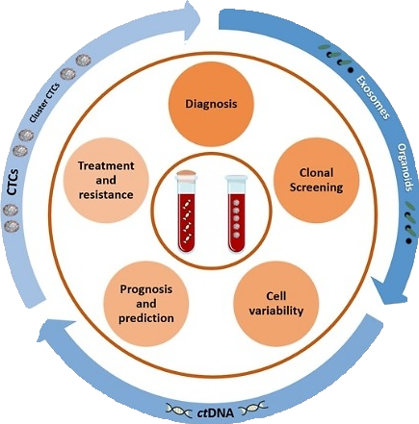
Challenges and opportunities of cfdna
 | Breast Cancer | Colorectal cancer | Lung Cancer
Targetable genomic alterations | Gene amplifications Gene expression Genomic signatures | Gene expression Genomic signatures Gene mutations | Mutations (insertions, deletions, etc..) Translocations Gene amplifications Gene expression Genomic signatures
Uses | BC CTCs based on prognosis cfRNA (miRNAs) in HER2 BC TEPs in BC diagnosis PIK3CA mutations in ctDNA ESR1 mutations CancerSEEK BC early diagnosis cfDNA plasma levels and BC stages BC intra/intertumoural heterogeneity | Cancer screening Residual disease evaluation CRC CTCs prognosis score Prognostic assessment in early CRC RAS panel mutation status Prognostic significance of miRNAs Mechanism of acquired resistance to anti-EGFR drugs | Drug selection (1L) Resistance detection Early disease detection in high-risk populations bTMB measurement CTCs and lung cancer prognosis ctDNA detection in pleural and CSF PD1/PDL1 expression in CTCs and exosomes Alteration such as EGFR, KRAS, BRAF , ALK, ROS1, RET fusions, MET exon 14 skipping
Step forward to personalised treatment
1L, first line; ALK, anaplastic lymphoma kinase; BC, breast cancer; BRAF, b-Raf proto-oncogene; bTMB, blood-based tumour mutational burden; cfDNA/RNA, cell-free DNA/RNA; CRC, colorectal cancer; CSF, cerebrospinal fluid; CTC, circulating tumour cell; ctDNA, circulating tumour DNA; EGFR, epidermal growth factor; ESR1, estrogen receptor 1; HER2, human epidermal growth factor receptor 2; KRAS, Kirsten rat sarcoma viral oncogene homologue; MET, hepatocyte growth factor receptor; miRNA, micro-RNA; PD-1, programmed cell death protein 1; PD-L1, programmed death-ligand 1; PIK3CA, phosphatidylinositol-4,5-bisphosphate 3-kinase catalytic subunit alpha; Ras, rat sarcoma; RET, rearranged during transfection; ROS1, ROS proto-oncogene 1, receptor tyrosine kinase; TEP, tumour-educated platelets
Rolfo C, et al. Crit Rev Oncol Hematol. 2020;151:102978

Slide 10
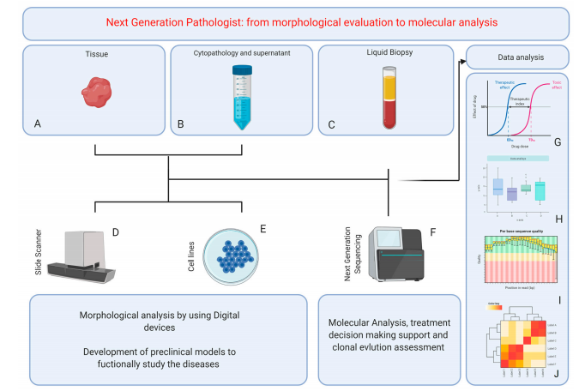
The Role of the Pathologist in the Next-Generation Era of Tumour Molecular Characterisation
Angerilli V, et al. Diagnostics (Basel). 2021;11:339

Slide 11
Methodological scenario for molecular testing in NSCLC patients
Point mutations and Indels
Protein expression and gene fusions
Sanger Sequencing | Real Time PCR | Digital PCR | NGS
10–20% | 1–5% | 0.1–1% | 0.01–5%
All the mutations present in the analysed gene regions | Only «hot spot» mutations (probe based) | Only «hot spot» mutations (probe based) | All the mutations present in the analysed gene regions
Immuno – histochemistry | Fluorescent in situ hybridisation | Multiplex digital colour-coded barcode | NGS
Tissue based technique (protein) | Tissue based technique (DNA) | 5–10% | 0.01–5%
All the fusions - protein (antibody based) | Only specific fusions (probe based) | All the fusions present in the analysed gene regions | All the fusions present in the analysed gene regions
v
v
v
v
AGTTGCA
AGTTGCA
AGTTGCA
AGTTGCA
AGTTGCA
AGTTGCA
AGTTGCA
AGTTGCA
Limit of detection
Reference Range
FP | FN | FP | FN | FP | FN | FP | FN
FP | FN | FP | FN | FP | FN | FP | FN
FN, false negative; FP, false positive; NGS, next generation sequencing; NSCLC, non-small cell lung cancer; PCR, polymerase chain reaction
Passiglia F, et al. J Thorac Oncol. 2019;14:2046-2052

Slide 12
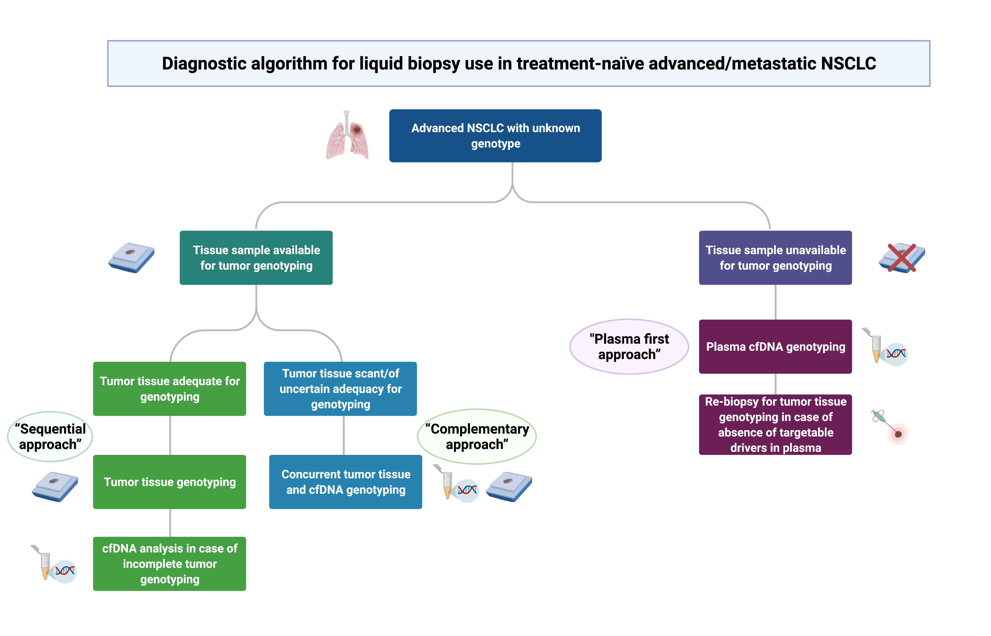
Positioning cfDNA genotyping in treatment naïve advanced NSCLC
Advanced NSCLC with
unknown genotype
Tissue sample available
for tumour genotyping
Tissue sample available
for tumour genotyping
“Plasma first approach”
Plasma cfDNA genotyping
Tumour tissue adequate
for genotyping
Tumour tissue scant/of uncertain adequacy for genotyping
“Sequential approach”
“Complementary approach”
Re-biopsy for tumour tissue genotyping in case of absence of targetable drivers in plasma
Tumour tissue genotyping
Concurrent tumour tissue and cfDNA genotyping
cfDNA analysis in case of incomplete tumour genotyping
cfDNA, cell-free DNA; NSCLC, non-small cell lung cancer
Rolfo C, et al. J Thorac Oncol. 2021;16:1647-1662

Slide 13
Why patients miss out on biomarker testing/diagnosis from tissue biopsy
NSCLC
Tissue biopsy may be unfeasible
in 9-18% of patients
Tissue biopsy
feasible
The overall tissue
biopsy failure rate
may be up to 43%
Tissue biopsy procedural failure
rates vary by technique and
can range from 4-42%
Tissue biopsy procedure
successful
Samples are inadequate for testing
in 8-26% of patients
Sample adequate
for testing
Access to testing varies by country
and region and depends on
infrastructure and reimbursement
Access
to testing
NSCLC, non-small cell lung cancer
Malapelle U, et al. J Mol Pathol. 2021;2:255-273

Slide 14


Estimate of patients in Europe who might benefit from liquid biopsy
In Europe, tissue biopsy may be unfeasible or inadequate, for molecular work-up in an
estimated 16,000 patients annually with NSCLC; these patients could potentially benefit from liquid biopsy
Based on published frequencies of NSCLC driver alterations, a molecular diagnosis based on liquid biopsy could
allow approximately 6,560 patients annually to benefit from current, emerging, and future targeted treatments
NTRK rearrangement
BRAF mutation
ROS1 rearrangement
RET rearrangement
MET mutation
ALK rearrangement
KRAS^{G12C} mutation
EGFR mutation
160 patients
320 patients
320 patients
320 patients
480 patients
800 patients
2,080 patients
2,400 patients
100 patients
ALK, anaplastic lymphoma kinase; BRAF, B-Raf proto-oncogene; EGFR, epidermal growth factor receptor; KRAS, Kirsten rat sarcoma viral oncogene homologue; MET, hepatocyte growth factor receptor; NSCLC, non-small cell lung cancer; NTRK, neurotrophic tyrosine receptor kinase; RET, rearranged during transfection; ROS1, ROS proto-oncogene 1, receptor tyrosine kinase
Malapelle U, et al. J Mol Pathol. 2021;2:255-273

Slide 15
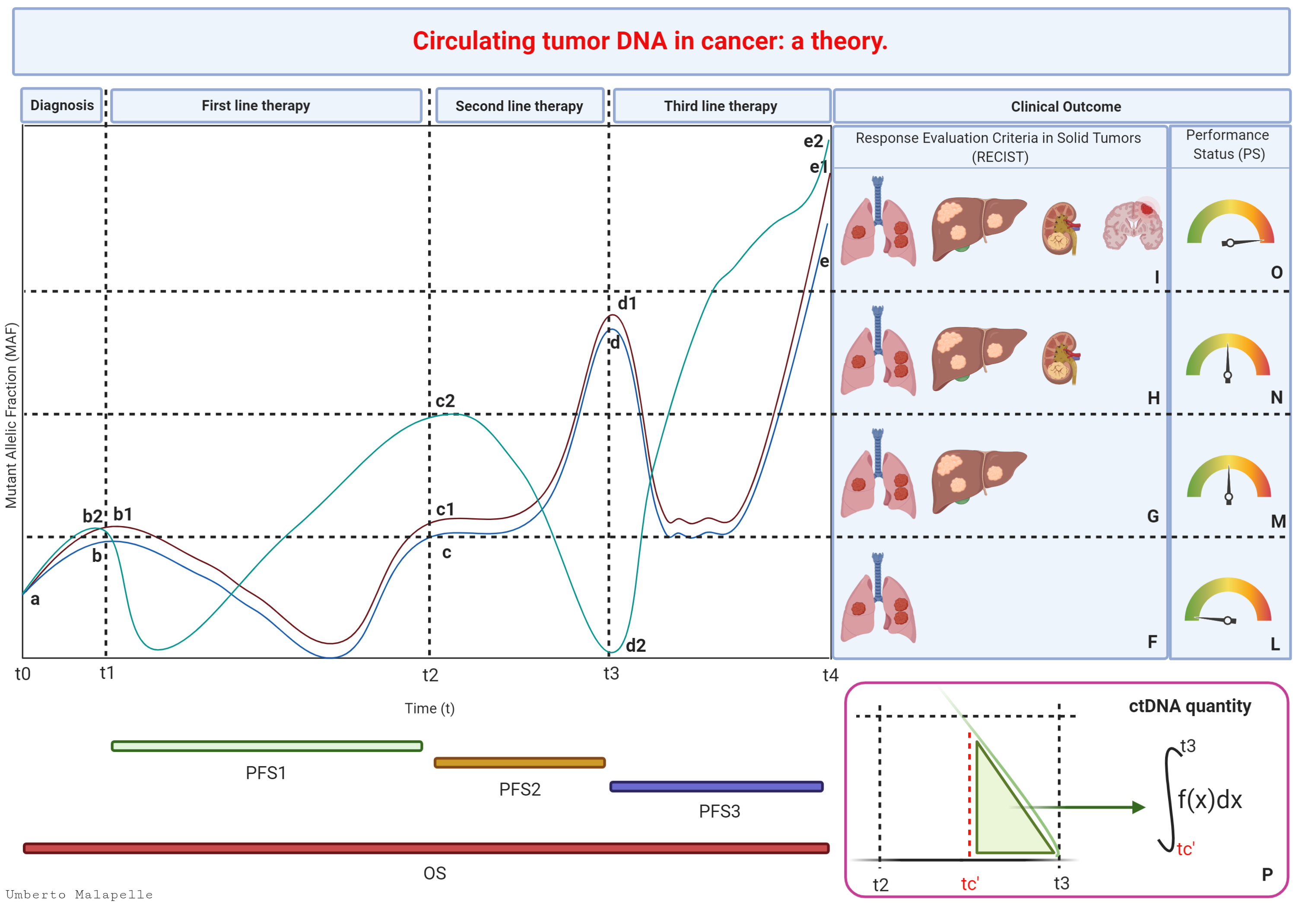
Following tumour evolution through liquid biopsy
ctDNA, circulating tumour DNA; OS, overall survival; PFS(1/2/3), progression-free survival (from start of first-, second-, third-line of treatment)
Malapelle U, et al. Manuscript in preparation

Slide 16
emerging molecular biomarkers in Breast Cancer
Predictive Biomarkers
Screening of healthy individuals
Diagnosis and prognosis
Treatment
selection
Treatment administration
Monitor for recurrence
Prognostic Biomarkers
Examples of predictive biomarkers in mBC | ER | BRCA1/2 | HER2 | 21-Gene recurrence score | PD-L1 | ESR1
Examples of prognostic biomarkers in mBC | HER2 | ER/PR | Ki-67 | Gene expression panels | DNA methylation
BRCA1/2, BReast CAncer gene 1/2; ER, estrogen receptor; ESR1, estrogen receptor 1; HER2, human epidermal growth factor receptor 2, mBC, metastatic breast cancer; Ki-67, antigen Kiel 67; PD-L1, programmed death-ligand 1; PR, progesterone receptor
American Cancer Society. Breast Cancer Facts & Figures 2019-2020. Atlanta: American Cancer Society, Inc. 2019; Ross D, et al. Modern Pathology 2018; 32: 81-87; Fu X, et al. Front Cell Dev Biol 2022; 10:813457

Slide 17
ESR1 mutation rate in mBC patients
There is a significant increase in DETECTION OF ESR1 alterations in metastatic samples
ESR1
Frequency of alterations in primary and metastatic BC
40%
35%
Primary
Metastasis
30%
25%
p val <0.05
20%
15%
10%
5%
0%
TP53
PIK3CA
CCND1
MCL1
MYC
FGFR1
ESR1
ERBB2
AKT1
NF1
PTEN
AKT1, AKT serine/threonine kinase 1; CCND1, cyclin D1; ERBB2, Erb-B2 Receptor Tyrosine Kinase 2; ESR1, estrogen receptor 1; FGFR1, fibroblast growth factor receptor 1; (m)BC, (metastatic) breast cancer; MCL1, induced myeloid leukaemia cell differentiation protein; MYC, myelocytomatosis oncogene; NF1, neurofibromin 1; PIK3CA, phosphatidylinositol-4,5-bisphosphate 3-kinase, catalytic subunit alpha; PTEN1, phosphatase and tensin homologue; TP53, tumour protein 53; val, value
Jeselsohn R, et al. Clin Cancer Res. 2014;20:1757-1767

Slide 18
Longer exposure to ET in 1L increases the chance of developing ESR1 mutation during treatment
1%
Early breast cancer
Metastatic breast cancer
Adjuvant ET
1st line ET
2nd line ET
3rd line ET
RECURRENCE
PROGRESSION
PROGRESSION
1%
5%
Up to 40%
Prevalence of ESR1-mut
33%
ESR1-mut occur almost exclusively after aromatase inhibitors in the metastatic setting⁵
Testing for ESR1-mut should occur at each progression on ET if not detected¹¹⁻¹³
1L, first line; ET, endocrine therapy; ESR1, estrogen receptor 1
Modified from: 1. Jeselsohn R, et al. Clin. Cancer Res. 2014;20:1757–1767; 2. Jeselsohn R, et al. Cancer Cell. 2018;33:173–186; 3. Allouchery V, et al. Breast Cancer Res. 2018;20:40; 4. Schiavon G, et al. Sci Transl Med. 2015;7(313);313ra182. 5. Brett JO, et al. Breast Cancer Res. 2021;23(1):85; 6. Toy W, et al . Nat Genet. 2013;45(12):1439–1445; 7. Bidard FC et al. J Clin Oncol 2022;40:3246–3256; 8. Jhaveri et al, Annals of Oncology (2023) 34 (suppl_2): S334-S390. 10.1016/annonc/annonc1299; 9. Lin et al, Annals of Oncology (2023) 34 (suppl_2): S334–S390; 10.1016/annonc/annonc1299; 10. Bhave et al, SABCS 2023_PO2-1605; 11. Lee N, et al Int J Mol Sci. 2020;21(22):8807; 12. Gennari A, et al. Ann Oncol. 2021;32(12):1475–1495; 13. Burstein HJ, et al J Clin Oncol. 2023;41(18):3423–3425.

Slide 19
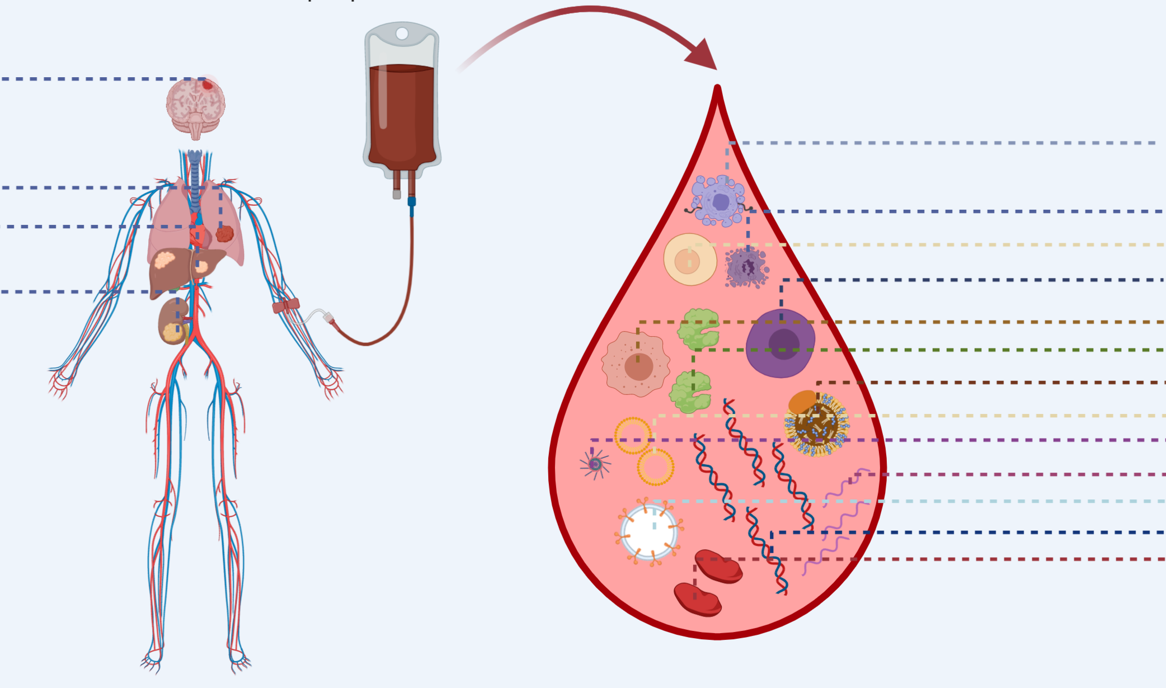
The “cancer world” in a drop
Peripheral blood
Brain metastasis
Macrophage
Primary tumour
Hepatic metastasis
Necrotic cell
Lymphocyte
Stem cell
Renal metastasis
Cancer cell
Protein
Liposome
Exosome
Inflammosome
ctRNA
Extracellular vesicles
ctDNA
Platelet
ctDNA, circulating tumour DNA; ctRNA, circulating tumour RNA
Malapelle U, et al. Manuscript in preparation

Slide 20

Liquid vs solid biopsies in cancer interception
CHOICE OF SAMPLE DEPENDS ON REQUIREMENT
Model 1 for cancer interception
(avoiding cancer)
Model 2 for metastasis interception
(avoiding dissemination: metastasis interception)
Predisposition
Early diagnosis
Late detection
Monitoring
Dissemination
Liquid biopsy
Liquid biopsy
Tissue biopsy
Liquid biopsy
Tissue biopsy
Cancer
interception
Adapted from: Serrano MJ, et al. Cancer Discov. 2020;10:1635-1644

Slide 21
summary
Liquid biopsy represents a dynamic, less invasive and easy-to-manage diagnostic tool for molecular analysis of actionable genes in clinical practice
Among the heterogeneous landscape of technical approaches, dPCR and NGS platforms
play a pivotal role in the diagnostic testing strategy of liquid biopsies
ESR1 molecular analysis is essential in the therapeutic algorithm for ER+ HER2- BC patients
Tissue and liquid biopsy derived molecular records are integrative for optimising clinical stratification of solid tumour patients
BC, breast cancer; dPCR, digital polymerase chain reaction; ER, oestrogen receptor; ESR1, oestrogen receptor 1; HER2, human epidermal growth factor 2;
NGS, next generation sequencing

